Slide 1
Microsoft Ignite NZ
25-28 October 2016
SKYCITY, Auckland

Slide 2
Women in Technology Lunch Session
WIT100
Kaye Harding
Nuwanthie Samarakone
Damian Sharkey
Sonia Cuff
Donna Wright

Slide 3
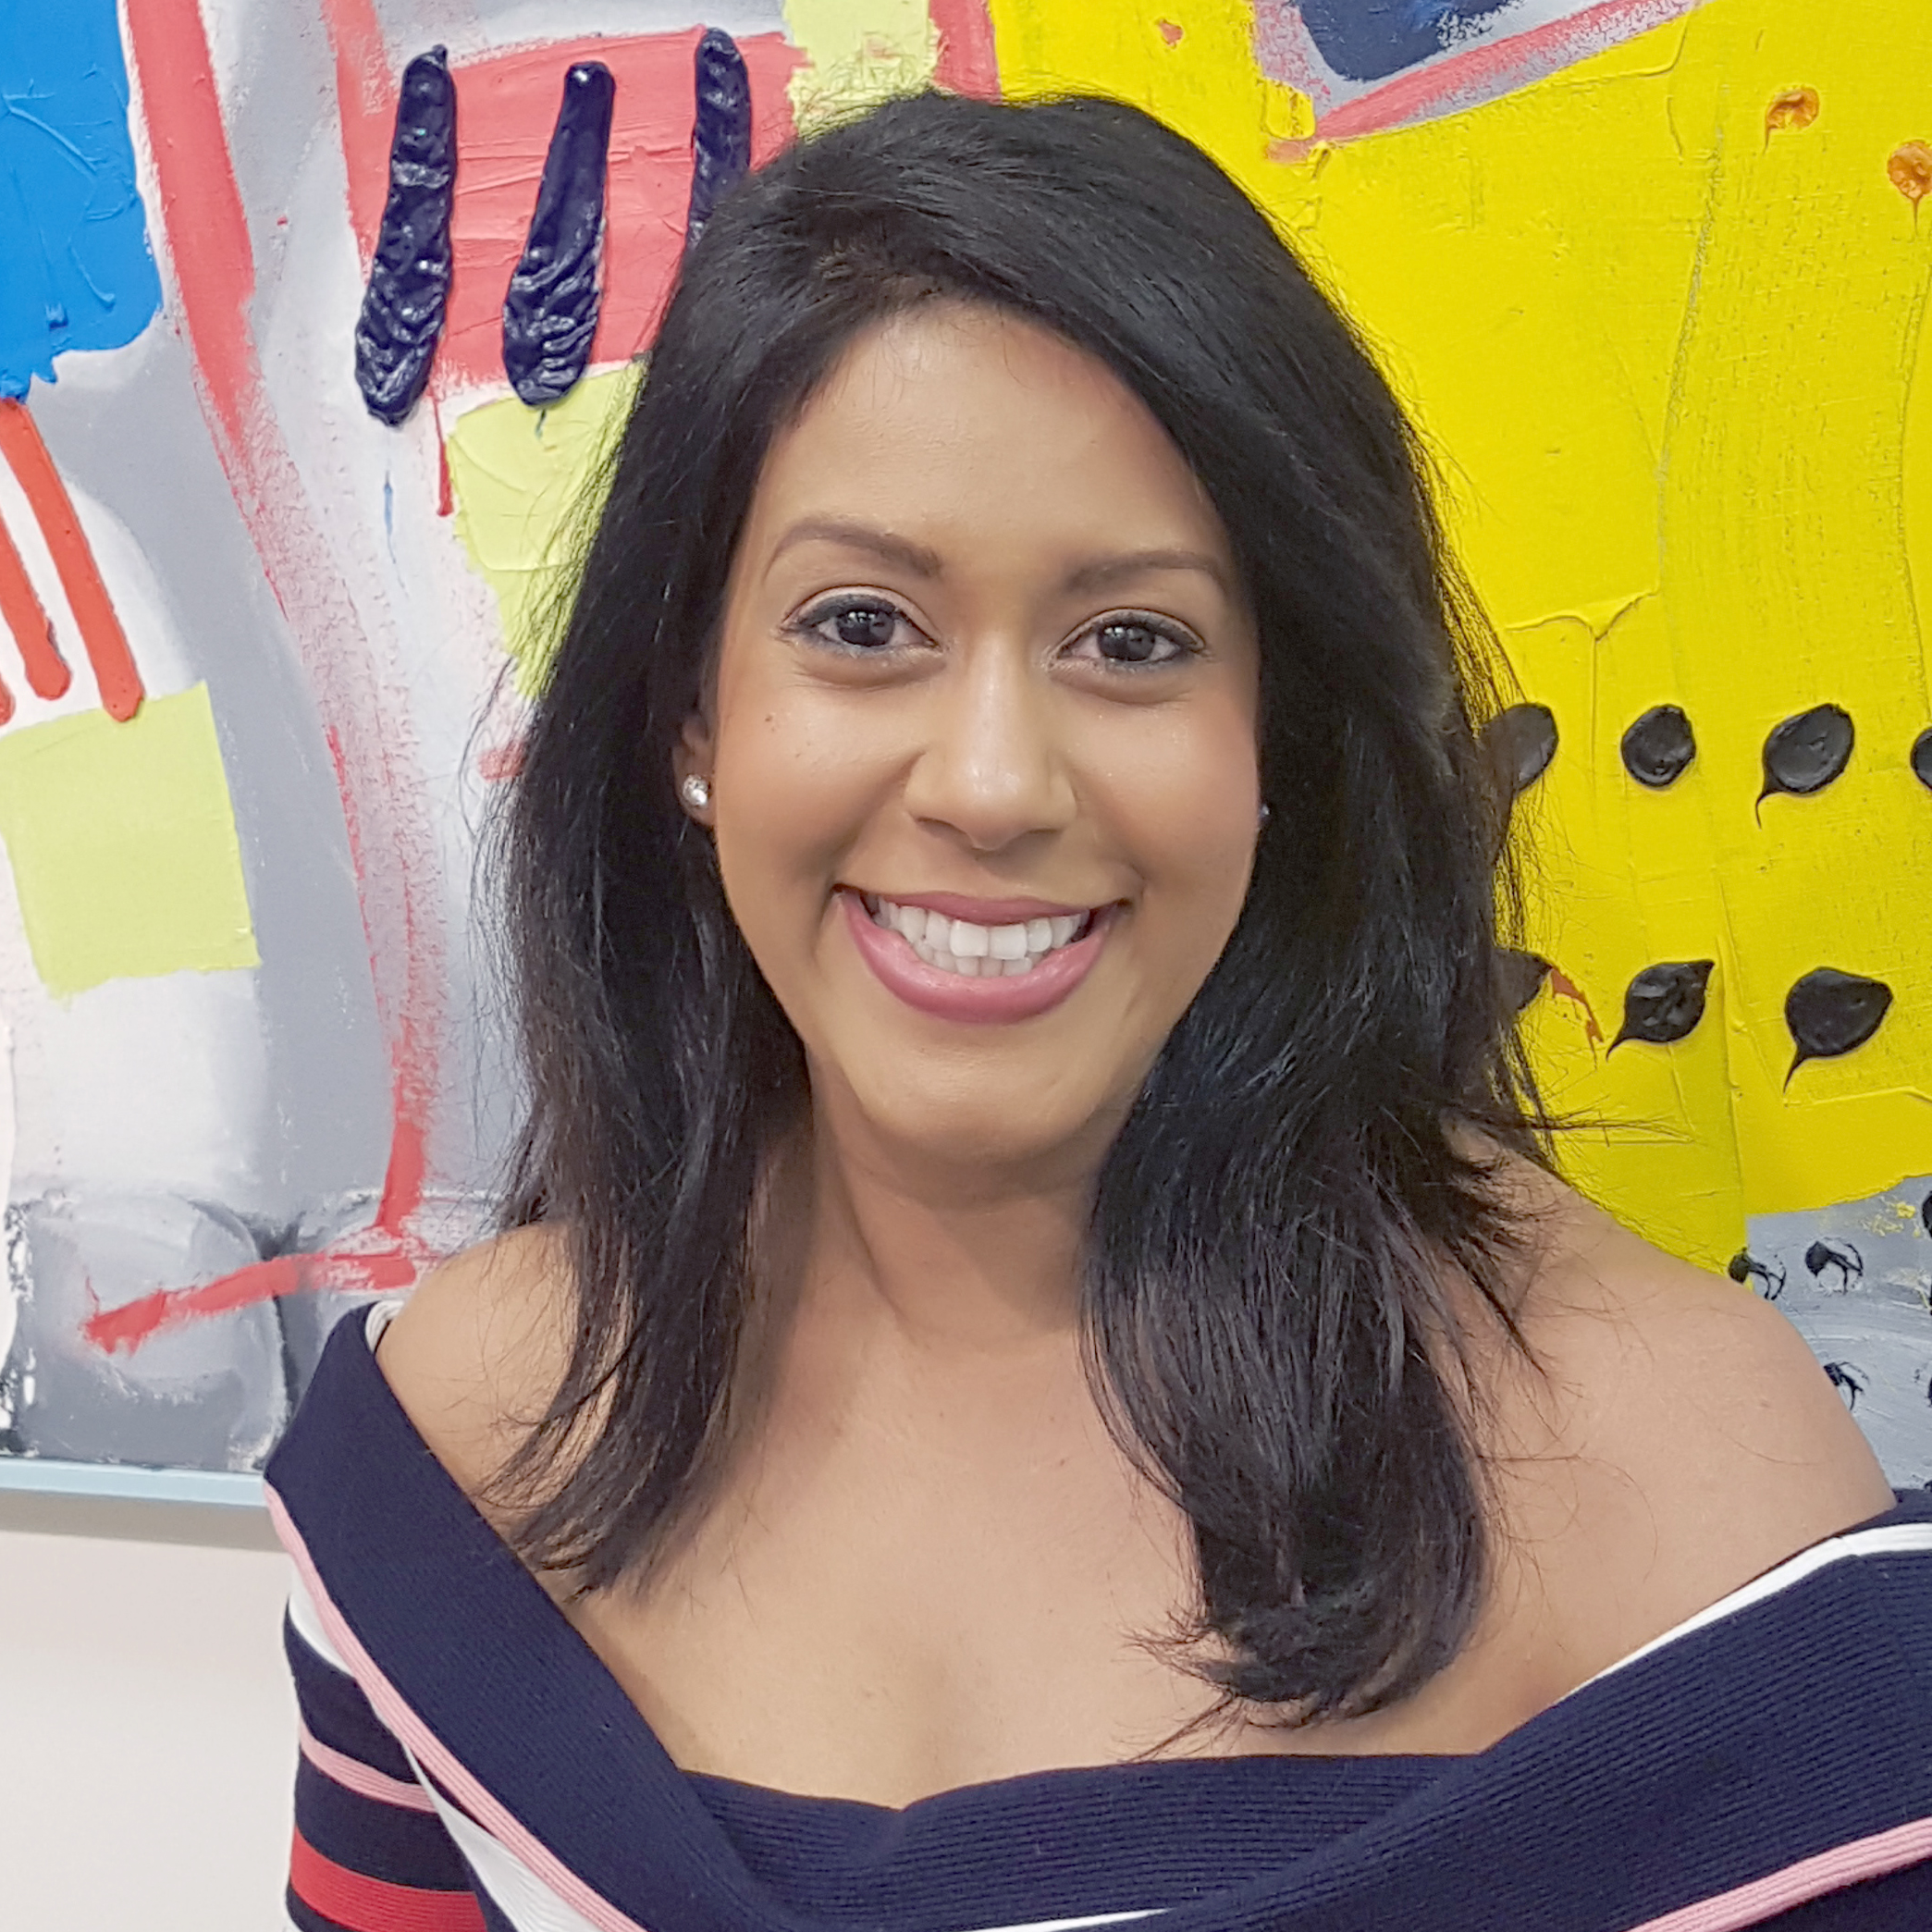
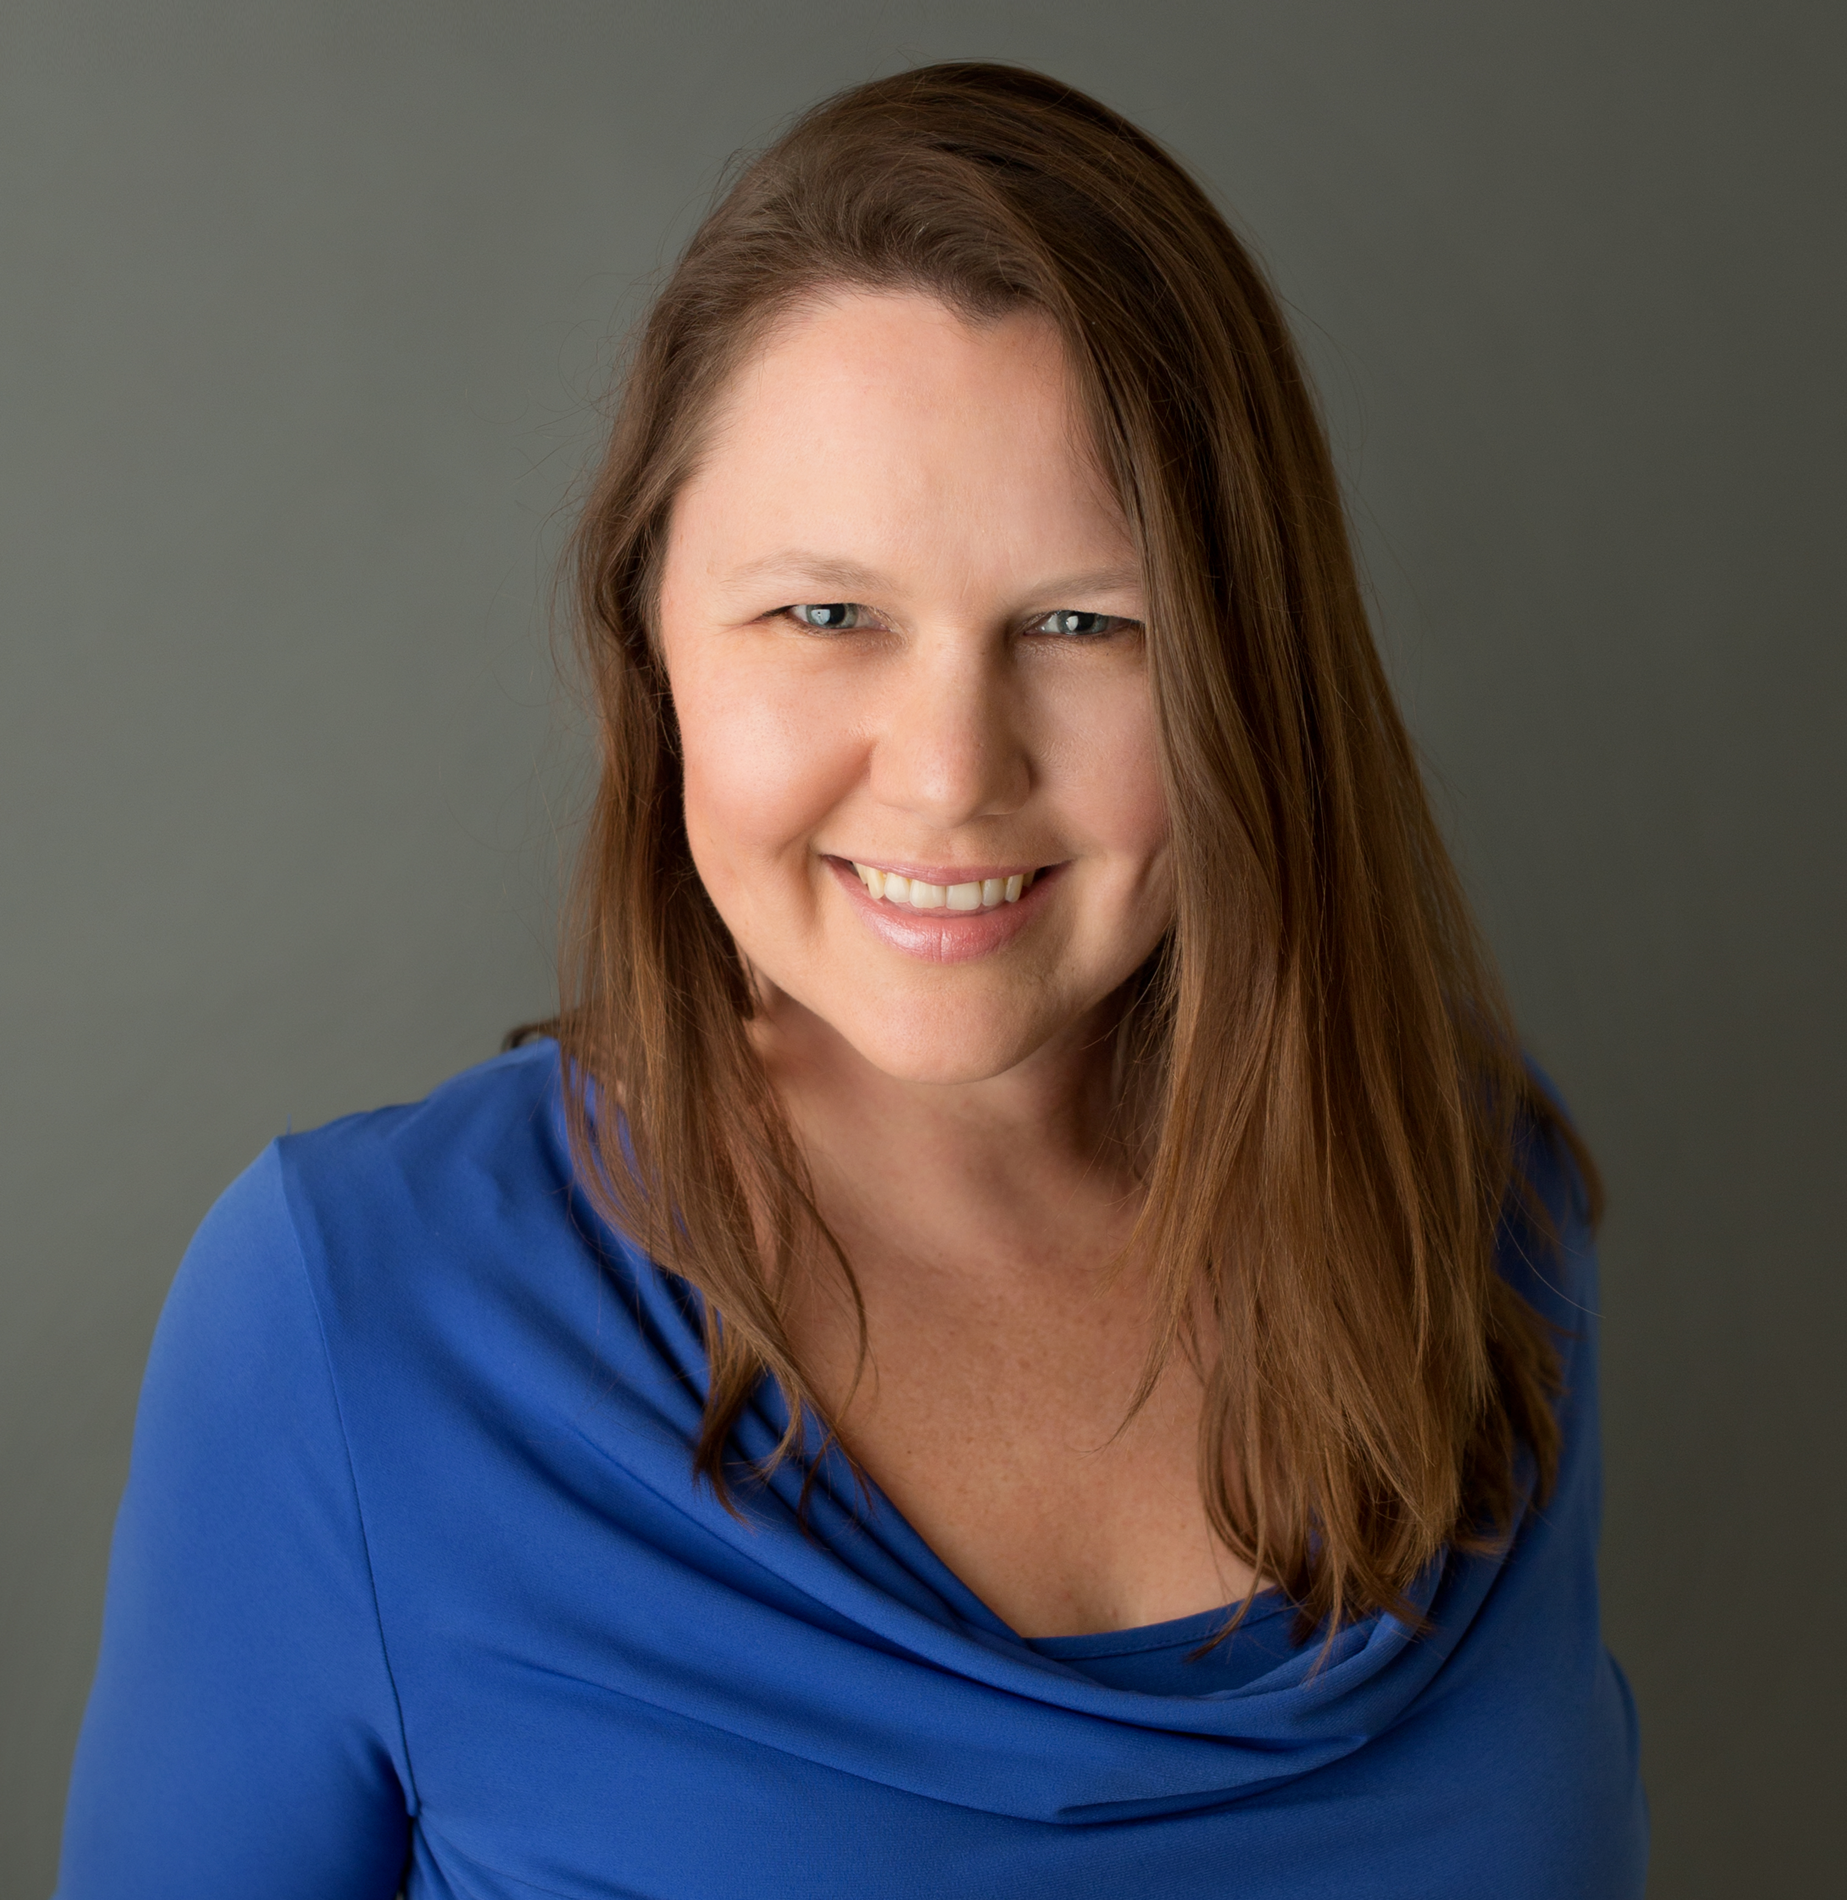
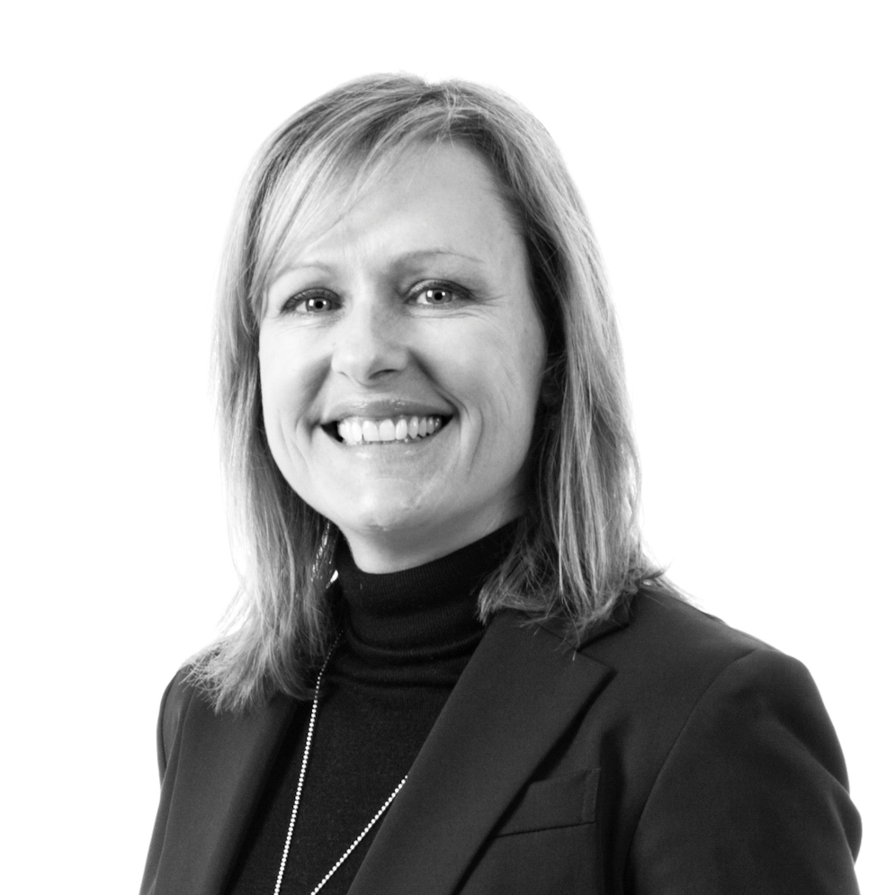
Your Panel…
Nuwanthie Samarakone
Damian Sharkey
Sonia Cuff
Donna Wright

