Slide 1
Microsoft Ignite NZ
25-28 October 2016
SKYCITY, Auckland

Slide 2
Windows Containers Internals
M402
Benjamin Armstrong

Slide 3
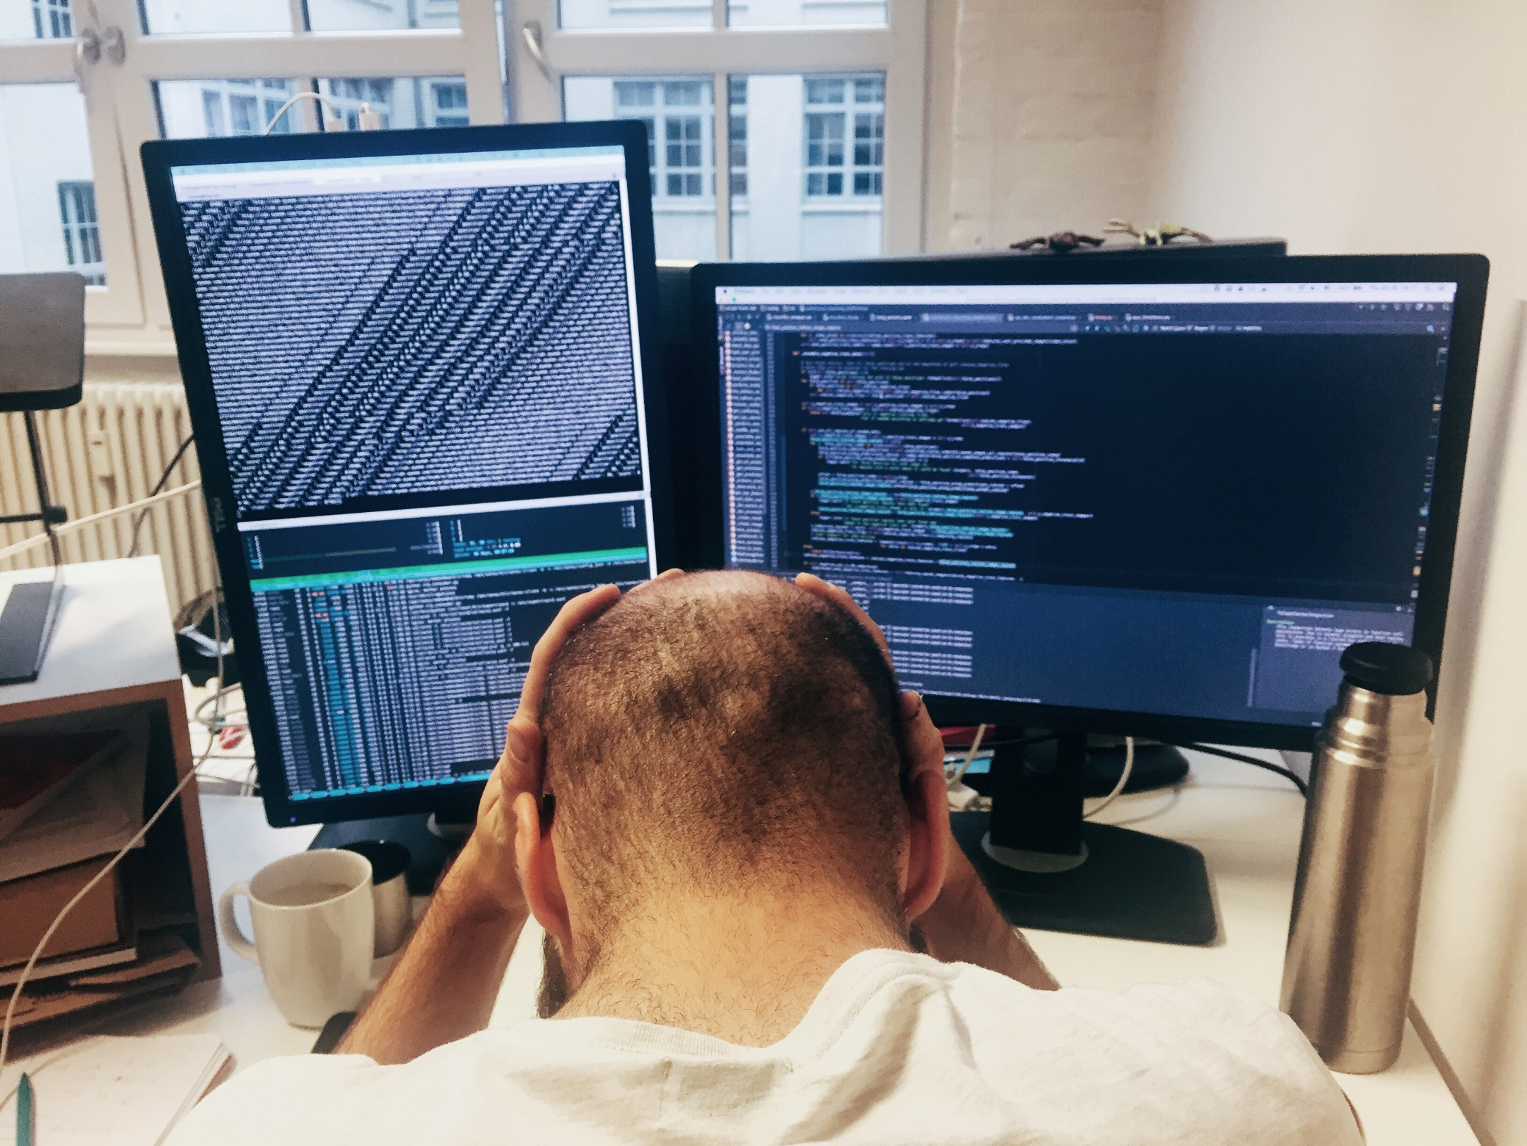
Why containers?
Transforming Existing Applications into Cloud Applications
Is Hard!
Building Hybrid Cloud
Applications
Is Hard!
http://www.gettyimages.com/license/649171837

Slide 4
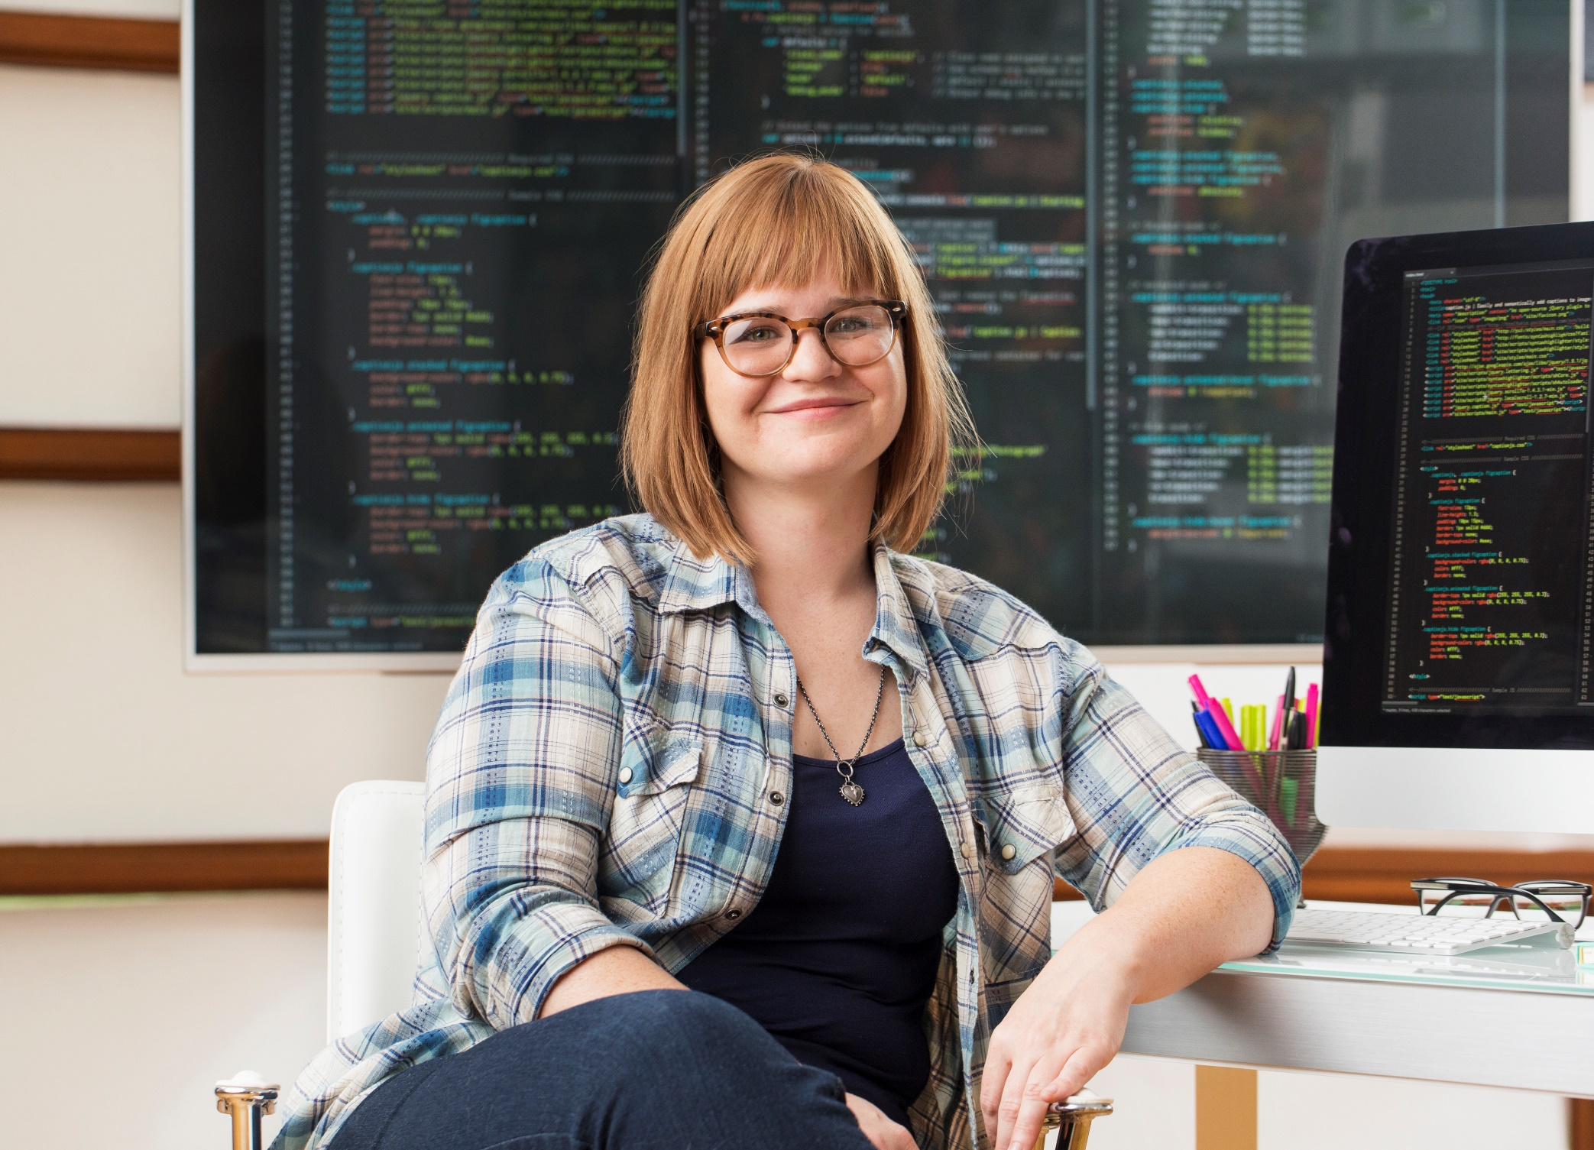
Why containers?
Containers Make It Much Easier…
http://www.gettyimages.com/license/606349595

Slide 5
How do containers make it easier?
Consistency
Efficiency
Rapid
Deployment
Fast Iterations
Service Separation
High Availability
Reproducibility
On Any Cloud
Scalability
Test at Scale
Immutability
Reduced Costs

Slide 6
Startup Performance
NodeJS with Nano Server
Windows Server Container
Under 600 Milliseconds!
Hyper-V Container
~1.75 seconds
A virtual machine takes ~3 seconds
NodeJS with Windows Server Core
Windows Server Container
~1 second
Hyper-V Container
~3.3 seconds
A virtual machine takes ~5 seconds to over a min

Slide 7
Density
NodeJS with Nano Server
Windows Server Container
First Container ~120MB
Additional Containers ~75MB
Hyper-V Container
First Container ~340MB
Additional Containers ~150MB
NodeJS with Windows Server Core
Windows Server Container
First Container ~150MB
Additional Containers ~75MB
Hyper-V Container
First Container ~555MB
Additional Containers ~280MB

Slide 8
Docker

Slide 9
Docker on Windows
Not “Docker for Windows”
Integration coming
Port of Docker Engine (not a fork)
Same remote API, same tools work on top (Compose, Swarm, etc.)
Built on new native container technology in Windows
Runs on Windows Server 2016 and on the latest Windows 10
Runs Windows Server containers on Windows hosts
Doesn't run Linux containers

Slide 10
Architecture In Windows
Docker Client
Docker Compose
Docker
Registry
Docker Swarm
Docker Engine
REST Interface
libcontainerd
libnetwork
graph
plugins
Operating System
Compute Service
Other OS Functionality
Control Groups
Job objects
Namespaces
Object Namespace, Process Table, Networking
Layer Capabilities
Registry, Union like filesystem extensions

Slide 11
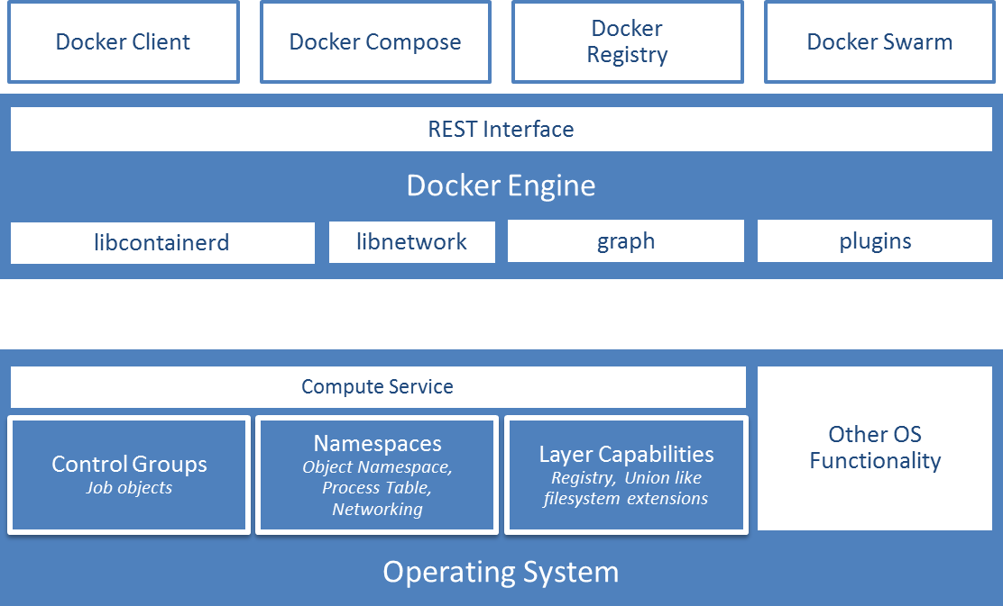
Compute Service
Public interface to containers
Manages running containers
Abstracts low-level capabilities
Language bindings available
C#: https://github.com/Microsoft/dotnet-computevirtualization
Go: https://github.com/Microsoft/hcsshim

Slide 12
Docker Demo

Slide 13
File System

Slide 14
File system
Windows applications expect NTFS semantics
Transactions, file IDs, USN journal
Building a full union FS with NTFS semantics is hard
Hybrid model
Virtual block device + NTFS partition per container
Symlinks to layers on host FS to keep block devices small

Slide 15
Windows Registry
Basically a simple file system
Built a true union FS
Saves cloning a full set of registry hives per container

Slide 16
Base images
Distributed by Microsoft
Two options
windowsservercore: large (huge?), highly compatible
nanoserver: small, fast, smaller API surface
docker pull
microsoft/windowsservercore
microsoft/nanoserver

Slide 17
Networking

Slide 18
Virtual Networking
Container
VM
vNIC
vmNIC
vmNIC
VM Switch
VFP
ACLs, Metering, Security
VNET
SLB (NAT)

Slide 19
Active Directory Identity for Containers
1) Use default accounts for services & tasks (LocalSystem, Network Service)
Image
IIS & ASP.Net
Running Container
Service: IIS
User:
LocalSystem
SQL Server
Domain\MyWebApp1$
Credential Spec
DefaultAccount: Domain\MyWebApp1$
3) Container connects using service account
2) Provide default service account to use when starting container

Slide 20
Memory

Slide 21
Memory management
Shared memory management key to performance
Builds on top of the file system cache

Slide 22
Core Architecture

Slide 23
Container contents
Public Windows API delivered via DLLs, not syscalls
Lots of interdependencies
Highly dependent on system services running
RPC calls hidden in Win32 APIs
Automatically starts smss
init equivalent
Launches a variety of system services

Slide 24
Namespaces
Silo: extension to Windows Job object
Set of processes
Resource controls
New: set of namespaces
New namespace virtualization
Registry
Process IDs, sessions
Object namespace
File system
Network compartments

Slide 25
Object namespace
System-level namespace, hidden from users
C:\Windows maps to \DosDevices\C:\Windows
Contains all device entry points
\DosDevices\C:
\Registry
\Device\Tcp
Silo can "chroot" to different object root
\Silos\foo\DosDevices\C:
\Silos\bar\DosDevices\C:

Slide 26
Silo Demo

Slide 27
Hyper-V Containers

Slide 28
Hyper-V Containers
Some workloads need more isolation
Hostile multi-tenancy
Regulated workloads
Solution: transparently run each container in a VM!
(Mostly) invisible to both Docker and the user
docker run --isolation=hyperv
Hyper-V Containers are the default on Windows 10
Images are the same

Slide 29
Windows Server Containers
Host User Mode
System Processes
Session Manager
Container Management
Local Security Authority
Windows Server Container
Windows Server Container
Docker Engine
Event Manager…
System Processes
Application Processes
System Processes
Application Processes
Compute Services
Etc…
Job Object
Net Interface
Storage
Registry
Job Object
Net Interface
Storage
Registry
Windows Kernel

Slide 30
Hyper-V Containers
Host User Mode
Virtual Machine Specifically Optimized To Run a Container
System Processes
Session Manager
Hyper-V Container
Container Management
Local Security Authority
Windows Server Container
Guest Compute Service
Docker Engine
Event Manager…
System Processes
Application Processes
Compute Services
Basic System Processes
Etc…
Job Object
Net Interface
Storage
Registry
Windows Kernel
Windows Kernel
Hyper-V Hypervisor

Slide 31
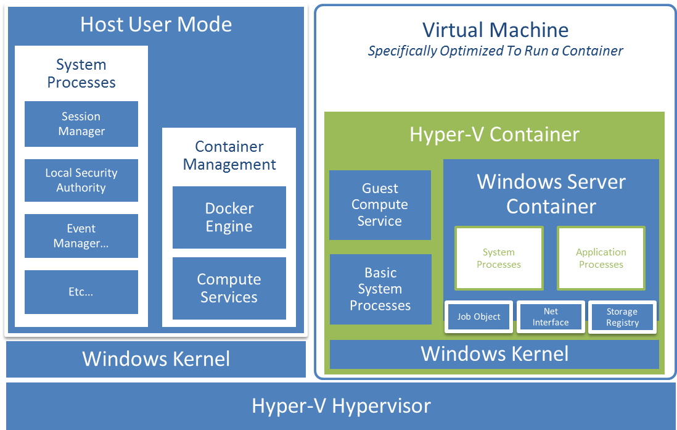
Making it work
Small, stateless “utility VM”
Smallest Windows yet?
Writes not persisted
Storage attached via SMB
VMBus transport
File cache sharing
Networking attached via virtual NIC

Slide 32
Cloning
Launching the utility VM takes time and memory
Do it once, freeze the result
Fork the VM for each new instance
Eliminates startup time
Shares memory

Slide 33
Hyper-V Container Demo

