Slide 1

Microsoft Ignite NZ
25-28 October 2016
SKYCITY, Auckland

Slide 2
Leveraging Microsoft Azure to Lower the Cost of Delivering Microsoft RDS and Windows 10 VDI
M395
Gavin Bennet
Scott Ellis
Scot Fordham

Slide 3



Speaker Introduction:
Gavin Bennett – Microsoft NZ
Scott Ellis –
Citrix ANZ
Scot Fordham –
Citrix NZ

Slide 4
Windows Server 2016 RDS Update
Gavin Bennett

Slide 5
Remote Desktop Services
The platform for your virtual workspace strategy
Windows apps anywhere
Deployment
flexibility
Cost
reduction
Secure extensible platform
Enable users to access Windows applications and data from any device and any location
On-premises,
cloud-based, or
hosted deployments
Consolidate your infrastructure to improve efficiency
Protect against loss and leaks of sensitive corporate data
Build customised solutions

Slide 6
Solutions to meet your requirements
Session-based computing
Virtual Desktop infrastructure
Session-based
computing in the cloud
Client desktops in the cloud
Session-based desktops
and RemoteApp
Cost-effective,
easy to manage
Access to pooled or personal Virtual Desktops running Windows Client OS
High performance,
app compatibility
Remote Desktop Session Host deployed on cloud infrastructure services
Customisable with minimum capital expenditure
Azure hybrid use benefit now covers Windows 10 desktops
Create a VDI solution without large capital expenditure
On-premises
In cloud

Slide 7

RDS innovations in Windows Server 2016
Increased performance
Enhanced scale
Optimised
for cloud
Graphics improvements
Connection broker, shared SQL connections
Efficient and secure architecture

Slide 8
Who is Citrix?

Slide 9
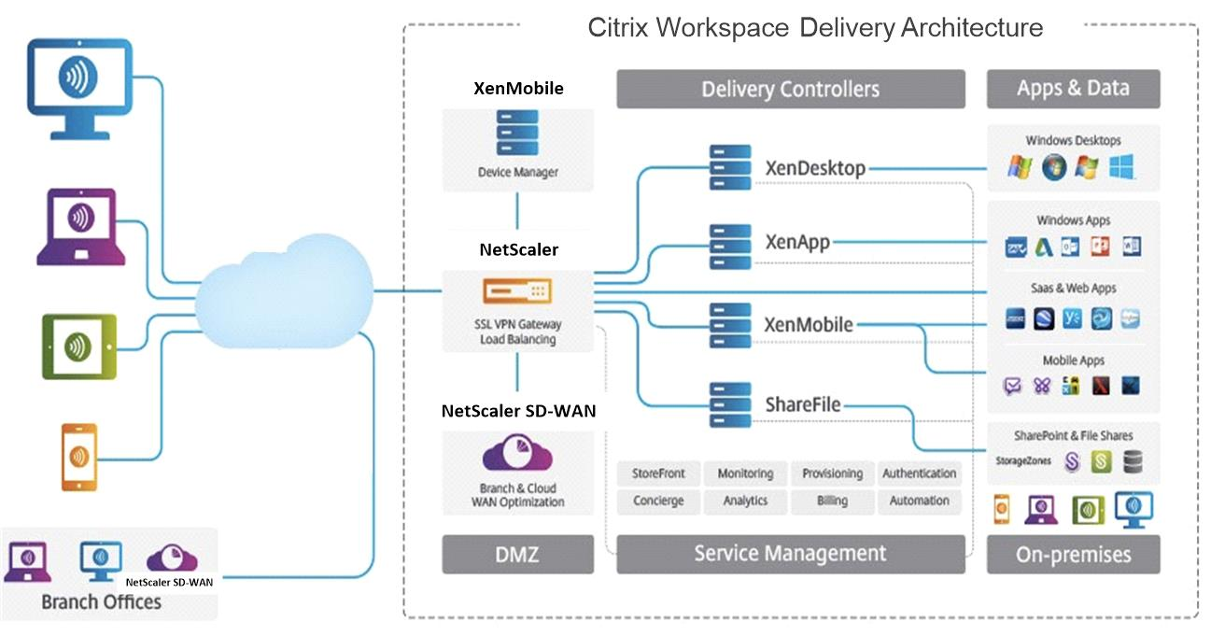

Slide 10
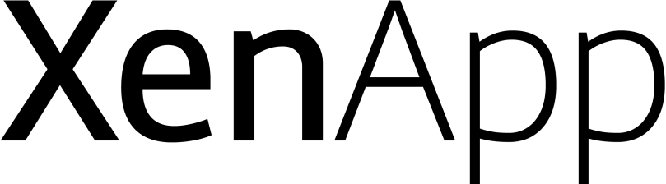
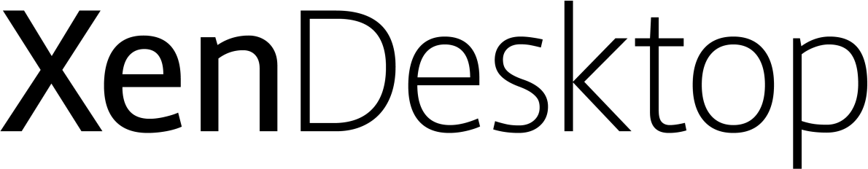
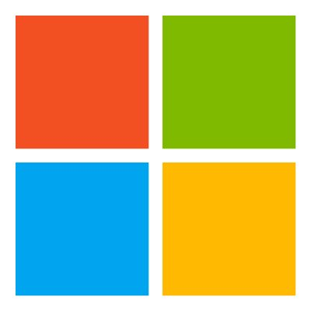


&
Microsoft Alignment | Management | User Experience
Context-aware Delivery
Historical Resource Utilisation
User Profile & UEM Improvements
Self-Service Password Reset
Windows Server 2016
Azure Resource Manager
Extended App-V Integration
SCVMM Support for AppDisks
Content Publishing
Improved Advanced Graphics
Expanded USB Device Support

Slide 11
Extending the platform through Citrix Solutions

Slide 12


Slide 13
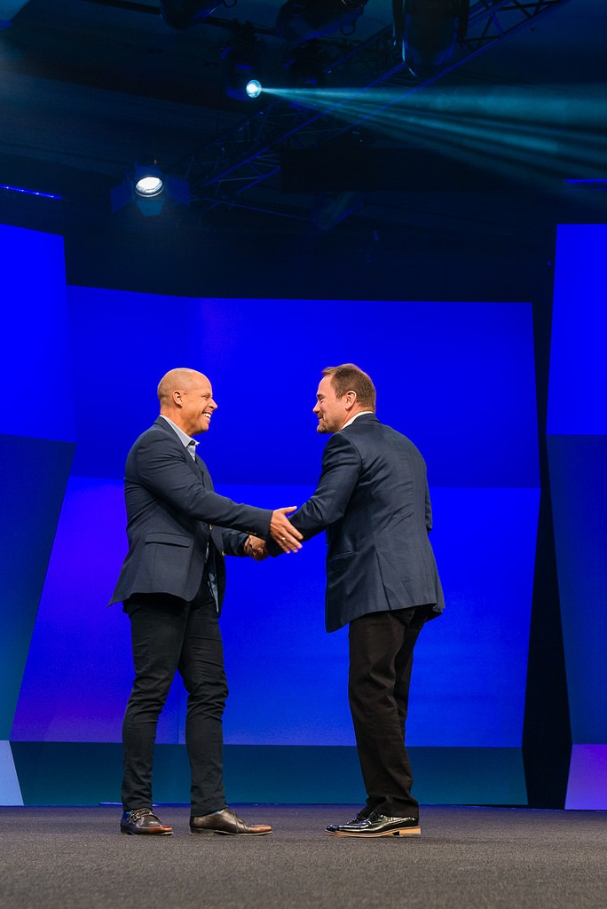
Citrix + Microsoft Strategic
Partnership
Office 365
Private and Public Cloud
Mobile
First and only to offer optimised Skype for Business experience
Azure-first solutions
and day 1 support for
Windows Server 2016
NetScaler & XenMobile integrations with
Microsoft EMS
NEW!
NEW!
Windows 10
XenApp Express
First and only to
enable Win10 VDI in
Azure public cloud
Fastest way to deliver Windows apps from Azure

Slide 14
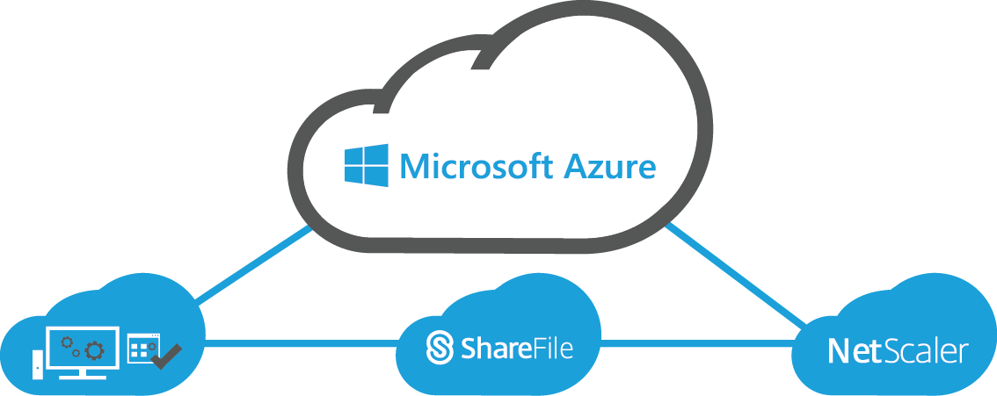
Three Proven Citrix-on-Azure Services
Hosted Desktops & Apps
Anytime, anywhere, any-device access
Simplify IT management and complexity
Predictable and simple to budget
ShareFile
Empower users with instant access to business data, synced across all devices
Improve collaboration and productivity through secure data sharing
Integrates with SharePoint, Office 365,
OneDrive for Business and network shares
NetScaler
Improve the performance, security and resiliency of applications delivered from the cloud
Ensure application availability and responsiveness
Optimise application performance and improve user experience
Secure remote access to applications and data
Hosted Desktops and Applications on Azure
ShareFile on Azure
NetScaler on Azure

Slide 15
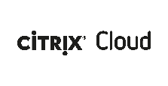


XenDesktop for Windows 10 on Azure
Citrix Cloud
XenDesktop for Windows 10 on Azure
Operated by Citrix
Sold through
Azure Marketplace
Citrix Cloud
Customer Subscription
Windows 10
Windows 10
Server VDAs
Server VDAs
Server VDAs
Server VDAs
Customer managed
Azure subscription
Customer also pays for IaaS consumption
Customer’s Azure Subscription

Slide 16
XenDesktop for Windows 10 Timeline
Citrix Synergy 5/23/2016
BriForum
Microsoft
Windows 10 CCB on Azure
CY 2016 Q4
Apr | May | Jun | Jul | Aug | Sep | Oct | Nov | Dec
Synergy Announcement
Citrix VDI Service
5/23/2016
New XenDesktop service for Windows 10 on Azure
Limited Preview
(MSFT initiated)
7/5/2016
New XenDesktop for Windows 10 on Azure service
Launch
Q4 2016

Slide 17
XenApp Express
Citrix Cloud
XenApp Express
Operated by Citrix
Sold through
Azure Marketplace
Citrix Cloud
Customer Subscription
Windows Apps
Windows Apps
Server VDAs
Server VDAs
Server VDAs
Server VDAs
Customer managed
Azure subscription
Customer also pays for IaaS consumption
Customer’s Azure Subscription

Slide 18
Citrix XenApp Express Timeline
Azure RemoteApp Deprecation
Public announce 8/12/2016
Azure RemoteApp
End of Sale
10/1/2016
Azure RemoteApp
End of Life
8/31/2017
CY 2016 Q4
Jul | Aug | Sep | Oct | Nov | Dec | Jan | Feb | Mar | Apr | May | Jun | Jul | Aug | Sep
CY 2017
MS/CTXS
Virtual Event
8/23/2016
XenApp Express
Public Tech Preview
XenApp Express
XenApp Express availability & tools to aid Azure RemoteApp to XenApp Express migration
Ignite U.S.
XenApp Express
Demo
9/26/2016

Slide 19
Azure Virtual App & Desktop Delivery Scenarios

Slide 20

3 Options for Azure Migration
Extend
Host
Cloud Service
Azure
Azure
Citrix Cloud
Azure
XenApp and XenDesktop management on-premises
Virtual app and desktops workloads on-premises and Azure
Managed by IT/Partners
XenApp and XenDesktop management on Azure
Virtual app and desktops workloads on Azure
Managed by IT/Partners
XenApp and XenDesktop cloud service on Azure, managed by Citrix
Virtual app and desktops workloads on Azure, managed by IT/Partners

Slide 21
Extended Deployment – On-prem Management of Cloud Workloads
On-premise/Co-Lo
Studio
Director
License Server
StoreFront/
Receiver for Web
SQL
Azure
Delivery Controllers
vNet
Server VDAs
Desktop VDAs
Server VDAs
Server VDAs
Server VDAs
Server VDAs
NetScaler Gateway
Hypervisors
Active Directory
Server VDAs
Desktop VDAs
NetScaler Gateway
Active Directory
Server VDAs
Server VDAs
Server VDAs
Server VDAs
Optional Components

Slide 22
Delivering Apps and Desktops using Azure
Available Today
Future
XenApp
XenDesktop
XenDesktop
Windows 10
XenApp Express
for
Citrix Cloud Services
Deployment | On-Premises | Cloud |  | Azure ONLY | Azure ONLY
Citrix Infrastructure | Customer IT | Managed by Citrix |  | Citrix | Citrix
Workloads | Private Cloud/Azure | Private Cloud/Azure |  | Azure | Azure
Model | Single Tenant | Single or Multi-Tenant |  | Multi-Tenant | Multi-Tenant
Licensing | Perpetual | Subscription |  | Subscription | Subscription
LEGEND
XA: Citrix XenApp. XD: Citrix XenDesktop

Slide 23
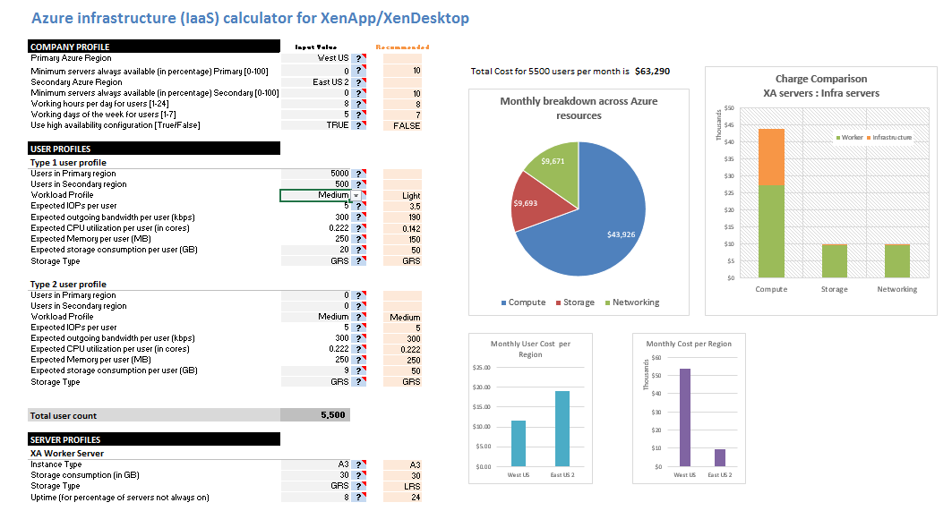
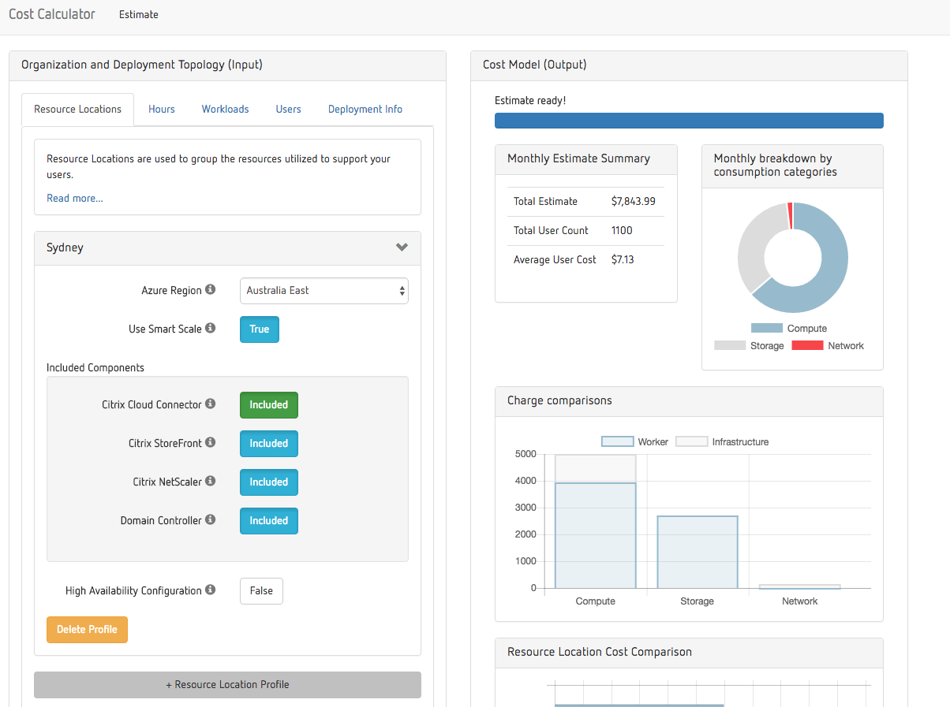
Cloud Economics
Driving down overall cost without sacrificing your business operations
  Calculate your costs and subscription of deploying Citrix on Azure with the Citrix cost calculators
Reduce capital expenses and maximise investments
Use Azure management interface to manually shut down and de-allocate virtual machines that are not active (Citrix Smart Scale can automate this)
Expand business in the cloud at the pace of growth without the cost of additional infrastructure
Coming Soon!

Slide 24
Demo:
Provisioning App & Desktop Workloads

Slide 25
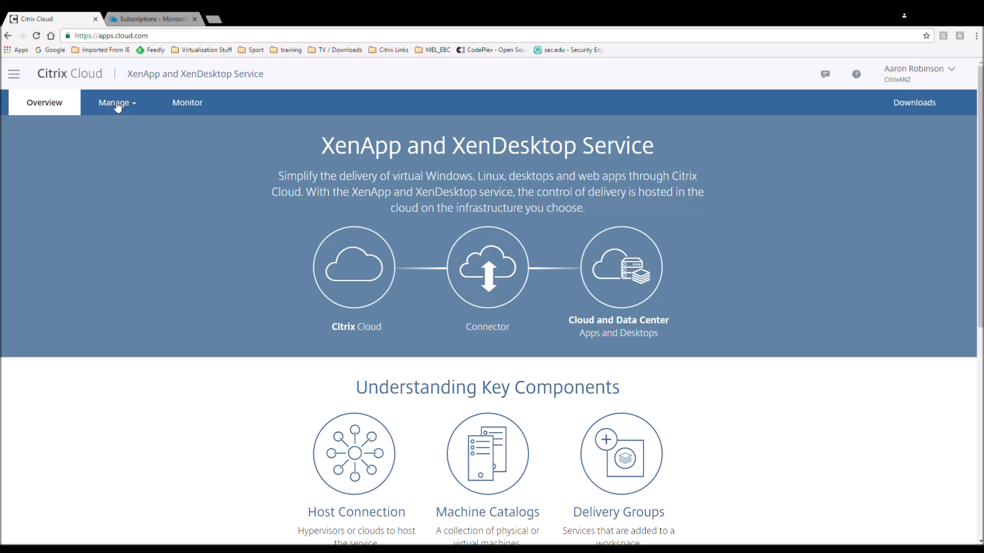

Slide 26
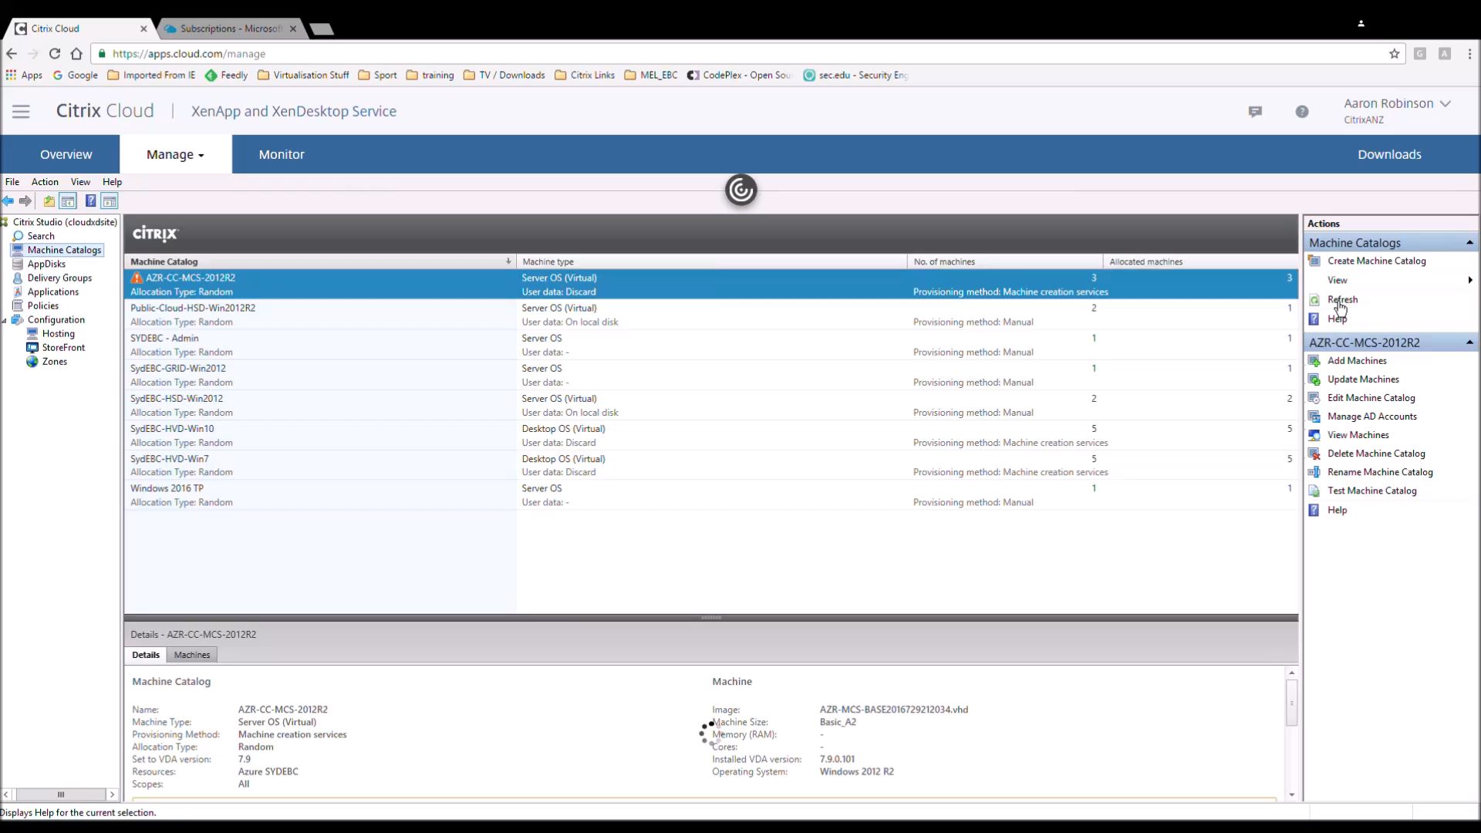

Slide 27
What is Citrix Cloud?

Slide 28


Slide 29

The IT Market is Changing.
  The “No” Organisation
  On-premise
  Installed Software
  Software Builders
  Capital Expenses
  Transactional Sales
  The “Yes” Organisation
  Cloud-First
  as-a-Service
  Service Brokers
  Operating Expenses
  Subscriptions

Slide 30

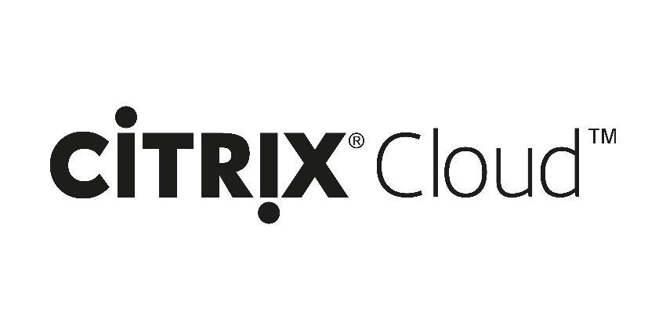
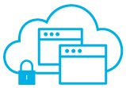
The Only Platform Integrating All Citrix Services
Unified cloud-based ability to deploy all Citrix technologies
UPDATE
XenApp and
XenDesktop
service
XenMobile
service
Secure
Browser
service
Lifecycle
Management
App
Migration
Service (labs)
NetScaler
Gateway
Service
IoT
Automation
(labs)
3rd Party
Services
ShareFile
Service available now
Service available soon

Slide 31


Slide 32

Traditional Citrix Deployment
Studio
Director
License Server
StoreFront/
Receiver for Web
Delivery Controllers
SQL
Customer/Partner managed
NetScaler
Hypervisors
Active Directory
Server VDAs
Desktop VDAs
Server VDAs
Server VDAs
Server VDAs
Server VDAs

Slide 33
Deployment With Citrix Cloud
Studio
Director
License Server
Citrix Cloud
(operated by Citrix)
StoreFront/
Receiver for Web
Delivery Controllers
SQL
Cloud Connector
Customer/Partner managed
NetScaler
Hypervisors/Azure
Active Directory
Server VDAs
Desktop VDAs
Server VDAs
Server VDAs
Server VDAs
Server VDAs
Resource Location(s)

Slide 34
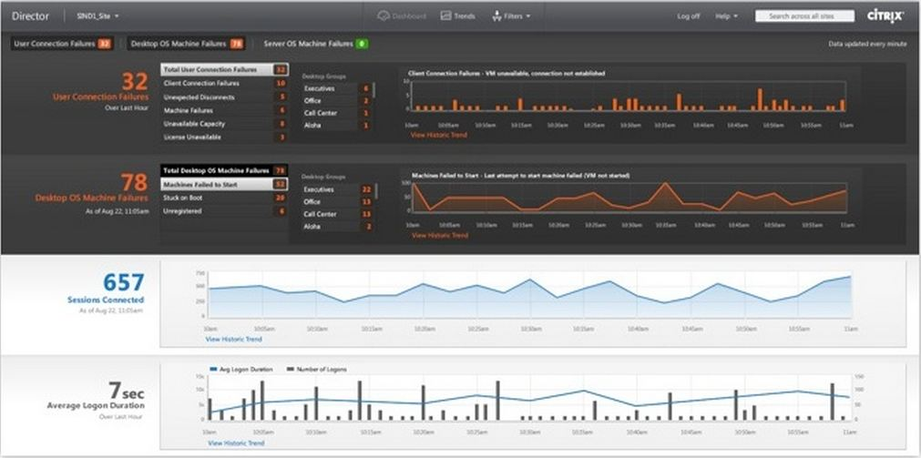
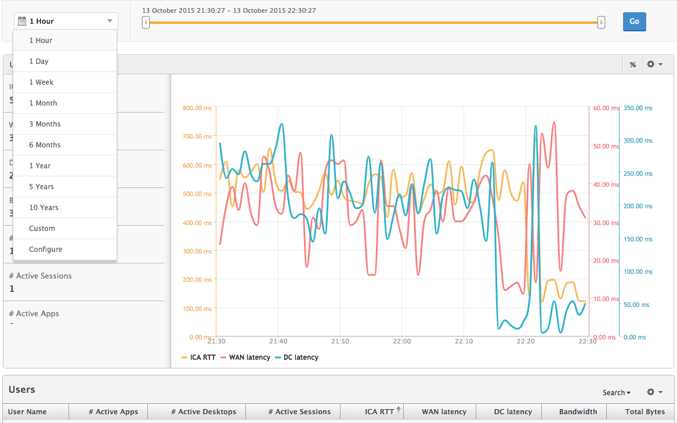
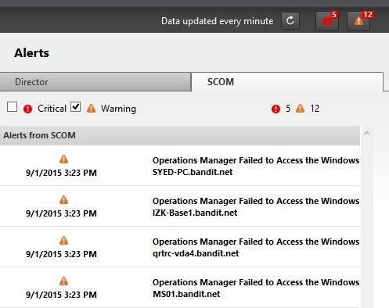
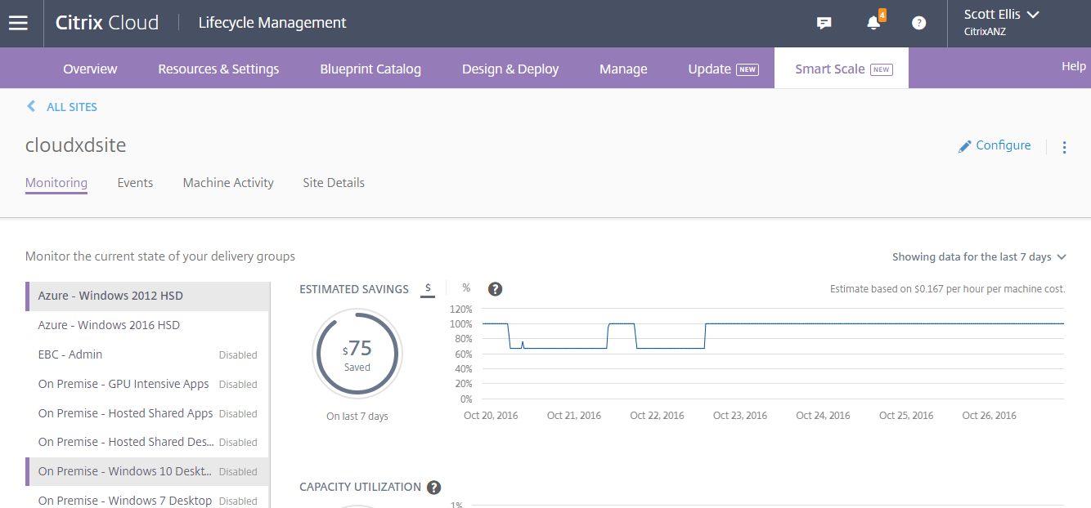
Operational Integration
Key Tools
Desktop Director
HDX Insight
SCOM Management Packs
Lifecycle Management

Slide 35



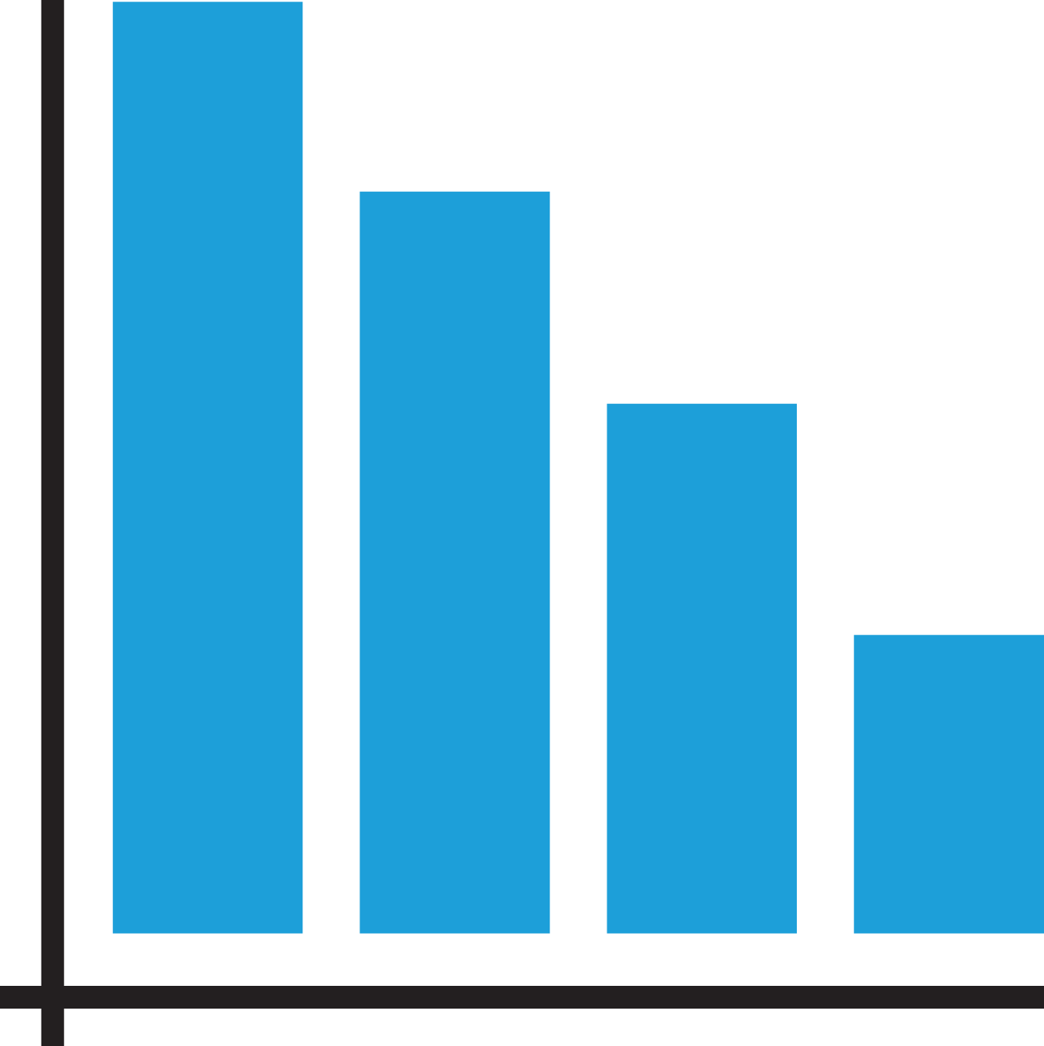
Lifecycle Management – Smart Scaling
Cost efficiency Auto optimise infrastructure costs helping to offset high expenses associated with public clouds Savings of ~105K/year for 1000 user deployment | Flexible Scaling Automatically scale-up/down & power on/off VDAs Load-based or time-based (off-peak, peak, weekend, etc.) scheduling | Track Dynamically Scaling Infrastructure utilisation Cost savings | Available for Azure AWS vSphere XenServer Hyper-V

Slide 36
Demo 2:
End User Experience

Slide 37
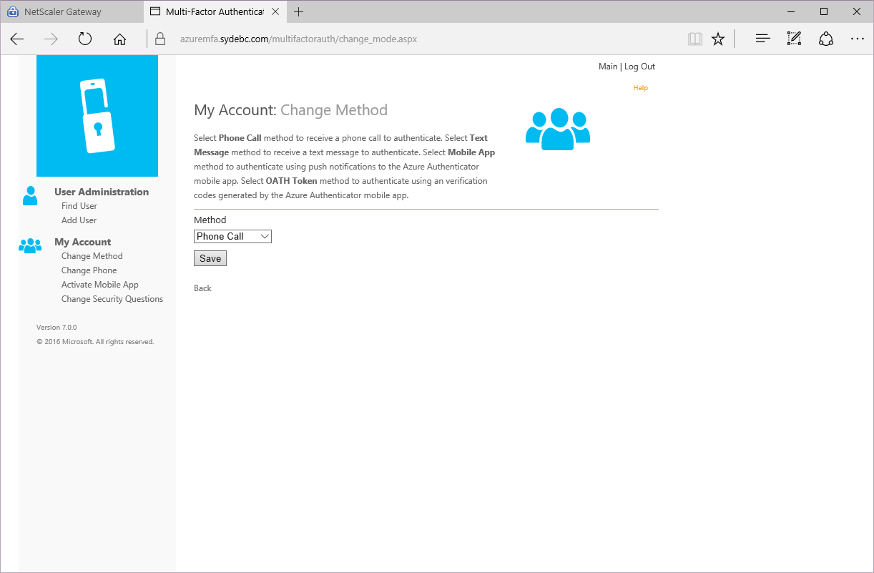
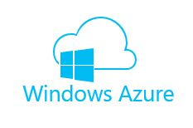
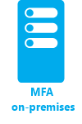







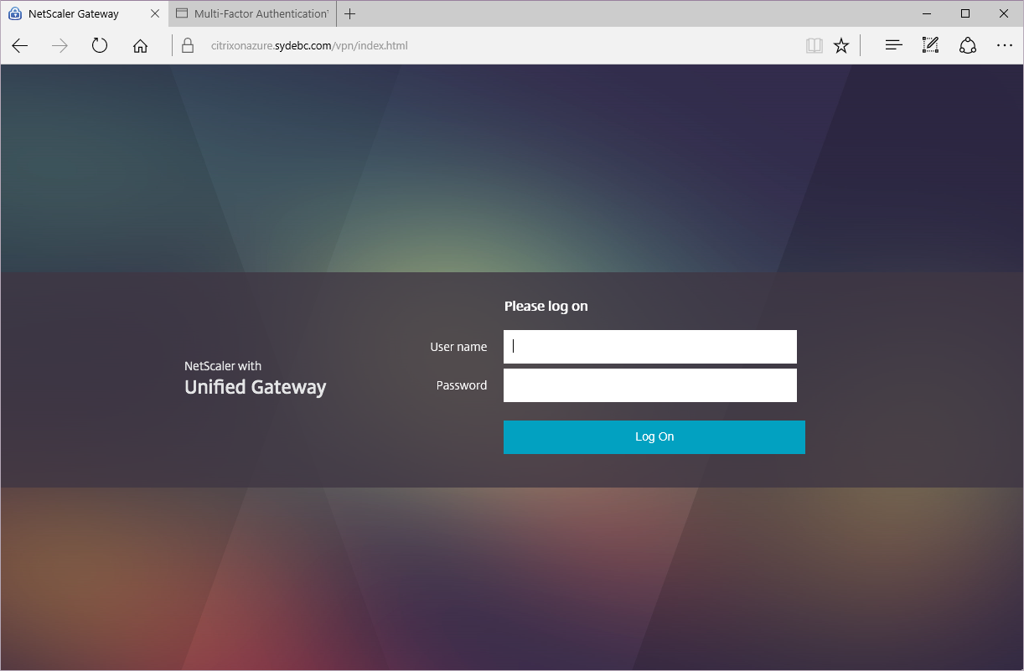
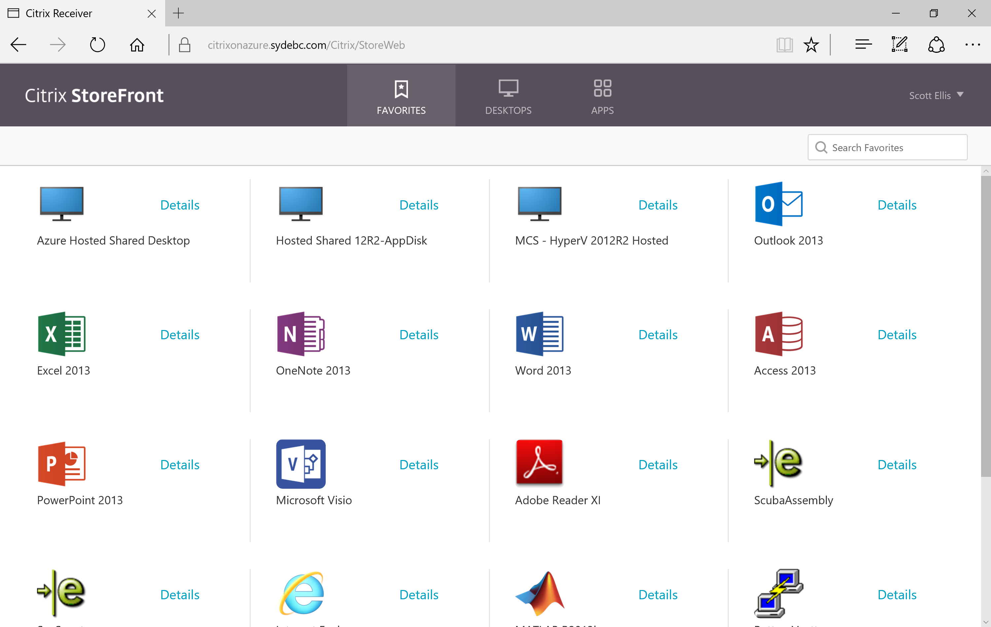
Citrix on Azure (including MFA) Demonstration
1
2

Slide 38
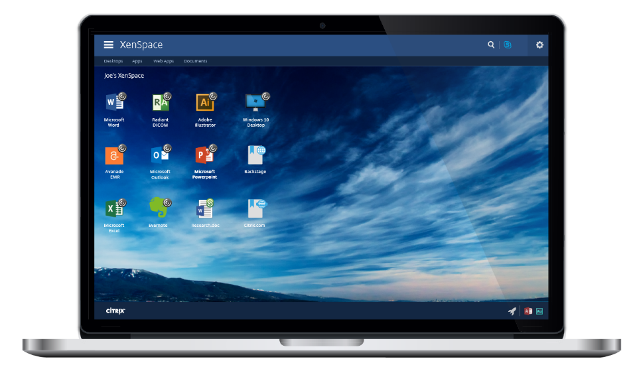

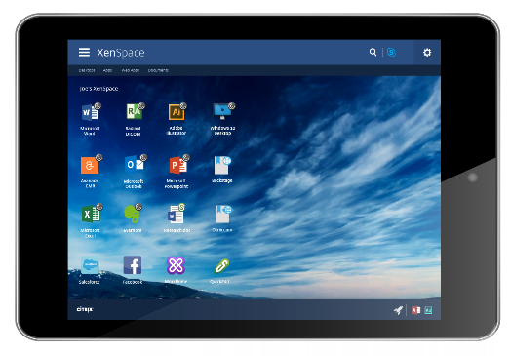
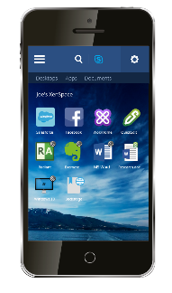
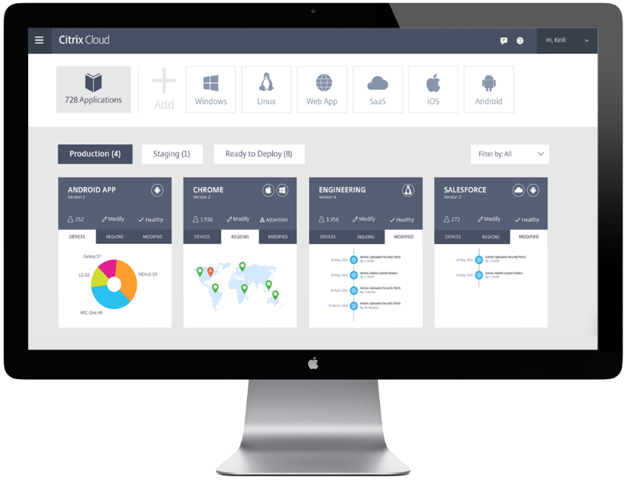
Deliver Everything Important to Getting Work Done, In One Place
Vision
Users: Unified Experience
Get everything you need to be productive
Access Windows apps & desktops, web, SaaS & mobile apps
Discover secure, identity-driven, unified, context-sensitive experience
Admins: Unified Operations
Simplify complex everyday workflows
Get single, unified consistent admin experience
Focus on apps, data, users (not infrastructure)

Slide 39
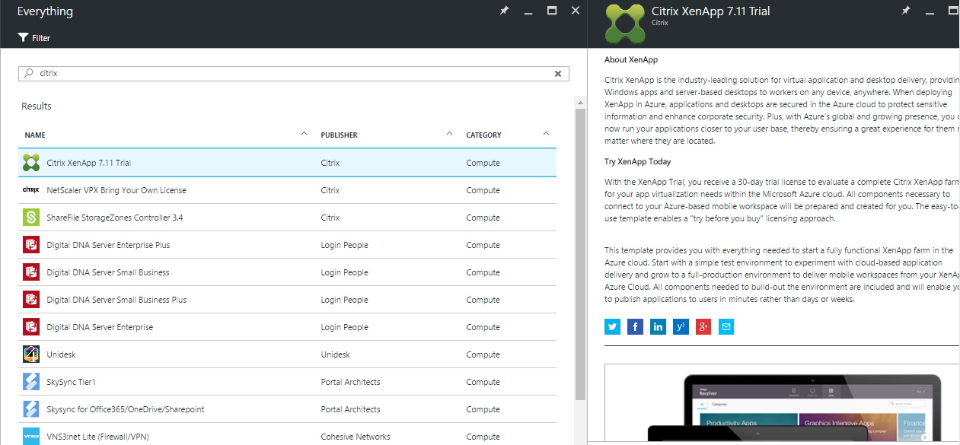
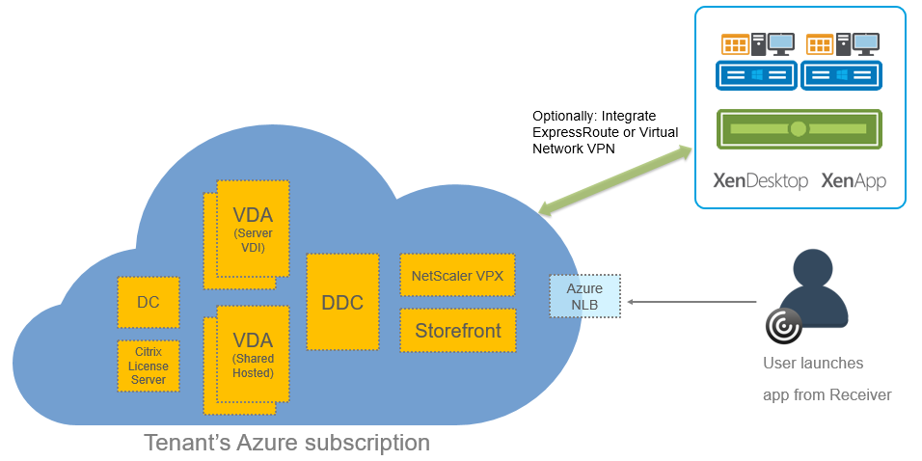
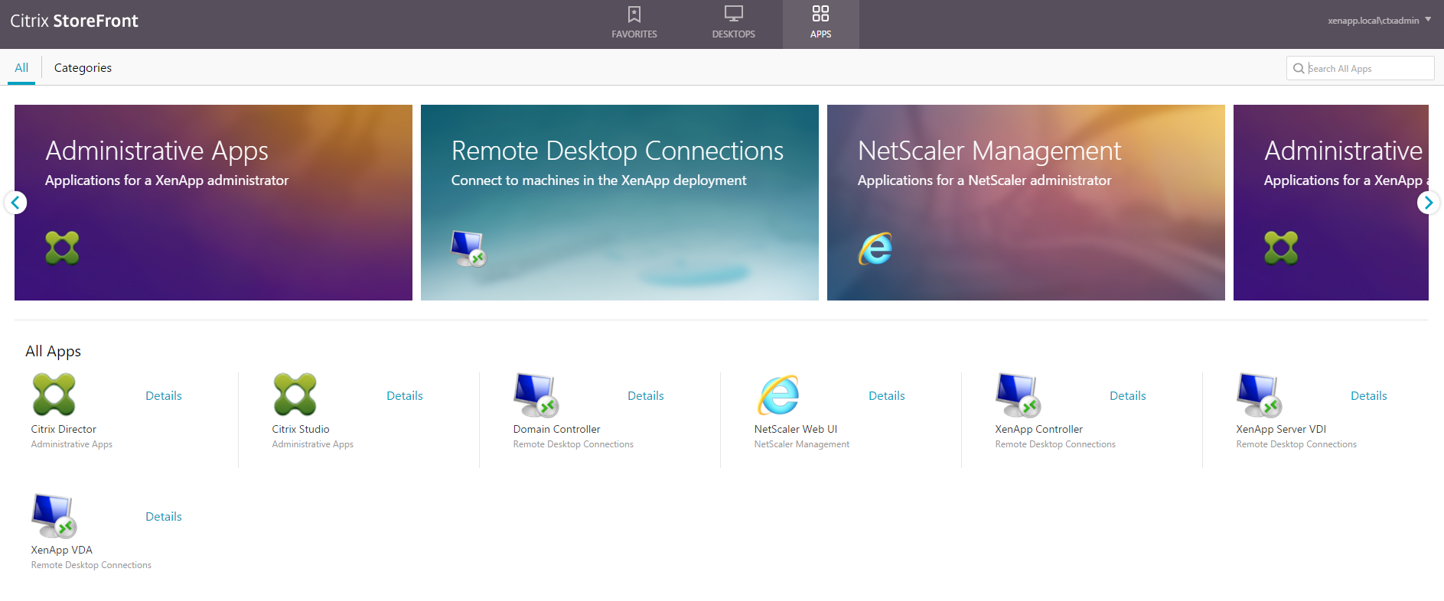
Try Citrix on Azure yourself…
Utilise an Azure Trial subscription or your own.
Search Marketplace for “Citrix”
Select the “XenApp 7.11 Trial”
2-3 hours later you’ll have a complete POC environment
Note – trial environments will only support 20 cores.

Slide 40
Key Takeaways
Item | Link
XenApp on Azure: Demystifying Azure AD Authentication | https://www.citrix.com/blogs/2016/09/30/demystifying-azure-ad-authentication/
XenApp/XenDesktop 7.11 on Azure Whitepaper | https://www.citrix.com/blogs/2016/09/26/xenapp-7-11-scalability-economics-on-microsoft-azure/
2016 Server Value-Add | https://www.citrix.com/content/dam/citrix/en_us/documents/product-overview/citrix-xenapp-and-xendesktop-711-built-on-microsoft-windows-server-2010-r2-and-windows-server-2016-rds-vdi.pdf
Using MCS in Azure | https://www.citrix.com/blogs/2016/09/12/using-xenapp-xendesktop-in-azure-resource-manager/
Citrix on Azure Cost Calculator | http://citrixandmicrosoft.com/Solutions/AzureCloud.aspx
XenApp Express Tech Preview | http://now.citrix.com/remoteapp
Citrix Cloud Trial Request | https://onboarding.cloud.com

Slide 41

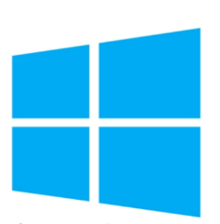
What Should You Do Next?
Plan for
Windows Server 2016
implementation
Sign up for
XenApp Express
Tech Preview
Join TAP program to try
XenDesktop Windows 10
service on Azure
Visit Citrix Booth Location: A12

Slide 42
It’s all about Choice Bro!

