Slide 1

Microsoft Ignite NZ
25-28 October 2016
SKYCITY, Auckland

Slide 2
Moving your Windows Desktop App to UWP with Desktop Bridge
M393
Sean Alexander
Principal Group SDE
Microsoft - Redmond
Twitter/LinkedIn: SeanAlex

Slide 3
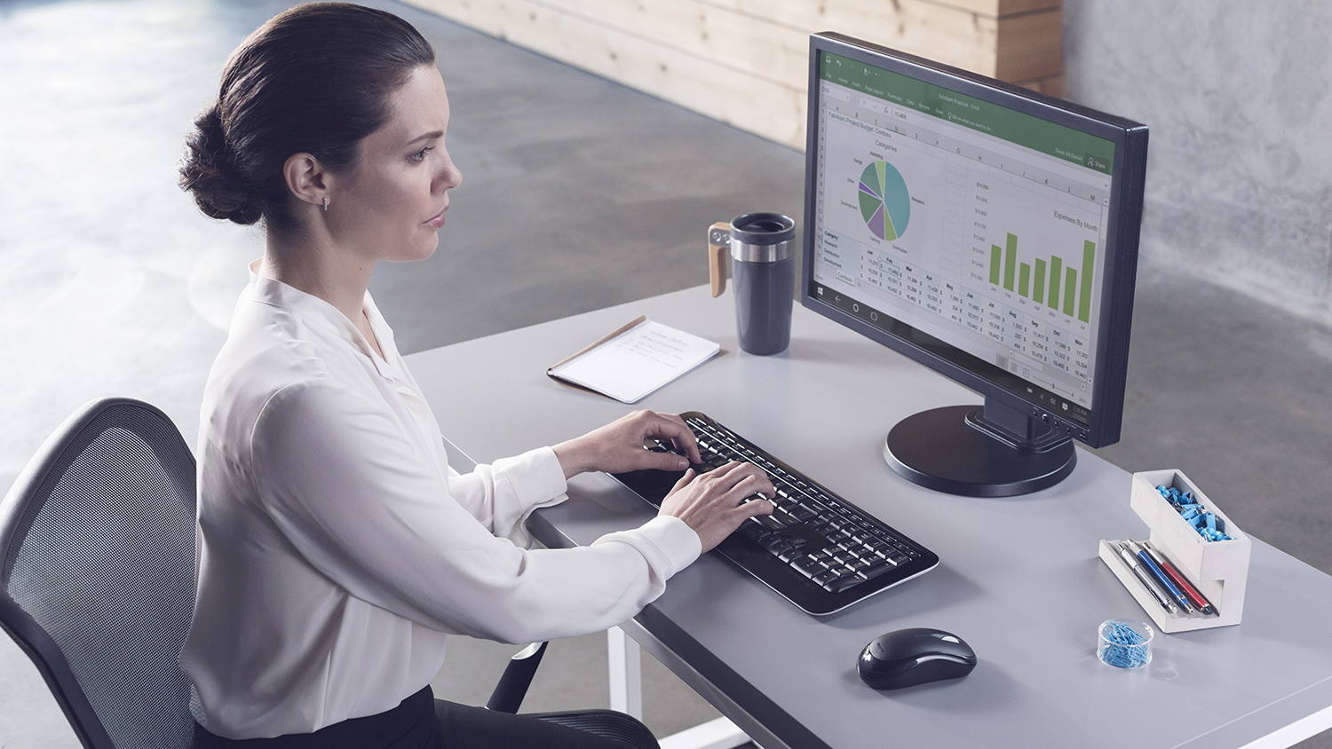
Millions of desktop solutions

Slide 4

User experience challenges today
Finding the right installer
Chain-installers (adware)
Staying up-to-date
Doing a clean uninstall

Slide 5

Software developer challenges today
Maintaining installer tech
Providing auto-updates
Monetization/licensing
Trustworthy distribution
“DLL Hell”
Modernization

Slide 6
Desktop Bridge
Accelerating bringing your desktop solutions to the Universal Windows Platform (UWP)
Deployment and distribution
  Convert desktop solutions to use modern deployment technology
  Distribute through the Windows Store or other/existing distribution channels
  Reach 350+ million users on Windows 10 and monetize globally through the Windows Store
Migrate at your own pace
  Enhance the app or game with UWP APIs
  Gradually migrate to a UWP app that reaches all Windows devices

Slide 7
Who is Publishing with Desktop Bridge?
Evernote
Arduino IDE
doubleTwist
PhotoScape
MAGIX Movie Edit Pro
Relab
SQL Pro
Virtual Robotics Kit
Voya Media
Predicted Desire
korAccount
many more…

Slide 8
How does Desktop Bridge Work?
Desktop
Process
  Activate
App Container
Process
Activate
Current code running in Desktop process
UWP app code runs in App Container
Activate Desktop process from App Container and vice-versa
Inter process communication (via AppService)
Communicate

Slide 9
Desktop Bridge and File System Management
App packages are installed to C:\Program Files\WindowsApps\package_name
File system captures changes to AppData, copied on write to per-user, per-app location under .\VFS
Merging of well-known File system folders happens real-time
Communicate

Slide 10
Desktop Bridge and Registry Management
Converted app packages capture registry changes in registry.dat equivalent of HKLM\Software
All writes to HKCU are copy-on-written to private per-user, per-app location
All writes are kept during package upgrade(s)
Communicate

Slide 11
Considerations when using Desktop Bridge
Cannot require UAC Prompt or Admin to run
NT Services and Drivers are not supported
CRT Version 11 or higher
.NET earlier than 4.6.1, update and test via in-box
Exposing another COM object works today; Out of Proc is underway
Writes to files/folders in the converted app packages are not allowed

Slide 12
Developer Workflow for Desktop Bridge
Convert
Enhance
Extend
Migrate
Reach all
App package
App package
App package
App package
App package
Desktop app
Desktop app
Desktop app
Desktop app
UWP app
UWP
APIs
UWP APIs
UWP APIs
UWP app
UWP app

Slide 13
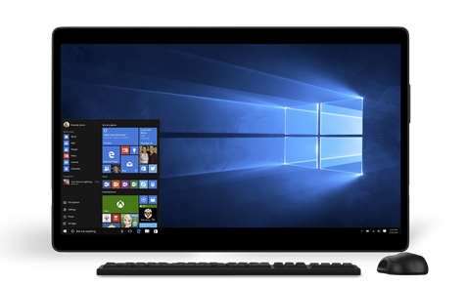
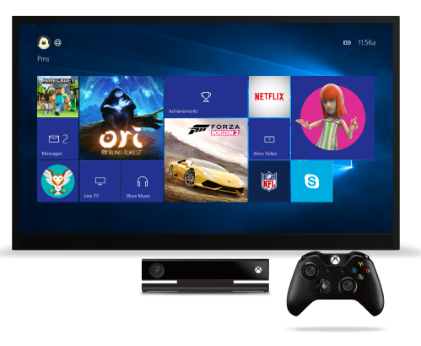
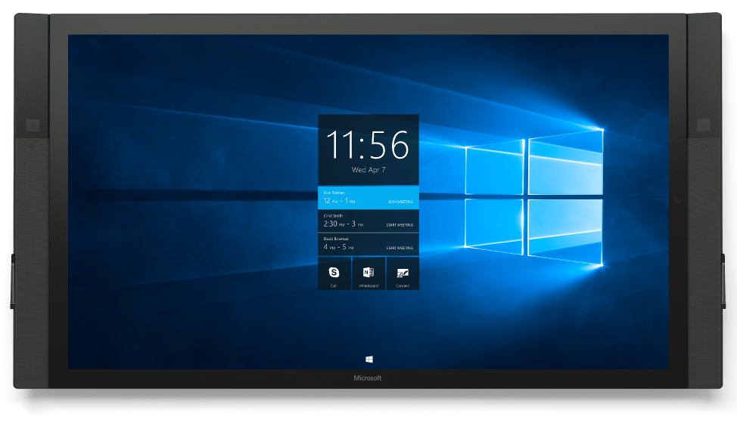
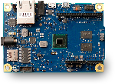
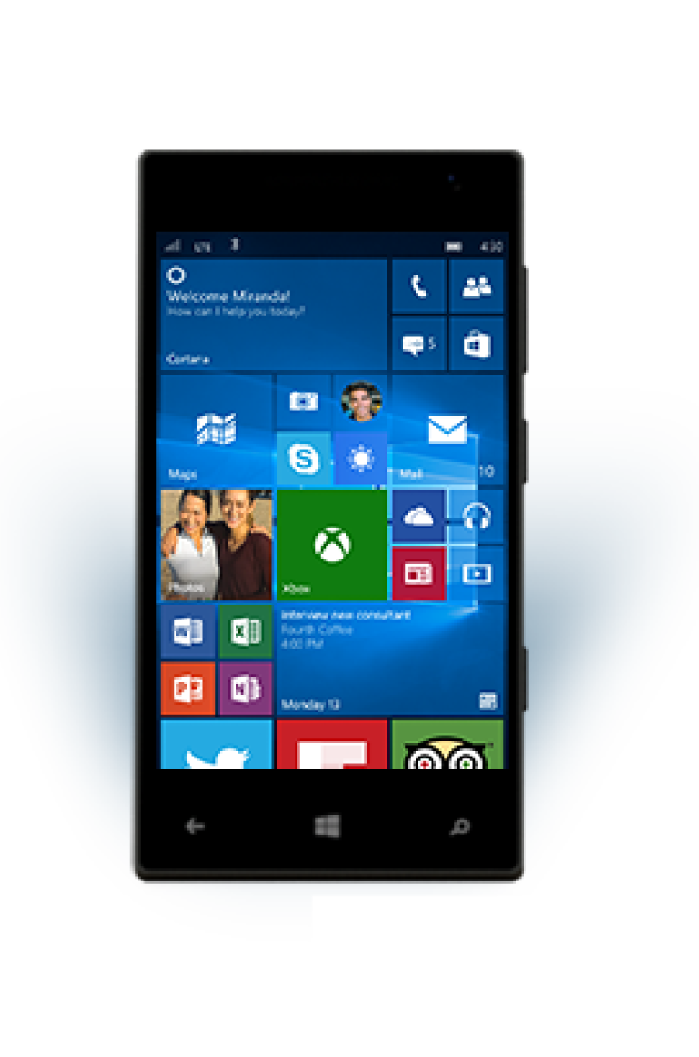
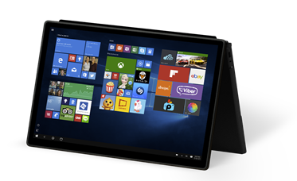
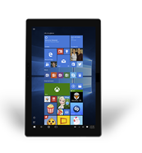

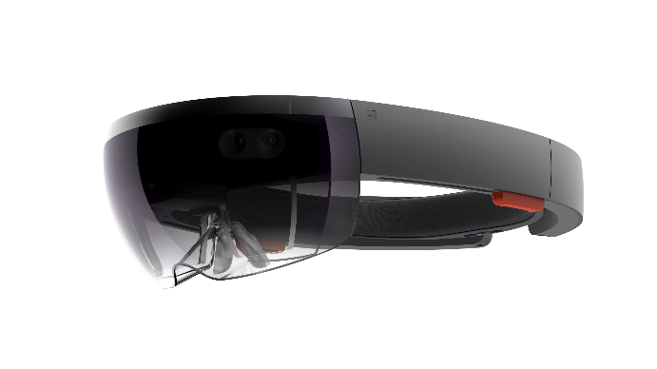
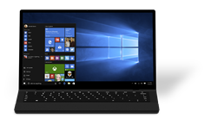
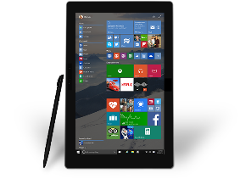
Do anything a UWP app can do
Take advantage of more UWP APIs
Take advantage of App Services, BG tasks & Triggers
Migrate UI to XAML
Devices +IoT
Holographic
PC
Mobile
Xbox
Surface Hub
Adaptive User Interface
Natural User Inputs
One SDK + Tooling
One Store +
One Dev Center
Cloud
Services
Configuration
Security
Management
Updates

Slide 14
Converting Your App

Slide 15



Three Options to Package your App
Convert
Desktop App Converter (DAC)
Manual Conversion (assemble package, files, manifest and sign) or UWP Packager Extension
Third party installers now support Desktop Bridge:

Slide 16
Prep your System for DAC
Convert
Install the Windows 10 SDK &
download the Desktop App Converter from http://aka.ms/converter
Get the Corresponding Base Image from http://aka.ms/converterimages
 
☑
 
☑
(Current recommended store submission image >=14926)

Slide 17
Using Desktop App Converter
Convert
C:\> DesktopAppConverter.exe -Setup -BaseImage BaseImage-<version>.wim

Slide 18
DEMO 1
Converting your App

Slide 19
Troubleshooting and Debugging
DesktopAppConverter : error 'E_BAD_INSTALLER_EXIT_CODE': Installer returned '10' when valid exit codes were '0'
Run Setup from elevated prompt NOT via Converter, note the exit code and if it failed, check app + OS
If succeeded but with error code, use
-InstallerValidExitCodes
If you run –Sign, add the .cer to TrustedPeople store

Slide 20
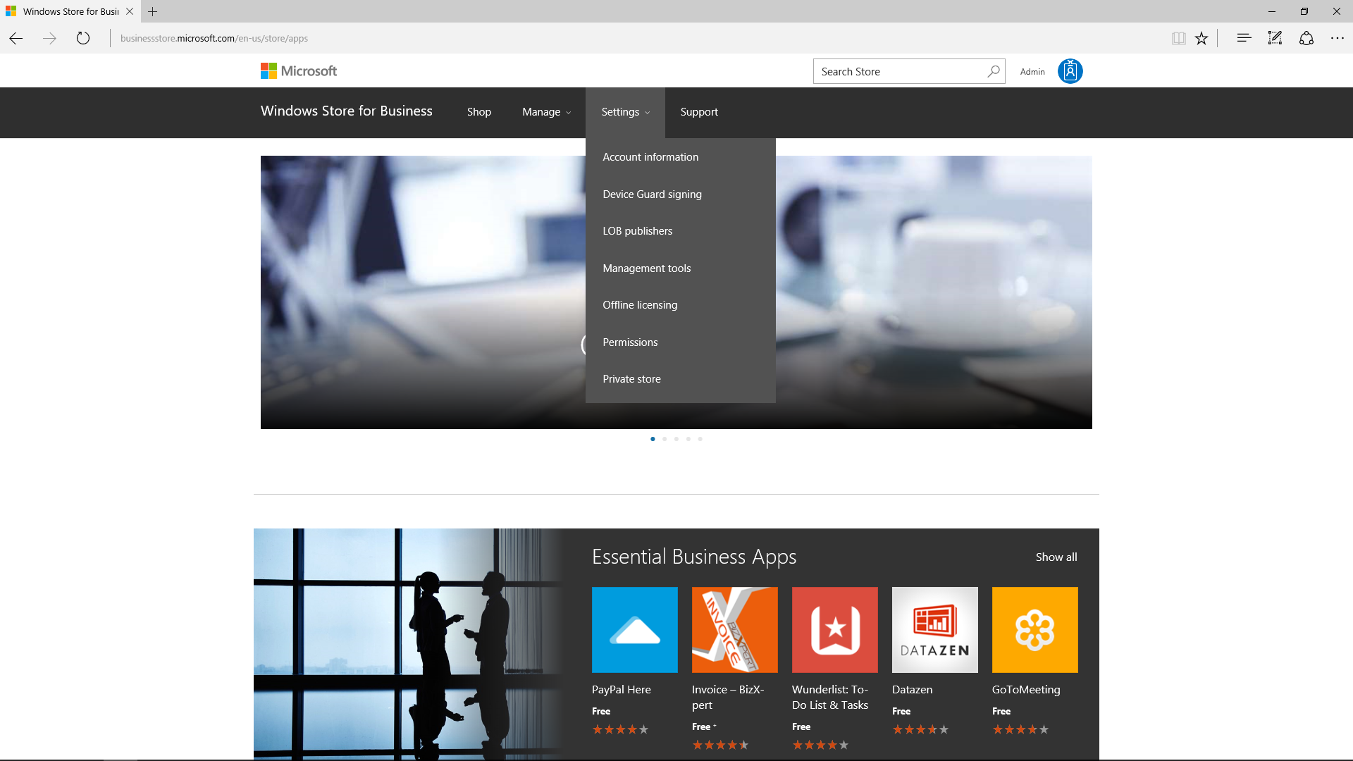
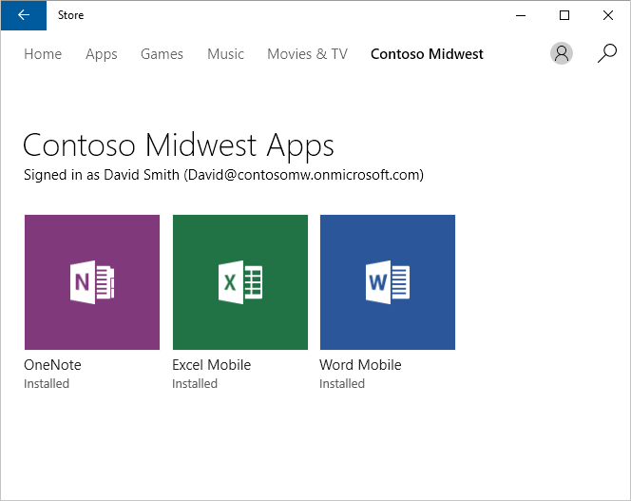
Publishing via Windows Store for Business
Extend your reach to organizations
  Access to business and education users
  Acquire free and paid apps in bulk
Designed for organizations
  Multiple ways to distribute apps
  Support for imaging and offline usage
One place, same tools
  Apps are submitted via Windows Dev Center
  Submit custom LOB apps directly to an organization
B851: Enterprise Apps and the Windows Store for Business

Slide 21
Publishing your App in Windows Store
Join
Build
Publish
Validate
Discover
Engage
Analyze
Experiment
Grow
Store account http://dev.windows.com
Reserve your app name in the store
Submit to run full trust on your account
Package Flighting with stub app and testing
Upload the package, add description, artwork
Publish

Slide 22
Publishing your App in Windows Store
<Capabilities>
<rescap:Capability Name="runFullTrust" />
</Capabilities>
<Application Id="MyDesktopAppStep3" Executable="MyDesktopApp.exe" EntryPoint="Windows.FullTrustApplication">
<TargetDeviceFamily Name="Windows.Desktop" MinVersion="10.0.14393.0" MaxVersionTested="10.0.14393.0" />

Slide 23
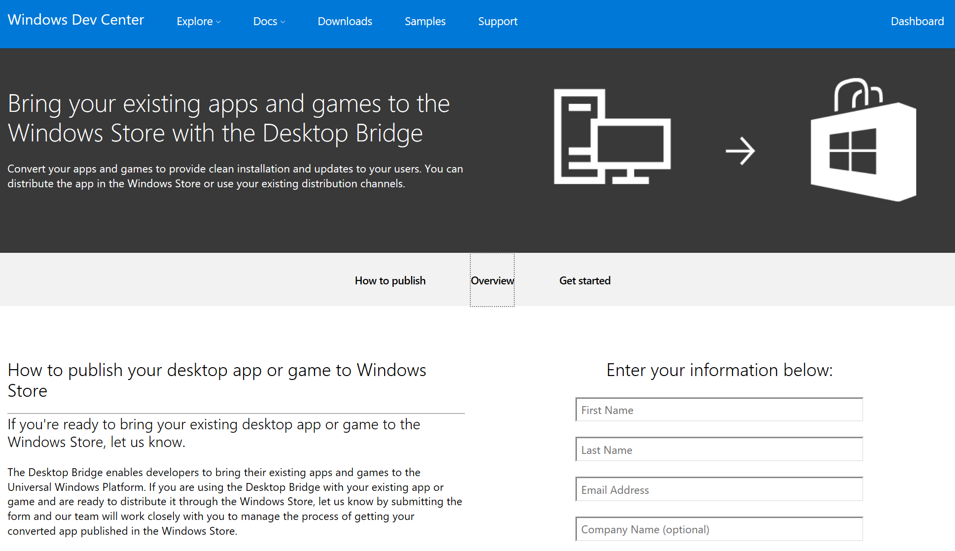
Submitting your App

Slide 24
Enhancing your App with Windows Store APIs

Slide 25
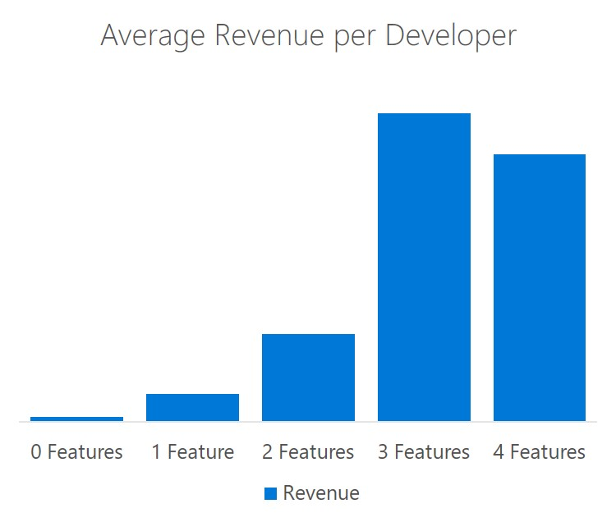
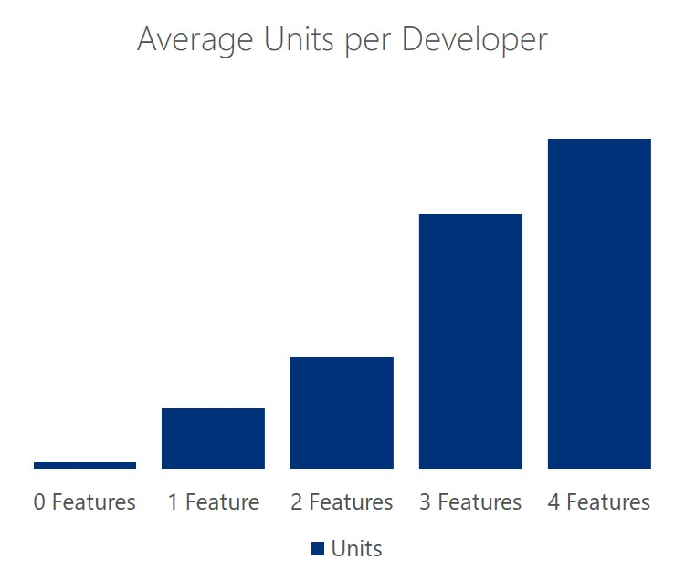
Why Enhance your App?
Enhance
Developers are achieving 10x revenue and 4x volume gains when using 3 or more features
10x
4x
Notes:
Features include: Microsoft Ad platform, IAP, Sale Pricing and Tokens
Among all Windows Publishers who have had at least one acquisition of a revenue generating app since Sept 2015
Does not include top 10 revenue generating Publishers or any Microsoft first-party titles
Does not include any potential 3P revenue generated from outside of the Microsoft features mentioned above

Slide 26
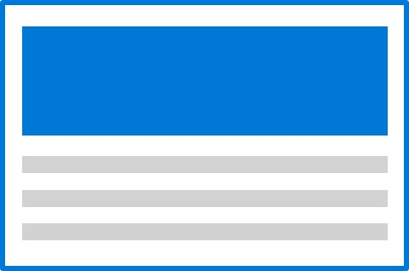


Windows Store Monetization Platform
Enhance
Paid Model
App purchase - In-app purchase - Sale Pricing
Store-managed Consumables - Subscriptions - DLC
Bundles - Discounts - Paid Upgrades - Pre-orders
Advertising Model
Ad networks - yield optimization - mediation
banner ads - interstitial ads - native ads - video ads
community ads - re-engagement ads - app install ads
Dev Center
Submit
Manage
User roles
App/Dashboard
Flighting
Store SDK
Purchases
Advertising
Experimentation
Analytics
Feedback
Developer Tools
Visual Studio
Azure
Xamarin
Cordova
HTML5
Storefronts
Collections
Featured
Categories
Sales
Specials
Analytics
PowerBI
HockeyApp
Analytics API

Slide 27
Adding Windows.Services.Store
Enhance
using Windows.Services.Store;
var store = Windows.Services.Store.StoreContext.GetDefault();
var license = store.GetAppLicenseAsync();
var result = store.RequestPurchaseAsync("<STOREID>");

Slide 28
Benefits: Package Flighting
Enhance
Sample scenario
  You already have an app in the Windows Store, with several million customers.
  You want to validate that your latest bug fix works end to end with a limited set of known people who already have the app installed.
  Once you have confidence in the fix, you’ll make the update available to everyone.

Slide 29
Benefits: New Concept of Customer Groups
Enhance
Who can see / acquire the app?
Which packages do they get?
Everyone can see /
Everyone can acquire
Customer groups
Package flights
Different packages delivered only
to group members
Known customers specified by Microsoft account email address
Only those with direct link can see /
Anyone with direct link can acquire
Everyone else gets the non-flighted packages
Customers who have opted-in to an app beta group
Targeted app availability
Only group members with a direct link can see / acquire the app
Only those with direct link can see / Only those w/ promo code can acquire

Slide 30
Flight to Multiple Groups Simultaneously
Enhance
Package flights contain only binary packages.
Only group members get these updates.
Your app or game has to be published before you can create a package flight.
Non-flighted submission
App distribution settings
(available to everyone)
Store listings
Packages v1.0
Package flight C
Group of 1500 enthusiasts
Packages v1.1
Package flight B
Group of 100 co-workers
Packages v1.2
Package flight A
Group of 15 testers
Packages v1.3

Slide 31
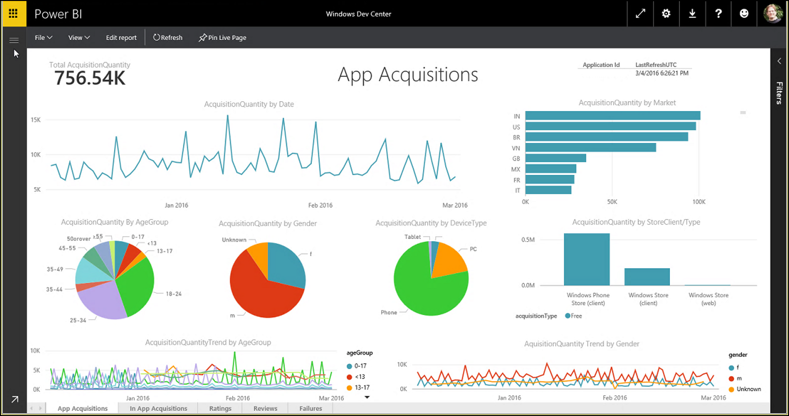

Make Data-Informed Decisions
Enhance
  Monitor your app
  New analytics API
PowerBI Content Pack
  Rich visuals
  Powerful filters
Video: Windows Store Analytics APIs: New ways to get your hands on your data with Stuart Hargreaves

Slide 32
Windows Store Analytics APIs
Enhance
Request
Method | Request URI
GET | https://manage.devcenter.microsoft.com/v1.0/my/analytics/appacquisitions?applicationId=9NBLGGGZ5QDR
Header | Description
Authorization | Required. The Azure AD access token in the form of Bearer <token>.

Slide 33
Windows Store Analytics APIs
Enhance
Response
{
"Value": [
{
"date": "2016-02-01",
"applicationId": "9NBLGGGZ5QDR",
"applicationName": “MyApp Demo",
"deviceType": "Phone",
"orderName": "",
"storeClient": "Windows Phone Store (client)",
"osVersion": "Windows Phone 8.1",
"market": "IT",
"gender": "m",
"ageGroup": "0-17",
“acquisitionType": "Free",
"acquisitionQuantity": 1
}
],
"@nextLink": "appacquisitions?applicationId=9NBLGGGZ5QDR&aggregationLevel=day&startDate=2015/01/01 &endDate=2016/02/01&top=10000&skip=20000&orderby=date",
"TotalCount": 46766
}

Slide 34
Windows Store Analytics APIs
Enhance
App Health
Example 1
  All crashes on tablets, grouped by failureName and packageVersion and aggregated by week:
  https://manage.devcenter.microsoft.com/v1.0/my/analytics/failurehits?ApplicationId=9NBLGGGZ5QDR&groupBy=failureName,packageVersion&aggregationLevel=week&filter=eventType eq 'crash' and deviceType eq 'Tablet'

Slide 35
Windows Store Analytics APIs
Enhance
App Health
Example 2
  All events for package version 2.1.1.2 grouped by eventType, eventName and packageName:
  https://manage.devcenter.microsoft.com/v1.0/my/analytics/failurehits?ApplicationId=9NBLGGGZ5QDR&groupBy=eventType,eventName,packageName&filter=packageVersion eq '2.1.1.2'

Slide 36
Extending Your App

Slide 37
Extend your App to call UWP APIs
Extend
Universal App Package
Feature Examples:
  Live Tile support
  Actionable Notifications
  Cortana
  etc.
Classic Windows App
Universal Windows API

Slide 38
Using Live Tiles in Desktop Apps
Extend
XmlDocument tileXml = TileUpdateManager.GetTemplateContent(TileTemplateType.TileSquare150x150Text03);
XmlNodeList textNodes = tileXml.GetElementsByTagName("text");
textNodes[0].InnerText = "MyDesktopApp";
textNodes[1].InnerText = "Status: ";
textNodes[2].InnerText = comboBox1.SelectedItem.ToString();
textNodes[3].InnerText = DateTime.Now.ToString("hh:mm:ss");
TileNotification tileNotification = new TileNotification(tileXml);
TileUpdateManager.CreateTileUpdaterForApplication().Update(tileNotification);

Slide 39
DEMO 2
Adding
Live Tiles

Slide 40
Adding Background Tasks
Extend
BackgroundTaskBuilder builder = new BackgroundTaskBuilder();
builder.Name = "TimeTrigger";
builder.SetTrigger(new TimeTrigger(15, false));
builder.TaskEntryPoint = "BackgroundTasks.MyBackgroundTask";
builder.Register();

Slide 41
DEMO 3
Adding
BG Tasks

Slide 42
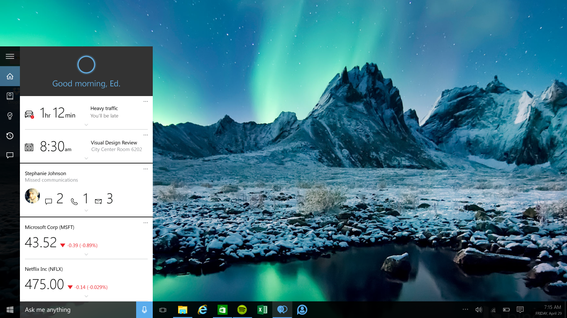
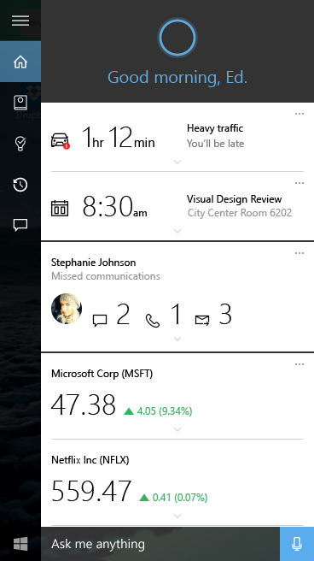
Hey Cortana, order me food with Just Eat
Hey Cortana, create a station for Hozier on Pandora
Hey Cortana, send a message to Jonas Brandell on Viber
Hey Cortana, Tweet flying into San Francisco tonight

Slide 43
DEMO 4
Migrating your
App

Slide 44
Bridge to the Universal Windows Platform
At this point our converted App already has:
Modern deployment
Activation via Tiles, file types or URI protocols
App Identity → access to more UWP API surface
UWP App Model

Slide 45
How can this help grow your business?
Global distribution with local payment methods
Reduce fragmentation of solution versions
Ability to modernize and innovate at your own pace

Slide 46
Resources
Windows Desktop Bridge on Developer Portal
UWP Packager in Visual Studio 15 Preview
Notifications Visualizer
UWP Community Toolkit
GitHub DesktopBridgetoUWP Resources

Slide 47
Q&A

Slide 48

© 2014 Microsoft Corporation. All rights reserved. Microsoft, Windows, and other product names are or may be registered trademarks and/or trademarks in the U.S. and/or other countries.
The information herein is for informational purposes only and represents the current view of Microsoft Corporation as of the date of this presentation. Because Microsoft must respond to changing market conditions, it should not be interpreted to be a commitment on the part of Microsoft, and Microsoft cannot guarantee the accuracy of any information provided after the date of this presentation. MICROSOFT MAKES NO WARRANTIES, EXPRESS, IMPLIED OR STATUTORY, AS TO THE INFORMATION IN THIS PRESENTATION.

