Slide 1
Microsoft Ignite NZ
25-28 October 2016
SKYCITY, Auckland

Slide 2
Universal Windows Platform apps on Xbox One OMG!
M392
Damian Karzon

Slide 3
What is UWP What’s different about Xbox? How do I do that?

Slide 4
What’s a Universal Windows Platform (UWP) app
One API set, One Package, One Store
Adaptive controls and input
Extension SDKs for device family features

Slide 5
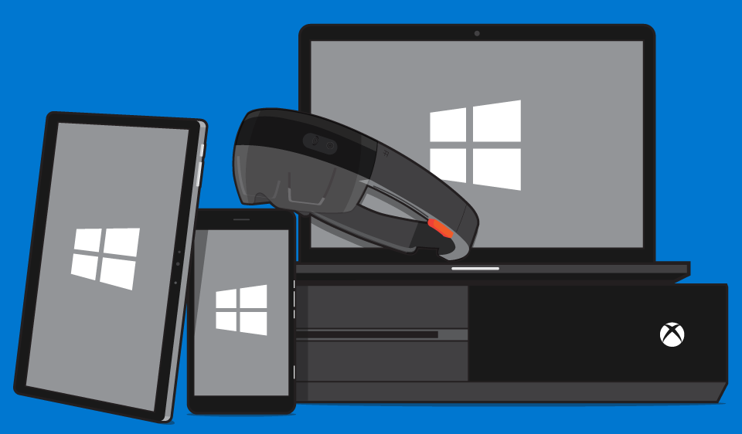
UWP design principles
Keep it simple
Effortless UI
Make it personal
People are people
Think universal
All of the world
Create delight
Enjoyable UX

Slide 6
dev.windows.com/design

Slide 7
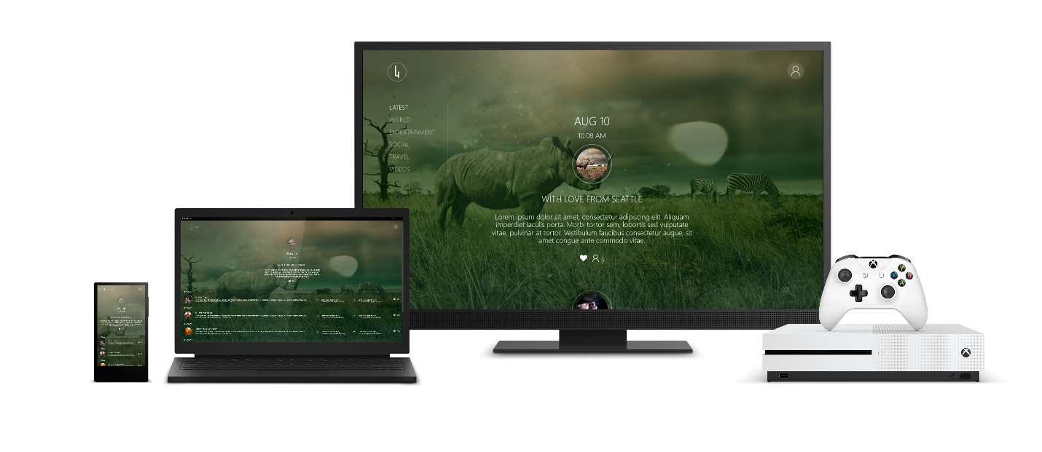
10-foot design principles (~3 metres)
Simple
Double simple
Coherent
Easy to use
Captivating
Immersive, cinematic experiences

Slide 8
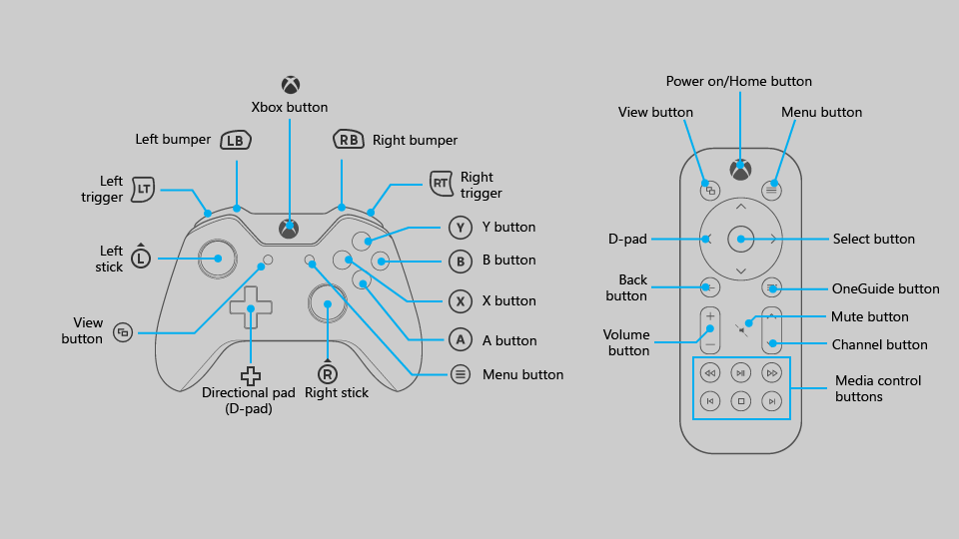
Controller/Remote
Less is more
Focus

Slide 9
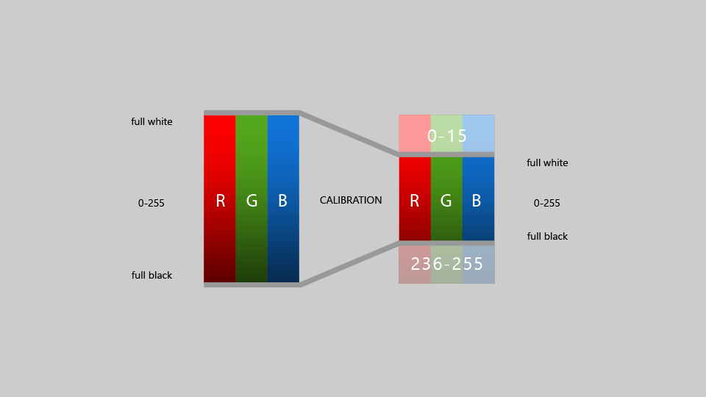
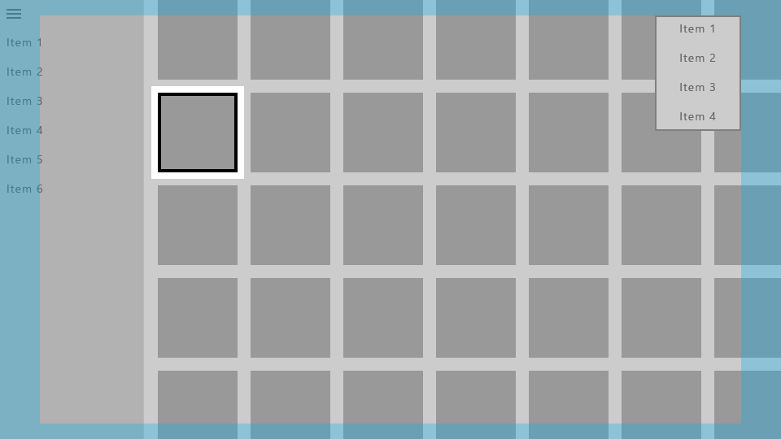
TV Safe Colours
TV Safe Area

Slide 10
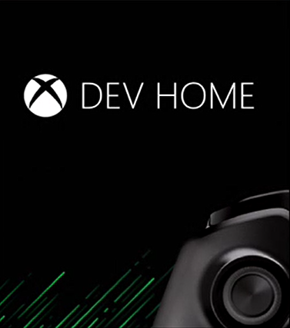
Getting setup with Xbox One dev
Requirements
Xbox One Anniversary Update
Dev mode activation app
Visual Studio 2015 Update 3
Developer Center Account

Slide 11
Demo
Environment
File -> New Project -> Deploy to Xbox One

Slide 12
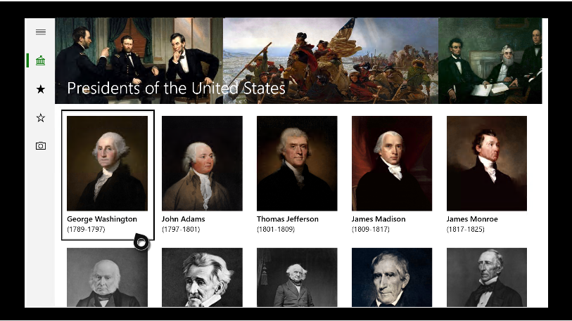
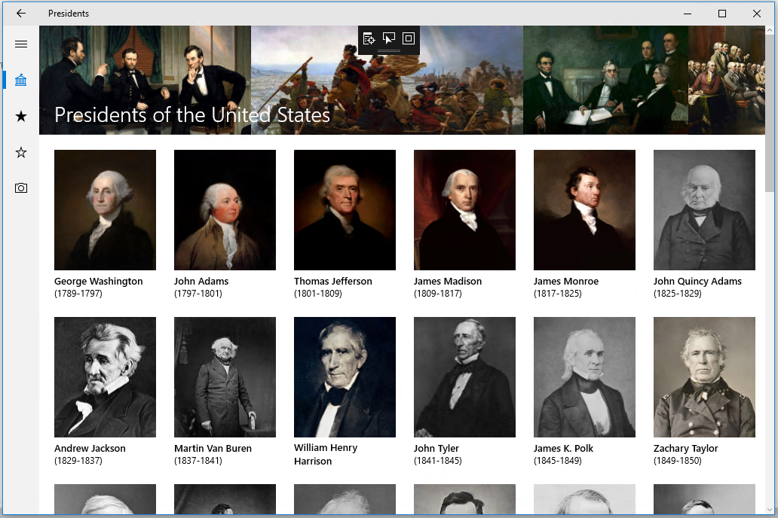
defaults for UWP “it just works”
“acceptable method”
UWP desktop example
UWP Defaults – Works on Xbox / TV
Scale Factor applied by default
TV safe box applied by default
“Mouse Emulation” with Gamepad
Automatic TV Safe Area

Slide 13
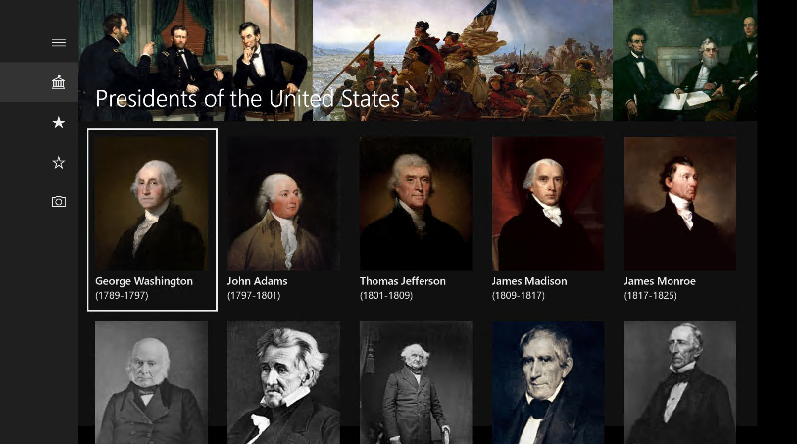
optimised for 10’
premium experience
UWP desktop example
“UWP XBOX” – Optimized for Xbox (TV)
Optimize for Gamepad (“X-Y Focus”)
Focus Rectangle for TV
Account for TV Safe area
Use TV Safe colors
Less dense control layout and bigger controls
Integrate SMTC (or use our media controls)
Use adaptive layout to account for snapped apps

Slide 14
Controller and Remote Interaction Basics
XY Focus
Requires Pointer
Recommended for most UI surfaces
Use for drawing canvases, web content, etc.

Slide 15
Configuring XY Focus vs. Requires Pointer
Application.RequiresPointer=
"Auto" : XY Focus or pointer depending on device (default)
"WhenRequested" : XY Focus, except on controls where specifically requested
For specific controls or pages where pointer makes sense:
Control.RequiresPointer="WhenFocused">
or
Control.RequiresPointer="WhenEngaged">

Slide 16
Tuning XY Focus
//focusable control
IsTabStop=true & Visibility=Visible
//Customise direction focus
control1.XYFocusLeft = control2;
control1.XYFocusRight = control2;
control1.XYFocusUp = control2;
control1.XYFocusDown = control2;

Slide 17
Demo
Optimise UWP app for Xbox

Slide 18
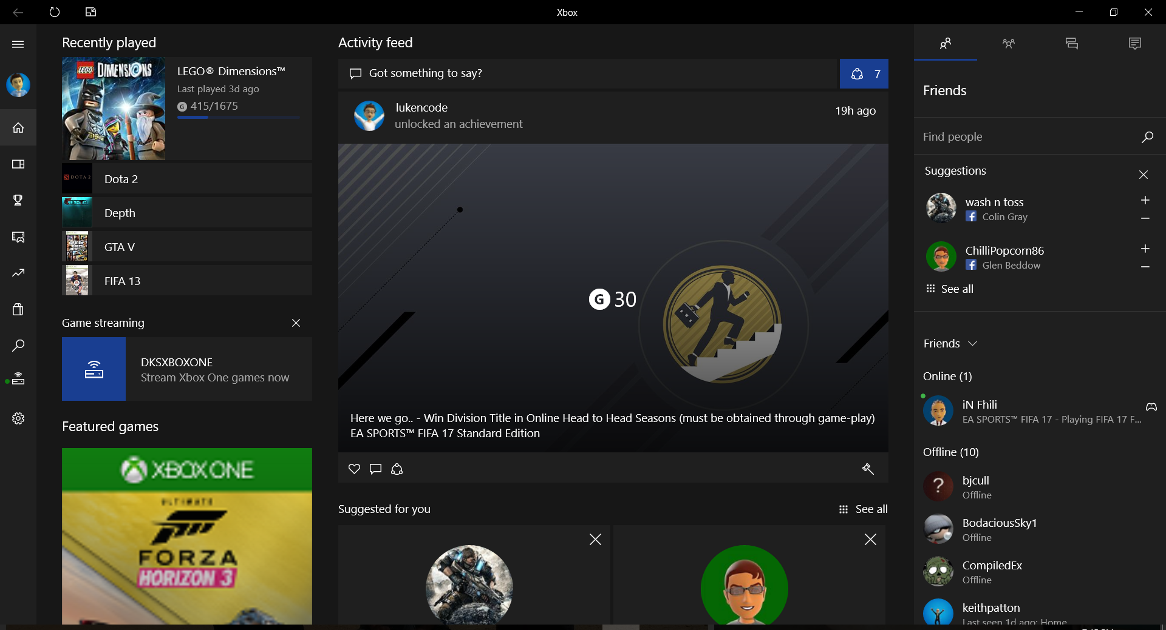

Slide 20
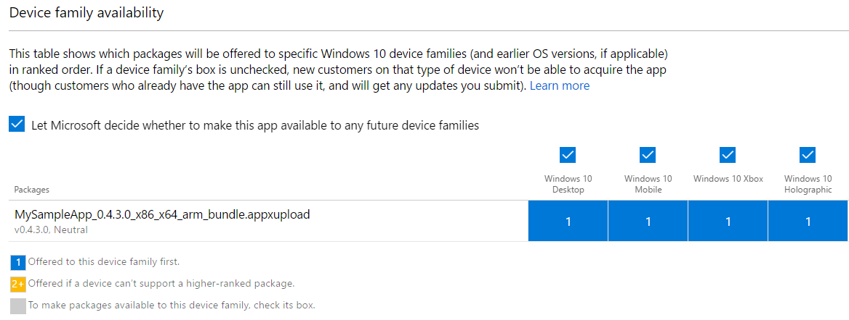
Universal Windows Store

Slide 21
Session recap
UWP Xbox design principles
Controller/Remote Input (Focus)
Interaction modes Inputs and Behaviors
Tuning XY Focus Focus Engagement
Focus Visualization
Presenting on the TV
UI sizing TV-safe area
Colors Sound

Slide 22
Questions?
/dkarzon
/dkarzon

