Slide 1
30 Terrible Habits of Server and Cloud Administrators
M389
Orin Thomas
@orinthomas

Slide 2
Builders often live in unfinished houses

Slide 3
Chefs rarely cook extravagant meals at home

Slide 4
Server and Cloud Administrators recognize good practice

Slide 5
We just don’t always get around to putting it into production environments

Slide 6
Server and Cloud Administrators develop bad habits because …

Slide 7
We practice reactive administration

Slide 8
We have an unwillingness
to pull on
loose threads

Slide 9
We don’t have time

Slide 10
“This is only a test workload for a dev environment, it won’t end up being used in production”

Slide 11
The last guy or girl did it

Slide 12
Management keeps prioritizing silly rubbish that stops people from doing their jobs

Slide 13
Why is it important to ensure that you don’t continue with bad habits?

Slide 14
SECURITY

Slide 15
A large number of attacks succeed because of poor security configuration

Slide 16
Anyone here interested in being responsible for the security of a politician’s on-premises Exchange deployment?

Slide 17
30%+ of attacks come from insiders

Slide 18
Administrators are often in a position to carry out attacks without getting caught

Slide 19
This also makes privileged accounts “grail items” for people with nefarious intent

Slide 20
hack the nerd is more effective than hack the system

Slide 21
Stuff that you might consider low priority detritus may actually provide an attacker with a route into your network

Slide 22
You don’t want to end up in a meeting explaining why you didn’t do something obvious

Slide 23
Lets talk bad habits …

Slide 24
Personal email address used as login account for organizational cloud account

Slide 25
Organizational email address used as login account for organizational cloud account …. But also used to sign up for sites like Ashley Madison and RedTube … Often with the same password

Slide 26
Everyone in the organization using the same highly privileged account when they want to do something in the Azure/AWS subscription

Slide 27
Keeping username and passwords for all privileged cloud & on-premises accounts in a single password protected Word doc or Excel spreadsheet

Slide 28
Not enabling 2 factor authentication on privileged cloud management accounts

Slide 29
Not applying software updates to IaaS VMs

Slide 30
Not cleaning up resources in subscriptions you or organization is still paying for when those resources are no longer being used

Slide 31
Service Accounts (on-premises and in IaaS VMs) with passwords that do not expire

Slide 32
A single service account used for all services

Slide 33
All service accounts using the same default password that is configured to never expire

Slide 34
This happens because Service Account password management is tedious

Slide 35
Getting security right is tedious

Slide 36
Service Account Solution?

Slide 37
Group Managed Service Accounts

Slide 38
Group Managed Service Accounts
Special account type
Password managed automatically by DC
Configure account in AD
Install account on server
Can then use GMSA account for services
Requires Server 2012+
Limited version available in 2008 R2 and has a degree of compatibility with 2012 GMSA

Slide 39
Virtual Service Accounts
Local service account solution
Use when you have to create a non-domain service account
Requires that application support Virtual Service Accounts (SQL 2012+ does)

Slide 40
Password management for Service Accounts isn’t the only problem …

Slide 41
Service Accounts that are members of the Domain Admins group

Slide 42
Service Accounts that are members of the Local Administrators group

Slide 43
This happens because
It’s a really quick way of making a service account that needs privileges work
It can take quite some time to configure local group policy and permissions correctly
Sometimes application vendors provide poor instructions

Slide 44
Solution: Do the hard work to make least privilege work

Slide 45
Cloud and on-premises Administrator account passwords that are configured to never expire

Slide 46
Search for on-prem accounts with non-expiring passwords
Search-ADAccount –PasswordNeverExpires

Slide 47
Day-to-day account is member of local administrators group on day-to-day machine

Slide 48
Even though everyone else in the organization
does not have this right

Slide 49
Hack the Admin
is much easier if the admin always logs on as an admin and disables UAC

Slide 50
Problem: Derelict Administrator Accounts

Slide 51
Problem: Derelict Scheduled Tasks & Scripts

Slide 52
Solution: Tear off the band-aid Disable the account or task & see what happens.

Slide 53
“do something and wait for the screams” in polite company we call this DevOps

Slide 54
Search for accounts that haven’t signed-on for 90 days
Search-AdAccount –accountinactive
–timespan 90.00:00:00

Slide 55
An account that isn’t being used can be disabled

Slide 56
Problem: Use of Domain Admin account to sign on to local workstation

Slide 57
Like using a building master key to lock and unlock your office

Slide 58
Why is it bad to sign on to your local computer with a Domain Admin account?

Slide 59
Pass The Hash Attacks

Slide 60
Pass the hash is a hacking technique that allows an attacker to authenticate to a remote server/service by using the underlying hash of a user's password

Slide 61
Retrieve the hash of a Domain Admin account from a locally compromised computer and then use it to spider across the network attacking other servers

Slide 62
Solutions to pass the hash
Verify difficult to guard against using current technology
Minimize use of accounts that have wide ranging privileges and ensure they are only used on hosts where they need to be used
Windows 10 and Server 2016 include Credential Guard. Keeps credentials in specially virtualized location

Slide 63
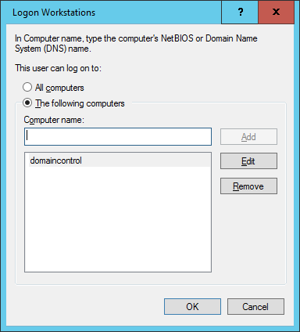
Solution: Restrict privileged accounts
Use account properties to restrict privileged accounts so that they are limited to specific machines

Slide 64
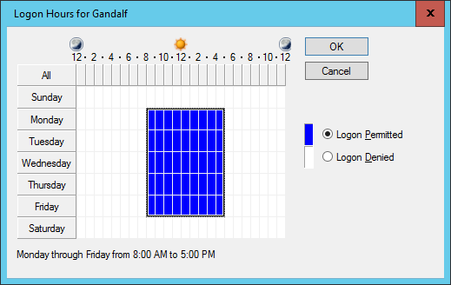
Solution: Restricting account sign on times
Use account properties to restrict privileged accounts so that they can only be used at certain times

Slide 65
Ask yourself:
Should all the accounts in the Domain Admins group actually be there?

Slide 66
Does your organization have a solution for controlling the membership of sensitive groups?

Slide 67
Multi-Admin-Role Account

Slide 68
Domain admin account
is also SQL Admin account
is also Configuration Manager admin account
is also Exchange Admin account
is also Azure admin account

Slide 69
Bad
If account is compromised, many other roles are compromised

Slide 70
Worse: No account lockout policy for administrators

Slide 71
If an admin account incorrectly authenticates three times, probably best to lock the account and require a manual unlock

Slide 72
Weak administrator password policy
Password policies requiring no complexity
Password policies requiring a low number of characters

Slide 73
Privileged accounts should have long complex passwords that are changed on a regular basis

Slide 74
Just In Time Privileged Access Management

Slide 75
Just In Time Privileged Access Management
Requires Microsoft Identity Manager
Requires Privileged Account Forest
Server 2016 functionality
Allows time based access to privileged groups
Membership of privileged group only occurs for limited duration
Can be configured with an approval framework

Slide 76
Azure Privileged Access Management
Certain accounts can request elevated privileges for a specified amount of time
Each elevation requires two factor authentication response
Phone call made to specified phone saying “do you want to elevate”
Makes account hijacking far more difficult
May end up working with on-prem

Slide 77
Just Enough Administration: PowerShell Endpoints configured to only allow specific operations to be taken against specific applications/services/files/objects

Slide 78
Problem: Disabled Windows Firewall

Slide 79
Because it is easier to turn it off than it is to figure out how to create the right rules

Slide 80
Solution: Enable firewall logging to figure out what the firewall is blocking and build rules using that data

Slide 81
Problem: GUIs on servers that don’t need GUIs

Slide 82
Most servers in your organization are doing boring things like:
Domain Controller
DNS Server
DHCP Server
File Server

Slide 83
GUIs increase attack surface (also require more extensive patching)

Slide 84
Solution: Nano Server & Server Core

Slide 85
Problem: Comatose physical servers

Slide 86
Problem: Comatose Virtual Machines (IaaS and on-premises)

Slide 87
Solution: Monitor VM and physical server activity

Slide 88
Problem: Derelict File Buildup

Slide 89
Solution: File Server Resource Manager to locate files that haven’t been accessed for a specific amount of time

Slide 90
Problem: Lack of Recovery Drills

Slide 91
You don’t know your data is protected until you verify that you can recover it

Slide 92
Problem: Unwillingness to Document

Slide 93
Problem: Lack of configuration documentation

Slide 94
Problem: Lack of change documentation

Slide 95
Solution: Ensure that environment is documented so that it is comprehensible

Slide 96
Solution: Move towards configuration management solutions such as DSC or Chef

Slide 97
Problem: Ignored event logs

Slide 98
Most breaches have involved months of network reconnaissance

Slide 99
Hostile activity was present in the Target logs for months prior to the biggest credit card breach in history

Slide 100
Administrators ignored the breach
as false positives

Slide 101
Solution: Understand what you need to respond to. You need to understand difference between suspicious and anomalous

Slide 102
Same password used for work and private accounts

Slide 103
Work email
(which these days often means work credentials)
and passwords exposed in breaches

Slide 104
Solution:
Advanced Threat Analytics in Azure detects when an Azure AD account turns up in a breach
haveIbeenpwned.com

Slide 105
Lack of administrator auditing Quis Custodiet Ipsos Custodes

Slide 106
Q & A

