Slide 1
Microsoft Ignite NZ
25-28 October 2016
SKYCITY, Auckland

Slide 2
Securing and Encrypting Workloads in Azure
M388
Alex Hague & Rie Dodsworth

Slide 3
Azure has the tools you need for securing and encrypting your workloads.

Slide 4
Azure Security Center

Slide 5
Operations Perspective
Single Dashboard for Whole of Subscription
See the security state across all your resources, even if the ability to provision cloud resources is distributed across the organization
Leverage Expertise
MS already knows how to do this (from defending O365, Azure, Xbox, etc)
Deep Visibility
Azure Security Center is part of Azure, it has deep visibility of everything that is happening in your environment

Slide 6
Why Azure Security Center interests me.
Prevent
Detect
Respond

Slide 7
Security Stats are in for 2015
In 2015, there were 38% more security incidents detected than in 2014.
– “The Global State of Information Security Survey 2016” | PWC
The median number of days that attackers stay dormant within a network before detection is over 200.
– “Microsoft Advanced Threat Analytics” | Microsoft
At least 52% of respondents felt that a successful cyberattack against their network would take place within the year.
– “2015 Cyberthreat Defense Report” | CyberEdge Group
Only 38 % of global organizations claim they are prepared to handle a sophisticated cyberattack.
– “2015 Global Cybersecurity Status Report” | ISACA International

Slide 8
Security Stats are in for 2015
Employees are the most cited source of compromised information.
Theft of “hard” intellectual property increased 56% in 2015.
Top means of cyber attach in 2015: Phishing and Malware
People who opened a phishing message in 2015: 30%
That also clicked on the malicious attachment of link: 12%

Slide 9
Security Stats are in for 2015
Research from Symantec:
Total Zero-Day Vulnerabilities
2013: 23 2014: 24 2015: 54 (up 125%)
There were vulnerabilities in three quarters of all web sites.
Ransomware increased 35%
Spear-Phishing Campaigns targeting employees increased 35%

Slide 10
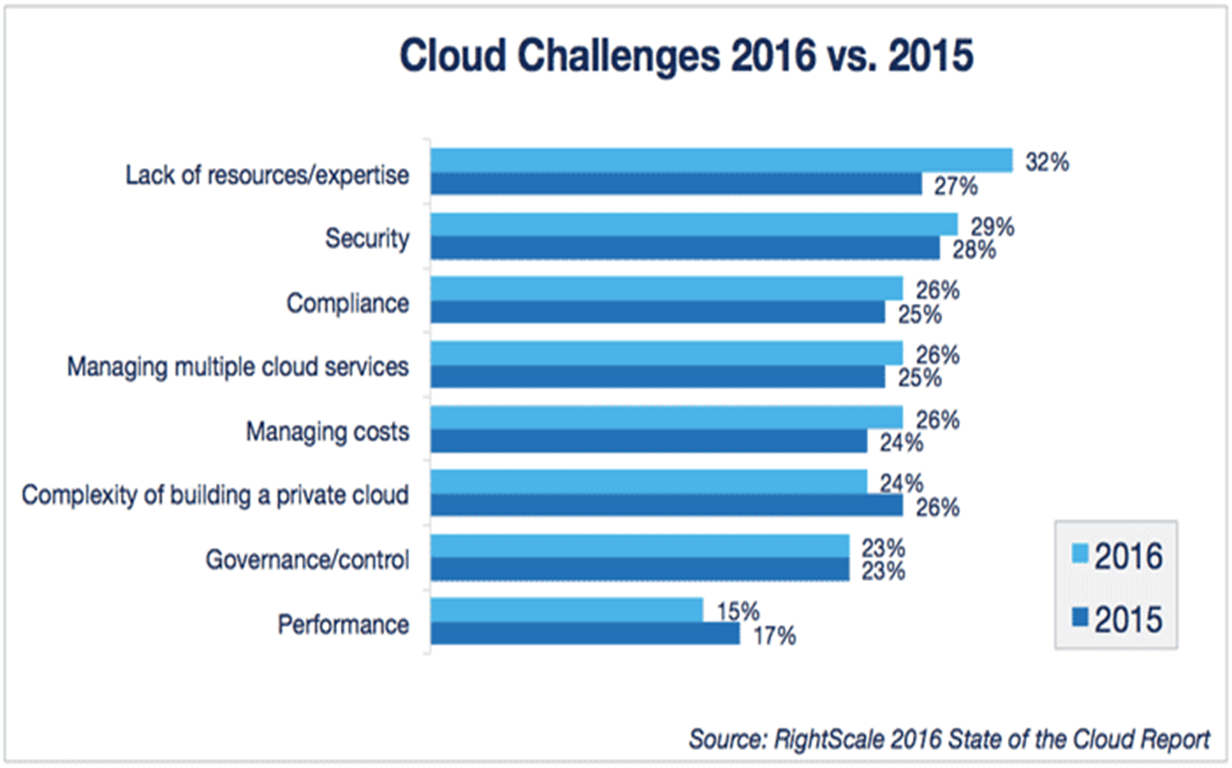
Security Stats are in for 2015

Slide 11
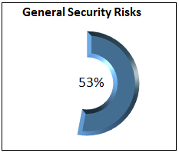
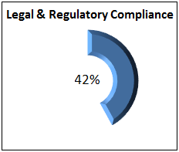
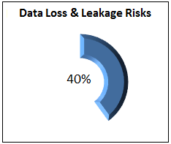
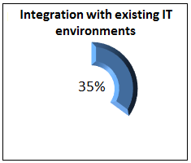
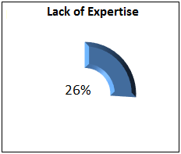
Barriers to Cloud Adoption - 2015
Up 8% Up 13% Down 1% Up 6% Up 10%
Source: 2016 Cloud Security Report
cert.isc2.org/cloud-security-spotlight-report/

Slide 12
Management may not be Technical
Aware of Terms
Firewall
Malware
Security Policy
Patch Schedule
Easy Access to Data
Graphical Representation
Tables and Charts
Standards and Policies
Consistency
Repeatability
Auditing

Slide 13
Security – Not like it used to be
Traditionally
Castle Mentality
Secure the Borders
Firewalls on the border
Anti-Virus
Today
End-Point Protection
Machine Leaning
SSL hides the data
Reputation
Firewalls everywhere
Anti-Malware

Slide 14
What is Security Center?
Prevention
Virtual Machines, Networking
SQL, Applications
Detection
Machine Learning
Response
Available via Drill Down

Slide 15
Demo
Alex Hague

Slide 16
What really got my attention
To-Do Lists
Prevention
Remediation
Reporting
Management can see what is going on
What we have.
What is going on.
What we are doing about it.
Monitoring
Suspicious Activity – e.g. Brute force attacks
Crash Dump Analysis
Machine Learning - Traffic Profiles

Slide 17
What really got my attention - too
Standards and Policies made Easy
Consistency
Repeatability
Auditing
Easy to drive interface
Which devices need work
What work needs doing
Simple methods to achieve results

Slide 18
Why Azure Security Center should interest you.
Prevention
Virtual Machines, Networking
SQL, Applications
Detection
Machine Learning
Response
Available via Drill Down

Slide 19
Key Vault

Slide 20
Why Key Vault?
Key Vault isolates cryptographic keys and secures data used by cloud applications.

Slide 21
Lexicon
Cypher Text – Plain Text
Plain Text is a readable text: Referred to as P
For example: No More Secrets!
Cipher text is an encrypted text: Referred to as C
For example: 6Z2mOq3TrwZrKZmoezi5ZA==

Slide 22
Lexicon
Cypher Text (C) / Plain Text (P)
Plain text : No More Secrets
Cypher Text : 6Z2mOq3TrwZrKZmoezi5ZA==
Encryption can be referred to as P > C (P to C)
As in Plain to Cypher
Decryption can be referred to as C > P (C to P)
As in Cypher to Plain

Slide 23
P to C – C to P
Encoding P to C | No More Secrets! |  | 7gCGyUwQxS7HpoT/Qbjf/p96wqNnmaIu7cwoZGsDxds=
Decoding C to P | 7gCGyUwQxS7HpoT/Qbjf/p96wqNnmaIu7cwoZGsDxds= |  | No More Secrets!

Slide 24
Lexicon
Key
Represented as JSON Web Key [JWK] objects
The initial release supports RSA keys only.
RSA: A 2048bit RSA key. This is a "soft" key, which is processed in software by Key Vault but is stored encrypted at rest using a system key that is in an HSM. Clients may import an existing RSA key or request that Azure Key Vault generate one.
RSA-HSM: An RSA key that is processed in an HSM. RSA-HSM keys are protected in one of the Azure Key Vault HSM Security Worlds (there is a Security World per geography to maintain isolation). Clients may import a RSA key, either in soft form or by exporting from a compatible HSM device, or request that Azure Key Vault generate one. This key type adds the T attribute to the JWK obtain to carry the HSM key material.

Slide 25
Lexicon
Secret
Octet sequences with a maximum size of 25k bytes each.
Data is stored it securely, returning a secret identifier, “id”.
Secret identifier is used to retrieve the secret at a later time.
Additional application-specific metadata in the form of tags may be used. Azure Key Vault supports up to 15 tags, each of which can have a 256 character name and a 256 character value.
Permissions can be set for access to a secret:
set: Create new secrets
get: Read a secret
list: List the secrets or versions of a secret stored in a Key Vault
delete: Delete the secret
all: All permissions

Slide 26
Key Vault
Key
Put an encryption key in
Now does P to C & C to P
Acts like a Function - f(X)
Once the Key is in it can’t be recovered.
RSA 2048
Secret
Any sequence of bytes <= 25K
Acts like a Variable - $X
SQL Connection String
PFX File
AES Keys to encrypt data

Slide 27
Key Vault - KEY
HSM – Hardware Security Module
FIPS 140-2 Level 2 validated.
Decryption performed inside Hardware Module.
Key Vault is designed so that Microsoft does not see or extract your keys.
Encrypt keys and small secrets like passwords.
Software
FIPS 140-2 Level 1 (pending).
Decryption performed inside VM.
Key-Chain Terminates in a HSM.

Slide 28
FIPS 140-2
Federal Information Processing Standard
The Federal Information Processing Standard (FIPS) Publication 140-2, (FIPS PUB 140-2),[1][2] is a U.S. government computer security standard used to accredit cryptographic modules.
The title is Security Requirements for Cryptographic Modules. Initial publication was on May 25, 2001 and was last updated December 3, 2002.

Slide 29
Lexicon
Key – Permissions
Azure Key Vault supports the following operations on key objects:
Create: Allows a client to create a key in Azure Key Vault.
Import: Allows a client to import an existing key to Azure Key Vault.
Update: Allows a client with sufficient permissions to modify the metadata (key attributes) associated with a key previously stored within Azure Key Vault.
Delete: Allows a client with sufficient permissions to delete a key from Azure Key Vault.
List: Allows a client to list all keys in a given Azure Key Vault.
List versions: Allows a client to list all versions of a given key in a given Azure Key Vault.
Get: Allows a client to retrieve the public parts of a given key in an Azure Key Vault.
Backup: Exports a key in a protected form.
Restore: Imports a previously backed up key.

Slide 30
Why Key Vault
Segregation of Duties
Never have to handle the key
Logging
Forensics + Useful for troubleshooting
Compliance
Existing FIPS compliant environment
Good Security Hygiene
Avoid repeating same security mistakes again and again

Slide 31
Many Ways To Interact With Key Vault
Azure Resource Manager Portal
Web based management
Ability to use Azure RM Templates to create Key Vaults and secrets
X-Platform CLI, PowerShell, SDKs
Automation, scripting, and software development
REST APIs
Most complicated, but covers all bases even if there is no SDK

Slide 32
Demo
Alex Hague

Slide 33
Why Key Vault?
Key Vault isolates cryptographic keys and secures data used by cloud applications.

Slide 34
Azure has the tools you need for securing and encrypting your workloads.
Now it’s up to you.

Slide 35
Useful Links
Security Center – Pricing (Free vs Paid)
https://azure.microsoft.com/en-us/pricing/details/security-center/?cdn=disable
Azure Virtual Machine Extensions
https://azure.microsoft.com/en-us/documentation/articles/virtual-machines-windows-extensions-features/?cdn=disable
Key Vault – MSDN Documentation
https://msdn.microsoft.com/en-us/library/azure/dn903623.aspx
Key Vault – SSL / TLS Certificates
https://azure.microsoft.com/en-gb/updates/azure-key-vault-certificates-helps-simplify-and-automate-tasks-for-ssl-tls-certificates/

