Slide 1
Microsoft Ignite NZ
25-28 October 2016
SKYCITY, Auckland

Slide 2
Beyond T-SQL: non-relational features in SQL Server 2016
M384
David Lyth

Slide 3
Deeper insights across data
Access any data | Scale and manage | Powerful Insights | Advanced analytics
PolyBase Insights from data across SQL Server and Hadoop with simplicity of T-SQL Enhanced SSIS Designer support for previous SSIS versions Support for Power Query | Enterprise-grade Analysis Services Enhanced performance and scalability for analysis services Single SSDT in Visual Studio 2015 (CTP3) Build richer analytics solutions as part of your development projects in Visual Studio Enhanced MDS Excel add-in 15x faster; more granular security roles; archival options for transaction logs; and reuse entities across models | Mobile BI Business insights for your on-premises data through rich visualization on mobile devices with native apps for Windows, iOS and Android Enhanced Reporting Services New modern reports with rich visualizations | R integration Bringing predictive analytic capabilities to your relational database Analytics libraries Expand your “R” script library with Microsoft Azure Marketplace

Slide 4
Mission-critical performance
Performance | Security | Availability | Scalability
Operational analytics Insights on operational data; Works with in-memory OLTP and disk-based OLTP In-memory OLTP enhancements Greater T-SQL surface area, terabytes of memory supported, and greater number of parallel CPUs Query data store Monitor and optimize query plans Native JSON Expanded support for JSON data Temporal database support Query data as points in time | Always encrypted Sensitive data remains encrypted at all times with ability to query Row-level security Apply fine-grained access control to table rows Dynamic data masking Real-time obfuscation of data to prevent unauthorized access Other enhancements Audit success/failure of database operations TDE support for storage of in-memory OLTP tables Enhanced auditing for OLTP with ability to track history of record changes | Enhanced AlwaysOn Three synchronous replicas for auto failover across domains Round robin load balancing of replicas Automatic failover based on database health DTC for transactional integrity across database instances with AlwaysOn Support for SSIS with AlwaysOn | Enhanced database caching Cache data with automatic, multiple TempDB files per instance in multi-core environments

Slide 5
Polybase

Slide 6
PolyBase and queries
RDBMS
Hadoop
PolyBase
Provides a scalable, T-SQL-compatible query processing framework for combining data from both universes
Access any data

Slide 7
PolyBase View in SQL Server 2016
PolyBase View
Execute T-SQL queries against relational data in SQL Server and semi-structured data in Hadoop or Azure Blob Storage
Leverage existing T-SQL skills and BI tools to gain insights from different data stores
Query
Results
SQL Server
Hadoop
Azure Blob Storage
Access any data

Slide 8
PolyBase use cases
Load data
Use Hadoop as an ETL tool to cleanse data before loading to data warehouse with PolyBase
Interactively query
Analyze relational data with semi-structured data using split-based query processing
Age out data
Age out data to HDFS and use it as “cold” but queryable storage
Access any data

Slide 9
How to use PolyBase in SQL Server 2016
PolyBase Group
Head Node
Compute Nodes
PolyBase T-SQL queries submitted here
SQL 2016
SQL 2016
SQL 2016
SQL 2016
PolyBase Engine
PolyBase DMS
PolyBase DMS
PolyBase DMS
PolyBase DMS
Optional
PolyBase queries can only refer to tables here and/or external tables here
Hadoop Cluster
Namenode
Datanode
Datanode
Datanode
Datanode
AB
01
01
01
01
File System
File System
File System
File System
Access any data

Slide 10
Step 1: Set up a Hadoop cluster…
Hadoop Cluster
Namenode
Datanode
Datanode
Datanode
Datanode
AB
01
01
01
01
File System
File System
File System
File System
Hortonworks or Cloudera distributions
Hadoop 2.0 or above
Linux or Windows
On-premises or in Azure
Access any data

Slide 11
Step 1: …or set up an Azure Storage Blob
Azure
Azure Storage Volume
Azure Storage Volume
Azure Storage Volume
Azure Storage Blob (ASB) exposes an HDFS layer
PolyBase reads and writes from ASB using Hadoop RecordReader/RecordWrite
No compute pushdown support for ASB
Access any data

Slide 12
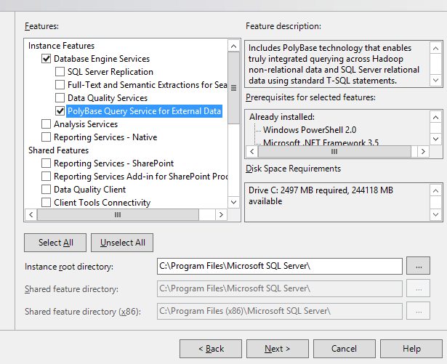
Step 2: Install SQL Server
Server Instances
SQL 2016
SQL 2016
SQL 2016
SQL 2016
PolyBase DLLs
PolyBase DLLs
PolyBase DLLs
PolyBase DLLs
Install one or more SQL Server instances with PolyBase
PolyBase DLLs (Engine and DMS) are installed and registered as Windows Services
Prerequisite: User must download and install JRE (Oracle)
Access any data

Slide 13
Step 4: Choose External Big Data Source
-- different numbers map to various Hadoop flavors
-- example: value 4 stands for HDP 2.x on Linux, value 5 for HDP 2.x on Windows,
value 6 for CHD 5.x on Linux
Values 0 - 7
Supported Big Data Sources
Hortonworks HDP 1.3 - 2.3 on Linux/Windows Server
Hortonworks HDP 2.4 – 2.5 on Linux
Cloudera CDH 4.3, 5.1 – 5.5 on Linux
Azure blob storage
https://msdn.microsoft.com/en-us/library/mt143174.aspx
What happens behind the scenes?
Loading the right client jars to connect to Hadoop distribution
Access any data

Slide 14
Step 5: Attach Hadoop cluster or Azure Storage
Head Node
Compute Nodes
SQL 2016
SQL 2016
SQL 2016
SQL 2016
PolyBase Engine
PolyBase DMS
PolyBase DMS
PolyBase DMS
PolyBase DMS
Azure
Hadoop Cluster
Namenode
Datanode
Datanode
Datanode
Datanode
AB
01
01
01
01
Azure Storage Volume
Azure Storage Volume
Azure Storage Volume
File System
File System
File System
File System
Access any data

Slide 15
Creating Polybase Objects
CREATE EXTERNAL DATA SOURCE HadoopCluster WITH(
TYPE = HADOOP,
LOCATION = 'hdfs://10.14.0.4:8020'
);
CREATE EXTERNAL FILE FORMAT CommaSeparatedFormat WITH(
FORMAT_TYPE = DELIMITEDTEXT,
FORMAT_OPTIONS (FIELD_TERMINATOR = ',', USE_TYPE_DEFAULT = TRUE)
);
CREATE EXTERNAL TABLE [dbo].[SensorData](
vin varchar(255),
speed int,
fuel int,
odometer int,
city varchar(255),
datatimestamp varchar(255)
)
WITH(
LOCATION = '/apps/hive/warehouse/sensordata',
DATA_SOURCE = HadoopCluster,
FILE_FORMAT = CommaSeparatedFormat
);
Create an external data source
Create an external file format
Create an external table for unstructured data

Slide 16
Polybase Queries
SELECT
[vin],
[speed],
[datetimestamp]
FROM dbo.SensorData
SELECT
[make],
[model],
[modelYear],
[speed],
[datetimestamp]
FROM dbo.AutomobileData
LEFT JOIN dbo.SensorData
ON dbo.AutomobileData.[vin] = dbo.SensorData.[vin]
Query external data table as SQL data
Data returned as defined in external data table
Join SQL data with external data
Join data between internal and external table
All TSQL commands supported
PolyBase will optimize between SQL-side query and pushdown to MapReduce

Slide 17
PolyBase query example #1
-- select on external table (data in HDFS) SELECT * FROM Customer
WHERE c_nationkey = 3 and c_acctbal < 0;
Possible execution plan:
EXECUTE QUERY
Select * from T where T.c_nationkey =3 and T.c_acctbal < 0
3
IMPORT FROM HDFS
HDFS Customer file read into T
2
CREATE temp table T
1
Execute on compute nodes
Access any data

Slide 18
PolyBase query example #2
-- select and aggregate on external table (data in HDFS) SELECT AVG(c_acctbal) FROM Customer
WHERE c_acctbal < 0 GROUP BY c_nationkey;
Execution plan:
What happens here?
Step 1: QO compiles predicate into Java and generates MapReduce (MR) job
Step 2: Engine submits MR job to Hadoop cluster. Output left in hdfsTemp.
hdfsTemp
<US, $-975.21>
Run MR job on Hadoop
Apply filter and compute aggregate on Customer.
<UK, $-63.52>
1
<FRA, $-119.13>
Access any data

Slide 19
PolyBase query example #2
-- select and aggregate on external table (data in HDFS) SELECT AVG(c_acctbal) FROM Customer
WHERE c_acctbal < 0 GROUP BY c_nationkey;
Execution plan:
Predicate and aggregate pushed into Hadoop cluster as MapReduce job
Query optimizer makes cost-based decision on what operators to push
4
RETURN OPERATION
Select * from T
3
IMPORT hdfsTEMP
Read hdfsTemp into T
2
CREATE temp table T
On DW compute nodes
hdfsTemp
1
Run MR job on Hadoop
Apply filter and compute aggregate on Customer. Output left in hdfsTemp
<US, $-975.21>
<UK, $-63.52>
<FRA, $-119.13>
Access any data

Slide 20
Demo
Using Polybase

Slide 21
JSON

Slide 22
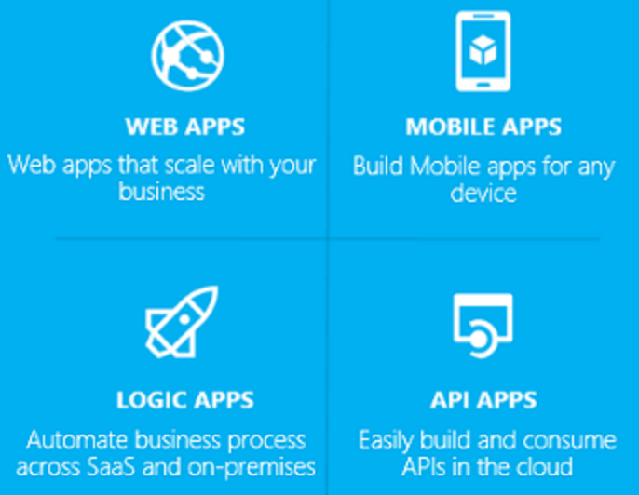
Why JSON in SQL ?
[ { "Number":"SO43659", “Customer":“MSFT", "Price":59.99, "Quantity":1 }, { "Number":"SO43661", “Customer":“Nokia“, "Price":24.99, "Quantity":3 } ]
Number | Customer | Price | Quantity
SO43659 | MSFT | 59.99 | 1
SO43661 | Nokia | 24.99 | 3

Slide 23
Features
Built-in functions
ISJSON
JSON_VALUE
JSON_MODIFY
JSON_QUERY
OPENJSON
Transforms JSON text to table
[ { "Number":"SO43659", "Date":"2011-05-31T00:00:00" "AccountNumber":"AW29825", "Price":59.99, "Quantity":1 }, { "Number":"SO43661", "Date":"2011-06-01T00:00:00“ "AccountNumber":"AW73565“, "Price":24.99, "Quantity":3 } ]
Number | Date | Customer | Price | Quantity
SO43659 | 2011-05-31T00:00:00 | MSFT | 59.99 | 1
SO43661 | 2011-06-01T00:00:00 | Nokia | 24.99 | 3
FOR JSON
Formats result set as JSON text.

Slide 25
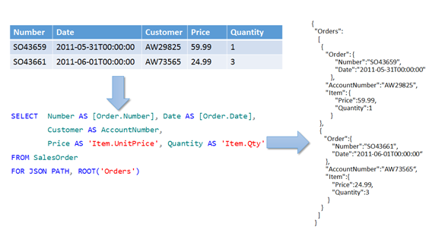
FOR JSON
In PATH mode dot syntax - 'Item.Price' – formats nested output.

Slide 26
Query JSON data
Built-in functions for JSON:
ISJSON - valid JSON ?
SELECT id, json_col FROM tab1 WHERE ISJSON(json_col) > 0
JSON_VALUE extracts scalar value
SET @town = JSON_VALUE(@jsonInfo, '$.info.address.town')
JSON_QUERY extracts an object or array
SELECT FirstName, LastName, JSON_QUERY(jsonInfo, '$.info.address')
AS Address FROM Person.Person ORDER BY LastName

Slide 27
JSON in SQL
Storage
NVARCHAR type
Collation support
Indexes
B-Tree on computed columns
Full Text Search
Compatibility
Works with any feature that supports NVARCHAR type
Works with any client driver
ColumnStore
Compression & Analytics

Slide 28
Demo
Using JSON

Slide 29
R

Slide 30
What is R?
Language Platform
A programming language for statistics, analytics, and data science
A data visualization framework
Provided as Open Source
Community
Used by 2.5M+ data scientists, statisticians and analysts
Taught in most university statistics programs
New and recent graduates prefer it
Active and thriving user groups across the world
Ecosystem
CRAN: 7000+ freely available algorithms, test data and evaluation
Many of these are applicable to big data if scaled

Slide 31
Deploying Analytics On-Prem in SQL 2016
Model & Deploy In SQL16:
Complete Lifecycle
Deploy via BI Tools or Applications
Advantages:
No Data Movement
SQL Skill Reuse
Operational Stability
SMP Parallel Performance
SQL 2016
Prepare
Model
Operationalize

Slide 32
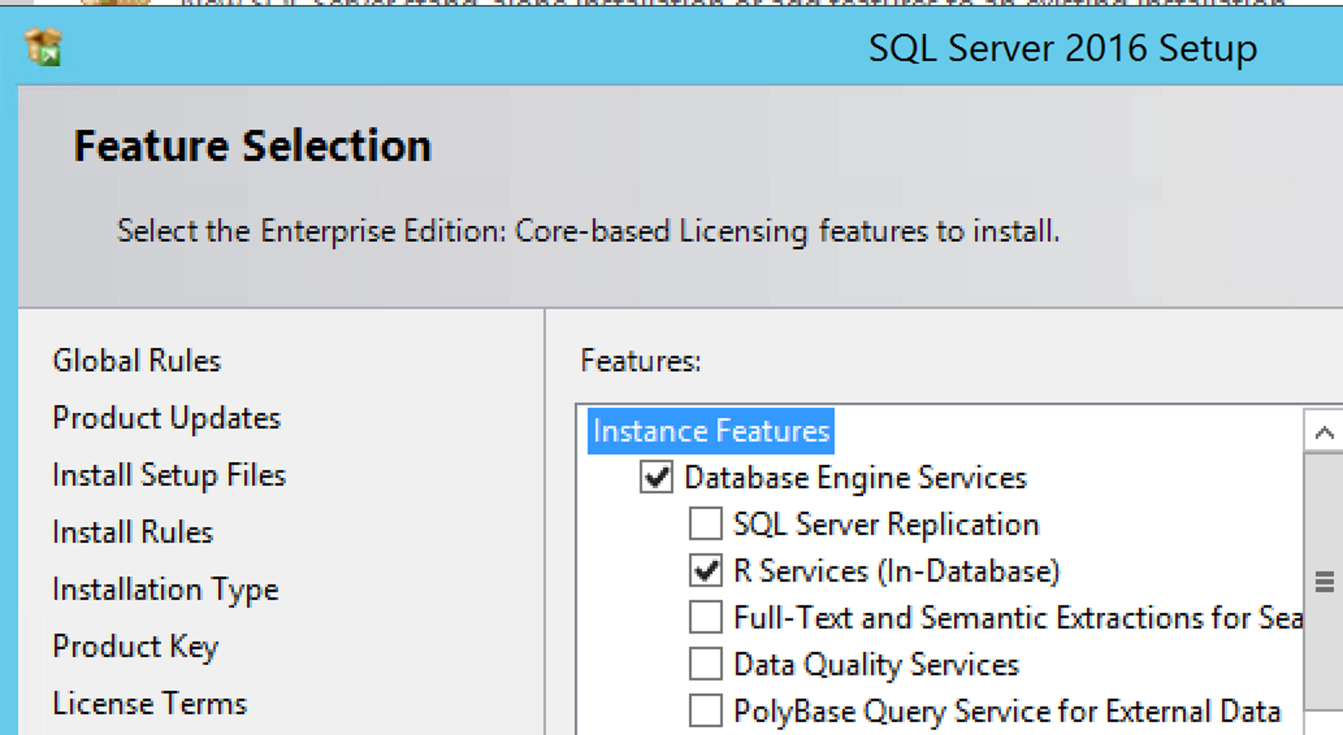
Installation
Install option “R Services”
(Standalone only)
Extra “I consent”
/IACCEPTROPENLICENSEAGREEMENT
…download and install Microsoft R Open
Exec sp_configure 'external scripts enabled', 1

Slide 33
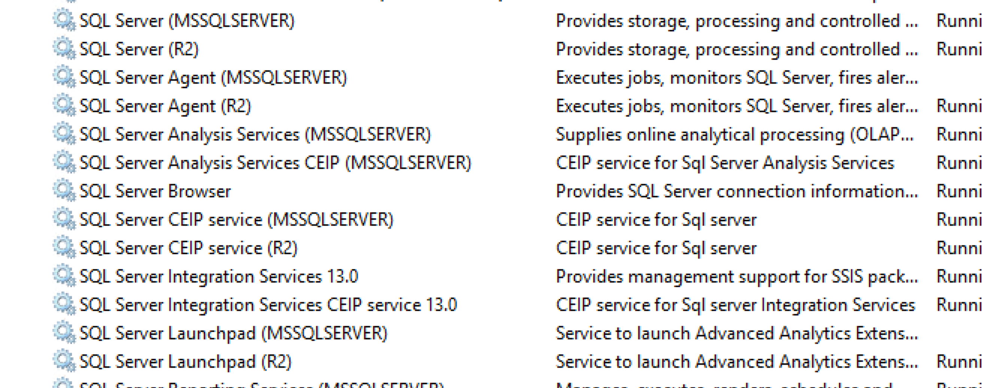
New things
Launchpad service
Local Users
20 accounts in SQLRUserGroup
GRANT EXECUTE ANY EXTERNAL SCRIPT

Slide 34
R Integration into SQL 2016 Architecture
1
RRO
RRE
Sqlsrvr.exe
SQL Server Trusted Launchpad
(MSLP$SQL16)
2
Launch External Process
Launch
RTerm.exe
BxlServer.exe
(MSLP$SQL16)
(MSLP$SQL16)
Rlauncher.dll
R.dll
4
SQL/R Reader, Writer, Converter
3
RxLink.dll
(Service Account)
TCP Data Channel
5
SqlSatellite.dll

Slide 35
Running R from T-SQL
exec sp_execute_external_script
@language =N'R',
@script=N'OutputDataSet<-InputDataSet', -- the R…
@input_data_1 =N'select name from sys.databases'
with result sets (([name] char(100)));

Slide 36
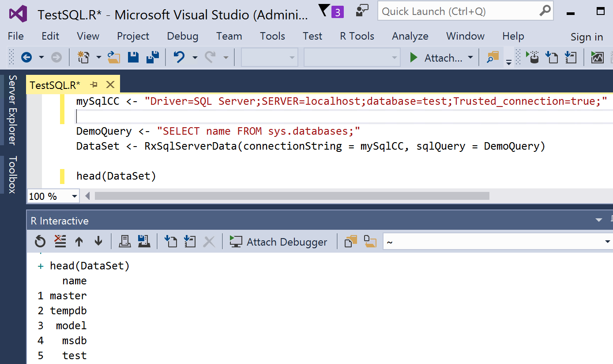
Running R from Visual Studio

Slide 37
Demo
Using R

