Slide 1

Microsoft Ignite NZ
25-28 October 2016
SKYCITY, Auckland

Slide 2
Demystifying the Windows Firewall
M377
Jessica Payne
Security Person
https://aka.ms/jessica @jepayneMSFT

Slide 3
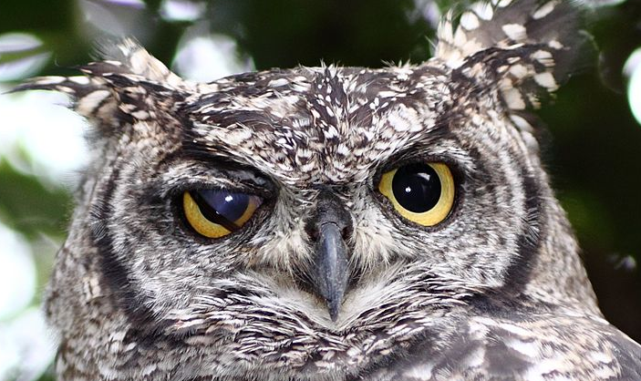

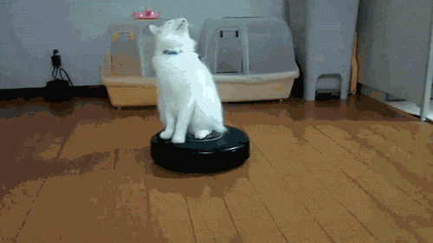
Windows Firewall - preconceived notions
Nope

Slide 4
Breach is inevitable

Slide 5














Typical Attack
Power:
Domain
Controllers
Attacker targets workstations with malware
User is compromised, Attacker performs recon/harvests credentials.
Attacker starts “credentials crabwalk”
Data:
Servers and
Applications
Attacker finds host with domain privileged credentials, steals, and elevates privileges
Attacker owns network, can harvest what he wants.
Alternate ending: Host firewall enabled,
irritating Attacker
Access:
Users and
Workstations
Try harder ☺
5

Slide 6
Your goal is not to stop attackers, but to irritate them.

Slide 7
“How do I disable
Powershell and WMI?”

Slide 8
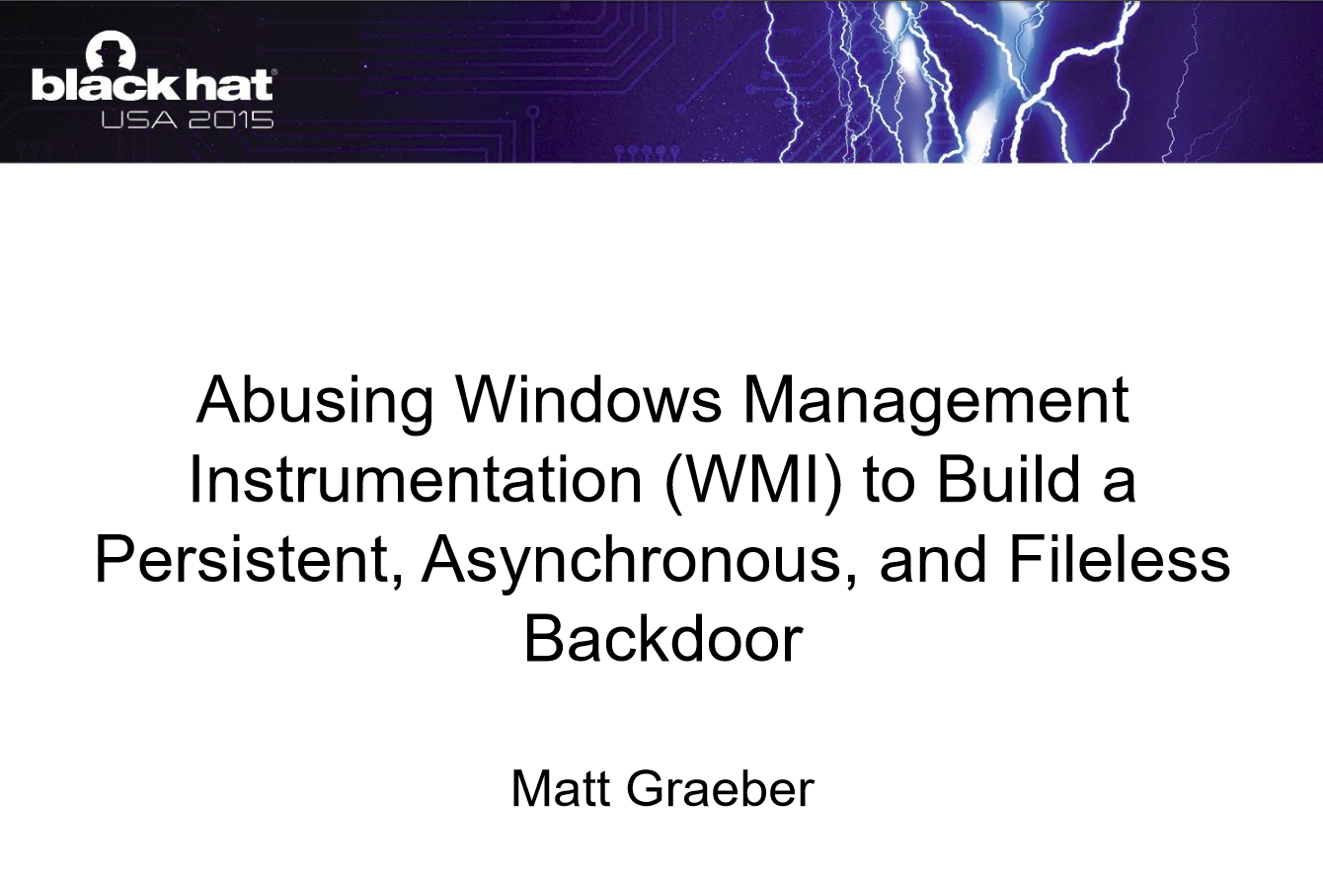
https://www.blackhat.com/docs/us-15/materials/us-15-Graeber-Abusing-Windows-Management-Instrumentation-WMI-To-Build-A-Persistent%20Asynchronous-And-Fileless-Backdoor.pdf
Notes:
https://www.blackhat.com/docs/us-15/materials/us-15-Graeber-Abusing-Windows-Management-Instrumentation-WMI-To-Build-A-Persistent%20Asynchronous-And-Fileless-Backdoor.pdf

Slide 9
“Powershell is not special.”
-@jaredhaight, developer of PSAttack

Slide 10
Authenticated Users
Notes:
Netsessions

Slide 11
The user is the DMZ.
Notes:
Netsessions

Slide 12
Network stuff 101

Slide 13
TCP
Notes:
TCP - Transmission Control Protocol
Reliable, ordered and error checked packets
Session stays open until someone closes it

Slide 14
UDP
Notes:
UDP - User Datagram Protocol
I would tell you a joke about UDP, but you might not get it and I wouldn’t care.
(The nerds in the audience are laughing because that’s how UDP works.)
Connectionless nature makes it useful for things like streaming video.

Slide 15
ICMP
Notes:
ICMP plaintext used for ping obviously which is just the alphabet but also for exfil ps pinging a website is a terrible test

Slide 16
Attackers love default ports.

Slide 17
Stateful firewalls

Slide 18


I didn’t ask for this, so I’m dropping the packet and ignoring you.
RPC (TCP135) & SMB (TCP 445)
Bob’s computer

Slide 19
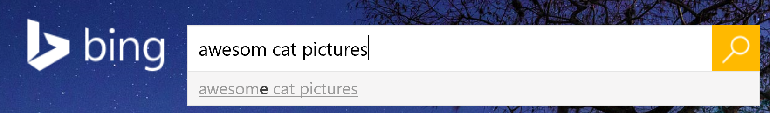

I talked to you first, so this packet is cool to come in.
HTTPS Request
TCP 443
HTTPS Response
TCP Crazy High Port
Bob’s computer

Slide 20
What port does a Windows 7 client firewall have to have open to receive group policy?

Slide 21
Answer: none.

Slide 22

GPOs please (445, etc)
GPOs for you!
Active Directory
Application Refresh Cycle (all the ports)
Bob’s computer
Apps for you! (all the ports)
System Center
Configuration Manager
Email please (TCP 443)
Spam!
Exchange/O365

Slide 23

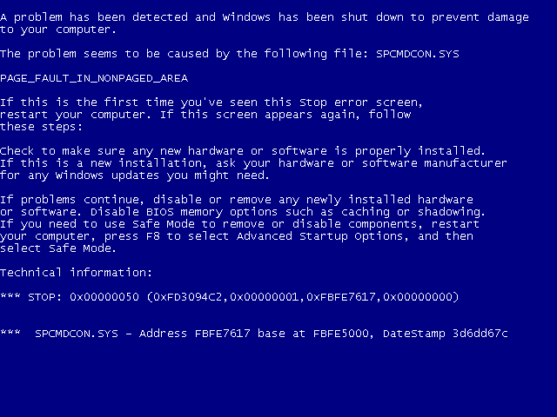
X
Remote assistance TCP 3389
Bob’s computer
Remote assistance

Slide 24
This might irritate me more than the attacker?

Slide 25
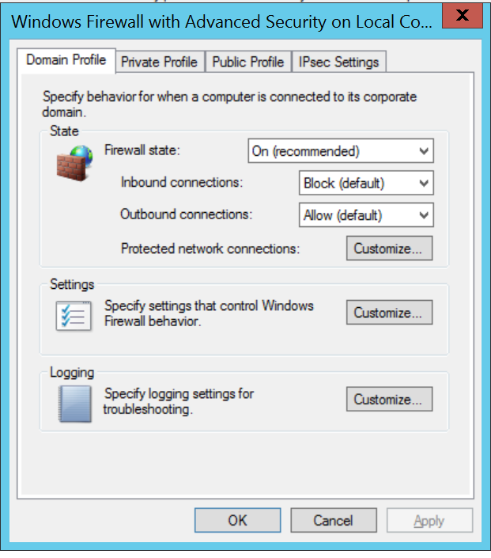
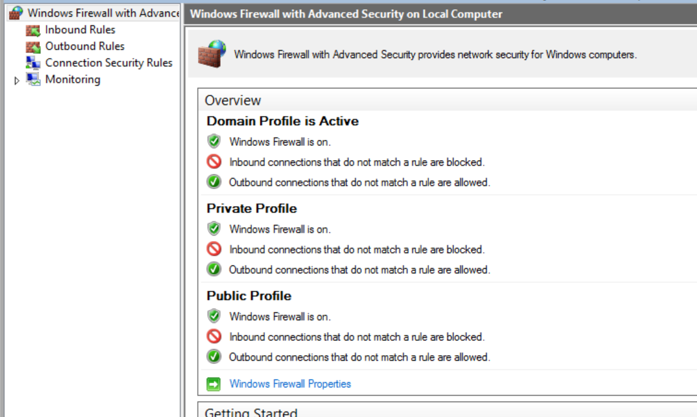
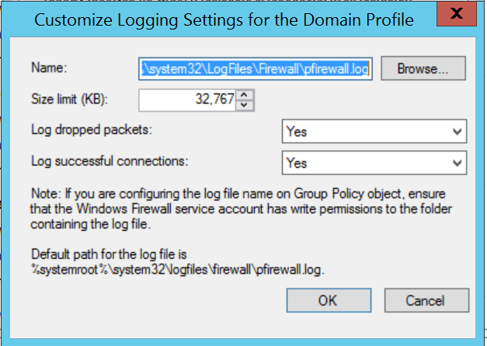

Slide 26
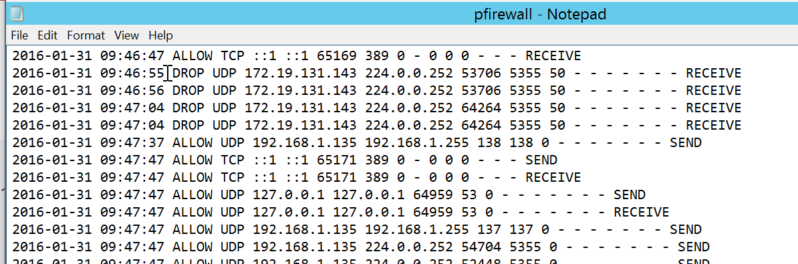
Logs – troubleshooting and security artifact
PS: https://blogs.technet/b/kfalde for logging enhancements

Slide 27
Exceptions are okay – as long as it is a trusted source.

Slide 28
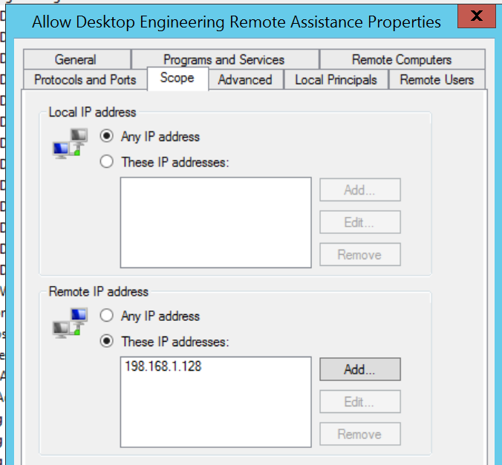
Stateful Firewall
Okay!
Remote assistance TCP 3389
Bob’s computer
Remote Assistance

Slide 29
But where do firewall rules come from?

Slide 30
Firewall basics
Local console via wf.msc
Local service mpssvc
          Don’t disable the service.
Group Policy based configuration located under Computer>Policies>Windows Settings>Security Settings>Windows Firewall with Advanced Security
Can configure firewall, rules, and IPsec within the same interface/policy

Slide 31
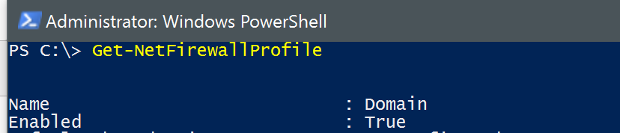
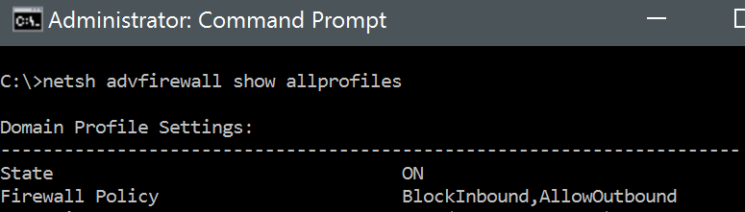
Like all things, there’s a command line too:
Powershell and netsh advfirewall

Slide 32
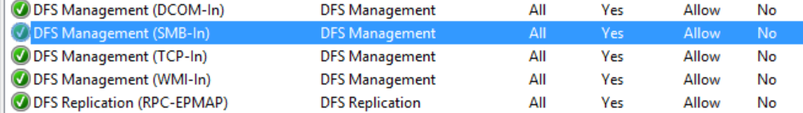
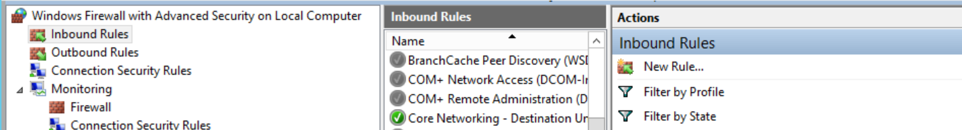
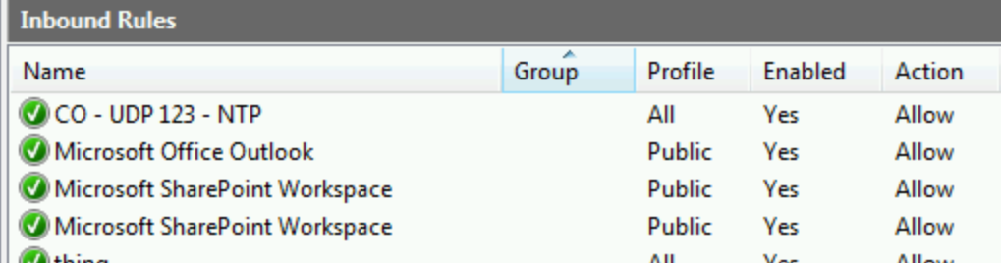
Built in rules (defaults not optimal)
Locally built rules
Group Policy rules

Slide 33
Firewall rule processing order
Windows Service Hardening
Connection Security Rules
Authenticated Bypass Rules
Block Rules
Allow Rules (including Allow if Secure)
Default (whatever Firewall Properties shows)
Or at least, that’s how it’s supposed to work. ☺

Slide 34
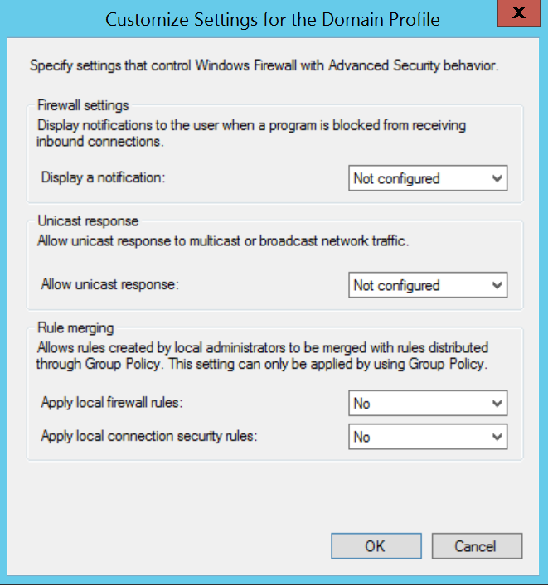
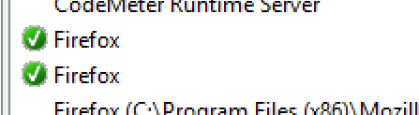
Apps can create
their own rules

Slide 35
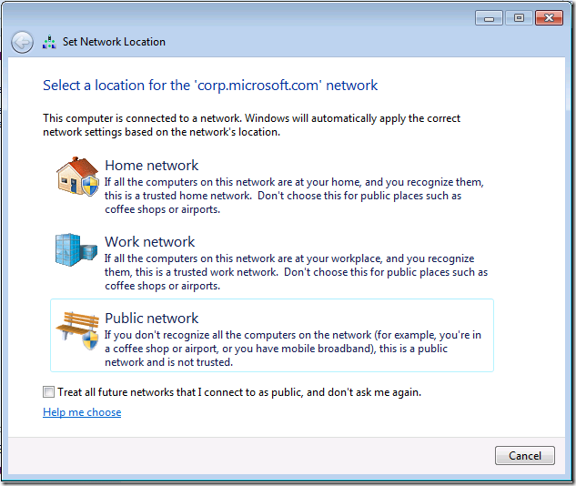
Firewall Profiles

Slide 36
Firewall Profiles
Domain
Public
Private
Not all were exposed in the old UI, causing much pain suffering and probably loss of jobs.
You might stick your rules in all three.
Notes:
If the Connection Specific DNS Name matches the HKEY_Local_Machine\Software\Microsoft\Windows\CurrentVersion\Group Policy\History\NetworkName registry key then the machine will attempt to contact a DC via LDAP. If both these steps succeed, you will get the Domain profile. It is important to note that if the steps succeed, processing stops here

Slide 37
This seems hard to manage.

Slide 38
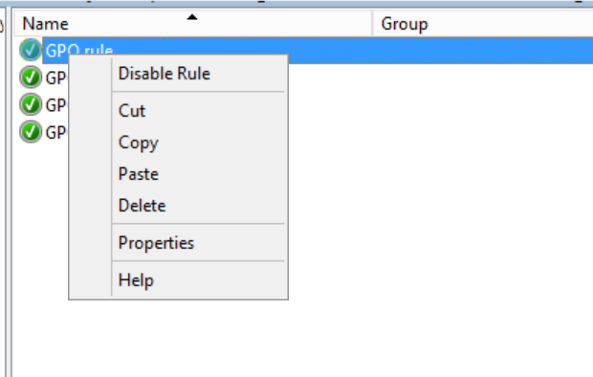
Usability tip
You can copy and paste in the firewall console!

Slide 39
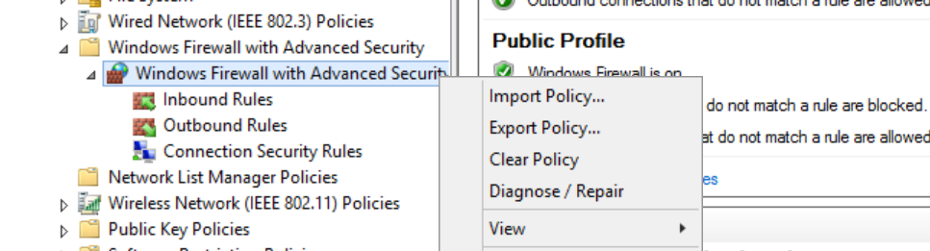
Build from basics
Build on reference computer -> import to GPO

Slide 40
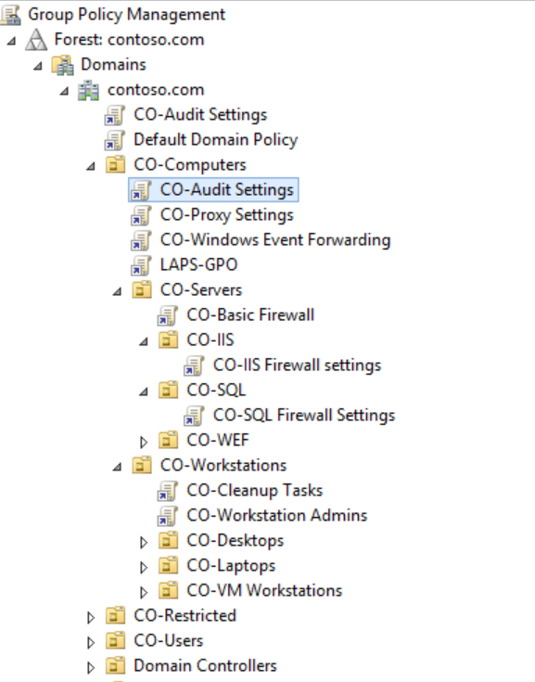
Granular OUs
Organizational Units are policy boundaries
You’ll need to think like this for lateral movement mitigations.

Slide 41
Aim for Default Deny

Slide 42
Just the basics can slow down lot of attackers.

Slide 43
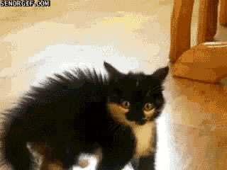
IPsec

Slide 44
ESP

Slide 45
IPsec – more than just encryption
Normal Packet
TCP 445 – secret file share
Null encapsulation
Packet now goes over UDP 500, labeled ESP
ESP Header
TCP 445 – secret file share
Integrity protection
ESP with SHA1 hash of packet
ESP Header
TCP445 – secret file share
Encryption
ESP bundle with AES 256 encryption
ESP Header
TCP445 – secret file share

Slide 46
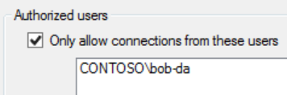
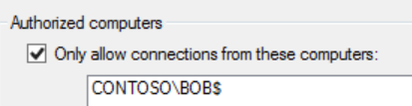
ESP Header
TCP 5985 – Domain Controller
Header :
Kerberos Auth of
Bob and Bob’s PC
You’re not doing this right.
Powershell Remoting TCP 5985
X
Active Directory
Steve the attacker using Bob-da’s account from l33tLaptop

Slide 47
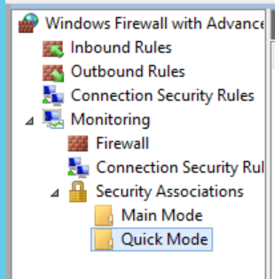
IPsec – Getting to know each other
Security Associations
Can be tracked in “Monitoring”
area of wf.msc
In a packet capture a good sign is
bidirectional ISAKMP packets.

Slide 48
The important thing to know about IPsec is that we can verify both the user and the computer before they reach an open port.

Slide 49
IPsec is for important things, not for everything.

Slide 50
Demo
Basic rule building

Slide 51
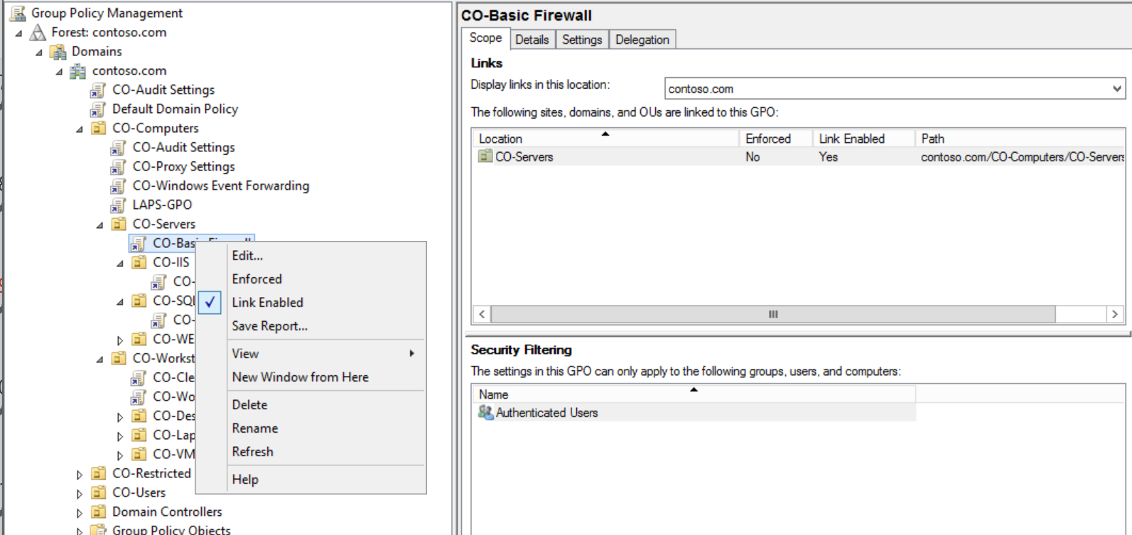

Slide 52
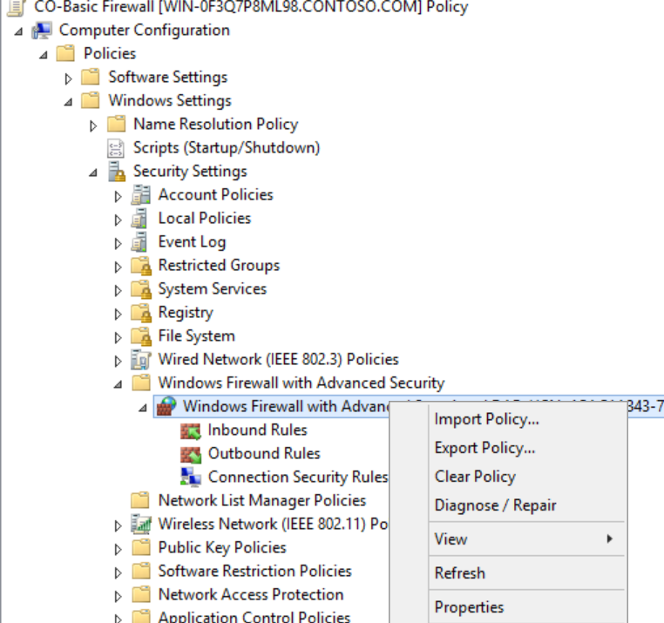

Slide 53
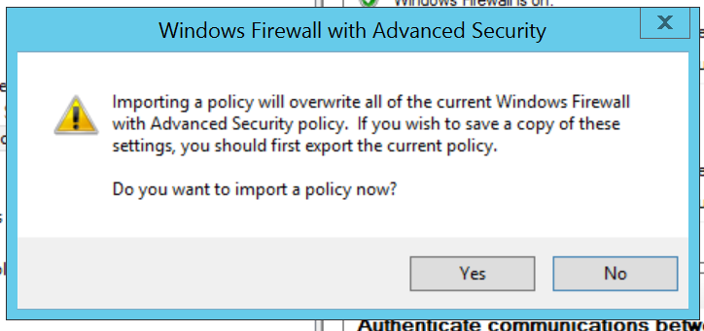

Slide 54
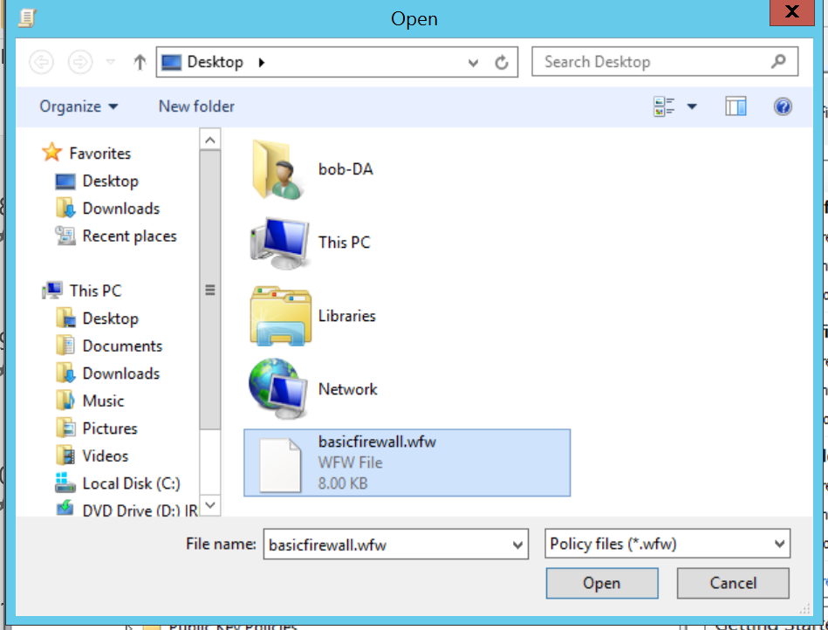

Slide 55
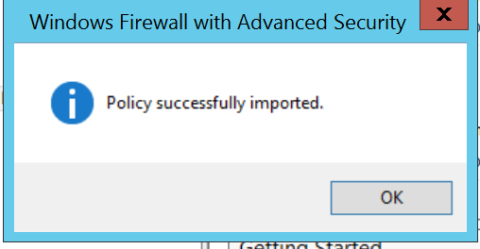

Slide 56
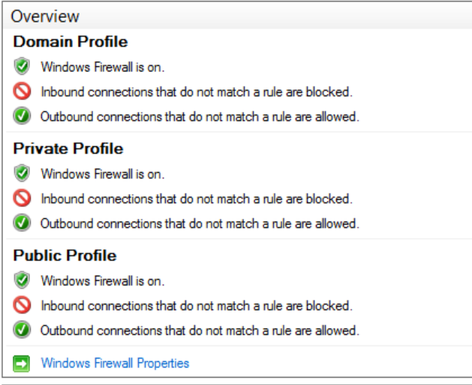

Slide 57
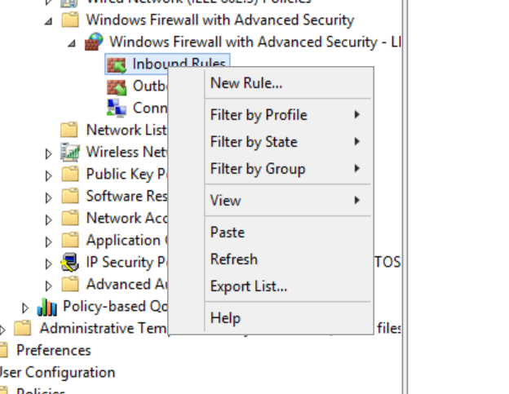

Slide 58
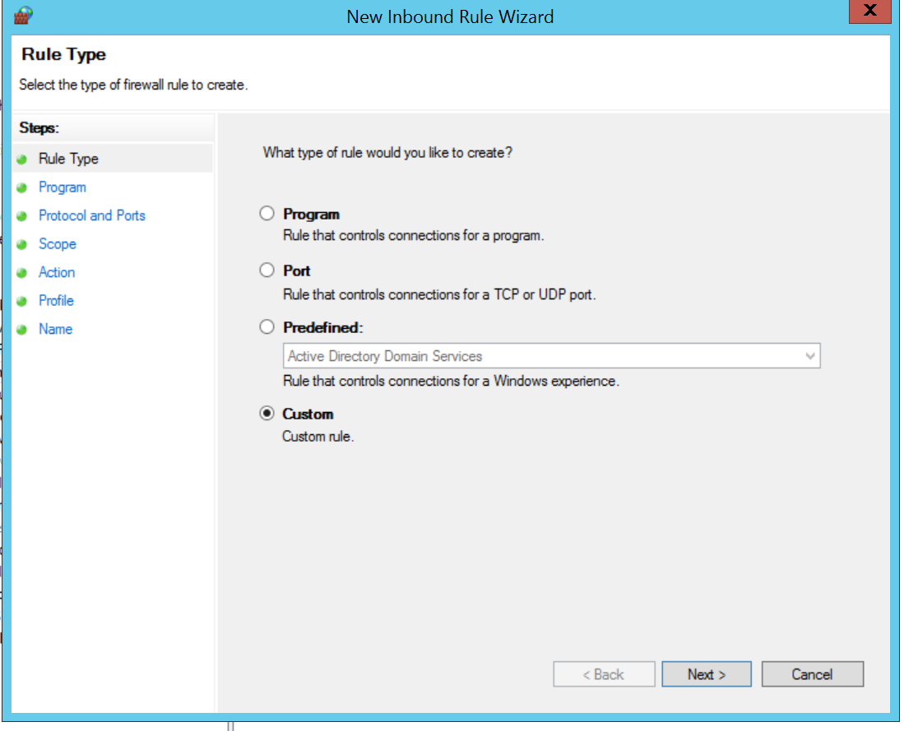

Slide 59
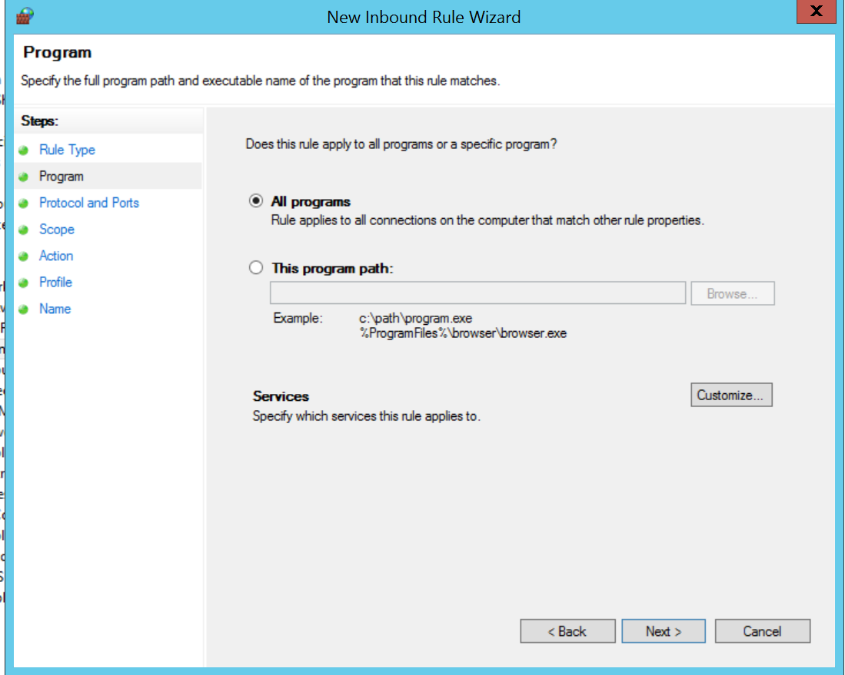
*note: there’s a really cool option not shown on this screen

Slide 60
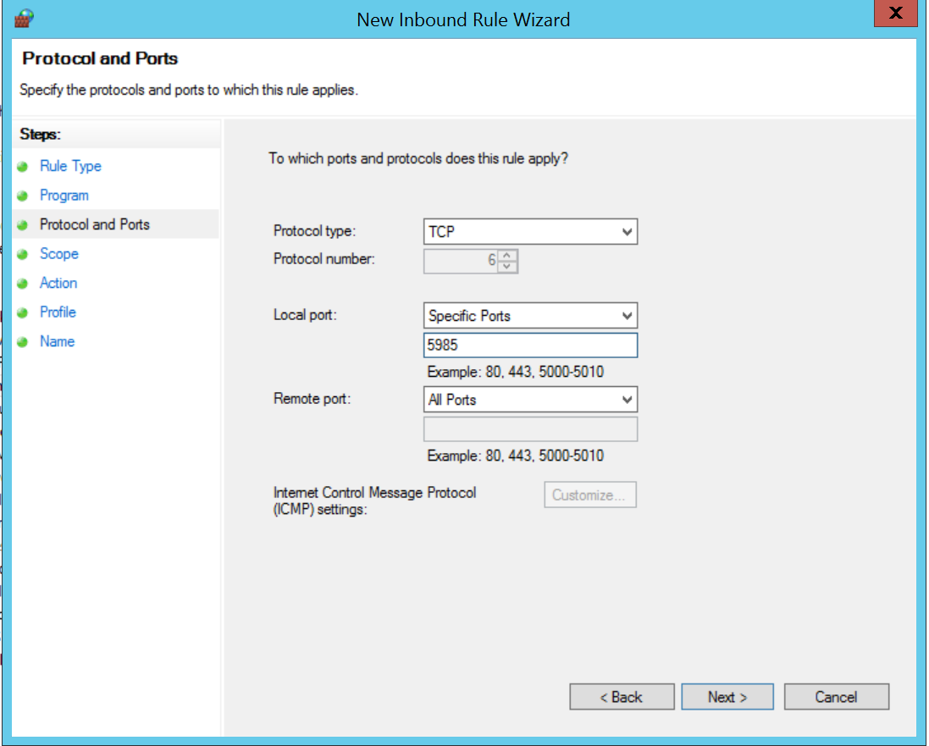

Slide 61
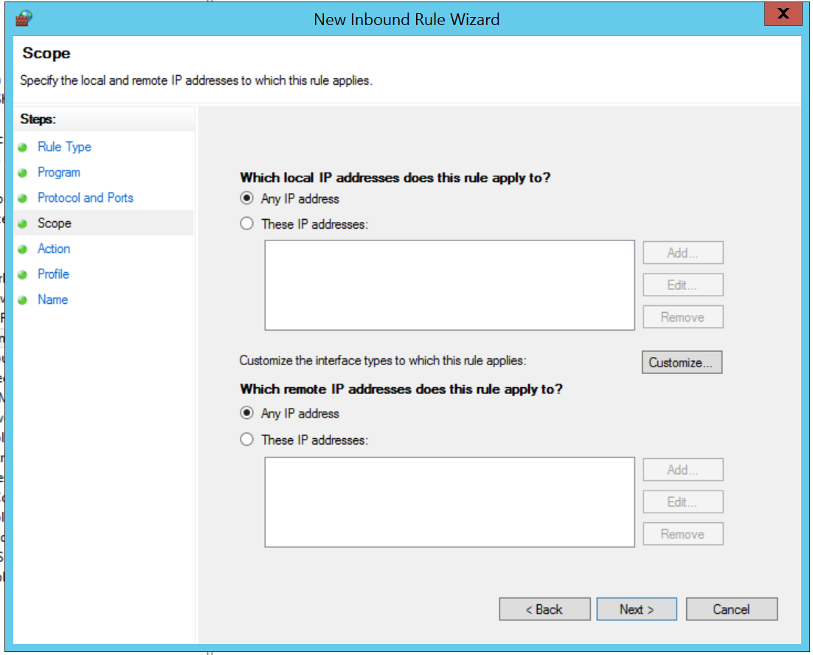

Slide 62
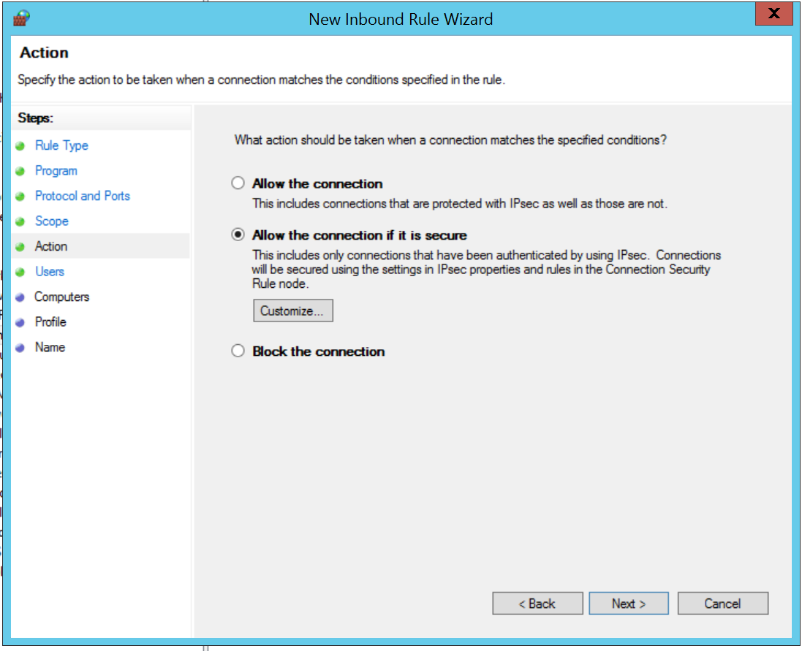

Slide 63
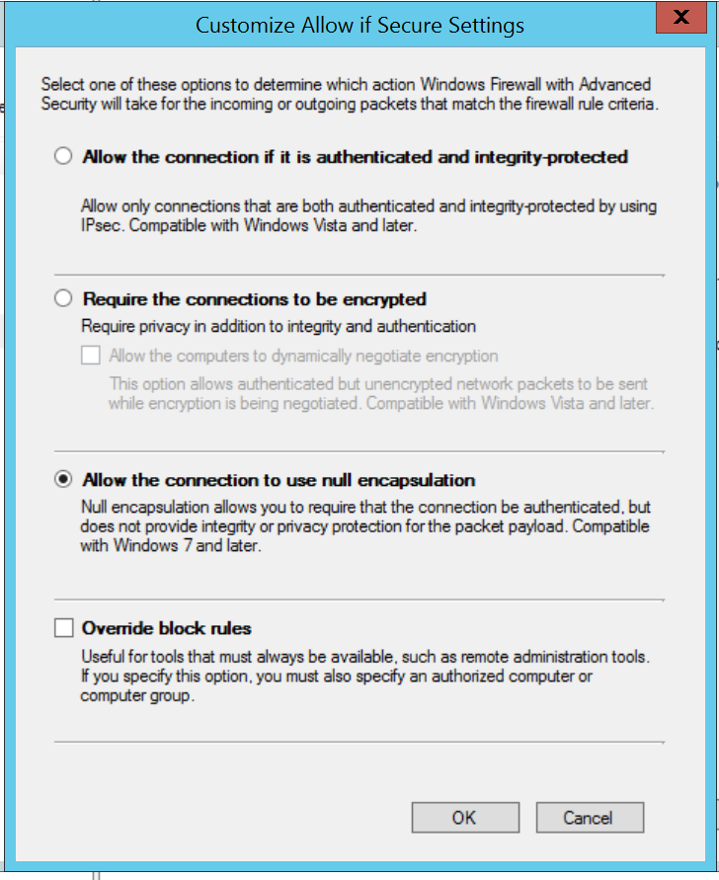

Slide 64
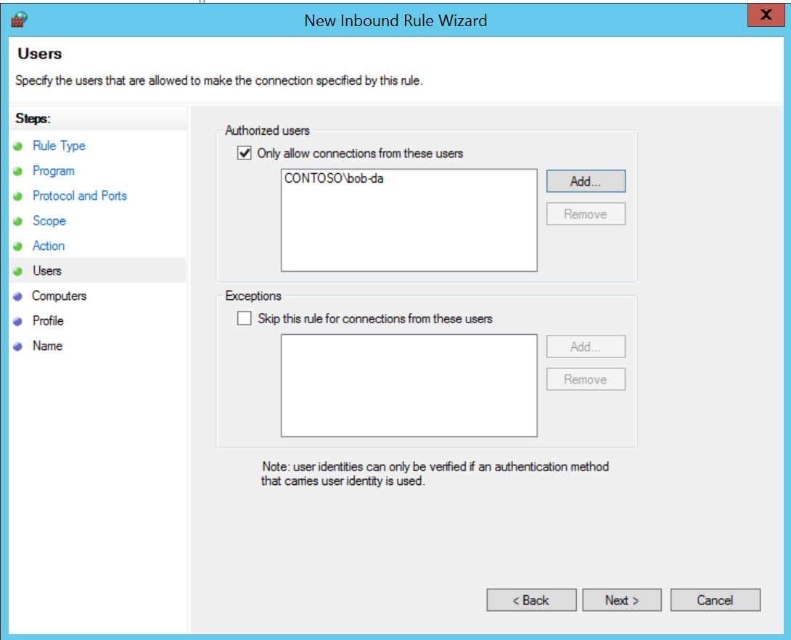

Slide 65
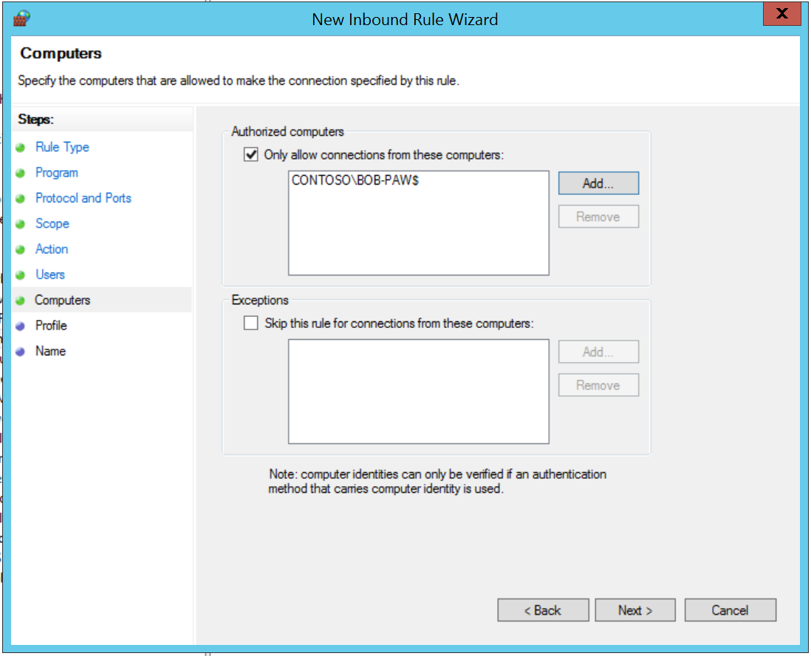
Groups of computers are helpful

Slide 66
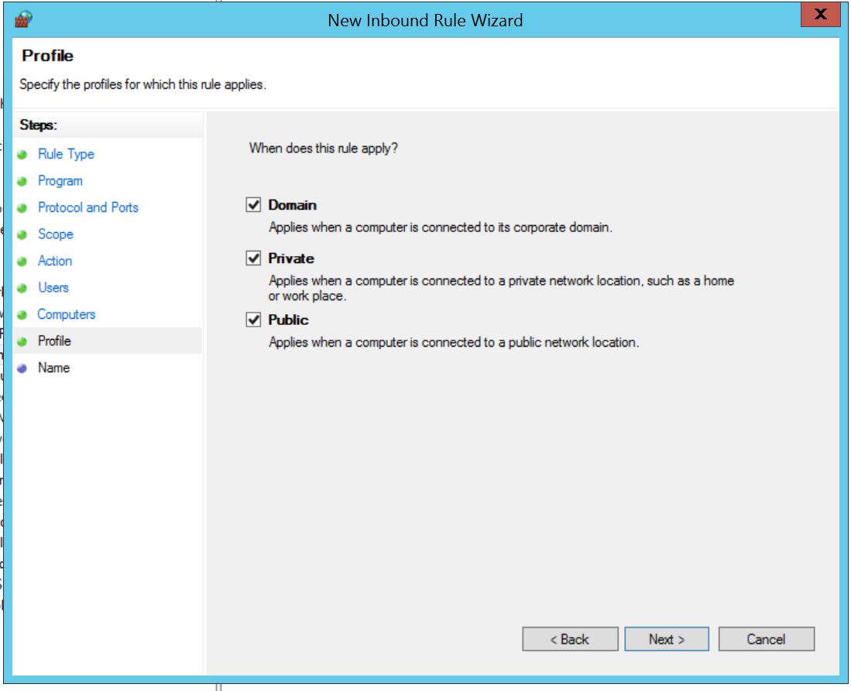

Slide 67
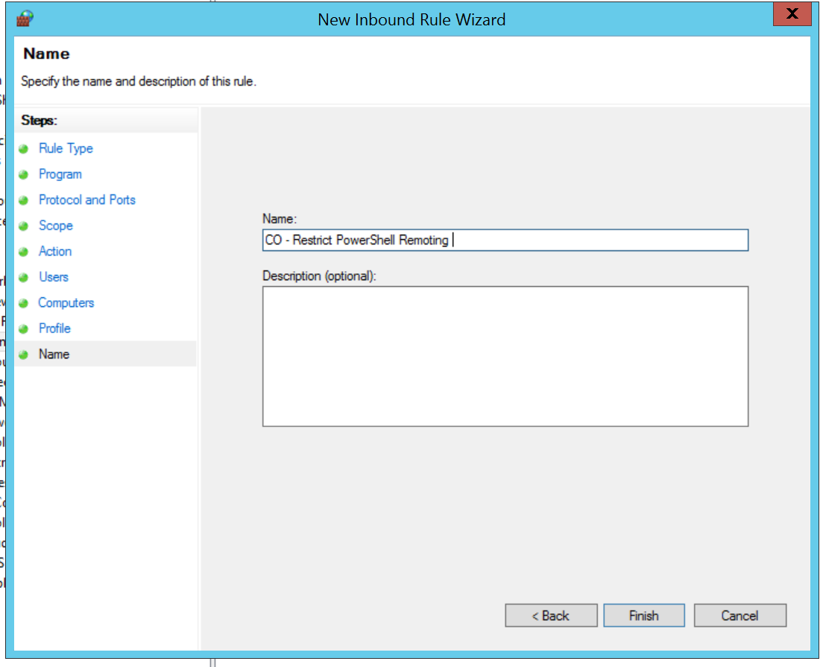

Slide 68
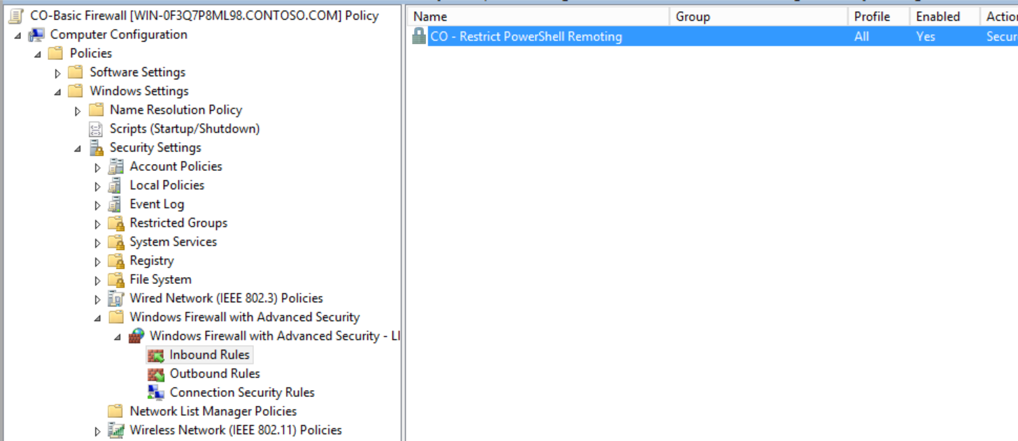
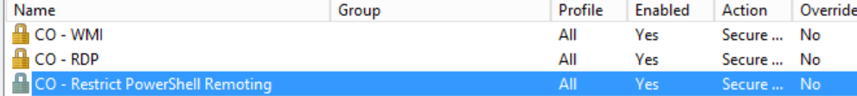

Slide 69
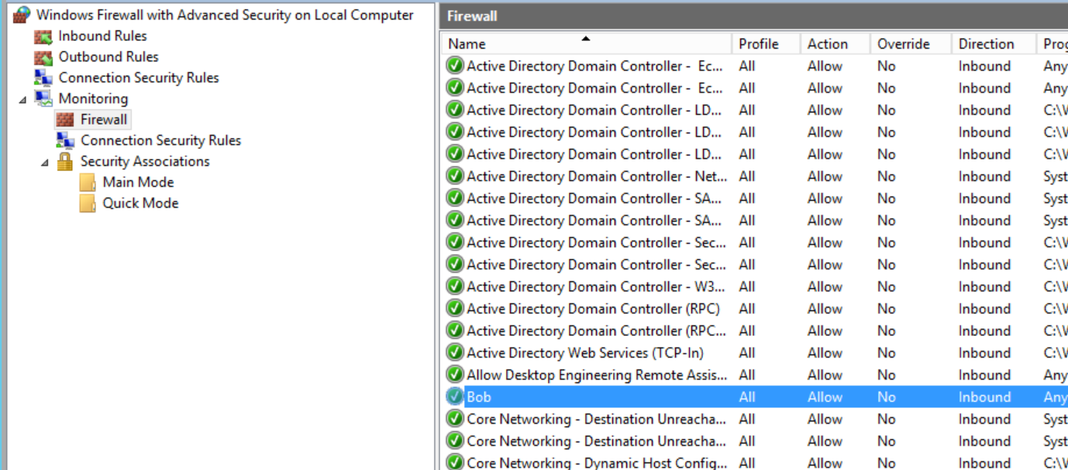

Slide 70
Necessary (and weird) step

Slide 71
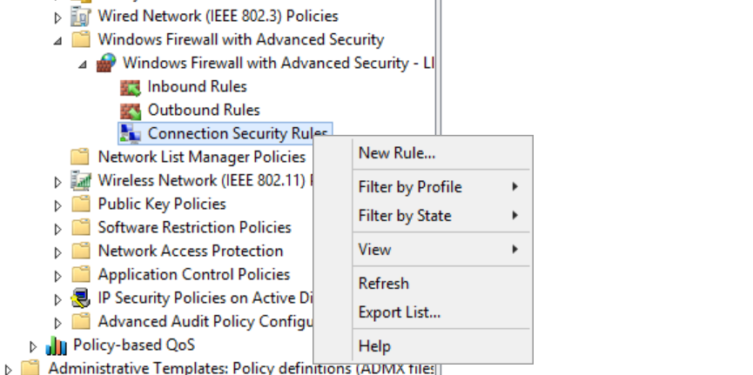

Slide 72
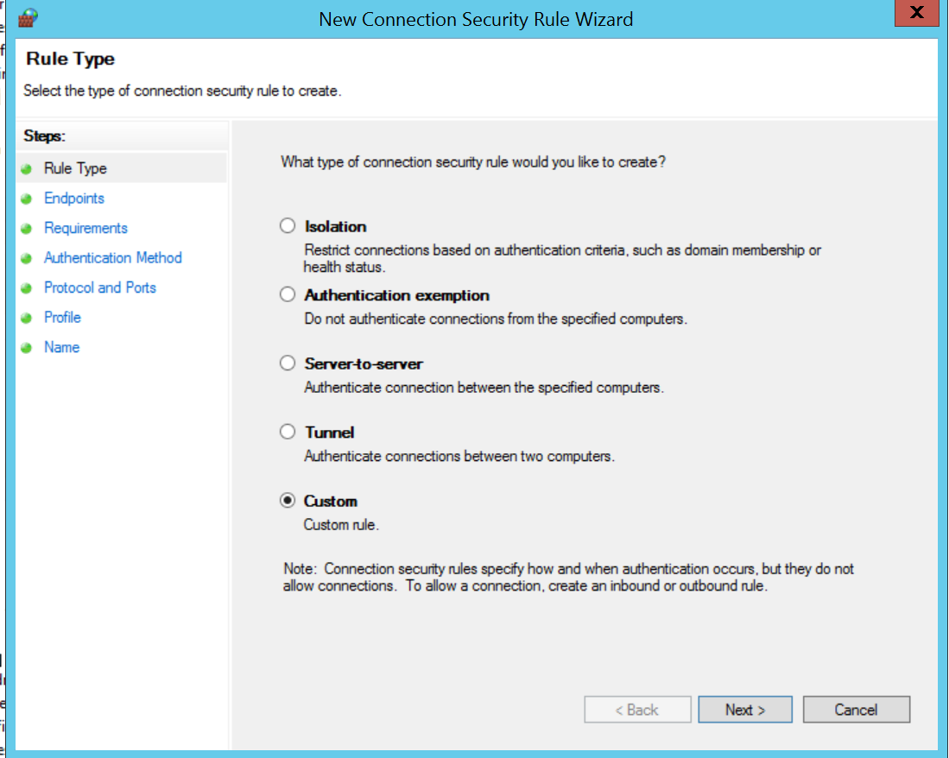

Slide 73
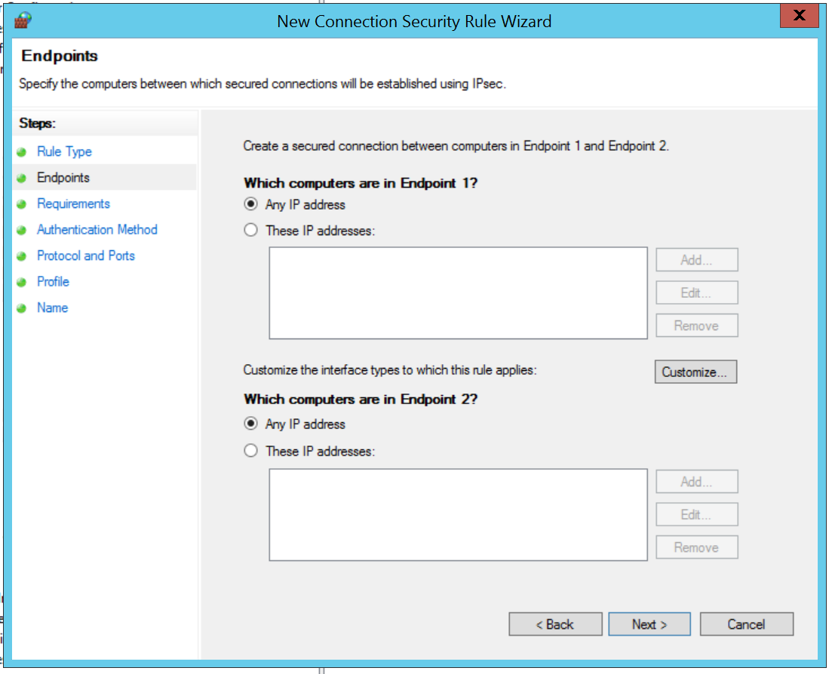
BE CAREFUL

Slide 74
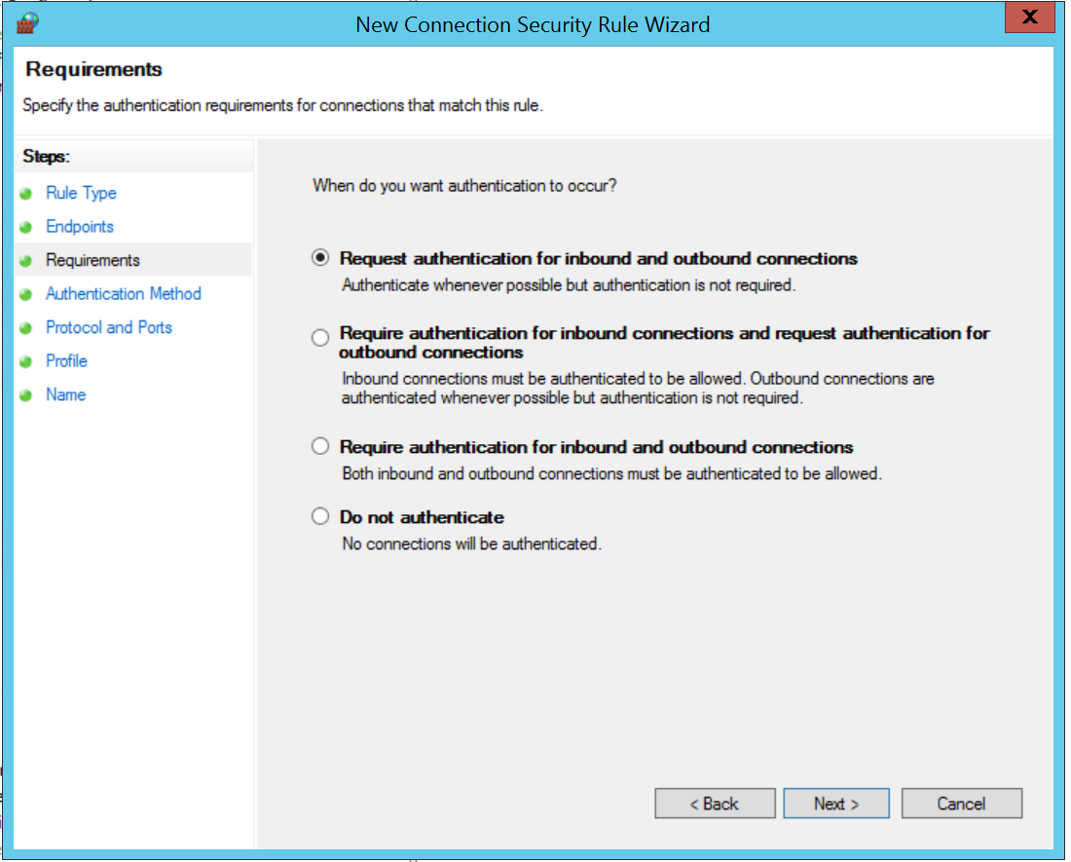

Slide 75
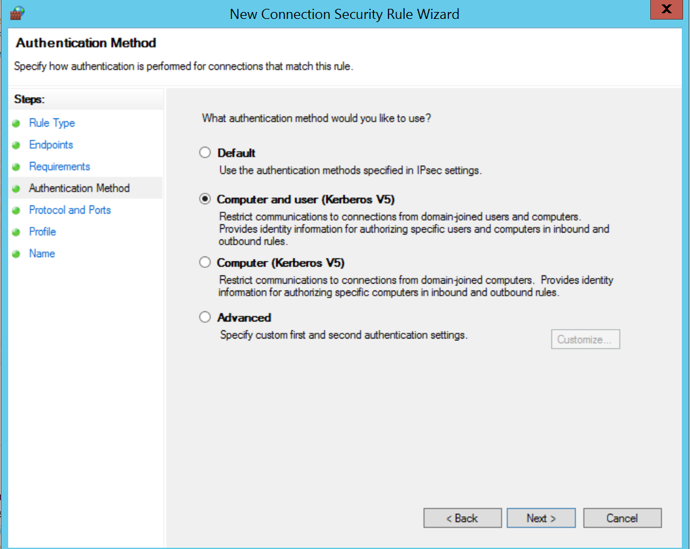

Slide 76


Slide 77


Slide 78


Slide 79
https://aka.ms/firewall

Slide 80
Start with the basics, irritate the attackers.

