Slide 1
Everything you forgot to ask about Certificate Services
M366
Orin Thomas
@orinthomas

Slide 2
In this session …
Certificates
Certificate Authorities
CRLs and CDPs
Offline Root CA
Certificate Templates
Autoenrollment
OCSP
CA Security
Key Archiving and Recovery

Slide 3
Certificates

Slide 4
PKI
What is a certificate?
A special digitally signed file
A way of proving identity

Slide 5
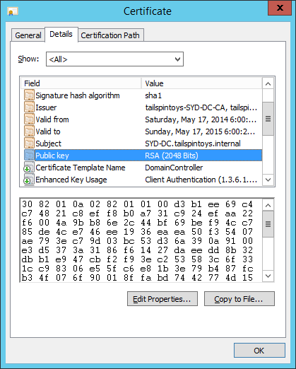
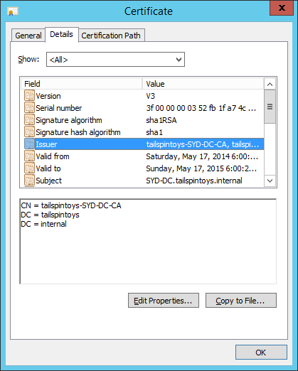
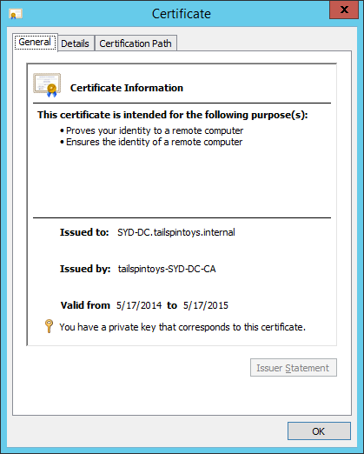
PKI
Certificate
Information

Slide 6
PKI
CA information

Slide 7
PKI (continued)
Public key

Slide 8
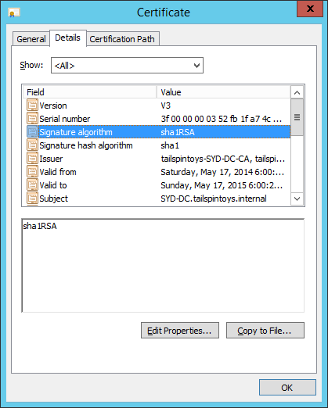
PKI (continued)
Signature
algorithm

Slide 9
_____________________________________
Stronger algorithms and longer keys
=
More trustworthy certificates
_____________________________________

Slide 10
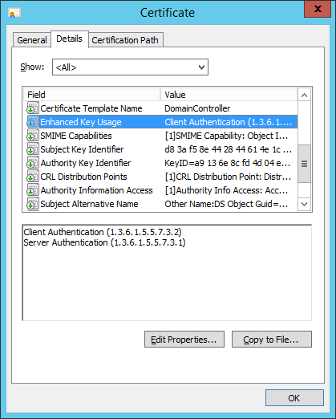
PKI (continued)
X.509 Extensions

Slide 11
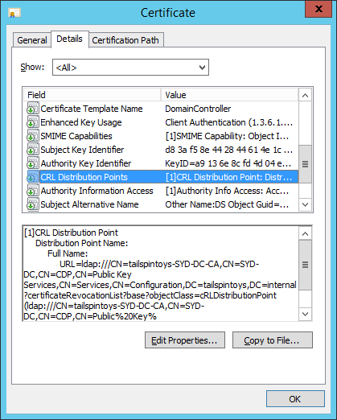
PKI (continued)
Certificate Revocation List (CRL)
Distribution Points (CDP)

Slide 12
What is a Certification Authority (CA)?
Windows Server role service
Issues and manages certificates
Request issued to the CA
  Can be manual or automatic
CA Administrator approves or declines the certificate request
  Approval can be automated
CA issues the certificate

Slide 13
How much you trust a CA depends on …
The criteria for validating the identity of the certificate requester
Big trusted 3rd party CAs have a rigorous process to validate the identity of a certificate requester

Slide 14
Certificate Revocation
Revoke a certificate to make it invalid
Certificate validity is checked when certificate first encountered
Heartbleed bug
  Organizations revoked their certificates
  because private keys may have been
  accessed
  If you suspect someone has access to
  private key, revoke the certificate
Certificate server
hosts revocation list

Slide 15
Certificate Revocation List (CRL)
List or revoked certificates is published
to certificate revocation list
CRL is regularly published by CA
Clients check this list when they
encounter a new certificate
Certificate revocation list must be accessible
to clients that use certificates
If CRL isn’t accessible, certificate may/should
be considered invalid
Certificate server
hosts revocation list

Slide 16
Trust chain
Delegate ability to sign certificates to subordinate CA
Bottom level CA provides information about itself and the CA that issued its signing certificate
To use a certificate, you must trust either the issuing CA, or a CA above the issuing CA in the trust chain
Windows clients trust a number of CAs by default
If a client trusts the CA at the top, you’ll trust the CAs further down the chain
Signing certificates can be revoked

Slide 17
Certificate Authorities

Slide 18
4 Types of Certificate Server
Root CA
Subordinate CA
Enterprise CA
Standalone CA

Slide 19
Root CAs
Ultimate trust point
Trust the CA
  Trust all certificates issued by the root
  Trust all certificates issued by CAs who have their signing certificates signed by the root CA
  Trust all certificates issued by CAs whose signing certificates were issued by CAs whose signing certificates were signed by the root CA … (and so on)

Slide 20
CA Trust Chains
Root CA

Slide 21
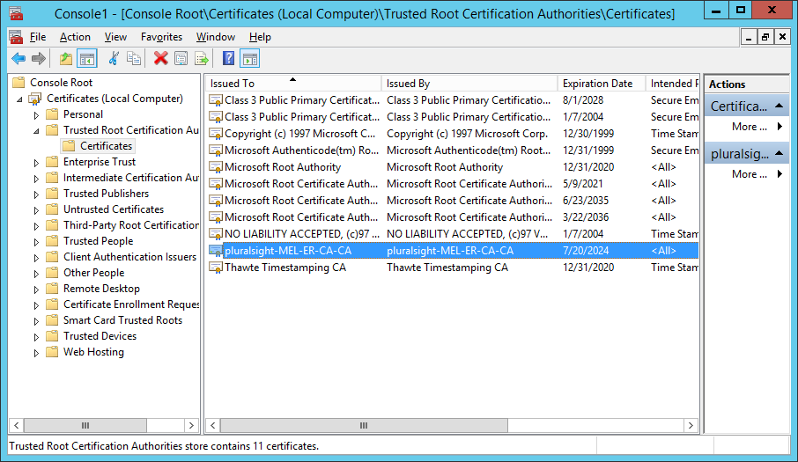
Root CA
Signs its own certificate
To trust the certificates issued by a root CA, or its subordinates, add the root CA’s certificates to a trusted certificate store

Slide 22
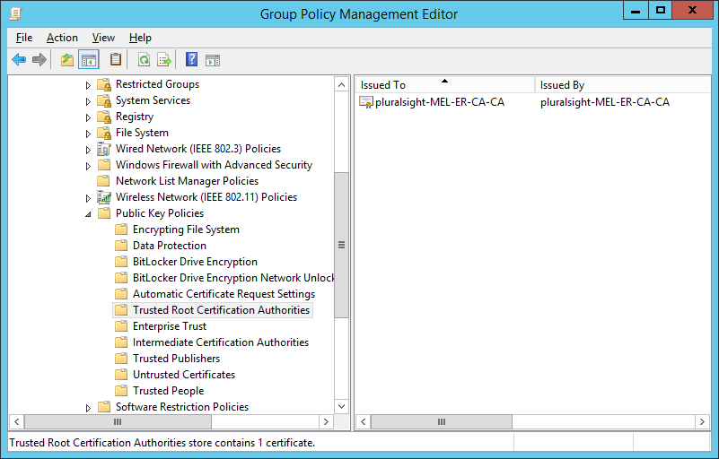
Trusted Root Certification Authority Policy

Slide 23
Root CA
Usually only issues certificates to subordinate CAs
In small environments, the root CA may be the only CA
Root CA

Slide 24
CA Trust Chains
Root CA

Slide 25
CA Trust Chains
Root CA

Slide 26
Compromised Root CA
Lost ultimate point of trust
Need to revoke all certificates
  Including signing certificates of subordinate CAs
Need to deploy a new CA
  Need to redeploy subordinate CAs

Slide 27
Subordinate CAs
Issuing CA
  Day to day certificate tasks
  Receives certificate requests
  Issues certificates
  Revokes certificates
  Publishes CRLs

Slide 28
CA Hierarchy
Root CA
Policy CA
Intermediate CA
Issuing CA
Issuing CA
Issuing CA

Slide 29
Policy CA
Allows you to spell out certificate issuance policies
Requires policy documents
Involves settings enforcing some policies
  Who can approve certificate requests
  Maximum certificate validity
  Revocation procedure
Separate sets of policies require separate policy CAs

Slide 30
Enterprise CA
Fully integrated into Active Directory
Can use Active Directory to obtain information required for certificate request and enrollment
Allows automation of certificate management
Only installed on domain member
Certificates are automatically trusted by domain/forest members

Slide 31
Enterprise CA
Not as useful for non-domain members
Stand alone or enterprise CA as parent
Certificate templates
  Defines the purpose and functionality of the certificate
  Stored in Active Directory
  Available to all enterprise CAs in the forest
Group policy certificate auto-enrollment and renewal
  Automate the process of deploying and renewing certificates

Slide 32
Stand Alone CA
Isn’t integrated into Active Directory
Can be installed on computer that is or is not a domain member
Offline root CA
CA deployed on perimeter network
Manual certificate request process
Does not support certificate templates stored in Active Directory
Supports advanced certificate requests

Slide 33
Four CA Types
Enterprise root
Stand alone root
Enterprise subordinate
Stand alone subordinate

Slide 34
CRL Distribution Point
Certificate Revocation List (CRL) Distribution Point (CDP)
Must be accessible for certificate to be valid
Client checks CDP for CRL
CDP
  File share
  Web site
  Active Directory
  OCSP Array

Slide 35
CRLs & CDPs

Slide 36
Certificate Revocation
Certificates have a natural lifespan determined by issuing CA
You can’t have a certificate that has an expiration date after the expiration date of the signing certificate of the CA that issued that certificate
Revoking a certificate makes a certificate no longer valid
A check is performed when a new certificate is encountered to determine if the certificate is still valid
Certificate properties include address of certificate revocation list

Slide 37
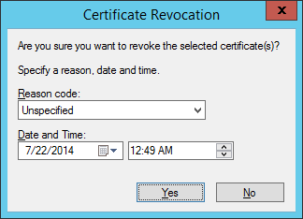
Revoking Certificates
Select the certificate in the Certification Authority console
Revoke the certificate

Slide 38
Certificate Revocation Reasons
Key compromise
CA compromise
Affiliation change
Superseded
Cessation of operation
Certificate hold
Unspecified
Remove from CRL

Slide 39
Certificate Revocation Lists
List of certificate serial numbers and revocation reasons
CRL contains a list of all revoked certificates
  By default is published once per week
Delta CRL contains a list of all certificates revoked since publication of the CRL
  By default is published once per day

Slide 40
How CRLs Work
When certificate is encountered by client:
  Retrieves CRL and Delta CRL from CDP
  Checks to see if certificate serial number is present on CRL or Delta CRL
  Caches CRL based upon publication schedule (default 1 week)
  Caches Delta CRL based on publication schedule (default 1 day)
  Will only retrieve new CRL or Delta CRL after version stored in cache expires

Slide 41
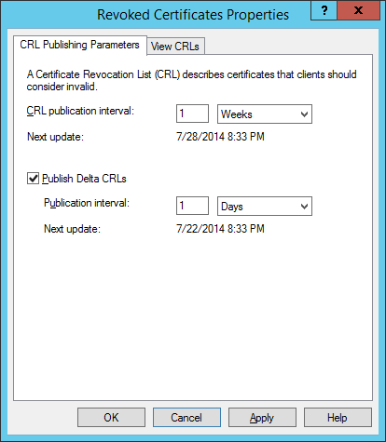
Publication Schedule
Edit publication schedule on CA

Slide 42
CRL Distribution Points (CDPs)
Location that hosts CRL and delta CRLs
Can be hosted on
  File share
  Local storage device
  Web site
  Active Directory
Needs to be accessible to the clients that consume the certificates issued by the CA
CDP location is published in a certificate

Slide 43
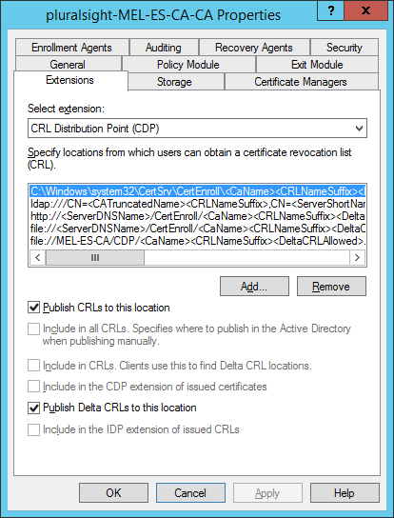
CDP Locations
Configure on Extensions tab of CA properties

Slide 44
CDP Availability
Clients that consume certificates need to perform CRL checks
If CDP is not available, most clients will assume certificate is invalid
Certificate consumers need read access to CDPA needs to be able to publish CRL to CDP

Slide 45
Offline Root CA

Slide 46
Why Use an Offline Root CA
Most secure form of CA deployment
Almost impossible to compromise a computer that is switched off and not connected to the network
If root CA is compromised any certificate issued by it or a subordinate CA is suspect
Suitable for large organizations where replacing suspect CA infrastructure would be extremely costly
Less necessary for smaller organizations where administrative effort exceeds compromise cost

Slide 47
Offline Root CA Server Requirements
Stand alone (not domain joined) computer
Stand alone root CA
Secure isolated network
Should avoid a VM in a production environment
  VM can be compromised if host is compromised
  VM can be inadvertently (or deliberately) powered on by attackers

Slide 48
Offline Root CA Server Functionality
Roles:
  To issue subordinate CA signing certificates
  To revoke subordinate CA signing certificates
  To publish CRLs to ensure checks can be made
Have non-network method of reliably transferring files to and from computer
  Certificate requests
  Issued certificates

Slide 49
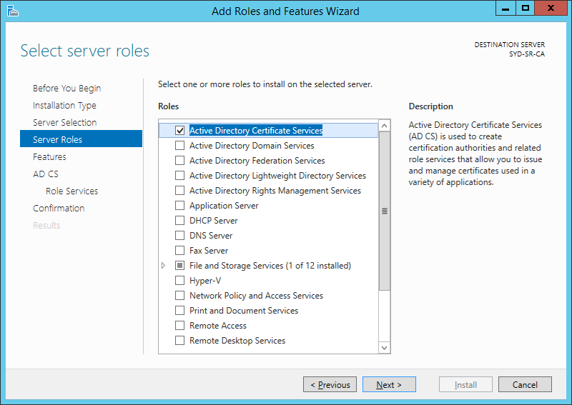
Deploying AD CS on the Offline Root CA

Slide 50
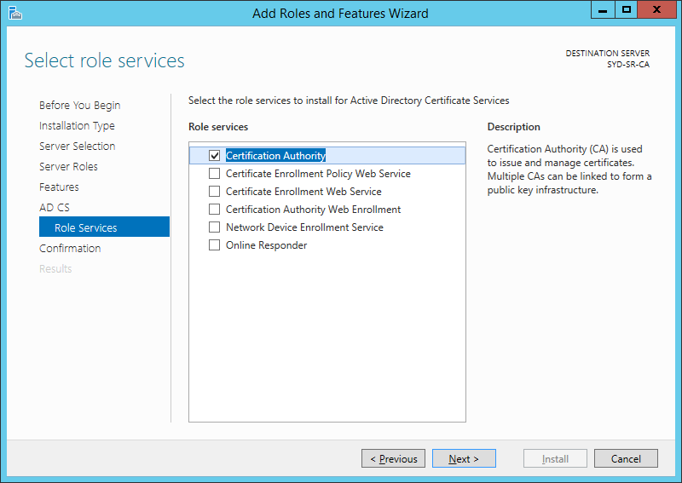
Deploying AD CS on the Offline Root CA

Slide 51
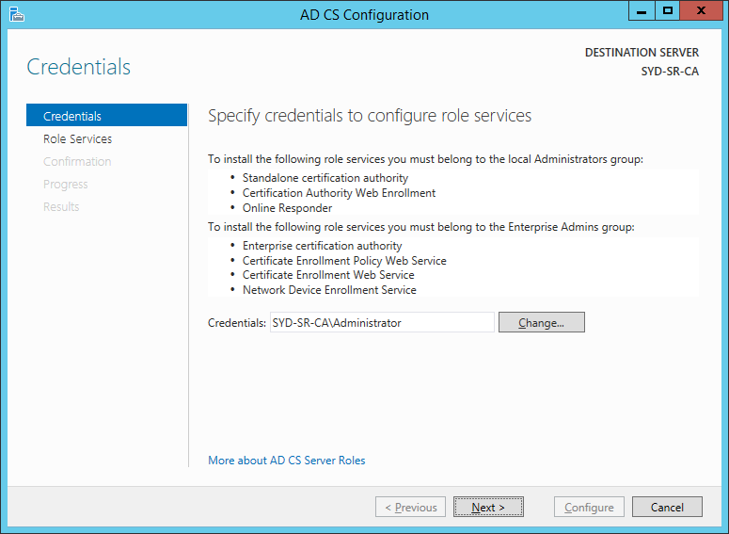
Deploying AD CS on the Offline Root CA

Slide 52
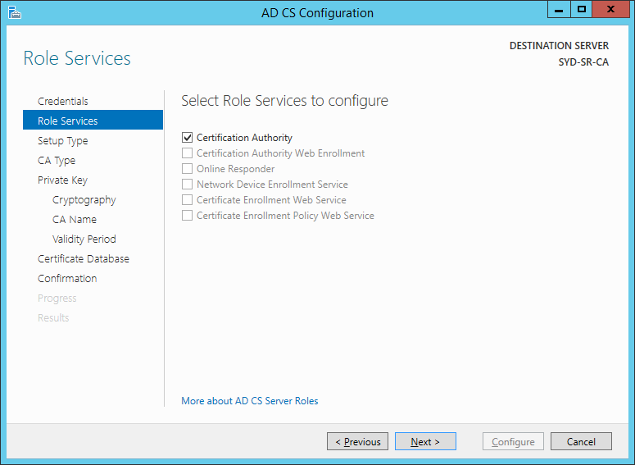
Deploying AD CS on the Offline Root CA

Slide 53
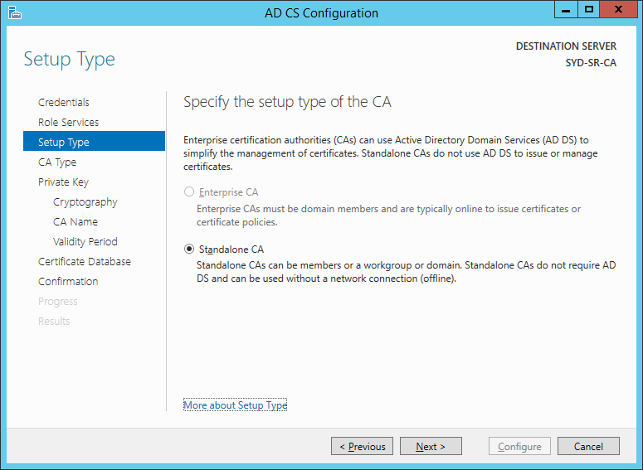
Deploying AD CS on the Offline Root CA

Slide 54
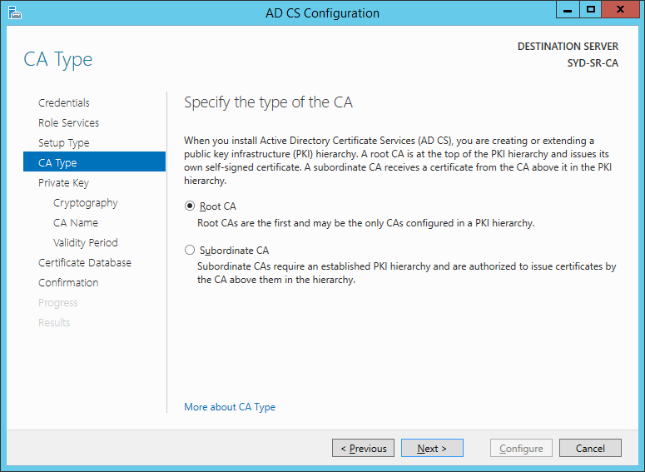
Deploying AD CS on the Offline Root CA

Slide 55
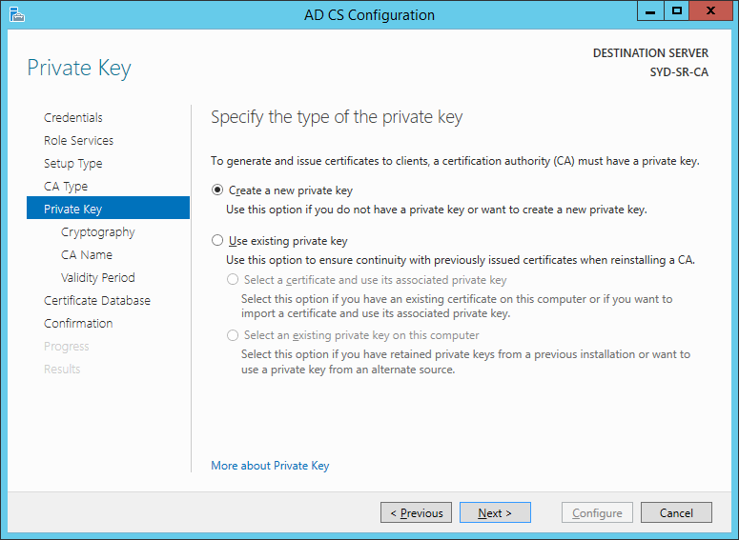
Deploying AD CS on the Offline Root CA

Slide 56
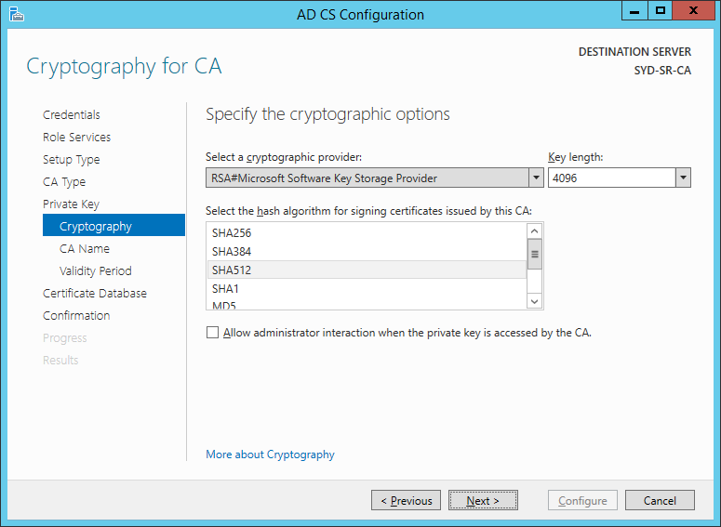
Deploying AD CS on the Offline Root CA

Slide 57
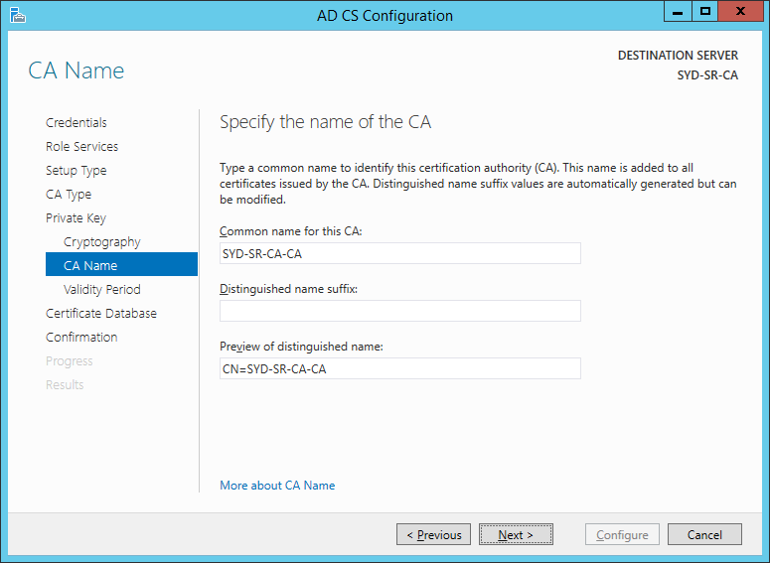
Deploying AD CS on the Offline Root CA

Slide 58
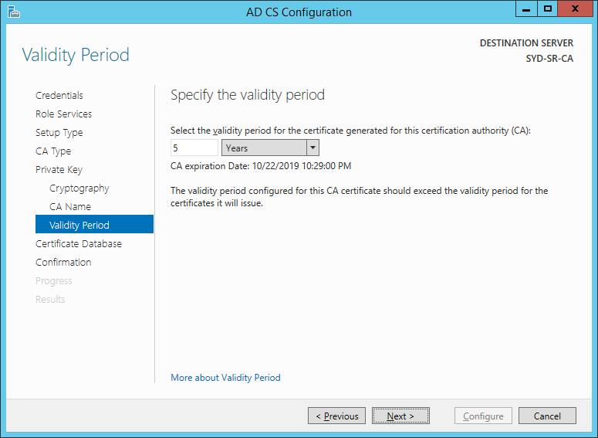
Deploying AD CS on the Offline Root CA

Slide 59
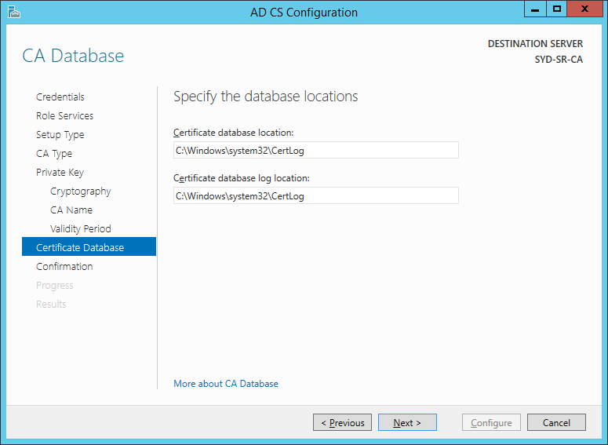
Deploying AD CS on the Offline Root CA

Slide 60
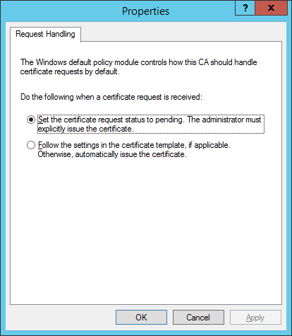
Configure Requests to Pending

Slide 61
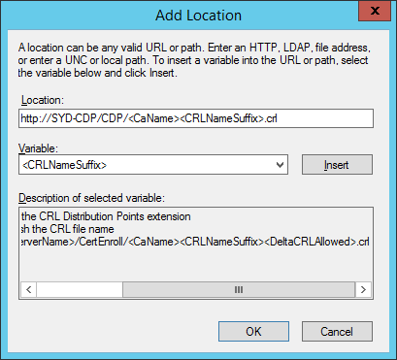
Change URL of CRL Distribution Point

Slide 62
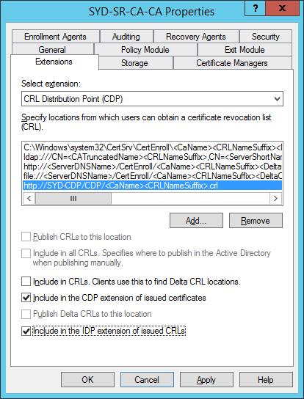
Change URL of CRL Distribution Point

Slide 63
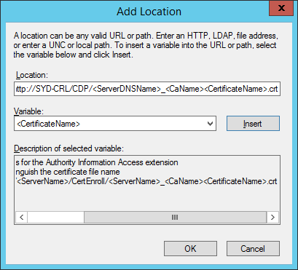
Change URL of AIA distribution point

Slide 64
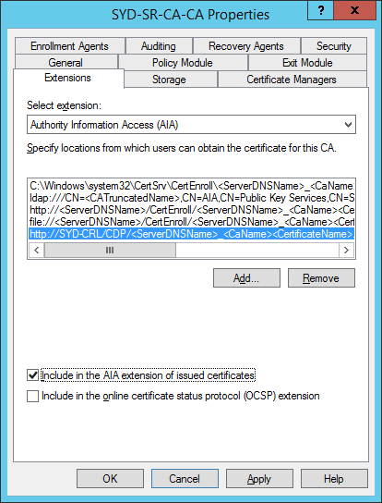
Change URL of AIA distribution point

Slide 65
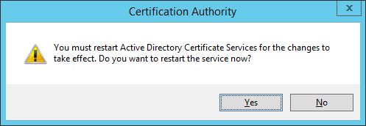
Restart AD CS

Slide 66
Configure the Offline Root CA to Support Certificate Revocation with Active Directory
certutil -setreg ca\DSConfigDN "CN=Configuration, Dnpath"
certutil -setreg ca\DSDomainDN "DNpath"
Restart AD CS
Examples for Pluralsight.internal domain
certutil -setreg ca\DSConfigDN "CN=Configuration,DC=pluralsight,DC=internal"
certutil -setreg ca\DSDomainDN “DC=pluralsight,DC=internal"

Slide 67
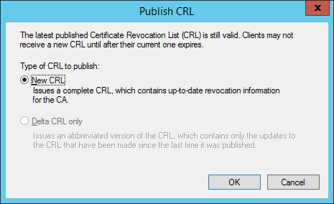
Publish CRL

Slide 68
Deploy CRL to CDPs
Copy CRL from %systemroot%\system32\Certsrv\CertEnroll
to removable storage
Copy CA certificate to removable storage
Copy CRL from removable storage to each CDP

Slide 69
Deploy CA Cert and CRL to Active Directory
Import CA certificate into trusted store
  Certutil –dspublish –f <filename>.crt RootCA
Import CRL into Active Directory
  Certutil –dspublish –f <filename>.crl

Slide 70
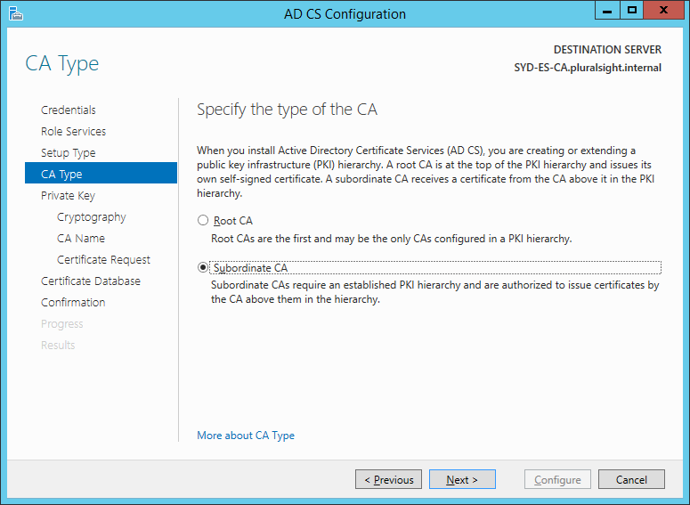
Deploy Enterprise Subordinate CA

Slide 71
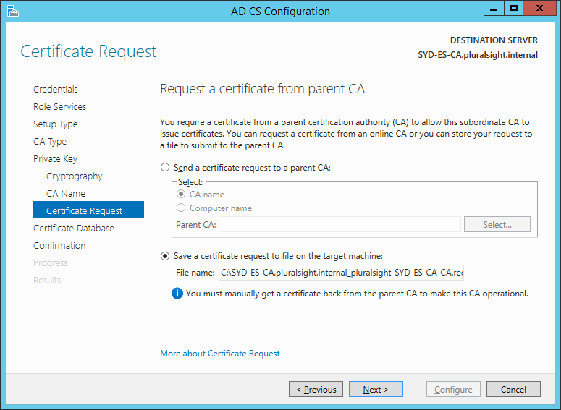
Deploy Enterprise Subordinate CA

Slide 72
Deploy Enterprise Subordinate CA
Copy certificate request to offline root CA
Approve request
Transfer enterprise subordinate CA certificate back to enterprise subordinate

Slide 73
Deploy Enterprise Subordinate CA
Submit a request to the CA
  Certreq –submit <filename>.req
Approve the request
Retrieve the certificate
  Certreq –retrieve ID <certificate>.cer
Install CA certificate

Slide 74
Certificate Templates

Slide 75
Certificate Templates
Certificates have different properties
  Purpose
  Minimum key length
  Algorithms
  Private key restrictions
A template is a collection of certificate properties that can be used to generate new certificates
Enterprise CAs issue certificates based on templates stored in Active Directory

Slide 76
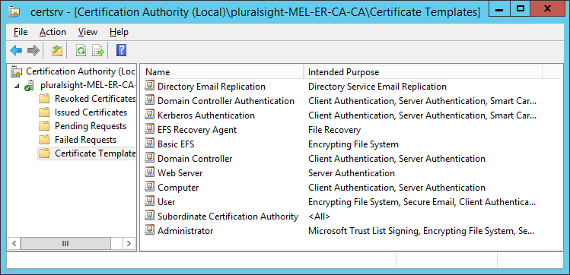
Default Enabled Certificate Templates

Slide 77
Certificate Templates Stored in Active Directory
Many more templates stored in Active Directory
Straightforward to configure an enterprise CA to deploy these templates

Slide 78
Requesting Certificates
Perform a request manually
Use MMC snap-in
Some certificates require approval
Only certificates with Enroll or Autoenroll permission visible
Drawback: Complicated process for average users

Slide 79
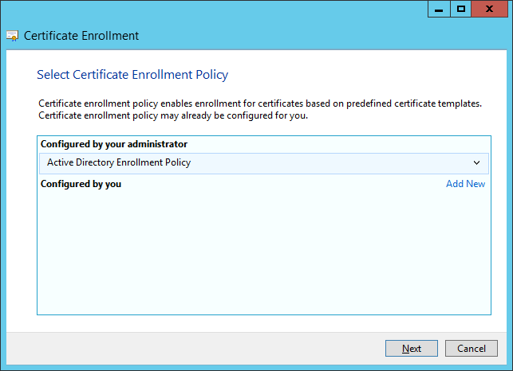
Enrollment Policy
Allows you to use default or custom enrollment policy

Slide 80
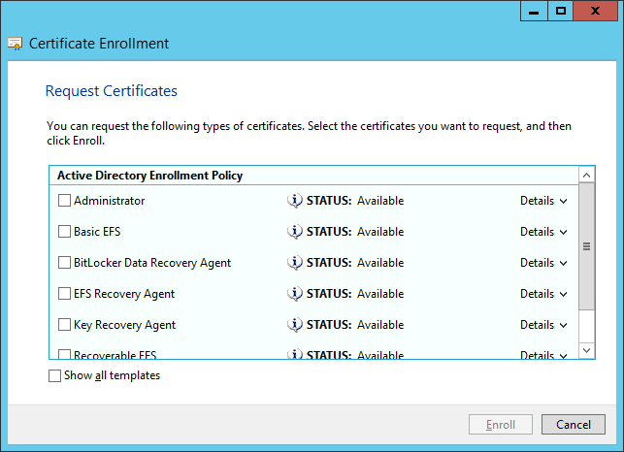
Manually Requesting Certificates
Use certificates snap-in in MMC

Slide 81
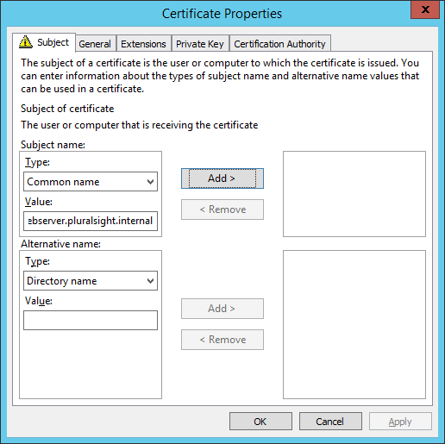
Extra Information
Some requests require you to enter more information

Slide 82
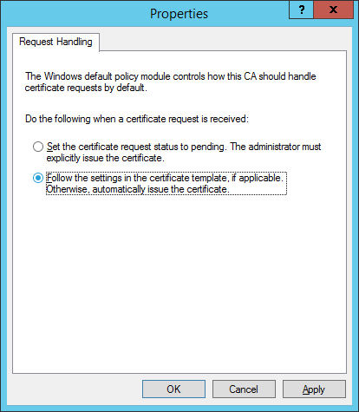
Request Handling
Configured on the CA

Slide 83
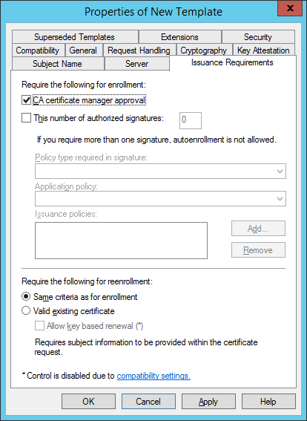
Template Approval
Configure certificate approval on the template

Slide 84
Autoenrollment

Slide 85
Autoenrollment
Allows automatic deployment of certificates
Requires configuration in Group Policy
Requires Autoenrollment permission on certificate template
Benefit of autoenrollment is that it simplifies the process of large scale certificate deployment
Avoid using with certificate templates that require approval if there is a large number of certificates to be issued

Slide 86
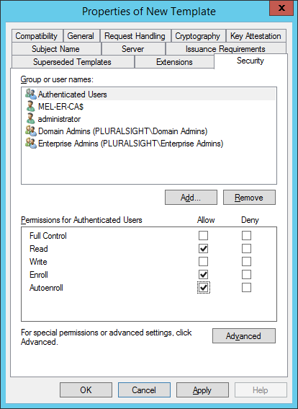
Autoenroll Permission
Configure Autoenroll for security groups that you want to enroll

Slide 87
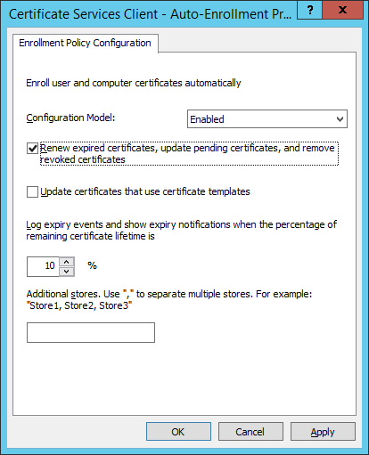
Group Policy Configuration
Configure Certificate Services Client – Auto-Enrollment policy
Allows certificates to be automatically renewed

Slide 88
OCSP

Slide 89
Revocation Check Overview
Each time a new certificate is consumed, the client consuming the certificate (should) perform a revocation check to verify the certificate’s validity
Checks include validating all certificates in the chain up to the root
  Verifying that certificate is valid for current date/time
  Verifying that the signature is valid
  Verifying that the certificate is not corrupt
  Verifying that the certificate has not been revoked
A certificate is invalid even if it is not revoked if a certificate higher up the chain is invalid

Slide 90
CRL Revision
CRL is a file that stores serial numbers of certificates that have been revoked
Delta CRL is a file that stores serial numbers of certificates revoked since publication of last CRL
Default publication schedule is
  1/week for CRL
  1/day delta CRL
To check revocation status, client must download CRL & delta CRL

Slide 91
OCSP Fundamentals
Web based method of checking certificate status
Certificate status request for specific certificate sent over HTTP to OCSP Responder
Returns result indicating certificate revocation status
Does not require client to download CRL / delta CRL
OCSP Responder checks CRL / delta CRL

Slide 92
OCSP Requirements
Existing AD CS deployment
Configure AD CS to deploy OCSP response signing certificates
Server that can host OCSP Responder

Slide 93
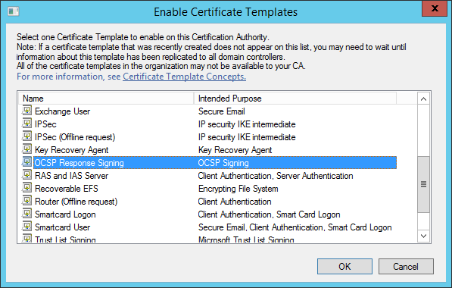
Deploy OCSP Signing Certificate Template

Slide 94
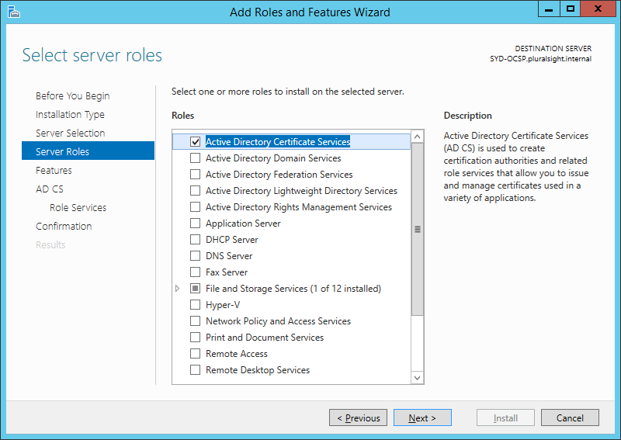
Deploying an OCSP Responder

Slide 95
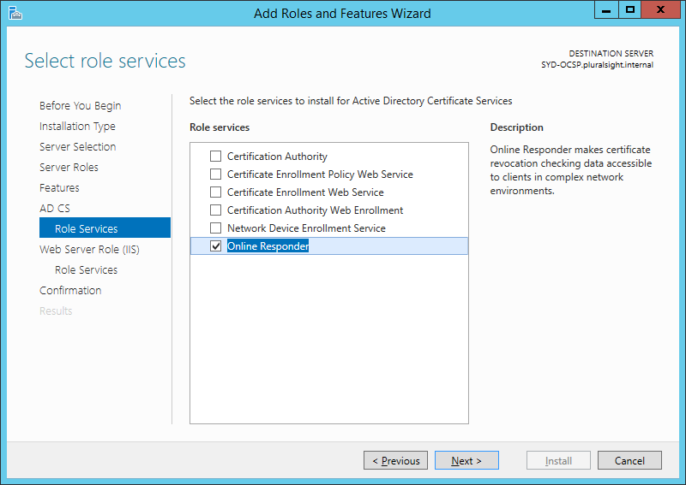
Deploying an OCSP Responder

Slide 96
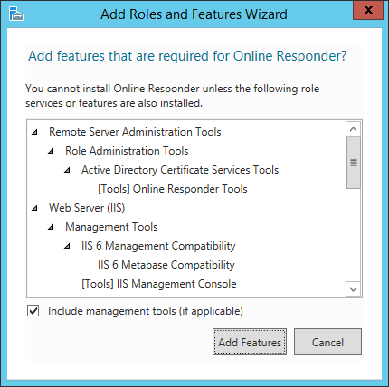
Deploying an OCSP Responder

Slide 97
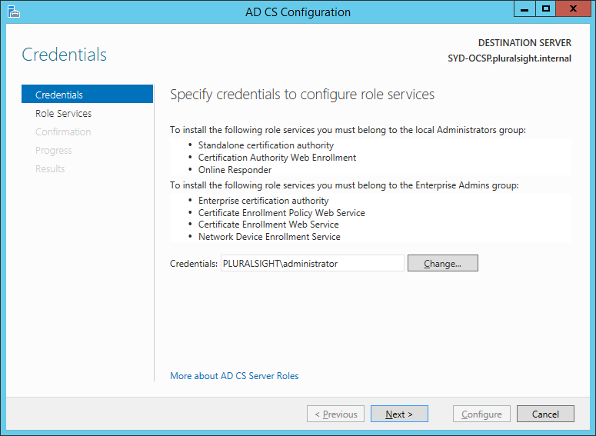
Configuring an OCSP Responder

Slide 98
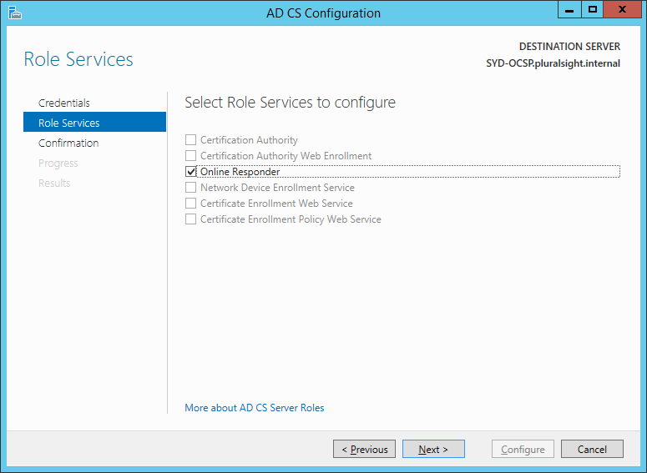
Configuring an OCSP Responder

Slide 99
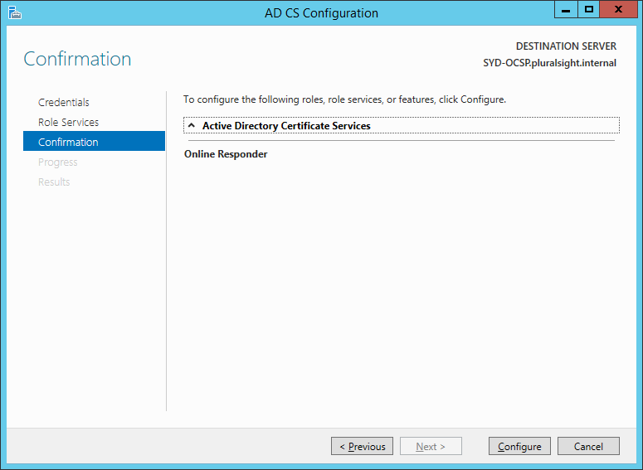
Configuring an OCSP Responder

Slide 100
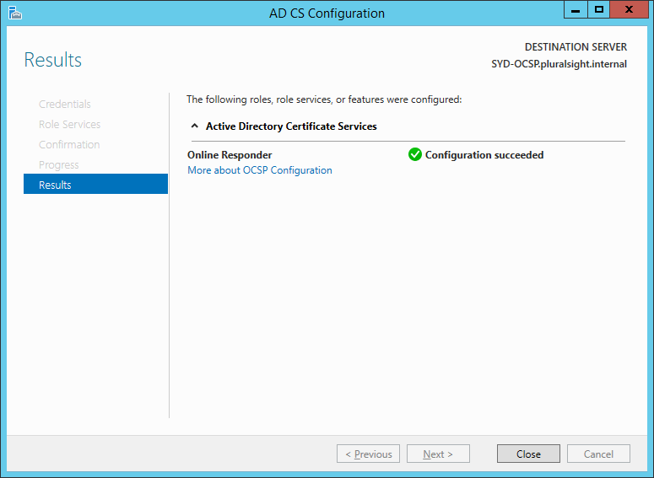
Configuring an OCSP Responder

Slide 101
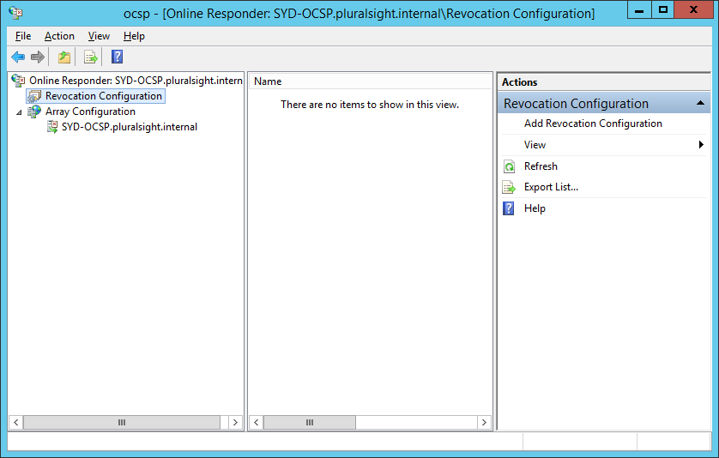
Configuring an OCSP Responder

Slide 102
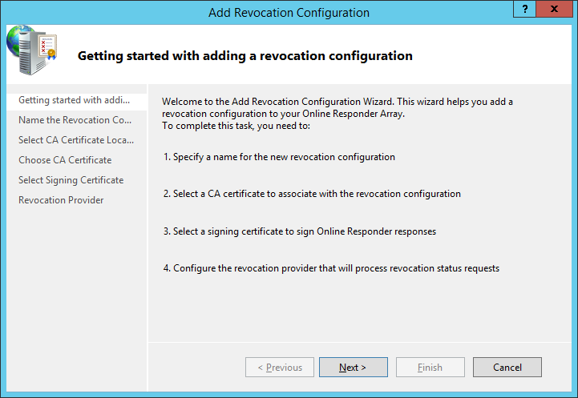
Configuring a Revocation Configuration

Slide 103
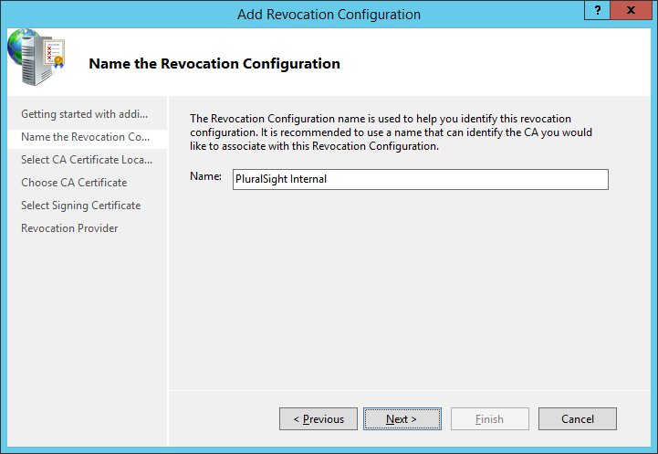
Configuring a Revocation Configuration

Slide 104

Configuring a Revocation Configuration

Slide 105

Configuring a Revocation Configuration

Slide 106

Configuring a Revocation Configuration

Slide 107

Configuring a Revocation Configuration

Slide 108

Update AIA Extension properties

Slide 109
CA Security

Slide 110
Securing CAs
Someone who gains access to a CA can issue and revoke certificates
CAs that are trusted by third parties are more likely to be attacked
Several .gov CAs around the world have been compromised and certs used to sign malware

Slide 111
General Security Tips
Restrict CA sign on
  RSAT tools allow remote management of CA
Use separate CAs to issue:
  General use certificates
  High sensitivity certificates
    Subordinate CA certificates
    KRA and DRA certificates
Limit which users can issue and revoke certificates.
  Does everyone in Domain Admins group need to be able to issue and revoke certificates?

Slide 112

Security Settings

Slide 113

Restricting Templates

Slide 114
CA Auditing
Need to enable Audit object access group policy setting
On the auditing tab, enable what you want to audit
Restart the CA

Slide 115

Auditing Options

Slide 116

Auditing Results

Slide 117
Key Archiving and Recovery

Slide 118
Data Recovery Agents
Allow certificate holder to view encrypted data
Useful for data encrypted using EFS or BitLocker
Used to recover encrypted data
Must be configured before data is encrypted
All data is encrypted to the user (EFS) or computer (BitLocker) account as well as the DRA certificate
Presents security risk
Allows recovery of encrypted data when other methods aren’t possible

Slide 119


Data Recovery Agents
BitLocker DRA requires custom certificate template
EFS DRA template included
Application policy only available if BitLocker installed

Slide 120

Data Recovery Agents
Configure data recovery agent in Group Policy

Slide 121

Backing Up AD CS
Backup private key and CA certificate
Certificate database and certificate database log

Slide 122

Backing Up AD CS (Advanced)
Backup CAPolicy.inf
Backup CA settings using Regedit

Slide 123

CA Recovery
Configure replacement computer with same name and domain settings as original CA
Install AD CS using existing CA key and certificate

Slide 124

CA Recovery (Advanced)
Restore the certificate database and database log
Restore registry and CAPolicy.inf
Edit registry before import if CA has a different name

Slide 125
Summary
Certificates
Certificate Authorities
CRLs and CDPs
Offline Root CA
Certificate Templates
Autoenrollment
OCSP
CA Security
Key Archiving and Recovery

Slide 126
Q&A
@orinthomas
orin@windowsitpro.com

