Slide 1
A World Without Passwords
Molly Dalton
@mollyadalton

Slide 2

Molly Dalton
Program Manager on Microsoft Edge
Works on partner & developer relations

Slide 3


Slide 4
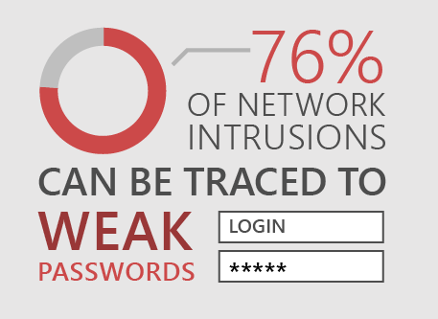

Slide 5
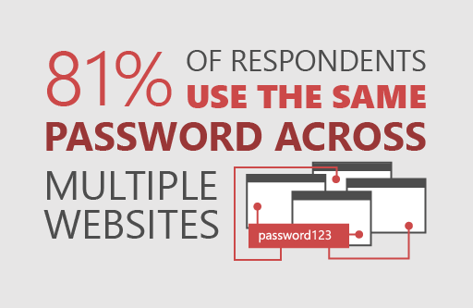

Slide 6
“People are prone to taking mental shortcuts. “
- Kevin Mitnick
Infamous information stealer
Top-notch Information Stealer

Slide 7


Slide 8
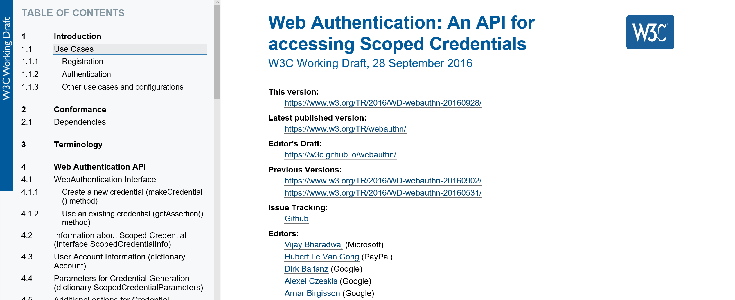

Slide 9
Overview of passwordless authentication
contoso.com
Client
Server
User requests to use passwordless login
Challenge
Sign Challenge with Private Key
Signed Challenge
Check signature
Return Information

Slide 10
Let’s make a few things clear
Relying Party
Client
contoso.com
Browser
Platform
Server
Website

Slide 11
Gestures
*****
Client
Authenticator
Windows Hello
TPM

Slide 12
work@outlook.com
One User
One Device
One Account
One credential

Slide 13
Molly’s Device
molly work account
outlook.com
molly personal account
Credentials for Molly
Outlook personal
Outlook work

Slide 14
Overview of traditional password authentication
contoso.com
Client
Server
Input password to site
Password + Salt
Username
Password
Hash (Password + Salt)
Sign-in user
Compare with stored
hashed password

Slide 15
Overview of passwordless authentication
contoso.com
Client
Server
Request information from Server
Challenge
Sign Challenge with Private Key
Signed Challenge
Check signature
Return Information

Slide 16
DEMO

Slide 17
Web Authentication API
- makeCredential (registering a user)
- getAssertion (authenticating a user)

Slide 18
Overview of registering a user
User requests to use passwordless login
contoso.com
Relying Party
Client

Slide 19
var webauthnAPI = navigator.authentication;
if(!webauthnAPI){
/*Handle Error*/
}

Slide 20
Overview of registering a user
User requests to use passwordless login
contoso.com
makeCredential call
Relying Party
Client

Slide 21
webauthnAPI.makeCredential(userAccountInformation, cryptoParams, challenge, options)
.then(function (newCredentialInfo) {
/* Send new credential info to server */
}).catch(function (err) {
/* No hardware or permission*/
});

Slide 22
makeCredential(userAccountInformation, cryptoParams, challenge, options)
var userAccountInformation = {
rpDisplayName: “Contoso Email”,
displayName: “Molly Dalton”,
name: “mollypersonal@outlook.com”,
id: “123345436344234242”,
imageURL: https:///pics.contoso.com/mad
};

Slide 23
makeCredential(userAccountInformation, cryptoParams, challenge, options)
var cryptoParams = [
{
type: "ScopedCred",
algorithm: "ES256"
},
{
type: "ScopedCred",
algorithm: "RS256"
}
];

Slide 24
makeCredential(userAccountInformation, cryptoParams, challenge, options)
var challenge = "Y2xpbWIgYSBtb3VudGFpbg";

Slide 25
makeCredential(userAccountInformation, cryptoParams, challenge, options)
var options = { timeoutSeconds: 300,
excludeList: [] // No excludeList
};

Slide 26
Overview of registering a user
User requests to use passwordless login
User account information, crypto params, and attestation challenge
contoso.com
makeCredential call
Relying Party
Client

Slide 27
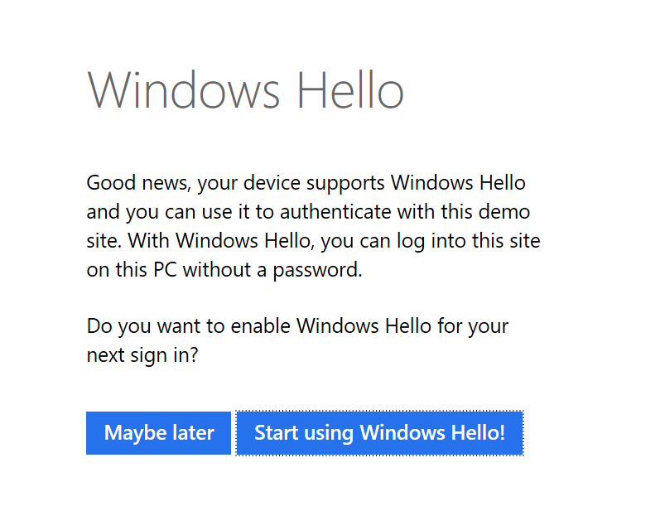

Slide 28
Overview of generating a credential
Unlock with Fingerprint
Authenticator
Client
Generate key pair
Public Key
Windows Hello
+ Credential ID
Attestation Statement
Private Key
TPM

Slide 29
Overview of registering a user
User requests to use passwordless login
User account information, crypto params, and attestation challenge
makeCredential call
contoso.com
Public key, attestation statement, and credential id
Relying Party
Client
makeCredential promise resolved
User is now registered

Slide 30
Molly’s Computer
bank.com
Public Key for
bank.com
social.com
Authenticator
Public Key for
social.com
Private Key for
social.com
Private Key for
bank.com
medical.com
Private Key for
medical.com
Public Key for
medical.com

Slide 31
Overview of authenticating a user
User requests to be authenticated
contoso.com
Client
Relying Party

Slide 32
webauthnAPI.getAssertion(challenge, options)
.then(function (assertion) {
/* Send assertion to server for verification*/
}).catch(function (err) {
/*No hardware or rejected*/
});

Slide 33
getAssertion(challenge, options)
var challenge = "Y2xpbWIgYSBtb3VudGFpbg";

Slide 34
getAssertion(challenge, options)
var options = {
timeoutSeconds = 300, // 5 minutes
allowList: []
};

Slide 35
getAssertion(challenge, options)
var cred1 = {
type: "ScopedCred",
id: "ISEhISEhIWhpIHRoZXJlISEhISEhIQo="
};
var cred2 = {
type: "ScopedCred",
id: "cm9zZXMgYXJlIHJlZCwgdmlvbGV0cyBhcmUgYmx1ZQo="
};
var options = {
timeoutSeconds: 300,
allowList: [cred1, cred2];
};

Slide 36
Login using no credentials
Outlook.com
allowList: []
Login Here
All credentials from Outlook.com

Slide 37
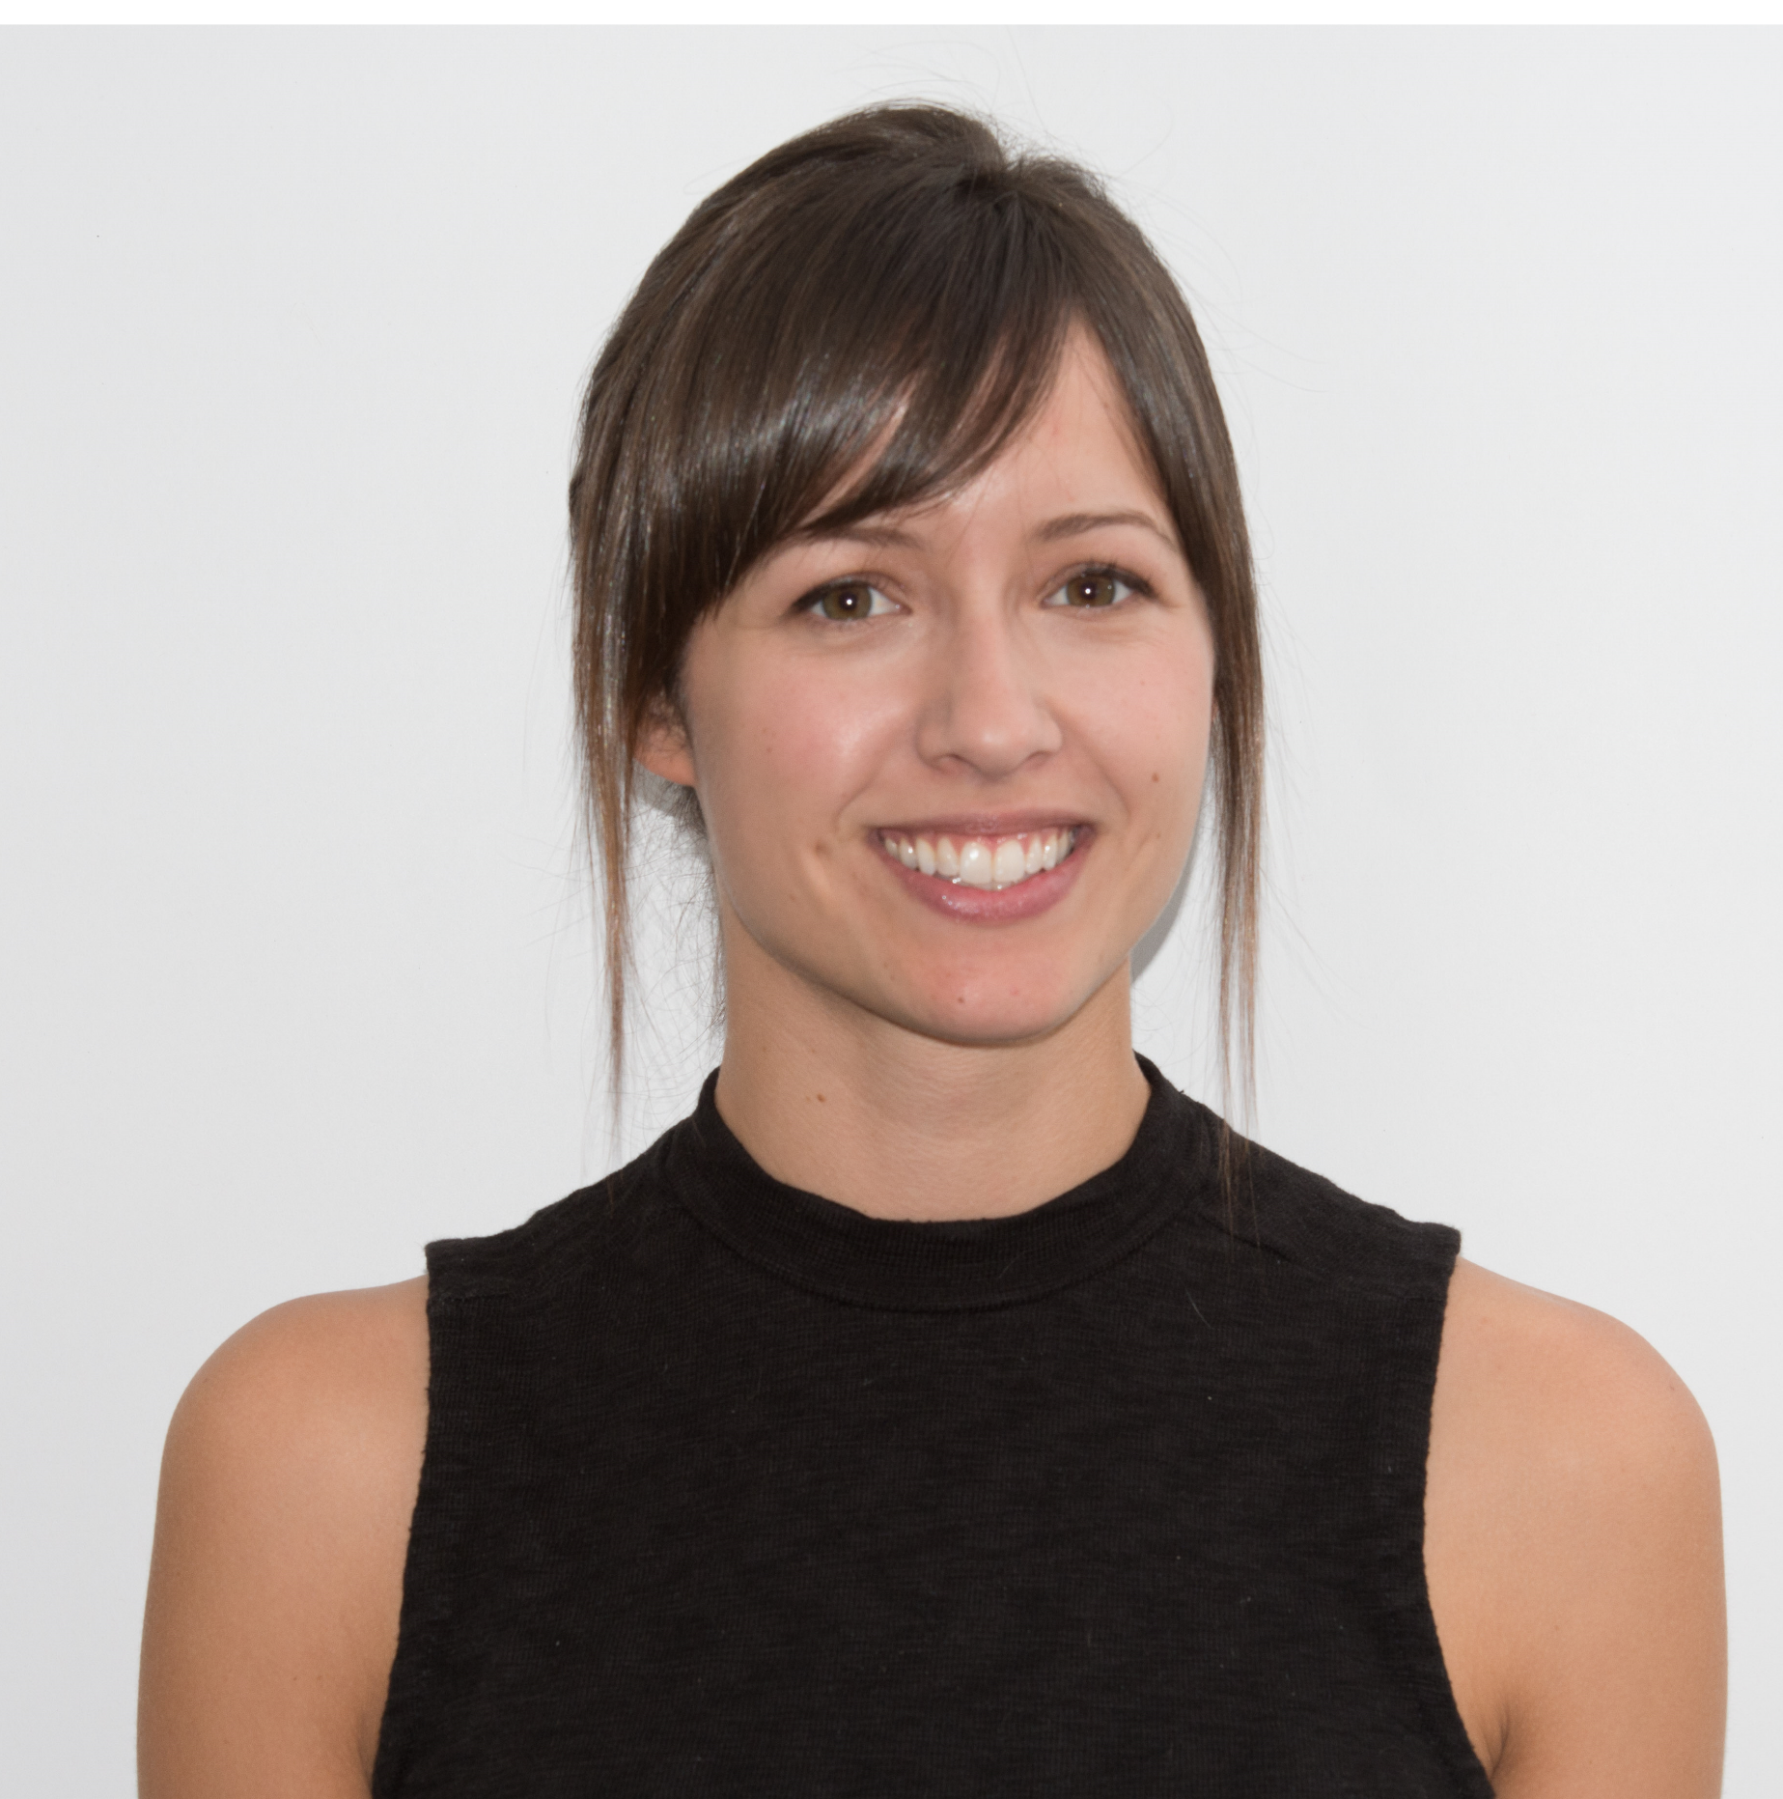

Microsoft.com needs your identity
mollywork@outlook.com
Molly Dalton
Microsoft
mollypersonal@outlook.com
Molly Dalton
Microsoft
Ok
Cancel

Slide 38
var userAccountInformation = {
rpDisplayName: “Outlook Email”,
displayName: “Molly Dalton”,
name: “mollypersonal@outlook.com”,
id: “123345436344234242”,
imageURL: https:///pics.outlook.com/mad
};

Slide 39
Login using username
UserInfo
Login with username
madMolly - Username
madMolly
“12321232312” - Credential ID
- Public Key
Outlook.com
Additional Information

Slide 40
Overview of authenticating a user
Requests to be authenticated
contoso.com
sends Challenge down to the authenticator
Client
getAssertion call
Relying Party

Slide 41
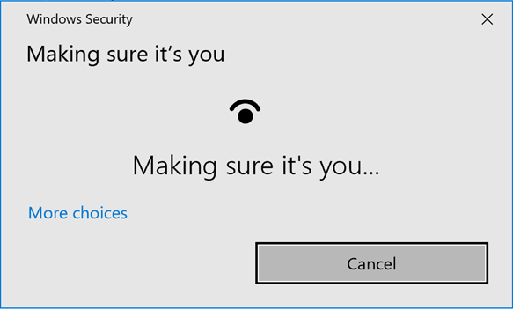

Slide 42
Overview of signing a challenge
Client
authenticatorData
clientDataHash
authenticatorData
clientDataHash
Private Key
Signature

Slide 43
Overview of authenticating a user
Requests to be authenticated
sends Challenge down to the authenticator
getAssertion call
contoso.com
signs challenge with private key
Client
Relying Party
getAssertion promise resolved

Slide 44
UserInfo
Relying Party
madMolly - Username
Signature
“12321232312” - Credential ID
- Public Key
Additional Information

Slide 45
Overview of authenticating a user
Requests to be authenticated
sends Challenge down to the authenticator
getAssertion call
contoso.com
signs challenge with private key
Client
Relying Party
getAssertion promise resolved
User is authenticated

Slide 46
What’s next

Slide 47
1. Experimental version now

Slide 48
2. Polyfill available

Slide 49
3. Build experience with new update

Slide 50
4. Read the spec

Slide 51
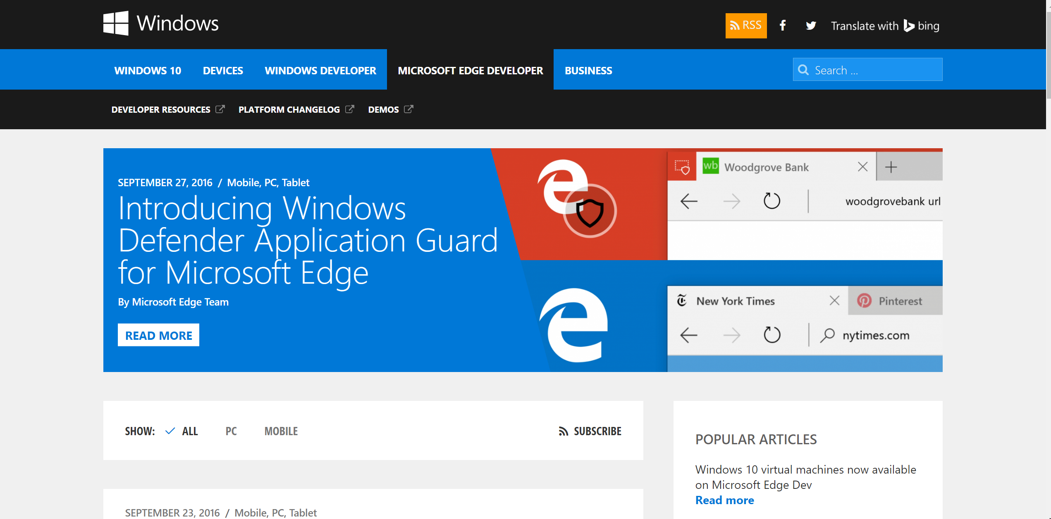
blog.microsoftedge.com

Slide 52
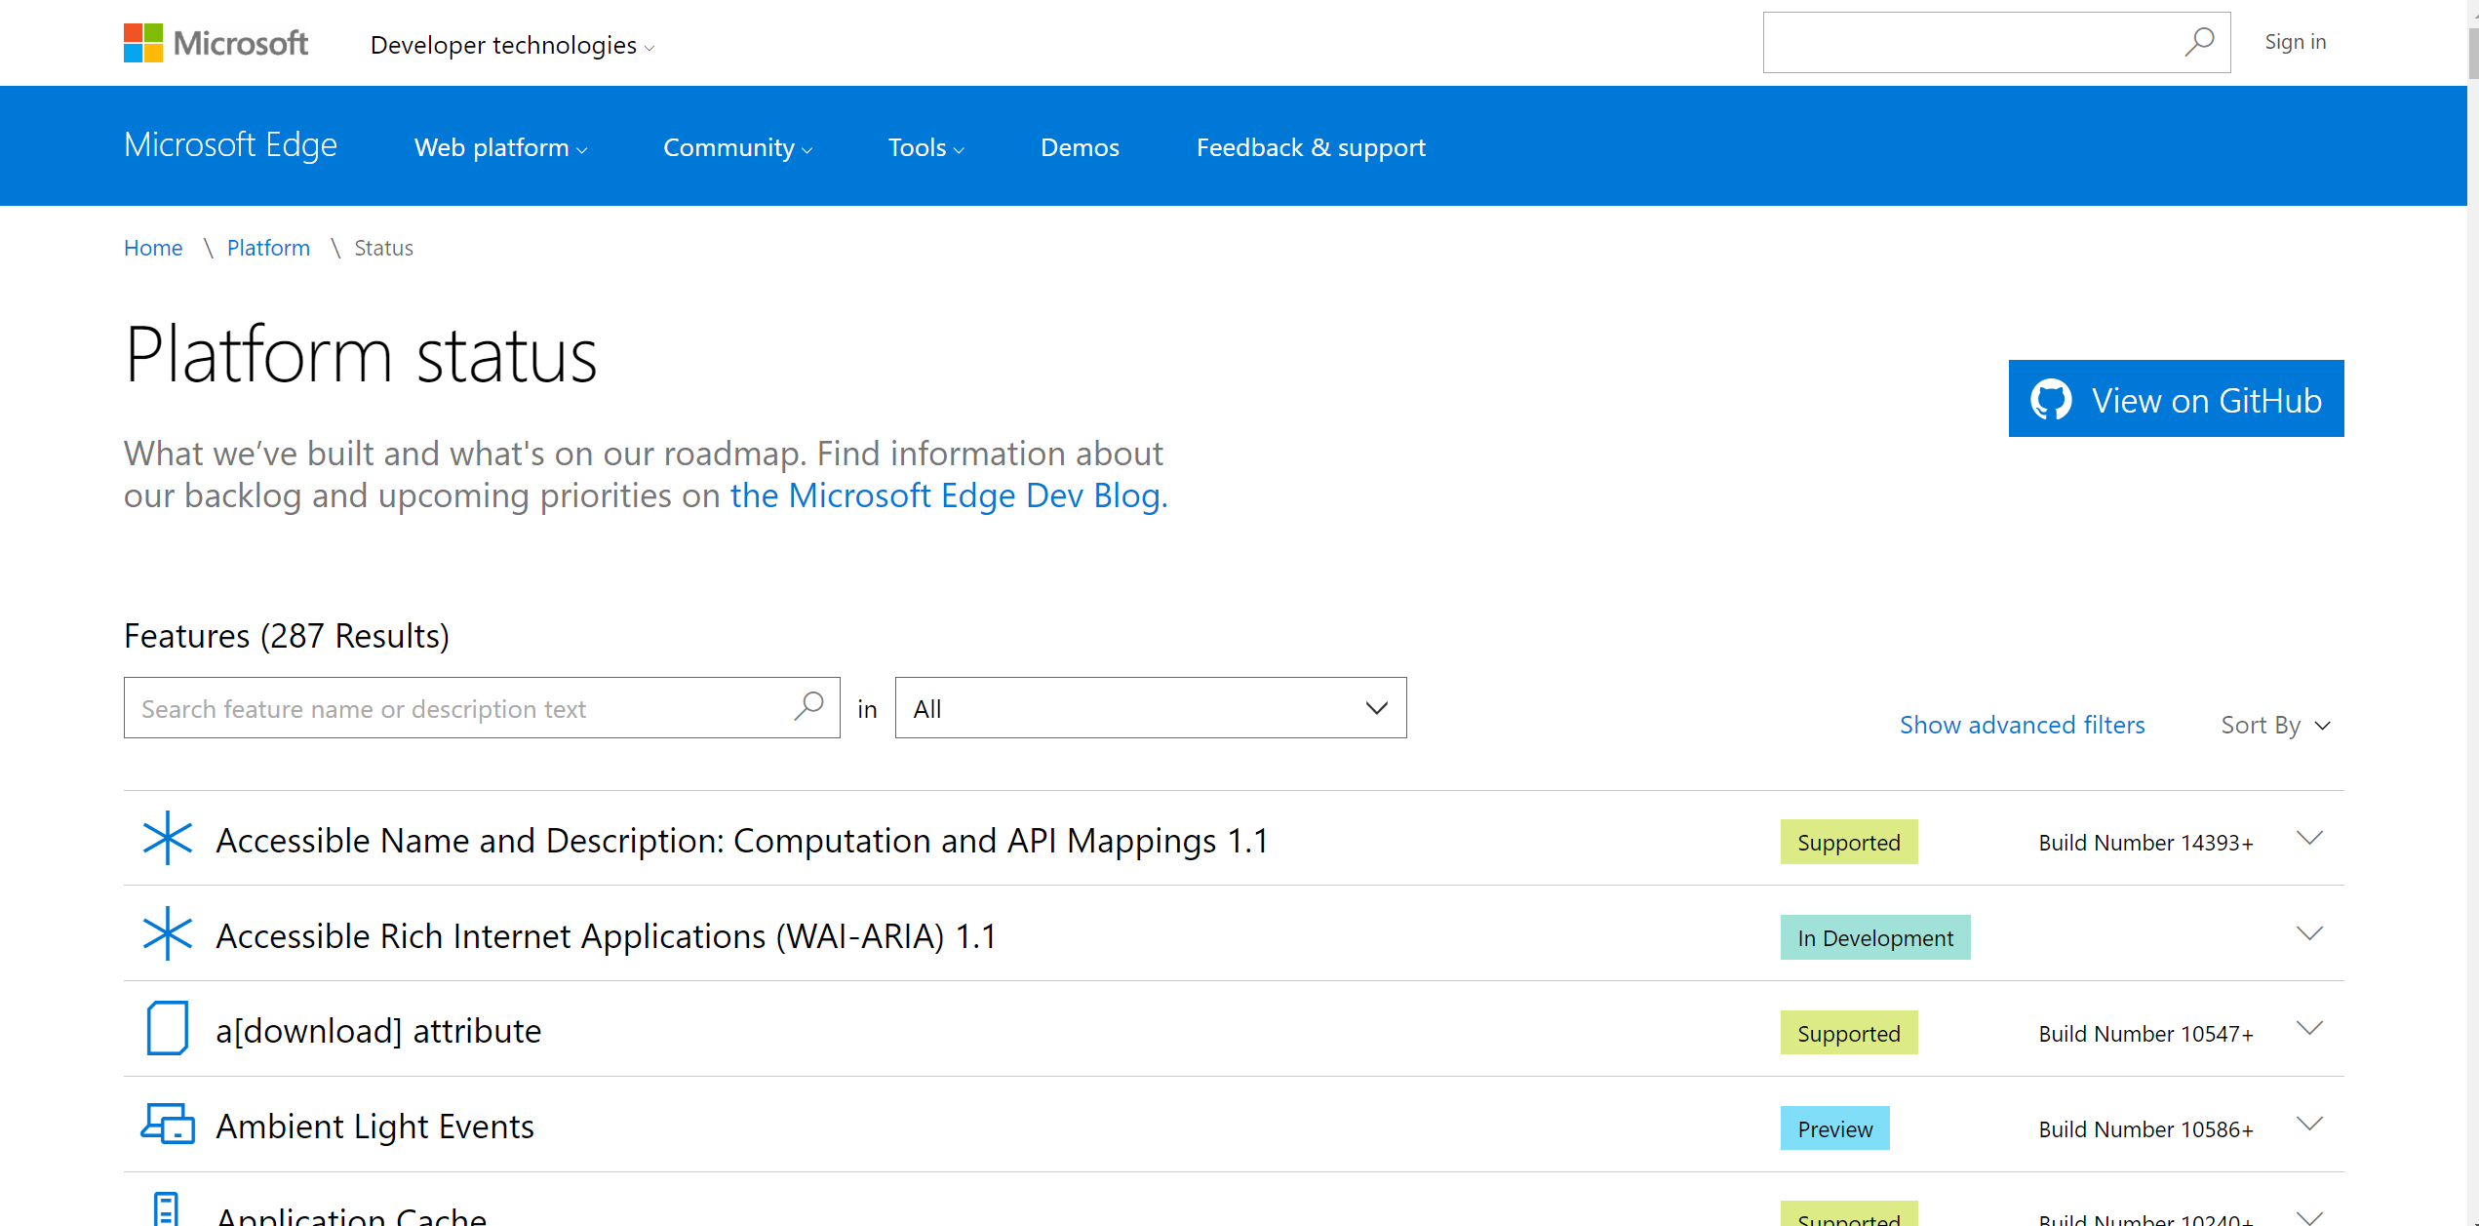
status.microsoftedge.com

Slide 53
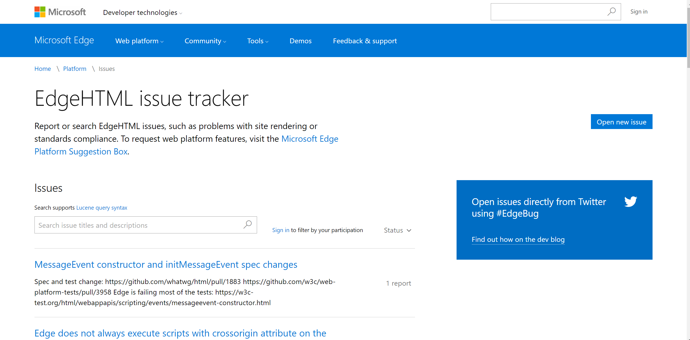
issues.microsoftedge.com

