Slide 1
Microsoft Ignite NZ
25-28 October 2016
SKYCITY, Auckland

Slide 2
Power BI for Developers Custom Visual SDK, Push with Key API & Power BI Embedded
M317
Jon Gallant, Principal SDE, Developer Experience, Microsoft
@jongallant

Slide 3
About Me
Life
Family
Blog
Coding
3D Printing
Coffee
Music
Work
Microsoft
Blog
Coding
3D Printing
Manager
Jon Gallant
@jongallant
jongallant.com
“A man is a success if he gets up in the morning and goes to bed at night and in between does what he wants to do.”
Bob Dylan

Slide 4
Agenda
Power BI for Developers Overview
Create a Custom Visual
Send Data with the Push with Key API
Embed in Website with Power BI Embedded

Slide 5
Power BI for Developers Overview
Power BI is Microsoft’s self-service cloud based BI offering.
Consumer: Desktop, Web, Mobile, Gateway, Publish to Web, Data Stories, Visuals Gallery
Developer: Embedded, REST APIs, Custom Visuals, SDKs
http://bit.ly/pbiindex
http://dev.powerbi.com

Slide 6
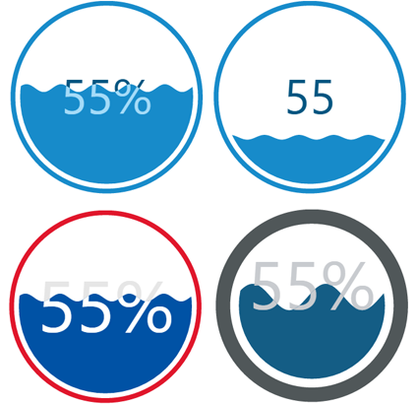
Create a Custom Visual
New Node.js SDK Released in July
https://github.com/Microsoft/PowerBI-visuals-tools
Big improvement
over previous custom
visuals tools.
https://bit.ly/pbicustomviz

Slide 7
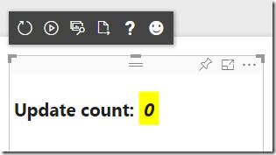
Create a Custom Visual – Dev Env Setup
Install Node.js
Install Power BI Visuals SDK
Install Local Cert
Enable Developer Visual
Create Sample Visual
Test Sample Visual on PowerBI.com
https://bit.ly/pbicustomviz

Slide 8
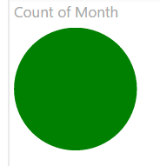
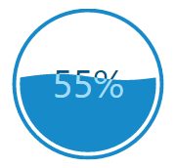
Create a Custom Visual – Reference Code
Create New Visual
Reference & Test d3
Add Liquid Fill Gauge OSS Code
Add TypeScript Definition File
Update References File (tsconfig.json)
Add Liquid Fill Gauge Instantiation Code
Test on PowerBI.com
https://bit.ly/pbicustomviz

Slide 9
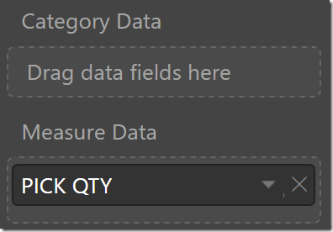
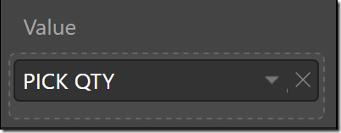
Create a Custom Visual – Capabilities
Simplify dataRoles & dataViewMappings
https://bit.ly/pbicustomviz

Slide 10
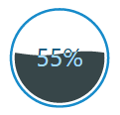
Create a Custom Visual – Format Properties
Define Property Metadata
Set Property Value - enumerateObjectInstances
Get Property Value – getValue<T>
Pass Property Values to Instantiation Code
Package & Test Visual
https://bit.ly/pbicustomviz

Slide 11
Create a Custom Visual – Recap
Setup Dev Env
Created Visual
Referenced d3
Imported OSS d3 Visual
Data Mapping
Format Properties
https://bit.ly/pbicustomviz

Slide 12
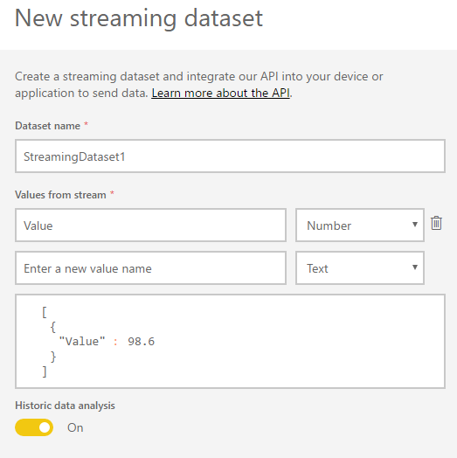
Send Data with the new Push with Key API
Create Streaming Dataset
Create Report
Pin to Dashboard
Push Data “Near Real Time”

Slide 13
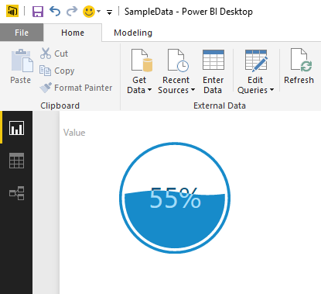
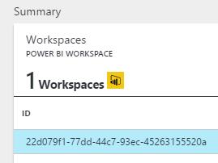
Use Custom Visual in Power BI Embedded
Create PBIX with Power BI Desktop
Import Custom Visual
Create PBIE Workspace Collection
Create PBIE Workspace
Import PBIX
Embed into Website
http://bit.ly/pbie

Slide 14
Create PBIX
Power BI Desktop
Import Custom Viz
http://bit.ly/pbiindex

Slide 15
Create PBIE Workspace Collection
https://portal.azure.com/#create/Microsoft.PowerBI
http://bit.ly/pbie

Slide 16
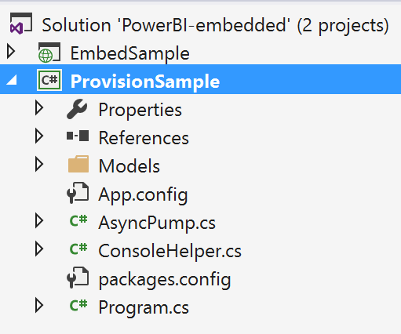
Create PBIE Workspace
Use ProvisionSample –
Option 5
http://bit.ly/pbie

Slide 17
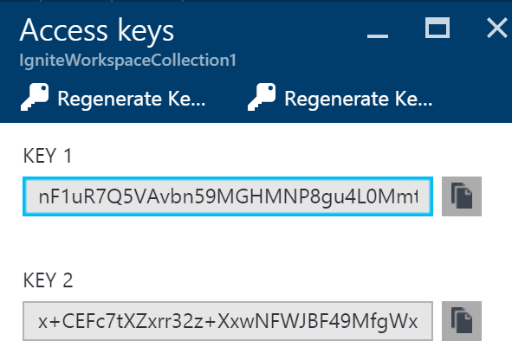
Create PBIE Workspace
Get Access Keys from
Azure Portal
ProvisionSample Creates
Workspace and Outputs ID
http://bit.ly/pbie

Slide 18
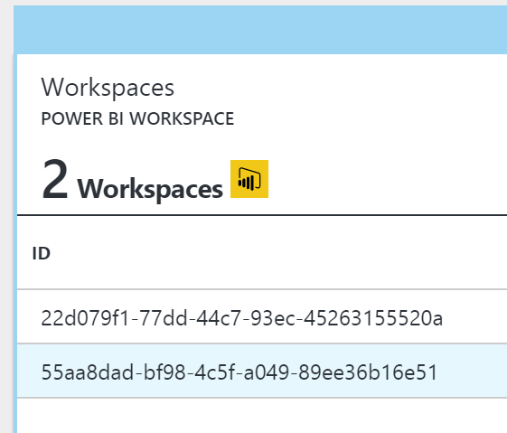
Create PBIE Workspace
You can get IDs from Azure Portal
http://bit.ly/pbie

Slide 19
Import PBIX
Use ProvisionSample – Option 6
http://bit.ly/pbie

Slide 20
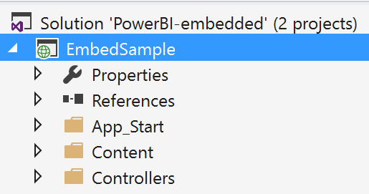
Embed into Website
Use EmbedSample
Put AccessKey,
WorkspaceCollection and
WorkspaceId in Web.config
http://bit.ly/pbie

Slide 21
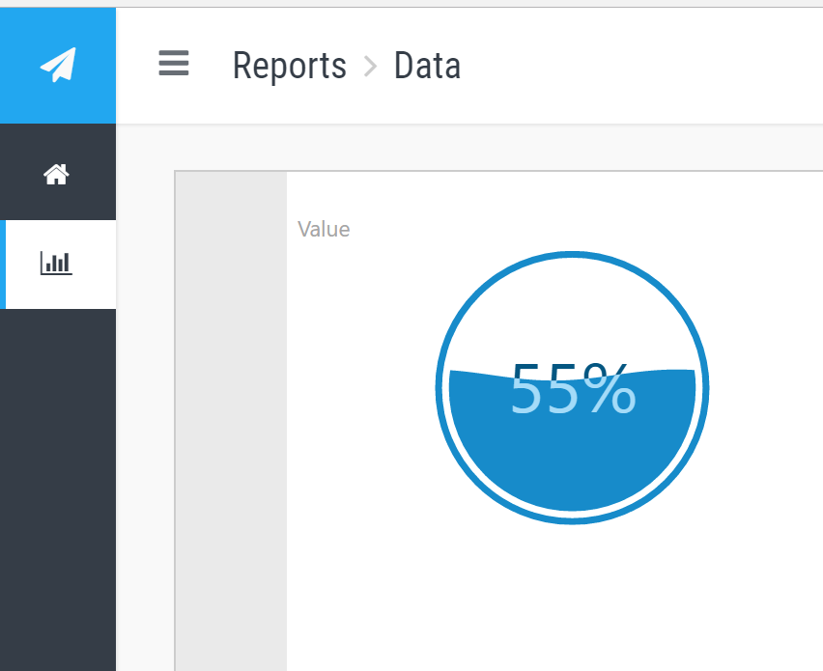
Run Website
Our Custom Visual
Embedded into
a Website
http://bit.ly/pbie

Slide 22
Wrap up
We Created a Power BI Custom Visual
We Sent “Near Real Time” Data to Power BI using the new “Push with Key” API.
We Embedded a Report with a Custom Visual into a Website using Power BI Embedded

Slide 23
My Ignite NZ Sessions
Azure IoT – Tues, 2:55pm, NZ 4
Power BI for Developers – Wed, 9:00am, NZ 3
Work:life Balance – Wed, 1:40pm, Theatre

Slide 24
Q&A

