Slide 1
Microsoft Ignite NZ
25-28 October 2016
SKYCITY, Auckland

Slide 2
Integrating OpenID Connect & OAuth2 with Azure AD and ADFS
M337
Rory Braybrook
@rbrayb

Slide 3
OpenID Connect and OAuth 2.0 provide modern authentication across the Microsoft stack for both enterprise and mobile

Slide 4
Modern authentication
REST
SOAP

Slide 5
Modern authentication
User consents
Admin

Slide 6
Modern authentication

Slide 7
Overview
Overview
AAD / ADFS
OIDC / OAuth 2.0
Protocols
Stacks
Use cases
Demos

Slide 8
Azure AD / ADFS

Slide 9
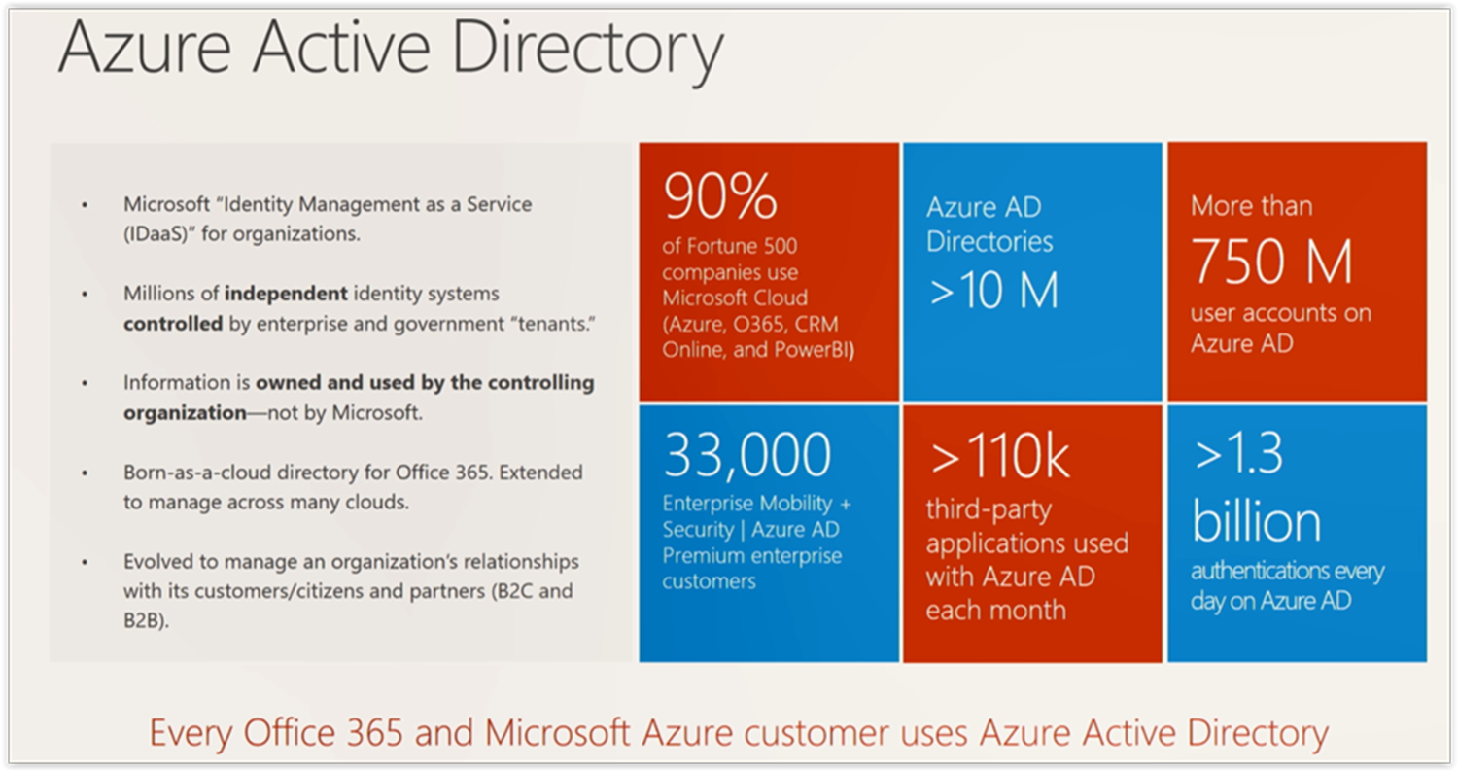

Slide 10
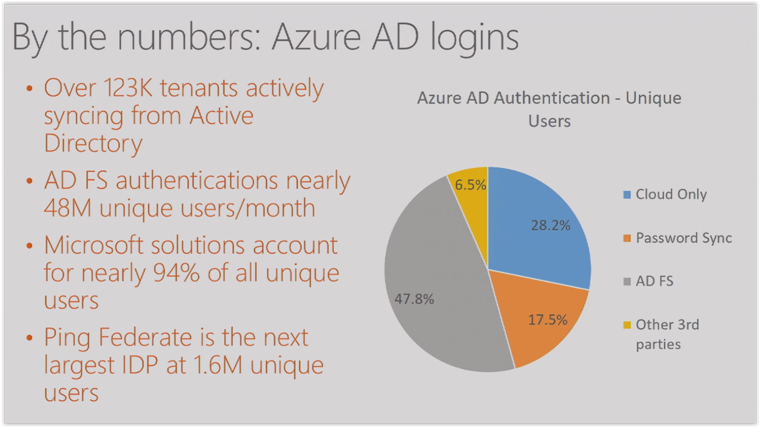

Slide 11
Azure AD and ADFS
SAML Token
IDP
JWT Token
Claims
OIDC OAuth
WS-Fed SAML

Slide 12
Differences between Azure AD and ADFS
ADFS
On premises
Claims rules
SaaS Applications
Sync. to AAD

Slide 13
Differences between Azure AD and ADFS
AAD
Cloud
No claims rules
SaaS Applications
Office 365

Slide 14
Before OAuth
App B needs user details from App A
App A
User passes credentials

Slide 15
OIDC / OAuth 2.0

Slide 16
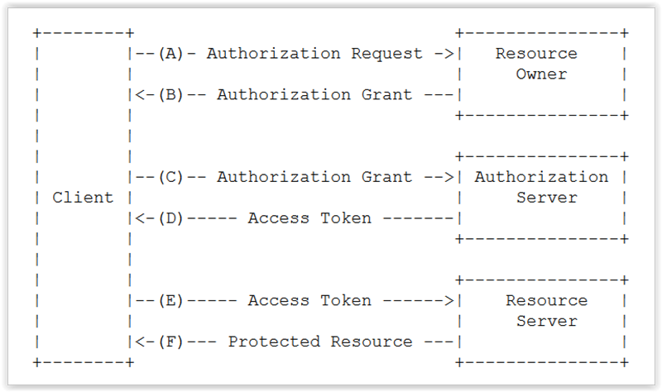
RFC 6749
End User
Printing
service
Authenticate
Photo
sharing
service

Slide 17
OIDC and OAuth 2.0
OIDC –
User authenticates
OAuth 2.0 - User consents

Slide 18
OIDC and OAuth 2.0
OIDC –
Verifying a person's identity
OAuth 2.0 - Accessing a person's attributes

Slide 19
OIDC and OAuth 2.0
OIDC specifies how to use OAuth 2.0 to communicate identity data
OAuth 2.0

Slide 20
OIDC and OAuth 2.0 Tokens
OIDC – Access token plus signed ID token
OAuth – Access token
Refresh token

Slide 21
OIDC and OAuth 2.0 endpoints
/authorize
/token
/discovery
/userinfo

Slide 22
OIDC and OAuth 2.0 Flows
Authorisation Code Grant
Implicit Grant
Client Credentials Grant
Resource Owner Password Credentials Grant
Hybrid

Slide 23
Manipulate (A)AD using API
Use OAuth endpoint to get token
(A)AD
Use token in REST call to endpoint
Token issued

Slide 24
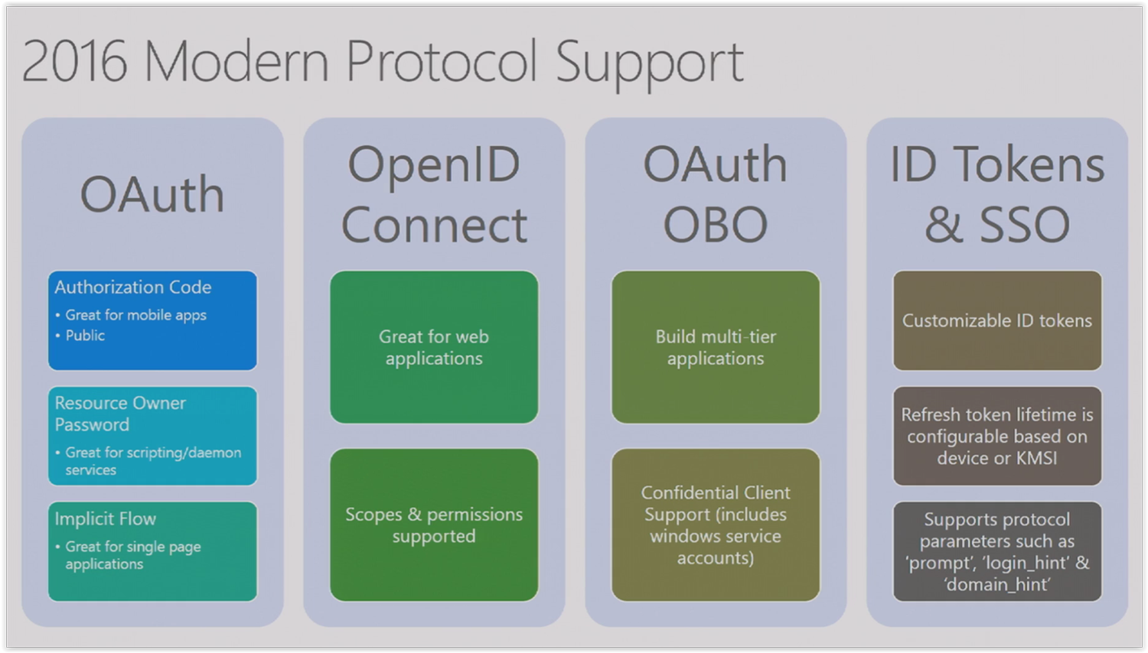

Slide 25
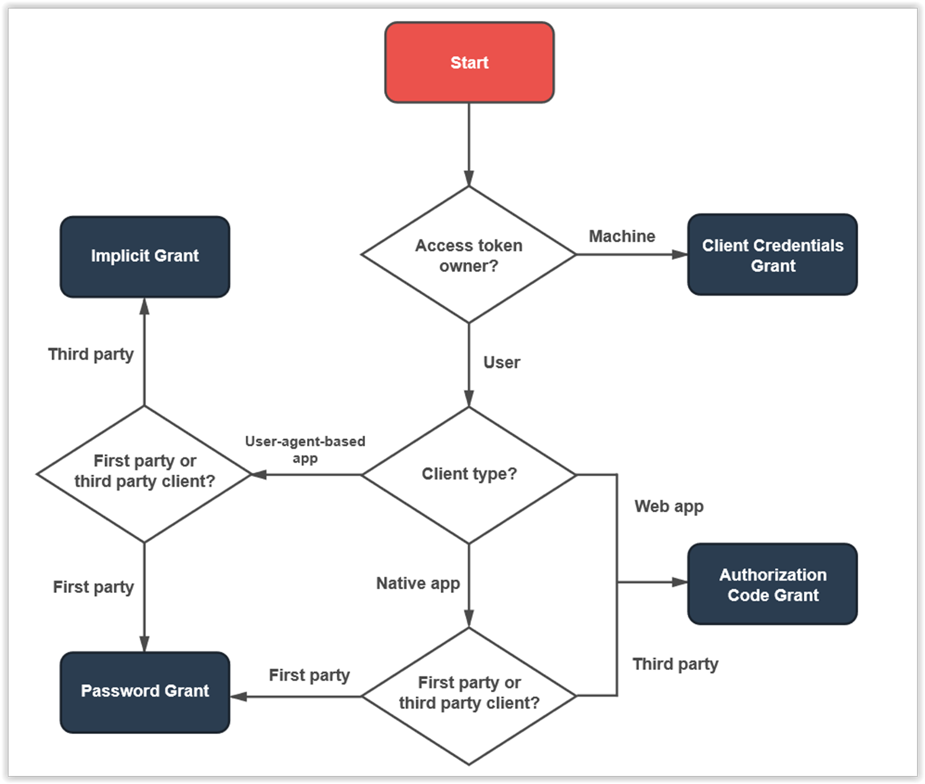

Slide 26
Demo
Using Visual Studio 2015 for OIDC / OAuth 2.0 with Azure AD

Slide 27
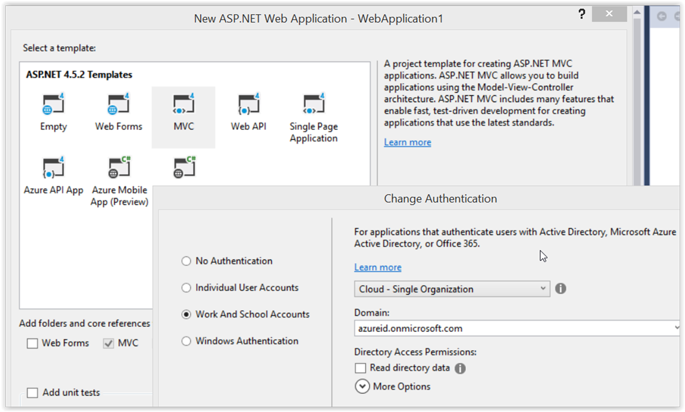

Slide 28
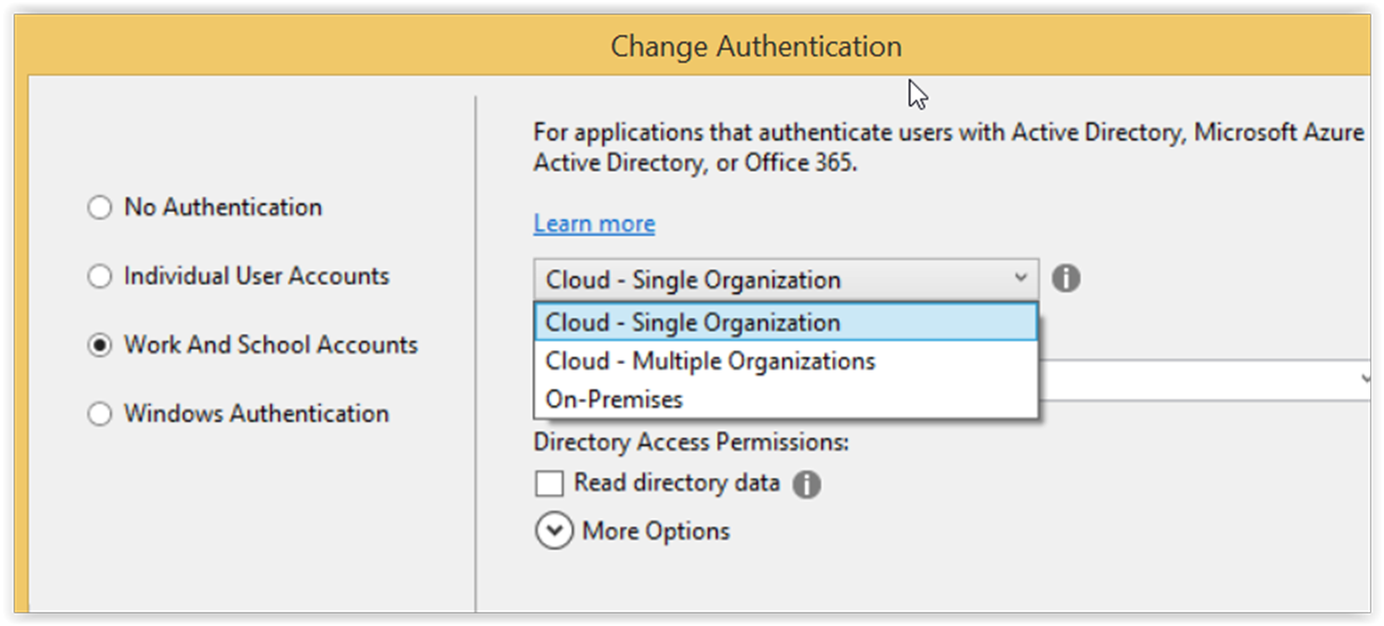

Slide 29
OIDC and OAuth 2.0 Stacks
OWIN – NuGet Package for OIDC
ADAL - Library to abstract implementation of underlying protocol.
(Currently based on OIDC)

Slide 30
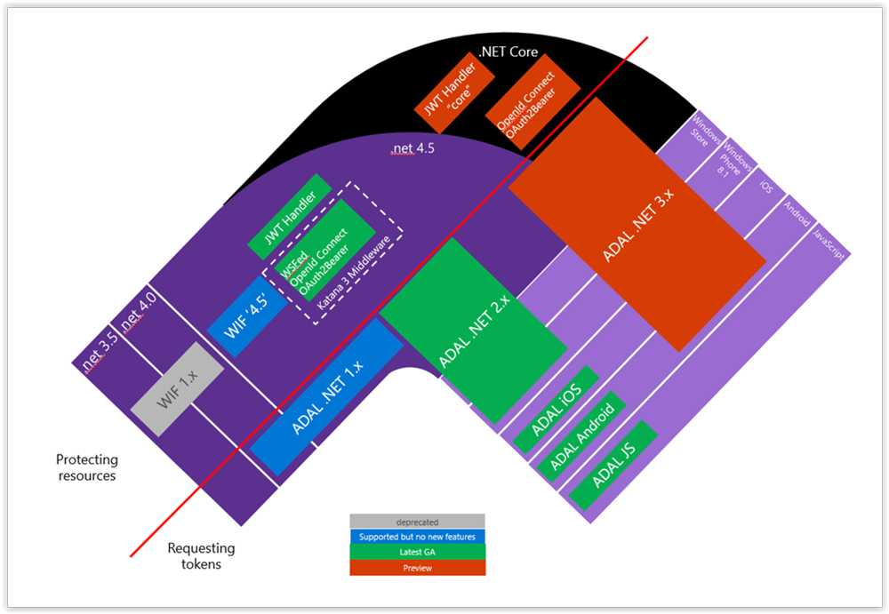

Slide 31
Active Directory Authentication Library (ADAL)
Multiple platforms
.NET, Windows Store, UWP, iOS, Android,
Node.JS, Java
Open source
Server 2016 and AAD with cache support and automatic refresh
NOT a protocol library
Works with ADFS and AAD only

Slide 32
ADAL.NET
Works with ADFS and AAD only
Current (and last) version is 3.0
Being replaced by Microsoft Authentication Library (MSAL) (Converged model)
Unified library that helps you to develop applications that work with Microsoft Accounts, AAD accounts and AAD B2C users

Slide 33
Demo
NuGet Package Explorer

Slide 34
Use cases

Slide 35
Authentication scenarios
Browser
Web application
Web API
js
Native app
Web API
Web API
Server app
Clients using wide variety of devices/languages/platforms
Server applications using wide variety of platforms/languages
video.ch9.ms/teched/2012/na/SIA209.pptx

Slide 36
Authentication scenarios
WS-Fed, SAML 2.0, OpenID Connect
Web application
OAuth 2.0
Web API
Browser
js
Native app
OAuth 2.0
OAuth 2.0
Web API
Web API
Server app
OAuth 2.0
OAuth 2.0
Standard-based, http-based protocols for maximum platform reach
video.ch9.ms/teched/2012/na/SIA209.pptx

Slide 37
Demo
JWT tokens with Postman and jwt.io with Azure AD and ADFS 4.0 on Windows Server 2016

Slide 38
Demo
Using Visual Studio 2015 for OIDC / OAuth 2.0 with ADFS 4.0 on Windows Server 2016

Slide 39
Demo
OIDC / OAuth 2.0 for native devices

Slide 40
Summary – OWIN vs ADAL “signatures”

Slide 41
OWIN
app.SetDefaultSignInAsAuthenticationType
(CookieAuthenticationDefaults.AuthenticationType);
app.UseCookieAuthentication(new CookieAuthenticationOptions());
app.UseOpenIdConnectAuthentication(
new OpenIdConnectAuthenticationOptions
{
ClientId = clientId,
Authority = Authority
};

Slide 42
ADAL
AuthenticationContext ctx = new AuthenticationContext
("https://login.microsoftonline.com/tenant.onmicrosoft.com");
AuthenticationResult ar = await ctx.AcquireTokenAsync
("https://outlook.office365.com",
"bf1cf655-58ad-4618-9680-315f4cc815e3")

Slide 43
Demo
Easy Auth with Azure AD

Slide 44
Demo
Device profile with Azure AD

Slide 45
Resources
Azure Active Directory developer's guide – https://aka.ms/aaddev
Azure code samples - https://aka.ms/aadsamples
Secure your web applications with Microsoft identity -
https://channel9.msdn.com/Events/Ignite/2016/BRK3181
Secure your native and mobile applications with Microsoft identity and application management
https://channel9.msdn.com/Events/Ignite/2016/BRK3182

Slide 46
Resources
Discover what's new in Active Directory Federation and domain services in Windows Server 2016
https://channel9.msdn.com/Events/Ignite/2016/BRK3074
Server 2016 ADFS Development -
https://technet.microsoft.com/en-us/windows-server-docs/identity/ad-fs/ad-fs-development
OInspector - https://github.com/vibronet/OInspector/tree/dev

Slide 47
Resources
A Guide To OAuth 2.0 Grants - https://alexbilbie.com/guide-to-oauth-2-grants/
NuGet Package Explorer - https://github.com/NuGetPackageExplorer/NuGetPackageExplorer

Slide 48
Identity Sessions
A lap around Azure AD B2C for developers (Business to Consumer) [M305] - Tue 25 Oct, 2:55 PM
Identity; What you need to know to be in the Microsoft Cloud [M209] - Tue 25 Oct, 4:15 PM
Deep Dive into the Microsoft Graph API [M331] - Wed 26 Oct, 1:40 PM
Integrating OpenID Connect / OAuth2 with Azure AD and ADFS [M337] - Wed 26 Oct, 2:55 PM
A world without passwords: building a more secure web [M362] - Thu 27 Oct, 1:40 PM

Slide 49
Attribution
Icon by Madebyoliver from flaticon.com
Icon by Freepik from flaticon.com
Icon by Hanan from flaticon.com
Icon by Appzgear from flaticon.com
Icon by Dave Gandy from flaticon.com

