Slide 1

Microsoft Ignite NZ
25-28 October 2016
SKYCITY, Auckland

Slide 2
How we serve 3 Trillion requests per week with Event Hubs
4
M336
@DanRosanova

Slide 3

What is Event Hubs?

Slide 4
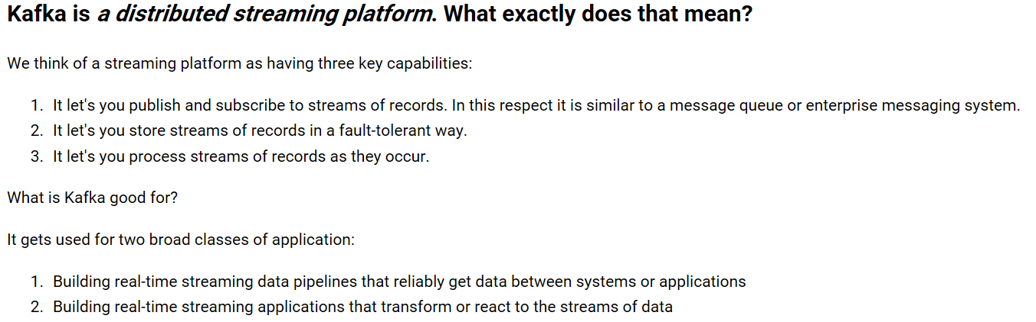
Event Hubs Conceptual overview
Event Hubs is a partitioned consumer messaging services. This definition from Kafka serves well:

Slide 5
Azure Messaging by the numbers
3.8 Trillion
Requests per week
in Event Hubs
6,335,813
Requests per second
average 24/7
99.9976%
Success Rate
50ms
Average Event Hubs
send latency
>28 PB
Monthly data volume
120 Billion
Daily average ingress
>60,000
Daily active Event Hubs Namespaces
>38
Regions where Event Hubs is available

Slide 6




Azure Architecture for Processing Telemetry
Event producers
Collection
Ingress
Stream Processing
Long-term storage
Presentation / action
Fast Data
Service bus
PowerBI Dashboards
Applications
Event hubs
Azure DBs
Legacy IOT
(custom protocols)
Stream
processing
Search and query
Cloud gateways
(web APIs)
HDInsight
Devices
Slow Data
Azure Storage
Cortana Analytics
IP-capable devices
(Windows/Linux)
Azure Data Lake
Low-power devices (RTOS)
Field
gateways
Devices to take action

Slide 7
Event Hubs conceptual architecture
Azure Event Hub
Consumer Group
Partition 1
HTTP
AMQP
Partition 2
Event Receivers
Partition 3
Consumer Group 2
Event Producers
Partition 4
AMQP

Slide 8
Event Hubs conceptual differences from queue
Azure Event Hub
Partition 1
Partitioned Consumer
Partition 2
Partition 3
Partition 4
Queue / et al
Competing Consumer
AMQP

Slide 9
How long did you wait in queue for lunch?
Food
There were actually two lines, so partition count = 2

Slide 10
Event Hubs Scaling
Scale has two components
Throughput Units
  Variable reserved capacity (The component you purchase)
  1 MB/second or 1,000 events/second ingress
  2 MB/second or 2,000 events/second egress
  Namespace wide – across Event Hubs
  Overages are throttled (Server Busy Exception)
Partitions
  Chosen at creation time – not changeable
  Equates to storage within our system
  Maximum ingress of 5MBps (i.e. 5 TUs) – more on this later

Slide 11
How you scale with Event Hubs
1-20 Throughput Units (20MBps / 20,000 eps)
  Use the portal
  Billed by the hour
20-100 in blocks of 20
  Call support
  In effect until you call support again
More than 100
  There is an option for dedicated capacity
  Call your Microsoft rep or get ahold of Ask Service Bus (or me)

Slide 12
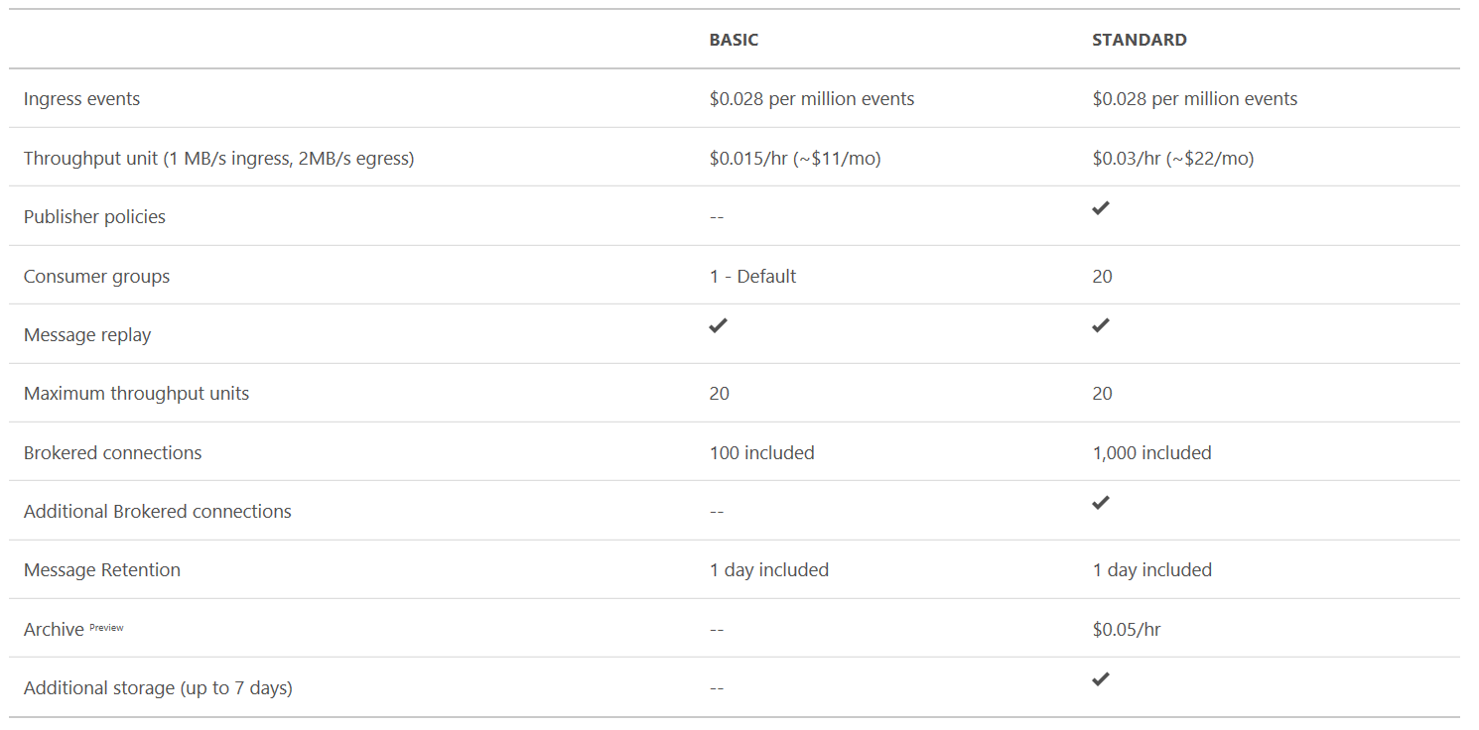
Event Hubs Pricing

Slide 13
Pricing sample 1: One month of data
1 TU = $22
1000 events per second
1000*60*60*24*30.5=2,635,200,000 events
At 1KB this is 2.6 TB of data
(2,635,200,000 / 1,000,000) * 0.028 = $73.79
$22 + $73.79 = $95.97 per month

Slide 14
Event Hubs Pricing Sample 2: One day
1 billion events per day: 12,000 events per second
$0.03 x 12 x 24 = $8.64
1,036,800,000 / 1,000,000 x $0.028 = $29.03
$37.67 per day

Slide 15
Who cares about money?
How does it work!

Slide 16
Event Hubs uses public Azure cloud services
Stuff we use
Worker roles
Blob Storage
Premium SQL Azure
Service Fabric MSI
You can use these same services to build just as scalable a platform

Slide 17
High level architecture of Event Hubs “stamp”
Service Fabric Ring
Storage
Azure Networking
Azure Page Blob (EventData)
Cloud Service 1
Front End
Cloud Service 2
Back End
Premium SQL Azure
(Metadata)

Slide 18
How an Event Hub maps to our stamp
Container 2
Container 1
Partition 3
Partition 1
Partition 4
Partition 2
Storage
Partition 1
Partition 2
Partition 3
EH1 SF Mapping
Partition 4
Azure Page Blob (EventData)
EH1
Premium SQL Azure
(Metadata)

Slide 19
Key characteristics
Once metadata is loaded from the DB it is cached
A Service Fabric “Container” always owns every partition
The container can move to any SF node based on SF load balancing
EventData for a partition is always stored in an exclusive blob (really quite a few blobs over time)

Slide 20
A little more detail
Service Fabric stateless service
Our state is elsewhere – storage really… for now
Custom load balancing metrics: easy to do in SF
8 upgrade domains
We never redeploy, only update (stable VIP)
Even with the update, since we route FE to BE & clients reconnect you generally won’t see it

Slide 21
Well why not just write to storage yourself?
Because we batch aggressively, but don’t really slow down to do it
We shard across storage accounts
We cache data – but avoid dirty reads
We read ahead to make it all faster

Slide 22
What this looked like when we launched
Storage
64
64
50
Azure Page Blob (EventData)
Not Much
Cloud Service 1
Front End
Cloud Service 2
Back End
Premium SQL Azure
(Metadata)

Slide 23
What could do when we launched
1 million 1KB events per second
Benchmarked for 24 hours at a time
We were able to generate 160,000 / second from A9s

Slide 24
What we’ve changed since then
We’ve learned fewer larger VMs work better for us
They are also generally more cost effective
D series v2 VMs are pretty awesome
Just upgrading VMs increased capacity ~200%

Slide 25
We recently split namespace
What does this mean?
Going forward Namespaces can now only host a single type of entity: Queues&Topics | Event Hubs | Relay
Why are we doing it?
To better serve each service, make it easier to use each service, increase pace of innovation, and scale efficiently
How will it impact customers?
From a runtime standpoint today, it won’t. Today this is an organizational concept, there is no pricing impact, we will auto-migrate this fall
Where can I learn more?
https://blogs.msdn.microsoft.com/servicebus/2016/09/14/azure-service-bus-messaging-relay-and-event-hubs-namespace-separation/

Slide 26
Client redirect
New and enabled by default in Gateways (FEs) and new SDK
For partition readers or direct partition senders
After initial connection the client will connect directly to the backend node
If there is a connection drop client will contact gateway again
Because milliseconds matter!

Slide 27
“Receivers being always redirected is how God intended for Event Hubs to work”
Engineering Manager – Azure Messaging

Slide 28
How we organize the team
There are three primary engineering teams
We heavily leverage DevOps
All engineers take rotations for on call
All deployments are automated and flighted

Slide 29
But I hear there is this thing called Kafka…

Slide 30
What am I responsible for?
  On-Premises
  IaaS
  PaaS
Application
Operating System
Virtualization
Hardware
Networking
Physical Security
Customer Responsibility
Microsoft Responsibility

Slide 31
PaaS vs. Software
OS Patching
Runtime monitoring
Load balancing
Software patching
Continual improvement
PaaS
(We do)
Non-PaaS
(You do)

Slide 32
PaaS vs. Software: what is real PaaS
PaaS is fully managed on your behalf – not merely installed
Platforms like EMR are very useful as they handle node provisioning, cluster setup, Hadoop configuration, and cluster tuning
But they don’t manage load balancing and cluster operation

Slide 33
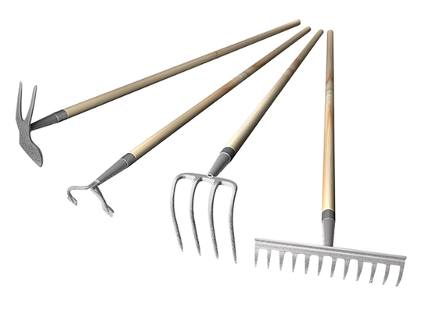

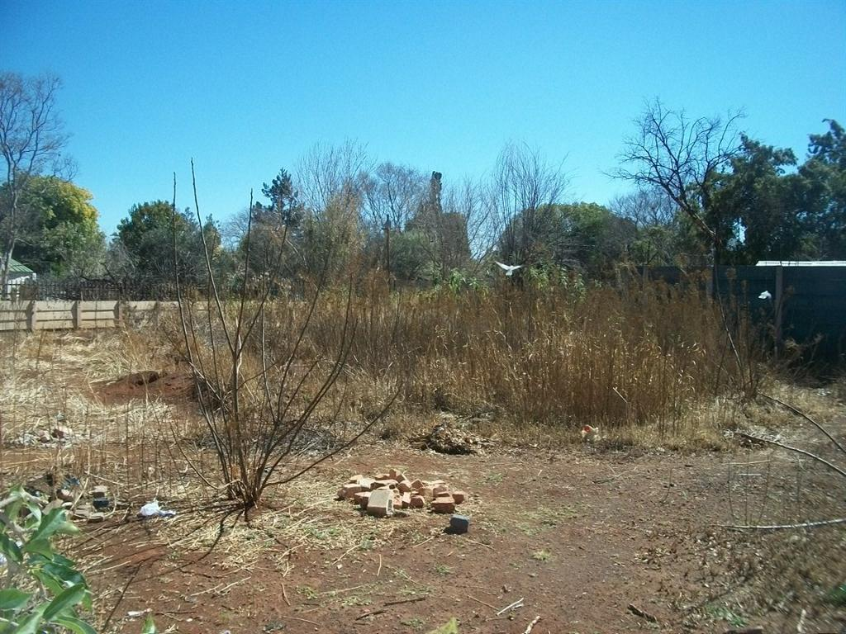
Software (Downloading Kafka)

Slide 34

Preconfigured “platforms” (Elastic EMR) aren’t true “PaaS”

Slide 35

True PaaS

Slide 36
Durability differences
In practice we found setting up an HA deployment of Kafka and Zookeeper a never ending whack-a-mole exercise of chasing yet another corner case of failure recovery.
-Tomasz Janczuk (Auth0)
From Kafka to ZeroMQ for real-time log aggregation

Slide 37
Scale differences?
They’re really not that different
Particularly when you take durability into consideration

Slide 38
Kafka in the real world: Netflix Keystone
Traffic
550 Billion events per day
8.5 million events per second (22GBps) peak
>1PB per day
Hardware
12 clusters across 3 regions
2700 servers
http://www.slideshare.net/mmddtmp/netflix-keystone-samzaeetup10132015

Slide 39
Scaling Kafka
For reference, here are the stats on one of LinkedIn's busiest clusters (at peak):
  60 brokers
  50k partitions (replication factor 2)
  800k messages/sec in
  300 MB/sec inbound, 1 GB/sec+ outbound
The tuning looks fairly aggressive, but all of the brokers in that cluster have a 90% GC pause time of about 21ms, and they're doing less than 1 young GC per second.
http://kafka.apache.org/documentation.html#operations

Slide 40
Load balancing differences
Bing Siphon (Does Microsoft really use Kafka?)
1300+ Windows Machines
Peaks at 1.3 million events per second
Even the Siphon team says load balancing is hard
Kafka assumes each topic is equal
Reassign tool doesn’t work well at scale
See their presentation at:
Bing Siphon at Kafka Summit 2016

Slide 41
Things you should real about Kafka
Quotas This is new to 0.9… and I can see why
Availability and Durability Guarantees
Unclean leader election as an American we can tell you all about this right now

Slide 42
Summary
Amazon and Microsoft are the two undisputed leaders in cloud computing…
Don’t take my word, ask Gartner
Neither of us used Kafka for our streaming service

Slide 43

Q&A

