Slide 1

Microsoft Ignite NZ
25-28 October 2016
SKYCITY, Auckland

Slide 2
What’s New in BizTalk 2016
M333
Mark Brimble
Principal Integration Architect, Datacom

Slide 3
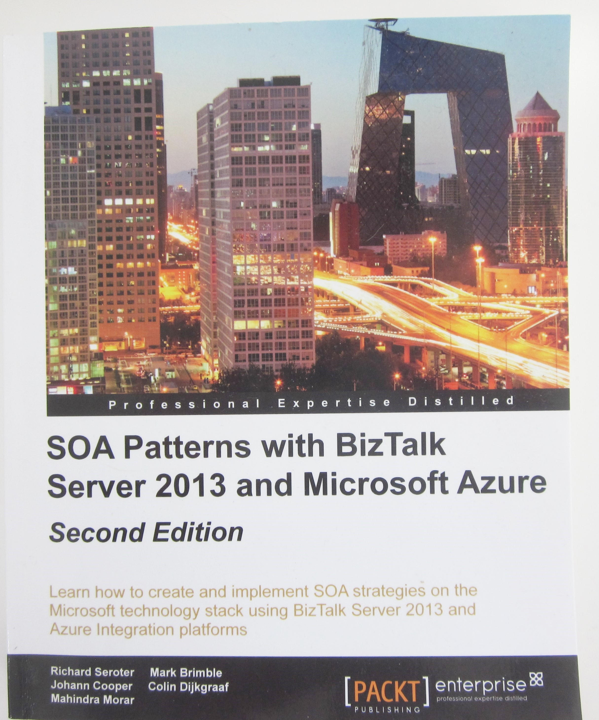

Slide 4


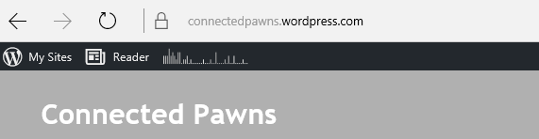
+
+

Slide 5
Connect on-premises LOB to SaaS with BizTalk
What’s new in BizTalk 2016
Why should you use BizTalk 2016 and SQL Server 2016
  HA with SQL 2016 availability groups
  Demo
  Using the BizTalk Logic App connector
  Demo

Slide 6


Where are we?
BizTalk Server
2013R2
BizTalk Server
2013
CONTINUOUS INNOVATION
BizTalk Server
2010
BizTalk Server
2009
BizTalk Server
2006
BizTalk Server
2006 R2
BizTalk Server
2004
BizTalk Server
2002
    Mapper UI enhancements
    Fine-grained Manageability
    Trading Partner Management
    Secure FTP
    Cloud Connect
    Updated Swift
    and HIPAA
    HIS 2010
BizTalk Server
2000
    VS + .NET
    Messaging + Orchestration
    BRE
    Routing
    BAM
    Scale-out
    Simplified configuration
    Adapters in box
    Runtime+
    BAM+
    EDI/AS2
    RFID
    WCF support
    Adapter Pack
    Adapter SDK
    HIS 2006
    BAHS
    ALM Support
    B2B+
    RFID Mobile
    Adapter Pack 2.0
    Hyper-V Support
    HIS 2009
    BAHS 2.0
    Rest Support
    PAAS
    Azure Connectivity
    SFTP
    XSL Compiled Transform Maps
    Deployment Tools
    XSD
    EAI (partner adapters)
    Vertical B2B
    Messaging
    XML tools
    XLang
    JSON Messages
    SAS support
500
Customers
2,000
Customers
4,000
Customers
7,000
Customers
8,500
Customers
10,500
Customers
12,000
Customers

Slide 7
What’s new in BizTalk Server 2016
SQL Server 2016 AlwaysOn Support
  Provides supported multi-node BizTalk deployment in Azure
  Modern, consistent HA/DR capabilities
  No more log shipping or active/passive clustering as HA solution
Platform Refresh
  SQL 2016, Windows 2016, Office 2016, Visual Studio 2015

Slide 8
What’s new in BizTalk Server 2016
BizTalk Logic Apps Adapter
Easily consume Logic Apps and > 30 connectors
Logic Apps BizTalk Connector and actions
Easily connect to and consume BizTalk functionality.

Slide 9
Customer-driven Improvements
SHA2 Support
SAP NcO Support
Shared Access Signature Support for Service Bus
basicHttpRelay, netTcpRelay, basicHttp, webHttp
Admin Console
Search/Filter on artifact name
Change settings for multiple hosts
Suspended messages - Multi-select on “Save To
File”
Mapping
Resizable window for schema selection dialog
Map-level config for xslCompiledTransform vs
xslTransform
Ordered Delivery on Dynamic Send Ports
HL7 Accelerator
Proactive MLLP adapter connection
Binding import/export improvements
Granular party-level for selected parties
Include/exclude tracking settings
Symmetric CLI commands
Improved SFTP adapter
Greater compatibility – now using WinSCP
SYST support not enforced
Better trace and error info
new ciphers – DES, Blowfish, ArcFour
File adapter – overwrite temp files on retry
Batching orchestration performance improvements
Admin console and engine perf improvements

Slide 10
Connect on-premises LOB to SaaS with BizTalk
Why should you use BizTalk 2016 and SQL Server 2016
  HA with SQL 2016 availability groups
  Demo

Slide 11
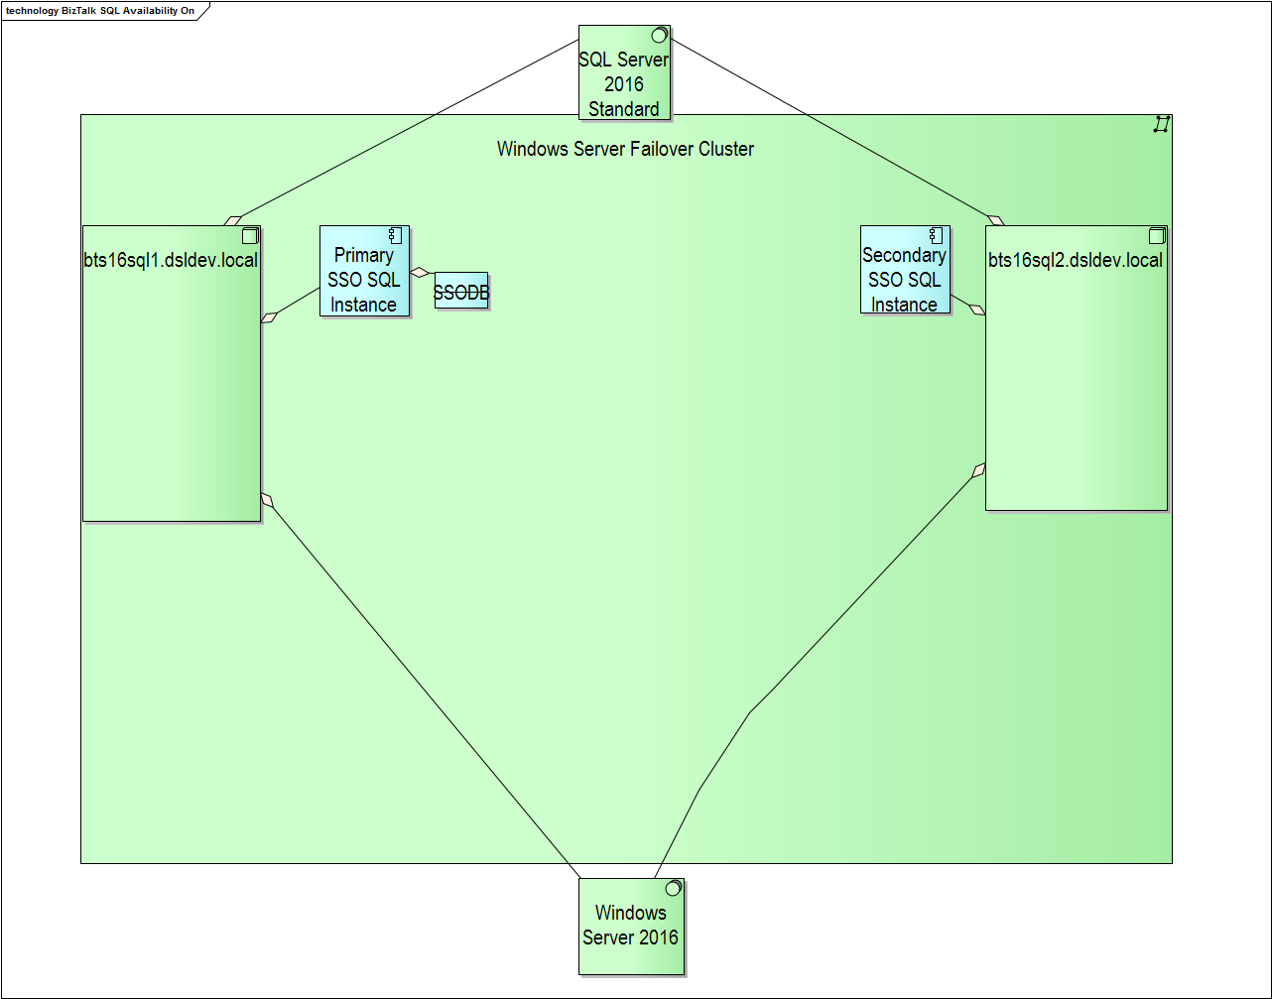
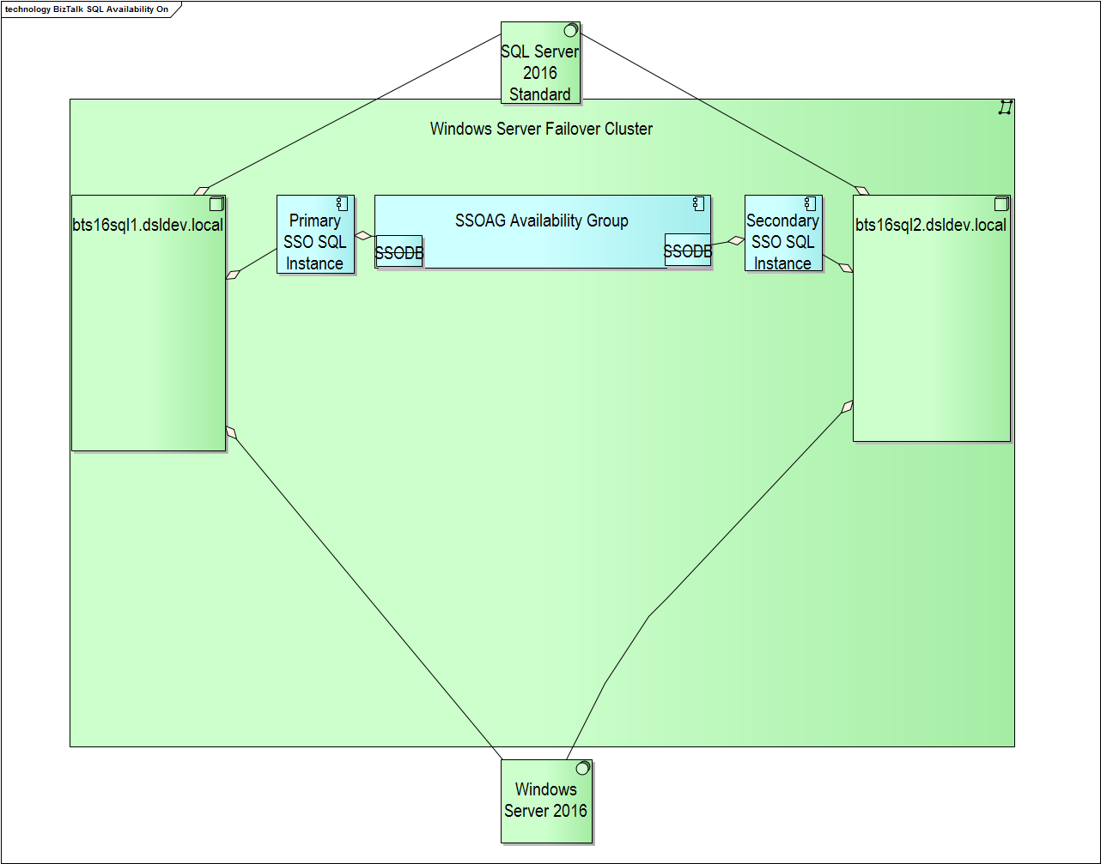
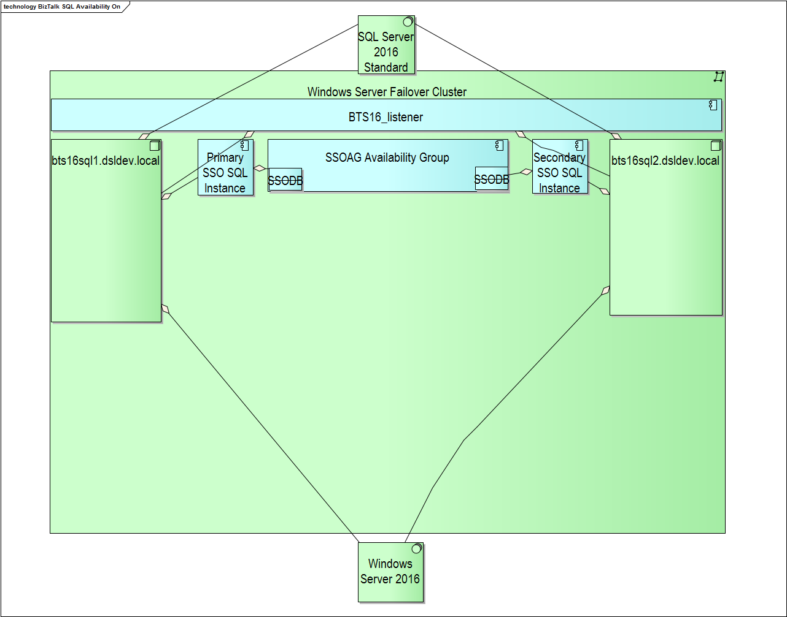
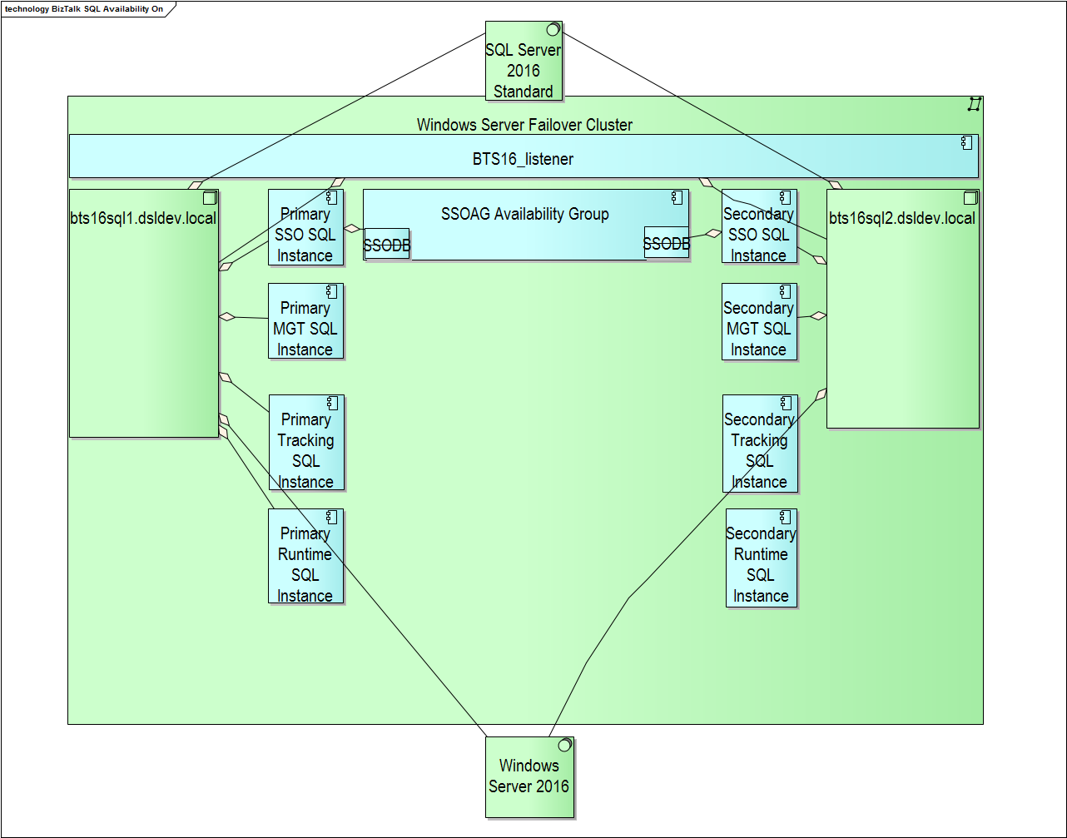
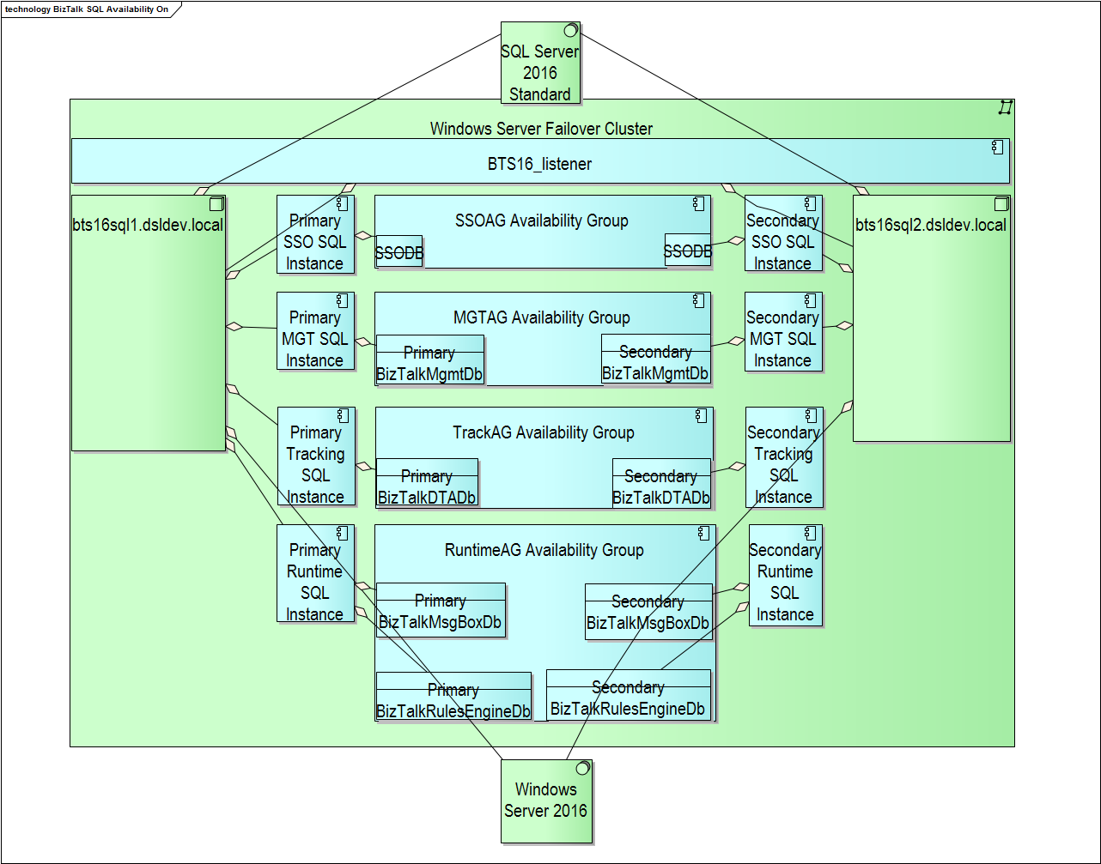
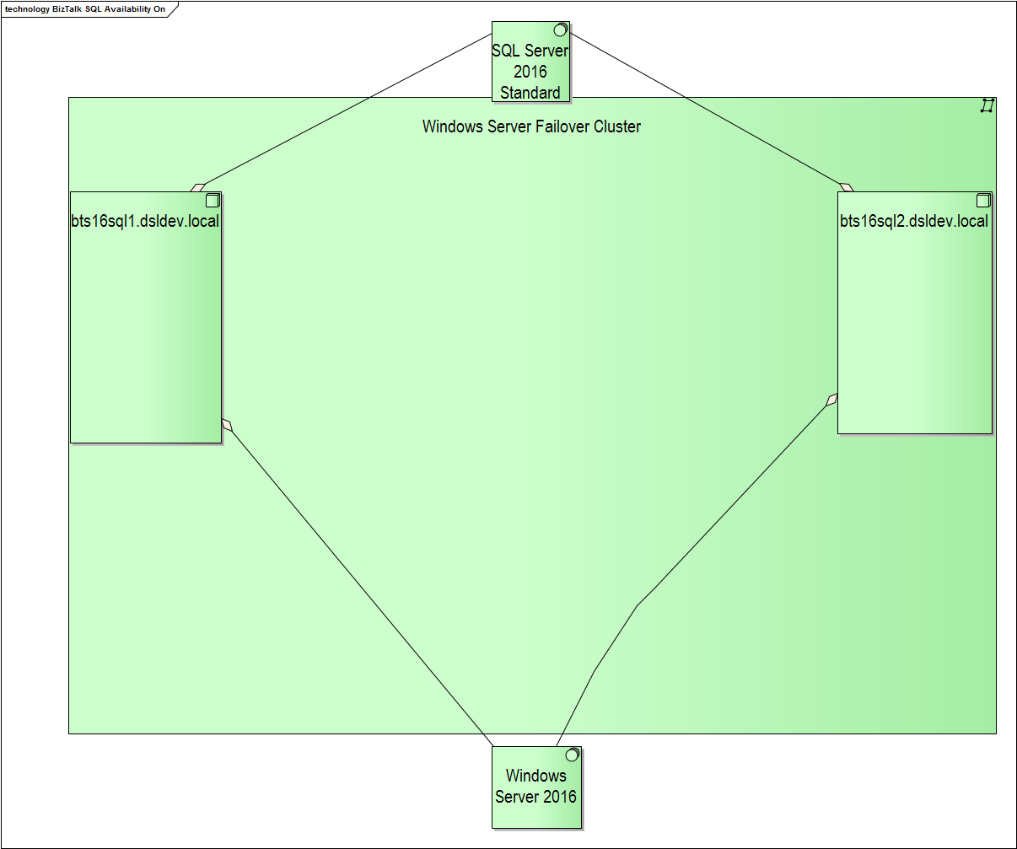

Slide 12
Demo
HA with BizTalk 2016 and SQL 2016

Slide 13
Connect on-premises LOB to SaaS with BizTalk
Why should you use BizTalk 2016 and SQL Server 2016
  HA with SQL 2016 availability groups ✓
  Demo ✓
  Connect to Logic App using BizTalk connector
  Demo
  Connect to BizTalk using a Logic App
  Demo

Slide 14
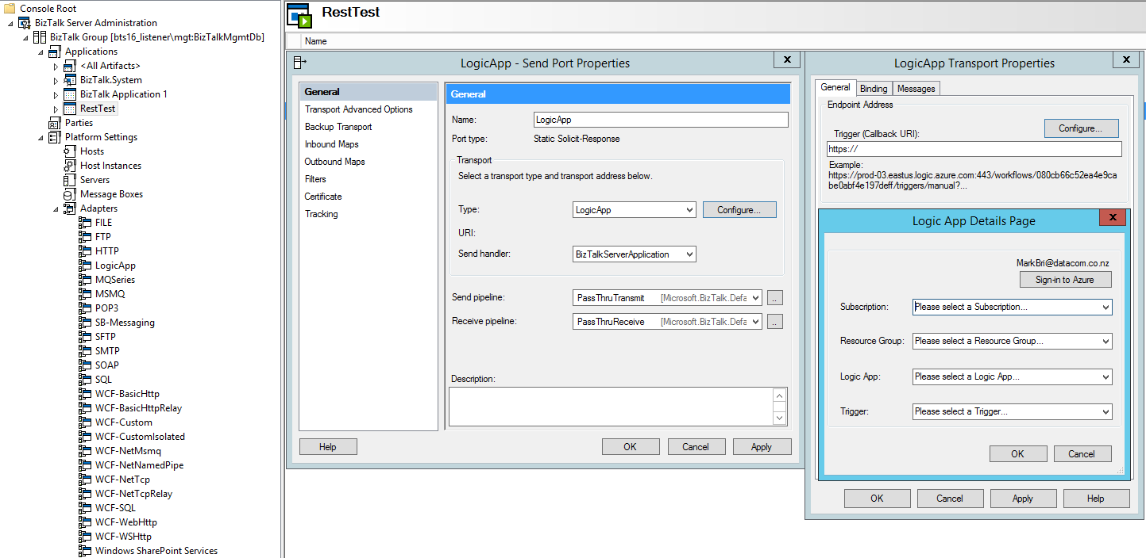

Slide 15
Demo
BizTalk-initiated processing

Slide 16
Connect on-premises LOB to SaaS with BizTalk
Why should you use BizTalk 2016 and SQL Server 2016
  HA with SQL 2016 availability groups ✓
  Demo ✓
  Connect to Logic App using BizTalk connector ✓
  Demo ✓
  Connect to BizTalk using a Logic App
  Demo

Slide 17
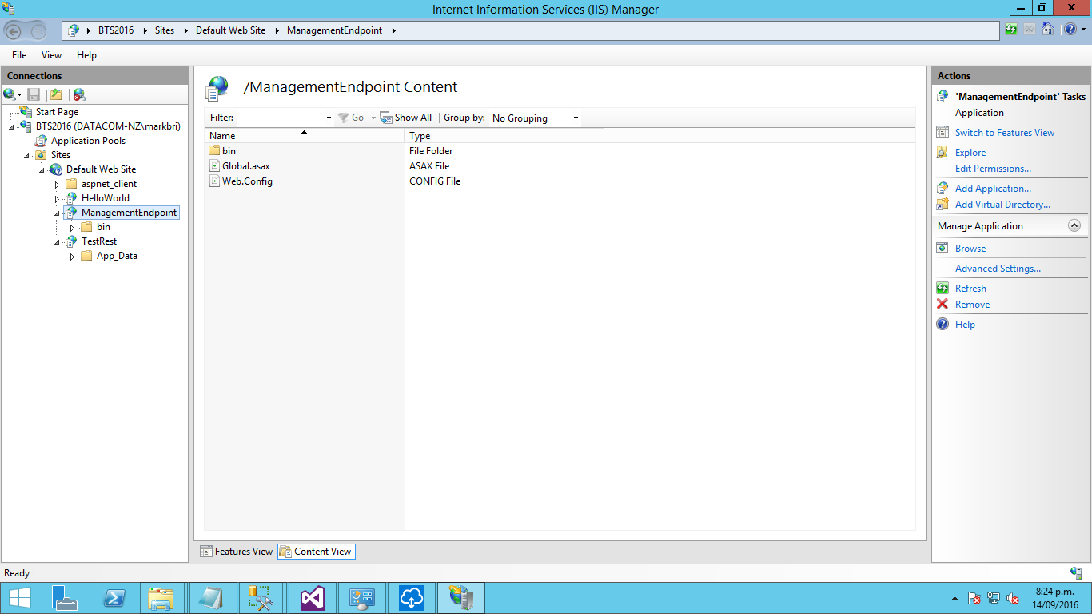
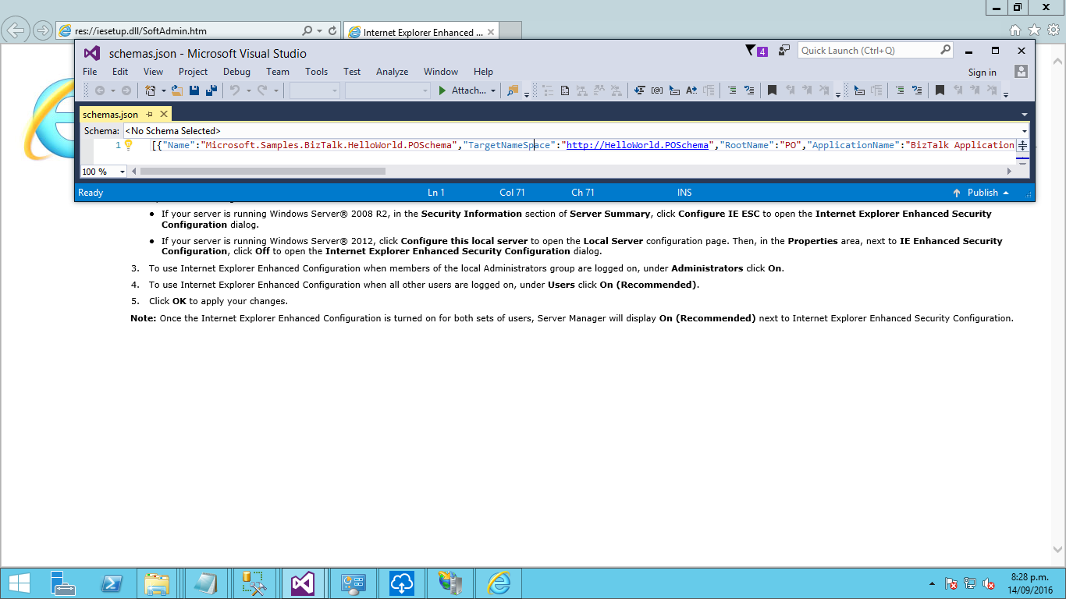
Logic App to BizTalk – 1. Setup an IIS Endpoint

Slide 18
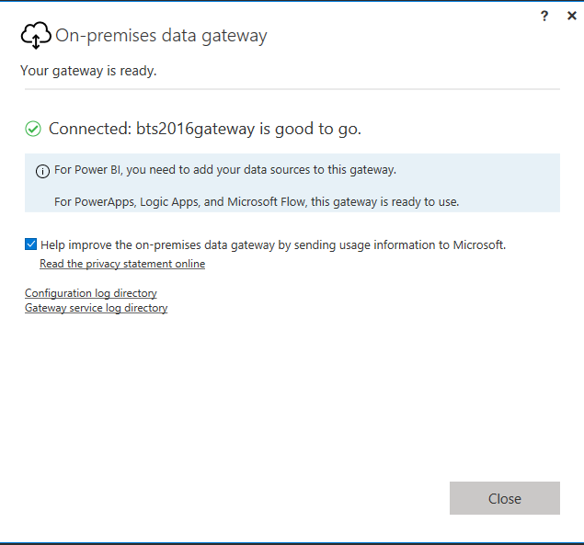
Logic App to BizTalk – 2. Install the Gateway

Slide 19
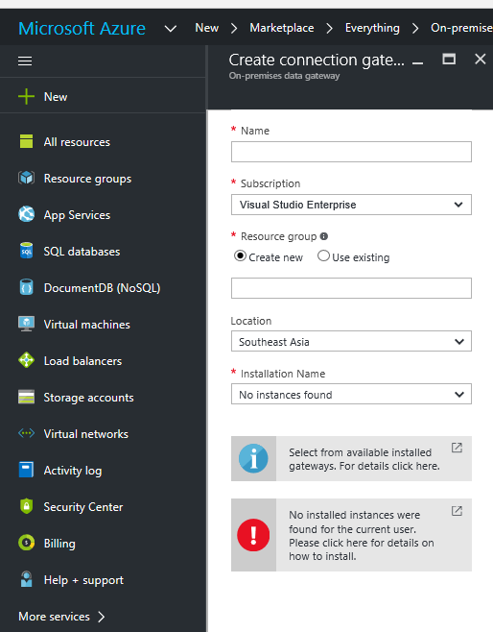
Logic App to BizTalk – 3. Configure Azure

Slide 20
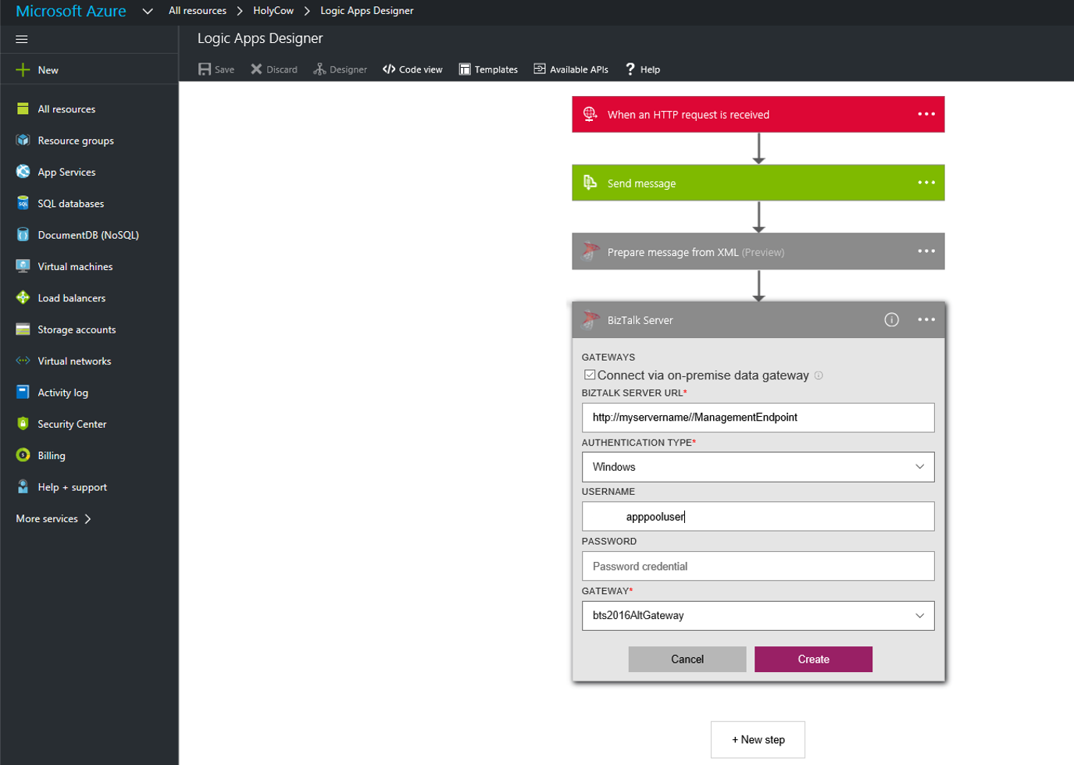
Logic App to BizTalk – 4. Configure Logic App

Slide 21
Demo
Logic App-initiated processing

Slide 22
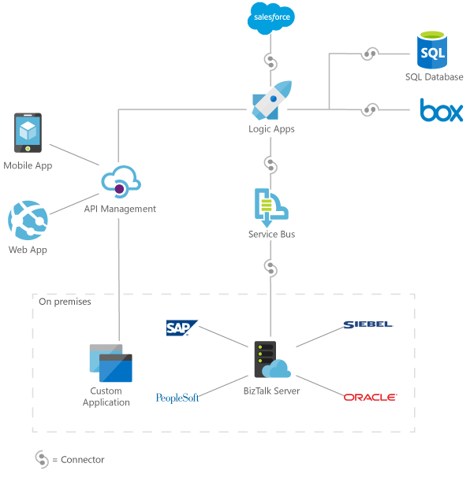
Connect on-premise LOB apps to SaaS Apps with BizTalk

