Slide 1
Microsoft Ignite NZ
25-28 October 2016
SKYCITY, Auckland

Slide 2
Tips and tricks for Power BI
M325
Philip Seamark - phil@trademe.co.nz

Slide 3
Demos galore
Lets get some Power!.....

Slide 4
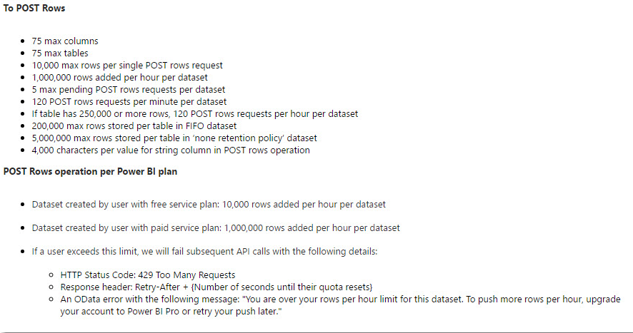
API Rate Limits

Slide 5
Handy Websites
www.daxpatterns.com
powerbi.tips
powerbi.microsoft.com/en-us/guided-learning/

Slide 6
Power BI User Groups
Auckland
Wellington
Dunedin

Slide 7
Tips and tricks for Power BI
M325
Philip Seamark - phil@trademe.co.nz

