Slide 1
Microsoft Ignite NZ
25-28 October 2016
SKYCITY, Auckland

Slide 2
Please bring me coffee! Using iBeacons to seamlessly engage with Xamarin apps
M324
Jim Bennett

Slide 3
Buying coffee is not as easy as it should be
By Takeaway (Own work) [CC BY-SA 3.0], via Wikimedia Commons

Slide 4
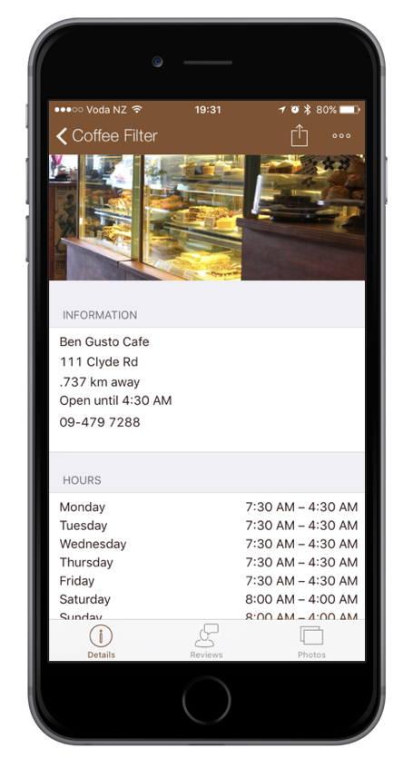
We interact with apps and the real world all the time…

Slide 5
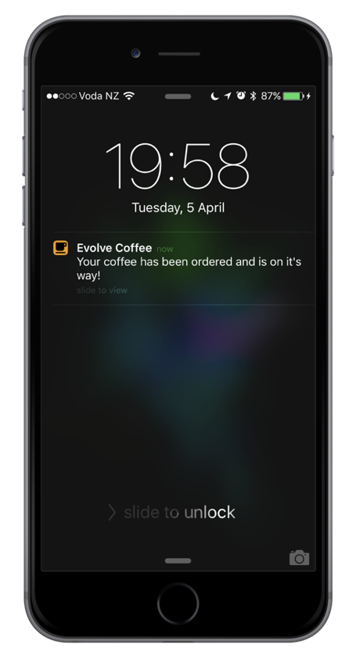
…but what if apps interacted with the real world for us?

Slide 6
iBeacons allow you to create context aware and indoor location aware mobile apps

Slide 7
What are iBeacons?

Slide 9
By Karthik Easvur (Own work) [CC BY-SA 3.0 ], via Wikimedia Commons
iBeacons transmit a BLE advertising packet containing an ID

Slide 11
The BLE packet also contains the iBeacon’s transmission power

Slide 12
Context aware apps

Slide 13
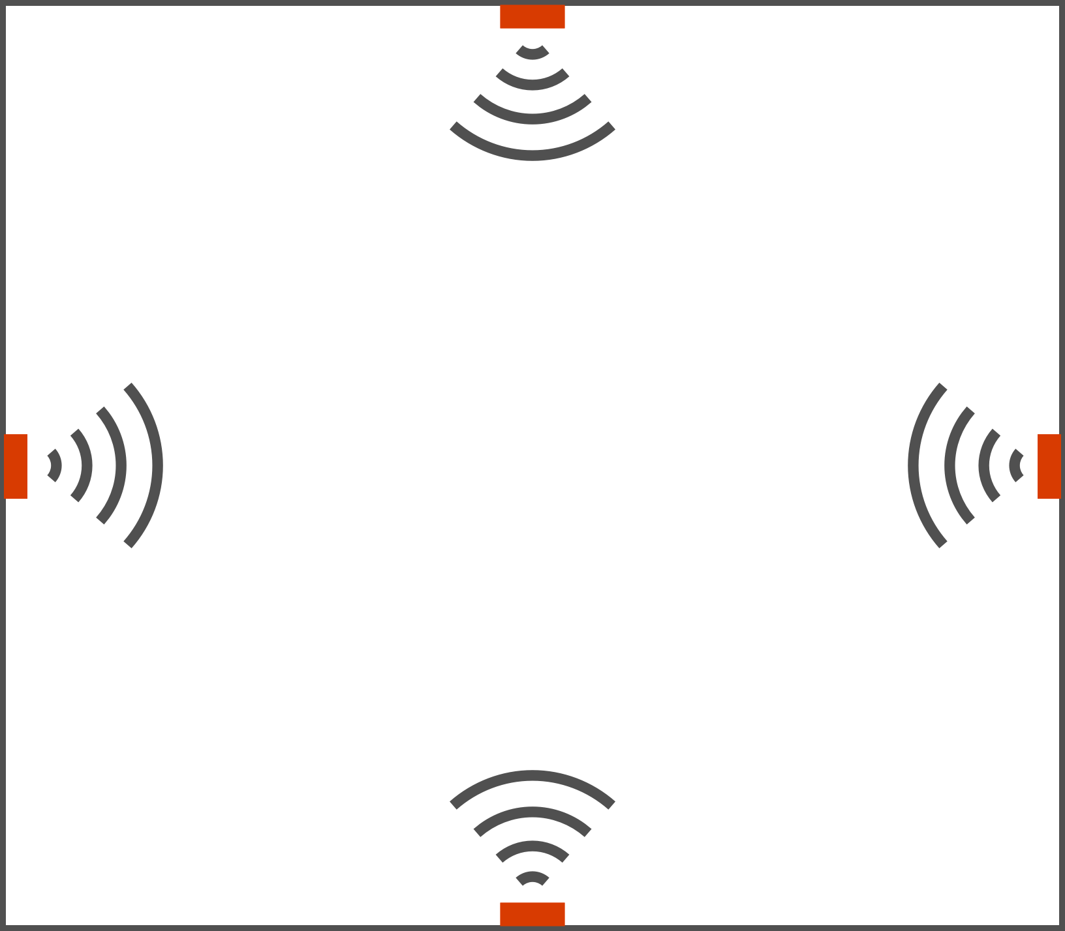
iBeacon region – multiple iBeacons with the same Id

Slide 14
When your device enters or leaves an iBeacon region it can wake your app up (and order your coffee…)

Slide 15
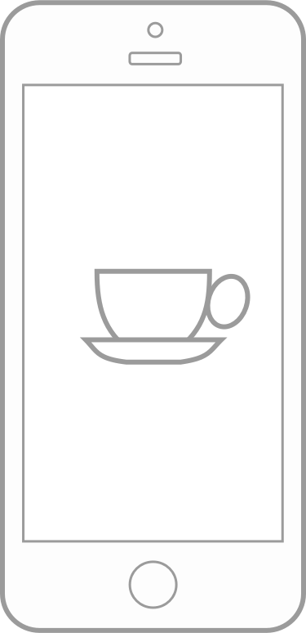
iOS wakes your app up!
Device moves into the range of an iBeacon
Once registered your app doesn’t need to be running
Your app is installed and monitors an iBeacon region

Slide 16
Demo – creating a context aware Xamarin.iOS app

Slide 17
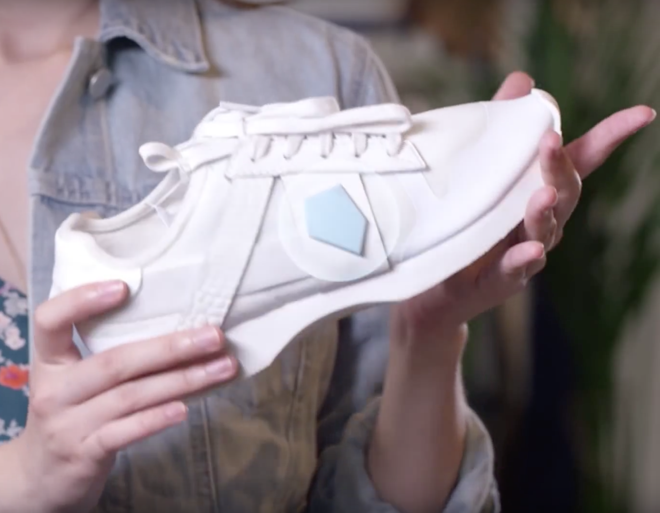
iBeacons can transmit all the time or as required

Slide 18
With the new iOS10 notifications API an iBeacon can trigger a notification

Slide 19
iOS 10 notifications
var region = new CLBeaconRegion(new NSUuid(ProximityUUID),
"MyRegion") region.NotifyOnExit = true; region.NotifyOnEntry = true;
var trigger = UNLocationNotificationTrigger
.CreateTrigger(region, false);
var request = UNNotificationRequest
.FromIdentifier(id, myContent, trigger); UNUserNotificationCenter.Current
.AddNotificationRequest(request, err => { });

Slide 20
Indoor location aware apps

Slide 21
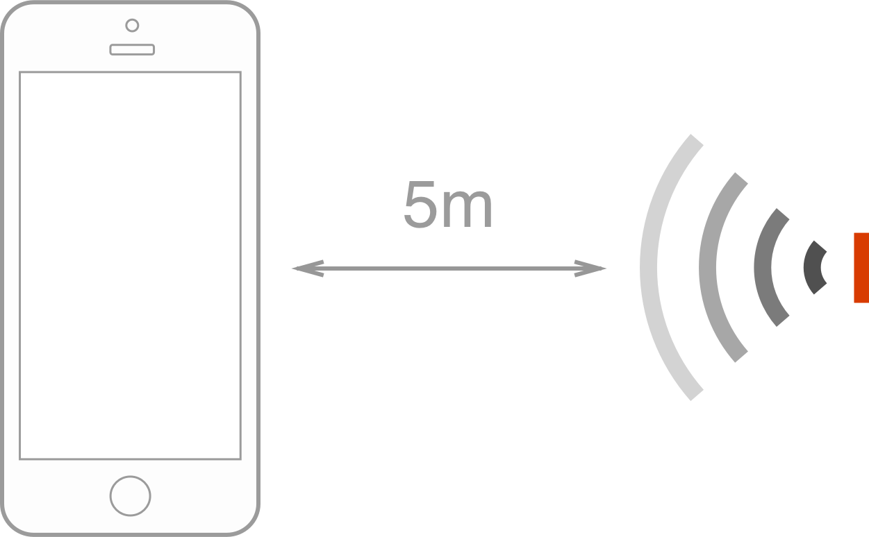
When your app is awake it can get signal strength readings and use these to get rough distances

Slide 22
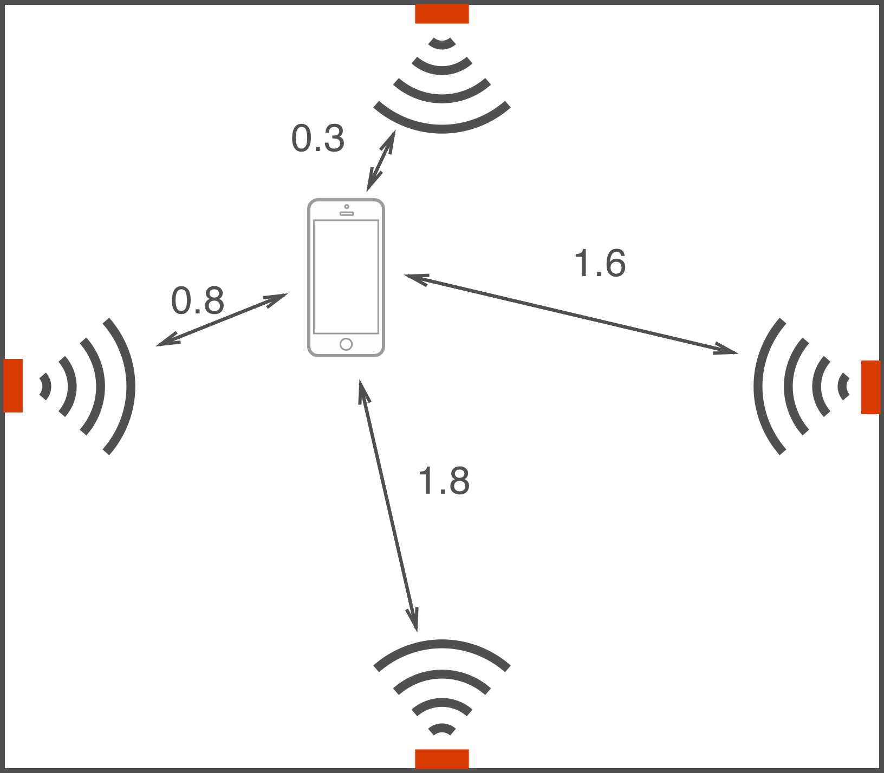
Getting the distance to multiple iBeacons can provide indoor location (where to bring the coffee to!)

Slide 23
Demo – adding location awareness

Slide 24
What about Android?

Slide 25
Background service running a BLE scan – or use vendor SDK
The Android robot is reproduced or modified from work created and shared by Google and used according to terms described in the Creative Commons 3.0 Attribution License.

Slide 26
Windows?

Slide 27
Background service running a BLE scan. No vendor SDKs currently available

Slide 28
Bringing it all together

Slide 30
By User 앤드류 on Flickr [CC BY 2.0], via Wikimedia Commons

Slide 31
What can go wrong?

Slide 32
Bluetooth has to be turned on

Slide 33
Location permissions must be accepted and not revoked

Slide 34
Power - batteries go flat, USB needs lots of sockets

Slide 35
Signals get blocked

Slide 36
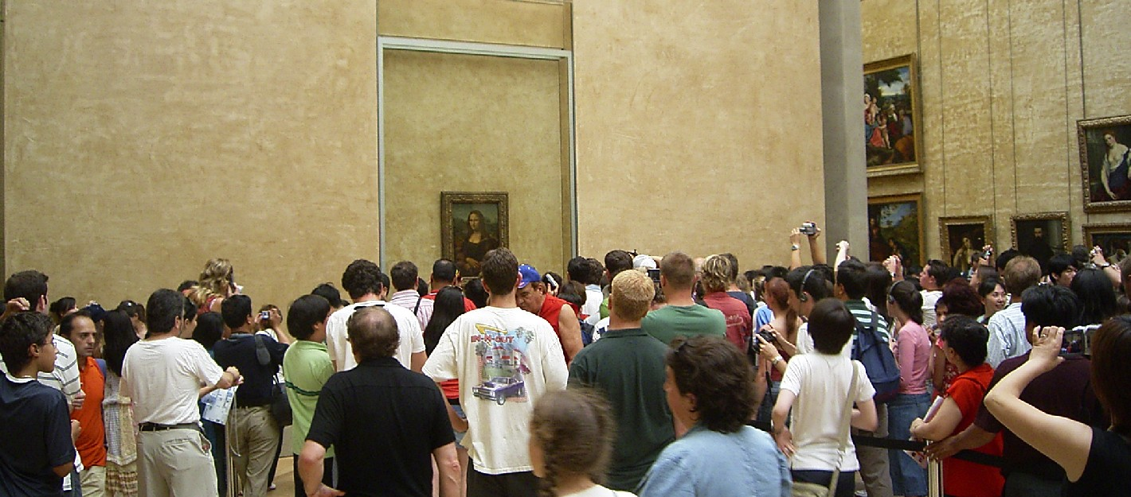
By Werner Willmann (Own work) [GFDL, CC-BY-SA-3.0 or CC BY 2.5], via Wikimedia Commons

Slide 37
Signals don’t get blocked

Slide 38
iOS limits you to 20 regions, iBeacon and GPS

Slide 39
ID is publicly broadcast and anyone can use any ID

Slide 40
Where to get iBeacons?

Slide 41
Xamarin Component available!

Slide 42
iBeacons allow you to create context aware and indoor location aware mobile apps

