Slide 1

Microsoft Ignite NZ
25-28 October 2016
SKYCITY, Auckland

Slide 2
Implementing Azure Site Recovery for on premises to Azure DR
M322
Daniel Bowbyes

Slide 3


A little about me
Daniel.Bowbyes@Datacom.co.nz
Innovation Lead at Datacom
@DBowbyes
http://Blog.Bowbyes.co.nz
http://www.meetup.com/Wellington-Windows-Infrastructure-User-Group/

Slide 4

Azure
Site Recovery

Slide 5


DR Instructions

Slide 6
Azure Site Recovery
Protect your applications
Azure
Replication of Hyper-V, VMware, and physical to Azure
Orchestrate the recovery of your apps for simplified disaster recovery
Achieve zero impact disaster recovery drills
Minimise app errors and data loss with application consistent recovery points

Slide 7

ASR to Azure
On-premises to Microsoft Azure protection with Azure Site Recovery
Microsoft Azure
Site Recovery
Microsoft Azure
Site Recovery
Microsoft Azure
Site Recovery
Orchestration
and replication
Orchestration
and replication
Orchestration
and replication
ASR Scout
New!
Enterprise & HSP primary site
SMB & branch
primary site
Enterprise, SMB & HSP primary site
Windows Server
Windows Server
VMware/Physical
Support for heterogeneous environments

Slide 8
ASR Site to Site
On-premises to on-premises protection with Azure Site Recovery
Microsoft Azure
Site Recovery
Microsoft Azure
Site Recovery
Communication channel
Download ASR Scout
ASR Scout
ASR Scout
Replication and orchestration channel
Replication channel:
Hyper-V Replica or SAN replication
Windows Server
Primary
site
Recovery site
Windows Server
VMware/Physical
Primary site
Recovery site
VMware
Key features include:
Automated VM protection and replication
Remote health monitoring
Customizable recovery plans
Integration with available investments
No-impact recovery plan testing
Orchestrated recovery of tiered applications
Support for heterogeneous environments

Slide 9
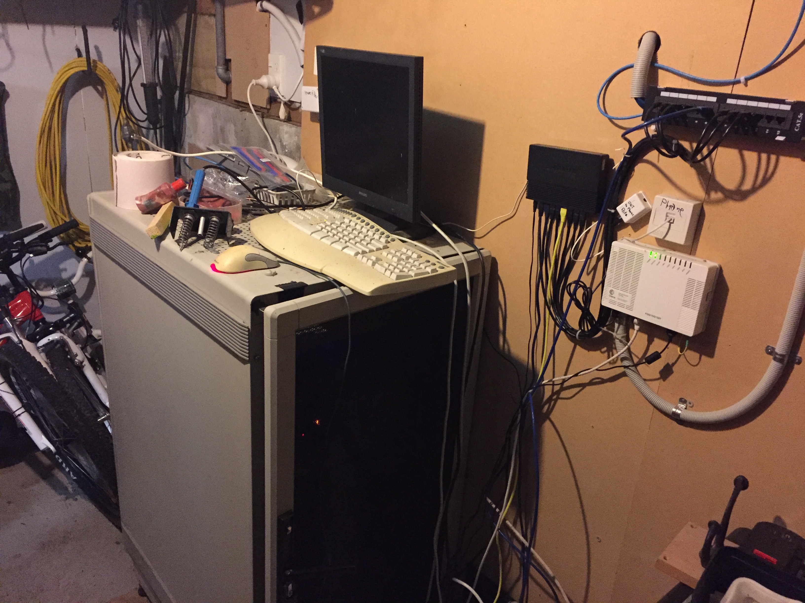
Bowbyes
Branch Office
Garage
Branch Office

Slide 10






ASR to Azure - Components
Azure
Datacenter
Master Target
Configuration
Server
Azure Automation Account
Virtual Network
On premises software
Azure VM agents
Recovery Services Vault
Storage Account

Slide 11
ASR Requirements

Slide 12
ASR Hypervisor- Requirements
Datacenter
VMware – ESX/ESXi version 5.1, 5.5 & 6.0
Hyper-V – Windows Server 2012 R2
VMM – System Center 2012 R2

Slide 13
ASR Guest VM - Requirements
Guest VM’s must be 64bit
Datacenter
Windows Server 2008 R2 SP1 +
RHEL 6.7, 7.1, 7.2
CentOS 6.5 – 7.2
Oracle Enterprise Linux – 6.4 – 6.5*
SUSE Linux Enterprise Server 11 SP3
*Red Hat compatible kernel or Unbreakable Enterprise Kernel Release 3 (UEK3)

Slide 14
Azure VM - Requirements
Datacenter
Maximum Disk Number – 64
Maximum Disk Size – 1024 GB
Application software running on guest should be confirmed as supported running in Azure.
https://support.microsoft.com/en-us/kb/2721672
Linux Guests must have DHCP assigned addresses and EXT3, EXT4, ReiserFS, XFS file systems.

Slide 15
ASR Capacity - Requirements
Azure
Datacenter
The number of VM’s, their size and average daily data change rate all impact network capacity and local storage requirements.

Slide 16
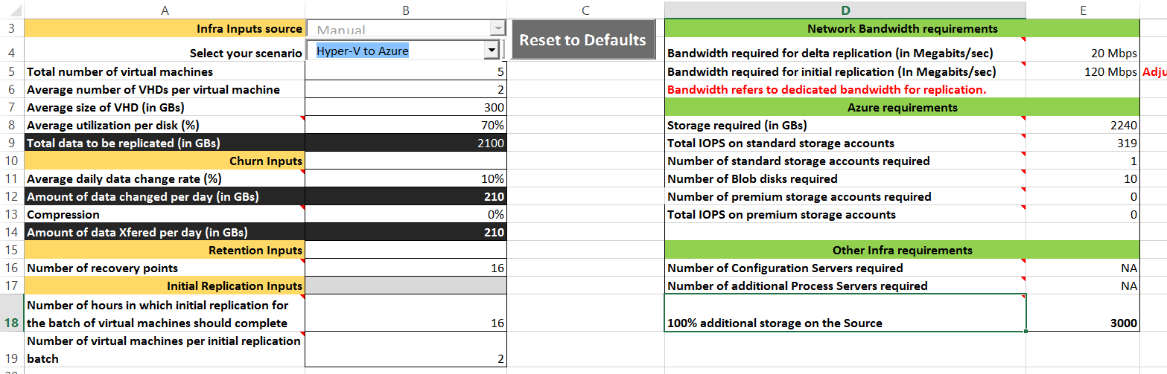
ASR Capacity Planner

Slide 17
Useful links
http://aka.ms/asr-capacity-planner-excel
https://labs.vmware.com/flings/vsphere-replication-capacity-planning-appliance
https://azure.microsoft.com/en-us/documentation/articles/site-recovery-capacity-planning-for-hyper-v-replication/
https://support.microsoft.com/en-us/kb/2721672

Slide 18



Azure Connectivity
Azure
Datacenter

Slide 19
Useful links
https://azure.microsoft.com/en-us/documentation/articles/site-recovery-best-practices/
https://azure.microsoft.com/en-us/documentation/articles/site-recovery-hyper-v-site-to-azure/
https://azure.microsoft.com/en-us/documentation/articles/site-recovery-vmware-to-azure-classic/#before-you-start-deployment

Slide 20
Check in on Planned Failover

Slide 21
Setting up ASR

Slide 22
ASR – Setup
Azure
Datacenter
Azure Site Recovery

Slide 23
Setting up ASR and checking the VM we failed over

Slide 24
ASR Failover in Detail

Slide 25
Step 1 – Initiating Failover

Slide 26
ASR Failover – Test Failover
Azure
Datacenter
Azure Site Recovery

Slide 27
ASR Failover – Planned Failover
Azure
Datacenter
Azure Site Recovery

Slide 28
ASR Failover – Unplanned Failover
Azure
Datacenter
Azure Site Recovery

Slide 29
Step 2 – Complete Failover

Slide 30
ASR Failover – Complete Failover
Azure
Datacenter
Azure Site Recovery

Slide 31
Complete Planned Failover

Slide 32
Step 4 – Commit Failback

Slide 33
ASR Failover – Commit Failback
Azure
Datacenter
Azure Site Recovery

Slide 34
Step 5 – Reverse Replication

Slide 35
ASR Failover – Reverse Replication
Azure
Datacenter
Azure Site Recovery

Slide 36
ASR – Recovery Plans

Slide 37
ASR– Recovery Plans
Azure
Datacenter
Azure Site Recovery

Slide 38
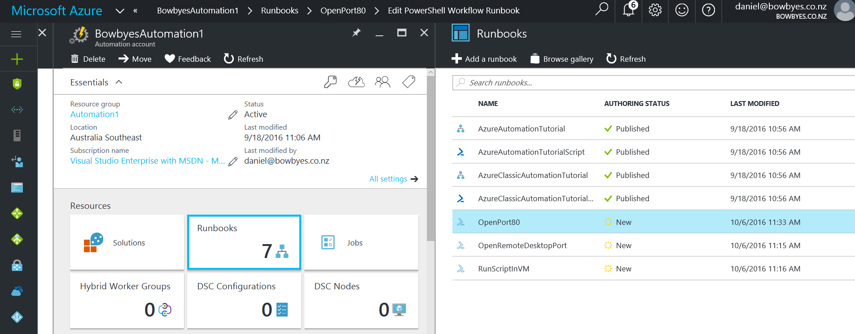
Azure Automation

Slide 39
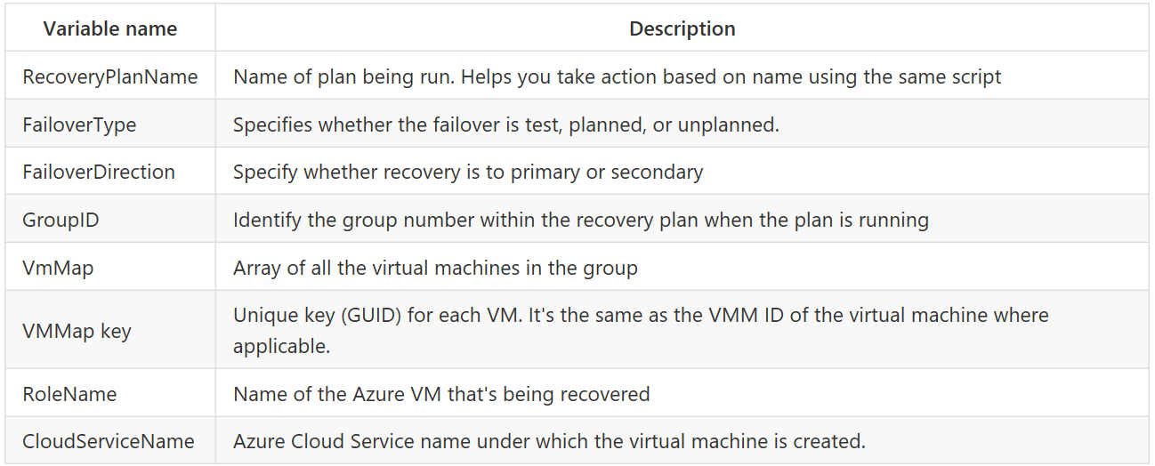
ASR– Azure Automation Context
https://github.com/Azure/azure-content/blob/master/articles/site-recovery/site-recovery-runbook-automation.md

Slide 40
ASR Recovery Plans

Slide 41
Useful links
https://azure.microsoft.com/en-us/documentation/articles/site-recovery-monitoring-and-troubleshooting/#kb-articles
https://azure.microsoft.com/en-us/documentation/articles/site-recovery-faq/

Slide 42
ASR – Wrap up
Azure
Datacenter
Azure Site Recovery

Slide 43
Azure Site Recovery makes
DR easy and affordable
https://blog.bowbyes.co.nz/presentations/asr/

