Slide 1

Microsoft Ignite NZ
25-28 October 2016
SKYCITY, Auckland

Slide 2
Upgrade Planning for SharePoint 2016 and Hybrid Considerations
[M313]
Chandima Kulathilake
hello@chandima.net

Slide 3

Introduction
Chandima (aka Chan) Kulathilake
  www.chandima.net > hello@Chandima.net
Many years of SharePoint experience
  Infrastructure
  Architecture
  Post Deployment Reviews
Lead Consultant @ Theta
  www.theta.co.nz
  Co Founder of NZ SharePoint User Groups
Runner @ runwellington.com

Slide 4
Agenda
What’s ‘New’ for SharePoint 2016 on premises
  What User’s will experience
  Deployment Architecture
Upgrade Planning
  Upgrading or Migrating
Hybrid Options
Q & A

Slide 5
What’s new for SharePoint 2016

Slide 6


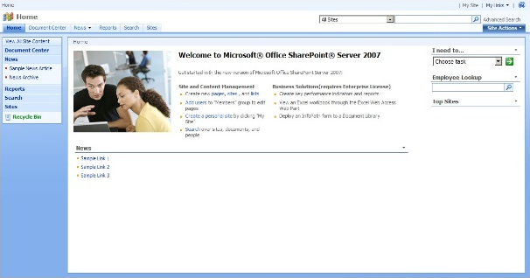
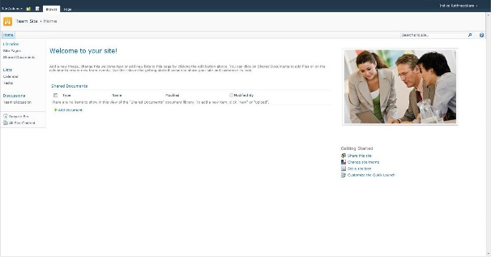
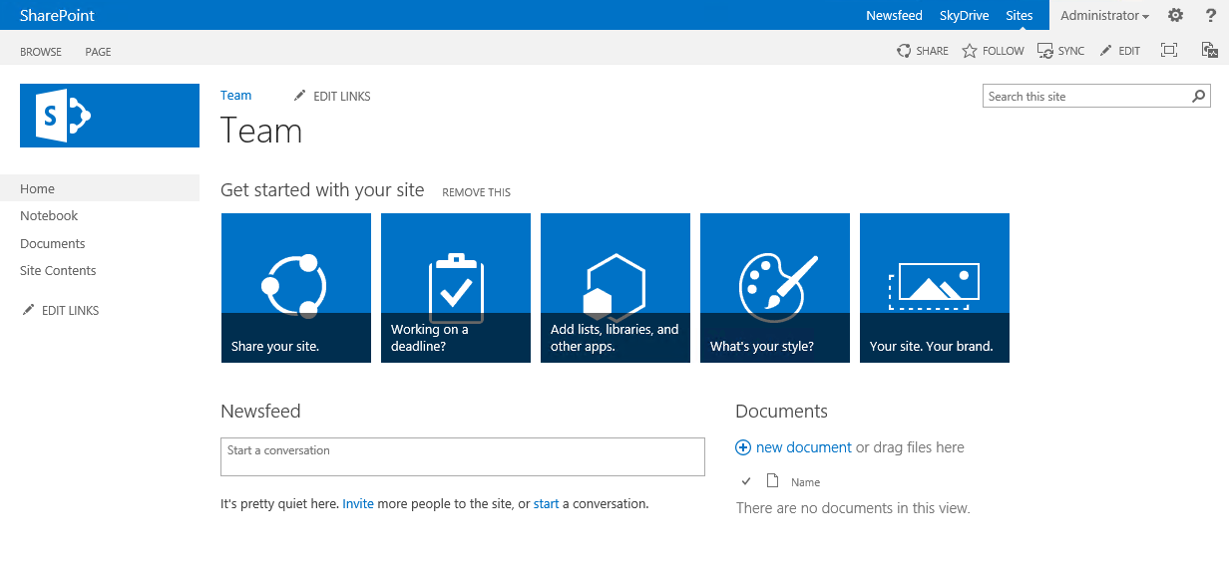
The Road to 2016
SharePoint
2007
BPOS
SharePoint
2010
Office365
SharePoint
2013
Office365

Slide 7
What’s new – from a user’s point of view
App Launcher – Common across both on premises and cloud
OneDrive for Business updates – users ‘can’ go to SharePoint online
Sites you follow – Accessed via ‘Sites’ tab in App Launcher
Keyboard shortcuts to do common tasks (ex: Alt + N = New Document)
Site creation – Is now faster than compared to 2013
Open Document Format (ODF) support
Increased File Size for uploads – 2GB is now 10GB (but really..?)
See more @ http://bit.ly/2933Tio

Slide 8
What’s new
Compliance Centre – great for Information management
Mobile Collaboration Experience across any device
Durable Links – requires Office Online Server (aka Office Web Apps)
My Sites are now under a new brand "OneDrive for Business“
Project Server is now built in
See more @ http://bit.ly/2933Tio

Slide 9
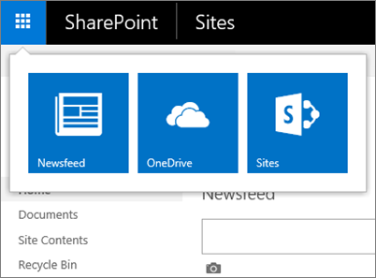
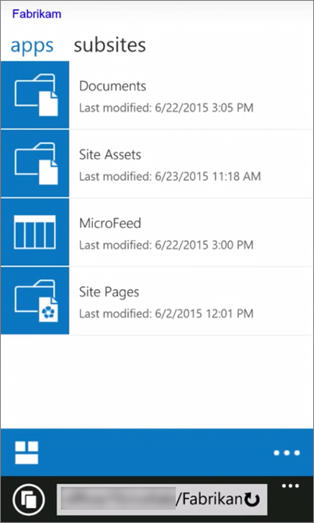
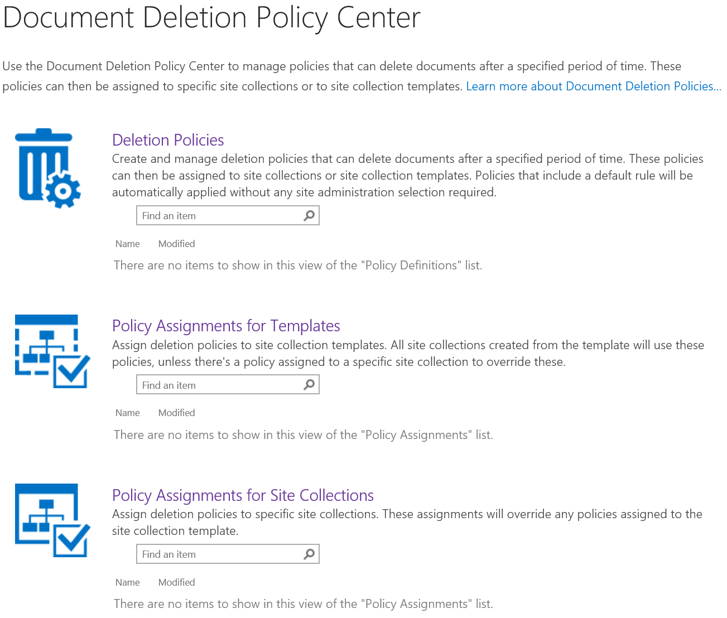
App Launcher
Mobile Device views
Compliance Center Template

Slide 10
What’s new – but ‘dead’
No more SharePoint Foundation
No more SharePoint Destroyer (I mean Designer)
Workflows will ‘still’ work in 2010/2013 mode
  Workflow Manager farm
No InfoPath but things will still (kind of) work
No ForeFront Identity Manager client (FIM)
  *new* Microsoft Identity Manager 2016
No Excel Services in SharePoint
  Now its part of Office Online Server

Slide 11
What’s new – Architect/Admin/Dev/Other
Ability to create SharePoint farms based on pre-defined server roles
  Forget what you know about SP2013
Each role maps to pre-defined services
  MinRole
Roles together include all services in a SharePoint farm
  Option to build a single-server farm still exists
Zero downtime patching (Not as easy as you’d expect)

Slide 12
What is ‘MinRole’?
Server roles to architect for scale – enter ‘MinRole’
Role | Description
Front end | For serving user requests – Low latency
Application | Service applications, services, and components that serve backend requests (such as background jobs or search crawl requests) belong on Application servers. These servers are optimized for high throughput
Distributed Cache* | Best isolated to own server(s) – however there are caveats
Search* | Based on requirements and recommended to be separated
Custom | For mix and match – BUT you really don’t want to
Single-Server Farm | Only meant for development requirements, not recommended for Production
* Wait for next couple of slides…

Slide 13
Why would you use MinRole?
No need to ‘tweak’ the services per server
All deployments follow the same rules & models
  Self diagnosing
Based on Office365 deployment learnings
Scalability – just add n servers to y roles

Slide 14
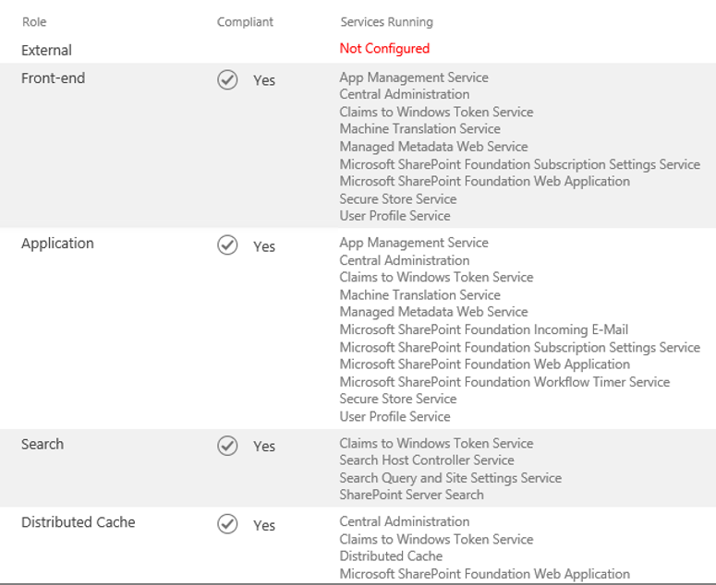
MinRole

Slide 15




The ‘supported’ starting point for ‘MinRole’
Scale by adding more instances
Front end
group
Application
group
WARNING!
To achieve ‘zero’ downtime patching you need to have redundancy
(ie – multiples of these at each group)
Read more: http://bit.ly/296169H
Distributed cache
group
Search
group

Slide 16
Requirements dictate your deployment
Requirement | Servers
MinRole | 4
High availability (some services need 3) | 5
Provider hosted apps (add in model) | 2
Workflow Manager farm | 3
Office Online Server (OOS) | 2
Data layer | 2
Grand total | 18
Web
Web
App
App
Cache
Cache
Cache
Search
Search
Workflow
Workflow
Workflow
OOS
OOS
Apps
Apps
Data
Data

Slide 17
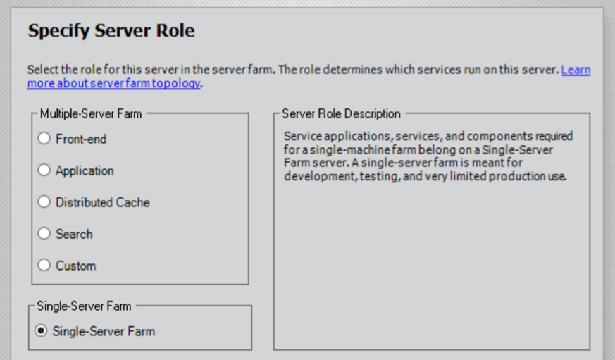
MinRole?
Yeah, Nah. Single is where it’s at…

Slide 18
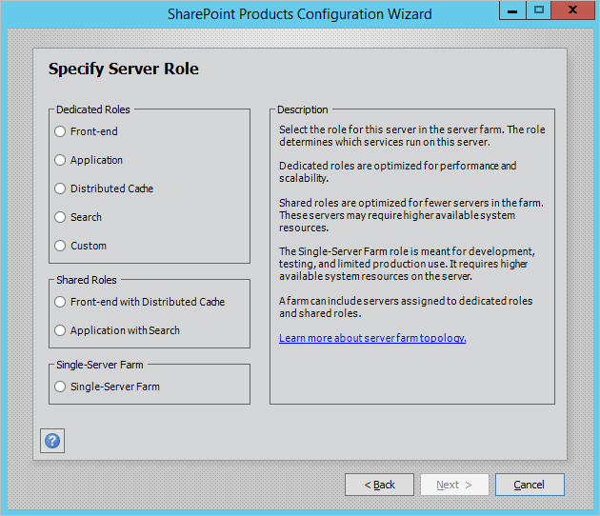
Shared Mode with Feature Pack 1
Logging of administrative actions performed in Central Administration and with Windows PowerShell.
Enhancements to MinRole to support small environments.
Plus other stuff
MinRole now looks a bit appealing ☺

Slide 19
Challenges with MinRole
Optimized for larger farms
  +10 servers sounds like overkill
Few bugs with role conversion
  Distributed Cache is the problematic one
Cannot combine roles on same server
Custom ‘custom’ roles are not supported
Yes – you can have
  Front end
  Custom type mix
  BUT Single-Server Farm role cannot co-exist with MinRole roles
  It is not ‘generally’ recommended
Learn more @ http://bit.ly/1IXQDVG

Slide 20
What is MinRole good for?
Best suited as a starting point
Gives the flexibility to change down the track
It is not a ‘Thing’ you see rather a logical segregation of services on server instances
  Read the FAQ – Understand your scenario before implementing
Capacity guidance updated for SharePoint 2016: http://bit.ly/sp16limits

Slide 21
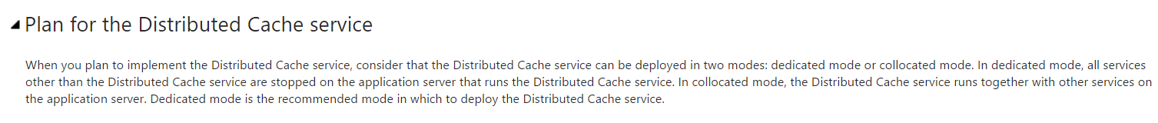
Distributed Cache
Dedicated vs. Collocated
  Microsoft recommendation for SP2013 on TechNet:
Distributed Cache is enabled (by default) only on ‘SingleServerFarmRole’ and ‘Cache’ roles
Licensing implications? – yes...
How many Distributed Cache hosts?
  You really need three – Yes 3!
Read more @ - http://bit.ly/29dmVDz

Slide 22
Why is Distributed Cache important
Login Token Cache
Activity Feed Cache
Activity Last Modified Time Cache
OneNote Throttling / “Bouncer Cache”
Access Cache
Search Query Web Part
Security Trimming Cache
App Access Token Cache
View State Cache
Default Cache
Read more @ - http://bit.ly/29dmVDz

Slide 23
Why is this complicated?
Holds data ‘in memory’
Have to configure it via PowerShell after initial deployment to assign correct RAM percentage
Most troublesome and corruption prone
In SharePoint 2013, the Distributed Cache size is set to half of ten percent of the total RAM on the server.
This means that on a server with 8Gb RAM, the Cache Size (the allocation for data storage) is 410Mb. Another 410Mb is used for the overhead of running the Cache.
www.harbar.net
Read more @ - http://bit.ly/29dmVDz

Slide 24
Ideal topology
It depends…
  On what your organization wants to achieve
  Be careful of guidance with regards to “Best Practice Topology”
  There are no “web servers” and “application servers”
    Server roles breakdown what services run on each role
      Front end
      Application
      Distributed cache (on its own or collocated with Front end*)
      Search (on its own or collocated with Application*)
      Workflow
      Office Online Server (A separate product)
      ‘Custom’ – use at your own risk
      Single server – for development & proof of concepts
  *Only with Feature Pack 1 under Software Assurance

Slide 25
Key Points: If you follow a MinRole deployment
You will need 4 server roles (as a starting point)
  Front end
  Application
  Distributed cache
  Search
With availability factored in
  Front end x 2
  Application x 2
  Distributed cache x 3 (called a quorum)
  Search x 2

Slide 26
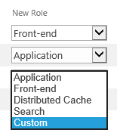
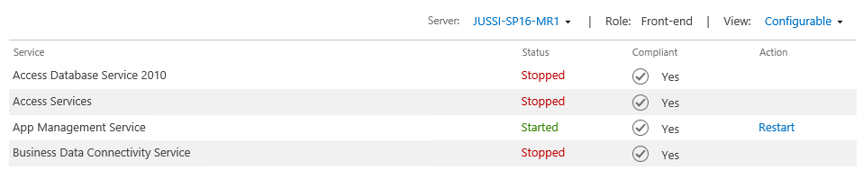
Can I change later?
Yes 2 options
  Via PowerShell
  Set-SPServer –Role { FrontEnd | Application | SingleServer | SingleServerFarm | DistributedCache | Search | Custom }
  Via Central Admin

Slide 27
Agenda
What’s ‘New’ for SharePoint 2016 on premises
  What User’s will experience
  Deployment Architecture
Upgrade Planning
  Upgrading or Migrating (cover a bit on 2010, 2013 as well)
Hybrid Options
Q & A

Slide 28
Upgrade Planning

Slide 29
Upgrading from 2007 to 2016
Hopefully no one is in 2001
Upgrade 2007 (SP2 or later) to 2010
Upgrade 2010 (RTM or later) to 2013
Upgrade 2013 (RTM or later) to 2016
Or use a migration tool

Slide 30
Going from SP2013 to SP2016
It’s an Upgrade for end users
  Because they see changes in functionality
Technology point of view it’s a
  Migration (of content) &
  Build new (Software/Servers)

Slide 31
Overall Process
Plan & Audit Existing
Run Tests
(Pre-Upgrade)
Run Upgrade
Architect, Build & Test
Test
Commit
Decommission

Slide 32
Plan and Audit
Know what you know well, also know what you don’t know
  Site collections
  Managed paths
  Custom solutions
  Web applications vs Host named site collections (HNSC)

Slide 33
Plan & Audit
Your overall plan for the upgrade
Minimum requirements to go to SharePoint 2016
  SP2013 with Service Pack 1 on your existing 2013 farm
Business application priority
Audit existing 2013 sites and applications
  Must be on SP 2013 SP1 Mode
  Site compatibility must be ‘15’ if upgraded from SP2010 to 2013
  Get-SPSite -Limit All | ? { $_.CompatibilityLevel -eq 14 }
  Get-SPSite -ContentDatabase <database name> -Limit All | ? { $_.CompatibilityLevel -eq 14 }

Slide 34
Tools of the trade
SPDocKit – Document and Compare farms – www.spdockit.com
  https://www.spdockit.com/blog/spdockits-emergency-kit-sharepoint-2016-upgrade-process/ <- Money well spent!
PowerShell plus manual tinkering – is a bit painful

Slide 35
Post Audit Tasks
Server Administrators – prepare servers and plan SP2016 deployment architecture
Developers – Re-evaluate custom code solutions and files for SP2016 compatibility
Project Managers – Review upgrade project plans and estimates – user training etc, change management, comms
  Identify business priorities early
  Don’t try a ‘Big Bang’ approach
  Gradual or parallel always works best

Slide 36
Build your 2016 platform
Requires a ‘re-think’ of your Architecture
  Infrastructure requirements
  Service model and servers
  Workload capacity planning
  Availability and redundancy

Slide 37
Key considerations
Hardware
  You will need more server resources
    Memory – 12-16GB
    CPU – 4cores or more
    Disk – As per deployment profile based on services and capacity planning
Software
  Application Servers
    Base OS Windows Server 2012 R2
  Data - Consider going with SQL Server 2016
    *2014 is recommended – will not work with SQL 2008

Slide 38
Upgrade vs Migrate
Upgrade your platform
  SP2010 > 2013 > 2016 (Software, Infrastructure)
Migrate your content
  Move existing content to a new SharePoint 2016 platform
  Use a third party tool or use content database attach
Custom Solutions must (should) be rebuilt to ensure compatibility
  The ‘Add-in’ model (Provider Hosted Apps)
  Vesa ‘Vesku’ Juvonen - https://blogs.msdn.microsoft.com/vesku/2015/12/08/architecture-models-for-sharepoint-provider-hosted-add-ins-in-on-premises/
  Office Dev PnP - https://aka.ms/OfficeDevPnP

Slide 39
Plan to Migrate content
Chance to re-organize
  Classify
  Archive
  Retain
  Delete

Slide 40
The Upgrade Process

Slide 41
Supported Databases
All content databases
    My Sites are now called OneDrive for Business
    More in the Hybrid section on ‘My Sites aka One Drive for Business’
Service Apps
  If you must upgrade them or bring them over
    BCS
    Managed Metadata
    PerformancePoint
    Secure store (need to know passphrase)
    User Profile databases
    Search administration (no index or property databases)

Slide 42
My Sites and OneDrive for Business
Should you upgrade them at all?
Better going into the cloud?
    RTM for 2016, Service Pack 1 for 2013
    Office 365 licenses
    Leads into a Hybrid deployment
Not migrated automatically (if doing hybrid)
    User can do it
    Use a third party tool

Slide 43
No more preupgradecheck
With PowerShell use:
  Test-SPContentDatabase –name Intranet_Content_DB -webapplication http://upgrade.sp.com
Works the same in 2010, 2013, and 2016

Slide 44
Quick Notes
Add managed paths manually before attaching databases
Always upgrade database with root site collection first
Try to use same URLs
No more Visual Upgrade
  14 = SharePoint 2010
  15 = SharePoint 2013
  16 = SharePoint 2016

Slide 45
Office Web Apps/Office Online Server
You need to use them in 2013 and 2016
They must be on their own server with nothing else
Office Web Apps require Claims authentication
Requires a specific Office License (volume license)
Office Online Server is required for Excel Services in 2016

Slide 46
Authentication
Claims authentication
Classic is still there but don’t use it
Recommended to upgrade to 2016 (or 2013) and then convert to claims
Required for Hybrid scenarios

Slide 47
Create and convert a Classic Web Application
New-SPWebApplication -Name Upgrade -ApplicationPool "SharePoint App Pool" -AuthenticationMethod NTLM -Port 80 -URL http://upgrade.sp.com
Get-SPWebApplication | Select URL, useclaimsauthentication
Convert-SPWebApplication -Identity "http://upgrade.sp.com" -To Claims –RetainPermissions [-Force]

Slide 48
Features and Solutions
Good time to look at the App Model, Add-ins, SharePoint Framework
  An Introduction to the SharePoint Framework Development Model [M200] – Gavin Barron
2010 and 2013 code mostly will work ;-/
Hopefully you did everything as WSPs
Export solutions from SharePoint.
  http://bit.ly/2embYW3

Slide 49
Upgrade a database
Test-SPContentDatabase –Name WSS_Content_Upgrade –WebApplication http://upgrade.sp.com
Mount-SPContentDatabase –Name WSS_Content_Upgrade –WebApplication http://upgrade.sp.com

Slide 50
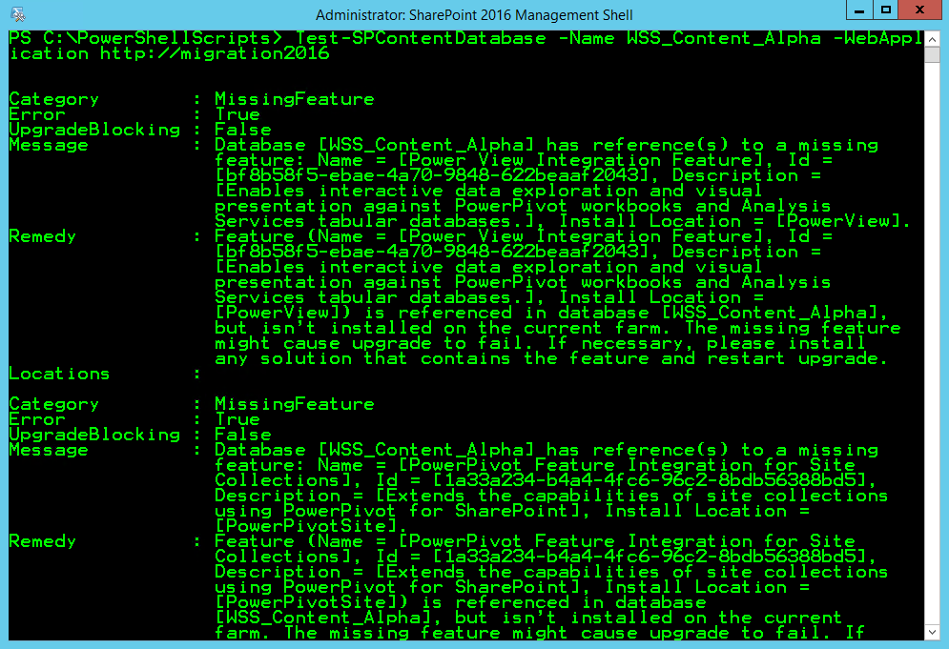
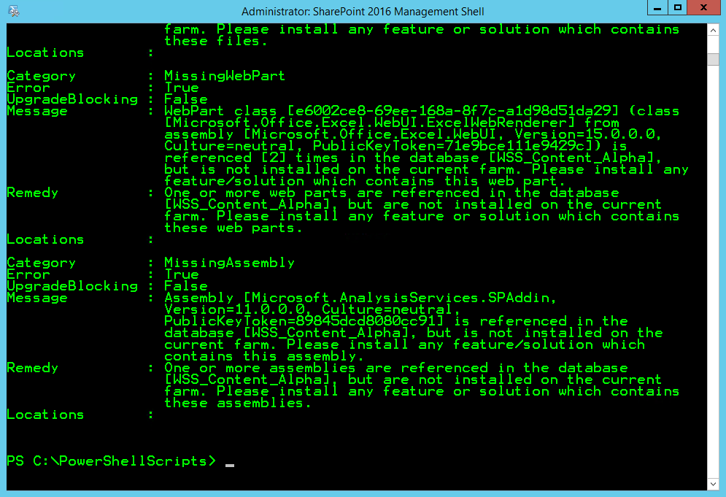
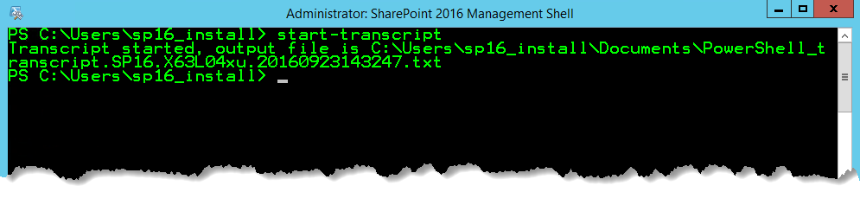
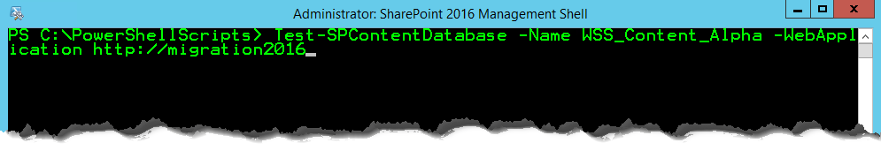
Testing…

Slide 51
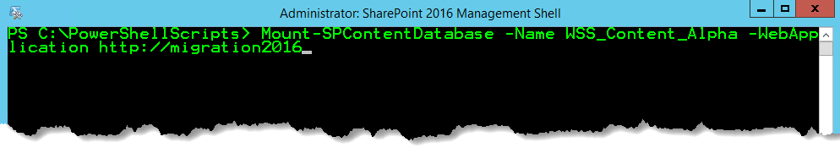
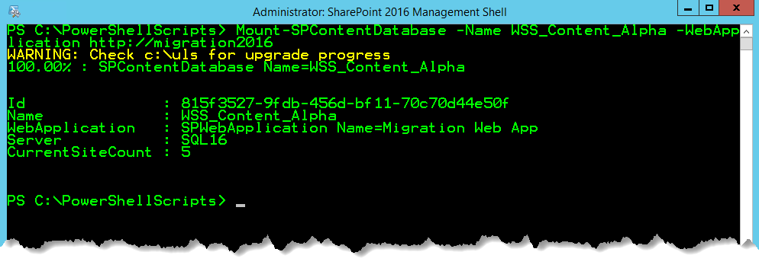
Upgrading…

Slide 52
Recap - Bring your Databases
Place Content Databases into ‘Read Only’ mode
Backup Content and Service Application Databases
Restore Content and Service Application Databases
Take Restored Databases out of ‘Read Only’ Mode
PowerShell > Test-SPContentDatabase –Name SP_Content –WebApplication http://upgrade.sp.com
Fix all errors, missing customizations, orphans, etc.
PowerShell > Mount-SPContentDatabase –Name SP_Content –WebApplication http://upgrade.sp.com
PowerShell > Upgrade-SPContentDatabase to resume failed upgrades
Test and Validate > Workflows, forms, solutions, apps
Repeat

Slide 53
Troubleshooting
One upgrade log file per upgrade
One upgrade error log file per upgrade
..\15\logs (\16\logs)
Still mount multiple databases at same time
Look and feel are upgraded automatically in SharePoint 2016

Slide 54
Upgrade Process
Do Service Apps first
Make Read-Only
Detach from old farm
  Don’t delete
Backup in SQL
Restore to new SQL instance
Fix permissions
Make Writeable
Attach

Slide 55
Patching Build to Build
Many Improvements in 2016
Smaller Patches
Feature Packs
Zero Downtime Patching for 2016
  TechNet video of ZDP (Thanks to Bob Fox and team from MSFT)

Slide 56
Hybrid
Deploy SharePoint on-premises with SharePoint online/Office365
  http://hybrid.office.com/downloads.html
Use Azure as a DR site for SharePoint on-premises

Slide 57
Before you do Hybrid
Azure Active Directory Synchronization
  Identity is key!
  For password syncs etc. must be setup
  https://azure.microsoft.com/en-us/documentation/articles/active-directory-aadconnect/
  Service applications must be setup correctly on-premises

Slide 58
Hybrid deployments
Provides a practical starting points
  On Premises and Cloud based team sites
  Cloud based Search application
    Search on premises content and SharePoint online content and a single view result set
    https://blogs.msdn.microsoft.com/spses/2015/09/15/cloud-hybrid-search-service-application/
Go see: Search - Going Hybrid [M351] on Thu 27 Oct, 9:00 AM Elliott Room (Crowne Plaza)
http://hybrid.office.com/downloads.html

Slide 59
Resource Links
Slides and Resource Links> http://www.chandima.net/ - will be published shortly!
Developers
  SharePoint Framework - https://docs.com/OfficeDevPnP/9609/pnp-web-cast-preparing-for-sharepoint-framework
  https://blogs.msdn.microsoft.com/vesku/
Architects/IT Pros/Admins
  Capacity Planning: http://bit.ly/sp16limits
  MinRole : http://cbt.gg/1T3JNXw

Slide 60

Thanks
Questions
hello@chandima.net
Twitter @chandimak
Image from : www.runwellington.com

