Slide 1
Microsoft Ignite NZ
25-28 October 2016
SKYCITY, Auckland

Slide 2
Voice Migrations keeping you up at night?
M247
Keith Copeland

Slide 3
The Engagement

Slide 4
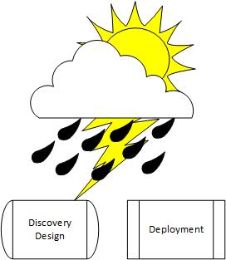
The Engagement

Slide 5
Trust Your Team

Slide 6
Trust Your Team
Through Discovery
Through Communications
With the Right Tools
With the Right Skillsets

Slide 7
First Challenges

Slide 8
Partner Led Engagement Building the team…

Slide 9
Partner Led Engagement High Staff Turnover Who took notes??

Slide 10
Partner Led Engagement High Staff Turnover Unclear Requirements You want what when??

Slide 11
Discovery and Design

Slide 12
Like For Like Deployment?

Slide 13
Like For Like Deployment? Existing Lync 2013 IM&P

Slide 14
Like For Like Deployment? Existing Lync 2013 IM&P Aging Cisco Infrastructure ISDN Lines In Several Regions Analogue Devices Everywhere

Slide 15
Coexistence… Bridging the Gap

Slide 16
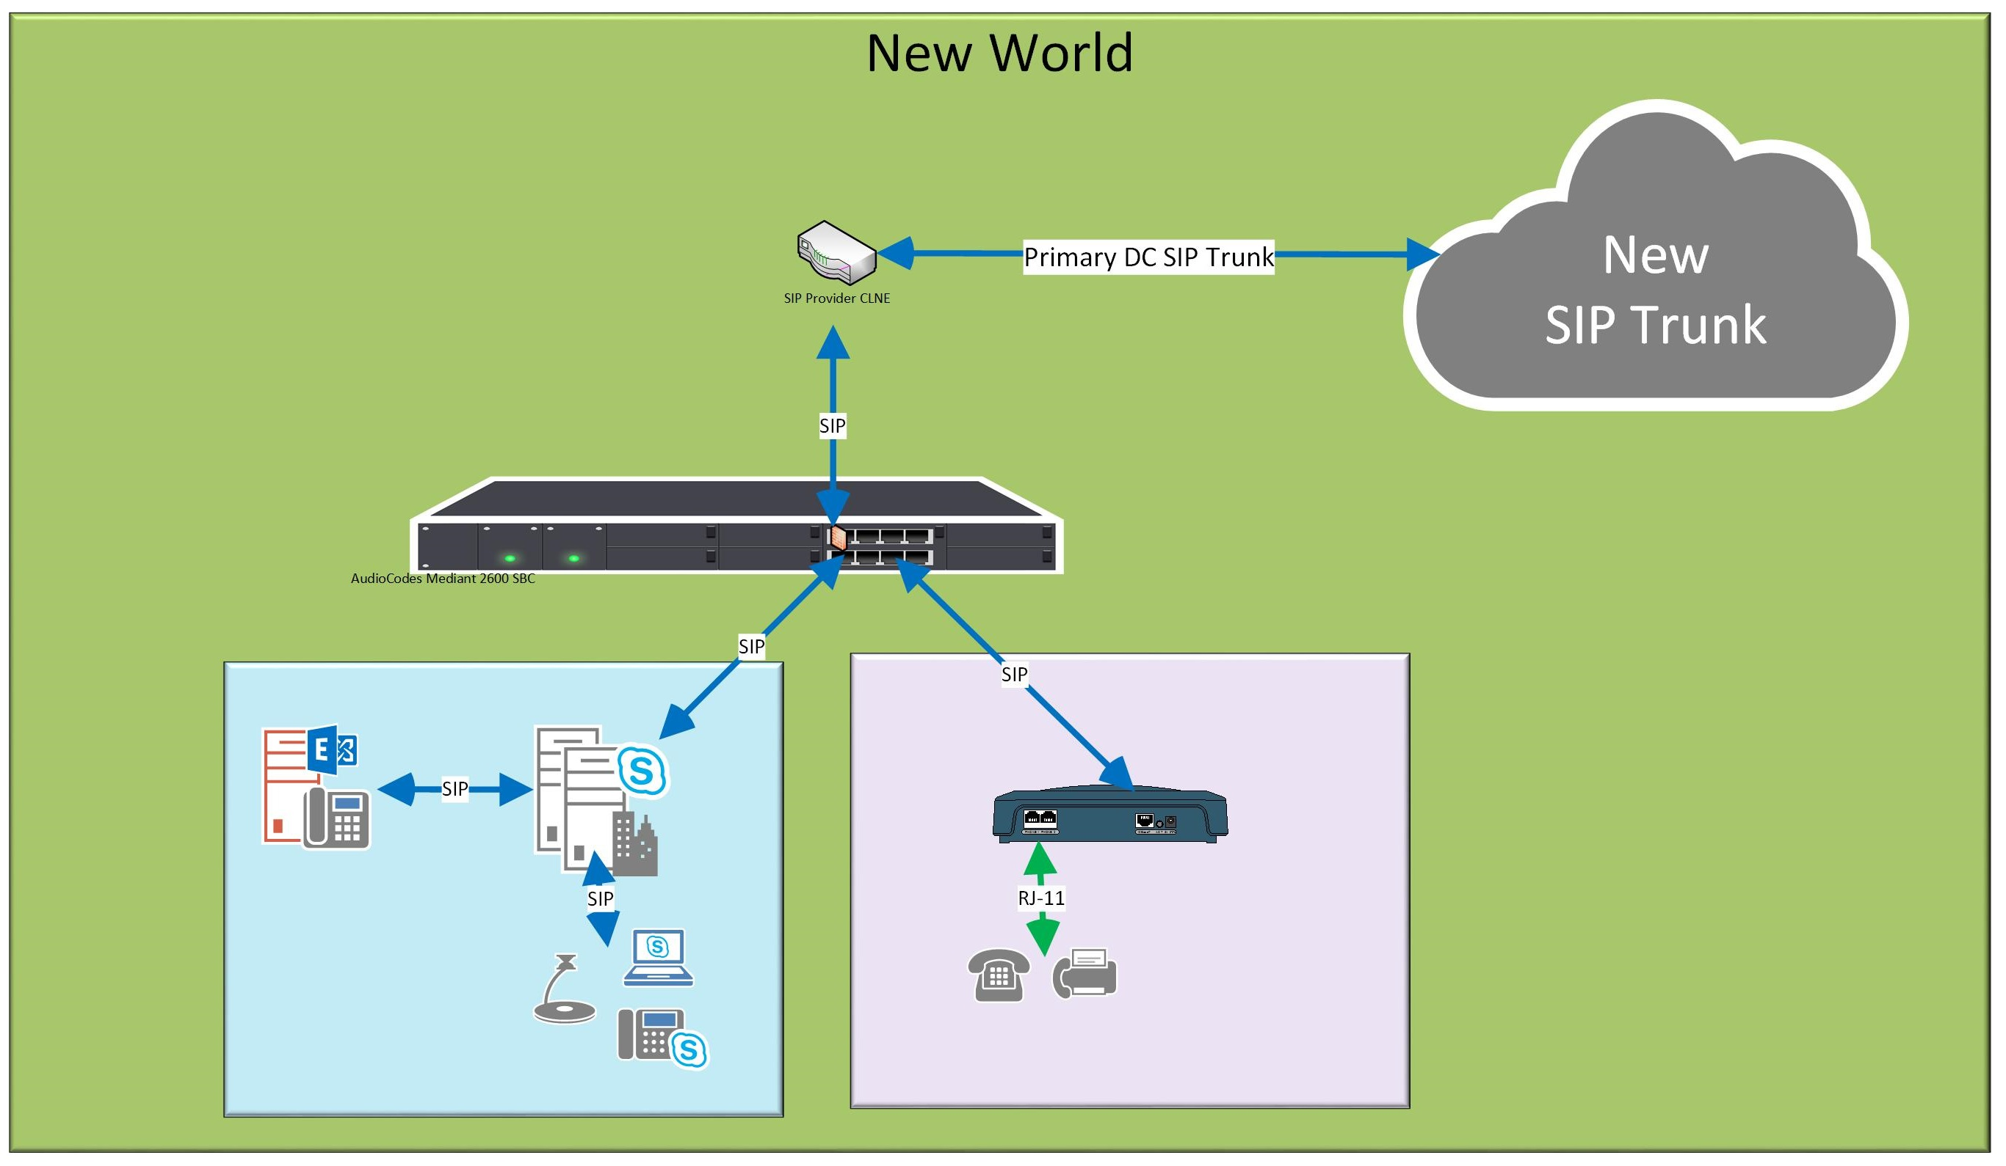
Coexistence?

Slide 17
Coexistence!

Slide 18
Deployment

Slide 19
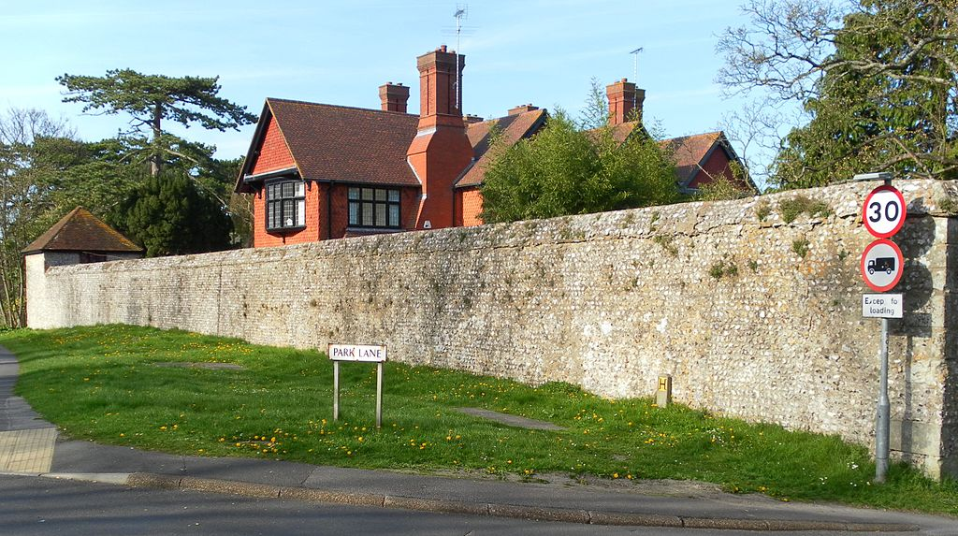
Deployment Phase
Changing Requirements
Scope Creep

Slide 20
Deployment Phase
Partner of a Partner
Microsoft Native Integration
Security Team Engagement
Trust your Partner

Slide 21
Transition and Migration

Slide 22
Transition and Migration
Reduce, Reuse, Recycle

Slide 23
Wins

Slide 24
Successful Project
2,500 Users Migrated onto EV
35 Sites Migrated
Federation with multiple Agencies
Contact Centre Integration
Re-Use of Analogue Devices
Cisco has been removed

Slide 25
Trust your team

Slide 26
Q&A keith.copeland@ucfx.com

