Slide 1
Microsoft Ignite NZ
25-28 October 2016
SKYCITY, Auckland

Slide 2
IoT without the hassle of hardware
M240
Vikram Kumar

Slide 3
IoT is primarily about data and customer value

Slide 4
Hardware, firmware, connectivity are typically a small fraction of selling price
Domain Expertise
Data
Hw etc

Slide 5
Hardware is critical yet often low value-add in IoT systems

Slide 6
Many SW devs don’t like or have no interest in HW

Slide 7
What if SW devs can start with data and not hardware?

Slide 8
Data input can be in the form of the raw data stream or using APIs for stored & processed data

Slide 9
Example 1

Slide 10
Alarm monitoring company wants to include remote smoke alarms

Slide 11
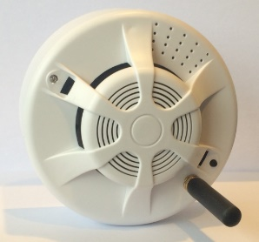
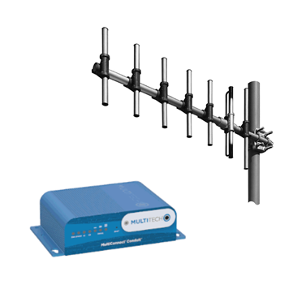
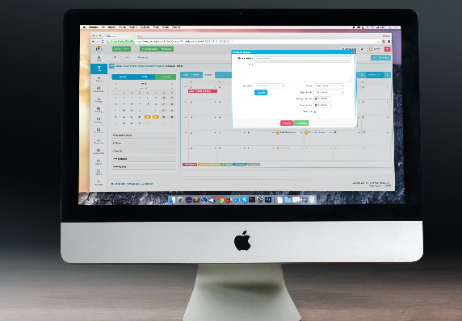
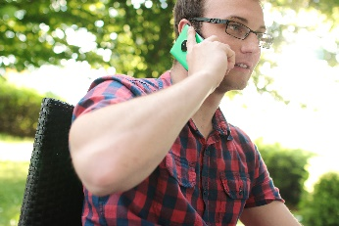
Data stream- remote smoke alarm monitoring
LoRaWAN
TCP/IP
Cellular

Slide 12
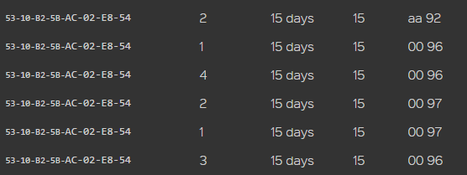
Data stream- remote smoke alarm monitoring
Alarm
Normal
Battery Voltage

Slide 13
Example 2

Slide 14
Lubricants company wants to monitor tank levels, switch pump off

Slide 15
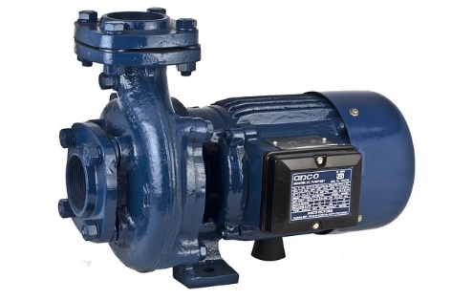
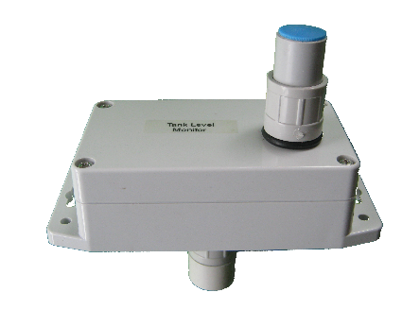
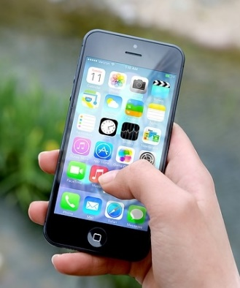
APIs- tank level monitoring, pump switch off
TCP/IP
MQTT
LoRaWAN
Azure IOT Suite
APIs

Slide 16
Lessons learned
It starts with connectivity and automation but data becomes the key driver
Software developers need to understand and promote the 2nd and 3rd order business benefits
Align focus and effort with customer value
Azure IoT Suite assumes direct device control. Networks like LoRaWAN only integrate at data level.
Double provisioning required with Device EUI the common key
In LoRaWAN networks, the network server (cloud based in our case) plays a central role in both real-time network management and data management
Cloud to cloud integration for a customer can be very easy or very hard

Slide 17
JSON message structure
{
cmd : 'rx'; // identifies type of message, rx = uplink message
EUI : string; // device EUI, 16 hex digits (without dashes)
ts : number; // server timestamp as number (seconds from Linux epoch)
ack : boolean; // acknowledgement flag as set by device
fcnt : number; // frame counter, a 32-bit number
port : number; // port as sent by the end device
data : string; // data payload (decrypted, plaintext hex string)
}

Slide 18
Data payload median size is 20 bytes
01 85 20 6c 03 34
01 85 Level of tank empty space in cm, e.g. 185 cm
20 6c Signed temperature in °C, e.g. +20.6°C
03 34 Battery voltage in V, e.g. 3.34V

Slide 19
Example 3

Slide 20
Reduce search & rescue costs using new business model

Slide 21
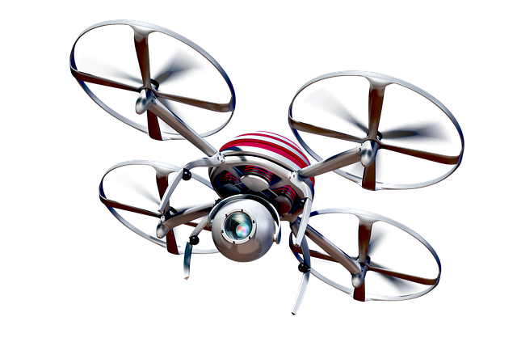
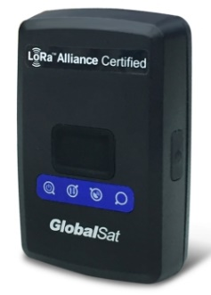
APIs- location tracking system
Azure IOT Suite

Slide 22
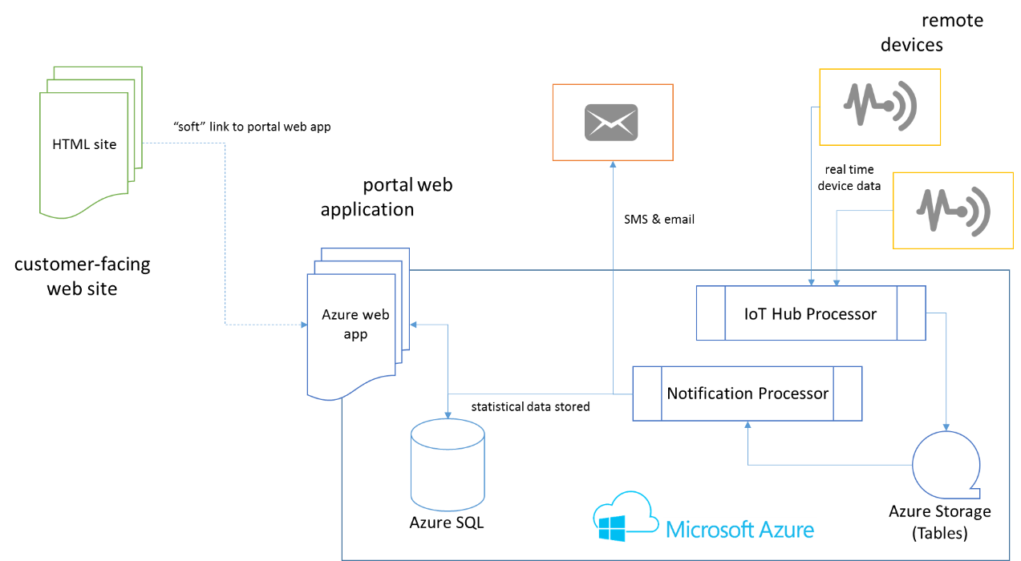
The Azure IoT Solution

Slide 23
Takeaway
Software developers need to focus efforts on the high value parts of the IoT value chain. This is often data, analytics and interactions- not hardware and firmware.
In some cases, one option is to start with data, leaving hardware and connectivity to others. Options are to use the data stream or APIs.

