Slide 1


Secure Modern Enterprise
Chris Jackson
Sr. Architect, Cybersecurity
Critical security assurances | Cloud-powered Threat Detection | Major Incident Management

Slide 2
“There are two kinds of big companies, those who’ve been hacked, and those who don’t know they’ve been hacked.”
-James Comey, FBI Director
200+
80
$3Trillion
$3.5Million
Median number of days attackers are present on a victims network before detection
Days after detection to full recovery
Impact of lost productivity and growth
Average cost of a data breach (15% YoY increase)
MICROSOFT CONFIDENTIAL FOR NDA DISCUSSION ONLY

Slide 3
How do breaches occur?
46%
of compromised systems had no malware on them
99.9%
of exploited Vulnerabilities were used more than a year after the CVE was published
Malware and vulnerabilities are not the only thing to worry about
23%
of recipients opened phishing messages (11% clicked on attachments)
50%
of those who open and click attachments do so within the first hour
Fast and effective phishing attacks give you little time to react
Source: Verizon 2015 Data Breach Investigation Report
MICROSOFT CONFIDENTIAL FOR NDA DISCUSSION ONLY

Slide 4
Attacks happen fast and are Hard to stop
If an attacker sends an email to 100 people in your company…
…23 people will open it…
…11 people will open the attachment…
…and six will do it in the first hour.
Source: Verizon 2015 Data Breach Investigations Report

Slide 5
Data Leakage
Data Leakage
$240
87%
58%
PER RECORD
…of senior managers admit to regularly uploading work files to a personal email or cloud account¹
Have accidentally sent sensitive information to the wrong person¹
Average per record cost of a data breach across all industries²
¹Stroz Friedberg, “On The Pulse: Information Security In American Business,” 2013
²HIPPA Secure Now, “A look at the cost of healthcare data breaches,” Art Gross, March 30, 2012

Slide 6
Can’t Stop Every Attack, But Can Rapidly Raise Attacker Cost
RUIN ATTACKER’S ECONOMIC MODEL
BREAK THE KNOWN ATTACK PLAYBOOK
RAPID RESPONSE AND RECOVERY
ELIMINATE OTHER ATTACK VECTORS
Change the Defender’s Dilemma to an Attacker’s Dilemma

Slide 7
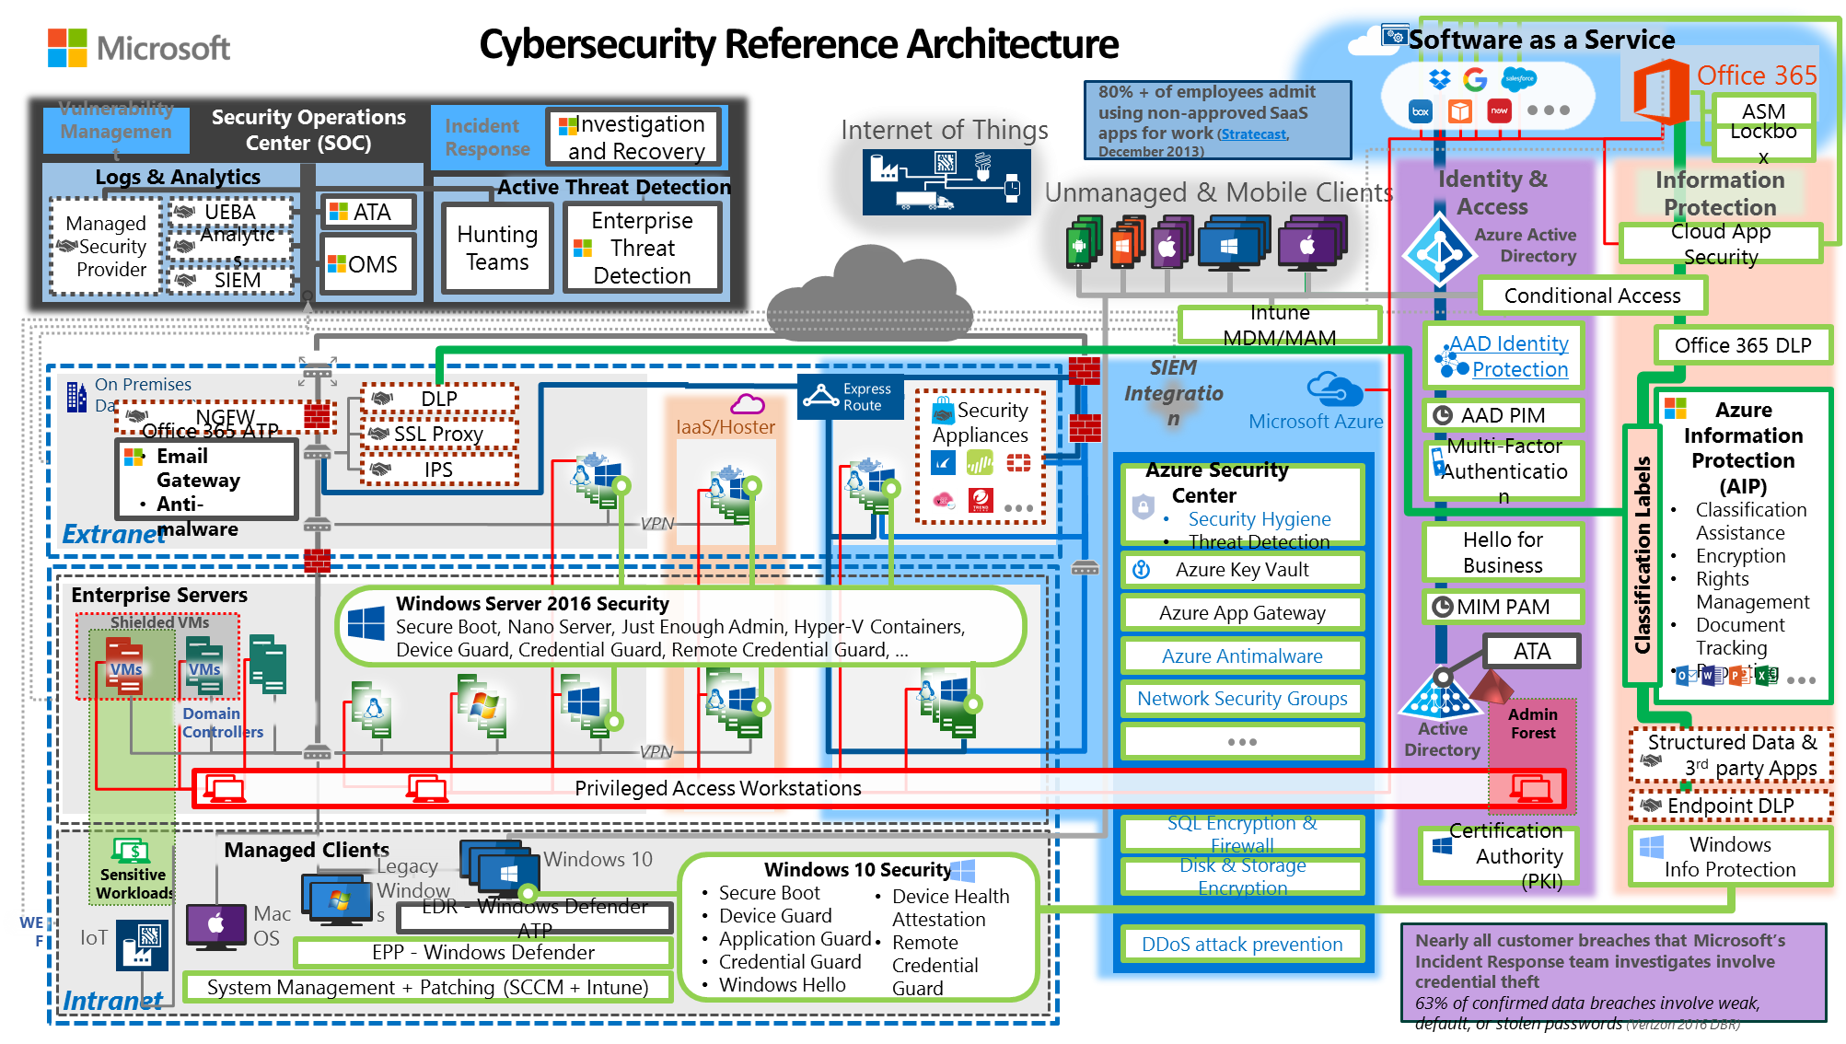

Slide 8
A secure modern enterprise is resilient to threats
Aligned to business objectives and current threat environment
SECURE MODERN ENTERPRISE
Identity
Embraces identity as primary security perimeter and protects identity systems, admins, and credentials as top priorities
Apps and Data
Aligns security investments with business priorities including identifying and securing communications, data, and applications
Identity
Apps
and Data
Infrastructure
Devices
Infrastructure
Operates on modern platform and uses cloud intelligence to detect and remediate both vulnerabilities and attacks
Devices
Accesses assets from trusted devices with hardware security assurances, great user experience, and advanced threat detection
Secure Platform (secure by design)

Slide 9
Getting started
Phase 2:
Secure the Pillars
Continue building a secure modern enterprise by adopting leading edge technology and approaches:
Threat Detection – Integrate leading edge intelligence and Managed detection and response (MDR) capabilities
Privileged Access – continue reducing risk to business critical identities and assets
Cloud Security Risk – Chart a secure path into a cloud-enabled enterprise
SaaS / Shadow IT Risk – Discover, protect, and monitor your critical data in the cloud
Device & Datacenter Security – Hardware protections for Devices, Credentials, Servers, and Applications
App/Dev Security – Secure your development practices and digital transformation components
SECURE MODERN ENTERPRISE
Phase 1: Build the Security Foundation
Start the journey by getting in front of current attacks
Critical Mitigations – Critical attack protections
Attack Detection – Hunt for hidden persistent adversaries and implement critical attack detection
Roadmap and planning –Share Microsoft insight on current attacks and strategies, build a tailored roadmap to defend your organization’s business value and mission
Identity
Apps
and Data
Infrastructure
Devices
Phase 2: Secure the Pillars
Phase 1: Build Security Foundation – Critical Attack Defenses
Secure Platform (secure by design)

Slide 10
Identity Pillar
Major Identity Challenges
Identity system security is critical to all security assurances
Attackers are actively targeting privileged access and identity systems
Identity systems are challenging to protect
Identity attacks like credential theft are difficult to detect and investigate
Individual accounts have large attack surface across devices and systems
Phase 2: Identity
Embraces identity as primary security perimeter and protects identity systems, admins, and credentials as top priorities
Elevated protection for privileged access & identity systems
Strongest protections for identity admins based on top attacks and leading edge hardware rooted protections
Advanced detection for identity and credential theft attacks
Expert analysts to help detect and respond to identity attacks
Industrial Grade Protections for all users
Hardware protection for credentials on devices
Leading edge biometrics authentication combining ease of use and high security
Integration of real time cloud intelligence into identity risk management

Slide 11
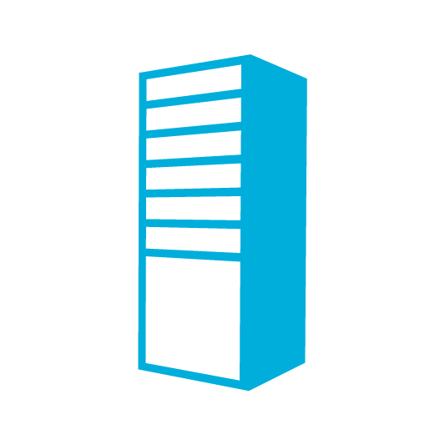





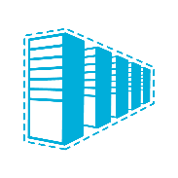
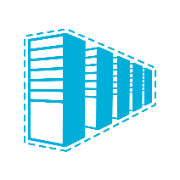



Phase 1 Critical Mitigations: Typical Attack Chain
Compromises privileged access
Tier 0
Domain &
Enterprise
Admins
  24-48 Hours
Directory Database(s)
Beachhead (Phishing Attack, etc.)
Lateral Movement
  Steal Credentials
Domain Controllers
  Compromise more hosts & credentials
Tier 1
Server
Admins
Privilege Escalation
  Get Domain Admin credentials
Execute Attacker Mission
  Steal data, destroy systems, etc.
  Persist Presence
Tier 2
Workstation
& Device
Admins

Slide 12
These practices are still important
Part of a complete long term security strategy
Domain Controller Security Updates
Target full deployment within 7 days
Remove Users from Local Administrators
Manage exceptions down to near-zero
Ensure only admin of one workstation
Baseline Security Policies
Apply standard configurations
Manage exceptions down to near-zero
Anti-Malware
Detect and clean known threats
Log Auditing and Analysis
Centralize logs to enable investigations and analysis
Software Inventory and Deployment
Ensure visibility and control of endpoints to enable security operations

Slide 13

Protecting Active Directory and Admin privileges
2-4 weeks
1-3 months
6+ months
First response to the most frequently used attack techniques
3. Unique Local Admin Passwords for Workstations
http://Aka.ms/LAPS
4. Unique Local Admin Passwords for Servers
http://Aka.ms/LAPS
Active
Directory
Azure Active Directory
1. Separate Admin account for admin tasks
2. Privileged Access Workstations (PAWs)
Phase 1 - Active Directory admins
http://Aka.ms/CyberPAW

Slide 14
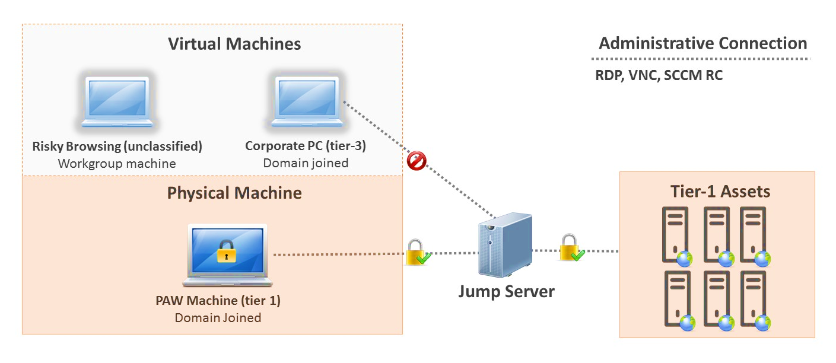
Physical PAW, Productivity VM
Jump Server is optional

Slide 15



Protecting Active Directory and Admin privileges
2-4 weeks
6+ months
1-3 months
Build visibility and control of administrator activity, increase protection against typical follow-up attacks
6. Attack Detection
http://aka.ms/ata
2. Time-bound privileges (no permanent admins)
http://aka.ms/PAM http://aka.ms/AzurePIM
3. Multi-factor for elevation
Active
Directory
9872521
Azure Active Directory
1. Privileged Access Workstations (PAWs)
Phases 2 and 3 –All Admins and additional hardening (Credential Guard, RDP Restricted Admin, etc.)
http://aka.ms/CyberPAW
4. Just Enough Admin (JEA) for DC Maintenance
http://aka.ms/JEA
5. Lower attack surface of Domain and DCs http://aka.ms/HardenAD

Slide 16

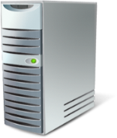

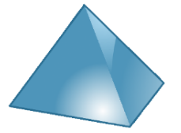


Privilege Vaulting
9:00
10:00
1. Request Access (10:00)
2. Auto-Approve (10:00)
11:00
PAM Server
12:00
3. Access Resource (10:01)
1:00
Admin Group
(or Custom Action)
Admin
Account
4. Access Resource (3:15)
Managed Servers
Domain Admin
Schema Admin
Top Secret Project
2:00
Customizable Workflows
Notifications
Approval
Actions
3:00

Slide 17
Protecting Active Directory and Admin privileges
2-4 weeks
6+ months
1-3 months
5. Shielded VMs for virtual DCs (Server 2016 Hyper-V Fabric)
http://aka.ms/shieldedvms
Move to proactive security posture
1. Modernize Roles and Delegation Model (Consulting)
https://www.microsoft.com/security
Active
Directory
Azure Active Directory
2. Smartcard or Passport Authentication for all admins
http://aka.ms/Passport
3. Admin Forest for Active Directory administrators
http://aka.ms/ESAE
4. Code Integrity Policy for DCs (Server 2016)

Slide 18


Privileged Access
Privileged
Access
Control
Tier-0
IPsec
Data and
Services
Tier-1
Access
Tier-2

Slide 19


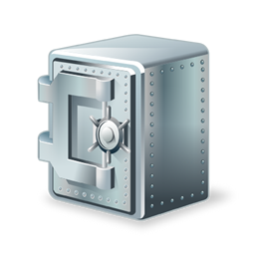


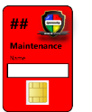

Production Domain
ESAE / Red Forest
IPsec
Greenfield
Domain Admins
(Gold Cards)
Domain Controllers
Admin Workstations
SCOM Gateway
Monitoring
(SCOM)
Certificate
Authority
WSUS
Red Forest
Domain Controllers
Secure Vault
Break-glass Account
Red Forest Admins

Slide 20
Apps and Data Pillar
Major App and Data Challenges
Business critical data is challenging to track and protect against determined adversaries
Data and App security dependent on identity, device, and infrastructure security
Limited IT visibility and protection for data leaving corporate networks (in both sanctioned and unsanctioned cloud applications)
Challenging to classify all data and apps
High architectural debt from legacy applications
Challenging regulatory mandates
Phase 2: Apps and Data
Aligns security investments to business priorities and applies both security fundamentals and modern protections
Update Strategy and Policy
Discover corporate data in sanctioned and unsanctioned cloud apps
Identify and Assess High Value Applications and Data
Enforce policy on data stored on corporate and personal devices
Protect against device loss and device compromise
Update Strategy and Policy
Develop strategy for protecting cloud and on-premises assets prioritized using business alignment and current threat intelligence
Create written policy and configure technical enforcement mechanisms

Slide 21
Infrastructure Pillar
Infrastructure Challenges
Business critical data is challenging to track and protect against determined adversaries
Data and App security dependent on identity, device, and infrastructure security
Limited IT visibility and protection for data leaving corporate networks (in both sanctioned and unsanctioned cloud applications)
Challenging to classify all data and apps
High architectural debt from legacy applications
Challenging regulatory mandates
Phase 2: Infrastructure
Operates on modern platform and uses cloud intelligence to detect and remediate both vulnerabilities and attacks
Security Integrate Cloud Infrastructure and Capabilities
Updating your policies, skills, and controls for cloud infrastructure
Rapidly see and correct security hygiene issues
Integrate Advanced Infrastructure Defenses
Expert Threat Detection Analysts monitoring your systems, alerting you, answering questions, and reporting on risk and vulnerability.
Critical attack defenses and monitoring for infrastructure and admins
Hardware-level boot integrity for on premises infrastructure
Advanced isolation for critical assets hosted on virtual machines

Slide 22
Devices Pillar
Device Challenges
Devices are frequently targeted and challenging to defend
Devices are frequently first stage of major attacks
Data and app security relies on device integrity
Advanced attackers requires advanced detection, response, and containment
Phase 2: Devices
Accesses assets from trusted devices with hardware security assurances, great user experience, and advanced threat detection
Post Breach attack detection and remediation
Cloud based detection of known threat actors and real time threat intelligence
Behavioral based indicators of attacks for new or unknown threat actors
Expert threat detection analysts monitoring your systems, alerting you, answering questions, and reporting on risk and vulnerability.
Advanced Device Protection
Deploy hardware rooted code integrity for devices and data on them
Configure hardware protection for credentials and application apps
Advanced biometrics to simplify strong user authentication
Visibility into configuration across multiple device platforms

Slide 23
Securing Devices Roadmap
Make more users standard users
Robust response to compromise
Modernize OS and software
Whitelist software
Harden OS image / policies
Blacklist user writable areas
Harden software

Slide 24
Security @ Microsoft
Protect/Detect/Respond
Ensuring trusted platforms
Protecting Microsoft assets, IP, and customer data
What we deliver to customers
Protect
Make enterprise, products,
services hard to attack
successfully
Engineering Systems
Governance, Risk
and Compliance
Code Quality (SDL)
Threat Intelligence
Incident Response
Service Quality (OSA)
Anti-Virus, Host, and
Application Security
Certifications
Security @ Microsoft
Detect
Collect, analyze and
disseminate information
Logging/Monitoring
Privacy
Vulnerability Analysis
Policy
Identity Management
Supplier Management/
Supply Chain
Network Security
Partnerships
Respond
When attacks succeed, remove
the attacker and restore normal
business operations
Physical Security
Cloud Service Offerings
Guidance
On Premise Product
Consulting Services
Go to Market

Slide 25


