Slide 1

Microsoft Ignite NZ
25-28 October 2016
SKYCITY, Auckland

Slide 2
SQL Server automation with Biml
M227
Simon Peck

Slide 4
The biggest benefit of automation is that it saves labour; however, it is also used to save energy and materials and to improve quality, accuracy and precision.
Faster, Cheaper, Better

Slide 5
Better with Biml

Slide 6
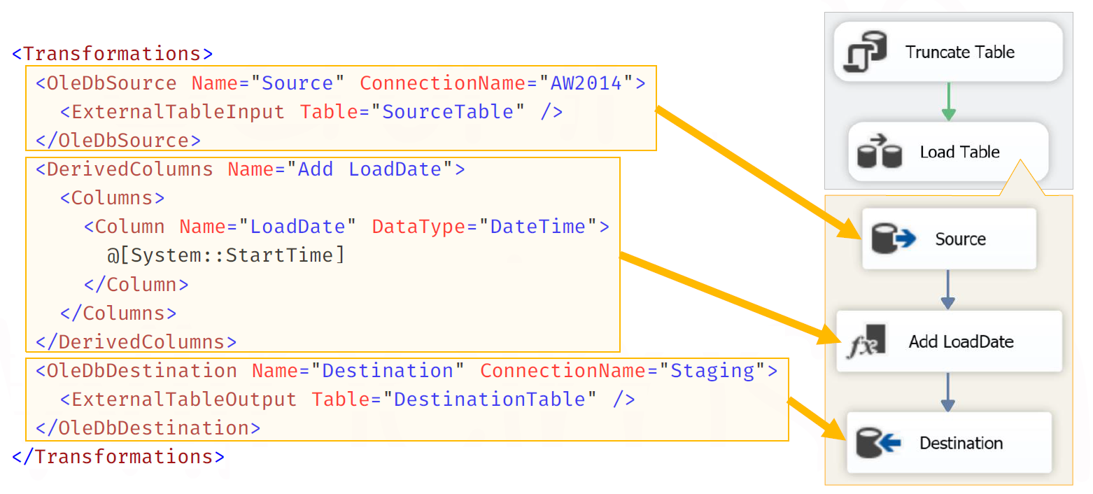
Biml Basics

Slide 7
Demo – Biml Overview
Simon Peck
Bespoke Business Analytics

Slide 8
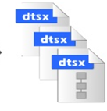




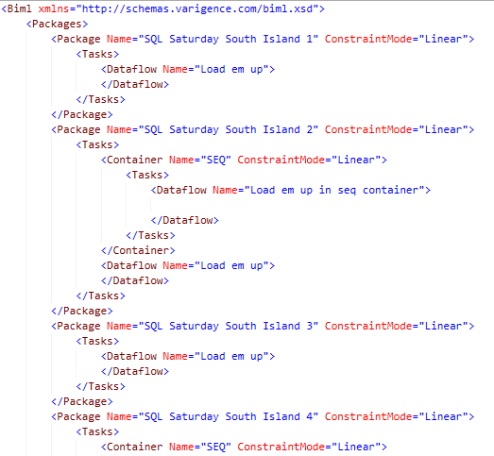
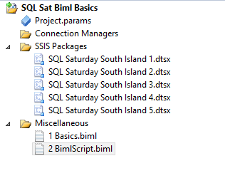
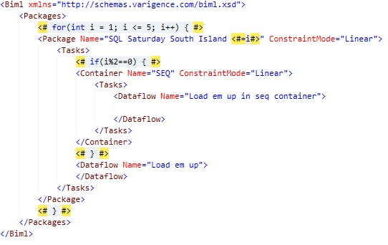
BIML Script is where the magic lives
Loop 1
Loop 2
Loop 3

Slide 9
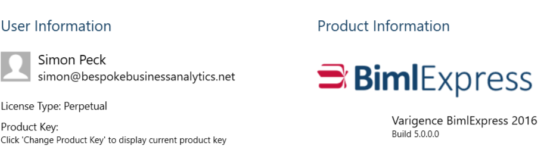

F r e e T o o l s
1
2

Slide 10
Have a go at http://bimlonline.com/

Slide 11

Full Functionality (not free)
Next release rebranded to

Slide 12
Demo – Biml CDC Pattern
Simon Peck
Bespoke Business Analytics

Slide 13
Working Project
Continuous Deployment
Simon Peck
Bespoke Business Analytics

Slide 14
Basic CD Lifecycle
Data steward updates metadata
Build Biml (Scheduled)
Unit Test (SSIS)
Schema Compare
Run (SSIS)
Deploy (Tables and SSIS)

Slide 15
Demo – Upgrade & Update
Simon Peck
Bespoke Business Analytics

Slide 16


Coming Up.

Slide 17
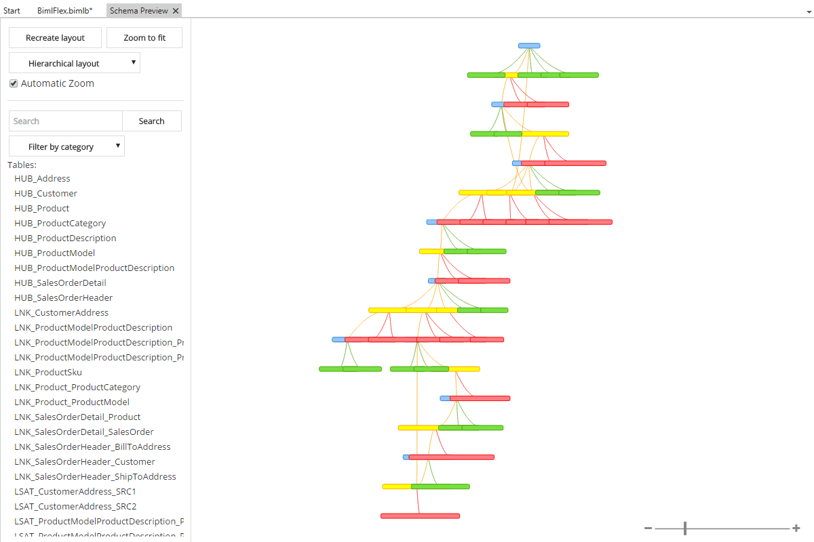

Slide 18
Resources / Q&A
http://bimlscript.com/ (Learn Biml / Tutorials, Videos, Tests)
http://www.sqlservercentral.com/stairway/100550/ (Stairway to Biml on SSC)
http://sqlblog.com/blogs/andy_leonard/archive/2016/06/02/so-you-want-to-learn-more-about-biml.aspx (Andy Leonard)
https://www.cathrinewilhelmsen.net/ (Catherine Wilhelmsen)
https://www.solisyon.de/biml-blog-de/ (Ben Weissman)
http://www.frysdisken.net/ (Martin Andersson)

Slide 20


Better with Biml
@biguynz
simon@bespokebusinessanalytics.net

