Slide 1

Microsoft Ignite NZ
25-28 October 2016
SKYCITY, Auckland

Slide 2
Building Secure Medical Applications in Azure
Session Code
David Carter and Matthew Tester
Stratos Technology Partners

Slide 3
Introduction

Slide 4

Crohn’s Colitis Cure
More than 60,000 Australians suffer from Crohn’s or Colitis. While a number of treatments exists and the disease can often be managed, the cause or causes of IBD remain unknown.
ANZIBDC is a collaborative research project involving clinicians and scientists at 12 IBD centres located at major hospital sites.
It is the largest and most important research project of its type ever undertaken in Australia and New Zealand.
A unique database for scientists and researchers.

Slide 5
What we’re going to cover
How to authenticate users
How to protect sensitive data
Maintain a great user experience

Slide 6
Architecture

Slide 7








Hosting
The question is “Why can’t you host on Azure?”

Slide 9
Authentication

Slide 10
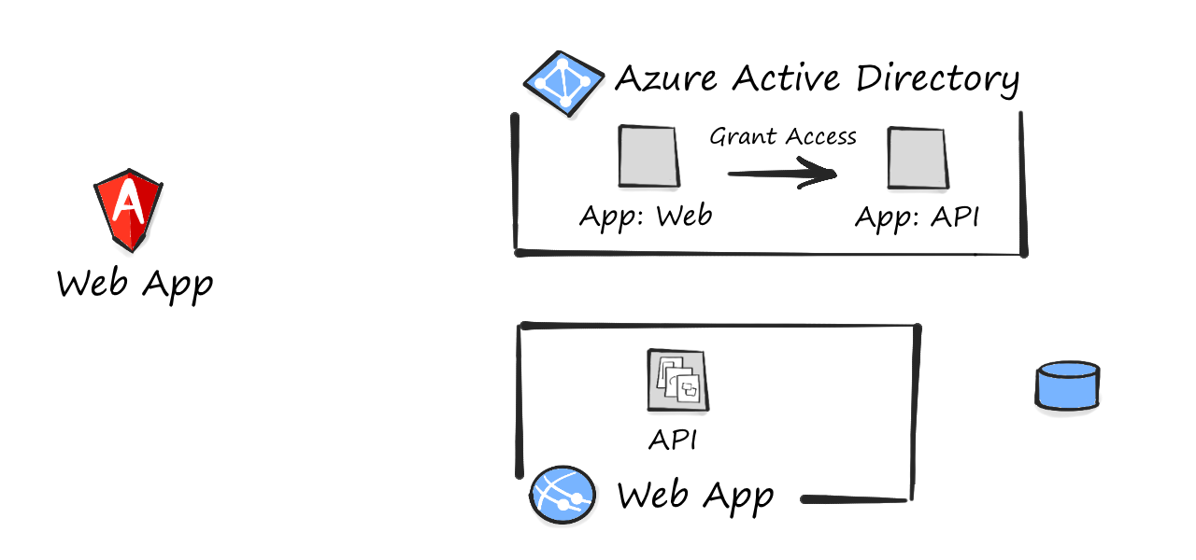
SPA Authentication

Slide 11
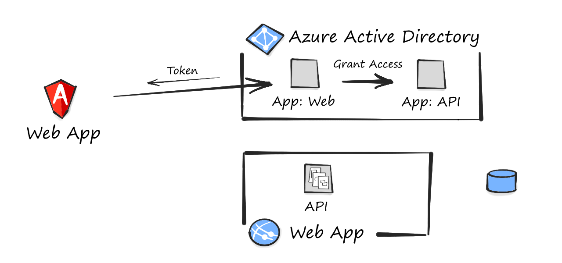
SPA Authentication

Slide 12
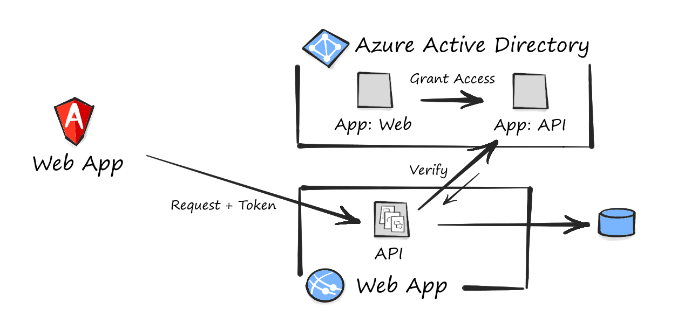
SPA Authentication

Slide 13
Data Protection

Slide 14
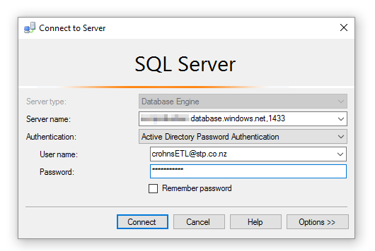
AD Authentication
.

Slide 15
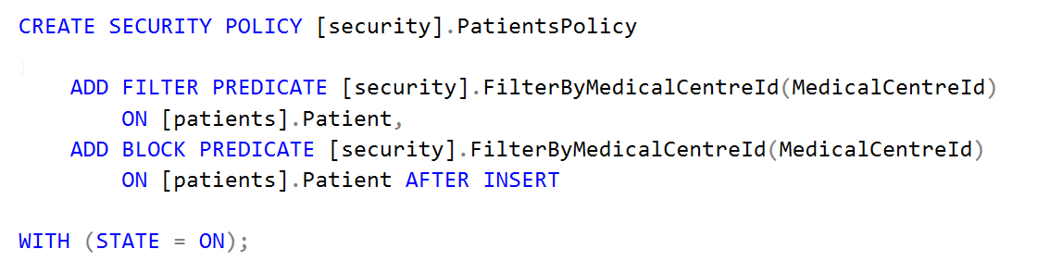
Row-level Security

Slide 16
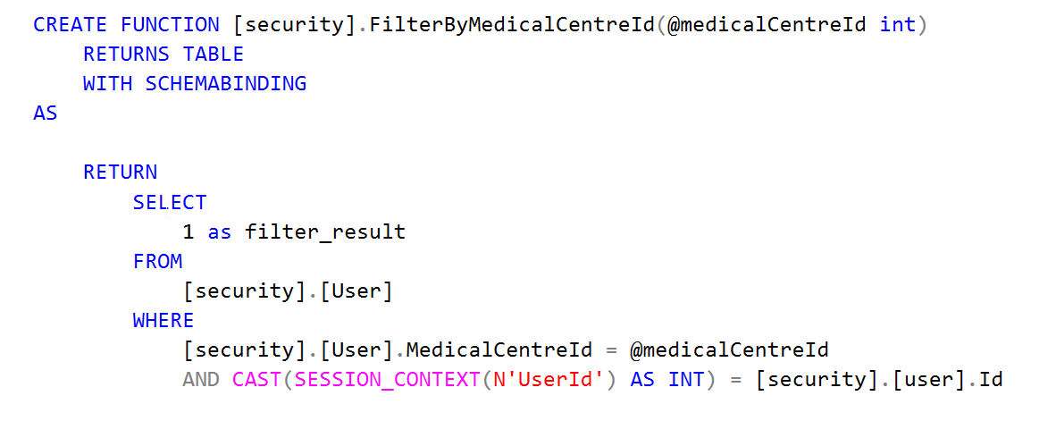
Row-level Security

Slide 17
Dynamic Data Masking
Mask function | Example
default() | XXXXX
email() | aXXX@XXXX.com
random(1, 12) | 11
partial(2,"X-XXXXXX",1) | 01X-XXXXXX5

Slide 18
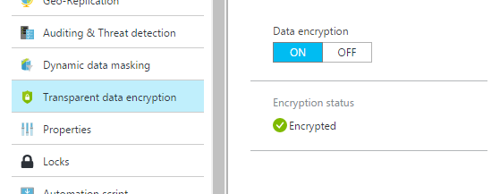
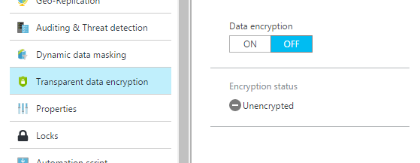
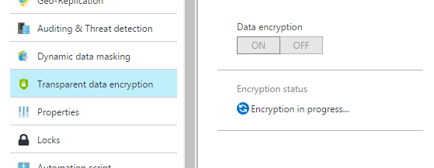
Transparent Data Encryption

Slide 19
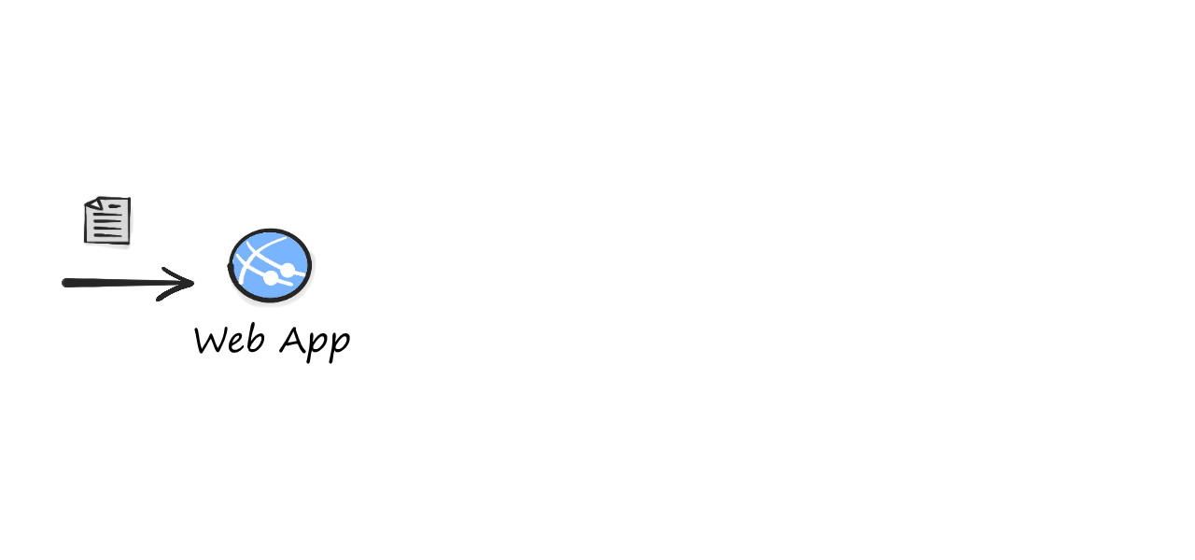
Encrypting Blob Files

Slide 20
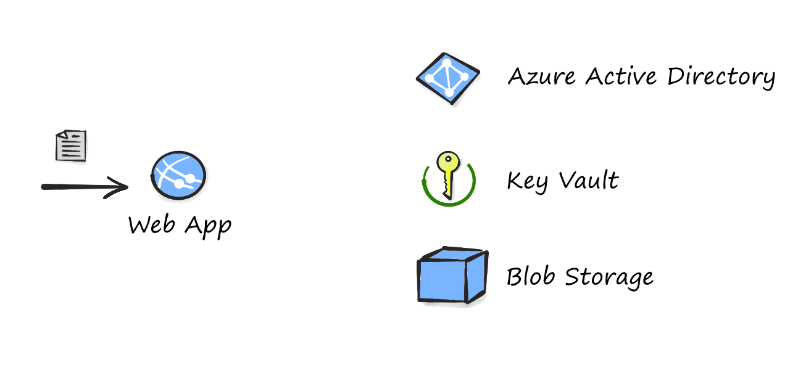
Encrypting Blob Files

Slide 21
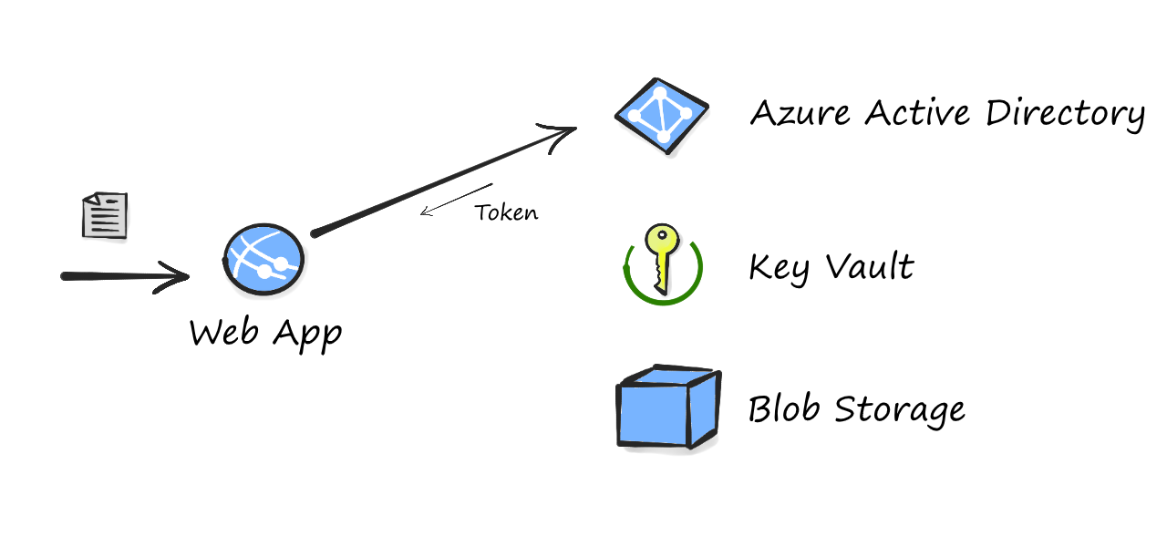
Encrypting Blob Files

Slide 22
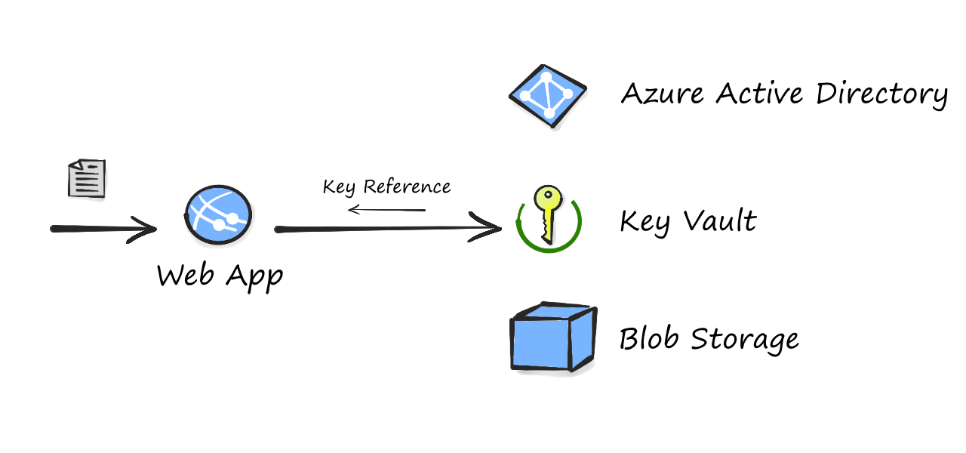
Encrypting Blob Files

Slide 23
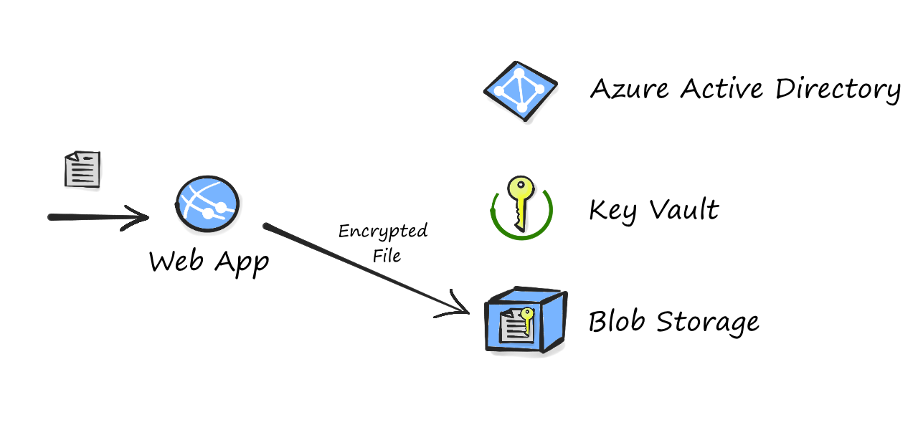
Encrypting Blob Files

Slide 24
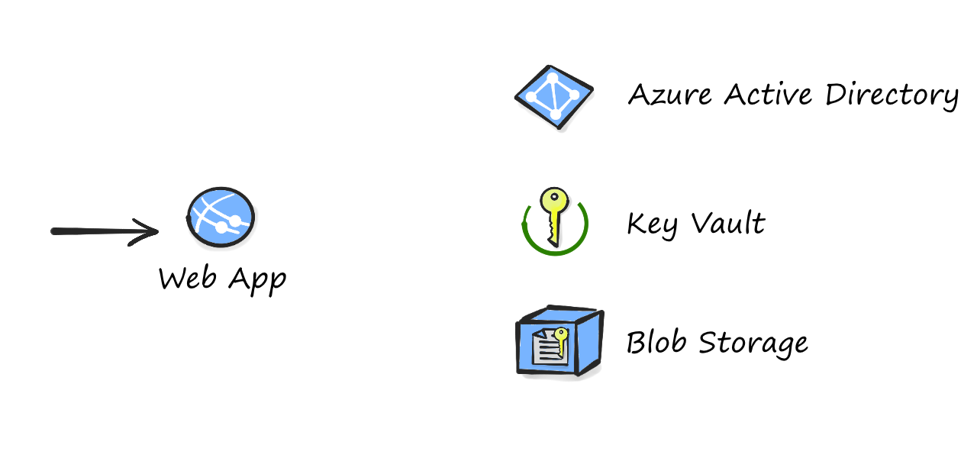
Decrypting Blob Files

Slide 25
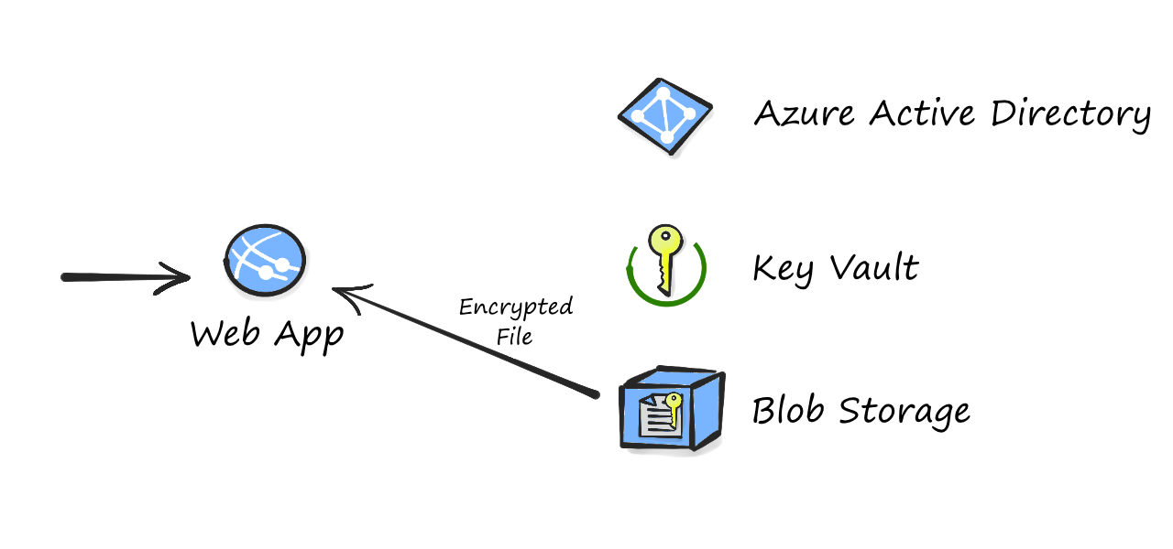
Decrypting Blob Files

Slide 26
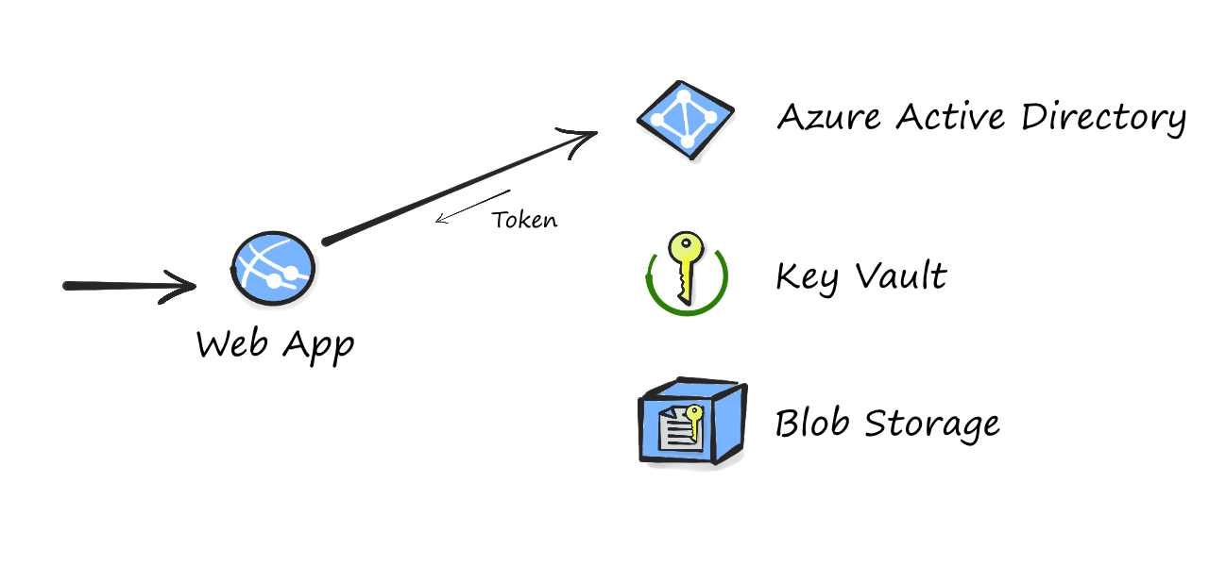
Decrypting Blob Files

Slide 27
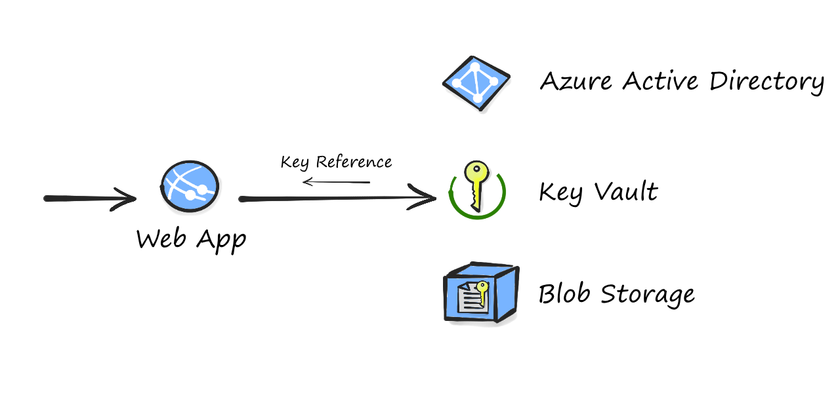
Decrypting Blob Files

Slide 28
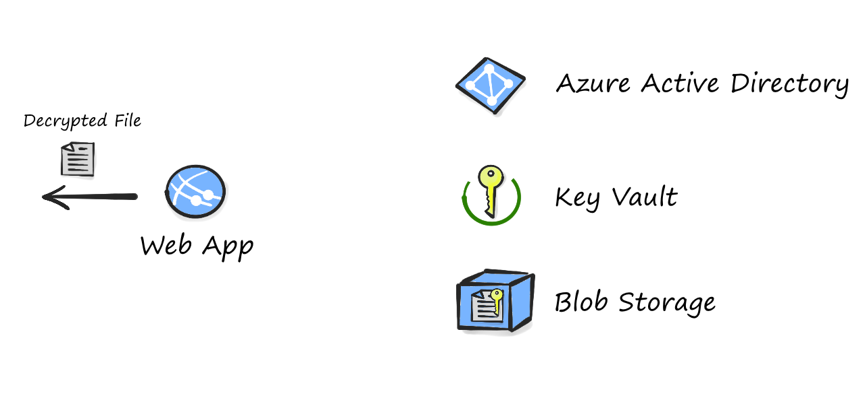
Decrypting Blob Files

Slide 29
User Experience

Slide 30
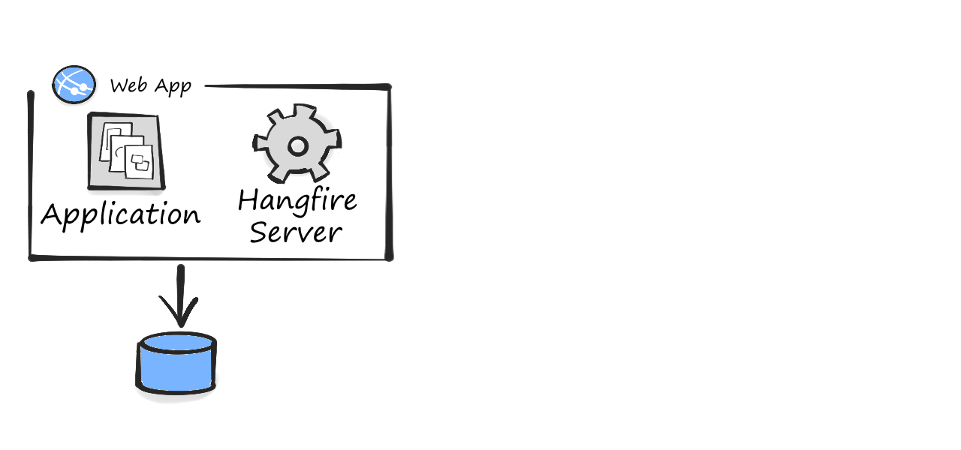
Hangfire

Slide 31
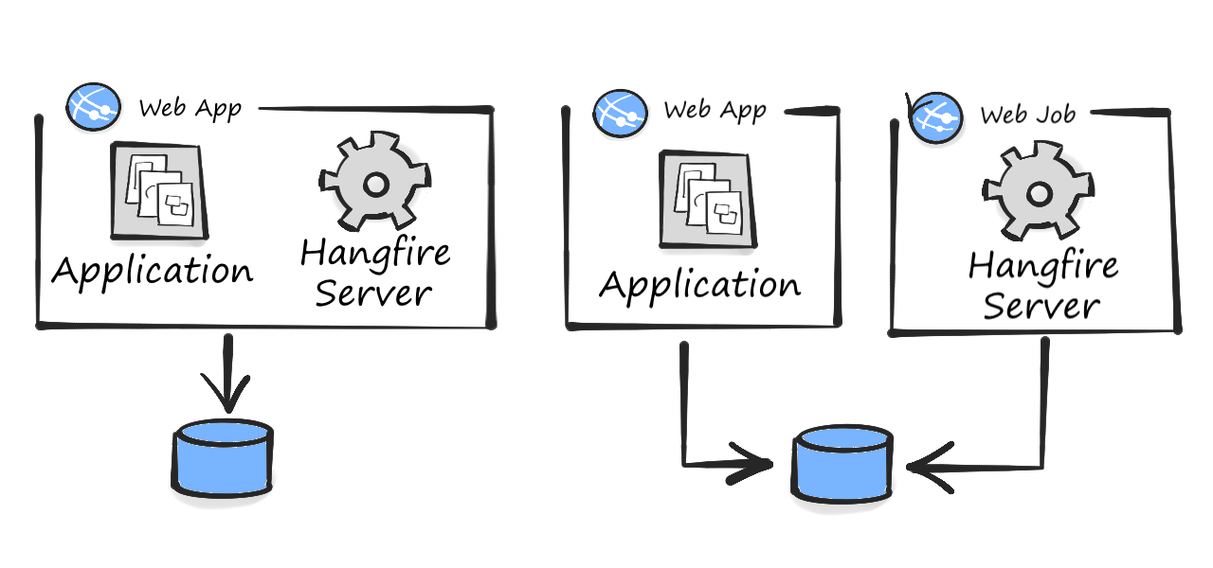
Hangfire

Slide 32
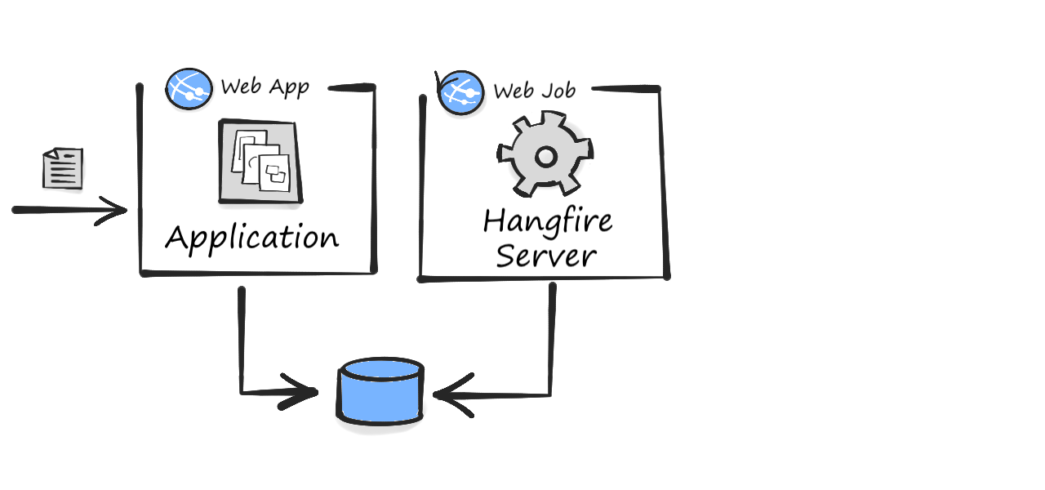
Hangfire

Slide 33
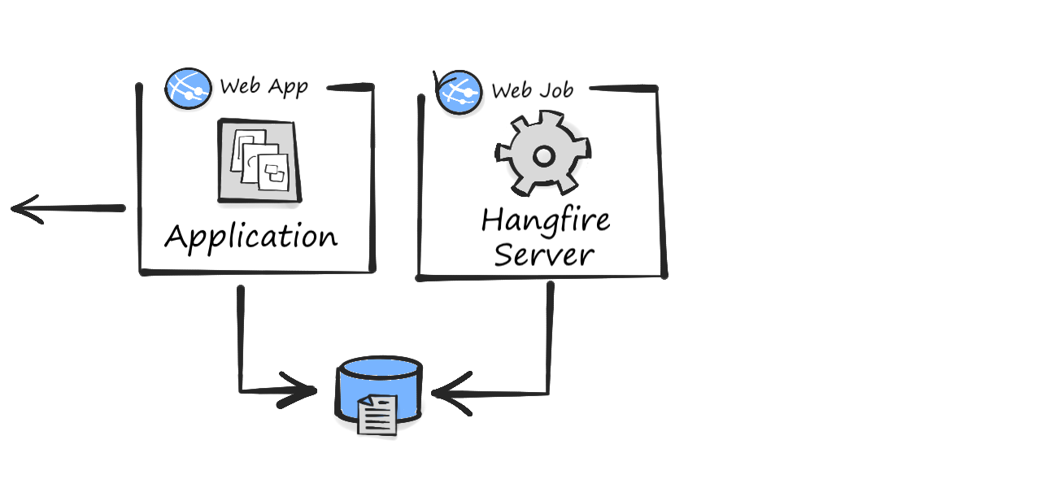
Hangfire

Slide 34
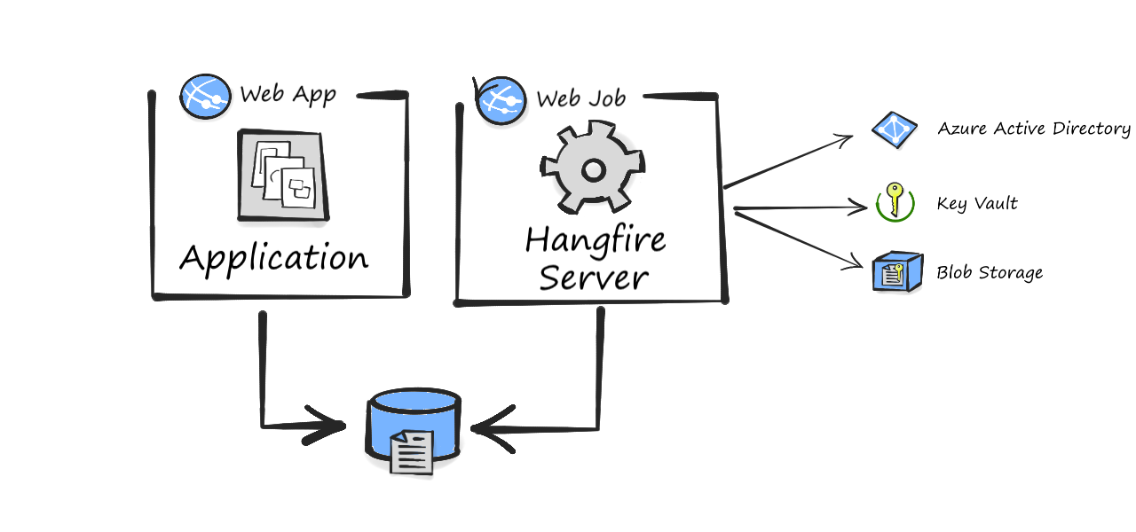
Hangfire

Slide 35

Angular Formly
JavaScript Powered Forms for AngularJS
“Maintain less html in favor of JavaScript “

Slide 36
Defining a form in Formly
{
key: 'surname',
type: 'text',
templateOptions: {
label: "Surname"
}
}

Slide 37
Defining a form in Formly
{
key: 'titleId',
type: 'lookup',
templateOptions: {
lookupName: 'title',
label: 'Title'
}
}

Slide 38
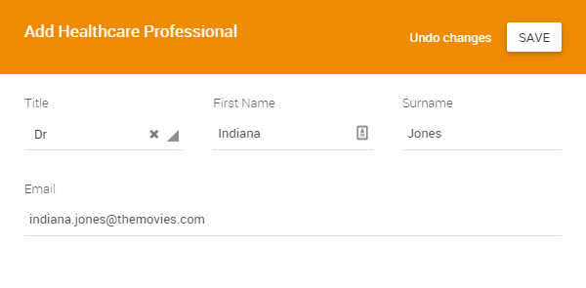
Defining a form in Formly
{ key: 'titleId' },
{ key: 'firstName' },
{ key: 'surname'},
{ key: 'email' }

Slide 39
Summary

Slide 40
What we covered
How to authenticate users
  Use Azure AD where possible. Outsourced security.
  ADAL library is a good start.
How to protect sensitive data
  Encrypt, encrypt, encrypt!
  SQL Server 2016 has many great features worth using
  Azure key vault makes storing keys easy
Maintain a great user experience
  Handle long running tasks asynchronously
  Use a Single Page Application framework

Slide 41
Key takeaway(s)
The tools are there to make secure apps in the cloud
Speak with the relevant health authorities up front in order to understand their particular requirements
Talk to Microsoft. They are a fantastic partner.

Slide 42

Get in touch
David Carter
  @dwcCBSL
  http://stp.co.nz/
Matt Tester
  @mattTester
  http://matthewtester.com

