Slide 1

Microsoft Ignite NZ
25-28 October 2016
SKYCITY, Auckland

Slide 2
Microsoft’s Trusted and Secure Cloud Services
M214
Russell Craig, National Technology Officer, MSNZ
Michael Brick, Legal Counsel, MSNZ

Slide 3

Consumer expectations
Pace of innovation
Digitally-native competition
The world we live in is increasingly complex
Connected devices
Workplace mobility
Laws and regulations

Slide 4
Digital Transformation
Engage your customers
Transform your products
Systems of Intelligence
Empower your employees
Optimize your operations

Slide 5
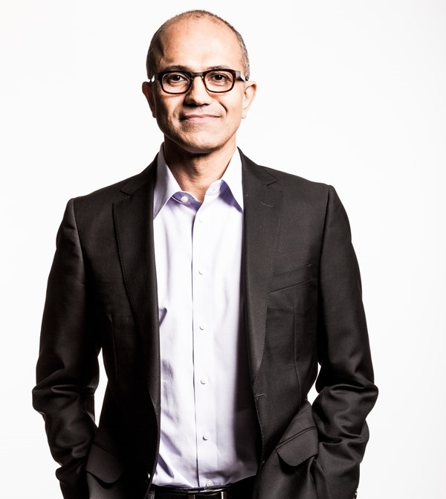
“Businesses and users are going to embrace technology only if they can trust it.”
Satya Nadella
Chief Executive Officer
Microsoft Corporation

Slide 6

top DRIVERS IN CLOUD ASSURANCE
Past Experience
Well Known
Data Protection
Experience
Proven Track Record
Data Privacy
Current Partner
Reputation
Longevity
Innovative
Security
Reliable
Established
Support
Industry Leader
Source: Penn Schoen Berland, Trusted Commercial Cloud, May 2016

Slide 7

OUR COMMITMENT TO YOU
SECURITY: we’ll help you keep your data secure
PRIVACY & CONTROL: your data is private and under your control
COMPLIANCE: we manage your data in accordance with the law
TRANSPARENCY: you know what we are doing with your data
RELIABILITY: we provide enterprise grade uptime for cloud services

Slide 8
COMPLIANCE & DATA RESIDENCY A KEY FACTOR IN CLOUD ADOPTION
Security and privacy are stated most important considerations while compliance drives behavior
  3000 customers were asked to rank their top 20 requirements related to cloud trust
1
2
3
  Compliance was ranked the second in regards to importance to cloud trust
Microsoft: Trusted Cloud Survey, 2016

Slide 9
ENABLING YOUR COMPLIANCE
Customers expect
Cloud services to enable compliance by adhering to international standards, certifications and applicable regulatory requirements.
Ability to see the certifications for each of their cloud provider’s cloud service.
What we’re doing about it
We lead the industry in pursuing compliance with the latest standards for data privacy and security, such as ISO 27018.
Our global infrastructure investments enables us to meet unique data residency, sovereignty and compliance requirements.
We regularly undergo independent audits to certify our compliance.
We collaborate with our partners, when requested, to work with their customers and regulators to help them meet their compliance requirements.

Slide 10

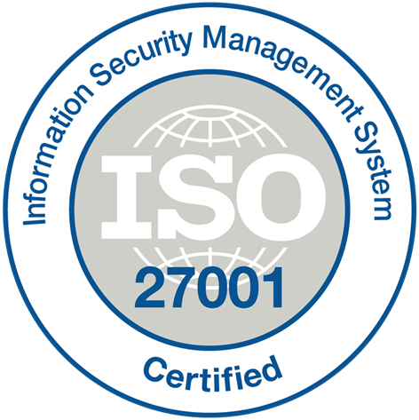












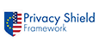




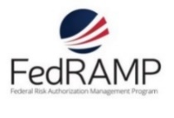








INDUSTRY’S LARGEST COMPLIANCE PORTFOLIO
Microsoft is meeting customer security needs with the industry's largest compliance portfolio
September 2016
Worldwide
ISO 27018
ISO 27001
Cloud Controls
Matrix
PCI DSS Level 1 *
SOC 2 Type 2
SOC 1 Type 2
Shared
Assessments
Content Delivery and
Security Association *
National
HIPAA / HITECH
European Union
Model Clauses
ENISA
IAF
EU-U.S.
Privacy Shield
Spain ENS
Singapore
MTCS Level 3
Australian Signals
Directorate
New Zealand
GCIO
Japan
Financial Services
China MLPS*, TRUCS*, GB 18030*
Government
Section 508 VPAT
United Kingdom
G-Cloud
FedRAMP
JAB P-ATO
FIPS 140-2
21 CFR
Part 11
FERPA
DISA Level 2
CJIS
IRS 1075
FISMA
NIST 800-171
*Denotes Microsoft Azure-specific certifications

Slide 11
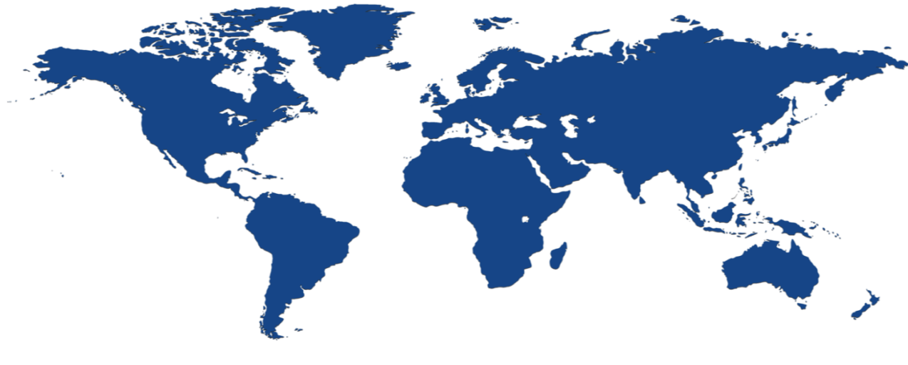


MICROSOFT INFRASTRUCTURE INVESTMENTS
36 datacenter locations worldwide¹
United Kingdom
South
Finland
North Central US
United Kingdom West
West Europe
West US 2
Central US
Canada Central
Canada East
North Europe
Germany Northeast**
Korea Central
Korea South
East US
Germany Central**
China West*
Japan East
West US
Vienna
West Central US
East US 2
China East*
Japan West
West India
East Asia
South Central US
  100 + datacenters
  One of 3 largest networks in the world
South India
India Central
Asia
SE Asia
Brazil South
Australia East
Chile
Australia South East
^{*Operated by 21 Vianet}
**German data trustee services provided by T-systems
.

Slide 12
PROTECTING DATA PRIVACY
Customers expect
Control over who has access to customer data.
Data access will require permission from the customer before their cloud vendor’s personnel or its subcontractors can obtain access.
Their data can be permanently deleted or taken with them if they leave.
What we’re doing about it
Your customers will have flexibility, choice and transparency on where customer data is stored.
We will not use your customer’s data for advertising or commercial purposes.
We will not disclose your customer’s information outside of Microsoft except with your customer’s consent or when required by law.
We can provide your customer with a variety of tools to extract their customer data.
We delete your customer data after your service is terminated or expires.

Slide 13
MAINTAINING TRANSPARENCY
Customers expect
Clear, plain-language explanation of how their cloud provider uses, manages and protects customer data.
Proactive transparency in requests for customer data from law enforcement.
What we’re doing about it
We provide understandable and strict policy of what we will—and will NOT—use customer data for.
When responding to law enforcement requests, we strive to defend customer rights and privacy, and ensure due process is followed.
For each of our services, we provide information on where customer data may be stored and processed.

Slide 14


Microsoft’s Commitment to Data Privacy & Security
Microsoft does not provide any government with direct, unfettered access to customers’ data
Microsoft does not provide any government
with encryption keys or assist their efforts to break
our encryption
Microsoft does not engineer back doors into our products
Microsoft has never provided business or government
data in response to a national security order
Microsoft will contest any attempt by the US government to disclose customer content stored exclusively overseas

Slide 15
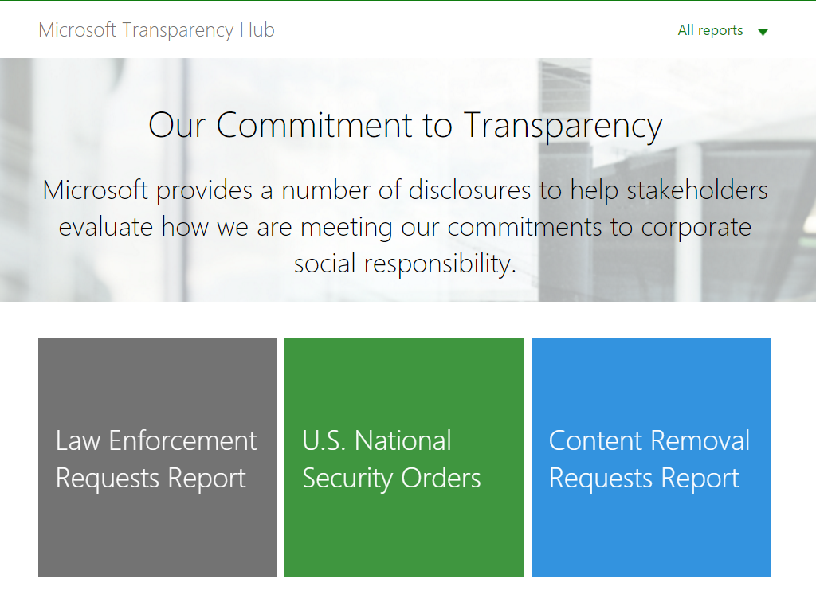
WE PUBLICLY DISCLOSE REQUESTS FOR CUSTOMER DATA
Microsoft Transparency Hub

Slide 16


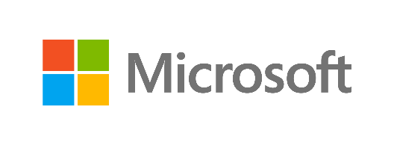
Microsoft Secure
Ensuring security to enable your digital transformation through a comprehensive platform, unique intelligence, and broad partnerships

Slide 17
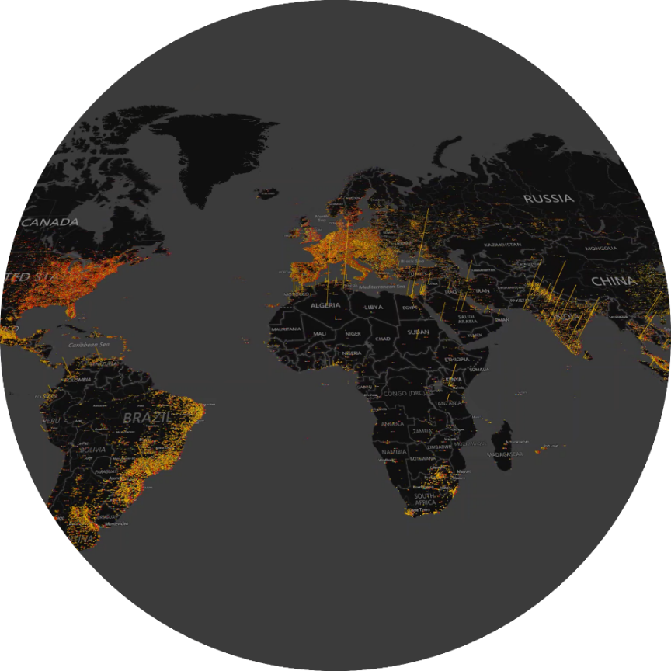
TURBULENT TIMES
160 MILLION customer records compromised
229 DAYS between infiltration and detection
$3 MILLION of cost/business impact per breach

Slide 18
YOUR
YOUR
IT ENVIRONMENT
OPPORTUNITY

Slide 19



Smart cities
Sensors
Vehicles
Partners
Energy systems
Cloud
Equipment
On-premises
YOUR
YOUR
IT ENVIRONMENT
O
P
P
O
R
T
U
N
I
T
Y
Mobile devices
Manufacturers
Marketplaces
Citizens
Supply Chains
Customers

Slide 20




YOUR
IT ENVIRONMENT

Slide 21




PROTECT
across all endpoints, from sensors to the datacenter
DETECT
using targeted signals, behavioral monitoring, and machine learning
YOUR
IT ENVIRONMENT
YOUR
SECURITY POSTURE
!
RESPOND
closing the gap between discovery and action

Slide 22
OUR UNIQUE APPROACH
PLATFORM
INTELLIGENCE
PARTNERS

Slide 23
OUR UNIQUE APPROACH
Identity
PLATFORM
Device
Apps & Data
Infrastructure

Slide 24



OUR UNIQUE APPROACH
Identity
OUR SECURITY PLATFORM
PLATFORM
Device
Advanced Threat Analytics
Cloud App Security
Intune
Windows Server 2016
SQL Server 2016
Windows Trust Boot
Privileged Identity Management
Credential Guard
Microsoft Passport
Windows Hello
Windows Defender ATP
Windows Update for Business
Enterprise Data Protection
Azure Active Directory
Azure Security Center
Azure Storage Service Encryption
Azure Key Vault
Advanced Threat Protection
Anti-Spam / Anti-Malware
Message Encryption
Customer Lockbox
Data Loss Prevention
Apps & Data
Infrastructure

Slide 25

Multi-factor authentication
Data encryption
User accounts
Device log-ins
Malware
Unauthorized data access
PLATFORM
INTELLIGENCE
PARTNERS
Attacks
INTELLIGENCE
User log-ins
Phishing
Denial of service
Spam
System updates
Enterprise security

Slide 26



OUR UNIQUE INTELLIGENCE
300B user authentications each month
1B Windows devices updated
200B emails analyzed for spam and malware

Slide 27
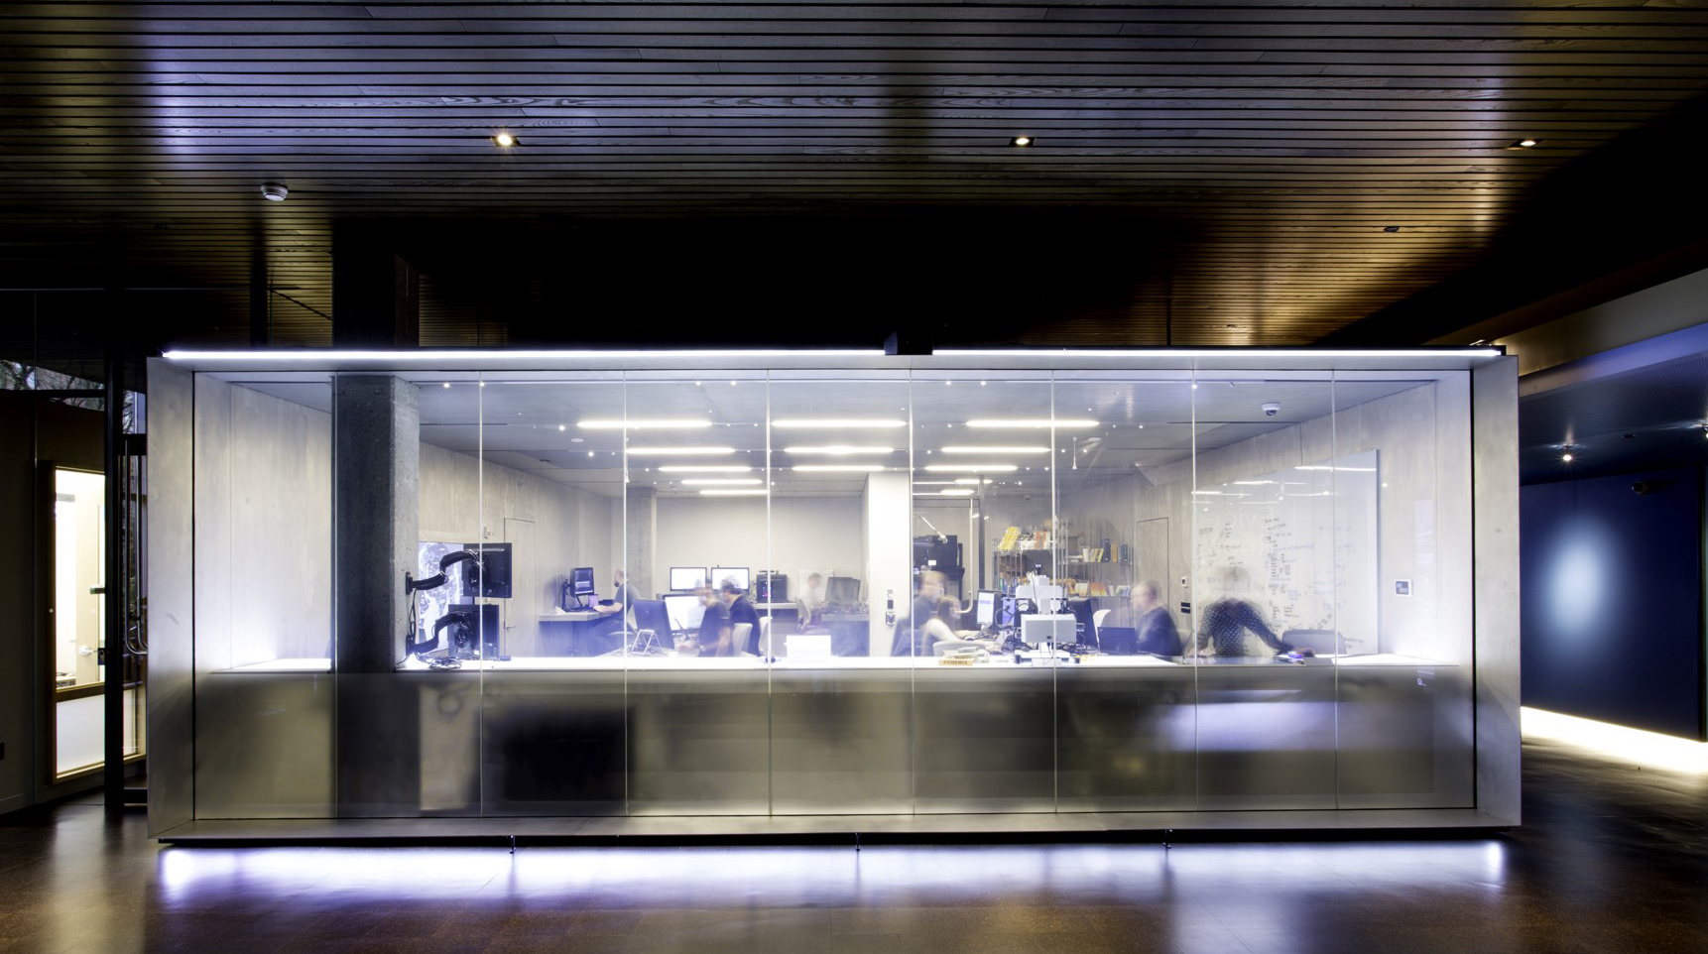

OUR INTELLIGENCE
OUR INTELLIGENCE
INTELLIGENCE

Slide 28
OUR PARTNERSHIP APPROACH
Partner with peers
PLATFORM
INTELLIGENCE
PARTNERS
Work with industry alliances
Work with government

Slide 29
Most relevant Resources
Discover more about our principled approach at www.microsoft.com/trustcenter
Explore our certifications at www.microsoft.com/trustcenter/compliance
Learn more about our approach to security at www.microsoft.com/security
Learn about digital reform at www.digitalconstitution.com

