Slide 1

Microsoft Ignite NZ
25-28 October 2016
SKYCITY, Auckland

Slide 2
Azure Compute & Networking Update
M205
Stu Fox
Rick Claus

Slide 3
Software is eating the world

Slide 4
Every company is a software company

Slide 5
Are you ready?

Slide 6


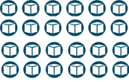


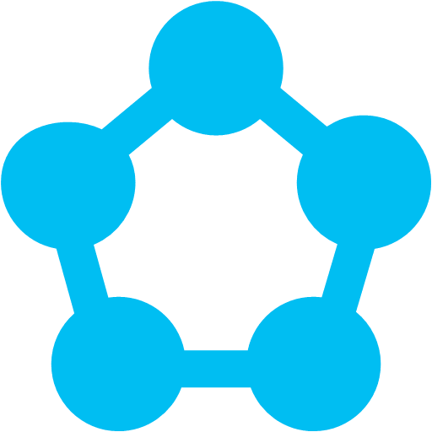

Azure Compute
Batch
Azure Functions
Container Service
App Service
VM Scale Sets
Service Fabric
Virtual Machines
Cloud Services

Slide 7

38
Hyper-scale
footprint
Azure regions

Slide 8
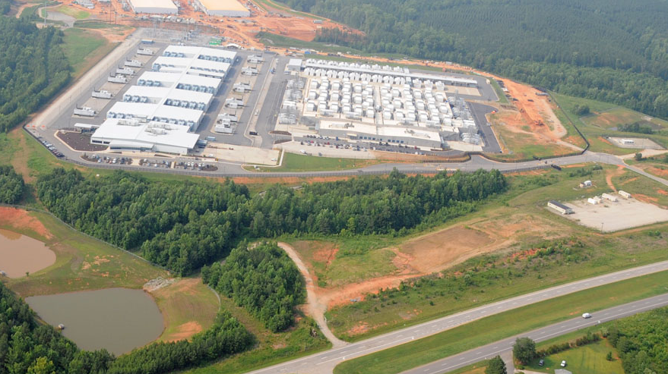

Slide 9
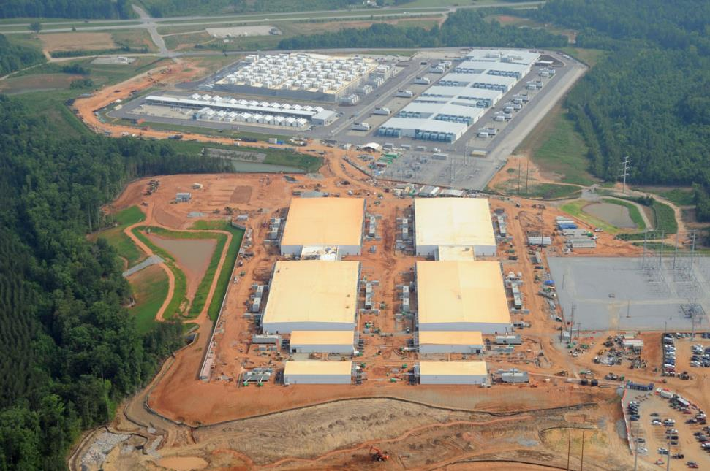

Slide 10
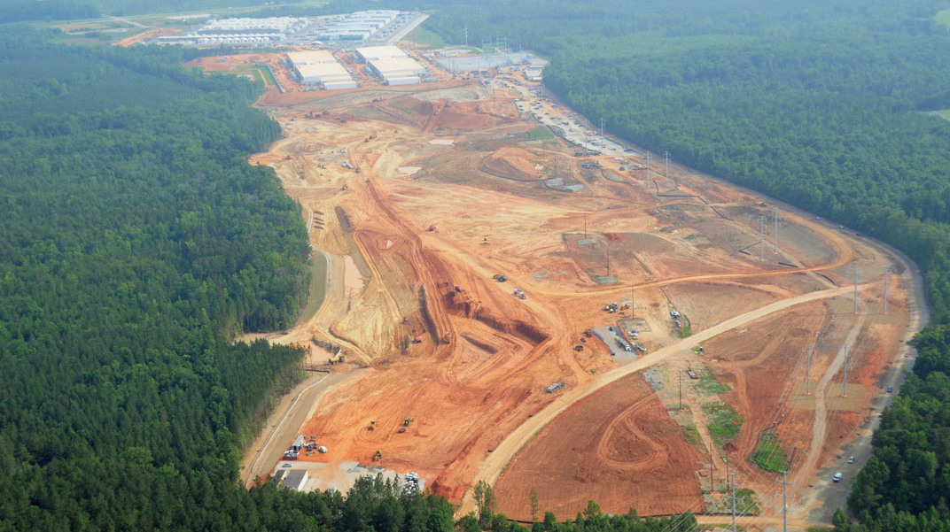

Slide 11
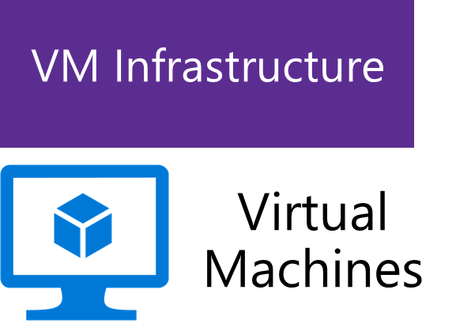
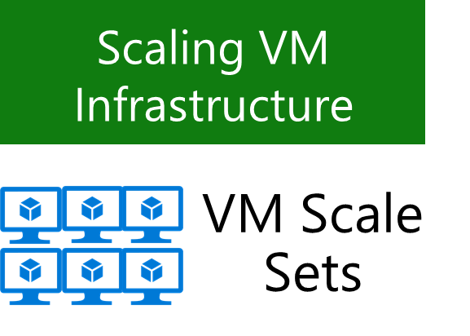
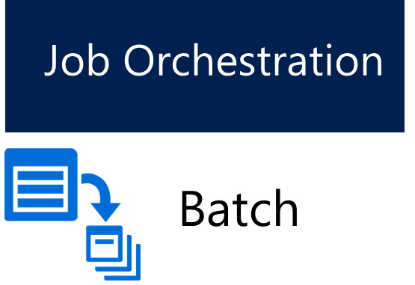
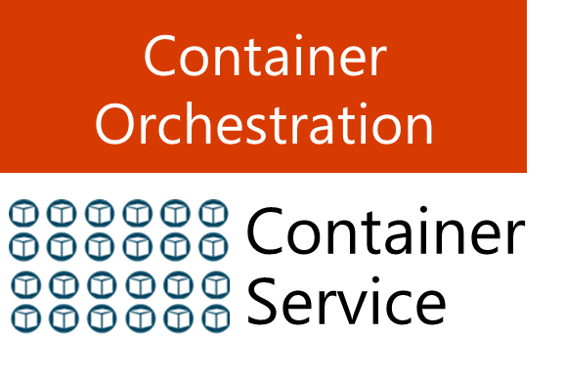
Infrastructure Compute

Slide 12
Virtual Machines

Slide 13

Virtual Machines
Ubuntu, Red Hat, Windows, SUSE, CoreOS
DevOps Extensions with Chef and Puppet
Multiple sizes
Hundreds of items in marketplace

Slide 14






































































Slide 15
Azure VM Sizes
Learn more!
M215 – Wednesday 10:30
Azure GPU
A
D
Dv2
G
Lowest Price
SSD Storage
Fast CPUs
New generation
of D family VMs
High memory and
Large SSDs
F
NC
NV
H
L
Av2
Compute Intensive
NVIDIA GPUs
K80 Compute
NVIDIA GPUs
M60 Visualization
Fastest CPU
IB Connectivity
Large SSDs
New A-Series
November

Slide 16
VM Scale Sets
Auto-configuration at scale
Auto-scale using preconfigured size
Easy updates at scale
Simple Portal Integration
Learn more!
M378 – Thursday 4:15

Slide 17
VM Scale Sets Demo

Slide 18
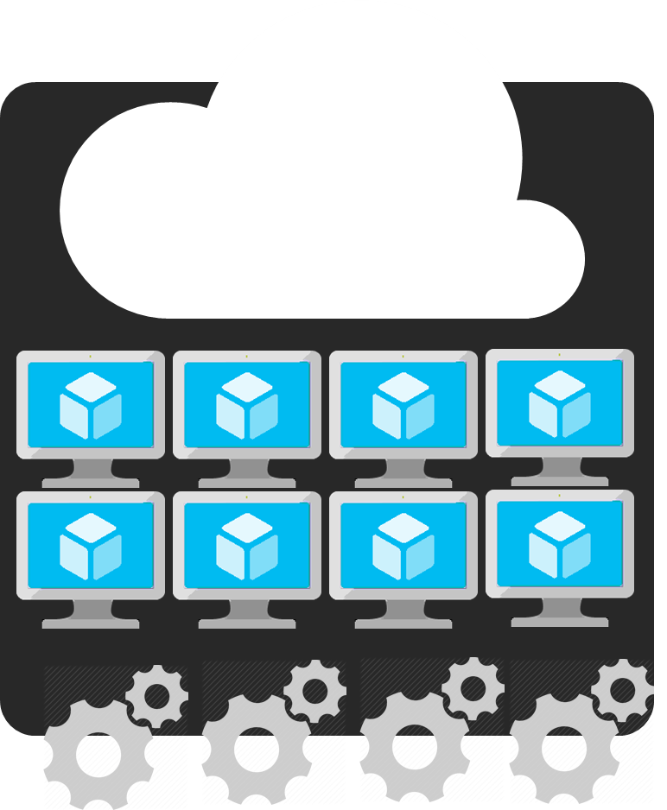
Azure Batch for job-based computation
Compute pools for job processing
Automatic scaling and regional coverage
Linux and Windows
Automatically recover failed tasks
Input/Output handling

Slide 19
Containers

Slide 20
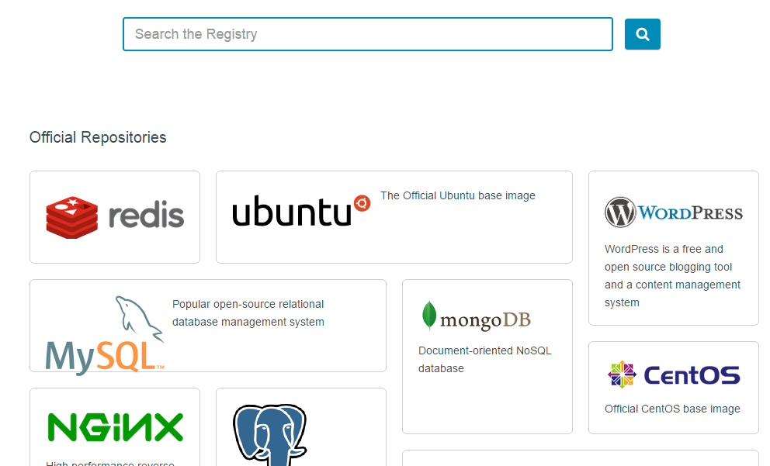
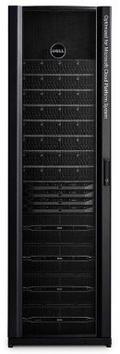
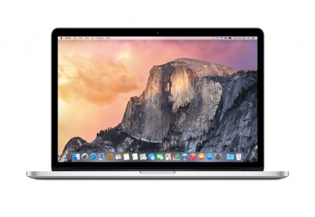
Why containers?
Fast and Agile
Unified deployment format
Build, Ship, Run
Huge Community
Dev
Test
Prod

Slide 21

How Containers Work
Learn more!
M402 – Wednesday 4:15
Windows Containers
Containers
Windows Server containers
Maximum speed and density
= Operating system virtualization
Container
Container
Container
Container
Container
Container
Application
OS
Hardware
Windows Server
Traditional virtual machines = hardware virtualization
Hyper-V containers
Isolation plus performance
Application
VM
VM
VM
Container
Container
Container
OS
Hardware
WS
WS
WS
Hyper-V

Slide 22
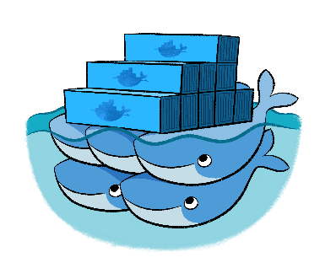
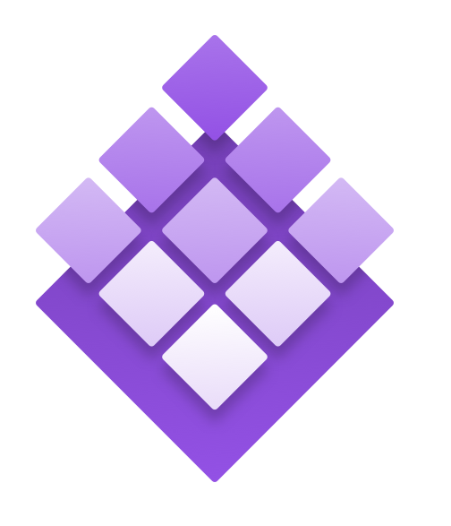
Learn more!
M403 – Thursday 10:30
Azure Container Service
Standard Docker tooling and API support
Streamlined provisioning of DCOS and Docker Swarm
Linux and Windows Server containers
Azure and Azure Stack
DC/OS
Swarm

Slide 23
Azure Container Service Demo

Slide 24



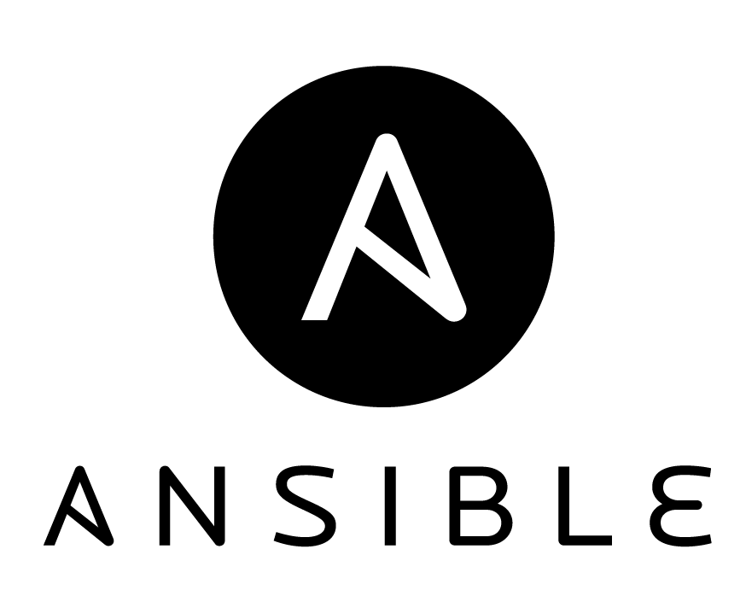

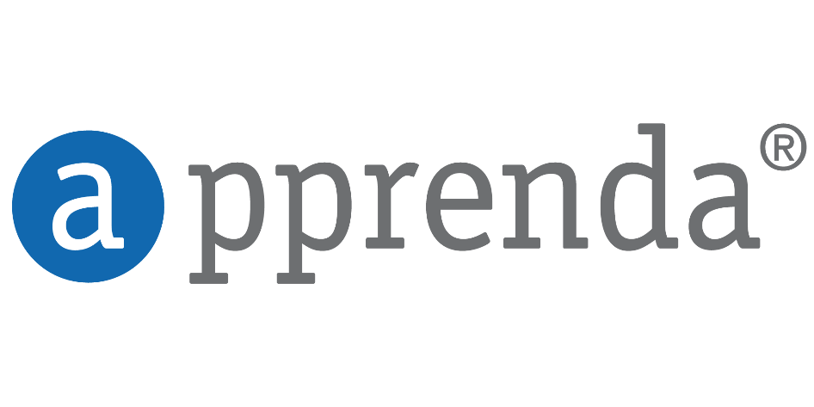






















Management
Applications
Choice + Flexibility
App Frameworks
Databases & Middleware
Infrastructure
Linux

Slide 25
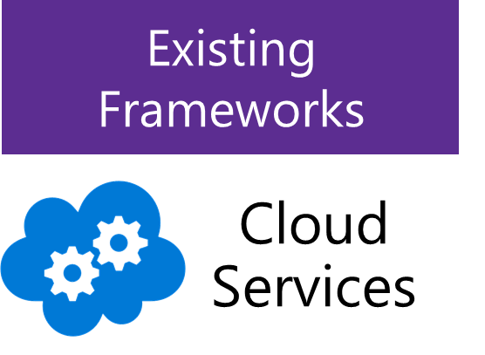
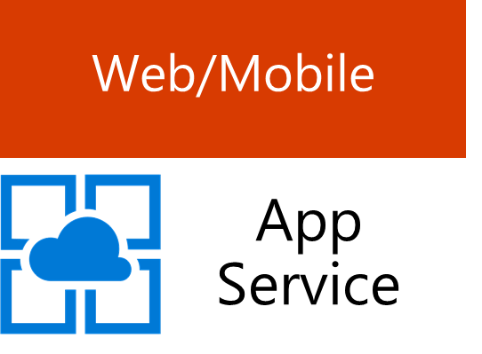
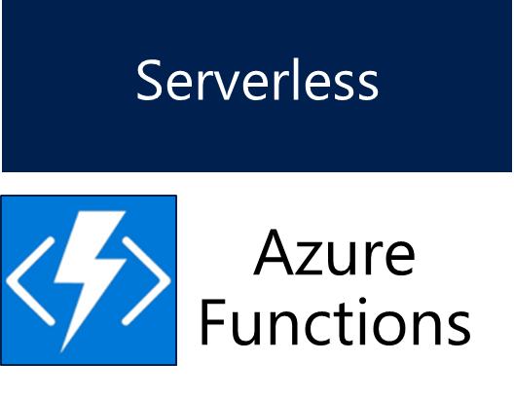
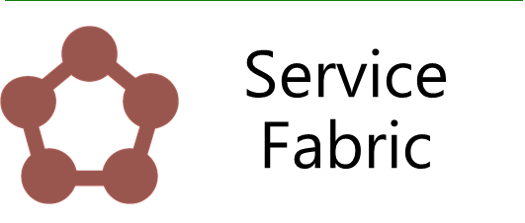
Platform Services
Prescriptive
Microservices
Event-based

Slide 26
Microservices

Slide 27
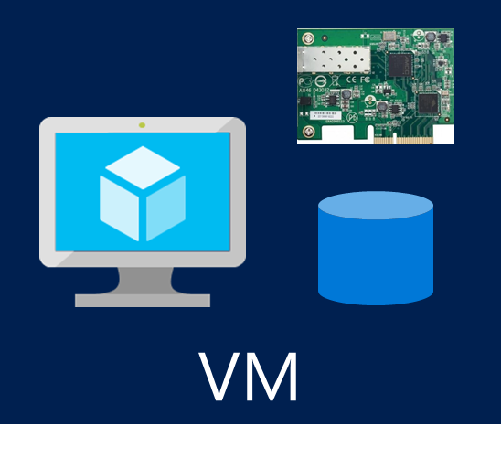
Container Service
Service Fabric
orchestration and composition
prescriptive managed framework
VM Scale Sets
flexible infrastructure
Microservices with Azure

Slide 28
Learn more!
M347 – Thursday 9:00
Service Fabric
Azure Service Fabric
Prescriptive microservice platform
Stateful and stateless microservices in Docker containers
.NET and Java API’s on Windows Server and Linux
Deploy on Azure, Azure Stack, VMware, OpenStack, AWS

Slide 29
Web + Mobile + Event-Based

Slide 30


Azure App Service
Build and scale great cloud apps
Web Apps
Mobile Apps
Logic Apps
API Apps

Slide 31




Code
Events + data
Learn more!
M383 – Friday 10:30
Azure Functions
Trigger on events in Azure + external services
Pay only per execution
C#, Node.js, F#, Python, PHP, Java, bash, batch
Open source runtime runs anywhere

Slide 32
Azure Functions Demo

Slide 33
No server management
No server patching
No server-based scaling
More granular transactions
App Service
Azure Functions
Serverless Compute platforms

Slide 34
Container Service
Service Fabric
Azure Functions
orchestration and composition
prescriptive managed framework
event-driven composition
VM Scale Sets
flexible infrastructure
Microservices with Azure

Slide 35
Networking

Slide 36





Virtual Network - Recap
VNet – Your network, your policies
Private and secure connectivity
DMZ and backend subnets
NSGs and custom routes (UDR)
Load balancing for Internet and Internal facing apps
Integration with PaaS
Custom traffic shaping with NVAs
VNet to VNet through Gateway
Hybrid connectivity (VPN and ER)
Internet
Front end subnet
Back end subnet
Traffic stays within MS network
Traffic to on-premises and other VNets
Storage
SQL DB

Slide 37
Virtual Network Enhancements
Network speed enhancements
Accelerated networking (SR-IOV, up to 25Gbps)
vNet Peering
MAC Persistence
IPv6 inbound via load balancer
Network diagnostics

Slide 38
vNet Peering Demo

Slide 39
Azure Innovation into the future
Regions
Sizes
Services
Development solutions
Management controls
Agility
>
(More)

Slide 40
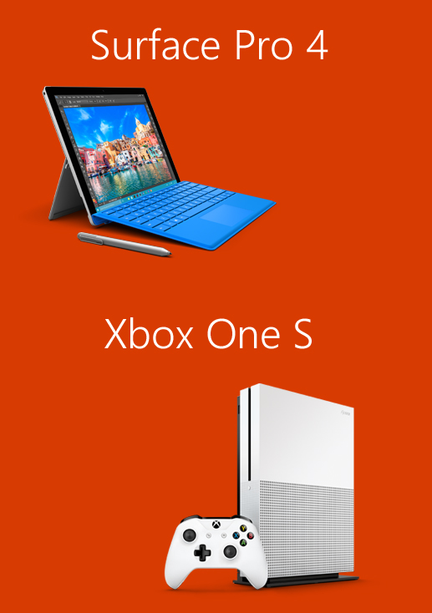
Please evaluate this session for the chance to instantly win great prizes like Surface Pro 4 and the brand new Xbox One S!
Your feedback is important to us!
From your PC or Tablet visit My Ignite at http://msignite.nz/my-ignite

