Slide 1

Microsoft Ignite NZ
25-28 October 2016
SKYCITY, Auckland

Slide 2
An Introduction to the SharePoint Framework Development Model
[M200]
Gavin Barron

Slide 3




About me.
Gavin Barron
@gavinbarron
gavinbarron
Solution Architect
http://gavinb.net
5x SharePoint Server MVP
Building on SharePoint since 2007
Building on Office since 2002

Slide 4
Agenda
What the heck is the SharePoint Framework?
How does this model differ from the previous ones?
Getting started
Hello World
Integration with SharePoint
Integration other data sources?

Slide 5
What the heck is the SharePoint Framework?
This is Preview Software!

Slide 6



SharePoint Framework Components
User Experience
Packaging
Build Process & Tooling
Client-Side Web Parts
Modern Page Canvas
JavaScript Resource Management
Page Context & Site Data APIs
Client-side Solutions
Tenant-Scoped Deployment
Yeoman Templates
Gulp-based Build Process
SharePoint Workbench

Slide 7
How does this model differ from the previous ones?

Slide 8






Open source tooling
Build Process & Tooling
JavaScript Frameworks
Code Editors
Yeoman Templates
Gulp-based Build Process
NodeJS/NPM
SystemJS
Webpack
SASS
TypeScript
React
Angular
Knockout
and more … your choice!
Visual Studio Code
Atom
Sublime
and more … your choice!

Slide 9


Dev tool comparison
IIS Express
C#
MSBuild
Project Templates

Slide 10



Office UI Fabric
Fonts, icons
Colors
Front end experiences for SharePoint
Powers our Microsoft’s experiences
Available out of the box
Design web parts seamlessly
Office UI Fabric React for rich set of reusable controls
Components

Slide 11
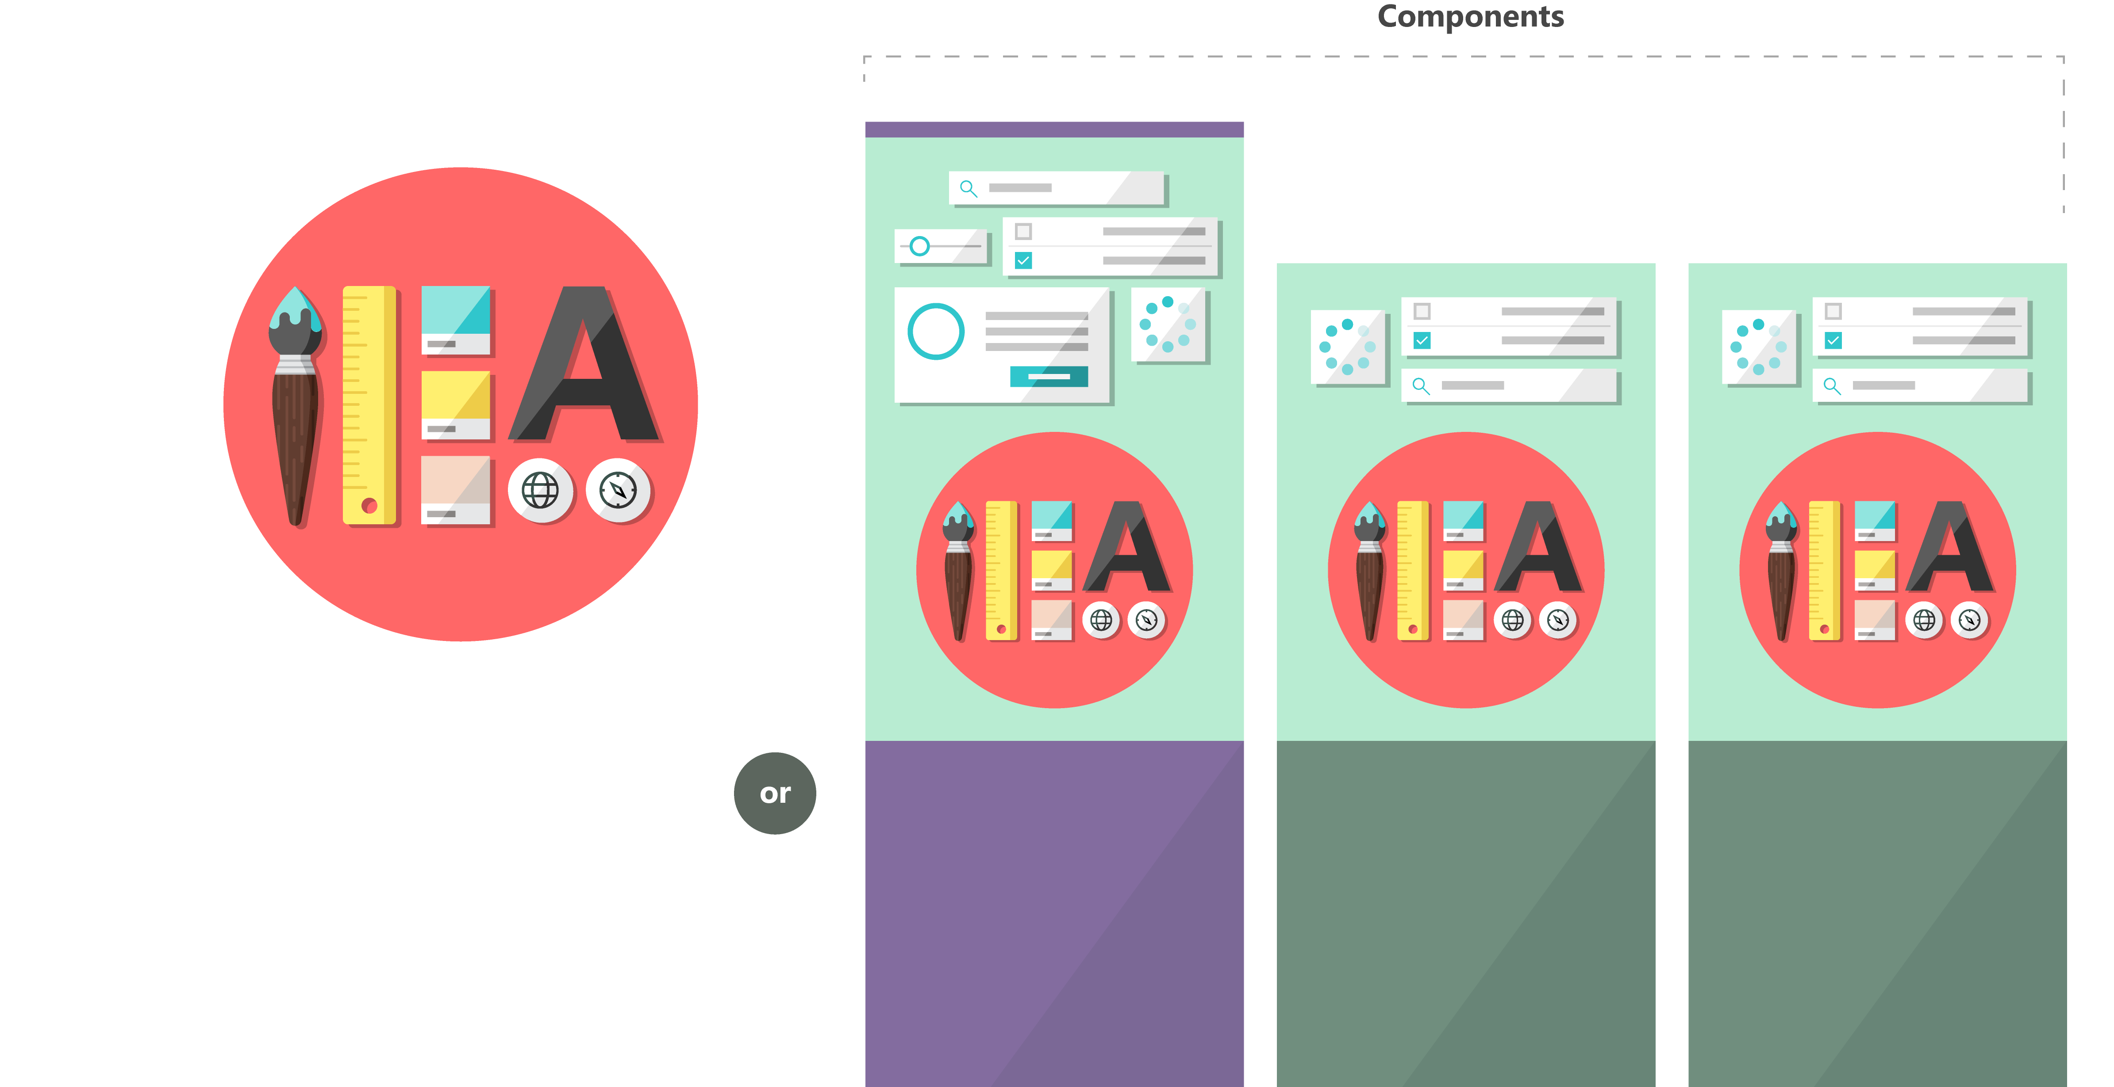

Fabric and its sub-projects
All depending on the Core, all open source
Community built
Fabric Core
Fabric React
Fabric JS
ngFabric
Fabric iOS
Core elements of the design language including icons, colors, type, and the grid
Robust, up-to-date components built with the React framework.
Simple, visuals-focused components that you can extend, rework, and build on.
Community-driven project to build components for Angular-based apps.
Native Swift colors, type ramp, and components for building iOS apps.

Slide 12
Getting started

Slide 13
Install all this:
Node.js LTS version (4.6.1)
Npm v3
Python v2.7
Microsoft Visual Studio 2015 update 3
  Or C++ Build Tools
Yeoman
Gulp

Slide 14
Or… just install node and use the prompt
npm i –g npm@3
npm i –g --production windows-build-tools
npm i –g yo gulp

Slide 15
Getting started
npm install –g @microsoft/sharepoint
yo @microsoft/sharepoint
Detailed instructions: https://github.com/SharePoint/sp-dev-docs

Slide 16
Hello World

Slide 17
Anatomy of a web part solution

Slide 18
Integrating with SharePoint

Slide 19
Using the workbench and mock data

Slide 20
Set up SharePoint
Create a developer site
Configure the Shared Documents library
Upload the workbench
Setup an App Catalog
Setup a CDN for deployment (optional)

Slide 21
Connecting to SharePoint

Slide 22
Setting up resources in SharePoint

Slide 23
What about other data sources?

Slide 24
Yes!
Any HTTP accessible data is available to you
Use External data to enhance SharePoint
BUT!
Take care about security

Slide 25
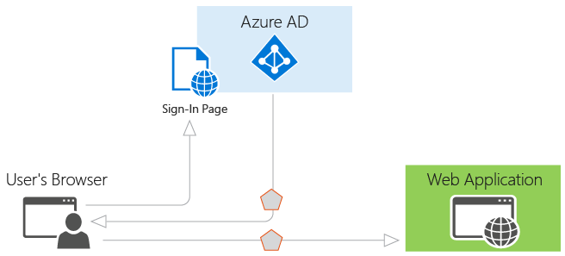
Tokens are vulnerable to replay

Slide 26
Wrap up

Slide 27
Conclusion
SharePoint Framework is a new way of working
There’s a learning curve
It’s easy to get started
It’s fun & productive
Integrate with care
https://github.com/sharepoint/sp-docs

Slide 28

Any questions?

Slide 29

Thank you.
Please keep in-touch:
Email: gavin.barron@teamintergen.com
Twitter: @gavinbarron
Blog: http://gavinb.net

