Slide 1
MS Ignite 101
IGNITE101
Naomi Moneypenny (MVP)
Andy Malone (MVP, MCT)

Slide 2
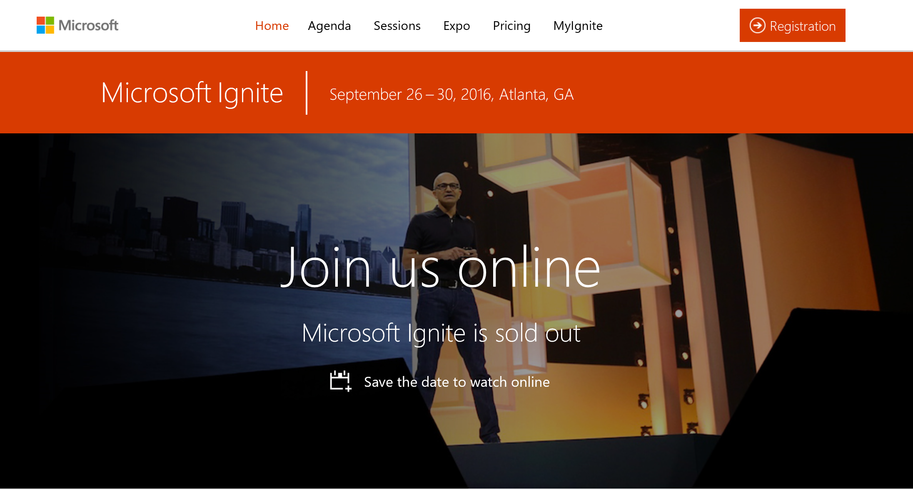
Welcome and THANK YOU for attending!
Microsoft Ignite
September 26-30, 2016
Atlanta, GA,
Georgia World Congress Center
(GWCC)
http://ignite.microsoft.com
http://myignite.microsoft.com

Slide 3
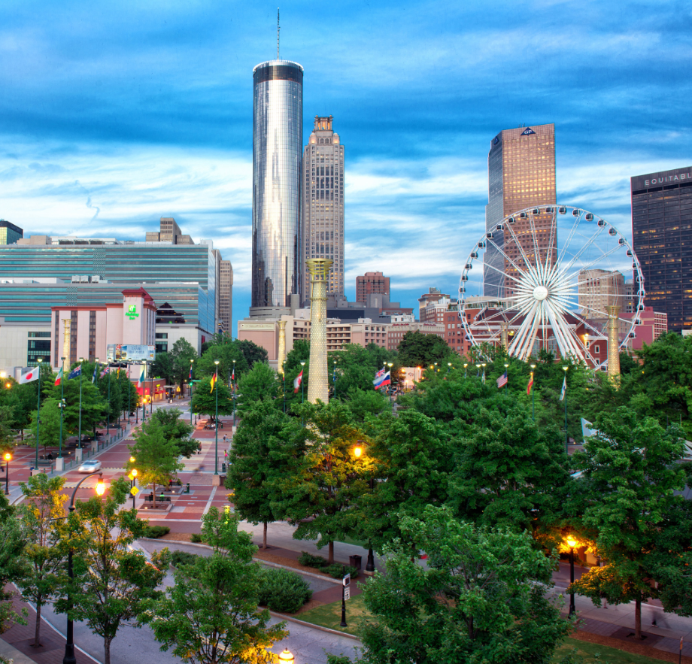
Microsoft Ignite
Sept 26 – 30, 2016
Georgia World Congress Center
|
Atlanta
Sold Out in July
Pre-days
Breakouts
Expo
Theater
Social Hours
Side Meetings
VIP Program
Networking
Labs
IT PRO
20,000+ attendees
ITDM
1300+ Sessions
Enterprise Dev & Architects

Slide 4
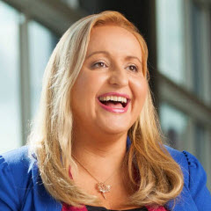
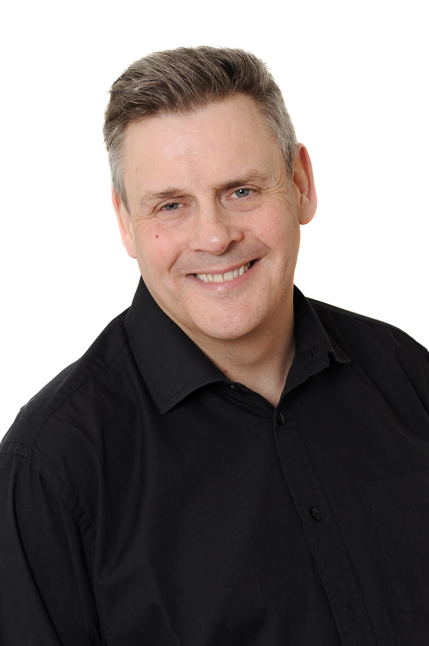
About Naomi…
About Andy…
CTO at ManyWorlds & MVP
Microsoft Tech Community, SPC, WPC, Build, Ignite, Channel 9
Drink at firehose of learning & sharing!
Microsoft MVP Security, Snr Tech Trainer, Security Specialist
Microsoft event speaker 12 Years, Ignite, TechEd etc
Great opportunity to learn new skills & Meet great folks

Slide 5
Microsoft Ignite Logistics

Slide 6
Microsoft’s Tier 1 Events:
Is this your first MS Ignite/MS Conference?
This is Microsoft’s second Microsoft Ignite Conference (last MS Ignite was in Chicago, May 2015)
Consolidation of Management Summit, the Exchange, SharePoint, Lync/Skype, Project, and TechEd conferences – Everyone in one place for a week!!!
Microsoft’s largest IT Pro Technology focused event: 20K+ Attendees
Target Audience
IT/Business Leaders
IT Pros & Decision Makers, Enterprise Developers
Developers
Partners
Tier 1 Event
Microsoft Envision
Feb/March
Microsoft Ignite
September
//build
March/April
WPC
July

Slide 7
Microsoft Ignite Audiences
Challenge what you know, reveal new opportunities, spark innovation, and see where technology is headed at the largest and most comprehensive Microsoft technology event.
IT Decision Makers
Final authority for purchase decisions in a particular technology area of their organization, but do not directly use or implement the technologies
IT Professionals
Technical SME for their organization in a particular technology area and have significant input on purchase decisions
Enterprise Developers & Architects
Developers create the programs that provide business solutions; architects link the business strategy, & processes to the IT strategy
Press & Analysts
Key industry influencers review our products and report on news to our customers

Slide 8
Microsoft Ignite
Atlanta | September 26-30, 2016
300+ partners at the Expo
20,000+Attendees
1300+ Sessions
IT Decision Makers
IT Pros, Enterprise Dev & Architects
Spark the future — Microsoft Ignite is for big thinkers looking for an edge. It’s for senior technical decision makers seeking what’s next, and who wants insights on key technology trends in the industry. It’s for IT professionals who need hands-on experience to enhance their technical skills. It’s for enterprise developers and architects looking for innovative ways to maximize application development. It’s for those who want to feel inspired and enlightened.
Objectives:
Establish Microsoft as the cloud vendor of choice
Educate IT and Developers and improve IT Pro satisfaction
Enable business and pipeline building
Build and invest in a vibrant customer community to expand reach and create advocates
Agenda at-a-glance
Day 1 | Day 2 | Day 3 | Day 4 | Day 5
Morning & afternoon keynotes General sessions & breakouts Tech Executive Forum Theaters Hands-on Learning Certification Testing Expo Hall Welcome Reception | Breakouts & mini breakouts Theaters Tech Executive Forum Hands-on Learning Certification Testing Expo Hall & Expo Social Hour Women in Technology Reception | Breakouts & mini breakouts Theaters Hands-on Learning Certification Testing Women in Technology Luncheon Expo Hall & Expo Social Hour | Breakouts & mini breakouts Theaters Hands-on Learning Certification Testing Expo Hall Attendee Celebration | Breakouts & mini breakouts Neighborhood theaters Hands-on Learning Certification Testing
More agenda details can be found here.
Content at-a-glance
Topics |  | Learning Experiences
Application Platform Communications Compliance Data Deployment Desktop Insights | Internet of Things (IoT) IT & Cloud Infrastructure Management Mobility Productivity Security Usage & Adoption | Best Practices Breakout sessions Case Studies Certification Testing Community Theaters Customer Showcases Deep Dives & Demos | Expert Connections General sessions Hands-on Learning Ignite Studios Immersions Interactive Digital Labs Keynotes | Microsoft theaters Overflow viewing Panel discussions Partner sessions Partner Theaters Personal Learning Paths Pre-Day Trainings | Product roadmaps, vision, & strategies Second Screen Experience Study halls & Exam Prep

Slide 9
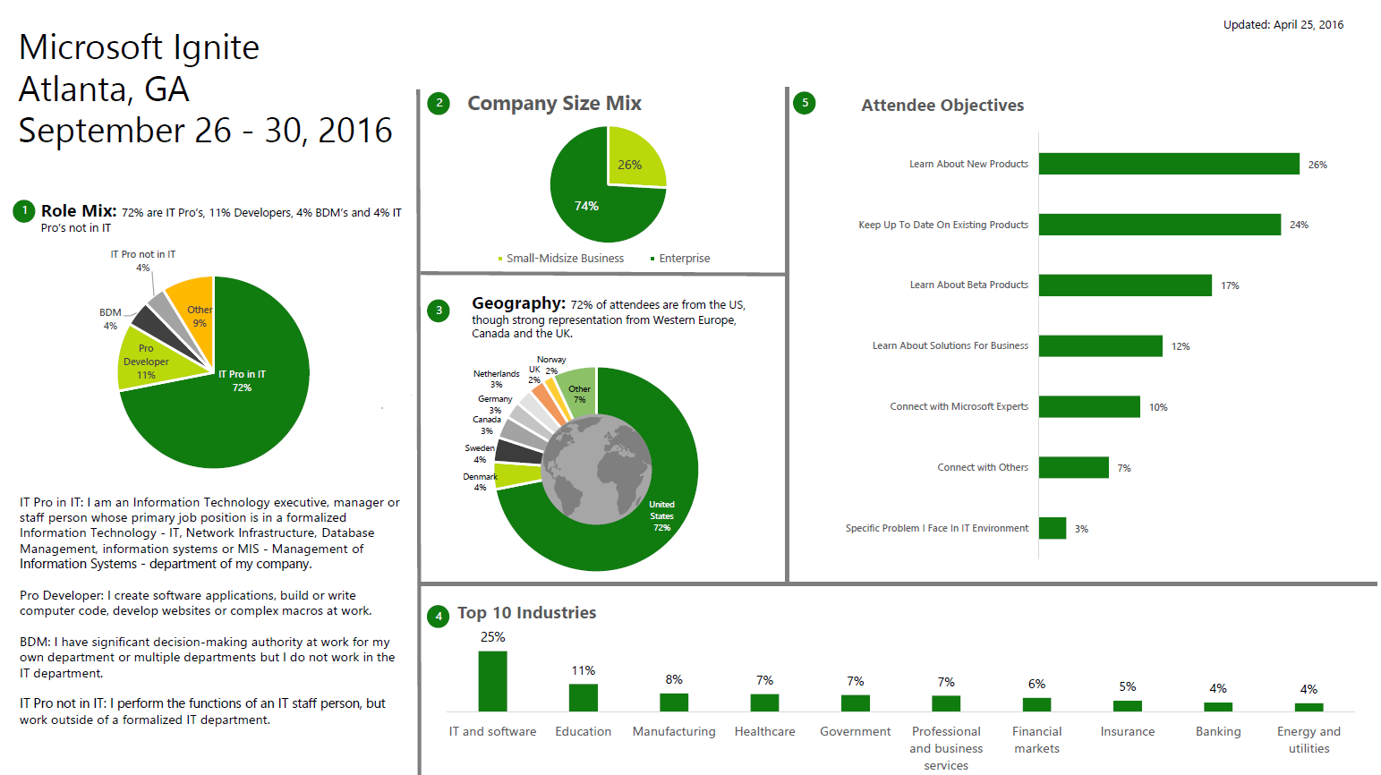

Slide 10
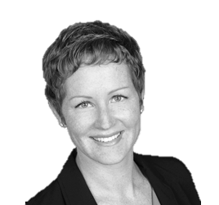
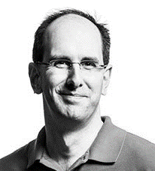
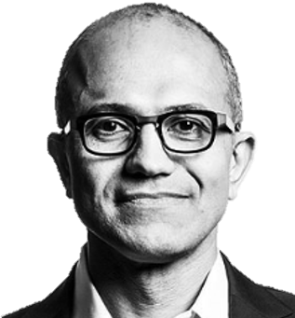
Keynotes
Keynote host
Monday, Sept. 26
9:00 – 10:30 AM, 4:00 – 5:00 PM
Phillips Arena
Julia White
GM, Cloud Platform
Microsoft
Morning Keynote
Monday, Sept. 26
9:00 – 10:30 AM
Phillips Arena
Scott Guthrie
EVP, Cloud & Enterprise
Microsoft
Innovation Keynote
Monday, Sept. 26
4:00 – 5:00 PM
Phillips Arena
Satya Nadella
Chief Executive Officer
Microsoft
Julia White is Microsoft Ignite’s conference and keynote host this year! Look for Julia during Monday’s keynotes where she’ll provide behind the scenes information and join both Scott Guthrie and Satya Nadella onstage to discuss the future of tech.
Join Scott Guthrie in the Phillips Arena on Monday morning to kickstart Microsoft Ignite. Scott will cover today’s key technology that is changing the role of IT in the future, and will be joined by special guests, some of whom will show off a few great demos.
Satya Nadella will close out the first day of Microsoft Ignite on Monday afternoon for a must-see presentation on next generation innovations that are fundamental to shaping IT in the foreseeable future.
.

Slide 11
General Sessions
Monday, Sept 26 | 11:00 A.M. –12:15 P.M.
Session Code | Topic + Title | Speaker(s)
GS02 | Cloud Voice: Move all your communications to Skype for Business Online | Gurdeep Pall
GS03 | Office 365: Powering IT Transformation with Office 365 | Kirk Koenigsbauer
GS04 | Developer: Overview of the Microsoft Application Platform for Developers | Scott Hanselman
GS05 | Cloud Infrastructure: Reinventing agility and productivity with the Microsoft Cloud | Jason Zander
GS06 | Security: Secure & Manage Your Digital Transformation | Brad Anderson
GS07 | Windows 10 Enterprise: The future is closer than you think; broadly deploying Windows 10 for business | Rob Lefferts
GS08 | Data & IOT: The Unreasonable Effectiveness of A.C.I.D | Joseph Sirosh

Slide 12
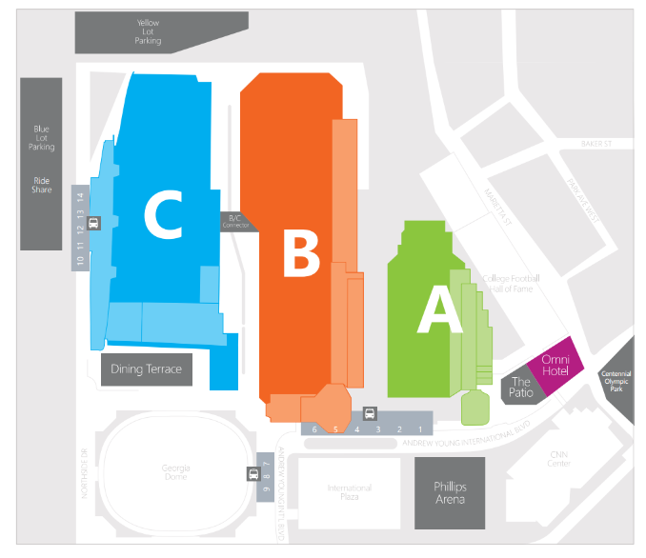
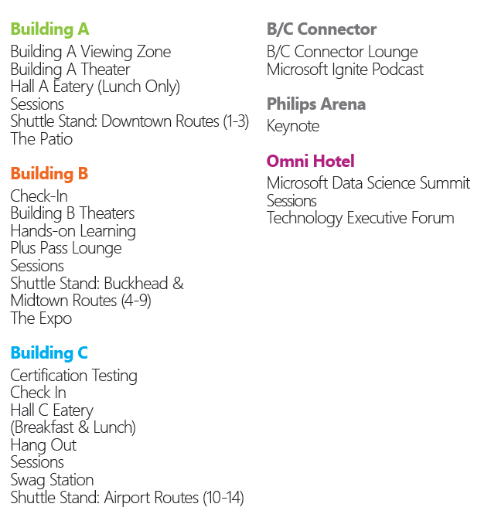
Microsoft Ignite campus
Developers: Building A
ITDM: Building B
IT Pro: Building C

Slide 13
The Expo
The Expo brings together Partner Solutions and Microsoft Product Groups, within the Microsoft Showcase, to bring to fruition a cohesive learning experience and create an interactive space for attendees to network, learn and do business.
Join us in Hall B to:
Discover partner solutions and product offerings
Learn about current and soon-to-be-released products and services
Talk to the product experts and evaluate solutions for your company's technological challenges
Network to establish or renew business connections
Discover tools, services, programs and experts to help make your job easier
Find training and learning opportunities to help you develop and hone your skills
Meet experts and peers to expand your professional network, share knowledge and build communities
Expo hours
Monday, September 26 | 12:15 PM – 7:00 PM
Tuesday, September 27 | 10:00 AM – 6:00 PM
Wednesday, September 28 | 10:00 AM – 6:00 PM
Thursday, September 29 | 10:00 AM – 4:00 PM

Slide 14
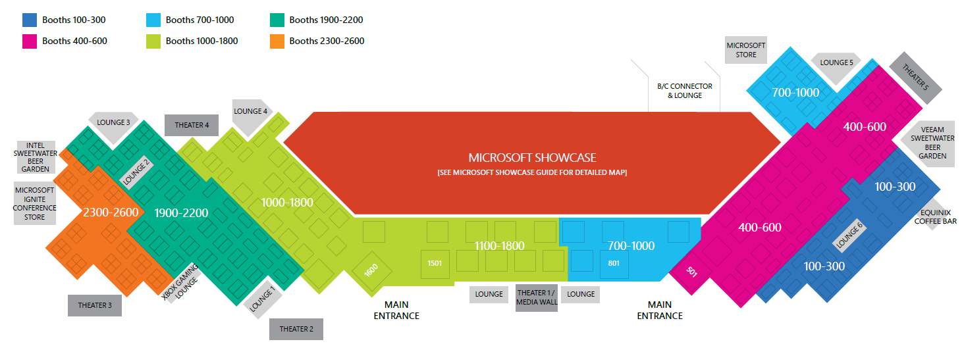
The Expo Map

Slide 15
Microsoft Showcase
Bring your top questions and challenges to the Microsoft Showcase in the Expo, where you can explore you organization’s opportunities in focused conversations with Product Experts for all of Microsoft’s products and services at over 150 product demos.
Microsoft Showcase offers
7 Microsoft theaters Microsoft Technology Center sessions Customer Immersion Experience – hear from successful customers such as Renault Sport Racing, Operation Smile and EcoLab
Microsoft Showcase hours
Monday, September 26 | 12:15 – 7:00 PM
Tuesday, September 27 | 10:00 AM – 6:00 PM
Wednesday, September 28 | 10:00 AM – 6:00 PM
Thursday, September 29 | 10:00 AM – 4:00 PM

Slide 16
Welcome Reception and Social Hours in The Expo
Welcome Reception
Social Hours
The Expo, Hall B1-B5
Monday, Sept 26, 5:00 – 7:00 PM
Join us in The Expo for a Welcome Reception to connect with the community of experts at Microsoft Ignite. Check out Microsoft product demos, talk with Microsoft Experts, engage with Microsoft Partners, and interact with Community experts.
The Expo, Halls B1-B5
Tuesday, Sept. 27 & Wednesday, Sept. 28
5:00 – 6:00 PM
Join us in The Expo to grab a beverage, network with your peers, and learn more about the offerings Microsoft Partners and Product Groups have to offer.

Slide 17
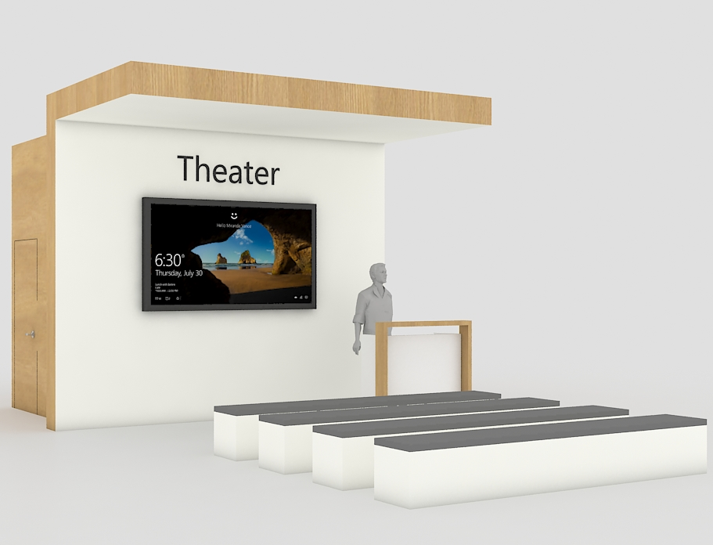
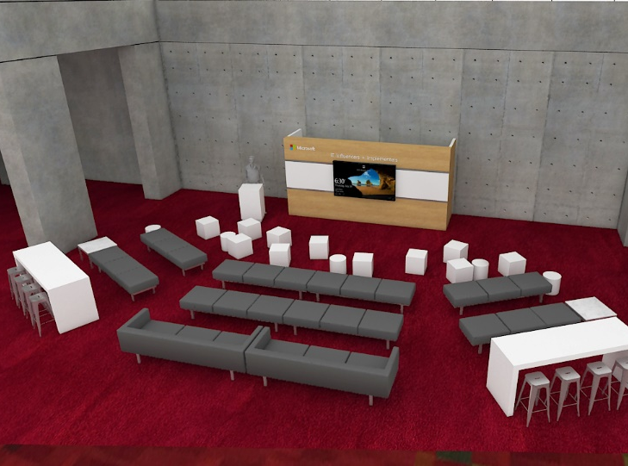
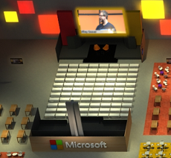
Theaters
At Microsoft Ignite this year we have several different theater locations though out the GWCC:
Microsoft Theaters
Partner/Community Theaters
Building A & B Theaters
Ignite Studios
7 total theaters located in the Expo in the Microsoft Showcase
Sessions presented by Microsoft
Seating for around 25 in each theater plus standing room
Theater sessions not recorded
5 total theaters located in the Expo
Sessions presented by Partners and Community
Seating for around 150 in each theater
Theater sessions not recorded
3 total theaters located out the Expo in the following locations:
Bldg B – Level 2
Bldg B – Level 4
Bldg A – Level 3
Repeated content from Microsoft theaters
Seating for around 50 in each theater
3 theaters are recorded
1 Large theater in the Hall C Hang Out
Sessions presented by Microsoft led by Jeremy Chapman
Seating for 300
Ignite Studio sessions are recorded

Slide 18
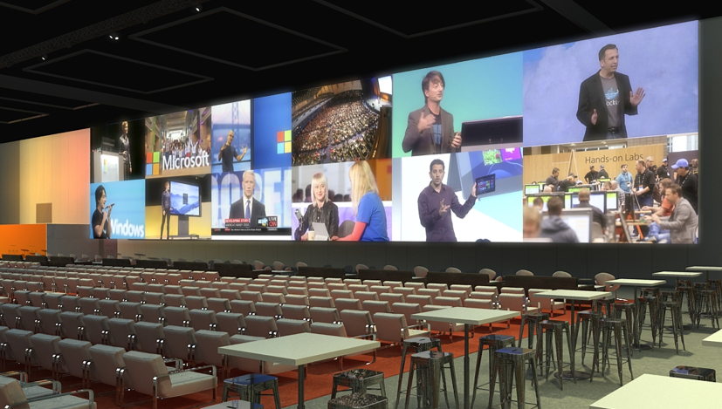
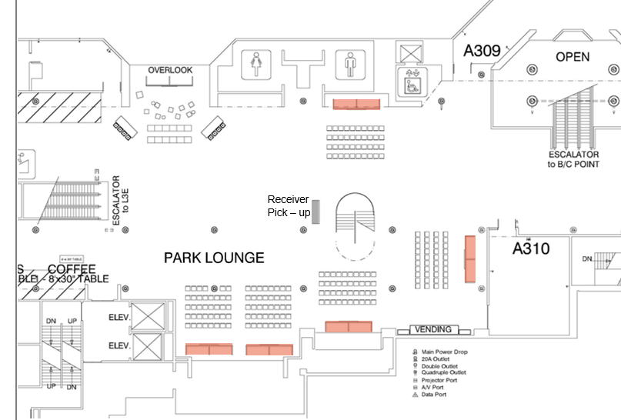
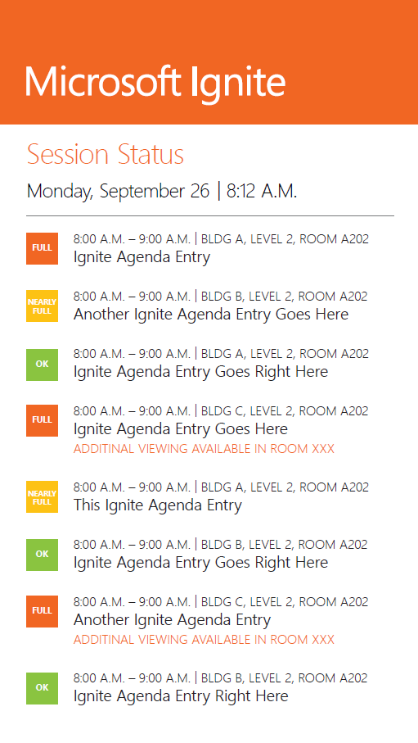
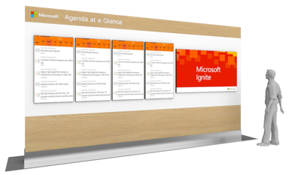
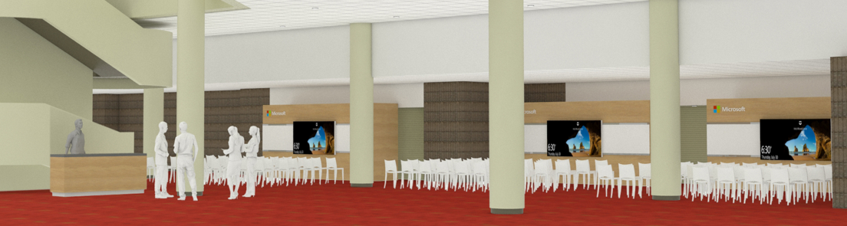
Additional Viewing Areas: Hall C & Hall A
Hall C Hang Out
Hall A
Digital Signage throughout Venue
Neighborhood theaters will be repeat content (150)
In Hall C Hang Out and Hall A Additional Viewing areas, attendees can watch and listen to breakout sessions that are full during each timeslot.
Attendees can use their own headphones or grab Microsoft Ignite provided headphones to tune in to selected breakout session.
The Content team will be closely monitoring which sessions are full to determine which sessions will stream to these additional viewing areas.

Slide 19
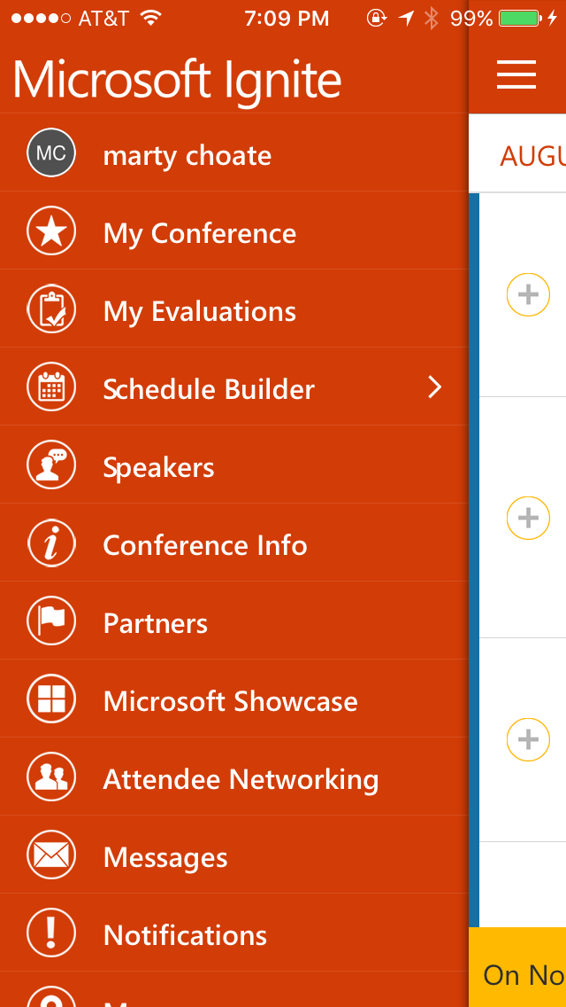
Microsoft Ignite mobile app
The Microsoft Ignite mobile app is your one-stop shop for all conference information.
In addition to providing easy access to essentials such as the Schedule Builder and speaker/session information, the app offers new features such as:
Second Screen Experience – launch your second screen experience on a laptop, tablet or mobile device and follow your session PowerPoint presentation, engage in Community discussions, and livestream a breakout session
Interactive Digital Labs bookmarketing and reminders – self-directed labs can be bookmarked, added to your schedule, and launched from MyIgnite
Session Recommendation Wizard – get recommendations for sessions most relevant to you
Session Playlist – create a playlist of sessions to watch on-demand
Download the app today (available on Windows 8.1/10, iOS, or Android):
https://aka.ms/ignite.mobileapp
Mobile navigation example

Slide 20
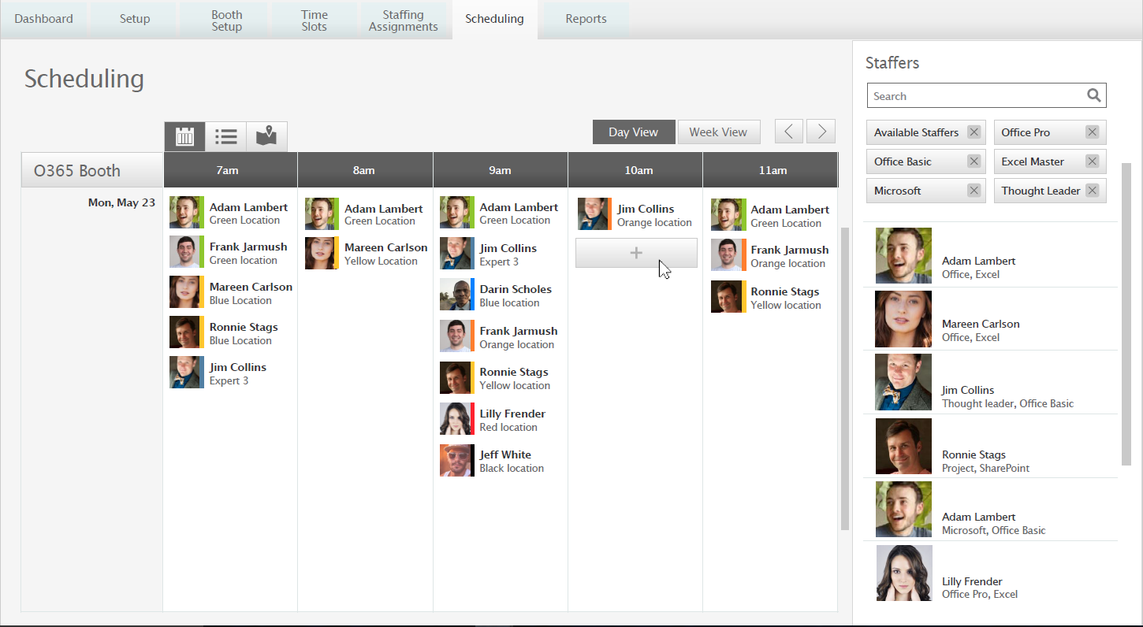
Microsoft Ignite Expert Finder
The Microsoft Expert Finder will enable attendees to search for Microsoft solution and product experts, see their availabilities, and find their locations at Microsoft Ignite.
Learn more at https://aka.ms/ignite.expertfinder

Slide 21
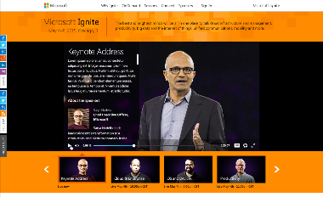
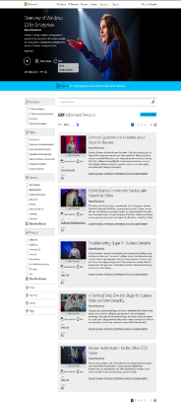
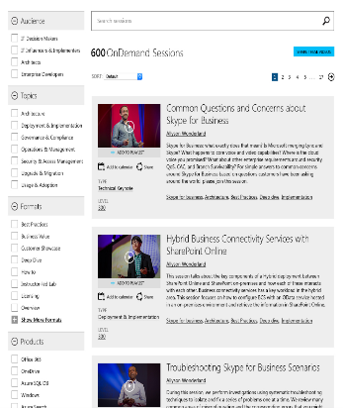
Online Viewing
Monday, September 26: Live Streaming Keynote & General Sessions on ignite.microsoft.com​
8:30 AM – 11:00 AM: Keynote and Pre/Post Show​
11:00 AM – 12:15 PM: Live streaming all 8 General Sessions – choose which one you want to see live and then the rest will be available On-Demand​
12:15 PM – 3:30 PM: Microsoft Ignite Studios​
3:30 PM – 5:30 PM: Keynote and Pre/Post Show
Monday, September 26 – Friday, September 30: In-person attendees will be able to launch a second screen experience (laptop, tablet, and mobile) from MyIgnite and the mobile app that will allow them to follow along via the session PowerPoint, engage in the Community discussions, and even live stream any breakout session. ​
​
Beginning Tuesday, September 27: Content (PPT and Video) will be available On-Demand 24-48 hours after each session and attendees will be able to access on MyIgntie and the mobile app

Slide 22
Wireless access
Feel free to connect to and use the following WiFi network: MSFTWIFI
When you are prompted for a password, use: Microsoft
Dedicated speaker WiFi will be available in breakout rooms.
To improve your WiFi experience, make sure you are not connected to an ad-hoc/peer-to-peer network, and that you are in an area that supports WiFi.
Due to the user load in congested areas, you may experience a slow connection or have difficulty connecting to the network at times. If that is the case, you may want to move to a less congested area. Rogue APs can cause problems for attendees attempting to use the wireless system and can degrade WiFi performance for everyone. Please don’t use Personal Access Points or base-stations of any kind inside the GWCC.
Security and the Microsoft Ignite Wireless Network
The wireless network at Microsoft Ignite is a shared network, designed to require minimal configuration by attendees. We’ve enabled WPA security protocol, though we do recommend that you be prudent in securing your resources, as you should on any public wireless network.

Slide 23
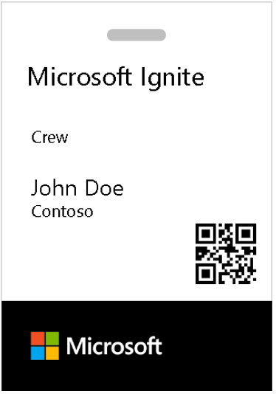
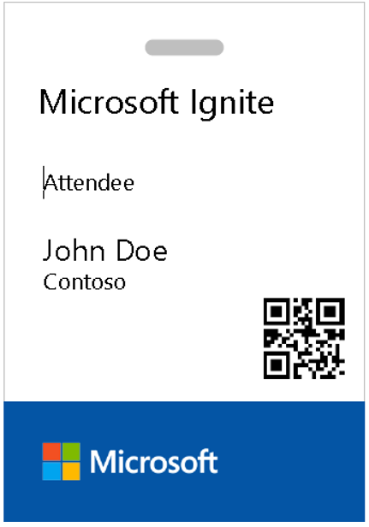
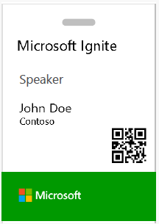
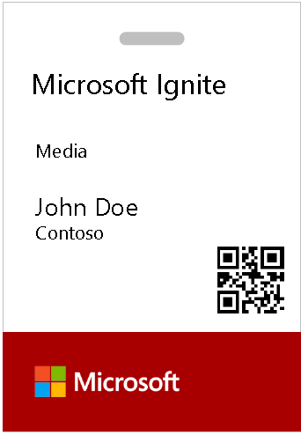
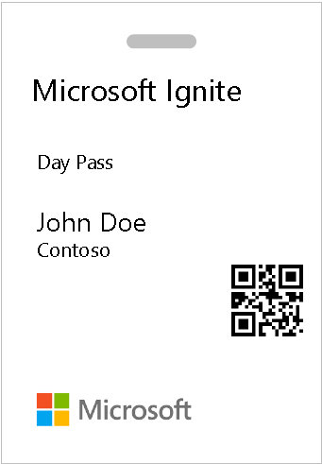
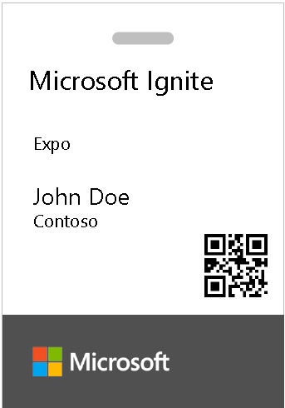
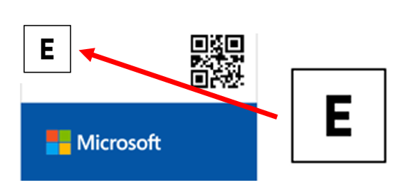
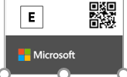
Badge identification
Crew
Valid Sept. 23-Oct 2 ALL AREAS/ALL HOURS
Crew meal room
Crew offices
Keynote – Sept 26 early set up access concourse & higher
No access to back stage or event level without keynote laminate
Attendee
Valid Sept. 26-30 ALL AREAS/ALL HOURS
Keynotes (show open hours only)
Attendee areas (show open hours only)
The Commons (show open hours)
Speaker+Staff
Valid Sept. 23-30
Keynotes (show open hours only)
Session room levels (24x7 access)
Access to Speaker Workroom
Press
Valid Sept. 26-30 Show Hours Only
Keynotes (show open hours only)
Access to Press Rooms
Attendee areas and events (show open hours only)
Day Pass
Valid Sept. 27-29 Show Hours Only
Note day/date of pass on badge
Access to attendee areas and events for day of badge
Access to Expo evening events for day of badge
Expo Pass
Valid Sept. 23-29 Show Hours Only
No access to Breakout Sessions
No keynote access – can view in Expo
Expo Sponsor/Exhibitor Attendee
Expo Sponsor/Exhibitor Staff

Slide 24
Attendee transportation schedule
Microsoft Ignite shuttles begin operation on Sunday, Sept. 25, and run through Friday, Sept 30. Make sure to check your conference guide and the mobile app for your route schedule and hours. Posted shuttle routes and Microsoft Ignite transportation ambassadors will be in most Microsoft Ignite hotel lobbies to assist with questions.
Stewart Transportation representatives will be available during all shuttle hours and will be located outside GWCC Halls A-C and the Georgia Dome. If you require special transportation needs, please call (206) 852-7695.
Sunday, Sept. 25 | Monday, Sept. 26 | Tuesday, Sept 27 | Wednesday, Sept. 28 | Thursday, Sept. 29 | Friday, Sept. 30
7:30am – 10:30am Continuous shuttle service every 10-15 minutes between 16 conference hotels, Georgia World Congress Center Halls A-C, & Georgia Dome 10:30am – 2:30pm No shuttle service 2:30pm – 5:30pm Continuous shuttle service every 10-15 minutes between Georgia World Congress Center Halls A-C, Georgia Dome & 16 conference hotels | 6:30am – 10:15am Continuous shuttle service every 10-15 minutes between 16 conference hotels, Georgia World Congress Center Halls A-C, & Georgia Dome 10:15am – 6:00pm No shuttle service 6:00pm – 8:00pm Continuous shuttle service every 10-15 minutes between Georgia World Congress Center Halls A-C, Georgia Dome & 16 conference hotels | 7:00am – 10:30am Continuous shuttle service every 10-15 minutes between 16 conference hotels, Georgia World Congress Center Halls A-C, & Georgia Dome 10:30am – 3:45pm No shuttle service 3:45pm – 6:45pm Continuous shuttle service every 10-15 minutes between Georgia World Congress Center Halls A-C, Georgia Dome & 16 conference hotels | 7:00am – 10:30am Continuous shuttle service every 10-15 minutes between 16 conference hotels, Georgia World Congress Center Halls A-C, & Georgia Dome 10:30am – 3:45pm No shuttle service 3:45pm – 6:45pm Continuous shuttle service every 10-15 minutes between Georgia World Congress Center Halls A-C, Georgia Dome & 16 conference hotels | 7:00am – 10:30am Continuous shuttle service every 10-15 minutes between 16 conference hotels, Georgia World Congress Center Halls A-C, & Georgia Dome 10:30am – 4:00pm No shuttle service 4:00pm – 6:00pm Continuous shuttle service every 10-15 minutes between Georgia World Congress Center Halls A-C, Georgia Dome & 16 conference hotels 7:00pm – 11:00pm Continuous shuttle service every 10-15 minutes between 16 conference hotels & Centennial Olympic Park | 7:30am – 2:00pm Continuous shuttle service every 10-15 minutes between 16 conference hotels, Georgia World Congress Center Halls A-C, & Georgia Dome

Slide 25
Event Conduct

Slide 26
Microsoft Ignite Event Code of Conduct
Microsoft's mission is to empower every person and every business on the planet to achieve more. This includes at Microsoft Ignite where we seek to create a respectful, friendly, and inclusive experience for all participants.
As such, we do not tolerate harassing or disrespectful behavior, messages, images, or interactions by any event participant, in any form, at any aspect of the program including business and social activities, regardless of location.
We do not tolerate any behavior that is degrading to any gender, race, sexual orientation or disability, or any behavior that would violate Microsoft’s Anti-Harassment and Anti-Discrimination Policy, Equal Employment Opportunity Policy, or Standards of Business Conduct. In short, the entire experience at the venue must meet our culture standards.
We encourage everyone to assist in creating a welcoming and safe environment. Please report any concerns, harassing behavior, or suspicious or disruptive activity to venue staff, the event host or owner, or the nearest security guard or event staff.
Microsoft reserves the right to refuse admittance to, or remove any person from Microsoft Ignite at any time in its sole discretion.

Slide 27
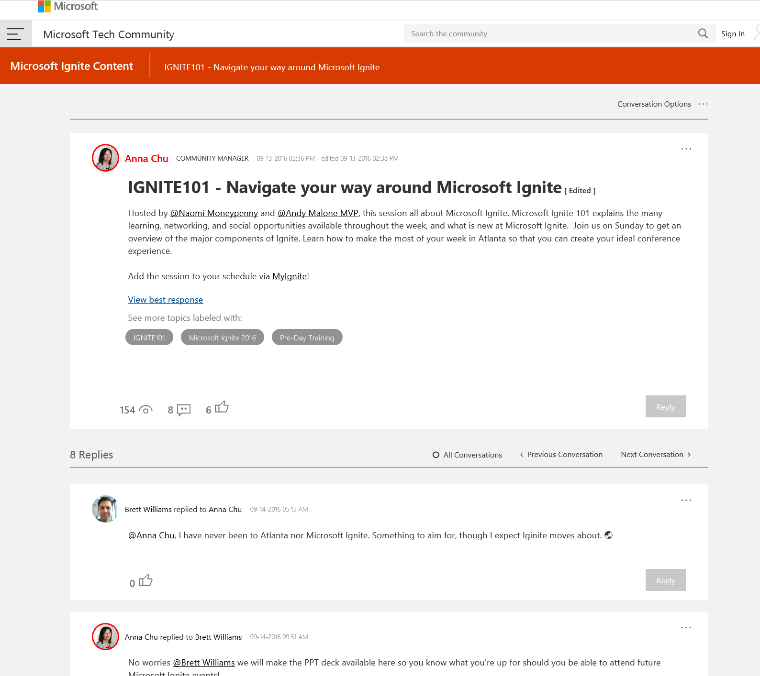
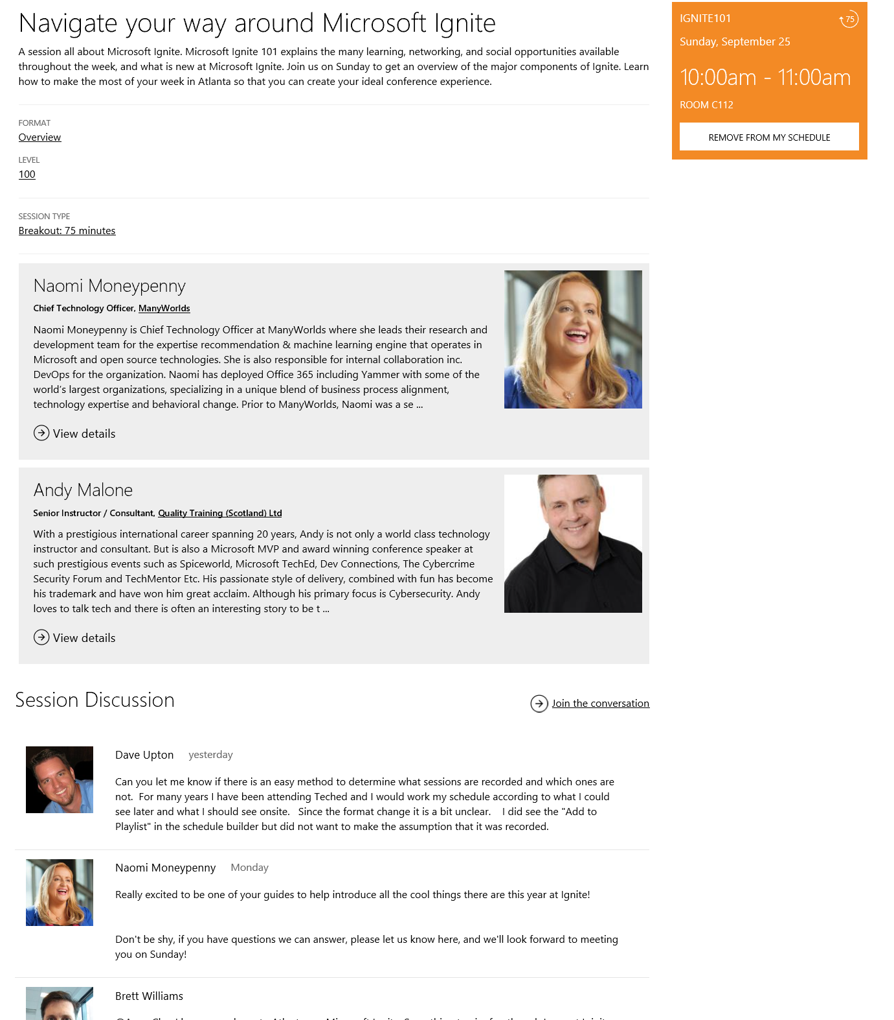
Join the conversation
Want to engage with speakers and fellow attendees on a specific session or topic? Need a place to direct questions online after you attend a session?
A conversation is aligned to each MS Ignite session! Get involved in the conversation at Microsoft Ignite – ask questions, seek advice and get to know the people who are delivering sessions!
Join the Microsoft Tech Community https://techcommunity.microsoft.com
Create a new account (if you are not already a member)
Search for a session by session code e.g. BRK1007
Post a question or comment in the discussion, watch session recordings or download the deck!
Discussions will be connected to MyIgnite app! You can go to http://ignite.Microsoft.com to post comments, watch videos and download decks as well.
Questions? Ask techcommunity@microsoft.com

Slide 28
Action Items
TODAY: Build your schedule for the week at http://myignite.Microsoft.com
TODAY: Download the Mobile App at https://aka.ms/ignite.mobileapp
THIS WEEK: Join the Tech Community discussion at http://techcommunity.Microsoft.com

Slide 29
Naomi's Top 10 Ignite Tips
Use Office Lens & OneNote to take collaborative notes, capture photo highlights to share with colleagues in Sway
Use Ignite App to connect with each other
Find experts all the time – search & get answers
Theater sessions in expo hall (mostly) not recorded
Create Playlists to help target sessions for different roles, or to rewatch later and share with others
Say Hello first – we’re here and we’re all on the geek spectrum!
Hydrate at every opportunity ☺
Party responsibly - remember everything lives forever on social media
Continue the conversations on Microsoft Tech Community all year!
Computer Science Edu Thursday @ 10.15am & my other sessions ☺

Slide 30
Andy's Top 10 Ignite Tips
Don't try and catch every Breakout session (They're Recorded)
Don't be Late to Sessions!
Please remember, your feedback helps make the event better
Solve Problems by chatting to the MS Boothbabes
Get Certified & Save 50% Off the price of exams
Take the Hands on Labs, They're awesome!
Grab the FREE Swag!
Be Sociable, Make Friends & New Contacts!
Attend the Party!
Don't forget to attend my sessions:-)

Slide 31
Questions?

Slide 32
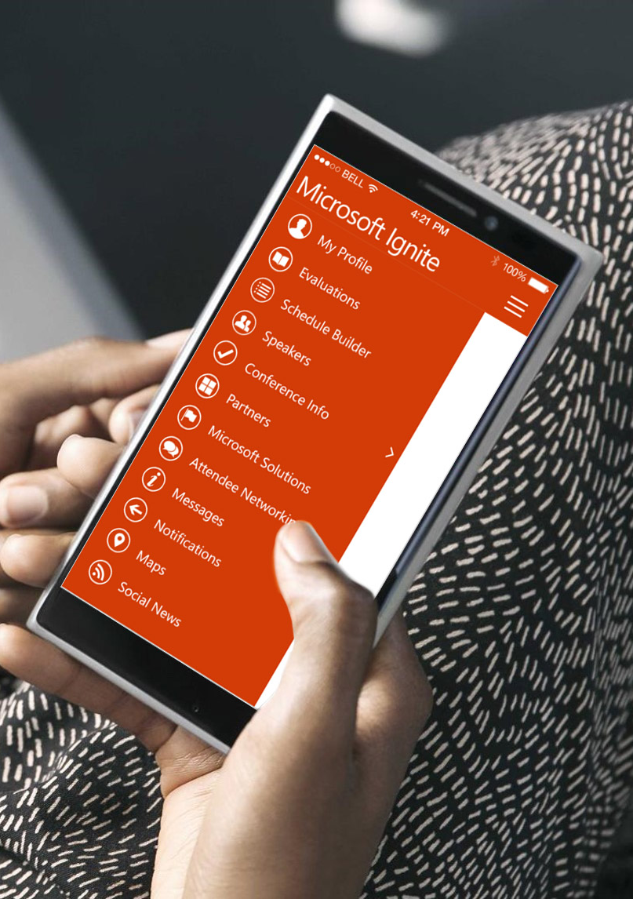
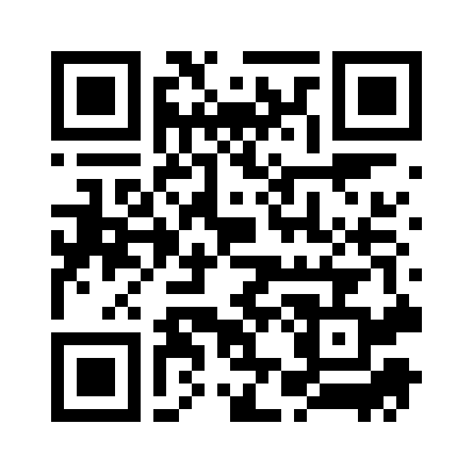
Please evaluate this session
Your feedback is important to us!
From your PC or Tablet visit MyIgnite at http://myignite.microsoft.com
From your phone download and use the Ignite Mobile App by scanning the QR code above or visiting https://aka.ms/ignite.mobileapp

Slide 33
Thank you!

