Slide 1
Maximize the performance and scale of Microsoft Dynamics AX
BRK4025
Christian Wolf

Slide 2
Agenda
Dynamics AX 7 scalability
  Understand how the new Dynamics AX scales
  See current load test results
  Scalability roadmap
Dynamics AX 7 performance troubleshooting
  See all tools available
  Demo: How to walk from tool to tool and when to use which tool
Dynamics AX 7 load testing
  The perfSDK
  Demo: Create a single user text
  Multi user testing

Slide 3
Dynamics AX 7 scalability

Slide 4
Architecture
Old
New
Win32 Controls
Client
Client.Session.Form
HTM / JS
Browser
Form design based view
AX32
Form data source based model
Interaction client
RPC / WCF
http requests(Click, Navigate, gotFocus) / WCF
AX32Serv.exe
AOS
Server.Session
Interaction service
Internet Information Server
Server.Session.Form
Change tracker
AOSKernel.dll

Slide 5








Deployment architecture for high availability (including optional retail server)
2..n VMs
Optional: Retail Server runs as an IIS WebApp. Scale out as needed.
Office365 including Power BI
Optional sync
to on-premises
Active Directory
OData
Optional: Azure BizTalk App Services
Azure Active Directory
AX App Server (AOS) runs as an IIS WebApp. Scale out as needed.
2..n VMs
Entity Store sync via batch fw and on demand sync
Azure Traffic
Manager
Azure Load Balancer
AX7 Client
(optional POS client)
Azure SQL Database Service Premium SKU (HADR). AX Database, both relational & columnstore
AX7 Client
(optional POS client)
2..n VMs
Azure BLOB Storage
AX files
Redirect to remote
Azure Data Center for business continuity
SSRS and Management Reporter run as IIS WebApps. Scale out as needed.
AX7 Client
(optional POS client)

Slide 6
Scalability features
Form Features (update 1 and 2)
    Optimized copy caller query
    Reduced loading of outer joined data sources
    Fast grid uptake
SQL Server features
  Read only secondary for tile cache and Query based reports without XDS.
Framework features
    RunAsync() – sample: Expense report
    Throttling of Async operations
    Asynchronous loading of fact boxes
    Create table as Hekaton table
Tooling
  Telemetry for finding slow running queries and monitor system performance
  Codegen for single and multi user testing
  PerfTimer
Entity Store on demand sync (Update 3)
  On demand sync is by analytics data model consisting of fact sheets and dimensions

Slide 7
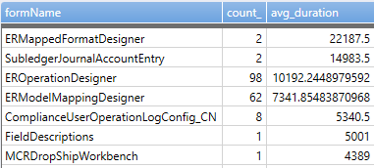
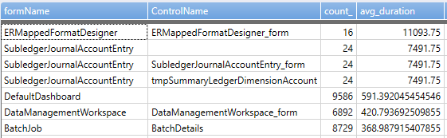
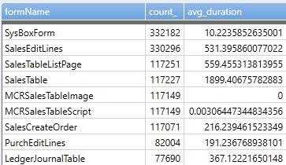
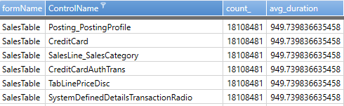
Scalability data from testing
100 Users
~ 7500 lines created and posted
300 Users
~22000 lines created and posted
500 Users
~39000 lines created and posted
800 Users
~60000 lines created and posted
No measurable or feel able regression
Overall small visible and feel able regression
AOS CPU ~ 48 %
SQL DTU ~ 40 %
AOS and SQL ~ 25-% avg
AOS and SQL ~ 10 %
Overall visible and feel able regression
AOS CPU ~ 95 %
System still feels very fast and responsive
SQL DTU ~ 60 %
Test composition
Tests run on update 2
Test flows are:
Order 2 Cash
Procure to Pay
General ledger Posting
Slow vs total Forms Slow vs total interactions
Environment
SQL Azure P6 (1000 DTU)
4 D13V2 AOS

Slide 8
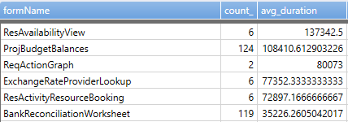
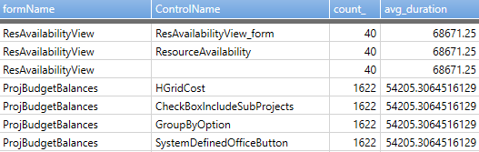
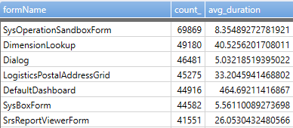
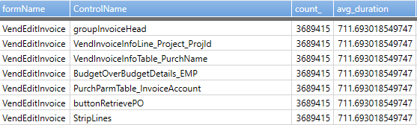
Live site performance
Slow vs total Forms Slow vs total interactions

Slide 9
Scalability roadmap (Planned)
Resolve temp db scale issue (Update 4)
  Log IO limitations on smaller SKUs cause 100 % DTU
  SQL team enabled global temp tables
  Build connection pool to keep objects alive
Insert_recordset uptake of sql sequences (Update 3)
  Removes interim step of temp table creation and truncate
  Contributes further to Log IO reduction but also overall speed
  Insert recordset often used together with update recordset and temp tables
Entity Store incremental sync (Update 4 or 5)
  Incremental sync

Slide 10
Dynamics AX 7 performance troubleshooting

Slide 11
Performance troubleshooting tools
While the issue is happening or with reproduction of issue
    PerfTimer
    F12 Menu
    Fiddler
Up to 4 weeks after the issue happened
  LCS Monitoring and diagnostics
  LCS SQL Insights
With repro / if everything else fails
    Trace Parser

Slide 12
Demo
Performance Troubleshooting flow AX 7

Slide 13
Dynamics AX 7 load testing

Slide 14
Dynamics Perf Testing Approach
Record Scenario using Task Recorder
Generate needed Data
(DET)
Run Load Test using VS Online
Generate C# Code
(VS Addin & Command line tool)
Modify code to make it a Multi-User Test

Slide 15
Evolution of Ax Perf Testing
On-Premise/Lab Based
Cloud IAAS Perf Approach
Cloud PAAS Perf Approach

Slide 16
The PerfSDK
Has all the bits to launch a perf test using VS Online
  Dispatchers
  CloudCTU
  FormProxies
  AosKernel
Has tools that help you create performance tests like codegen
Contains sample projects

Slide 17
Demo
Create single user test

