Slide 1
Develop, build, test and deploy your Dynamics AX applications
BRK4024
Robert Badawy
Principal Program Manager

Slide 2
Outline
Develop, Build and Test
  Development, build and testing tools
  Guidelines
Deploy code and data
  Overview of supported processes
Install hotfixes
  Overview of supported processes
Demo
Q&A

Slide 3
Develop, Build and Test

Slide 4
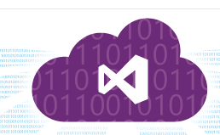

Slide 5
Guidelines
Continuous delivery
Be agile, deliver incremental features every sprint (2 weeks) or cycle (1 month).
  Take advantage of Dynamics AX build and test automation tools.
Use VSTS for work item tracking
  Always prioritize bugs over new features to avoid a large bug debt.
Rely on test automation
  Concentrate on Unit tests (SysTest framework) that are data independent or create their own data. Unit test can run on any environment.
  Smaller number of functional scenario tests (based on Task recorder) that relies on demo data.
    Scenario tests are more expensive to maintain.

Slide 6
Guidelines
Test automation
Write tests that run independently and not assume any kind of ordering.
Task recorder tests should be limited to functional scenarios tests.
  Write scenario tests once scenarios are complete and after completing unit tests.
Create test helper classes whenever possible so others on your team can leverage that as well.
The SysTest framework supports role-based testing, leverage this feature.
  Your tests will run within the context of a security role.

Slide 7
Guidelines
Test data
Create and manage your test database:
Start on a clean environment.
Create all base data as required. Base data will serve as the starting point for all the tests.
Take a backup (.bak) of your AxDB database.
Share this backup with developers.
On build VM, copy this backup over to the I:\DynamicsBackup\Databases, it can be restored with every build.

Slide 8
Guidelines
Customization
Use extensions instead of customizations (over-layering)
whenever possible.
  Faster build and dev tools experience, minimal upgrade impact, simpler ALM.
When you need to over-layer a method:
  Do not include functional or business logic in the over-layered code.
  Instead, define and call a delegate method, then implement the logic in your extension model using an event handler.
Report common over-layering scenarios to Microsoft, request extension support.

Slide 9
Deploy Code and Data

Slide 10
Some Definitions
Model
A Dynamics AX model is a group of elements (metadata and source files) that typically constitute a distributable software solution (including customizations of an existing solution). A model is a design-time concept.
For example: A warehouse management model, a project accounting model, …etc.)
Deployable package
  A Dynamics AX package is a deployment and compilation unit of one or more models. It includes model metadata, binaries, reports and other associated resources. One or more packages can be packaged into a deployable package, which is the vehicle used for deployment on demo, sandbox
  and production environments.

Slide 11
Some Definitions
Data package
  A collection of data entities along their data records. A data package can used in many scenarios, including configuring a Dynamics AX environment, importing or exporting of Dynamics AX data, bulk editing of data …etc.
DSE
  Dynamics Service Engineering, a Microsoft team in charge of the Dynamics AX service.
Metadata hotfix
  A code package, published by Microsoft, containing metadata/X++ fixes. A metadata is applied to a development environment.

Slide 12
Deploy packages to your sandbox environment

Slide 13
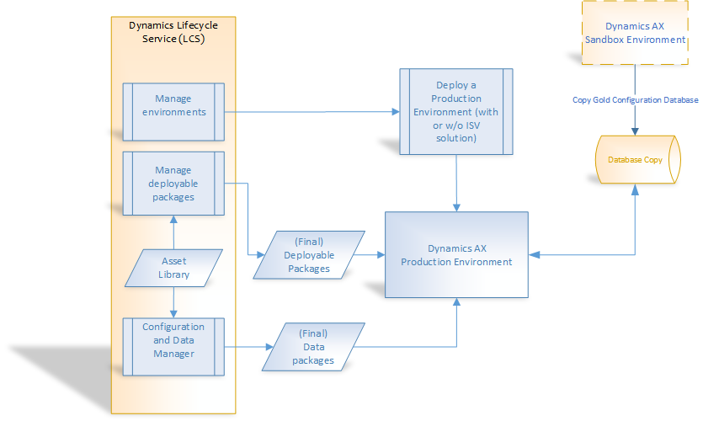
Deploy gold packages to production
Deploy final deployable packages to production (DSE request)
Copy Gold configuration database to production (DSE request, first time go live only)
Deploy additional data packages to production (Self service from LCS)

Slide 14
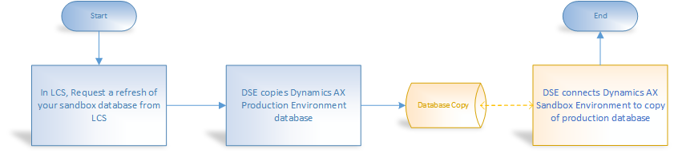
Refresh Sandbox database with production data

Slide 15
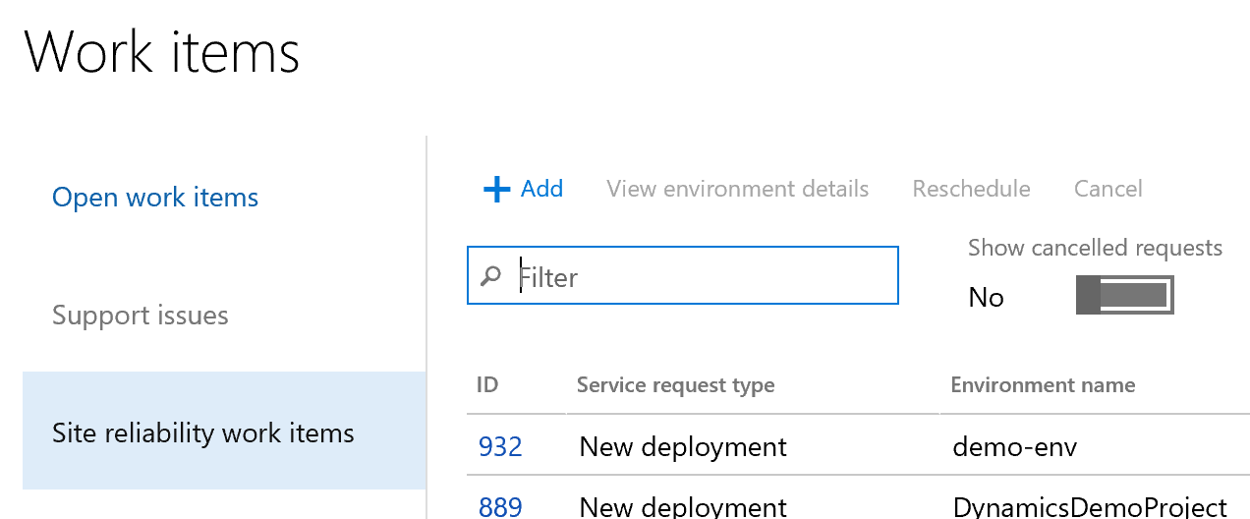
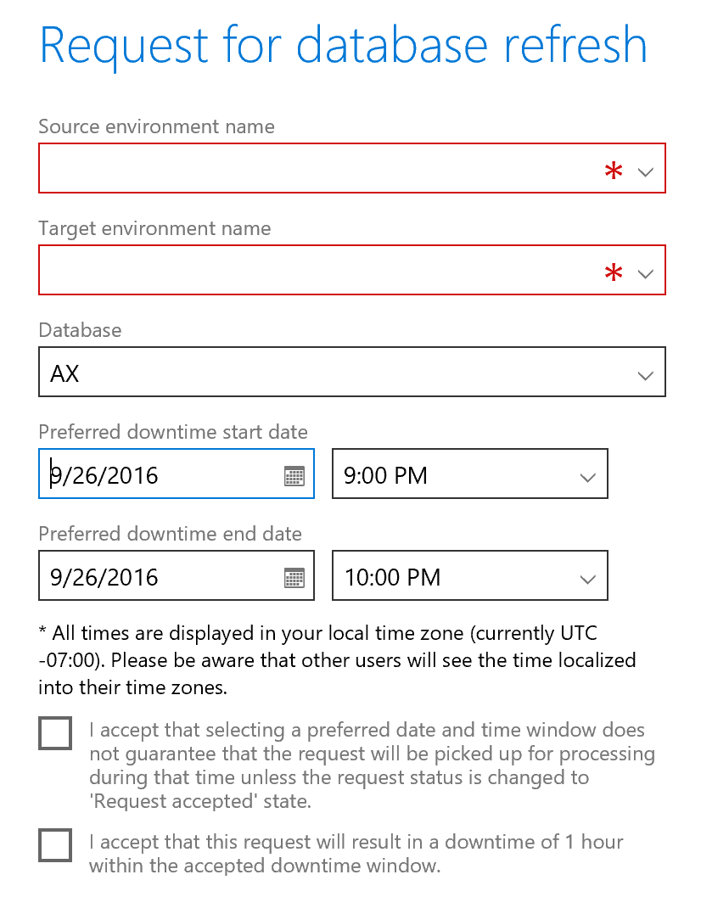
Refresh Sandbox database with production data

Slide 16
Configuration and Data Manager
Introduction

Slide 17
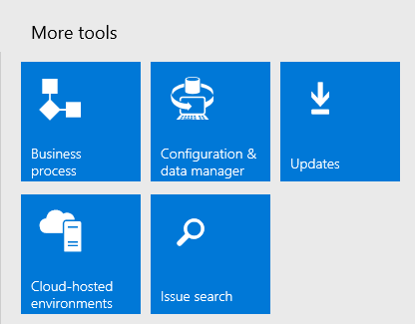
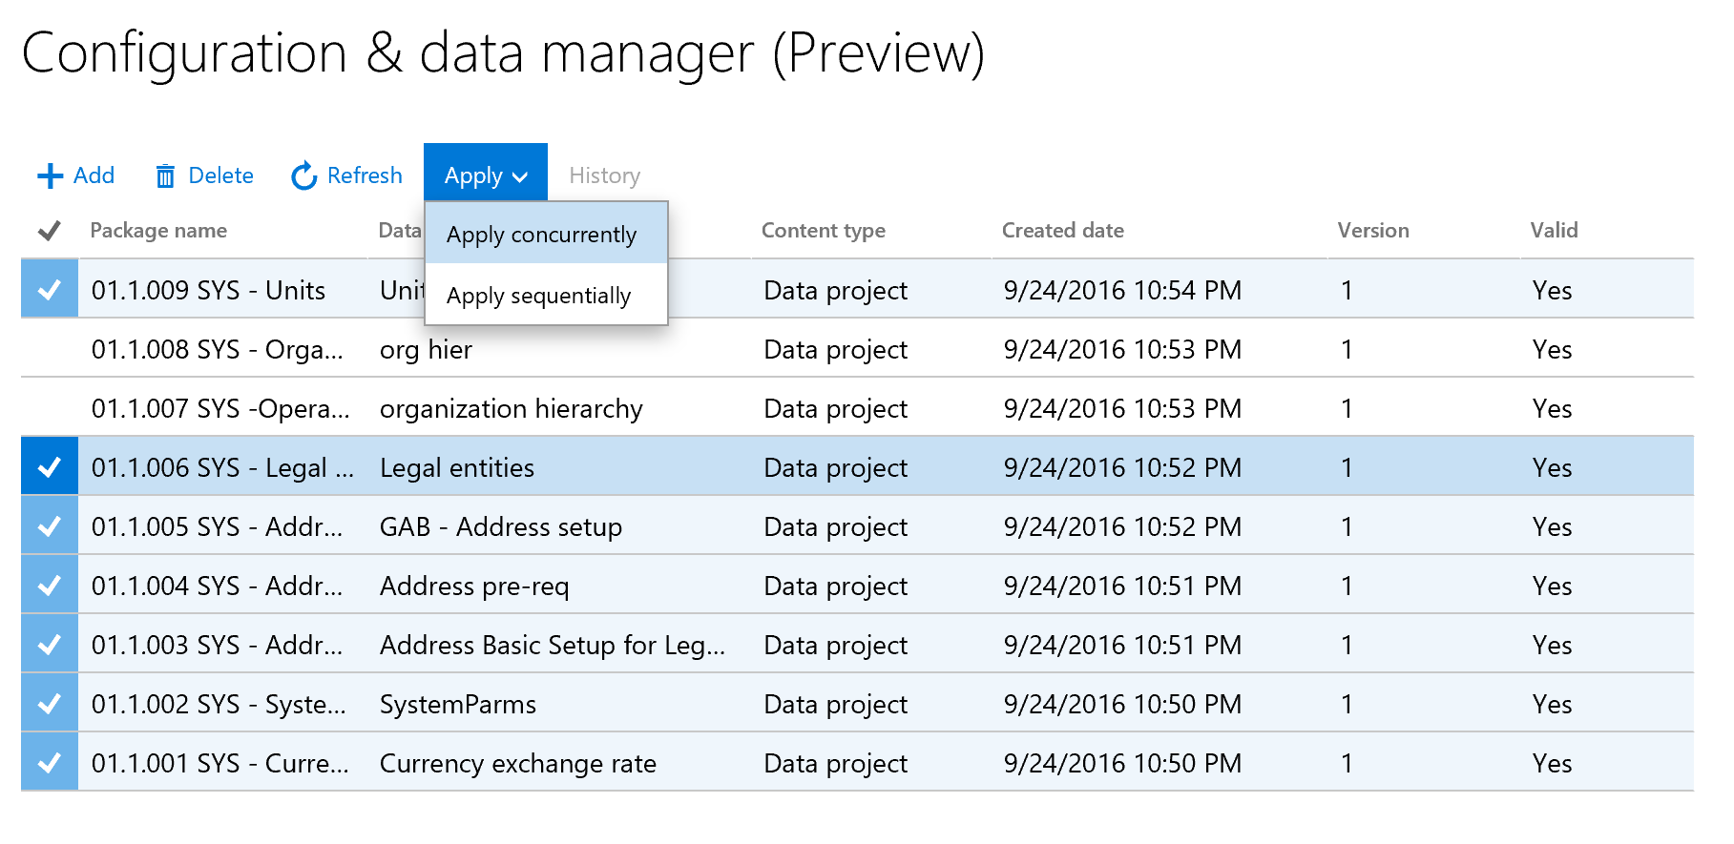
Apply data packages to an existing cloud environment using Configuration and Data Manager (CDM).

Slide 18
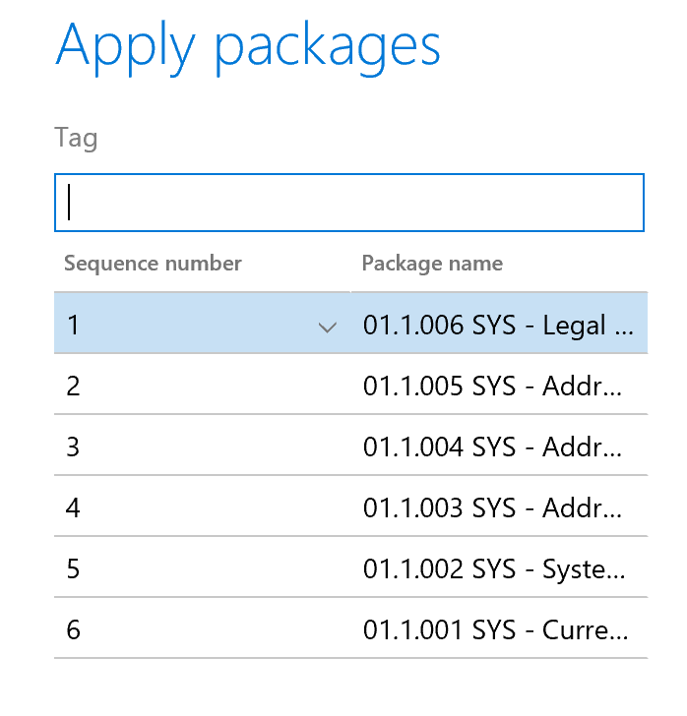
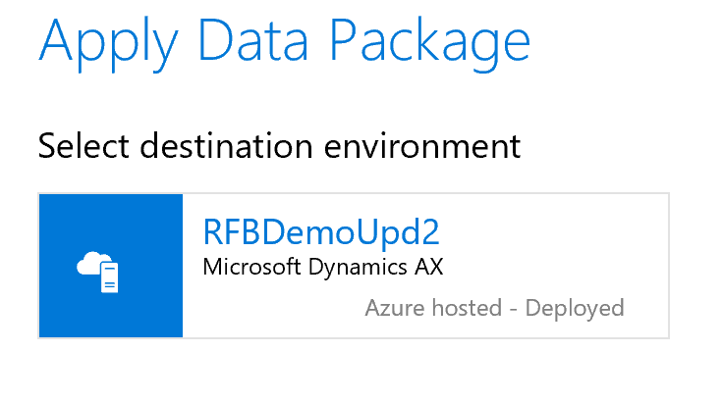
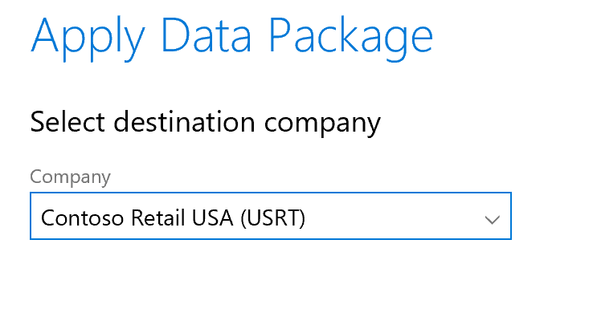
Apply data packages to an existing cloud environment using Configuration and Data Manager (CDM).

Slide 19
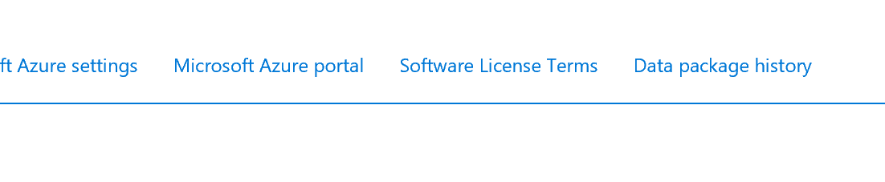
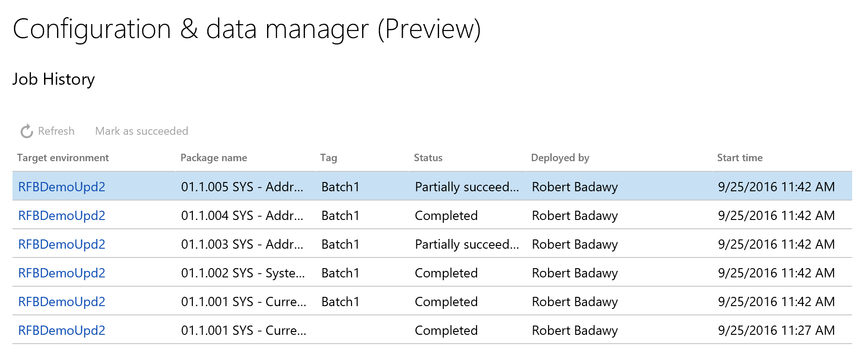
Apply data packages to an existing cloud environment using Configuration and Data Manager (CDM).

Slide 20
Install hotfixes

Slide 21
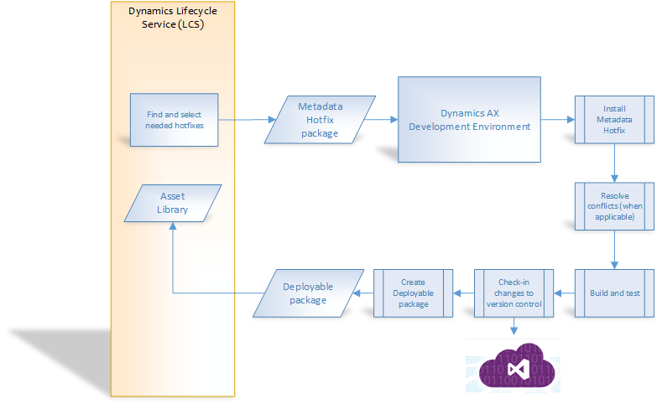
Servicing: Apply a metadata hotfix

Slide 22
Servicing: Binary hotfixes
Binary hotfixes are cumulative
Find them using Issue Search
Or
Download them from the updates tiles of your environment
Binary hotfixes are deployable packages
Add them to your asset library
Using LCS, apply them to your dev and sandbox environments
Using LCS, file a request to apply them to your production environment

Slide 23
Servicing: Binary hotfixes (and other deployable packages)

Slide 24
Demo
From development, to build, to cloud sandbox
Configuration and data manager

Slide 25
Questions?

Slide 26
Additional References
Servicing and hotfixes
  https://ax.help.dynamics.com/en/wiki/technical-concepts-guide/#servicing-environments
Build and test automation
  https://ax.help.dynamics.com/en/wiki/continuous-delivery-home-page
  Development resources
https://ax.help.dynamics.com/en/wiki/technical-concepts-guide
http://community.dynamics.com/ax/b/newdynamicsax

Slide 27
Related Sessions
BRK3174 Speed up your Dynamics AX Code upgrade: tips and techniques to stay continually current
  Tariq Bell, Wednesday, September 28, 10:45am - 12:00pm
BRK3169 Use ALM as a differentiator with Dynamics AX and Lifecycle Services (LCS)
Clay Wesener, Meera Mahabala, Thursday, September 29, 9:00am - 10:15am

Slide 28
Related Sessions
  BRK4026 Develop and customize Dynamics AX safely and effectively
  Friday, September 30, 9:00am - 10:15am
BRK3168 How to operate and service the Microsoft Dynamics AX Cloud
  Christian Wolf, Robert Badawy, Friday, September 30, 10:45am - 12:00pm
  BRK3174 Improve solution readiness with the new Task Recording feature in Dynamics AX
  Friday, September 30, 12:45pm - 1:30pm

Slide 29
Related Sessions (App Source Theatre Sessions)
  THR2111 Discover the strategy and benefits of Microsoft AppSource, the marketplace for SaaS business apps
  Satish Thomas, Tuesday, September 27, 5:00 pm - 5:30 pm
THR2160 Discover the strategy and benefits of Microsoft AppSource, the marketplace for SaaS business apps
  Satish Thomas, Wednesday, September 28, 10:20 am - 10:40 am

Slide 30
Free IT Pro resources
To advance your career in cloud technology
Plan your
career path
Cloud role mapping
Expert advice on skills needed
Self-paced curriculum by cloud role
$300 Azure credits and extended trials
Pluralsight 3 month subscription (10 courses)
Phone support incident
Weekly short videos and insights from Microsoft’s leaders and engineers
Connect with community of peers and Microsoft experts
Microsoft IT Pro Career Center
www.microsoft.com/itprocareercenter
Get started
with Azure
Microsoft IT Pro Cloud Essentials
www.microsoft.com/itprocloudessentials
Demos and
how-to videos
Microsoft Mechanics
www.microsoft.com/mechanics
Connect with peers and experts
Microsoft Tech Community
https://techcommunity.microsoft.com

Slide 31


Please evaluate this session
Your feedback is important to us!
From your PC or Tablet visit MyIgnite at http://myignite.microsoft.com
From your phone download and use the Ignite Mobile App by scanning the QR code above or visiting https://aka.ms/ignite.mobileapp

Slide 32
Backup slides

Slide 33
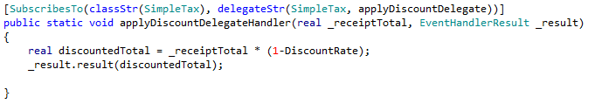
Delegates Example
Define and call delegate in overlayered class
Subscribe to delegate in your extension package

Slide 34
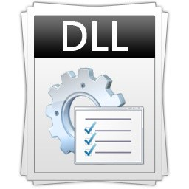


Extensions: Concept and value proposition
AOS Runtime
Compile Isolation & performance
Deployment, servicing and ALM
Minimal code upgrade cost
Dynamics.AX.ApplicationSuite.dll
Dynamics.AX.AppSuiteExtension.dll
Compile
Compile
AxTableExtension
AxForm
AxTable
AxForm
Events & Plugins
AxClass
Code Extensions
AxTable
AxFormExtension
References
Application Suite Package
Application Suite Extension Package

