Slide 1
Master Windows 10 Deployments - Expert Level
BRK4023
Johan Arwidmark (@jarwidmark)
Chief Technology Officer
Mikael Nyström (@mikael_nystrom)
Principal Consultant

Slide 2
Assumptions
Familiar with MDT / ConfigMgr

Slide 3
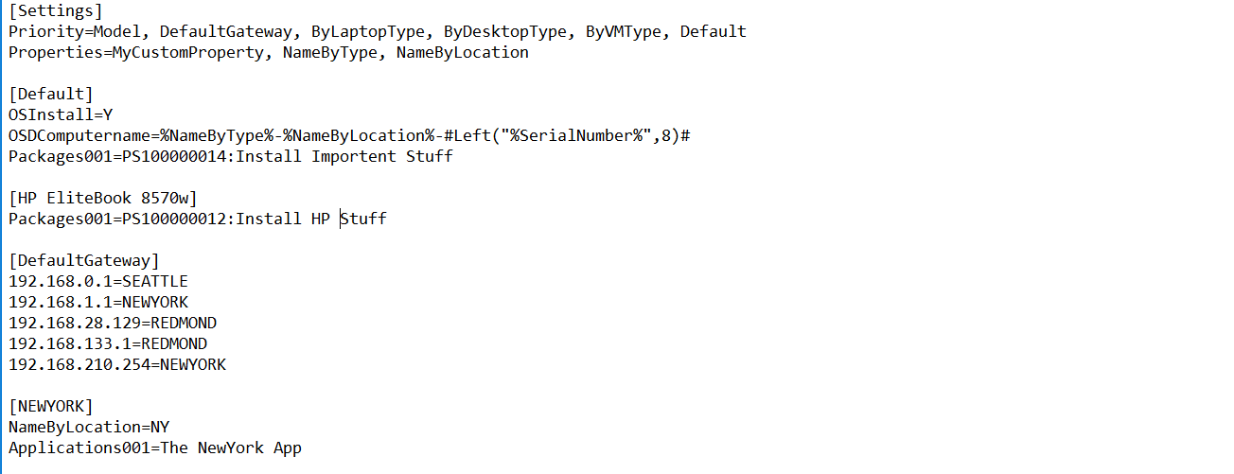
CustomSettings.ini

Slide 4
Demo
Mikael Nyström

Slide 5
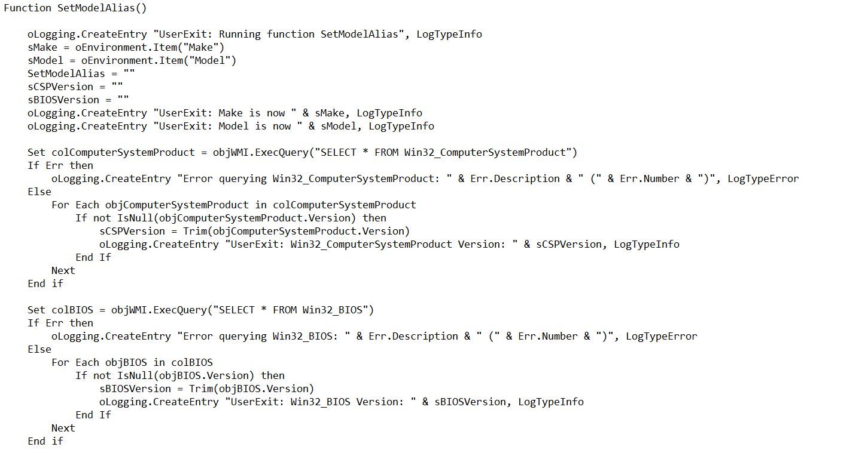
UserExit Scripts
Extend Inventory
Convert WMI to Properties
Most common: AliasUserExit.vbs

Slide 6
Demo
Johan Arwidmark

Slide 7
The MDT Database
Data storage
Stored Procedured
Script Access - PowerShell

Slide 8
Demo
Mikael Nyström

Slide 9
Web Services
Access external data (Securley)
MDT DB
ConfigMgr DB
Active Directory
Develop your own

Slide 10
Demo
Johan Arwidmark

Slide 11
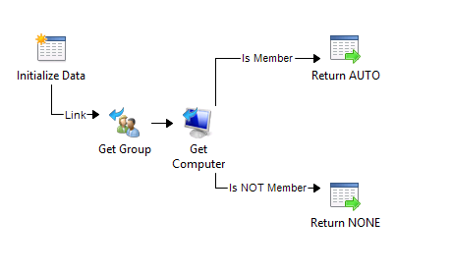
Orchestrator Runbooks
Access external data (Securley)
- Build your own Runbooks to access anything

Slide 12
Demo
Mikael Nystrom

Slide 13
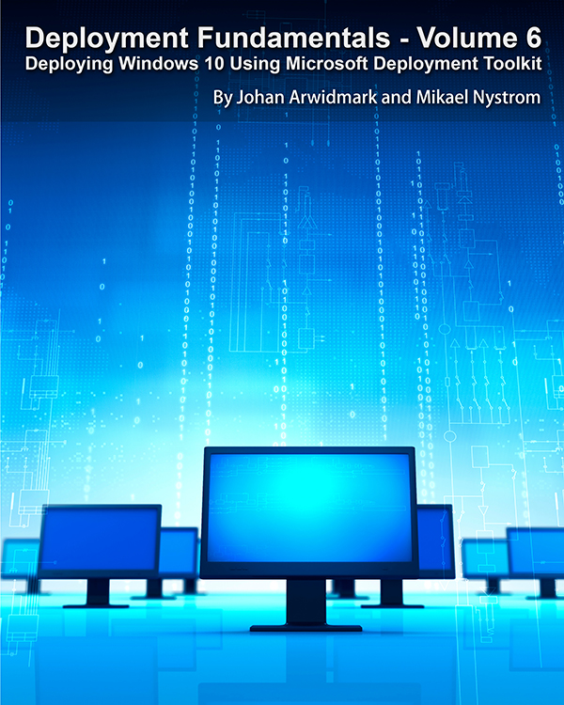
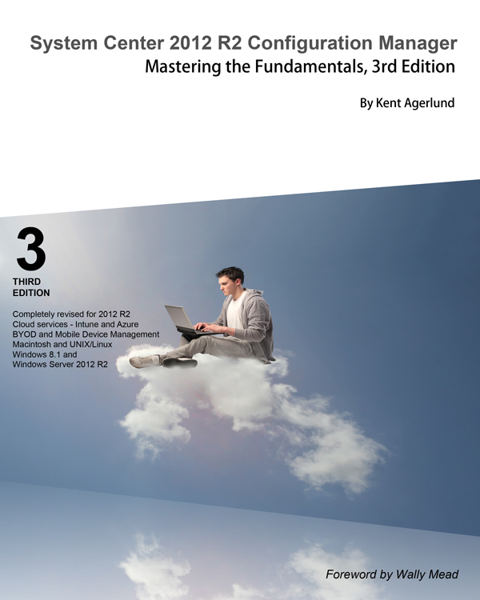
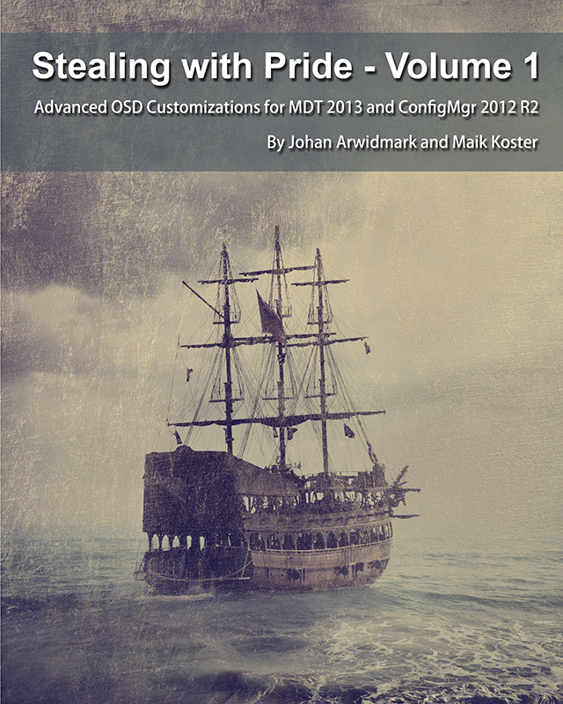
Resources: Trainings - Videos - Books
deploymentartist.com

Slide 14
Resources
deploymentresearch.com
deploymentbunny.com

Slide 15
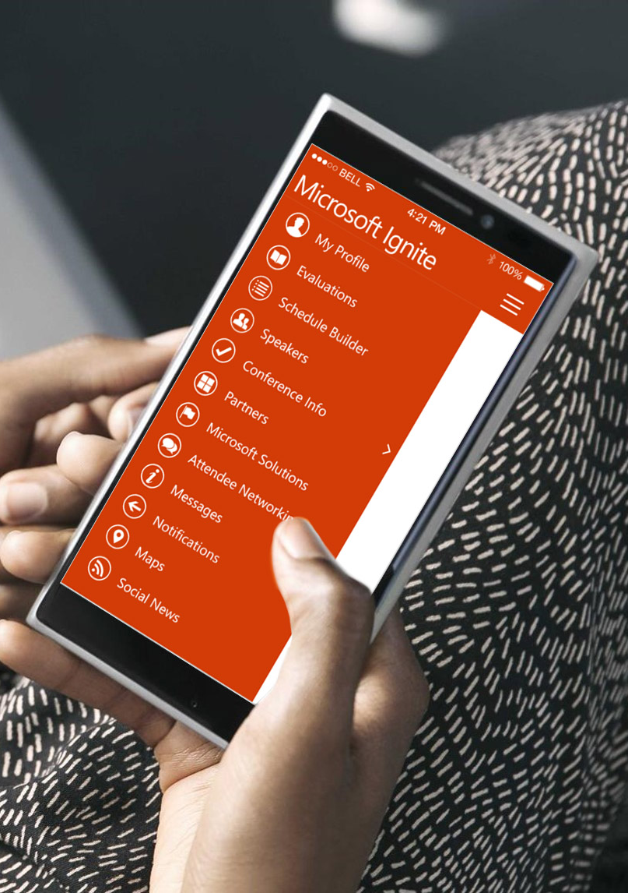
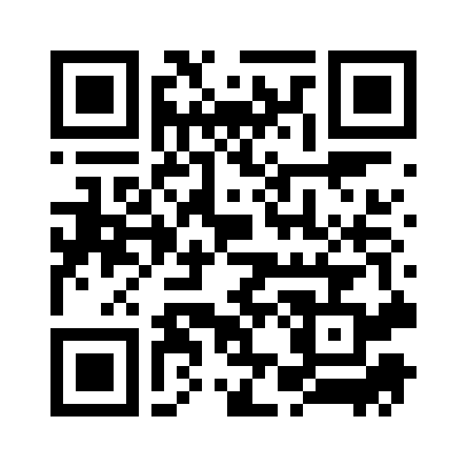
Please evaluate this session
Your feedback is important to us!
From your PC or Tablet visit MyIgnite at http://myignite.microsoft.com
From your phone download and use the Ignite Mobile App by scanning the QR code above or visiting https://aka.ms/ignite.mobileapp

Slide 17
Presentation title goes here
Speaker name
Title

Slide 18
Please evaluate this session
Your feedback is important to us!
From your PC or Tablet visit MyIgnite at http://myignite.microsoft.com
From your phone download and use the Ignite Mobile App by scanning the QR code above or visiting https://aka.ms/ignite.mobileapp

