Slide 1
Dig deeply into BranchCache: Learning from the experts
BRK4022
Andreas Hammarskjöld
Co-Founder of 2Pint Software
Techie gone Dev Guy
@andhammarskjold

Slide 2

Key TakeAways
1. What is BranchCache?
2. Why is it in my soup?
3. Gotchas to live with!
4. What else can I do?
5. Go home & Love IT!

Slide 3
How much beardness do you want?
100 - 200
300 - 400
>500
“Since 1969 I have never used Microsoft Windows, have never used Apples’ systems, and have never shaved my beard.” – http://LinuxBeard.com
”2016 was the year when Linux got PowerShell & .Net Core. Windows now runs Linux and FreeBSD finally got WiFi…” - Quote from Twitter

Slide 4
What is BranchCache?
Source
Download
P2P
P2P
P2P
P2P
P2P
User #1 downloads a file
User #2 gets a copy

Slide 5
It’s not just P2P… It’s a WAN Accelerator!
Faster
Bigger
Puh!

Slide 6
So Why is BranchCache in my Soup?
So opening a Word document will be faster? Answer: Yes!
So copying a file in Explorer over the network will be faster?
Answer: Yes!
So all ConfigMgr stuff will go faster?
Answer: Yes!
My own App?
Answer: Yes!
3rd Party Applications
My batch file to copy stuff will be faster?
Answer: Yes!
So my SharePoint Intranet will be faster?
Answer: Yes!
WSUS, Intune… you name it! #BCISKING!
Office
CopyFile
Explorer
WMP
IE
SCCM
WSUS
Intune
3rd Party Protocols
SMB 2
HTTP
BITS
Microsoft BranchCache™ Platform

Slide 7


Customer Example – Anonymously via my son
“I think BranchCache is great, we’ve saved many hundreds of GB with it in the last few months alone – it’s just not very well understood.
I had a real problem selling it internally due to lack of information online and tools to manage.”
It ain’t all about the beans!

Slide 8

BranchCache User Quote
“My experience with Windows 7 and Win Server 2008 R2 is it’s very very good at BITS and SharePoint and far less good at SMB. This maybe better with later versions of Windows. Personally I think more companies should use BranchCache – it deserves more focus really.”

Slide 9

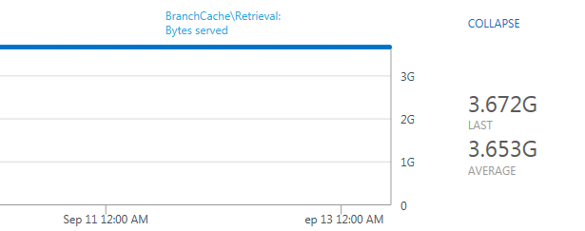
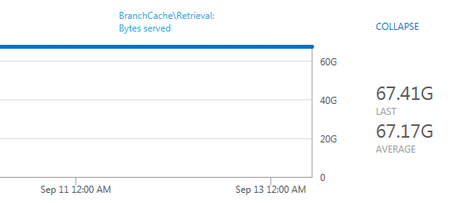
Customer Implementation
“We use BranchCache for caching BITS (Windows Update primarily), http (SharePoint) and SMB.We do collect some stats using Microsoft OMS, where we can see BranchCache Hosted Cache serving content at sites”

Slide 10
BranchCache 101
Important Bit
Two Versions! V1 & V2
Feature & Role on Windows Server
  Feature = HTTP Support
  Role = SMB Support
  Responsible for handing out ”Content Identifiers (CI)”
Client – Service on every Windows PC – Check!
  Control through GPO/LPO/PowerShell/Netsh.exe
  Uses Web-Service Discovery protocol to find peers with CI data
  Gets data from other peers

Slide 11

ID, Fingerprint, Hash, Content Identifier, CI
All the same stuff!
And it’s not what you smoke…

Slide 12

More Facial Hair For y’all! Or is it Hipster Style?
Hashes (CI’s)
V2 Hashes are DeDuplication Hashes
DeDuplication is just purely awesome! Hashes are 1/2000 in size
Treat it like a black box.
...Big beard… n’stuff…

Slide 13
First Off – BranchCache Concepts
CI is now ID?
I am lost already….
ID
ID
ID
IIS/Web Srv
Data
Data
HTTP
HTTP
HTTP
Data
HTTP
This is cool though, only over the WAN once!
Typical WAN

Slide 14
Getting The Hash
Andreas Hammarskjöld

Slide 15
Security
OK, It’s Secure…
BranchCache accelerates
  Regular HTTP/SMB traffic
  End-To-End encrypted traffic (TLS/HTTPs, Ipsec)
Cached data encrypted
  On disk AND In transit between clients
Prevents unauthorized access to cache
  Hash is key, so no domain needed! (Cloud Yeah!)
  No hash – No data

Slide 16
The Windows BranchCache Framework
Enterprise & Educational vs Pro
3rd Party Applications
Office
CopyFile
Explorer
WMP
IE
SCCM
WSUS
Intune
3rd Party Protocols
SMB 2
HTTP
BITS
Microsoft BranchCache™ Platform

Slide 17


HTTP/HTTPS Integration. Oh dear… technical…
I am a just a Server. Not a cloud!
IE/Edge
IIS
Open
URL
Data
Data
“Branch Cache Capable”
Get data
Wininet/
Winhttp
http.sys
Hashlist
Hashlist
Data
Data
Hashlist
Branch
Cache
Branch
Cache
Didn’t we agree on calling it CI?
Data
Hashlist
H1
H2
H3
H4
H5

Slide 18




Some Help On The Way!
BranchCache PowerShell Module
On Windows 8 and above! Configure & Export/Import etc.
BranchCache Hash Test Tool
HashiBashi2 kind of…
BranchCacheTool.exe
Like PowerShell but old-school and more control
BITSBCReporter.exe
Live Output of BranchCache Ratio

Slide 19
Get Down With P2P
Andreas Hammarskjöld

Slide 20
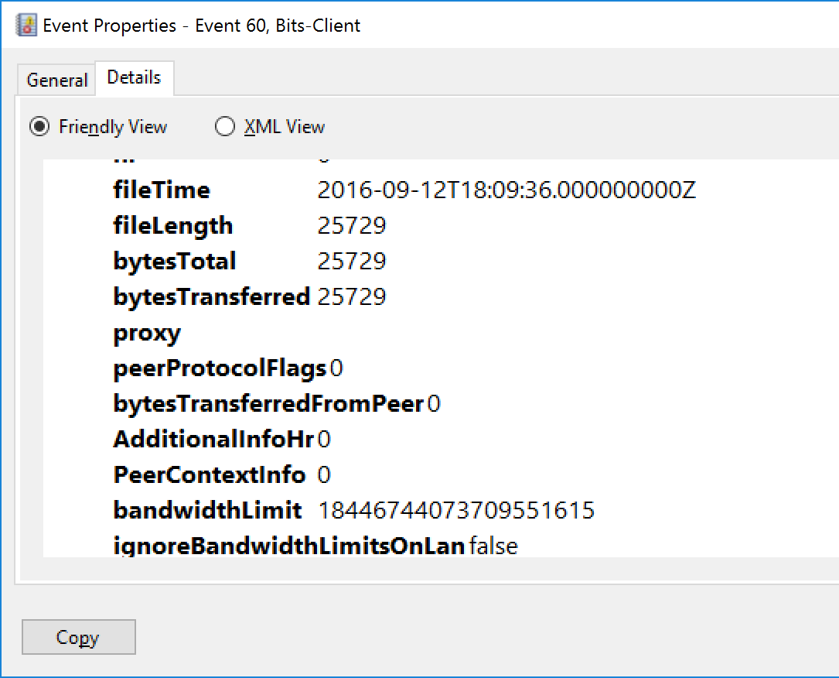
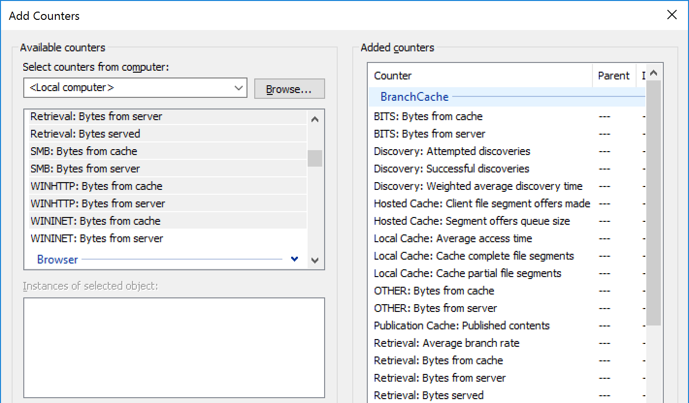
How did it go? Did it Cache? From where?
BranchCache Performance Stats
  Performance Monitor
BITS-Client Event Log
0 = No BC even tried
1 = Tried BC
Also from local cache!
Sure Not Missing Stats!

Slide 21

This is all very good technical stuff, but for the love of God, where are the reports for my managers and other clueless executives?

Slide 22
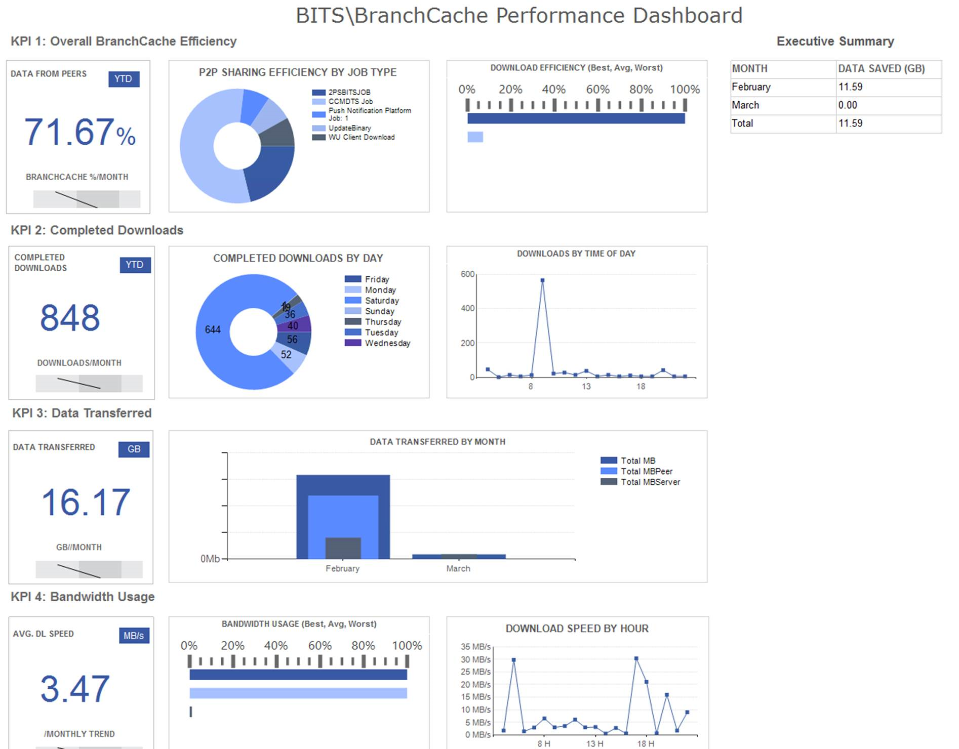
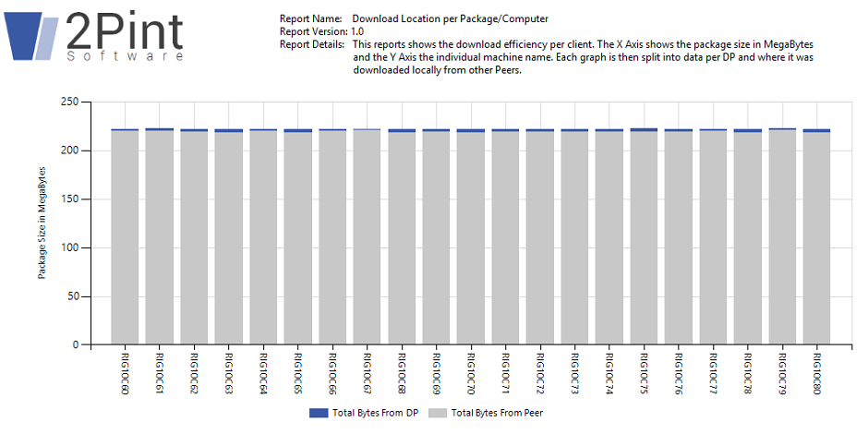
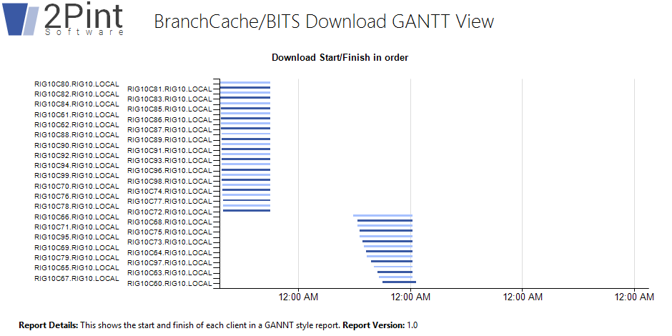
Reporting – That’s Seperate #FREE

Slide 23
Issues, Issues, Issues…
No native .Net Support
Not that hard!
Parse CI to the BranchCacheTool.exe if you are really lazy!
No CDN support - Currently
Supported role on all Azure VM’s
Encryption & Compression
Not so alike, i.e. full download again for any change
The Full Monty - Everybody Board the Download Train!
Script and spread the start, a few seconds is often enough
For ConfigMgr Use “Run As Soon As Possible”

Slide 24
Best Practice #1
START SMALL
Play – Have Fun!
One Server
Two Networks
Three Clients
Start There
GO DEDUPE
Get De-Duplication on the source
DP’s if using ConfigMgr
Remember: DeDupe is BranchCache!
SHAKE & BAKE!
Make sure hashes are available before clients downloading or you will be very frustrated
Use Reporting to save your sanity
Get off Windows 7
If you are serious about BranchCache start by getting to Windows 10. But don’t forget you can use BranchCache in Windows 7 to help you there!
READ
This is rocket science technology! You are not “just going to get it.”
MVP’s have a hard time to grasp this. They don’t get BranchCache.

Slide 25

Best Practice #2
Wanting to try out BranchCache over SMB?
Deploy Windows 10 First unless on Windows 8.1
Be Brave, ask questions!
This is rocket science technology after all
Start with the 2Pint Software get going guide
http://2pintsoftware.com/microsoftbranchcache/
New Microsoft BranchCache Guidance
https://technet.microsoft.com/en-us/itpro/windows/manage/waas-branchcache
Still on Windows 7?
You get the point… don’t miss out on DeDupe

Slide 26
Overdrive > 400

Slide 27
V1 Hashes – Simple to understand... ish...
Every 512 block hashed, Representing a 32M segment, are hashed.
Each Segment Hash is HMAC signed with server secret.
File
64K Block
64K Block
64K Block
64K Block
<=64K Block
SHA-256
SHA-256
SHA-256
SHA-256
SHA-256
Segment HASH
SHA-256

Slide 28
V1 - House of Cards
Inject 1 single little darn Byte at first offset (or anywher in first segment)
File
64K Block
64K Block
64K Block
64K Block
<=64K Block
Whole segment hash is invalid!
SHA-256
SHA-256
SHA-256
SHA-256
SHA-256
Segment HASH
SHA-256

Slide 29

V2 – Pulling Tricks & Hash Bananza
Fingerprint
Used to choose boundaries
Blocks
32K – 128K
Identifiers
Block Hashes
ID1
ID2
ID3
ID4
ID5
ID6
ID7
ID8
ID9

Slide 30
BranchCache & DeDuplication
BranchCache
DeDupe
IT Love

Slide 31
DeDuplication & BranchCache
Andreas Hammarskjöld

Slide 32
Savings Galore – Average DeDupe Savings
Scenario | Content | Typical Space Savings
User documents | Documents, photos, music, videos | 30-50%
Deployment shares | Software binaries, cab files, symbols files | 70-80%
Virtualization libraries | Virtual hard disk files | 80-95%
General file share | All of the above | 50-60%
Source: TechNet

Slide 33
New In Server 2016/Windows 10 - BranchCache
New Telemetry
  Monitoring Event Channel
  Logs BranchCache activity both on client and server
Dynamic Cache Sizing
  Low disk space management
Server Side – More Threads! More Power!
DeDupe Eval Tool – Show BranchCache Savings!
  DDPEval.exe comes with DeDuplication Feature
  DeDupe Savings = BranchCache Savings!!!

Slide 34
I’m sweating already… so is your Server Buddy!
Hash generation is CPU & Disk Intensive
~100 GigaByte per hour
  ~50 MegaByte per second in Windows Server 2012 R2
  ~20 MegaByte of data per second in Windows Server 2012
  Real world, up to 1TeraByte per hour – Spank that Server!
Don’t > 64TB volume – Don’t push it VSS will fall over
Files approaching or larger than 1 TB in size can be tricky…
Didn’t we agree on calling it CI?

Slide 35
PeerDist* is very, very well over-documented:
[MS-CCRSO] – BranchCache Overview
[MS-PCCRC] – The 'fingerprint' format
[MS-PPCRD] – Finding local copies
[MS-PCCRR] – Retrieving local copies
[MS-PCCRTP] – PeerDist over HTTP
[MS-PCHC] – Using a hosted cache
[MS-SMB2] – PeerDist over SMB2.1+
API: https://msdn.microsoft.com/en-us/library/windows/desktop/dd407951(v=vs.85).aspx
*PeerDist is the MS internal name for BranchCache so that people cant find the good documents…

Slide 36
Informational Resources
2Pint Software BranchCache FAQ
  http://2pintsoftware.com/2psfaqs/
Microsoft TechCommunity
  https://techcommunity.microsoft.com/
Microsoft TechNet Forums
2Pint Software Forums
  http://2pintsoftware.com/forums/forum/public-forums/
Twitter: @andhammarskjold @phil2pint @2pintsoftware
MyITForum Emailing Lists (mssms & MDT-OSD)
  http://myitforum.com/myitforumwp/newsletter/email-lists-2/

Slide 37
Q&A
: Do I need Enterprise SKU?
  No, but it helps. Pro has BranchCache for BITS, which a great start.
: Can I do OS Deployment?
  Yes, for free: http://2pintsoftware.com/products/branchcache-for-osd-toolkit/
: Can I visualize it?
  Yes, free: http://2pintsoftware.com/products/branchcache-reporting/
: Can I BranchCache Cloud Content?
  Yes, ish… CDN don’t do CI’s. But you can create it yourselves!
: Can I script or code it?
  Yes: But C++! Use BranchCacheTool.exe for scripting until C# .DLL for PS

Slide 38


Please evaluate this session
Your feedback is important to us!
From your PC or Tablet visit MyIgnite at http://myignite.microsoft.com
From your phone download and use the Ignite Mobile App by scanning the QR code above or visiting https://aka.ms/ignite.mobileapp

Slide 40
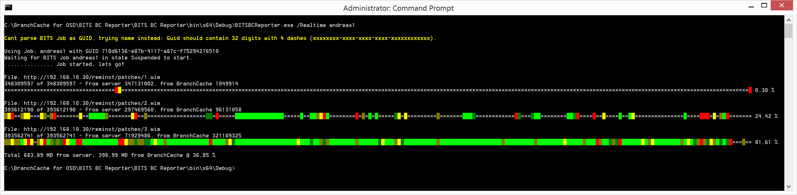

Slide 41
