Slide 1
Build Client-side web parts for Microsoft SharePoint
BRK4015
Chakkaradeep (Chaks) Chandran
Program Manager, Microsoft
https://twitter.com/chakkaradeep
http://www.chakkaradeep.com

Slide 2
Use #BRK4015 throughout the session…

Slide 3
Session objectives and takeaways
Session objectives:
  How SharePoint client side web parts are being developed and deployed.
  What kind of tooling will be initially available for developers around SharePoint Framework.
  How the development cycle will work with offline and online development.
Session takeaways:
  SharePoint development is aligned with industry standard development methods for web.
  Available dev tooling will assist you on the journey for building needed customizations.

Slide 4
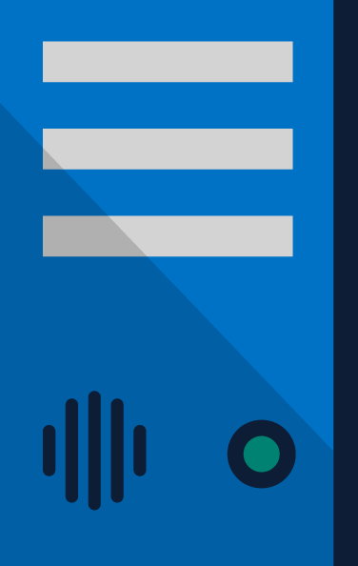
SharePoint Extensibility Principles
Build long-term, value-added services for enterprise mobility
Principles
To provide an Application Development Framework that aligns 1st and 3rd parties
To build industry leading client side solutions On-Premises and in the Cloud
Unlocking the potentials of SharePoint
and the Microsoft Graph on desktops
or any device

Slide 5
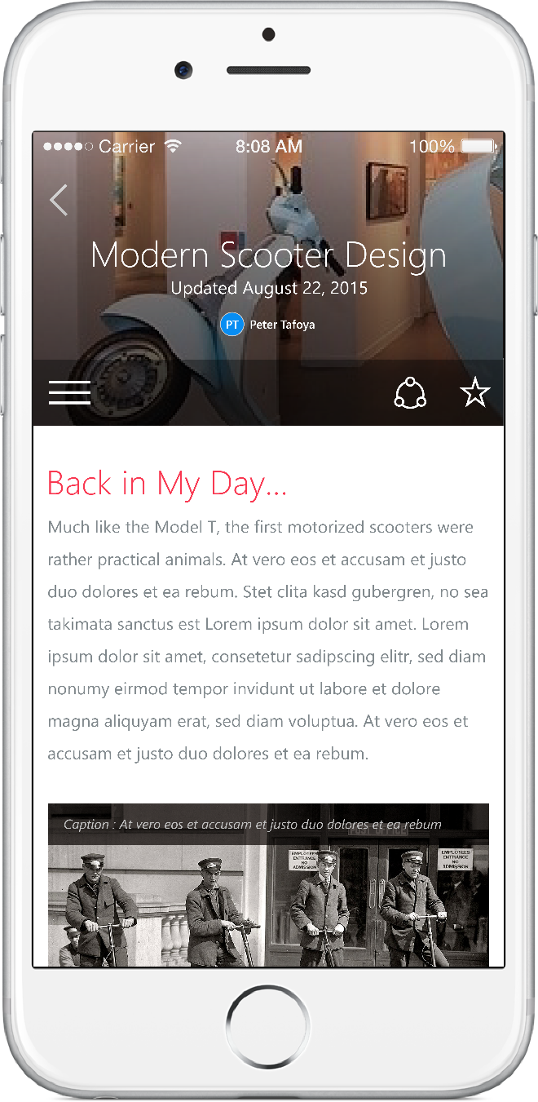
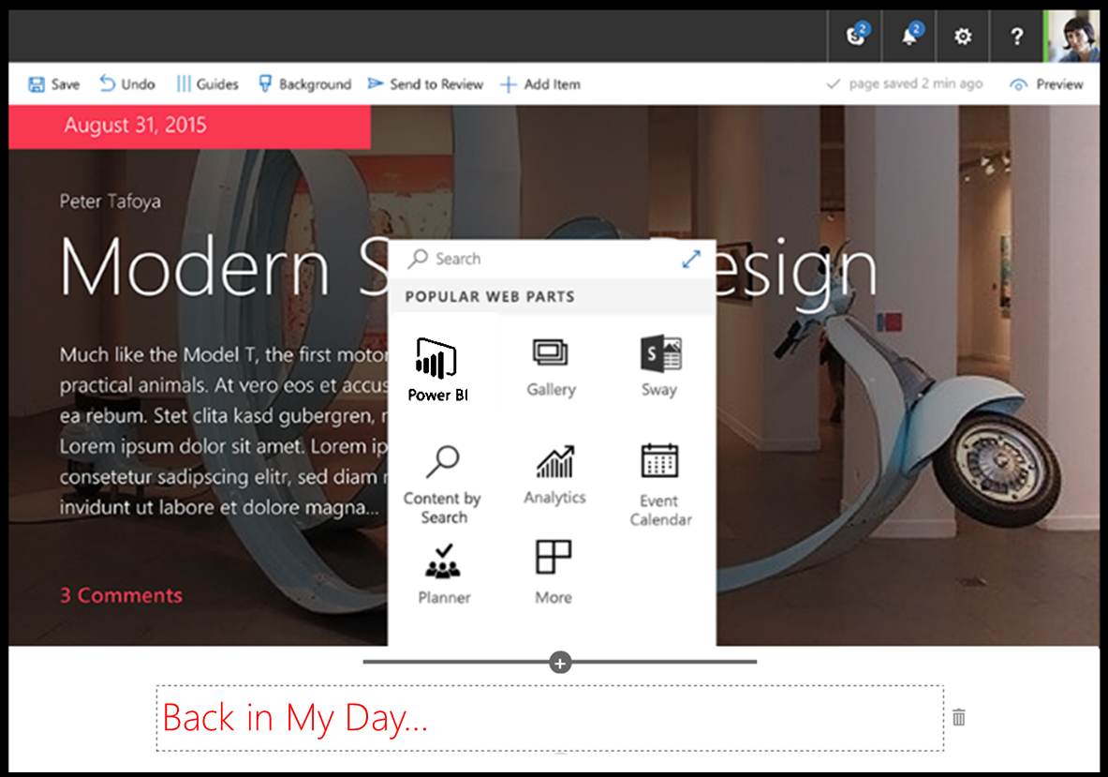
SharePoint Framework (SPFx)
Modern client-side development
Lightweight web and mobile
Powers our own experiences
Backward compatible
Supports open source tools
and JavaScript web frameworks
SharePoint framework
Microsoft Graph
LOB Systems and Cloud Services
BRK2114 – Get an introduction to SharePoint Framework

Slide 6



SharePoint Framework Components
User Experience
Packaging
Build Process & Tooling
Client-Side Web Parts
Modern Page Canvas
JavaScript Resource Management
Page Context & Site Data APIs
Client-side Solutions
Tenant-Scoped Deployment
Yeoman Templates
Gulp-based Build Process
SharePoint Workbench

Slide 7
Developer Preview Release
http://github.com/sharepoint || http://dev.office.com/sharepoint
September 1, 2016
SPFx Drop 2
September 21, 2016
SPFx Drop 4
Submit/discuss SPFx Issues
http://aka.ms/spfx-issues
Community Contributions
SPFx Documentation
SPFx Web Part Samples
August 17, 2016
SPFx Drop 1
September 14, 2016
SPFx Drop 3
BRK2117 – Discover the future of Microsoft SharePoint development

Slide 8
SharePoint Client-side web parts

Slide 9
SharePoint Web Parts
Configurable, reusable, purpose built components
Add functionality to SharePoint experiences
Web Parts
Framework for connecting related components
Context aware parts
BRK2040 – Discover the new SharePoint content publishing experiences

Slide 10
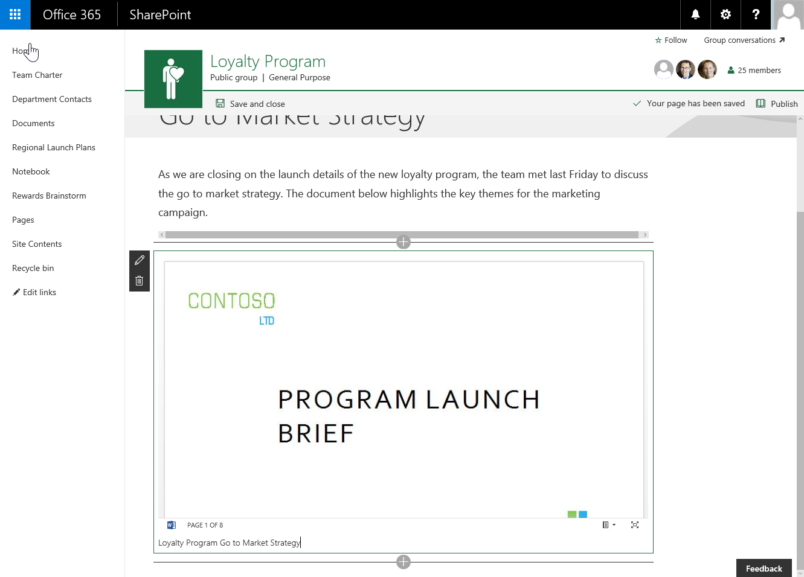
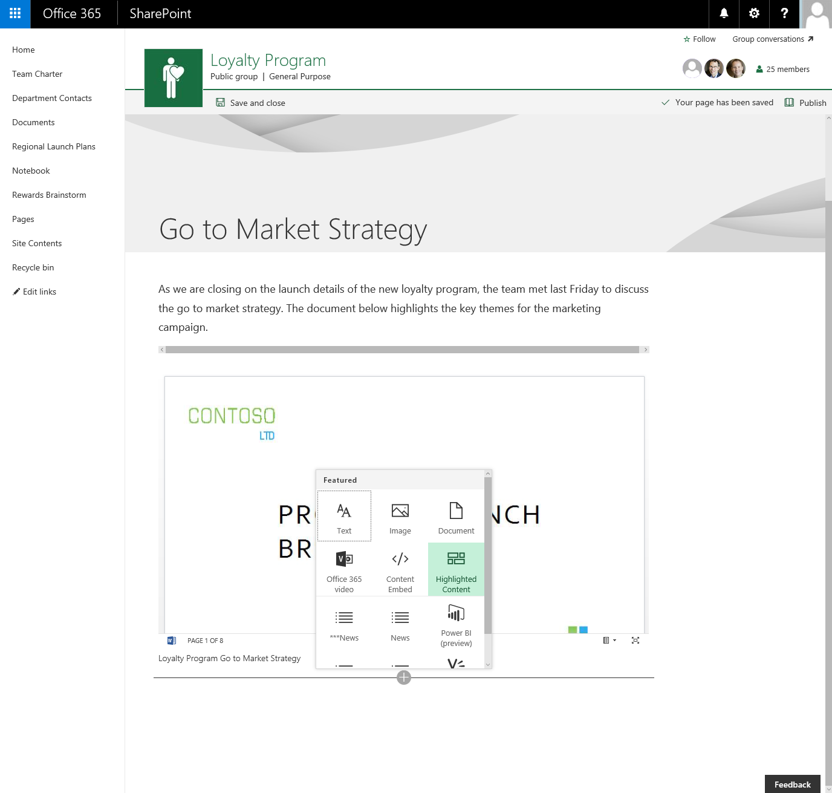
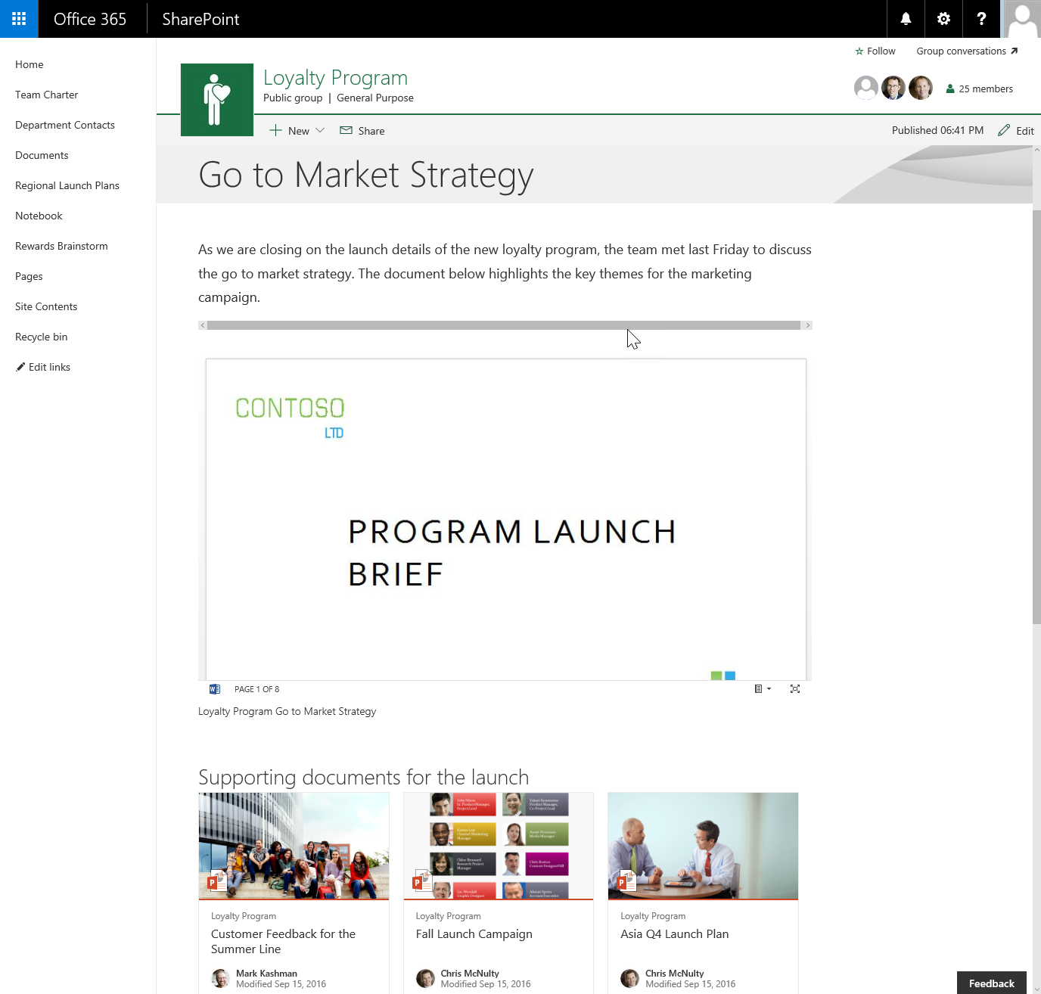
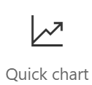
Client-side Web Parts
They are still web parts!
Built for the modern, JavaScript-driven web.
Runs directly inside a SharePoint Page.

Slide 11
Pages in Team Sites
Chakkaradeep Chandran

Slide 12
SharePoint Framework Tooling

Slide 13






Open source tooling
Build Process & Tooling
JavaScript Frameworks
Code Editors
Yeoman Templates
Gulp-based Build Process
NodeJS/NPM
SystemJS
Webpack
SASS
TypeScript
React
Angular
Knockout
and more … your choice!
Visual Studio Code
Atom
Sublime
and more … your choice!

Slide 14


Server side tool comparison
IIS Express
C#
MSBuild
Project Templates
BRK3246 – Looking behind the scenes at how we're making SharePoint's front end/UX modern, responsive, and open

Slide 15



Office UI Fabric
Fonts, icons
Colors
Front end experiences for SharePoint
Powers our own experiences
Available out of the box
Design web part seamlessly
Office UI Fabric React for rich set of reusable controls
Components
BRK3246 – Looking behind the scenes at how we're making SharePoint's front end/UX modern, responsive, and open

Slide 16
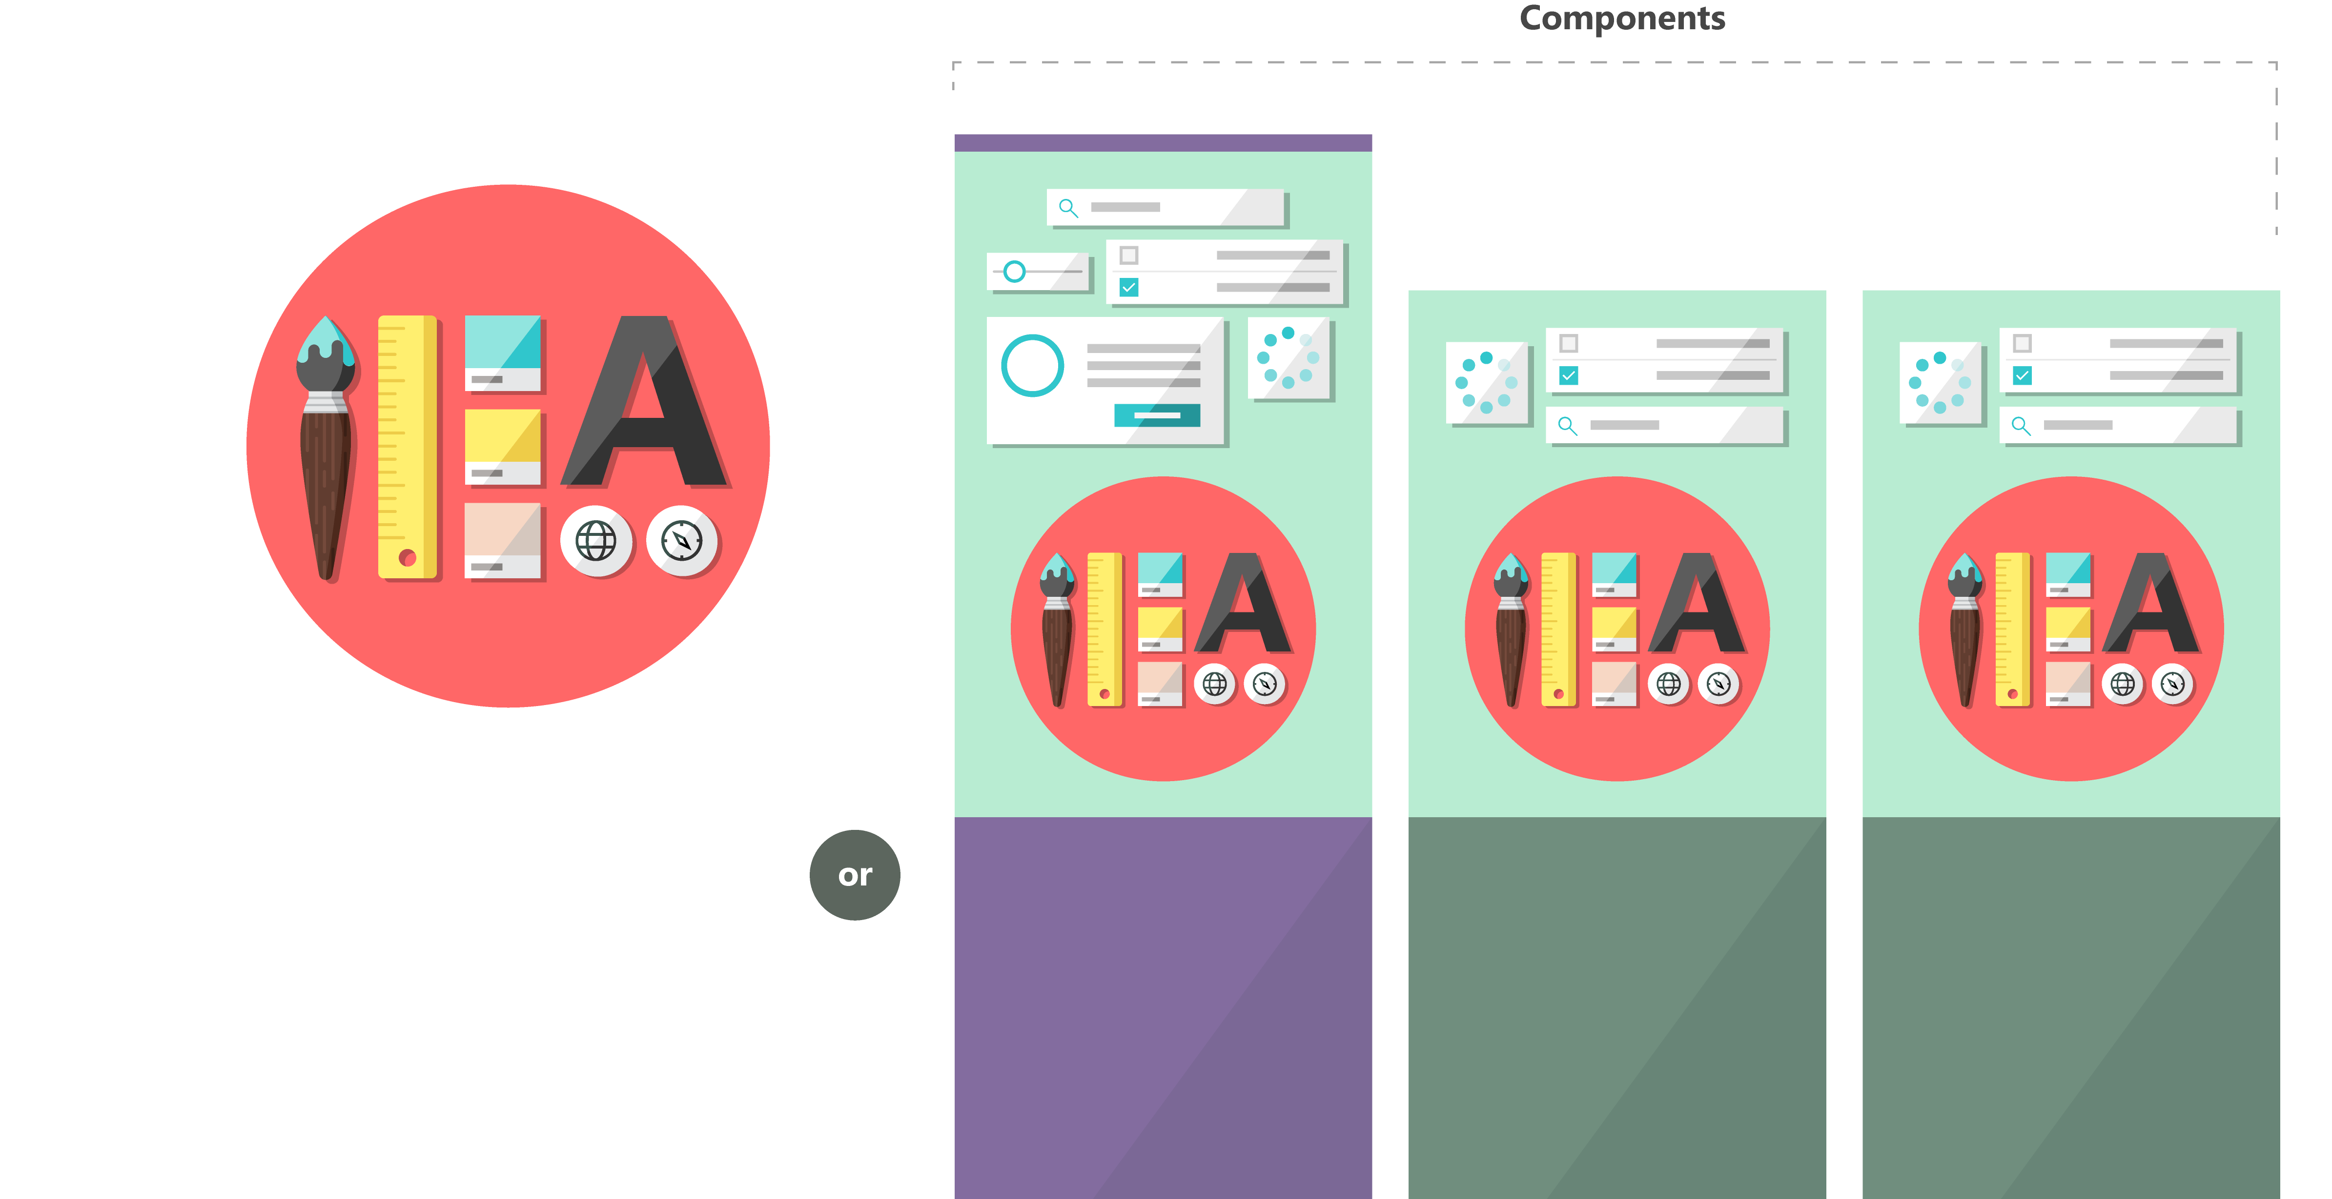

Fabric and its sub-projects
All depending on the Core, all open source
Community built
Fabric Core
Fabric React
Fabric JS
ngFabric
Fabric iOS
Core elements of the design language including icons, colors, type, and the grid
Robust, up-to-date components built with the React framework.
Simple, visuals-focused components that you can extend, rework, and build on.
Community-driven project to build components for Angular-based apps.
Native Swift colors, type ramp, and components for building iOS apps.

Slide 17
Building blocks of a web part

Slide 18
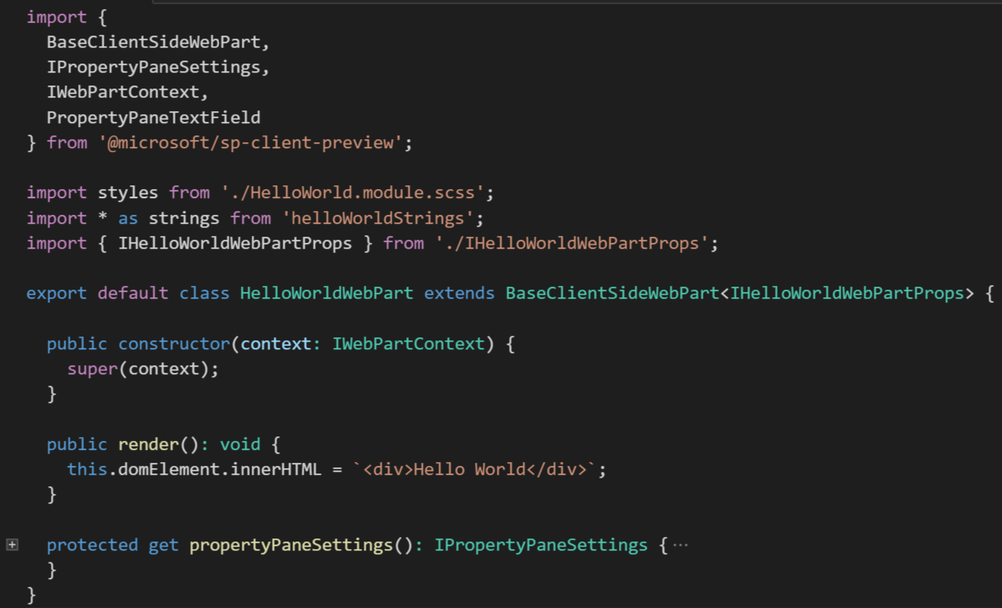
Building blocks: BaseClientWebPart Class
Base functionality for the web part
Rendering life cycle
Access to web part DOM
Access to page context & instance data
Property pane integration

Slide 19
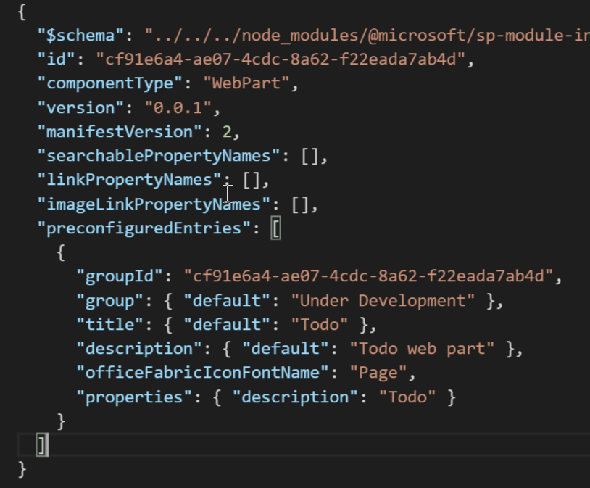
Building blocks: Web part manifest
Defines your web part
Web part information
Web part properties behavior
Specify default property values
Deployed to SharePoint

Slide 20
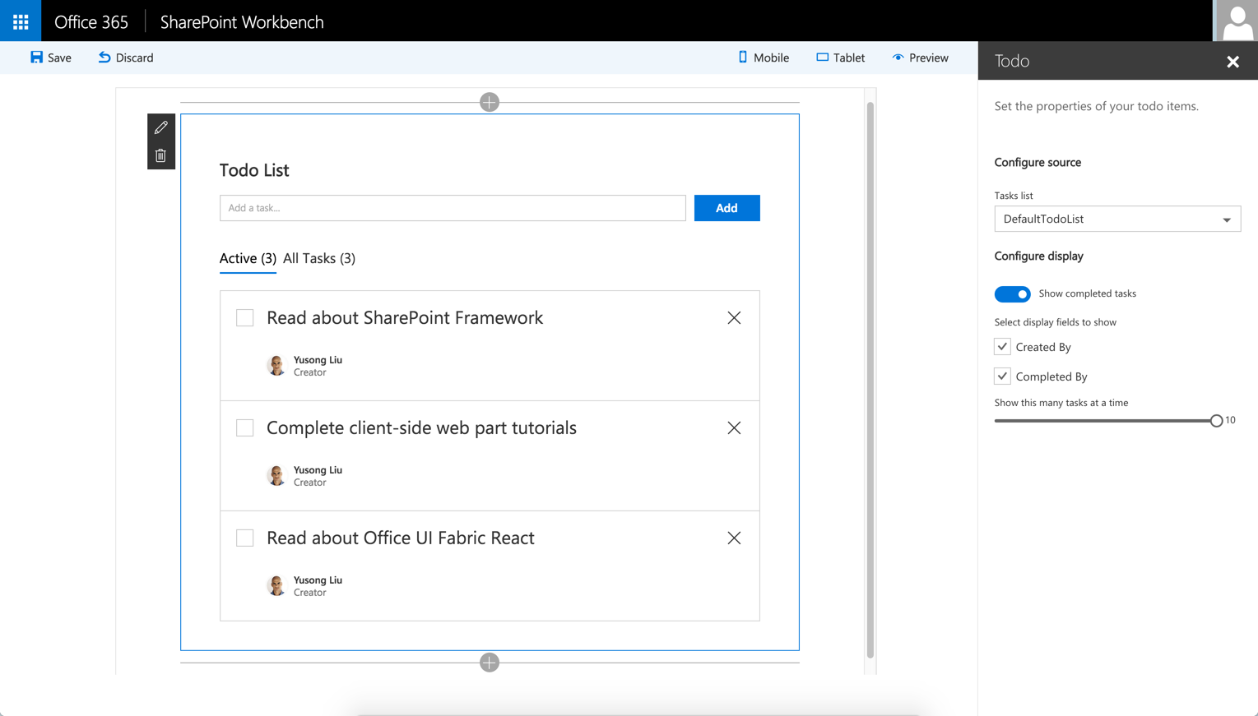
SharePoint Workbench
Developer tool to debug web parts
Local development experience
Test your changes locally
SharePoint Framework available offline
Available in SharePoint Online as well

Slide 21
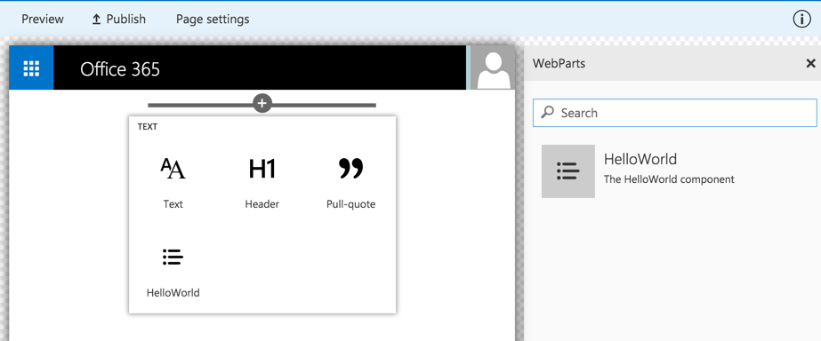
Client-side Web Part Build Flow
npm i @microsoft/generator-sharepoint -g
gulp serve
gulp package-solution
Install SharePoint Generator
Test
Package/Deploy
yo @microsoft/sharepoint
workbench local
gulp deploy-azure-storage
Scaffold SharePoint Web Part Project
Local
Package/Deploy
Code
workbench SPO
manual upload of the app
Build Web Part Code
UAT / Pre-production
Release using app catalog*
Ship?
Available on Classic and Client-Side Pages

Slide 22
HelloWorld Web Part
Client-side tooling and development.
Chakkaradeep Chandran

Slide 23


Web Part Deployment Flow
Package as an client-side solution
Deliver the package to
upload, trust and
Tenant App Catalog
todo.spapp
Approved
Developer
Tenant Admin
deploy the package to
yo @microsoft/sharepoint
gulp –ship
gulp bundle --ship
gulp package-solution --ship
gulp deploy-azure-storage
Available to
SharePoint Sites
Install/Uninstall app
Site Admin
Todo Web Part
Add
Configure
Page Authors
End Users
Interact

Slide 24
Web Part Deployment
Chakkaradeep Chandran

Slide 25
Training Path – How to master SP Framework?
Conceptual process – Checkout “JavaScript embed models” with add-in model implementations from PnP
Learn used technologies – Web stack tooling
  Install node.js and cmd tooling for testing web stack development on your computer
  Learn webpack for bundling your applications
Learn JavaScript Framework(s)
  Light-weight frameworks - Knockout, Handlebars etc.
  Fully-fledged frameworks – Angular, React, Ember etc.
  Get understanding on how they can be used and what the benefits are of using them
Learn Office UI Fabric usage
  By default available for SP Framework customizations. Other UX frameworks can also be used

Slide 26
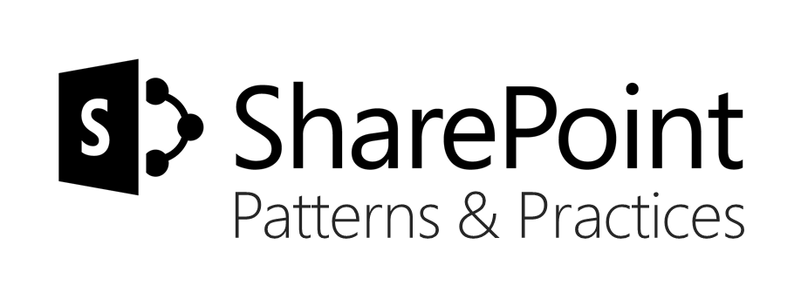


Sharing is caring…
Code samples
Guidance documentation
Monthly community calls
Case Studies
Themes
SharePoint Framework
SharePoint add-ins
Remote API models with SharePoint development
http://aka.ms/SharePointPnP
BRK2115 – Learn about PnP and the new SharePoint Framework

Slide 27


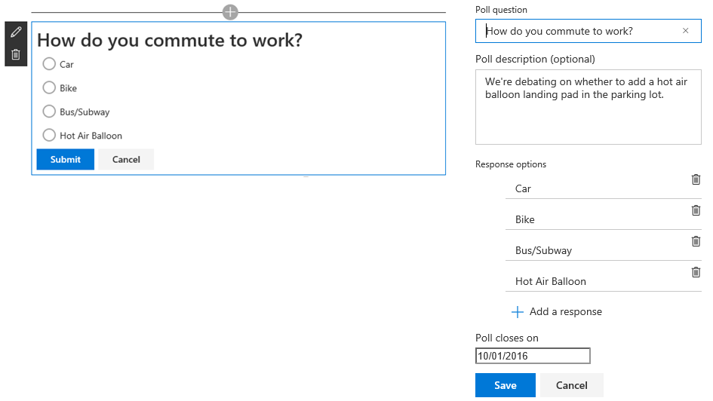

Web Part contest winner!!!
Quickly publish short, multiple-choice polls right on the page. Respondents are shown survey results immediately in a pie chart format.

Slide 28
Session objectives and takeaways
Session objectives:
  How SharePoint client side web parts are being developed and deployed.
  What kind of tooling will be initially available for developers around SharePoint Framework.
  How the development cycle will work with offline and online development.
Session takeaways:
  SharePoint development is aligned with industry standard development methods for web.
  Available dev tooling will assist you on the journey for building needed customizations.

Slide 29


Please evaluate this session
Your feedback is important to us!
From your PC or Tablet visit MyIgnite at http://myignite.microsoft.com
From your phone download and use the Ignite Mobile App by scanning the QR code above or visiting https://aka.ms/ignite.mobileapp

Slide 31

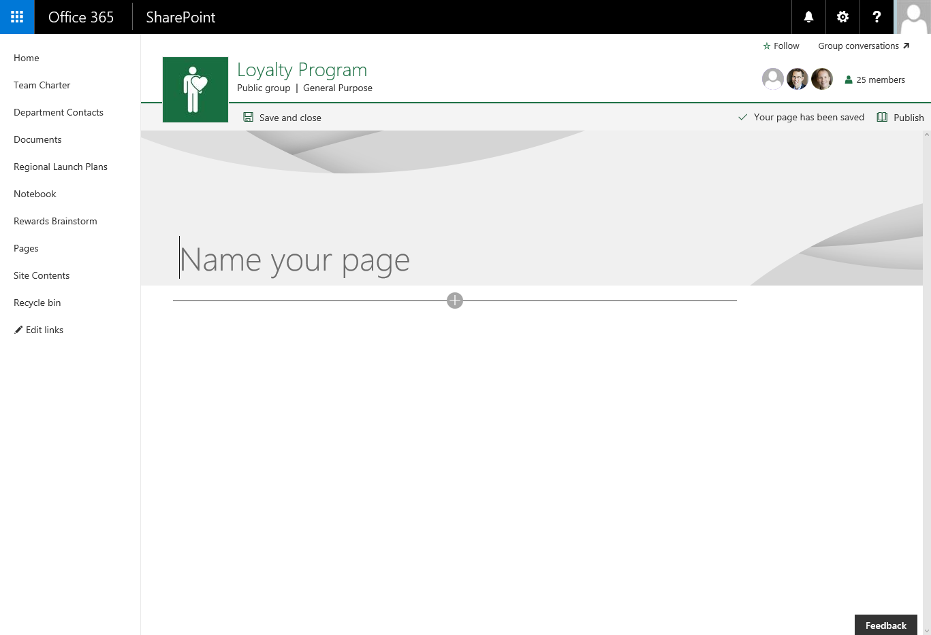

Slide 32
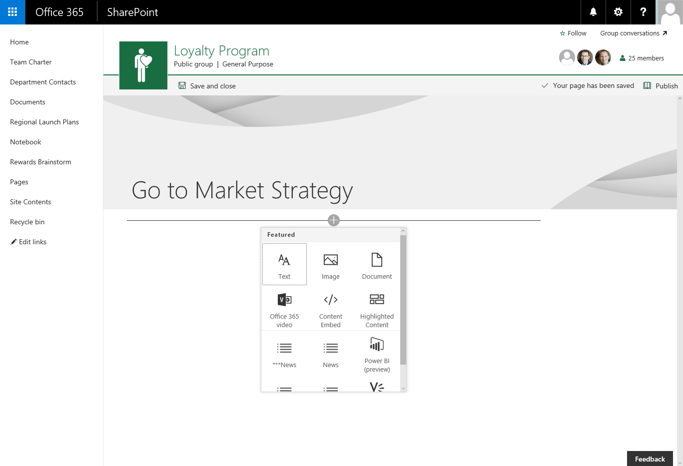

Slide 33
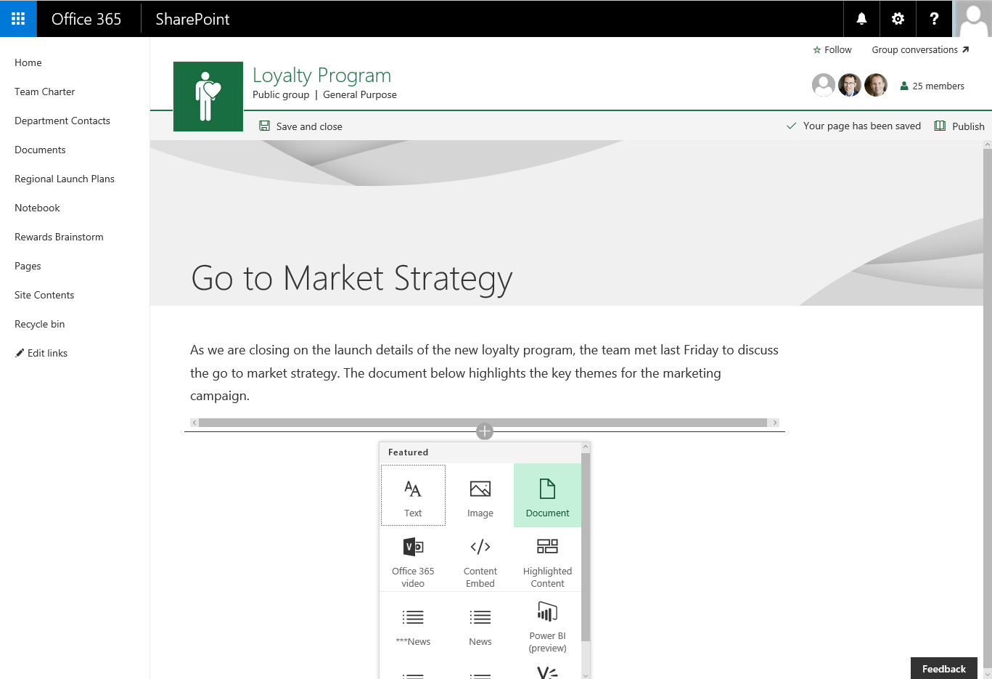

Slide 34
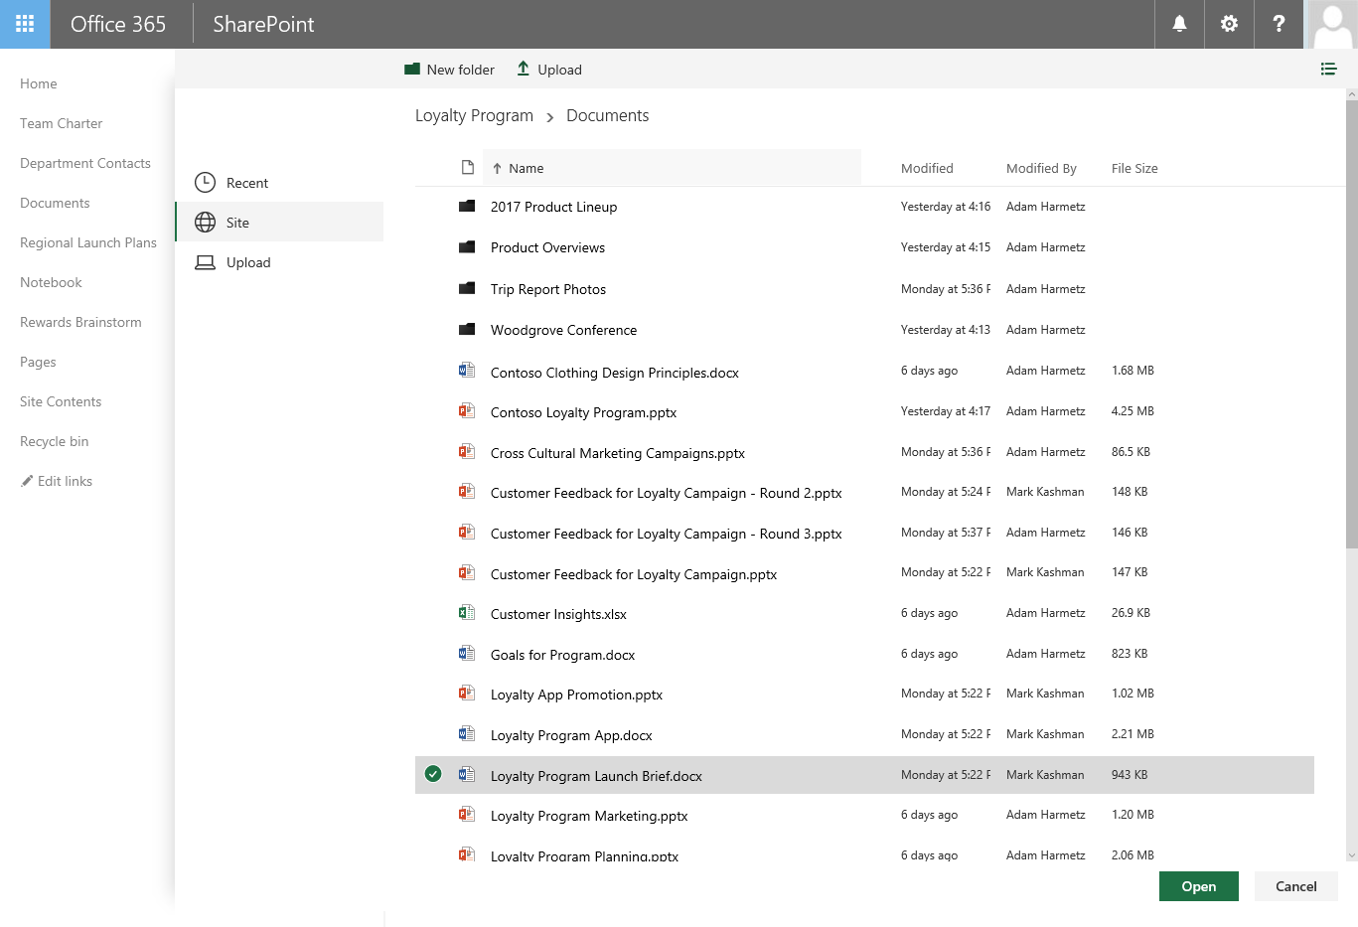

Slide 37
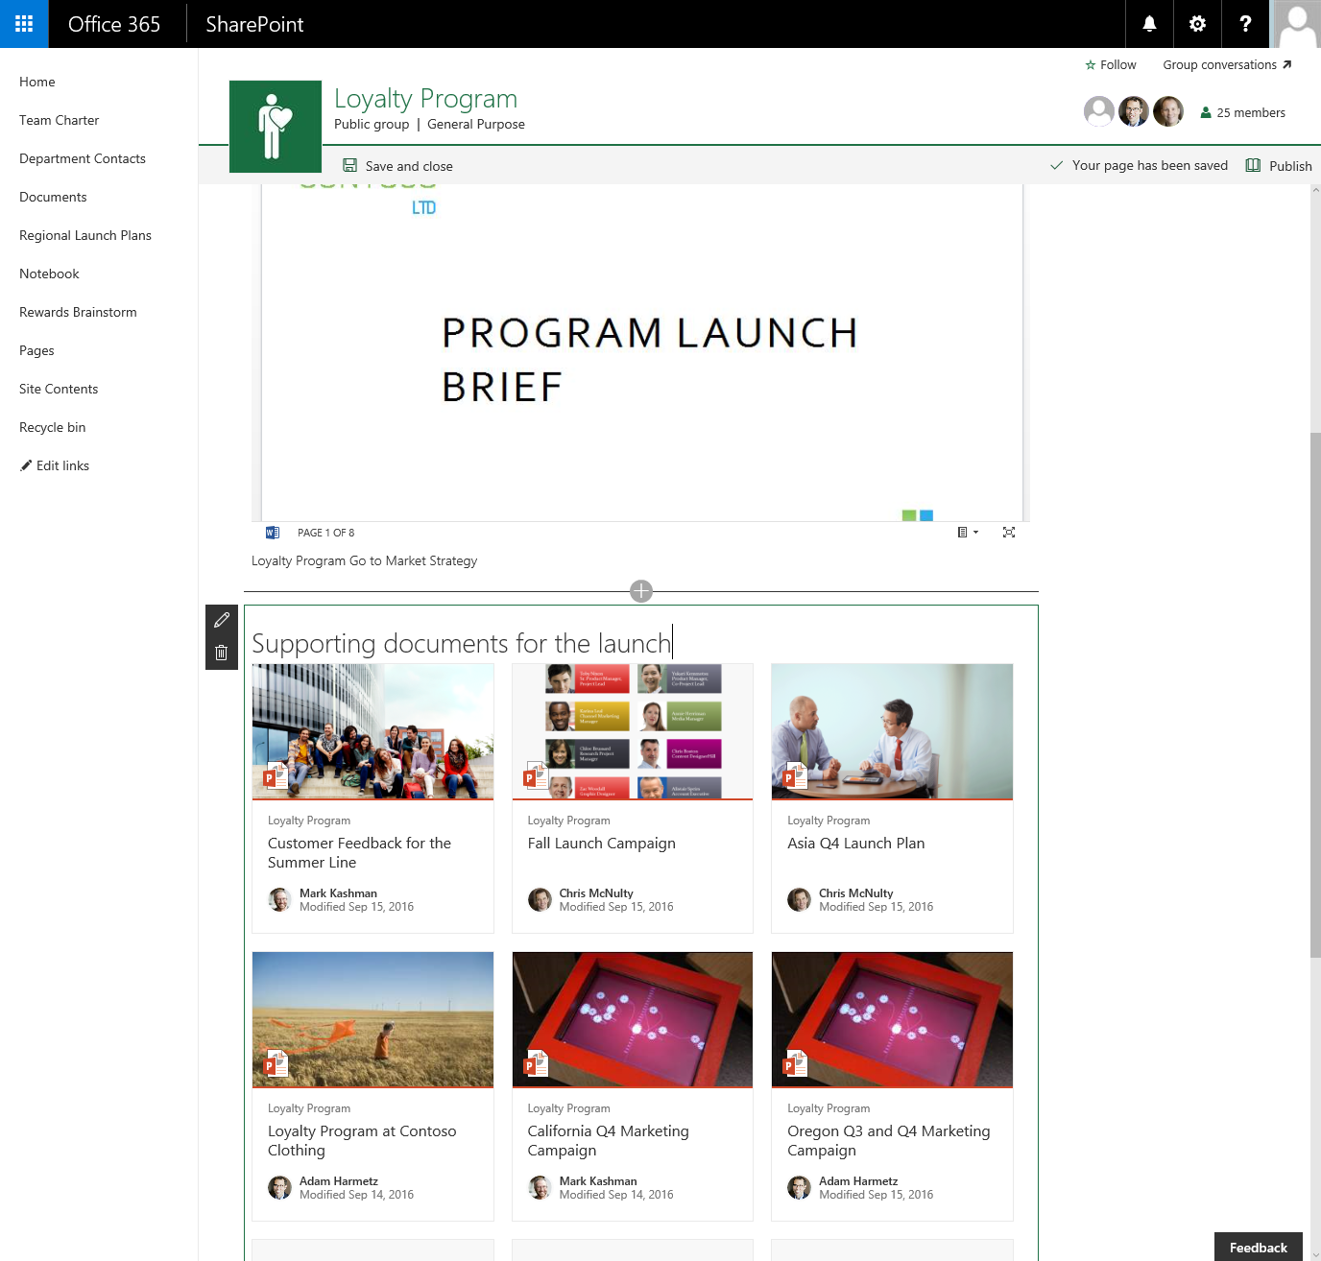

Slide 38
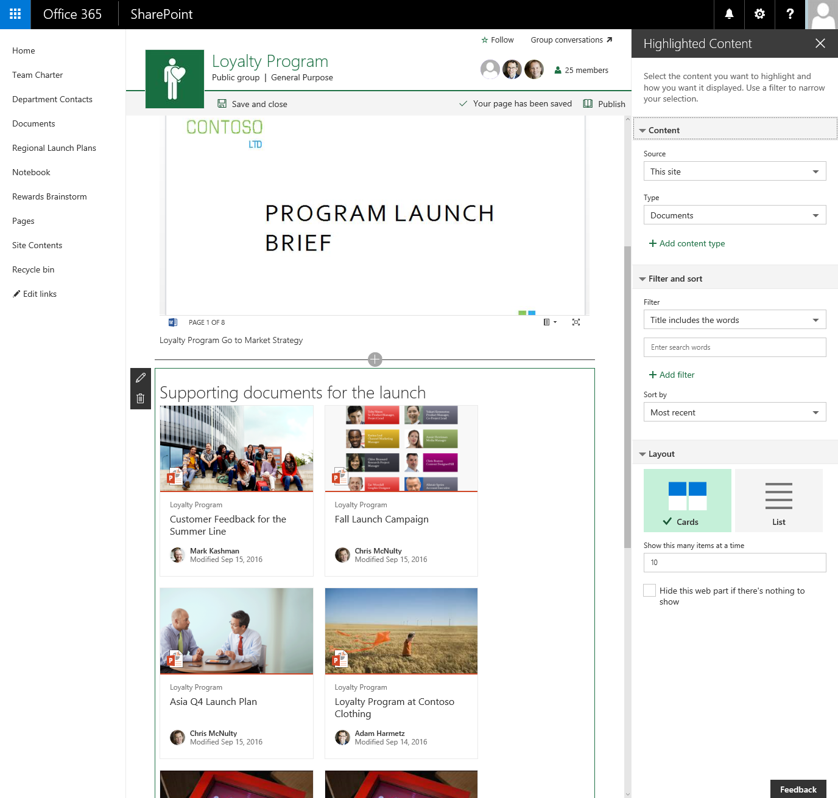

Slide 40

Deploy, ramp-up on new services and onboard new users with Microsoft FastTrack: http://fasttrack.microsoft.com/

Slide 41

Join the Microsoft Tech Community to collaborate, share, and learn from the experts: http://techcommunity.microsoft.com

Slide 42
Please evaluate this session
Your feedback is important to us!
From your PC or Tablet visit MyIgnite at http://myignite.microsoft.com
From your phone download and use the Ignite Mobile App by scanning the QR code above or visiting https://aka.ms/ignite.mobileapp

