Slide 1
Dive deep on Skype Web SDK & Skype for Business App SDK - Build apps across Web, IOS & Android
BRK4012
Srividhya Chandrasekaran Amit Sehgal Sidharth Vijayachandran
Senior Program Manager Principal Engineering Manager Senior Software Engineer

Slide 2
Session Objectives And Takeaways
Enable you to embed communications and build compelling solutions using the Skype Web SDK and Skype for Business App SDK with ease.
Demonstrate how to work with the SDKs as part of your development project.

Slide 3
Scenarios - Demo

Slide 4
Skype for Business Online Development
Your web app
Your mobile/tablet app
Instant Messaging
Presence
Ad-hoc meeting join and schedule
Integrated app management with O365 & AAD
Embedded Audio/Video (preview)
Skype Web SDK
Skype for Business
App SDK (Preview)
JavaScript
iOS (Objective C), Android (Java)
Object Model
Media
Object Model
Media
Client
Service / Server
Skype Developer Platform
User API / UCWA
Object Model
Skype Capabilities

Slide 5
Skype Web SDK

Slide 6
Skype Web SDK Architecture
Application Experience
YourApp.html + YourApp.js (app layer)
Skype Web SDK
UX Controls
JavaScript Object Model and Interfaces
Media Controller
Signaling
Identity / Auth
Media Provider
(Audio / Video / Sharing)
HTTP
Identity Provider
Skype Network
Skype for Business Web App Plug-in
Skype Plug-in
oRTC / WebRTC

Slide 7
Code Walkthrough Developing Skype Web SDK App and using the Skype Conversation UI

Slide 8
Skype for Business App SDK

Slide 9
Skype for Business App SDK Today!
Provide a native platform for SfB customers to build “Remote Advisor” scenarios for their mobile/tablet applications.
Provide platform-specific projections in native languages – Objective-C on iOS and Java on Android.
Provide support for joining scheduled meetings as a guest user using audio, video and chat services.
Align the semantics of the App SDK and the WebSDK to the greatest extent possible.

Slide 10
Guest meeting join
Client Mobile/Tablet Application
Business Services
Woodgrove bank Client Business logic
Auth
Woodgrove bank Business-specific services
Meeting
URL
Init &
Seed URL
Conversation,
Audio, Video
Chat Services
Skype for Business Application SDK
Skype for Business Services

Slide 11
Object Model Overview
Configuration Manager
Application
Devices Manager
Conversation
Self Participant
Remote Participants
Chat Service
Audio Service
Video Service
History Service
Join Conf

Slide 12
Code Walkthrough Developing using Skype for Business App SDK

Slide 13
References
https://msdn.microsoft.com/en-us/skype/websdk/skypewebsdk
https://msdn.microsoft.com/en-us/skype/appsdk/skypeappsdk
http://developer.skype.com
A Technical Deep Dive into Building Web Apps with the Skype Web SDK (Ignite 2015)
Engage and Win Users with Your Apps Through Intelligent Conversations (Build 2016)
Relation Sessions
Drive real-world success with Skype for Business platform solutions https://myignite.microsoft.com/sessions/2631
Dive deep on the new Trusted Application API for Skype for Business Online https://myignite.microsoft.com/sessions/2629
Build native cloud apps for Skype for Business: Skype Developer platform overview
https://myignite.microsoft.com/sessions/2630

Slide 14
Q&A
If you have questions please proceed to the Q&A MICROPHONE located in your session room.

Slide 15
Deploy, ramp-up on new services and onboard new users with Microsoft FastTrack: http://fasttrack.microsoft.com/

Slide 16
Join the Microsoft Tech Community to collaborate, share, and learn from the experts: http://techcommunity.microsoft.com

Slide 17
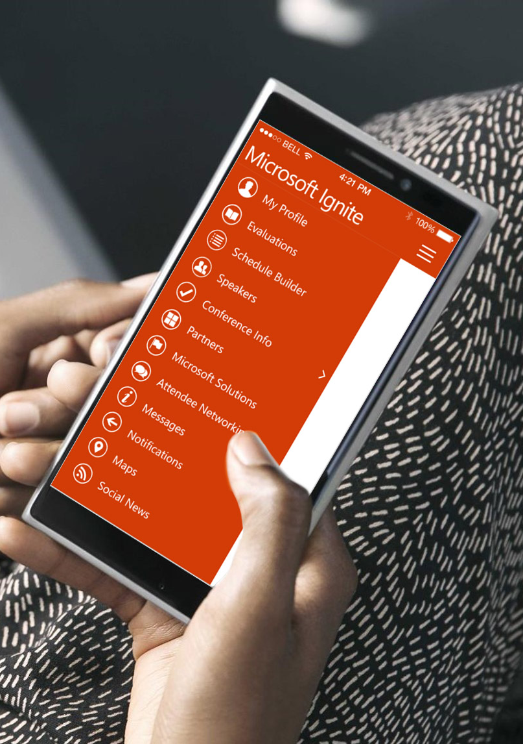
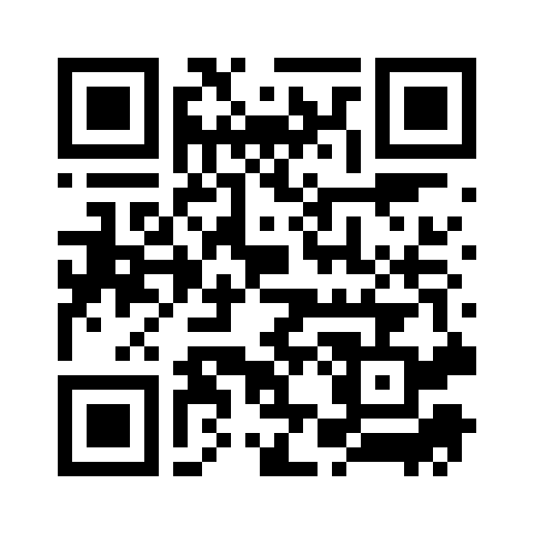
Please evaluate this session
Your feedback is important to us!
From your PC or Tablet visit MyIgnite at http://myignite.microsoft.com
From your phone download and use the Ignite Mobile App by scanning the QR code above or visiting https://aka.ms/ignite.mobileapp

