Slide 1
Troubleshoot new Skype for Business offerings
BRK4004
Jason Collier
Sr Customer Engineering Architect
Ricardo Garcia
Beta Team Lead

Slide 2
Agenda
Method to the madness
Desktop client
PSTN Calling / Conferencing
Mac and Mobility
Q&A

Slide 3
What this session is not
Not a debugging session
We expect you to know the basics of SIP
Good if you know how to use Fiddler

Slide 4
Method to the madness

Slide 5
Method to the madness
Random Approach
Reboot the server not once but twice
Ask user to test from home
Reinstall the application
Call Microsoft Support
Structured Troubleshooting
Do the right questions
Determine potential components with problems
Investigate on the correct places

Slide 6
Asking the Right Questions
User cannot place calls.
“The call could not be completed.” error message presented on call attempts from Redmond office to (555) 555 1234 and other numbers. Call to other Skype users are working.
What happened?
When?
Where?
Who’s affected?
Error message / Symptom

Slide 7
Classify the issue
Network
WAN
Faulty device
Congestion
QoS settings
Wireless issues
Service
Configuration issues
Unplanned outage
Client
Incorrect settings
Local connectivity
Application issues
Drivers issues
Cached information
3rd party app conflict

Slide 8
Drive the Resolution
Test
Compare
Reproduce
Use other tools
Validate
Test every hypothesys
Compare logs after changes
Do phased and controlled changes
Apply the fix
Document
Execute
Validate the fix
Share

Slide 9
Desktop Client

Slide 10
Desktop Client
New features
Video Based Screen Sharing
Offline Messaging
Client architecture
SIP signaling channel
HTTPS communication with Front End
HTTPS communication with Exchange
Direct media
Relay communication with Edge

Slide 11
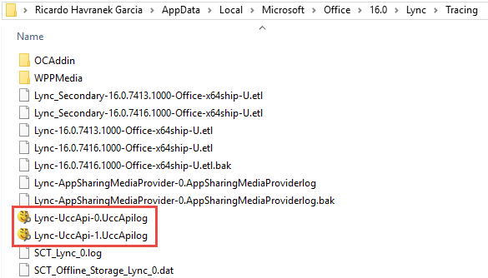
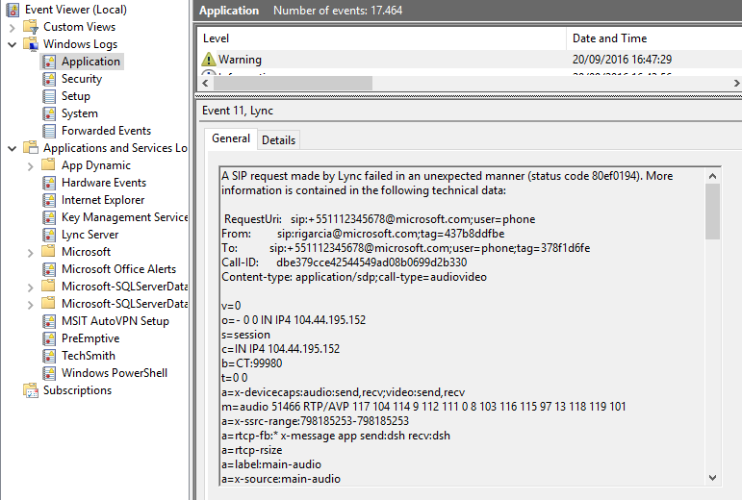
Desktop Client - Overview
%localappdata%\Microsoft\Office\16.0\Lync\Tracing
Event viewer
*.UccApilog
*.ETL
Windows Logs \ Application

Slide 12
Video Based Screen Sharing
RDP
  Remote Desktop Protocol
  TCP Only
  8 Frames-per-second max
  No hardware acceleration
VBSS
  TCP or UDP
  Faster call setup
  Up to 30FPS@4Mbps
  H.264 using HW or SW
Fallback
  Older client
  Remote control
  Meeting recording
  Client Policy

Slide 13
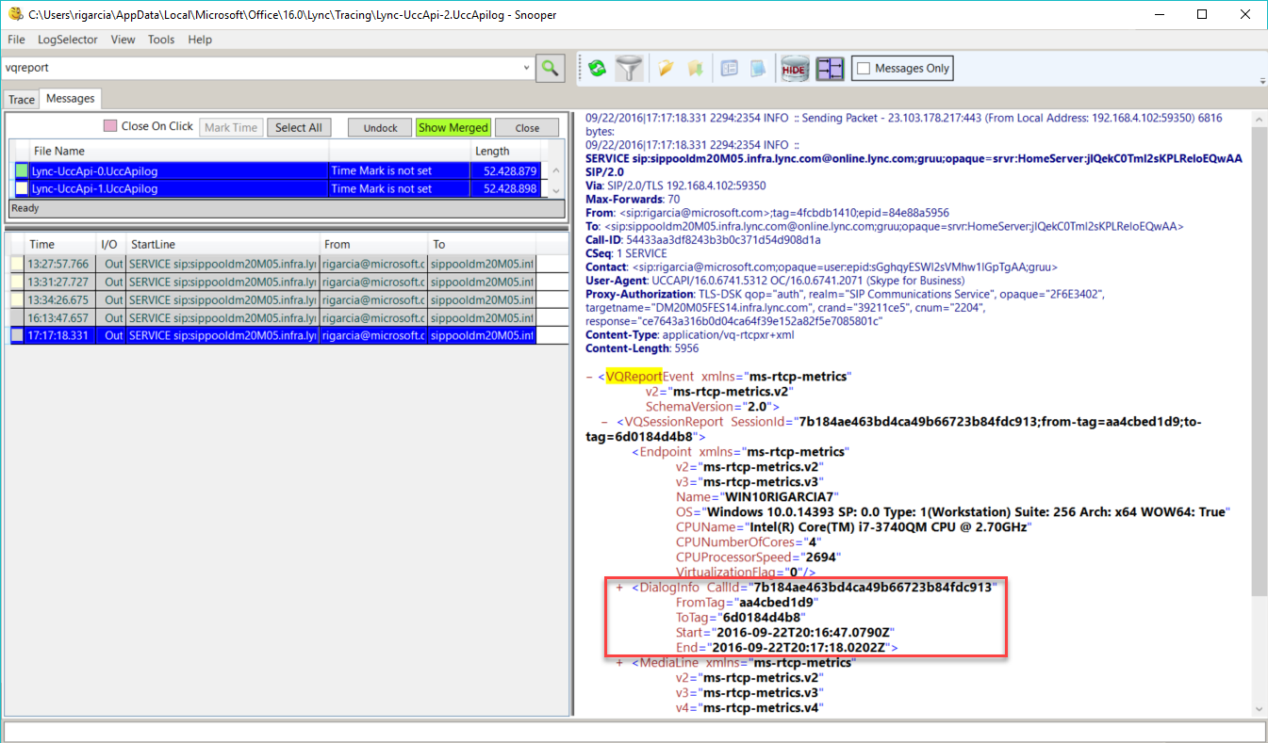
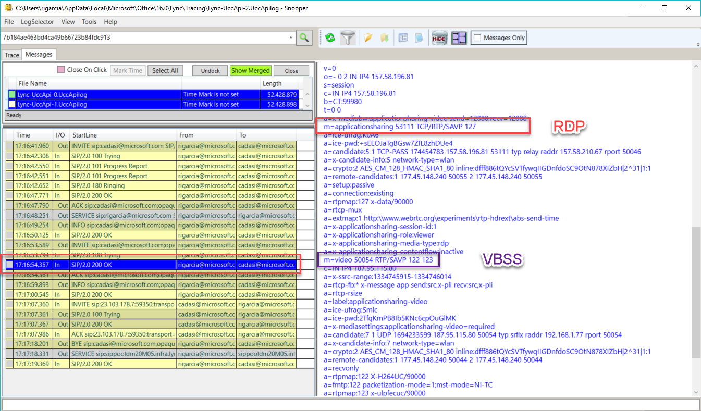
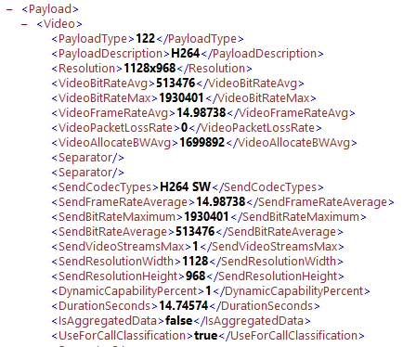
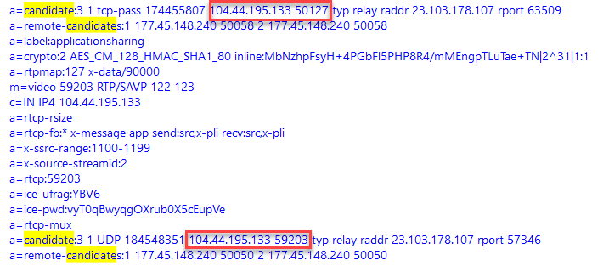
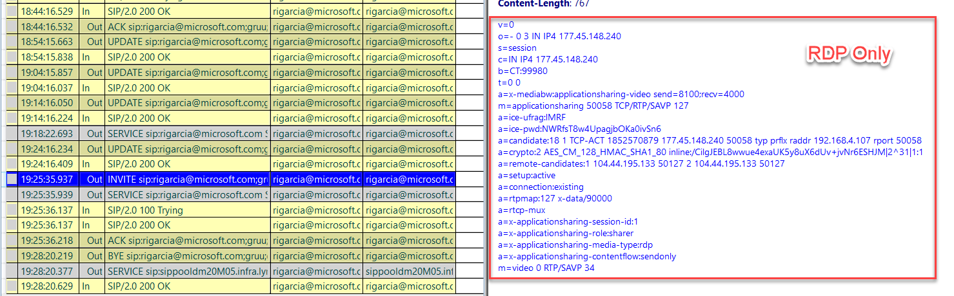
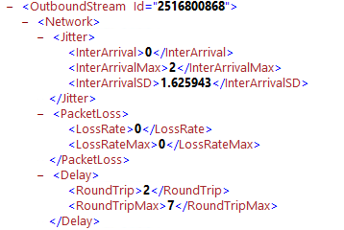
Working with the logs
Identify the call
Check the protocol used
Analyze medialine statistics

Slide 14
RDP vs VBSS Demo

Slide 15
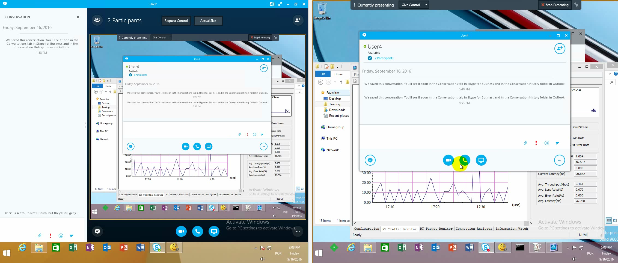
RDP on a 10% loss network

Slide 16
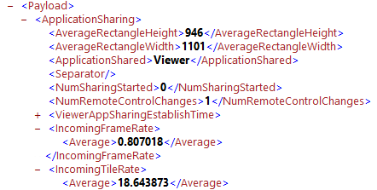
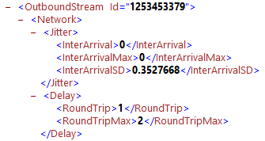
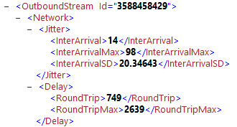
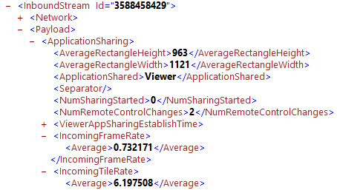
RDP Quality Report
Good network
0% packet loss, Local LAN (good network)
vs
10% packet loss, 250ms WAN (bad network)
Bad network
Good network
Bad network

Slide 17
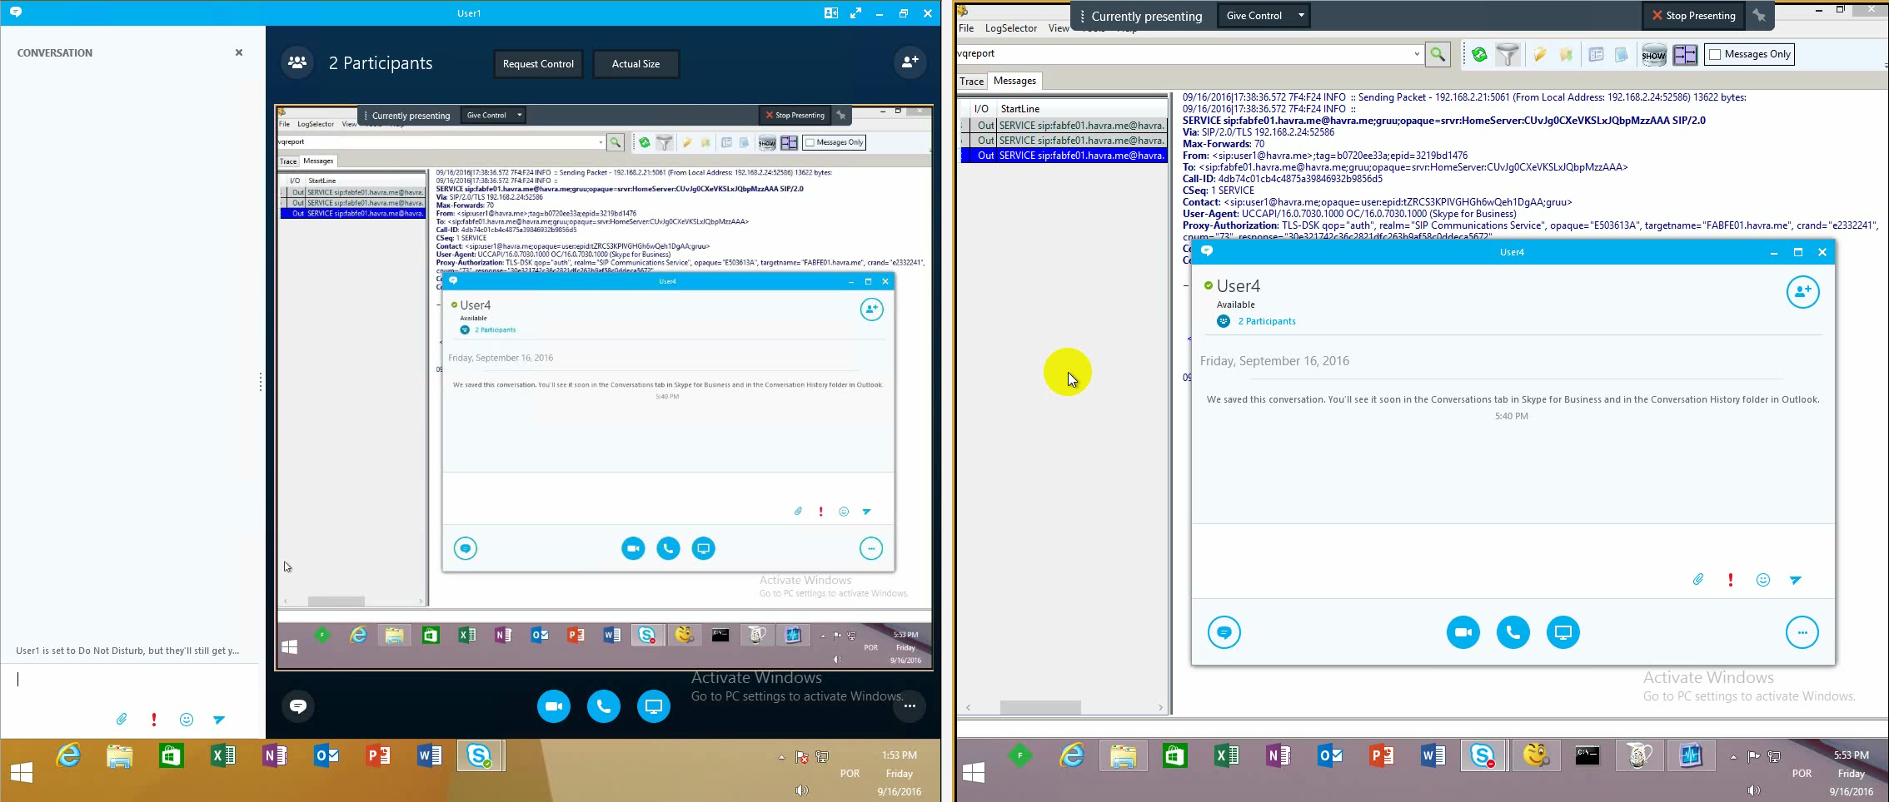
VBSS on a 10% loss network

Slide 18
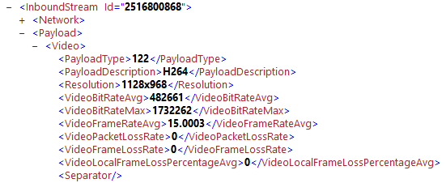
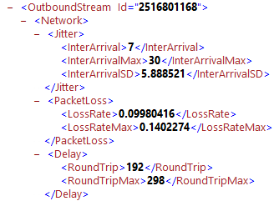
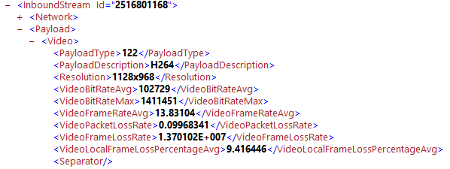
Some examples
Good network
0% packet loss, Local LAN (good network)
vs
10% packet loss, 250ms WAN (bad network)
Bad network
Good network
Bad network

Slide 19
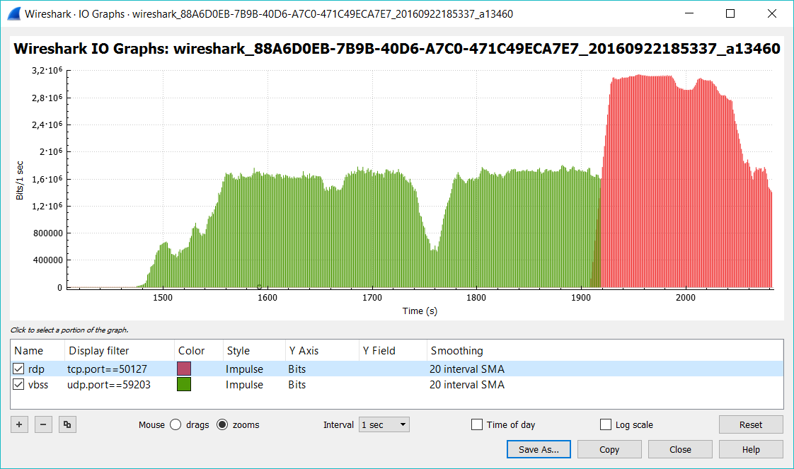
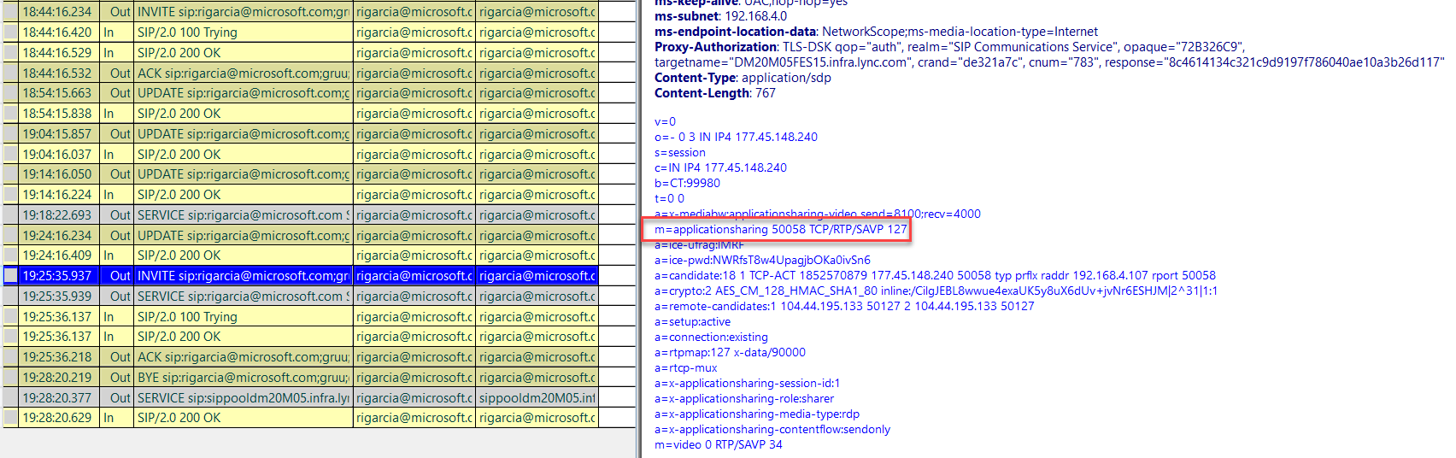
Fallback
VBSS and RDP candidates
Bandwidth on RDP
RDP invite

Slide 20
Offline Messaging

Slide 21
Offline Messaging
Relies on Exchange integration
EnableIMAutoArchiving must be true on Client Policy
Client Side Only, no Server Updates Required
Flow of message
Client attempts to send an offline message. The server will return that the message could not be delivered.
Client goes directly to remote mailbox and write the message there
Limitations
Federated messages are just sent as e-mail
SIP signaling channel
HTTPS communication with Front End
HTTPS communication with Exchange
Direct media
Relay communication with Edge

Slide 22
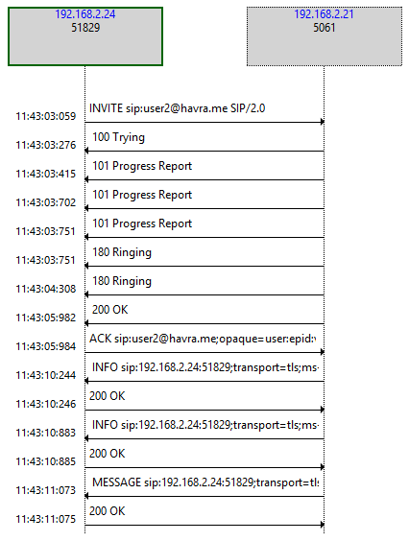
Online Message
Only SIP signaling
200 OK Expected
SIP signaling channel
HTTPS communication with Front End
HTTPS communication with Exchange
Direct media
Relay communication with Edge

Slide 23
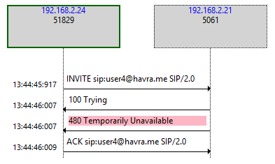
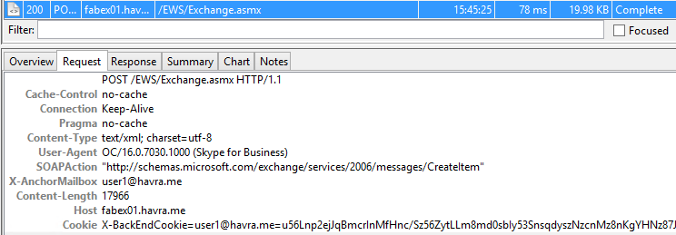
Offline message
SIP Messages is sent
Server returns a SIP/2.0 480 Temporarily Unavailable
Sender goes to EWS and uses Conversation History Functionality.
SIP signaling channel
HTTPS communication with Front End
HTTPS communication with Exchange
Direct media
Relay communication with Edge

Slide 24
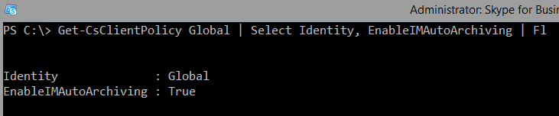
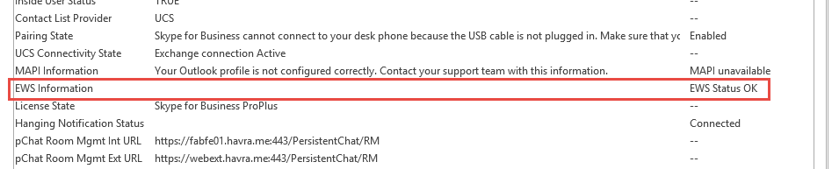
Offline message
Policy setting
EWS deployment

Slide 25
PSTN Calling / Conferencing

Slide 26
PSTN Calling
Available in US, UK and Puerto Rico
More countries to come
Important things to know:
Dial plans are different on each country
Dialing with + will bypass any dial plan
Users without MCOEV also have a dial plan

Slide 27
PSTN Calling troubleshooting
Call Establishment
Failed to connect
Disconnected on initial 10s
Call Quality
Broken up audio
Echo
Delay
Volume
Noise
Distortion
One way audio
Dropped after initial 10s

Slide 28
Common causes
Failed to connect
Network
Disconnected on initial 10s
Broken up audio
Delay
Distortion
Service
Echo
Volume
Noise
One way audio
Client
Call dropped after some time

Slide 29
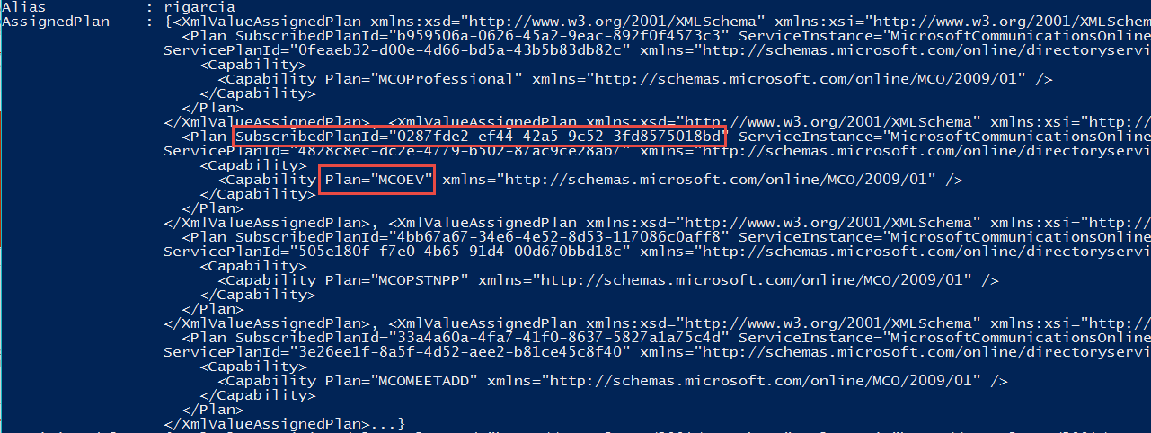
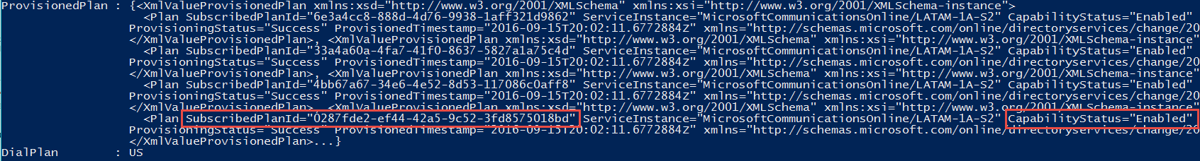
PSTN Calling – Investigating configuration
SIP URI of the user placing the call
Called to number
Licensing plan status:

Slide 30
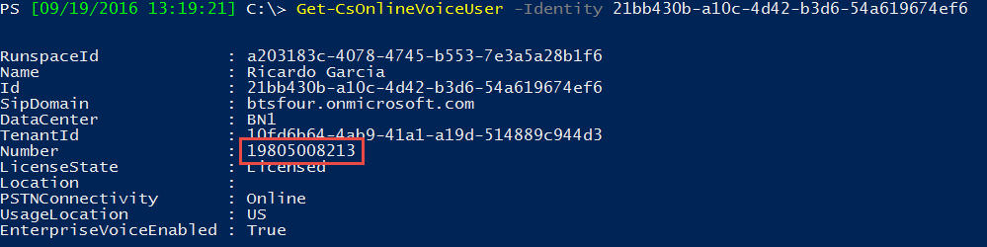
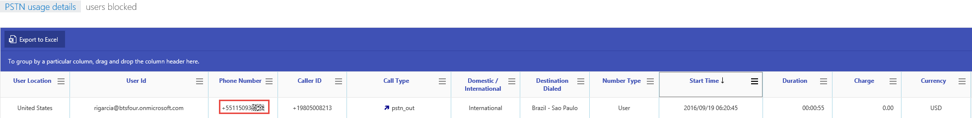
PSTN Calling – Investigating call information
Telephone number of the user placing the call
CDR Information from the PSTN usage details report on Skype for Business Administration Portal.

Slide 31
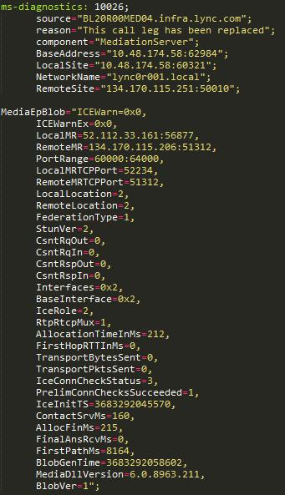
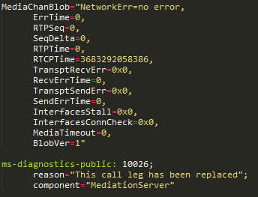
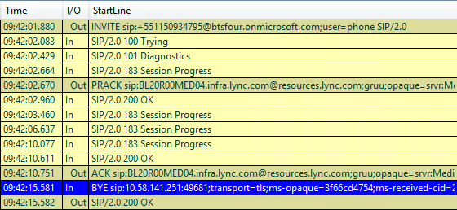

PSTN Calling – Investigating SIP Messages
Inside the SIP messages – BYE Message

Slide 32
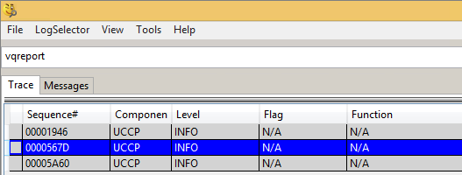
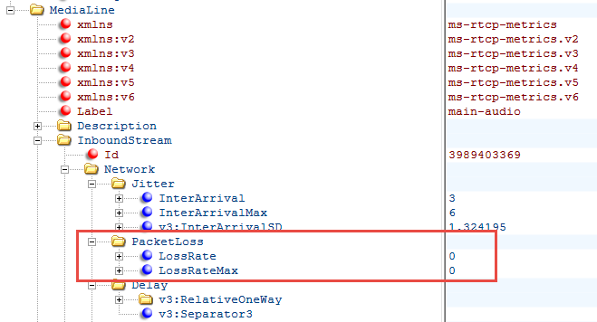
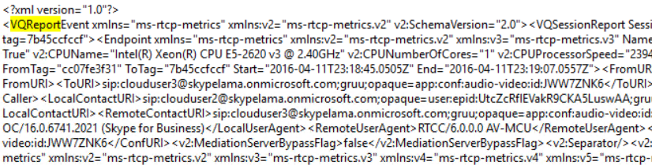
PSTN Calling – Investigating Media Quality
Inside the SIP messages – Quality Report

Slide 33
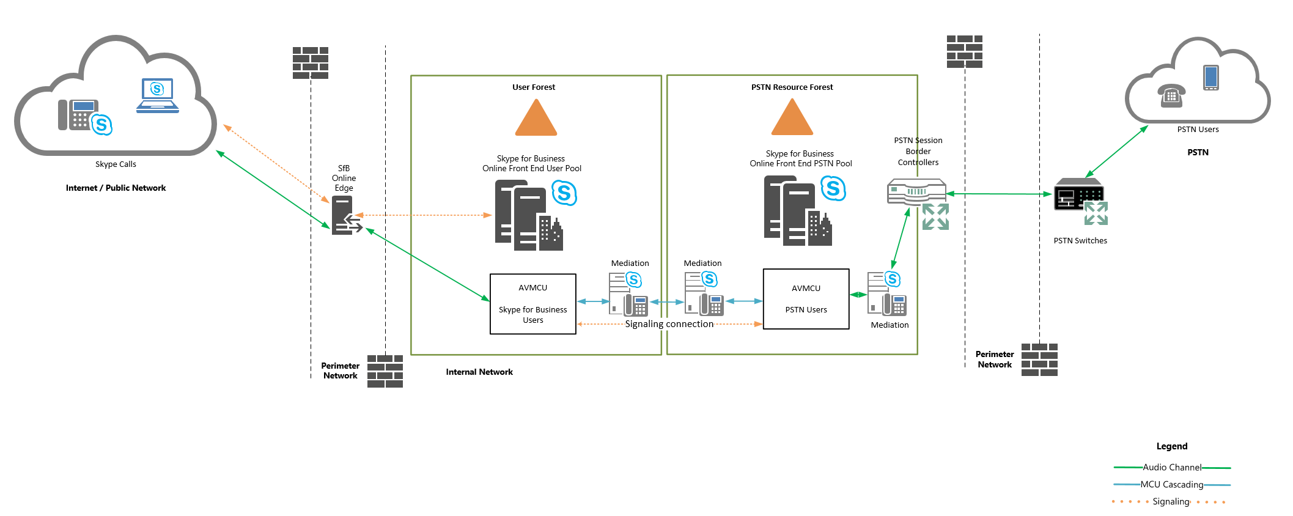
PSTN Conferencing Architecture

Slide 34
Skype for Business for Mac and Mobility

Slide 35
Logs, Logs and More Logs
~/Library/Containers/com.Microsoft.SkypeForBusiness/Data/Library/Logs/com.microsoft.SkypeforBusiness
SfbMac.log
SfbMac.old.log
~/Library/Containers/com.microsoft.SkypeForBusiness/Data/Library/Application\ Support/com.microsoft.SkypeForBusiness
Skype For Business.htrace0
Skype For Business.htrace0.bak

Slide 36
Logs, Logs and More Logs
Clearing Logs and Cache files
  rm -rf ~/Library/Application\ Support/com.microsoft.SkypeForBusiness
  rm -rf ~/Library/Caches/com.microsoft.SkypeForBusiness
  rm -rf ~/Library/Saved Application\ State/com.microsoft.SkypeForBusiness
  rm -rf ~/Library/Caches/com.microsoft.skypeforbusiness.shellapp
  rm -rf ~/Library/Logs/LwaTracing
  rm -rf ~/Library/Preferences/com.microsoft.SkypeForBusiness.plist
  defaults delete com.microsoft.SkypeForBusiness
  killall cfprefsd
  Doing a full capture (Logs + System + Network Capture + system_profiler)
    Close the client
    Remove the cache using above lines
    Start a capture with (sudo tcpdump -w ~/Desktop/CaptureMSFT.pcap)
    Clear the DNS cache (sudo killall -HUP mDNSResponder)
    Clear the CRL cache (sudo crlrefresh r f)
    Repro the issue
    Stop the capture on step 3 with Control+C
    Run system_profiler with (system_profiler > ~/Library/Logs/com.microsoft.SkypeForBusiness/systeminfo.txt)
    Collect the files
~/Desktop/CaptureMSFT.pcap
~/Library/Logs/com.microsoft.SkypeForBusiness/*.*
~/Library/Logs/LwaTracing/LccMedia/*.*
/var/log/system.log

Slide 37
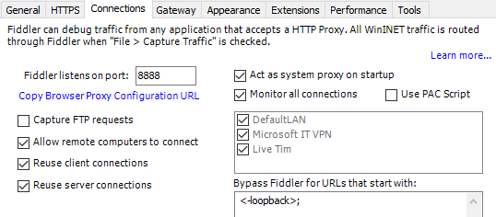
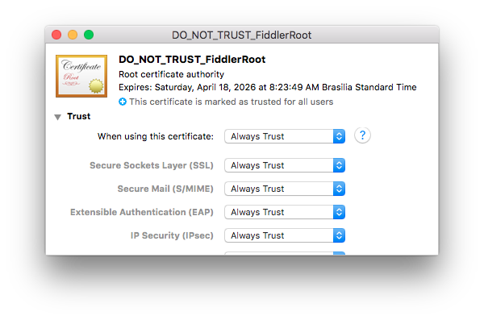
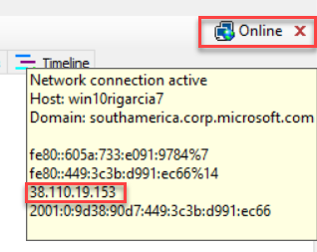
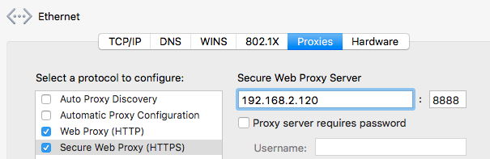
Fiddler
Collect the HTTPs traffic
1 – Enable Fiddler on PC and let remote users to connect
2 – Install the Fiddler Root CA cert on the Mac by accessing Fiddler Echo Service: and downloadingFiddler Root Certificate. Normally on http://<pc address>:8888/
3 – Configure your network proxy settings on Mac OS Network Advanced Settings:

Slide 38
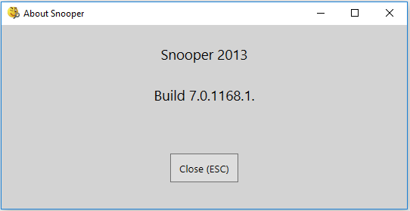
Snooper
Read all Lync/Skype for Business Logs
  Server
  Desktop
  Mobility

Slide 39
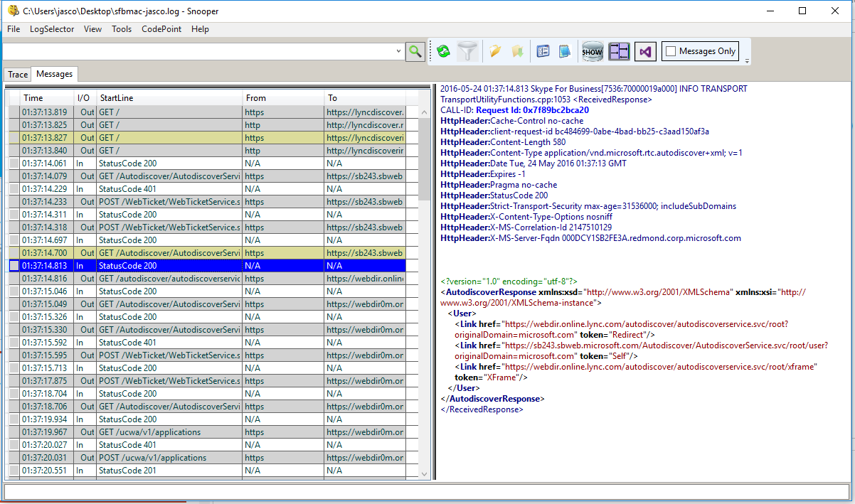
Snooper

Slide 40
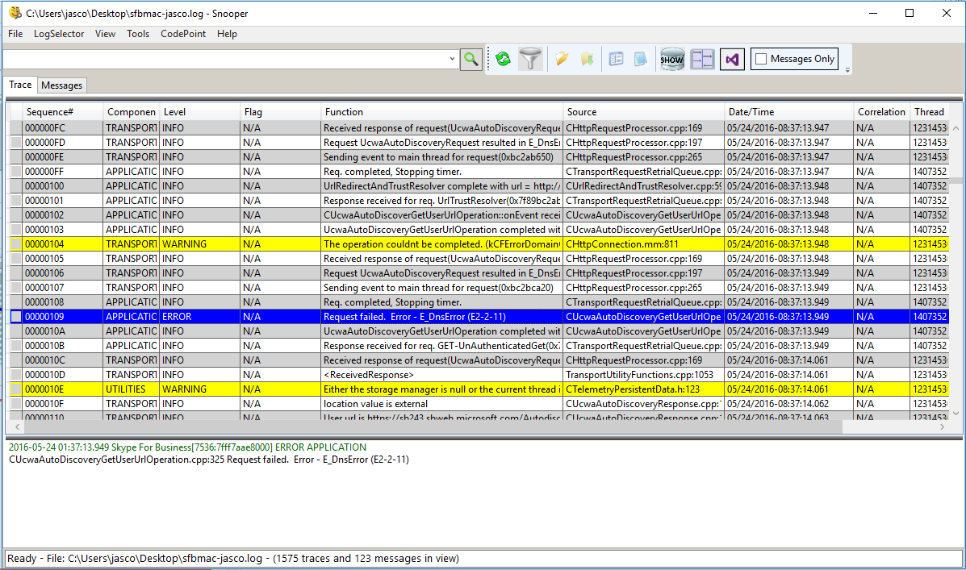
Snooper

Slide 41
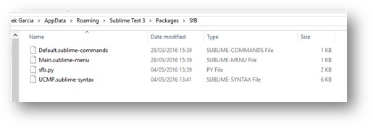
Sublime
Text Editor Available for Windows and Mac
  Free or Purchase version available
  http://www.sublimetext.com
UCMP Parsers
  http://aka.ms/UCMPParsers
  Extract the 4 files of the zip to the folder:
  %appdata%\Sublime Text 3\Packages\SfB

Slide 42
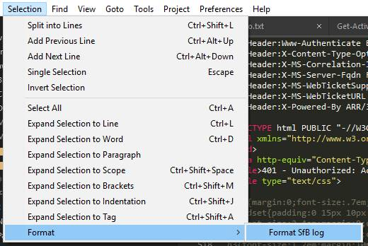
Sublime

Slide 43
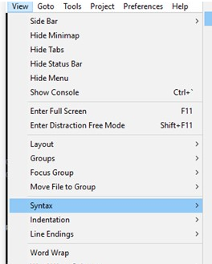
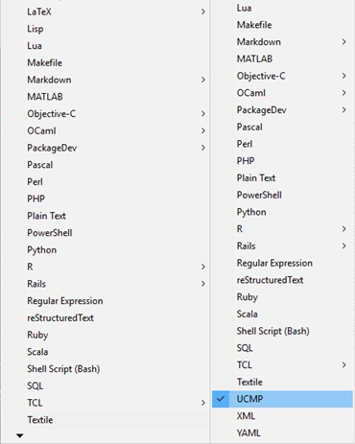
Sublime

Slide 44
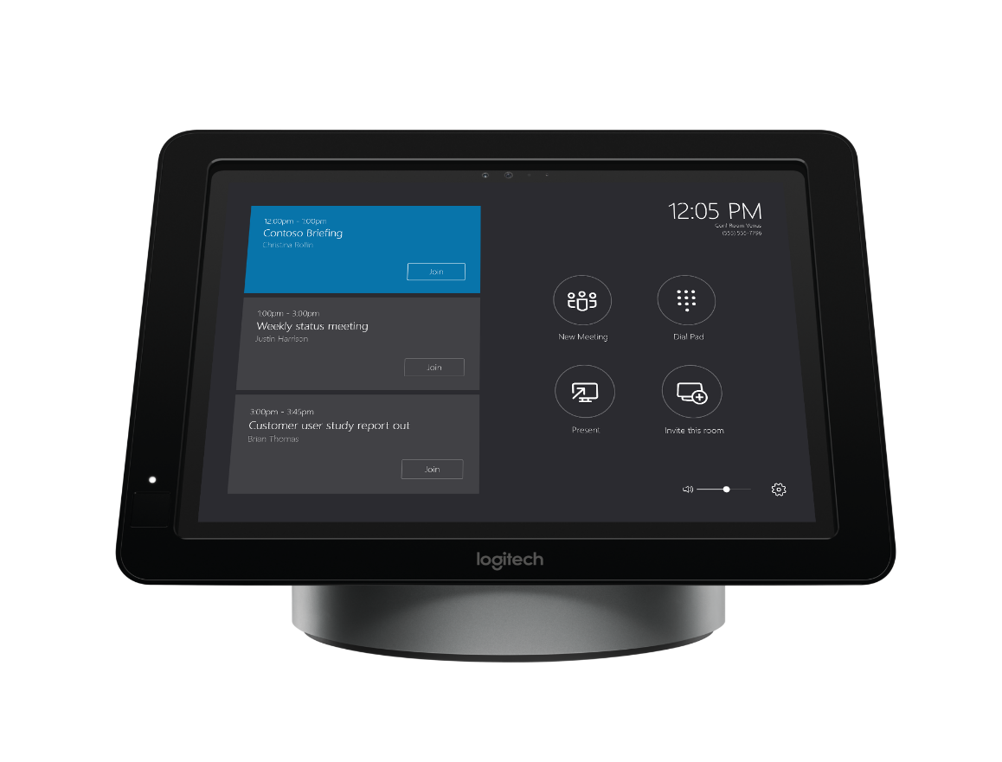
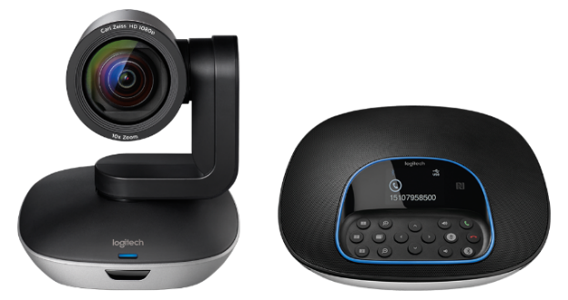
#MeetingAccomplished
Want to win a new Skype Room Systems meeting room bundle from Microsoft and Logitech?
Check out Skype Room Systems in the Expo Hall at
Microsoft Showcase MS 111 or Logitech Booth 1818.
Snap a photo of the device in action and share your photo on Twitter or Instagram with the hashtag #MeetingAccomplished, or upload it to www.SkypeMeetingAccomplished.com,
to enter to win your own Skype Room Systems bundle!*
*No purchase necessary. Open only to legal United States residents. Sweepstakes ends 9/30/2016. See www.SkypeMeetingAccomplished.com for Official Rules.
Microsoft Ignite #MeetingAccomplished

Slide 45

Join the Skype for Business Community
Discover rich discussions and
information sharing across
customers, partners, and users
IT Pro Forums
User Forums
Broadcast Updates
Tips and Tricks
Product Updates
http://aka.ms/sfbcommunity

Slide 46
Q&A

Slide 47

Deploy, ramp-up on new services and onboard new users with Microsoft FastTrack: http://fasttrack.microsoft.com/

Slide 48

Join the Microsoft Tech Community to collaborate, share, and learn from the experts: http://techcommunity.microsoft.com

Slide 49


Please evaluate this session
Your feedback is important to us!
From your PC or Tablet visit MyIgnite at http://myignite.microsoft.com
From your phone download and use the Ignite Mobile App by scanning the QR code above or visiting https://aka.ms/ignite.mobileapp

Slide 50
Resources

Slide 51
Resources
https://gallery.technet.microsoft.com/Skype-for-Business-and-7857597d - Skype for Business Troubleshooting Guide
http://www.nirsoft.net/utils/winlister.html - WinLister
https://technet.microsoft.com/en-us/library/jj945448(v=office.14).aspx – Remove Lync for Mac 2011
  http://www.sublimetext.com – Sublime Text
  http://www.telerik.com/fiddler - Fiddler

Slide 53
Fiddler tricks

Slide 54
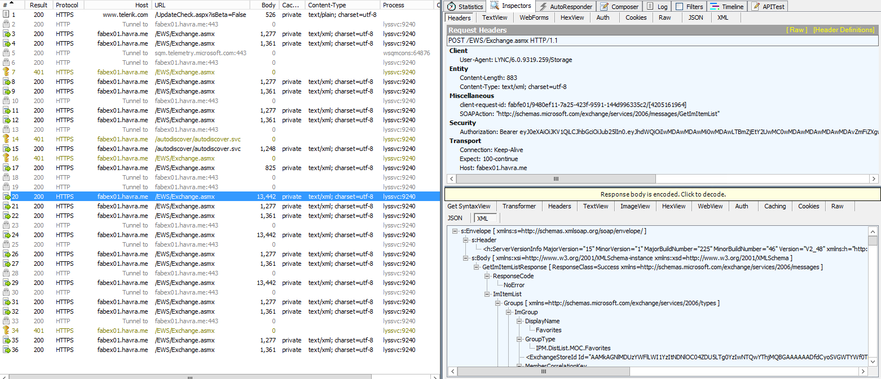
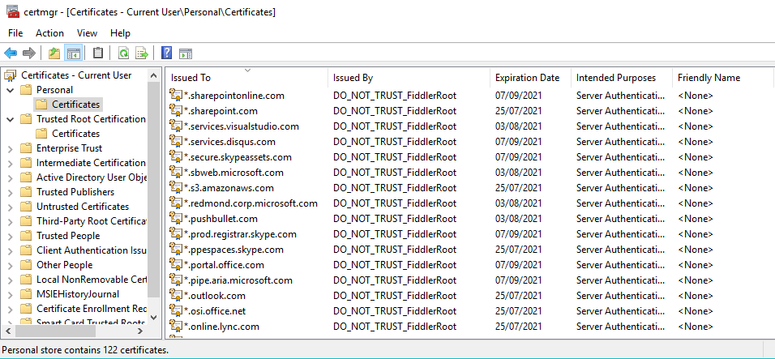
Investigating Web Traffic with Fiddler
Proxy able to generate self signed certificates and decrypt HTTPS requests

Slide 55



Check a remote Skype for Business PowerShell session, with Fiddler?
Why not? It’s all about HTTPS traffic!

Slide 56

Offline Messaging – Investigating Logs
I don’t trust server settings. Want to see the logs:
To read client logs on
%localappdata%\Microsoft\Office\16.0\Lync\Tracing
we use:
Snooper (https://www.microsoft.com/en-us/download/details.aspx?id=47263)
To capture and analyze web traffic:
Fiddler
(http://www.telerik.com/fiddler)

