Slide 1
Customize and Tune Microsoft Office 365 Data Loss Prevention
BRK4001
Jack Kabat
Wesley Holley

Slide 2
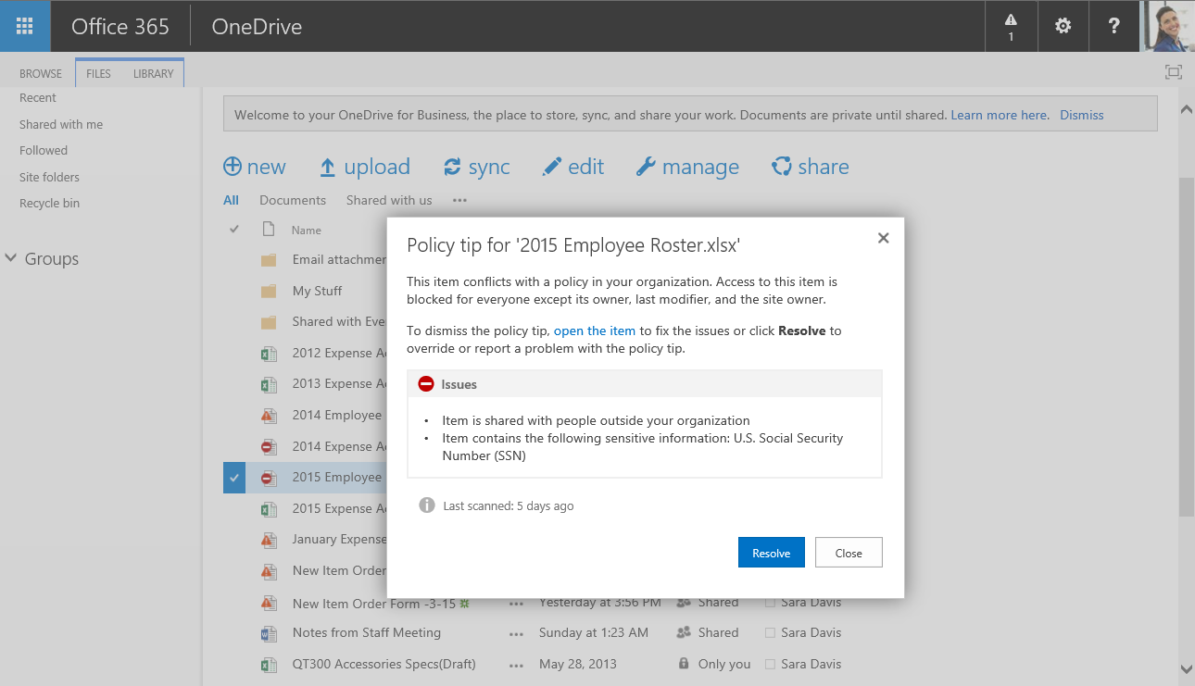
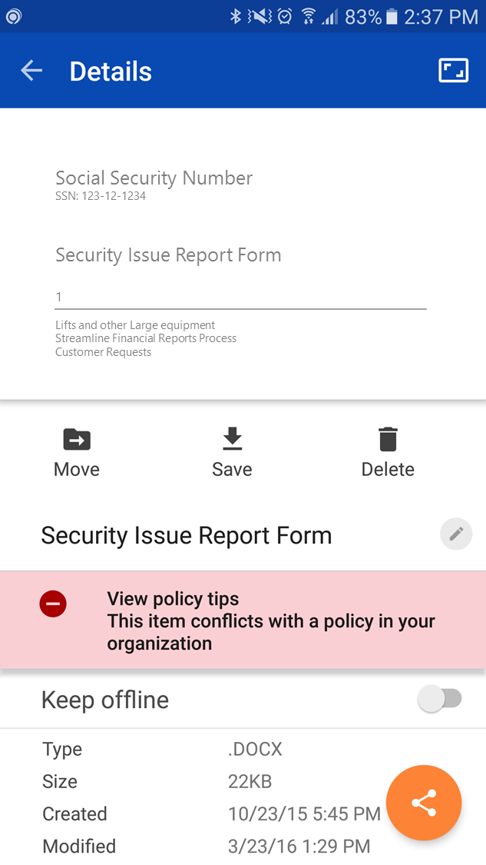
Balancing User Productivity and Risk

Slide 3
Identifying the Right Content is Key
50%
Year over year growth rate
Volume and complexity of data is increasing

Slide 4
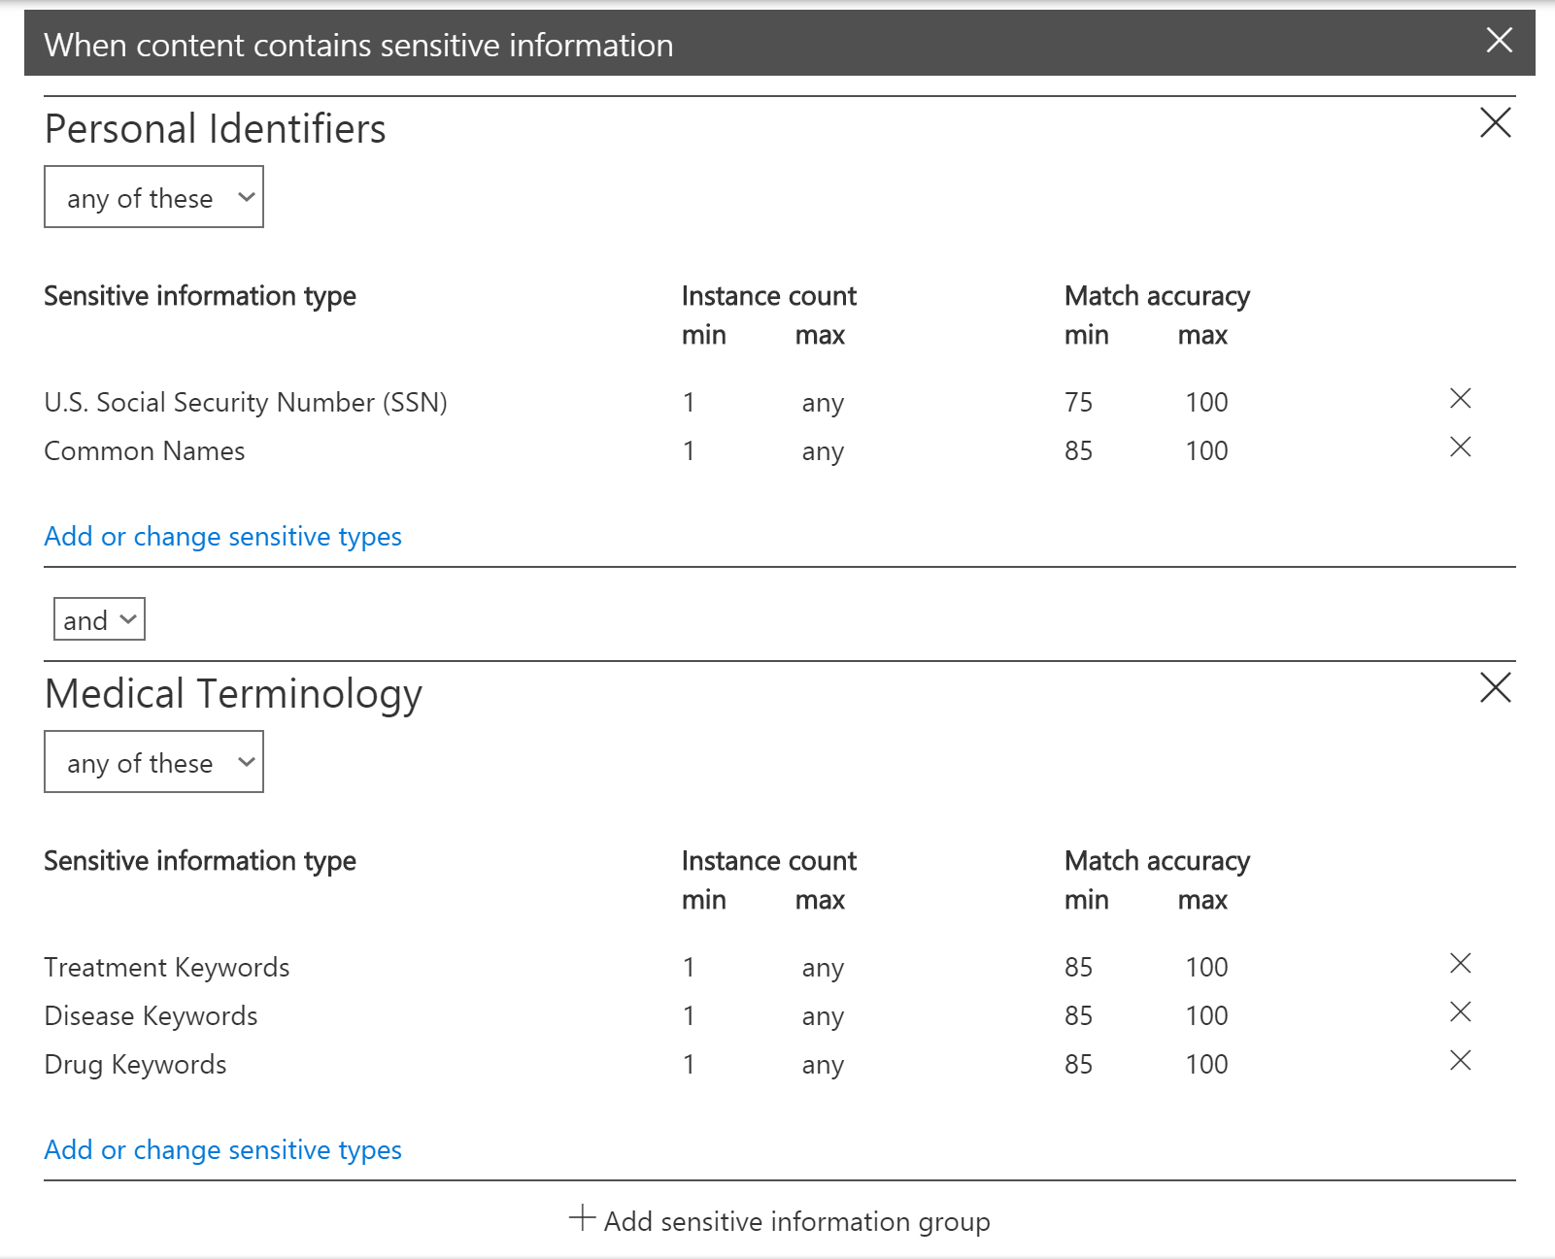
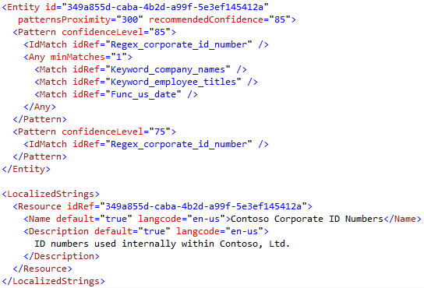
Customization Capabilities
Count &
Confidence
Settings
Keyword and Grouping Adjustments
Adjustment of Built-in Types
Creating Own Custom Types

Slide 5
Demo: Policy-based Customization
Jack Kabat

Slide 6
Customization Capabilities
Count &
Confidence
Settings
Keyword and Grouping Adjustments
Adjustment of Built-in Types
Creating Own Custom Types

Slide 7
Principles of Matching Content
Pattern
Characters, formatting, checksum
908475021

Slide 8
Principles of Matching Content
Pattern
Characters, formatting, checksum
Additional Evidence
Proximity
Keywords, dates, other patterns, etc.
Proximity window
Proximity window
…Provider: Lamna Healthcare Co. Record Number: Processed by: Sofia Neves Total Covered…
908475021
Match
IdMatch

Slide 9
Demo: Creating Own Custom Types
Wesley Holley

Slide 10
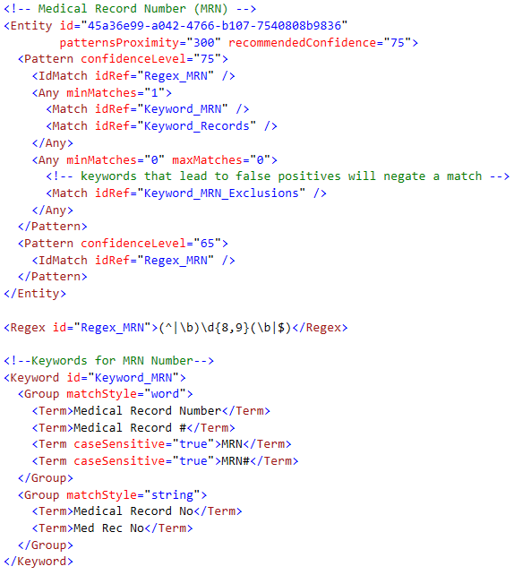
Detection Methods Summary
Regular expressions
Other evidence in proximity
Internal functions (dates, checksums)
Dictionaries
M of N keyword matches
Unique matching
Logical grouping operators
Negative evidence
Fingerprinting algorithm
Fully extensible to support custom types extending built-in types of creating fully custom

Slide 11
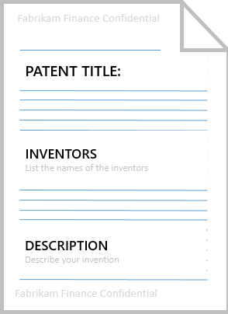
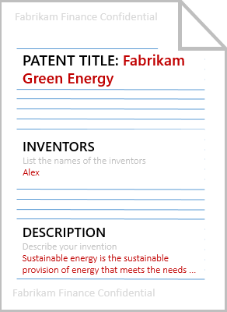
Document Fingerprinting
GET TEMPLATE CONTENT
Fabrikam Patent Form Tracking Number Author Date Invention Title Names of all authors...
CLASSIFICATION RULE with FINGERPRINT
CONFIGURATION
CREATE FINGERPRINT
Condensed representation of the template content
Document is not stored
Stored as a sensitive information type
Evaluation
+ verdict
GET EMAIL CONTENT
Fabrikam Patent Form Tracking Number 12345 Author Alex Date 1/28/2014 Invention Title Fabrikam Green Energy...
CREATE FINGERPRINT
Temporary in memory representation
Used for comparson with source fingerprint created at config time
FINGERPRINT
GENERATION
RUNTIME
VERDICT
Compare the two fingerprints
Evaluate a ’containtment coefficient’ to declare template contained in email content

Slide 12
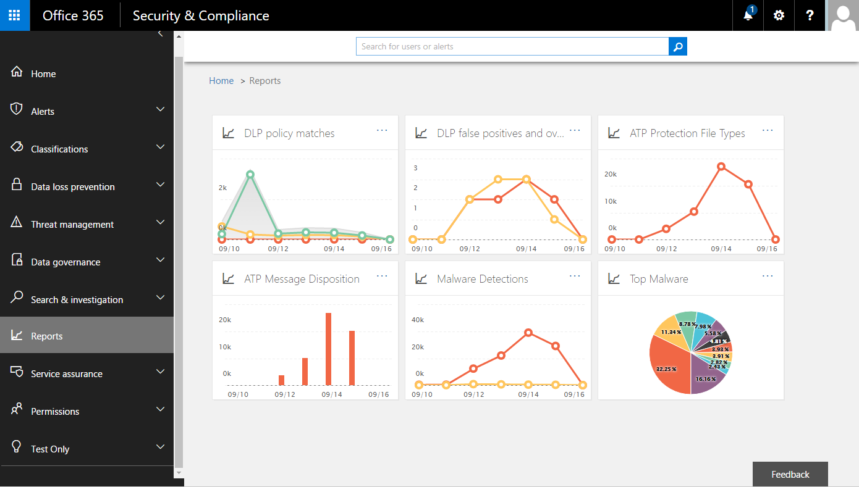
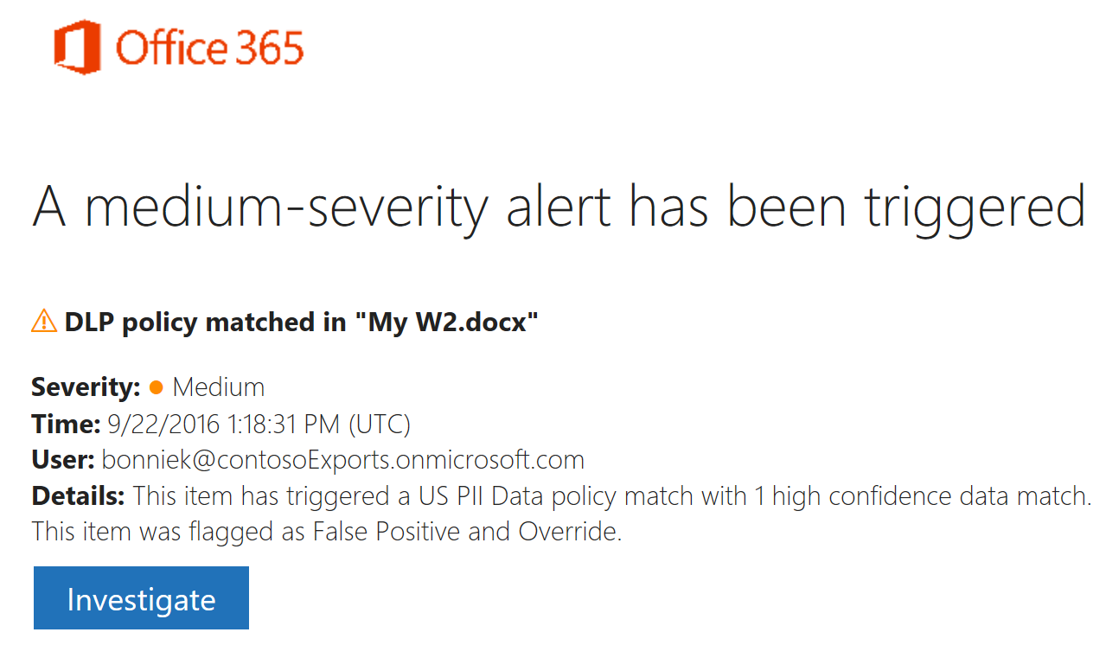
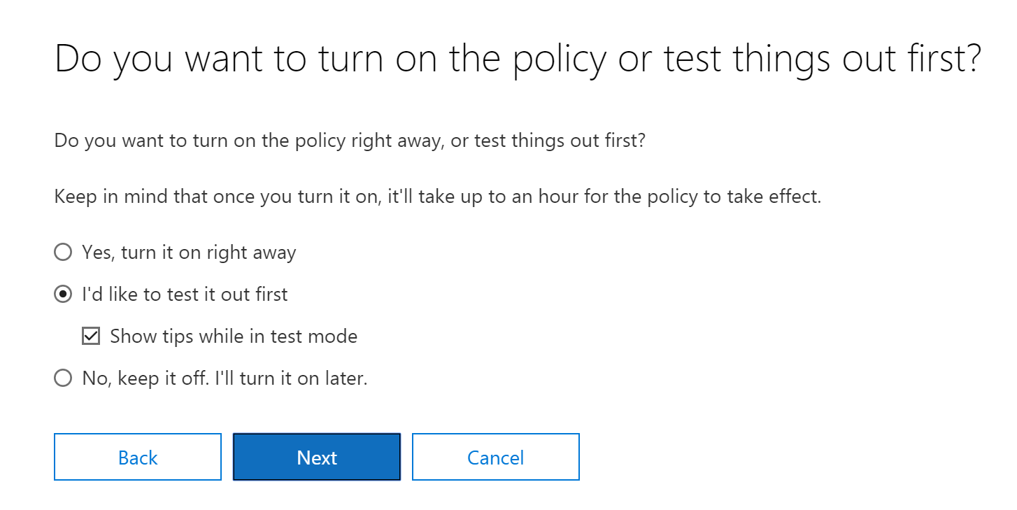
Data Driven Tuning
See “what-if” with audit policy mode
Your users are your signal – false positives
Reporting trends filtered pivoted by rule
Test classification document matching
Use Alerting notification for proactive notices

Slide 13
Demo: Data Driven Tuning

Slide 14
Customization and Tuning Capabilities Summary
Count &
Confidence
Settings
Keyword and Grouping Adjustments
Adjustment of Built-in Types
Fully Custom Types

Slide 15
Related Content
BRK3021 - Protect your sensitive information with Office 365 Data Loss Prevention
BRK3017 - Own your data and service - monitor and investigate with Office 365 Auditing, Insights and alerts
BRK1009 - Learn how Office 365 security and compliance leverages intelligence in a cloud first world

Slide 16
Deploy, ramp-up on new services and onboard new users with Microsoft FastTrack: http://fasttrack.microsoft.com/

Slide 17
Join the Microsoft Tech Community to collaborate, share, and learn from the experts: http://techcommunity.microsoft.com

Slide 18
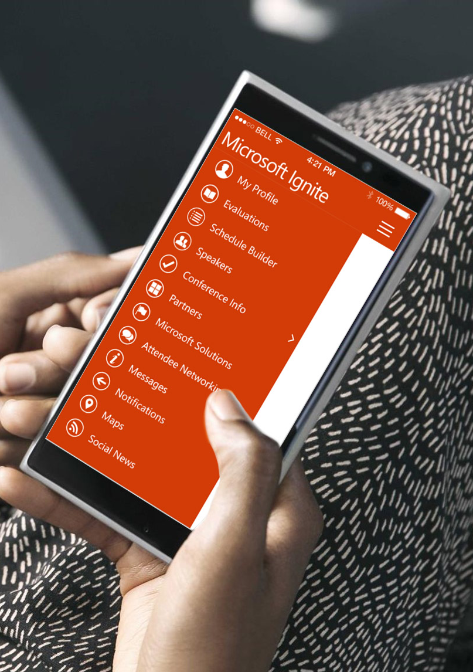
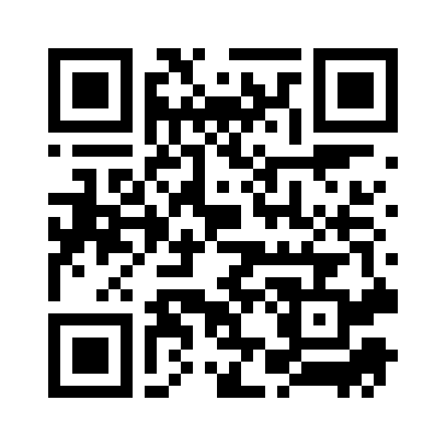
Please evaluate this session
Your feedback is important to us!
From your PC or Tablet visit MyIgnite at http://myignite.microsoft.com
From your phone download and use the Ignite Mobile App by scanning the QR code above or visiting https://aka.ms/ignite.mobileapp

