Slide 1
The Road to Modern Management
BRK3335
Deen King-Smith
Program Manager, Windows Commercial

Slide 2
The Road
Modern Management
Traditional Management

Slide 3
Traditional Management

Slide 4
Enabled Through
Active Directory
Group Policy
SCCM/Configuration Manager
3rd party Security Management tooling
Primarily Desktop
On Prem

Slide 5
IT Life Cycle
56%
IT time spent on app/update testing, managing security
Complex process
Acquire Windows
On-premise Active Directory
SCCM
Deploy
Identity
Managing Device & Apps
(Test, Manage & Monitor)
Update
Wipe & Reload
(SCCM OSD)
Group policy, SCCM, 3rd party security mgmt. tools, Win32 app install

Slide 6
Modern Management

Slide 7
In a mobile-first, cloud-first world, management should empower users to be productive from anywhere and always up-to-date, while keeping enterprise data and assets secure.

Slide 8
Benefits
Simpler scenario-driven policies and settings
Devices are always secure, everywhere
Data is always protected, everywhere
Minimal overhead & light touch Management options
Robust BYOD support

Slide 9
Enabled Through
Azure Active Directory
Windows Store for Business
Windows Analytics
Mobile Device Management
Mobile Application Management
On Prem or Cloud
Mobile and/or Desktop
And More…..

Slide 10
IT Lifecycle
Windows Update for Business, Intune
Simplify with per user licensing
Acquire Windows
Azure AD (w/ Identity based roaming)
Update
WDATP, Security mgmt
Identity
Security
App Mgmt
Manage licenses
Deploy
Analytics & Mgmt
Enterprise Store, Centennial
Windows as a subscription
Windows Analytics, Intune
Cloud based Provisioning

Slide 11
The Journey
Modern Management
Traditional Management

Slide 12
Management options
Traditional Management
Modern Management
Provisioning
OS Deployment/Imaging
AAD Join and Auto enrollment into Intune / Provisioning Package
Identity and Authentication
Active Directory
Azure Active Directory
Membership
Domain Join | Workgroup
Azure Active Directory join
Software Updates
Granular patch selection, targeting, scheduling
Windows Update for Business, light scheduling with rings/deferrals
Applications
Win32
Universal, Centennial, SaaS*
Agent
SCCM
Inbox MDM (OMA-DM)
Policy
Group Policy
MDM Policies (OMA-DM)

Slide 13
How do I choose?

Slide 14
IT Lifecycle – Modern Management
Acquire Windows
Update
Identity
Security
App Mgmt
Manage licenses
Deploy
Analytics & Mgmt
Settings and Configuration

Slide 15
Decision Tree
Device is Primarily on the go?
No
Yes
Device is Domain joined?
Domain Join
Identity & Membership
Yes
No
Traditional Management
Domain Join + SCCM
COD or BYOD?
COD
BYOD
Modern Management
MDM + AADJ
Modern Management
MDM + Work Account

Slide 16
Decision Tree
Device is Domain joined?
Yes
No
Feature level control required?
Settings & Configuration
Yes
No
Traditional Management
GP + Config Manager
Modern Management
MDM + Work Account

Slide 17
Scenario specific guidance

Slide 18
Scenarios
New deployment
On-Prem to hybrid
Start with Office 365
Start with mobile + On-Prem
On-Prem to cloud
Traditional On-prem to modern on-prem

Slide 19
New Deployment
Company Profile:
Tech startup; >50 Employees; Mix of BYOD and COD devices; Highly mobile Workforce
Goal(s):
Enable access to company Sharepoint/Office 365 via SSO; Remote wipe for BYOD
Decision Drivers:
Cost; Ease of use

Slide 20
New Deployment
Solution:
Use AAD for Identity and Authentication
Intune(MDM) for device management
Cloud based
Per device cost
AAD
ID+Auth
Intune
AADJ
MDM
New
Device

Slide 21
On-Prem to Hybrid
Company Profile:
Automotive; >200,000 Employees; Everything is on-prem
Goal(s):
Enable access to Office 365(and other cloud services)
Decision Drivers:
Access to a cloud service; enable a specific set of services accessible outside of the corporate network; test the waters with Azure AD; move away from physical smart cards for two factor authentication

Slide 22
On Prem to Hybrid
Azure AD
Connect
SCCM/ Config Manager
On Prem AD
AAD
ID+Auth
Intune
GP/GPP
AADJ
MDM
ADJ
Domain Joined Device
Mobile Device
Solution: Use AD synced with Azure AD via Azure AD Connect for provide identity and authentication for online services; Passport for Work + certs for stronger two factor authentication

Slide 23
Starting with Office 365
Company Profile:
Retail/Entertainment; >50,000 Employees; Existing Office 365 deployment
Goal(s):
LOB apps accessible from outside of the corporate network; provide broader access for BYOD Devices
Decision Drivers:
Influx of BYOD usage; Enable work anywhere scenarios

Slide 24
Starting with Office 365
O365
Azure AD
Connect
ID+Auth
SCCM/ Config Manager
On Prem AD
AAD
ID+Auth
Intune
AADJ
MDM
GPO
ADJ
New Device
Domain Joined Device
Solution: Continue using AAD for Office 365 Identity; Leverage Azure AD Join + Work Account to secure BYOD end points; AADJ+MDM for COD devices

Slide 25
Starting with Mobile + On-Prem
Company Profile:
Financial Services; >200,000 Employees; COD Desktops managed with GP, BYOD Mobile managed via MDM
Goal(s):
Consistent Management story for all devices in the estate; move away from SCCM for end point management
Decision Drivers:
Cost, simplification of device management; Single method for managing end points

Slide 26
Starting with Mobile
Azure AD
Connect
SCCM/ Config Manager
On Prem AD
AAD
ID+Auth
Intune
AADJ
MDM
GPO
ADJ
Domain Joined Device
Existing Mobile Device
New Device
Solution: Continue Using AAD for Identity for new devices; Intune MDM for Management

Slide 27
On-Prem to Cloud
Company Profile:
Municipal ; ~25,000 Employees; everything is currently on-prem
Goal(s):
Migrate to the cloud to realize cost savings and efficiencies; employee self-service of LOB applications that run anywhere
Decision Drivers:
Office 365; Cost reduction; standardization across city departments; write once, run anywhere apps

Slide 28
On Prem to Cloud
Azure AD
Connect
SCCM/ Config Manager
On Prem AD
AAD
ID+Auth
Intune
AADJ
MDM
GP/GPP
ADJ
Replacement Device
New Device
Domain Joined Device
Solution: Build out migration plans that move to AAD for identity and authentication; leverage Intune for MDM management of COD Win10 and BYOD devices

Slide 29
On-Prem to Modern On-Prem
Company Profile:
Government; >500,000 Employees; everything is currently on-prem
Goal(s):
Simplify management of end points while maintain intranet network.
Decision Drivers:
Reduce management complexity and cost by simplifying E2E management story
Solution:
Use a 3rd party MDM solution that integrated with the existing AD controller for identity and Authentication

Slide 30
Road to Modern Management
Multiple Options
Options are Designed to work together
Pick what works best for you based on your goals & scenarios
Get Started Today

Slide 31
What’s next?
BRK2137: Align your Windows 10 Management Strategy to you end-user IT Needs
Thursday Sept 29th 4-5:15pm
Georgia Ballroom

Slide 32
Be a part of the community Help shape the Windows experience for millions of people Get early access to releases Deploy Windows 10 devices efficiently
Windows Insider Program
Visit the Insiders at the Microsoft Showcase in Expo Hall
http://insider.windows.com

Slide 33
Resources
Windows 10 MDM reference: http://aka.ms/win10mdm
Group policy ADMX for anniversary update: http://aka.ms/win10RS1admx
MDM policies with corresponding GP: http://aka.ms/policymdmandgp
What’s new in Windows 10 for MDM: http://aka.ms/newinmdm
Powershell scripting with WMI bridge: http://aka.ms/UsingMdmWmiBridge
Windows Device Provisioning: http://aka.ms/win10provisioning
Windows 10 Management with Intune: http://aka.ms/win10withintune
Windows 10 Management with ConfigMan: http://aka.ms/win10configman

Slide 34
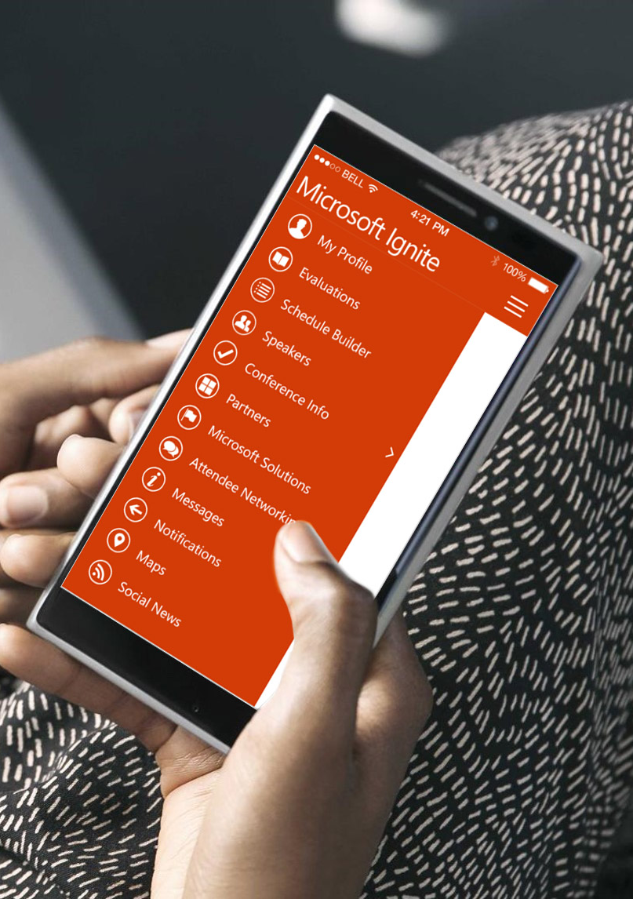
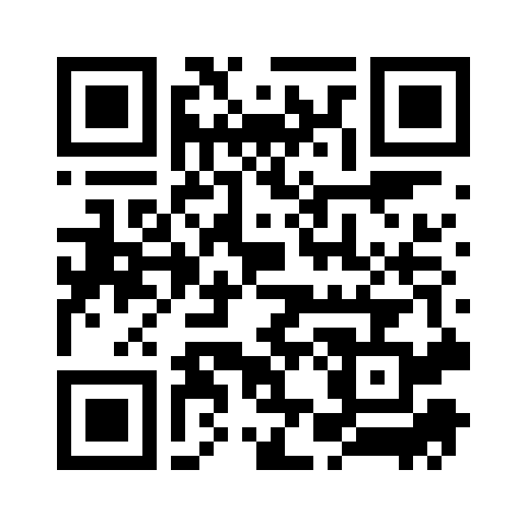
Please evaluate this session
Your feedback is important to us!
From your PC or Tablet visit MyIgnite at http://myignite.microsoft.com
From your phone download and use the Ignite Mobile App by scanning the QR code above or visiting https://aka.ms/ignite.mobileapp

