Slide 1
Assess security posture of your datacenter in under one hour using OMS
BRK3328
Meir Mendelovich Tigran Shahbazian
Program Manager Program Manager
@MMendelovich @tigran25

Slide 2


The Challenge
Moving from zero to security hero in less than an hour

Slide 3
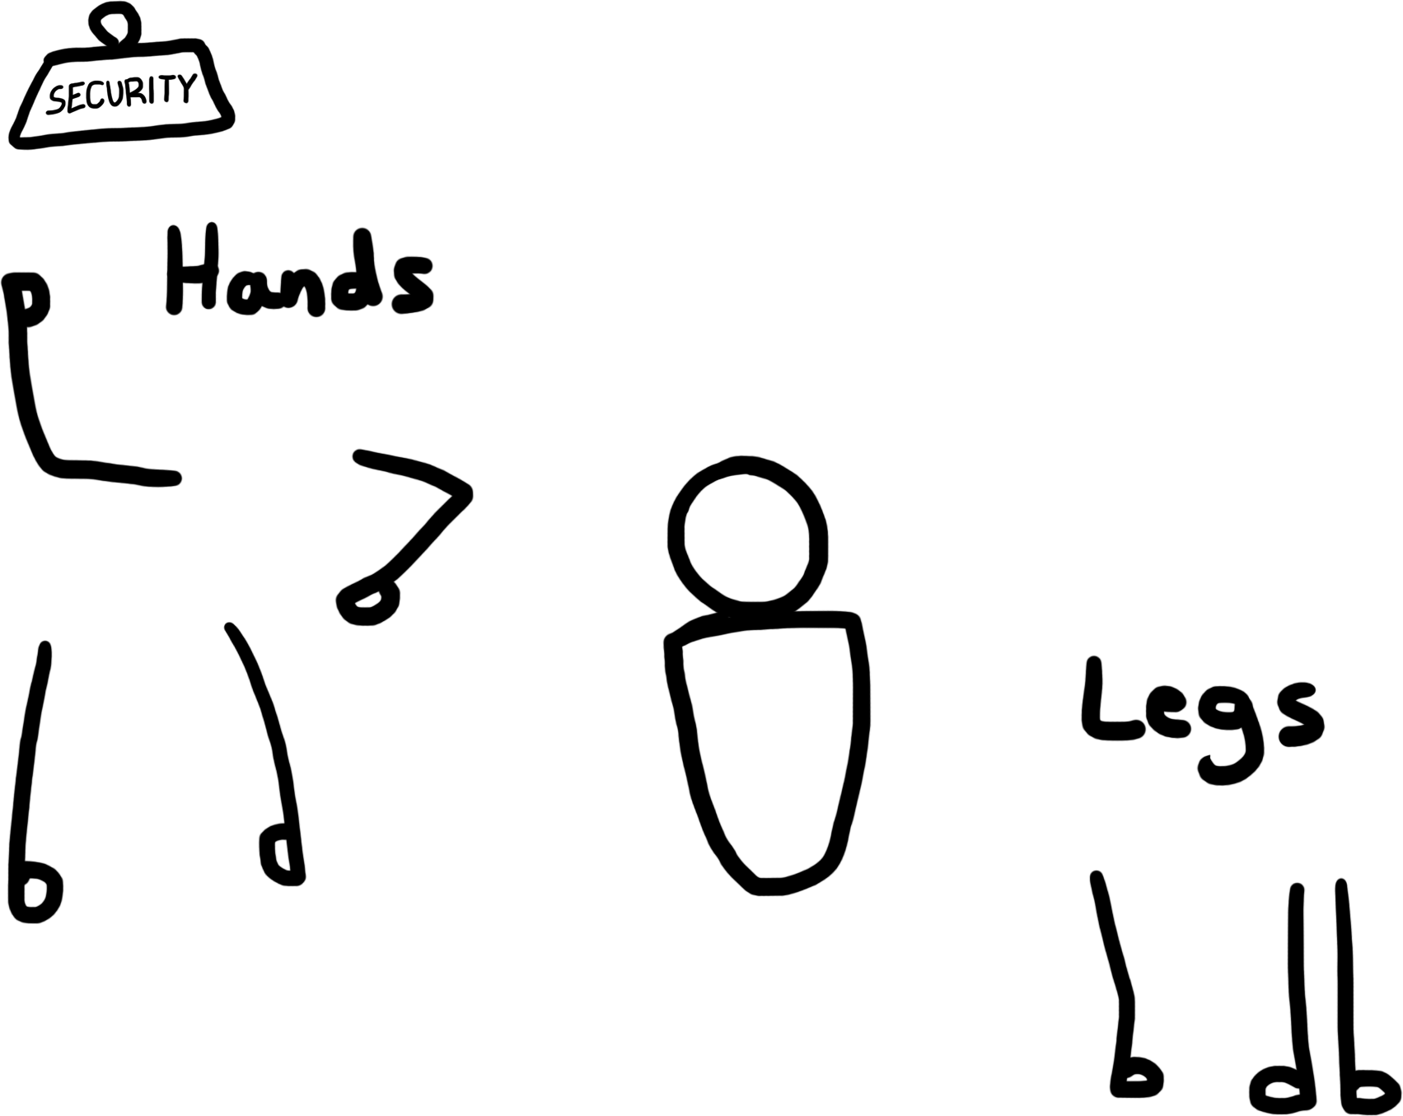
Quick overview of OMS Security
?

Slide 4
OMS Security – Securing the hybrid datacenter
AWS
Private
  Collect, correlate, and act on any security data
Analyze and visualize your security posture
  Gain insights into notable issues and threats

Slide 5
Bring all of your security data to OMS
Any machine on any environment
  Just install the OMS agent and you are ready to go
  Linux and Windows
Collect data from your security solutions
  Use CEF (Common Event Format) supported by most security solutions
  Additional solution for Cisco ASA
  Collected over Syslog to OMS Linux agent
AWS
Private

Slide 6
Out-of-the-box security posture assessments
Update
  View the update and patching status on all your servers
Antimalware
  Discover antimalware software deployed and your current protection state
Security Configuration Baseline
  Assess best practice security configuration rules on all of your computers
Identity
  Snapshot of the identities that access your servers

Slide 7
Integrated Threat Intelligence
OMS Security comes with Threat Intelligence feed
  Based on the leading vendors in this market and Microsoft own intelligence
  No need to purchase anything
Log records are cross-correlated and enriched
  Relevant log records are matched to find traffic involving malicious IP addresses
  No need for complex integrations
Search and visualize threats on maps
  Records are geo-tagged
Full threat report with on the adversary

Slide 8
Advanced Detection Analytics
Built-in advanced detection analytics
  Hundreds of detection rules and patterns based on common security events
  Behavioral and machine learning tools calibrated for low false-positive
Always current, constantly updated
  Our security research team is constantly analyzing new threats and update the analytics
Integrated with Microsoft ATA
  Microsoft Advanced Threat Analytics (ATA) detections are normalized and presented side-by-side

Slide 9
Starting from zero

Slide 10
Meet Contoso99
Has servers on-prem, in Azure and in AWS
  C99 SharePoint Farm + an Ubuntu machine
  Two servers on-prem
Has both Windows Server and Linux
  But doesn’t have real experts in both ☹

Slide 11
How much time would it take to deploy security monitoring for Contoso99?
Azure
Sql-1
Sps-web-0
sps-app-0
Ad-pdc
Sql-0
Sps-web-1
sps-app-1
Ad-bdc
Sql-w
C99-Ubuntu
On-Prem
LinuxSrv
WinServ

Slide 12
Setup steps
Add new “Security & Compliance” solution
Attach it to a new OMS workspace
Once deployment is done, open the workspace
Under Data Sources / Virtual Machines, add your VMs
Under General / Quick Start, get the agent download, workspace ID and workspace keys

Slide 13
Under the hood

Slide 14
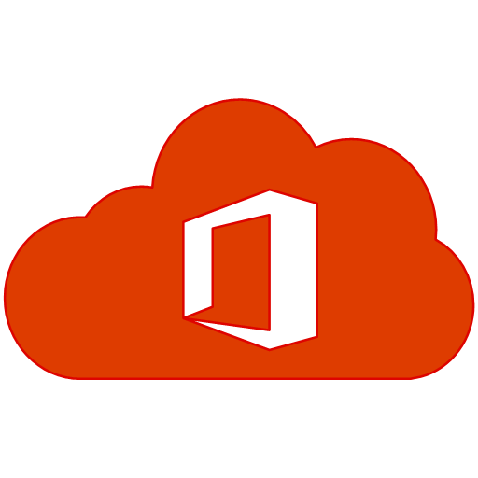
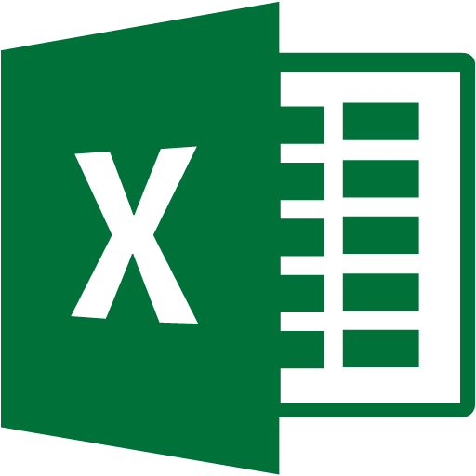









OMS Security Architecture
IP to Geo mapping
Azure
Data export
Threat Intelligence feeds
Logs
Web
Normalization & Enrichment
On-prem / private cloud
Any public cloud
Queries
Logs
System Center Operations Manager (SCOM)
Mobile
Detections
Advanced Detection
Logs
API
Alerts via
Mail, WebHooks, automation
Security MPs
Direct Windows or Linux agents
SCOM agents
Syslog/ CEF
Security products

Slide 15

You are now a hero!

Slide 16
Call to action:
Try OMS on your servers/desktops
Go to http://oms.microsoft.com and sign-in
It takes minutes to get up and running
It is free for small deployments

Slide 17
Operations Management Suite Sessions at #MSIgnite
Day | Time | Code | Room | Title | Focus Topics
Monday | 2:15-3:30 | BRK1017 | C202-204 | Take your management and security strategy to the cloud with Operations Management Suite (OMS) | Top-line breakout
Tuesday | 9:00-9:45 | BRK2198 | B206 | Protect your data with a modern backup, archive and disaster recovery solution | Protection & Recovery
Tuesday | 10:45-12:00 | BRK3063 | C302 | Back up born-in-the-cloud and hybrid applications with Operations Management Suite and Azure Backup | Protection & Recovery
Tuesday | 12:30-1:45 | BRK2001 | B405-407 | Get control over your datacenter with security monitoring using Operations Management Suite | Security & Compliance
Tuesday | 11:30-12:15 | BRK1018 | C114 | Discover how Manulife and Rackspace manage their hybrid environments today | Overview
Tuesday | 12:30-1:45 | BRK2001 | B405-407 | Get control over your datacenter with security monitoring using Operations Management Suite | Security & Compliance
Tuesday | 4:00-5:15 | BRK3163 | B401-402 | Manage and troubleshoot infrastructure and application issues using Operations Management Suite | Insights & Analytics
Wednesday | 9:00-10:15 | BRK2178 | Thomas Murphy Ballroom 1 | Dive deep into Operations Management Suite for applications and infrastructure | Overview
Wednesday | 10:45-12:00 | BRK3328 | C112 | Assess security posture of your datacenter in under one hour using Operations Management Suite | Security & Compliance
Wednesday | 12:30-1:45 | BRK2181 | C202-204 | Protect every app: transform disaster recovery with Operations Management Suite | Protection & Recovery
Wednesday | 2:15-3:30 | BRK2180 | B213-B214 | Monitor Linux in any cloud with Operations Management Suite | Insights & Analytics
Wednesday | 4:40-5:15 | BRK1000 | B206 | Discover how Accenture and Time Warner manage hybrid environments today | Overview
Thursday | 9:00-10:15 | BRK3042 | C112 | Migrate and disaster recover Azure workloads using Operations Management Suite | Protection & Recovery
Thursday | 11:30am - 12:15pm | BRK2293 | C114 | Mitigate datacenter security threats with guided investigation using Operations Management Suite | Security & Compliance
Thursday | 12:30-1:45 | BRK2179 | C113 | Manage your Azure Resources at scale with Operations Management Suite | Overview
Thursday | 4:00-5:15 | BRK3164 | Sidney Marcus Auditorium | Automate tasks and gain efficiency for your hybrid environment | Automation & Control
Friday | 9:00-10:15 | BRK2095 | C112 | Uncover system and service issues of any app with Operations Management Suite | Insights & Analytics
Friday | 10:45-12:00PM | BRK2091 | A411-412 | Manage updates across on-premises and clouds for Windows Server & Linux | Automation & Control
Friday | 12:30-1:45 | BRK2092 | Thomas Murphy Ballroom 2&3 | Explore configuration and change management in Operations Management Suite | Automation & Control

Slide 18
System Center sessions at #MSIgnite
Day | Time | Code | Room | Title | Focus Topics
Monday | 2:15-3:30 | BRK2204 | B312-314 | Meet Windows Server 2016 and System Center 2016! | Top-line breakout
Tuesday | 9:00-10:15 | BRK2159 | Georgia Ballroom | Take advantage of new capabilities in System Center 2016 | Top-line breakout
Tuesday | 4:00-5:15 | BRK3166 | Thomas Murphy Ballroom 2&3 | Manage your software-defined datacenter using System Center 2016 Virtual Machine Manager | System Center
Thursday | 2:15-3:30 | BRK3165 | Georgia Ballroom | Monitor your changing datacenter using Microsoft System Center 2016 Operations Manager | System Center
Wednesday | 12:30pm - 1:45pm | BRK 2121 | B213-214 | Monitor and diagnose web apps & services with Application Insights & SCOM | System Center
Management theater sessions at #MSIgnite
Day | Time | Code | Room | Title | Focus Topics
Monday | 1:00-1:20 | THR3028 |  | Build solutions with Operations Management Suite extensions and integration | OMS
Tuesday | 10:20-10:40 | THR3023 | Microsoft Theater 1 | Witness cloud attacks illustrated: insights from Operations Management Suite and Security | Security & Compliance
Wednesday | 10:20-10:40 | THR3029 | Microsoft Theater 1 | Learn lessons and notes from the field - Operations Management Suite Site Recovery and Backup | Protection & Recovery
Wednesday | 2:10-2:30 | THR3024 |  | Evolve your automation strategy with Operations Management Suite | Automation & Control
Thursday | 12:05-12:25 | THR3022 | Microsoft Theater 1 | Evolve your MP experience in System Center Operations Manager 2016 | System Center

Slide 19
Free IT Pro resources
To advance your career in cloud technology
Plan your
career path
Cloud role mapping
Expert advice on skills needed
Self-paced curriculum by cloud role
$300 Azure credits and extended trials
Pluralsight 3 month subscription (10 courses)
Phone support incident
Weekly short videos and insights from Microsoft’s leaders and engineers
Connect with community of peers and Microsoft experts
Microsoft IT Pro Career Center
www.microsoft.com/itprocareercenter
Get started
with Azure
Microsoft IT Pro Cloud Essentials
www.microsoft.com/itprocloudessentials
Demos and
how-to videos
Microsoft Mechanics
www.microsoft.com/mechanics
Connect with peers and experts
Microsoft Tech Community
https://techcommunity.microsoft.com

Slide 20


Please evaluate this session
Your feedback is important to us!
From your PC or Tablet visit MyIgnite at http://myignite.microsoft.com
From your phone download and use the Ignite Mobile App by scanning the QR code above or visiting https://aka.ms/ignite.mobileapp

