Slide 1
Task recorder in Dynamics AX
BRK3322
Sharrief Shabazz
Program Manager

Slide 2
Outline
Task recorder basic usage
Advanced Usage
Task guide
AX Help
Each topic includes
Overview
Demo
Architecture/Technical
F.A.Q.

Slide 3
Task recorder basic usage Overview
Task recorder is a tool for capturing
business process steps in Dynamics AX
Automatically captures actions as you complete them
Captures the data and metadata
Saves recordings in Lifecycle Services (LCS)
Multi-purpose recordings
Business Process Modeler (BPM) diagrams
Generating X++ code
Task guides and AX Help
Repro steps support cases

Slide 4
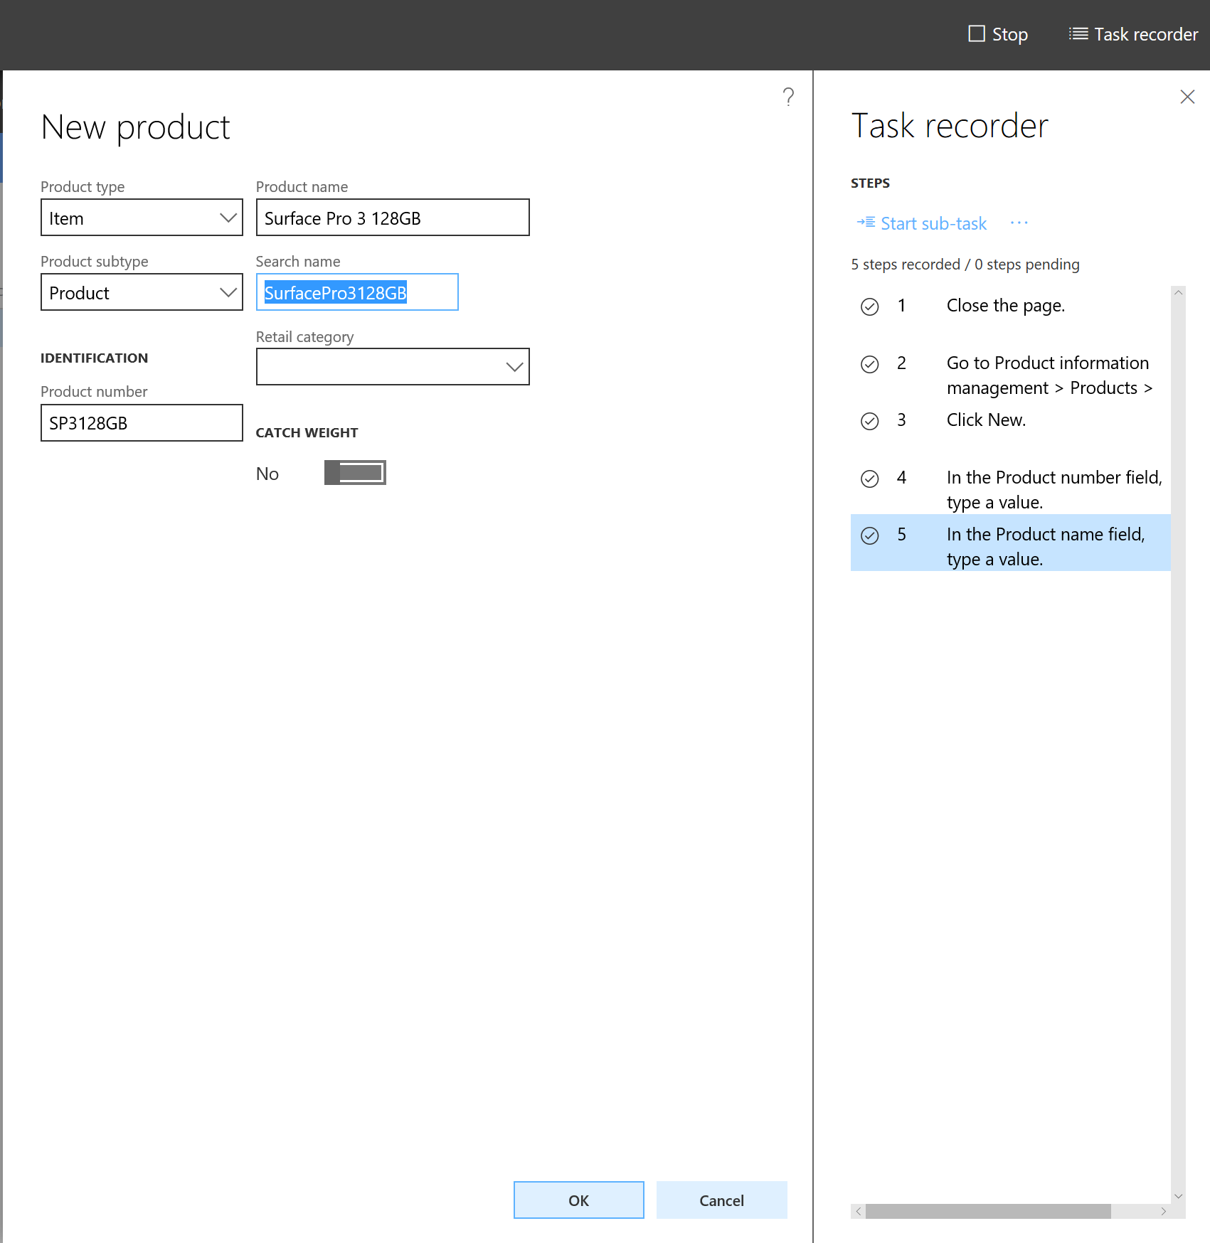
Demo basic usage

Slide 5
Basic usage (diagram)
Dynamics AX (browser)
AOS
Task recorder recording system
Do actions
Log events
Record
Take actions
New recording
User

Slide 6
Basic usage: F.A.Q.
Q: Will Task recorder work with my customized solution?
A: Yes
No special steps needed to make a form recordable. For custom controls, adding Task recorder support is easy.
Q: Are recordings upgradable?
A: Yes
Recordings do not depend on the version of AX running.

Slide 7
Basic usage: F.A.Q.
Q: Do I have to be an admin to use Task recorder?
A: No
You can optionally limit access to the Task recorder menu item.
Q: Does Task recorder allow someone to bypass security?
A: No
Using Task recorder has no effect on security mechanisms.

Slide 8
Basic usage: F.A.Q.
Q: Is there a performance overhead when Task recorder is running
A: No
Q: Does the data I enter remain in the database after I’m done?
A: Yes
Q: Does the recording contain sensitive information?
A: Possibly
Only if you type the data in. Data that is simply shown while recording it not captured.

Slide 9
Advanced usage Overview
Task recorder allows you to quickly re-record
by automatically performing actions for you.
Playback system can auto-perform actions
When actions are auto-performed, they are recorded again
You can pause the playback in order to record new action
You can skip actions so that they are not recorded again
When done, your new recording may contain some old actions and some new actions

Slide 10
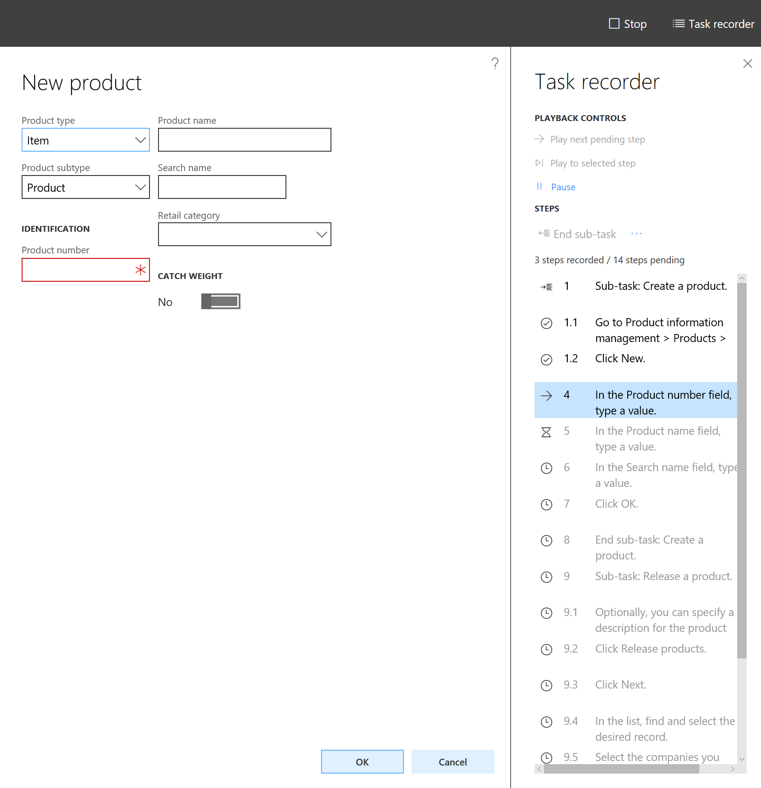
Demo advanced usage

Slide 11
Advanced usage (diagram)
User
AOS
Task recorder recording system
Dynamics AX
(browser)
Log event
Record
Task recorder playback system
New recording
Old recording

Slide 12
Advanced usage: F.A.Q.
Q: My recording stopped during auto playback. Why?
A: Because the action was attempted but could not be performed.
When the playback system detects that a step was attempted, but the step was not recorded successfully, then the playback system will automatically pause. This provides the user with an opportunity to correct the issue by performing the correct action. There are 2 general possibilities for what a step will not be recorded after being attempted by the playback system:

Slide 13
Advanced usage: F.A.Q.
The form did not allow the action to be taken
Because AX is a very complex and dynamic application, there are various reasons that an action may not be allowed. The common reasons are:
The form needed by the action was closed.
The dialog, drop-dialog, message box, or lookup needed by the action was closed.
The button or field was disabled or hidden by the form

Slide 14
Advanced usage: F.A.Q.
The form has been changed Not all changes to a form will affect the recording. Only changes to things that are directly used in the recording will affect the recording. Common changes that can cause the playback system to pause:
Changing the AOT name of a form, menu item, or control
Removing a form, menu item, or control
Hiding or disabling a control
Adding a new message box or dialog
Changing the data or security requirements

Slide 15
Task guides Overview
A Task guide is a guided training experience,
Powered by a business process recording.
Immersive experience that offers high-retention training
Tells the user what forms to open and where to click or enter data
Automatically recognizes when an action is completed, and prompts the user to take the next action
Very easy to use and follow along

Slide 16
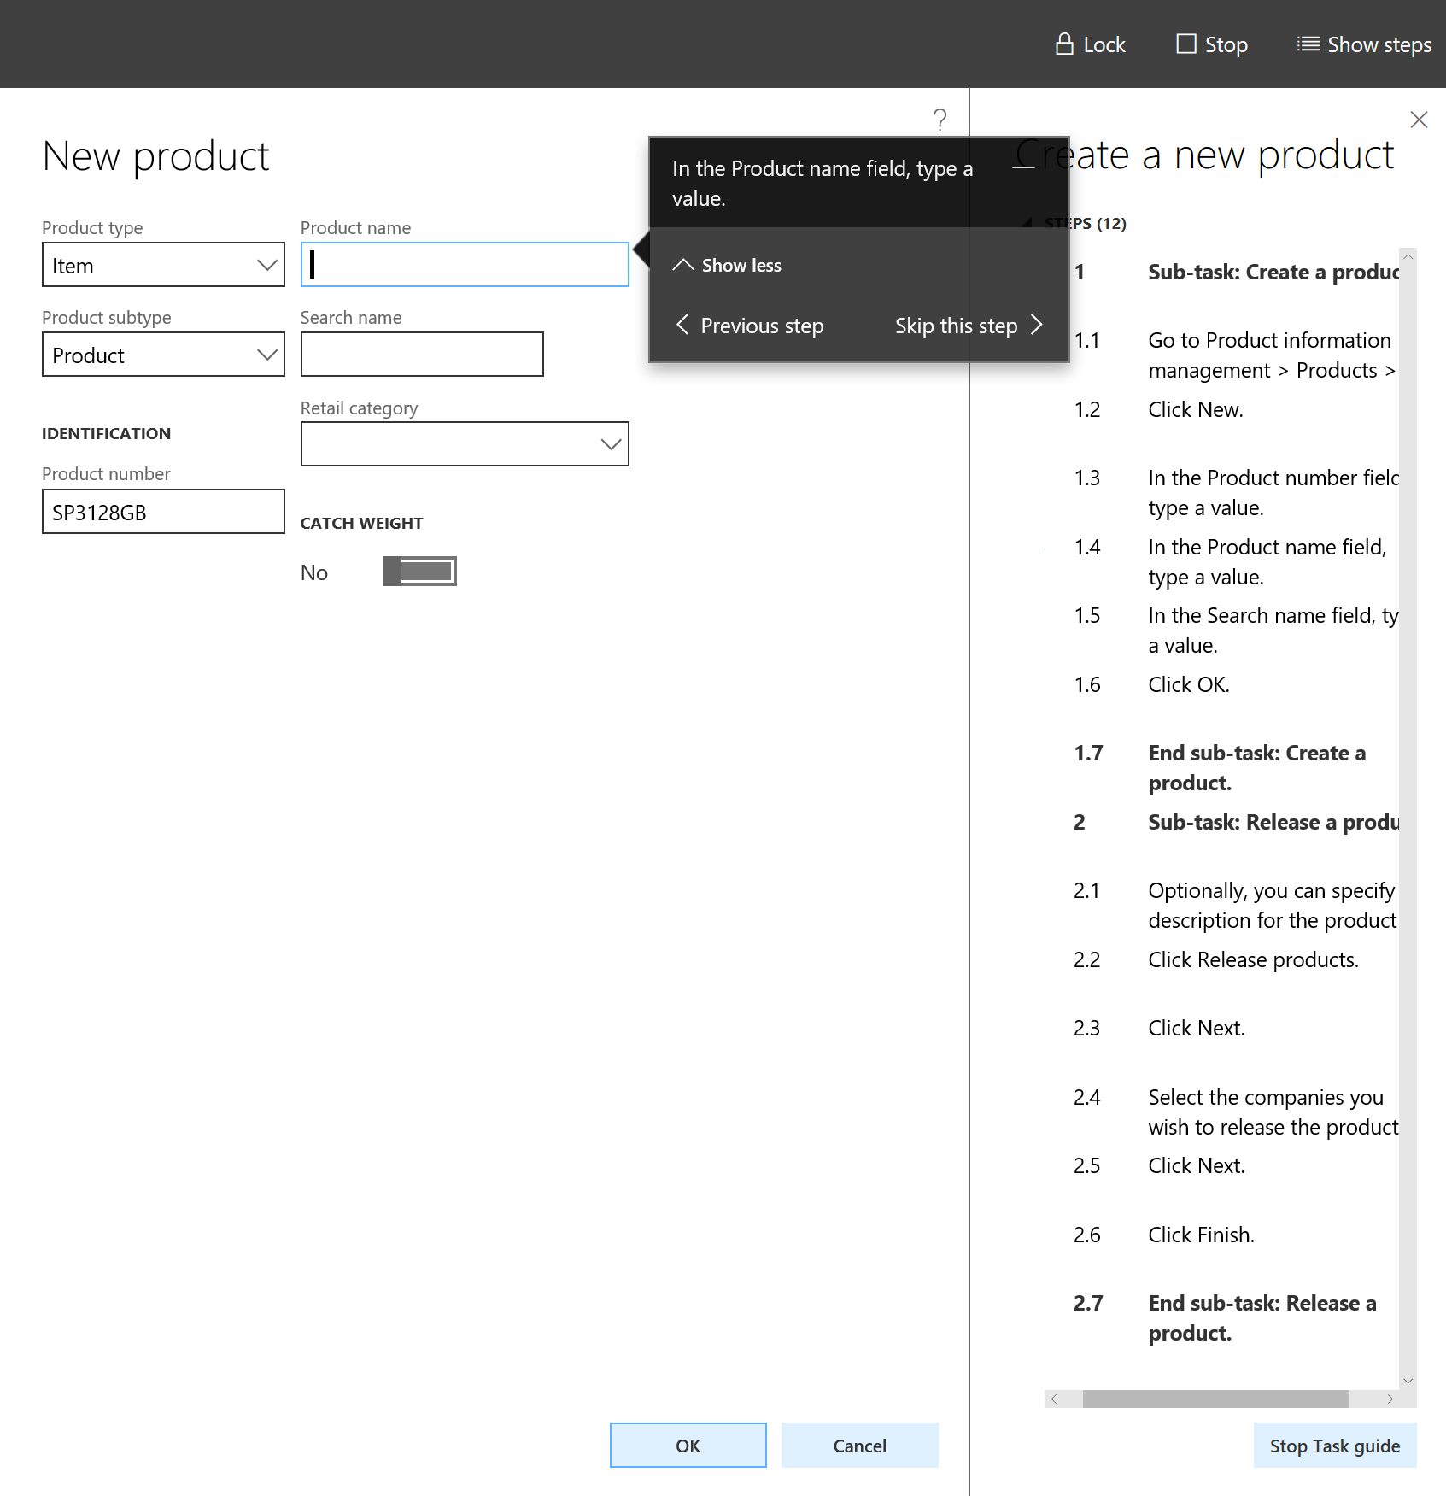
Demo task guides

Slide 17
Task guides (diagram)
User
Correct action taken?
Task guide
Prompt action
Next action
Keep waiting
Yes
No
Take action
Record
AOS
Dynamics AX (browser)
Task recorder recording system
Do action
Log event

Slide 18
Task guides: F.A.Q.
Q: The task guide seems to be encountering an error, why?
A: The task guide has detected that the user cannot complete the prompted action. This situation is usually the result of the user opening the wrong form or closing the needed form. When the task guide detects this situation, it informs the user and suggests how the user might get back on track. To reduce this occurrence of this issue task guides should be thoroughly manually tested. Task guides should also be thoughtfully designed with consideration for the common issues a user might run into while using Dynamics AX.

Slide 19
AX Help Overview
The AX Help content is stored Lifecycle Services (LCS)
and in the AX Wiki website
Open AX Help by clicking the “?” button
Help shows task guides useful to the current page
Users can search for other task guides
The AX Help system use the LCS searching and indexing system

Slide 20
AX Help Configuration
Pre-requisites
The machine must be provisioned from LCS and be cloud-hosted
The logged in AX user must be in the organization that is associated with the LCS Project
Steps
Open the System Parameters page
Specify the Project that contains the libraries
Check each of the libraries you wish to be used for AX Help

Slide 21
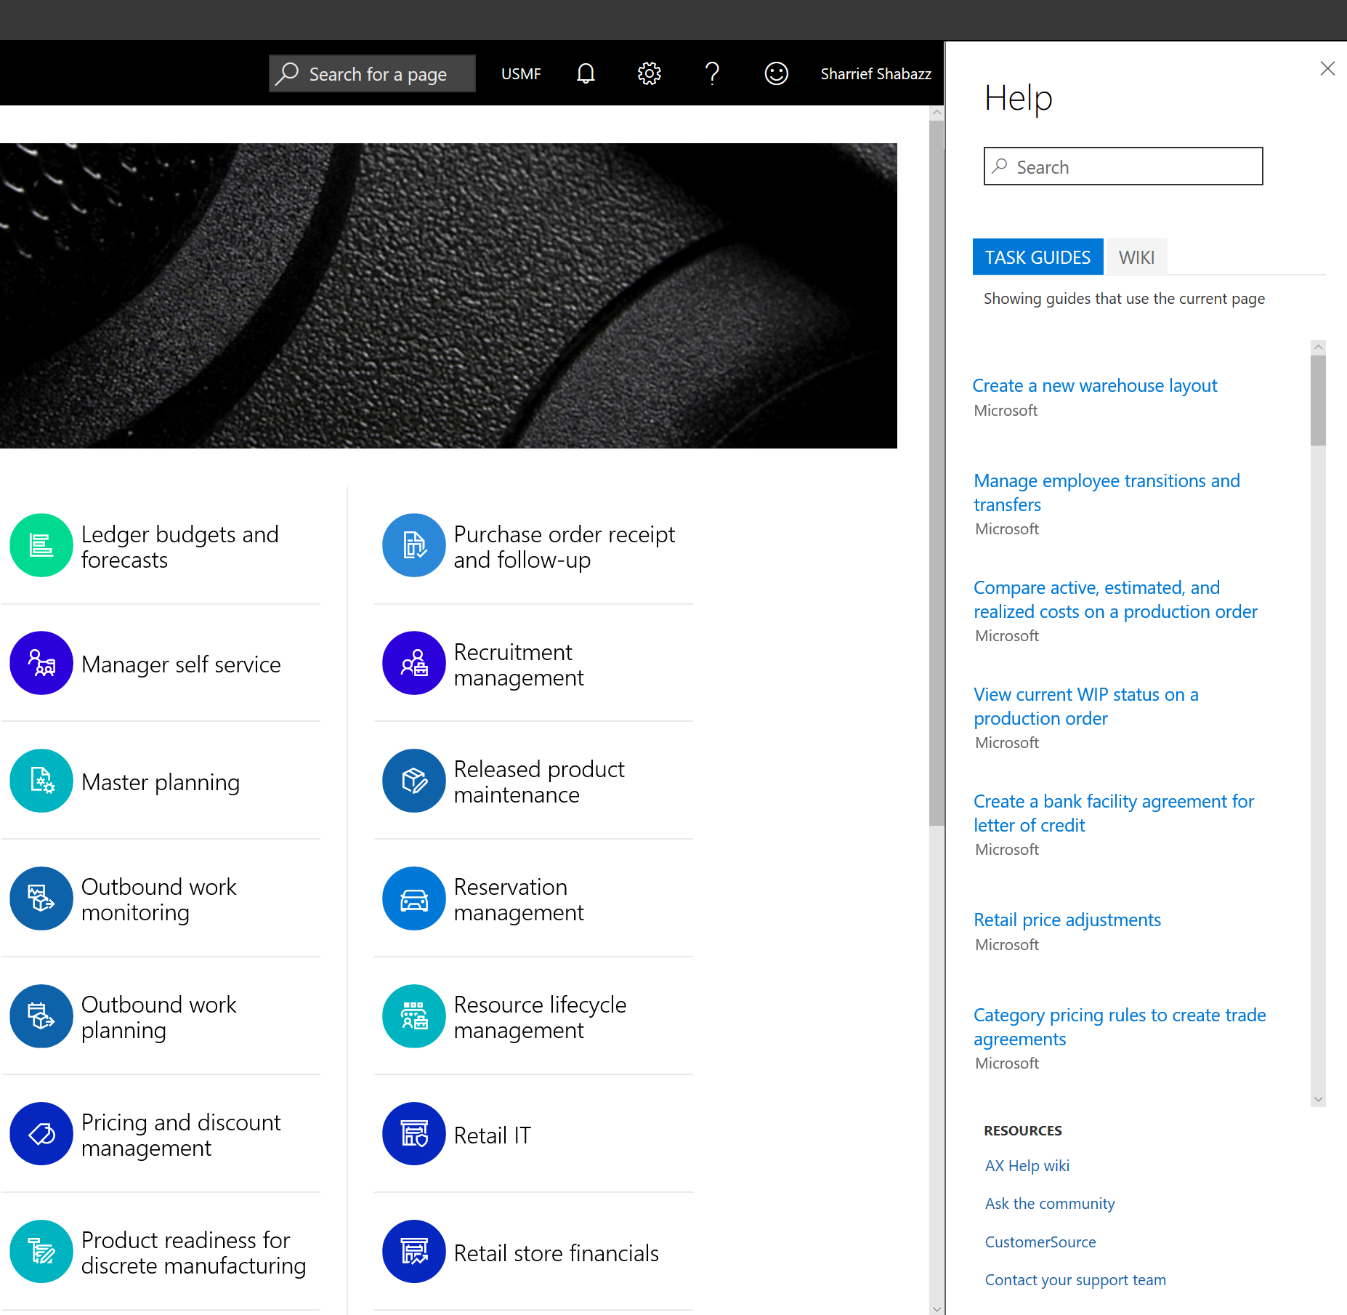
Demo help

Slide 22
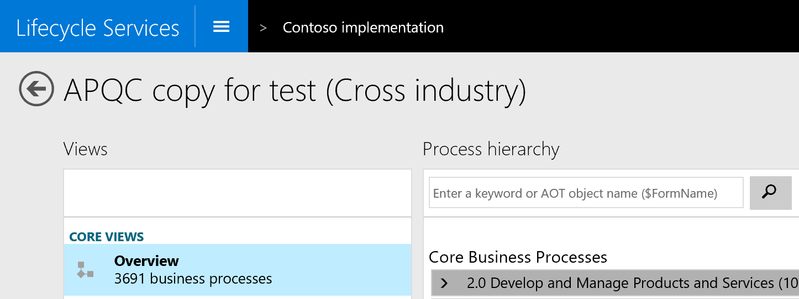
AX Help: F.A.Q.
Q: I have configured everything, but task guides are not showing up!
A: LCS may still be indexing your library if the library is new.
If this search box is available, then indexing is complete. Try using this search box to see if the task guide shows up.

Slide 23
More resources on Task recorder
First time walk-through
https://ax.help.dynamics.com/en/wiki/task-recorder-in-ax7/
Using task recorder to create help content
https://ax.help.dynamics.com/en/wiki/task-recorder/
Configuring the AX Help system
https://ax.help.dynamics.com/en/wiki/working-with-help/#connecting-the-help-system

Slide 24
Free IT Pro resources To advance your career in cloud technology
Plan your career path
Cloud role mapping
Expert advice on skills needed
Self-paced curriculum by cloud role
$300 Azure credits and extended trials
Pluralsight 3 month subscription (10 courses)
Phone support incident
Weekly short videos and insights from Microsoft’s leaders and engineers
Connect with community of peers and Microsoft experts
Microsoft IT Pro Career Center
www.microsoft.com/itprocareercenter
Get started with Azure
Microsoft IT Pro Cloud Essentials
www.microsoft.com/itprocloudessentials
Demos and how-to videos
Microsoft Mechanics
www.microsoft.com/mechanics
Connect with peers and experts
Microsoft Tech Community
https://techcommunity.microsoft.com

Slide 25
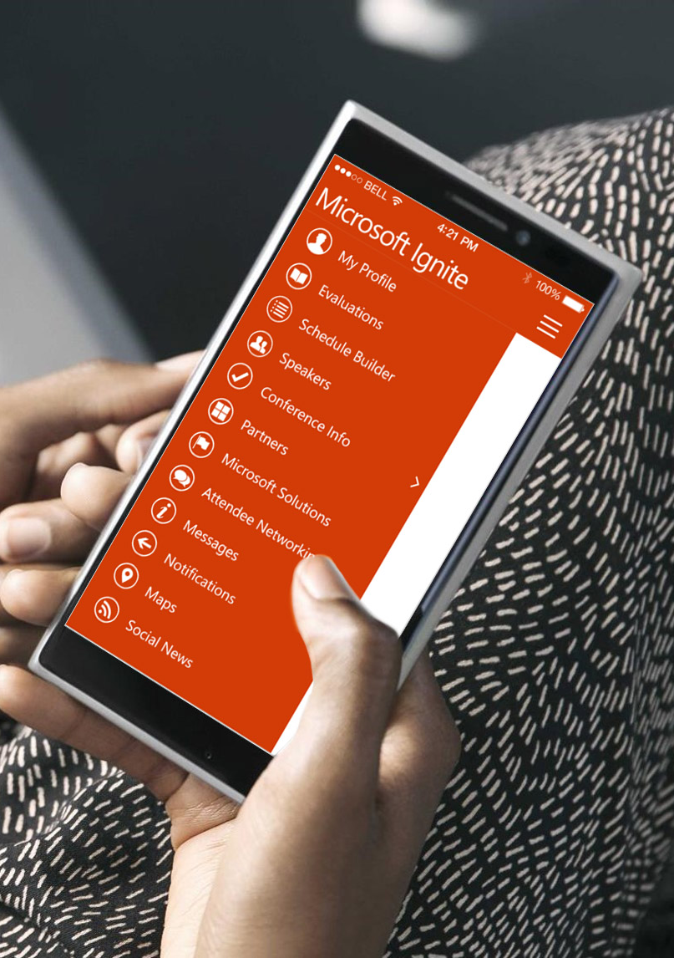
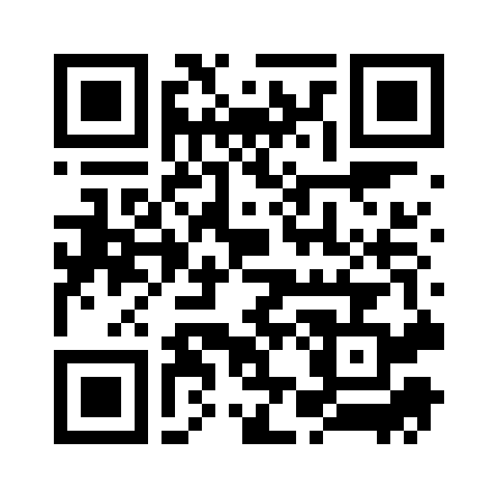
Please evaluate this session
Your feedback is important to us!
From your PC or Tablet visit MyIgnite at http://myignite.microsoft.com
From your phone download and use the Ignite Mobile App by scanning the QR code above or visiting https://aka.ms/ignite.mobileapp

