Slide 1

Deliver ‘Everything Built-In’ –
Building the Optimal Platform for Success
Dell PowerEdge
BRK3321
John Hettenhaus
Director, PowerEdge Product Management
Dell - Internal Use - Confidential

Slide 2
Agenda
Trends In The Market : Big Data Analytics & Database
SQL Server 2016 - DB/Analytics Overview
Management tools: System Center
Dell EMC Server Portfolio for MS SQL Server
Dell EMC 4S Studies and Benchmarks
DEMO : Accelerating SQL Server 2016 with R930/Fibre Channel/SC9000
Demo Results
Q & A

Slide 3
“Data is the new Electricity”.
$50 BN
COMPANIES GENERATING
REVENUE FROM DATA
NORTH AMERICA: 58%
EUROPE: 56%
ASIA: 63%
23 %
ANNUAL GROWTH

Slide 4
Landscape of the database market and trends
48%
organizations are deploying BI/Analytics next 12~18 months
67%
IT pain points related to OPEX (labor and aging infrastructure cost)
On-demand, real time
analytics
Greater adoption of
in-memory technologies
On-going focus on security
Databases that bridge SQL/NoSQL/Big Data
39%
large and medium customers list application performance as top consideration

Slide 5
The need for Big Data and Analytics
HIGH
PERFORMANCE
TCO
SAVINGS
MISSION
CRITICAL
WORKLOAD
OPTIMIZATION

Slide 6
Real-time Operational Analytics
In-memory
built-in
Mission critical OLTP
In-memory ColumnStore
SQL Server
Data Warehouse
2-24
hrs
Up to 30x faster transactions with in-memory OLTP
Queries from minutes to seconds
Real-time
operational analytics
ETL
Real-time business problem
detection
NEW

Business problem
0100101010110
SQL Server OLTP
In-memory
OLTP

Slide 7
In-database Advanced Analytics
Build intelligent applications with SQL Server R Services
Advanced Analytics
R built-in to your
T-SQL
NEW

Real-time operational analytics
without moving the data

NEW
Advanced Analytics
End-to-end mobile BI
Open Source R with in-memory & massive scale - multi-threading and massive parallel processing
High-performance DW
NEW

Mission critical OLTP
R built-in to SQL Server

Slide 8
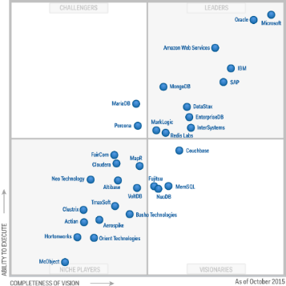
SQL Server 2016: Everything built-in
Industry leader in
Mission Critical OLTP
Most secure database
Highest performing data warehouse
End-to-end mobile BI on any device
In-database
Advanced Analytics
built-in
built-in
built-in
built-in
built-in
Industry leader
6 years in a row
least vulnerable
#1 performance
TPC-H
A fraction of the cost
R + in-memory
$2,230
SQL Server
SQL Server
SQL Server
#1
$480
#2
#3
$120
Oracle
is #5
Microsoft
Tableau
Oracle
Self-service BI per user
at massive scale
SQL Server
Oracle
MySQL2
SAP HANA
In-memory across all workloads
Consistent experience from on-premises to cloud
The above graphics were published by Gartner, Inc. as part of a larger research document and should be evaluated in the context of the entire document. The Gartner document is available upon request from Microsoft. Gartner does not endorse any vendor, product or service depicted in its research publications, and does not advise technology users to select only those vendors with the highest ratings or other designation. Gartner research publications consist of the opinions of Gartner's research organization and should not be construed as statements of fact. Gartner disclaims all warranties, expressed or implied, with respect to this research, including any warranties of merchantability or fitness for a particular purpose.
National Institute of Standards and Technology Comprehensive Vulnerability Database update 5/4/2015
Subject to NDA
TPC-H non-clustered results as of 04/06/15, 5/04/15, 4/15/14 and 11/25/13, respectively. http://www.tpc.org/tpch/results/tpch_perf_results.asp?resulttype=noncluster

Slide 9
Industry Leading TCO
$648K
$2.2M
3.4x
Built-in with SQL Server vs. expensive add-ons with Oracle
+ $120
per user for Power BI
+ $2,230 per user for BI
20x
per user
ADVANCED ANALYTICS
ADVANCED ANALYTICS
built-in
In-memory
BUSINESS INTELLIGENCE
BUSINESS INTELLIGENCE
built-in
End-to-end security
DATA WAREHOUSING
DATA WAREHOUSING
built-in
Advanced Analytics
OLTP
OLTP
built-in
Complete mobile BI
SQL Server 2016
Note: For OLTP and DW scenario, the price comparison
is based on a server with 2 proc, 8 cores each

Slide 10
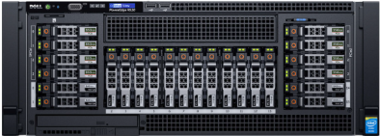

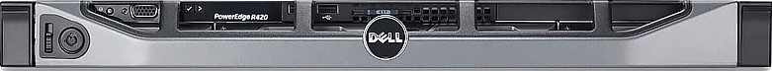





Dell EMC | Microsoft SQL Server 2016
PRE
Implementation
Window Server 2016 and SQL Server 2016
SMALL
SMALL-MEDIUM
MEDIUM-LARGE
LARGE
DB Upgrade
DB Upgrade
DB Consolidation
In-Memory/Analytics
R930
R430
R730XD
R830
S4080
S4080
S4080
S4080
SC4020
SC4020
SC9000
SC9000
Implementation
SQL health check, data migration and back up services
ProDeploy services for hardware and OS
POST
Implementation
ProSupport for hardware and software
Unified management through integration of Dell & Microsoft solutions

Slide 11

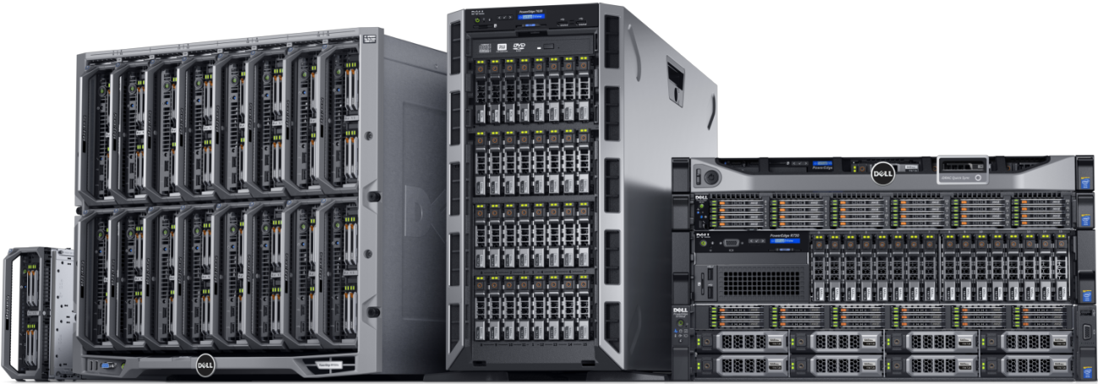


OpenManage and System Center Transform IT management so you spend less time maintaining, more time innovating
Faster
server configuration Hyper-V deployment
Faster firmware updates
96%
less time*
39%
less time*
Easier
system discovery
Simplified, Unified Mgt for:
Applications incl. SQL Server
Windows Server & Hyper-V
PowerEdge Servers
OpenManage Integration Suite for Microsoft System Center enables management of Dell EMC hardware directly through the System Center console
Fewer
tools and interfaces
50%
fewer steps*
50%
less*
October 2015
Results from 3rd party competitive tests*

Slide 12







OpenManage Integration Suite for Microsoft System Center
DEPLOY
UPDATE
MONITOR
VIRTUAL MANAGEMENT
Dell Server Deployment Packs
Dell Server
Catalogs
Dell Hardware
Management Pack Suites
DLCI for SCVMM
Dell Server
PRO Pack
Dell Lifecycle Controller Integration (DLCI)

Slide 13

Dell EMC Server Strategy – solving the CIO dilemma
operational efficiency
flexibility at any scale
worry-free computing
Reduce firmware updating time by 92% using iDRAC and Repository Manager
99% reduction in configuration time with
Dell's Zero-Touch automated configuration
FX2: 28% faster VM migration than Cisco UCS at ½ the cost
*Tolly report 10/2015

Slide 14






The Dell EMC Enterprise Server Portfolio
PowerEdge
T
PowerEdge
R
PowerEdge
VRTX
PowerEdge
FX
PowerEdge
M
PowerEdge
C
Extreme Scale
Infrastructure
TRADITIONAL
MODULAR
Tower platforms optimal for remote offices, small and medium businesses
Rack-optimized designs for improved density in medium and larger businesses
Integrated IT platform designed from the ground up
for office environments
Redefining
data center converged architecture
Blade platform for datacenters needing maximized density and efficiency
Optimized for distributed workloads, scaled-out applications and cloud deployment
Solutions specifically tailored for the large scale-out application deployments
General Purpose
Distributed Applications

Slide 15
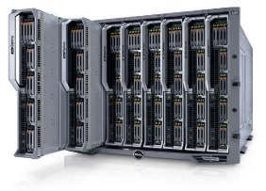


Dell EMC’s most comprehensive 4-Socket Portfolio
Innovative, scalable platforms featuring consistent management
R930 | R830 | FC830 | M830
Data-intensive applications World Record leading performance | Scale-out dense virtualization The original and leading 2U 4S platform | Unprecedented density, converged infrastructures of the future Double the density of any 4S solution | Maximized data-center consolidation Leading East-West traffic minimizing latency
Designed to meet performance needs and adjust to operational constraints

Slide 16
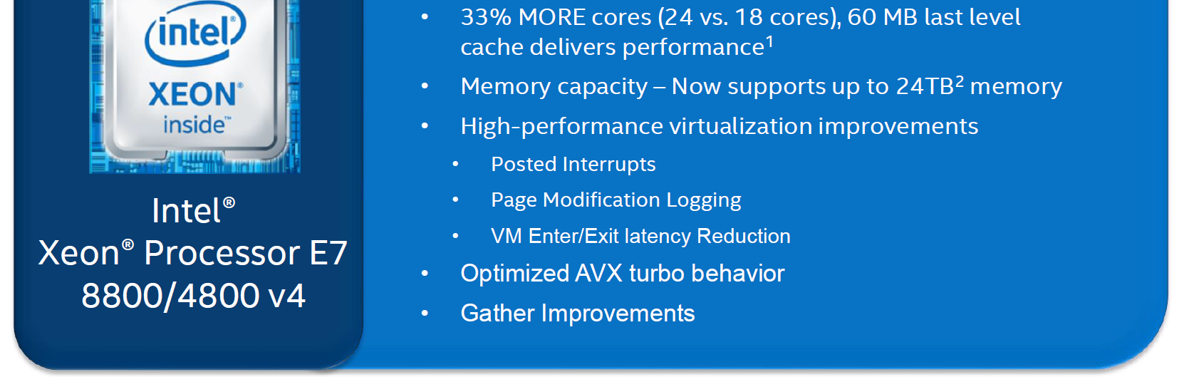
Intel® Xeon® Processor E7 v4 (Broadwell-EX)
New Performance Features to deliver performance, capacity

Slide 17
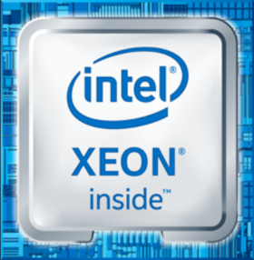




Intel® Xeon® Processor E7-8800/4800 v4
The Foundation for Better Business Intelligence
  SCALE-UP to 33% MORE cores (24 vs. 18 cores), 60 MB last level cache delivers performance¹, offers high-capability virtualization
  LARGEST memory capacity (24 TB²) for Real-time/Advanced Analytics, In-Memory Computing and other data-demanding workloads
    ADVANCED reliability combined with greater performance with
    Intel® Run Sure Technology
    ENHANCED Security capabilities and improvements
    for crypto performance, key generation and malicious software
SpecIntRate on the top bin. Please consult competition.intel.com for the latest
8S design with latest 3DS LRDIMMs
Software and workloads used in performance tests may have been optimized for performance only on Intel microprocessors. Performance tests, such as SYSmark and MobileMark, are measured using specific computer systems, components, software, operations and functions. Any change to any of those factors may cause the results to vary. You should consult other information and performance tests to assist you in fully evaluating your contemplated purchases, including the performance of that product when combined with other products. For more complete information visit http://www.intel.com/performance/datacenter .

Slide 18
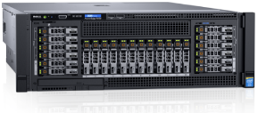





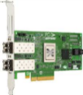

The PowerEdge R830 & R930
Industry’s best E7 and E5 v4 performances!
BW-AML
#1
33% and 35% greater SAPS scores with R930 and R830, respectively!
More than 17x better performance across 12 VMs
Over 6X database performance 2X # VM’s with SQL Server 2016 workload: Dell R930 /SC9000/Qlogic latest 16G FC than HP DL580 G7 with SQL 2005, Legacy Storage Array and legacy 8G FC
Maintained 99.4% greater storage
HANA
R830/Qlogic Latest 16G FC/SQL2016/ improved the response time by 47% on decision support workload from R820/8G FC/SQL2005
throughput with SQL Server 2016 data warehousing workload with
World Record 4-Socket Performance for SAP!
Industry best performance across the top mission critical workloads
Enabled by differentiated by DAS Cache & leading internal storage capacity
R930 Emulex latest FC16 +Dell SC9000 SAN Architecture For Best Performance
SAP SD
Big data analytics
for customers
R930 best performance in the industry running the new SAP BW-AML benchmark with 4 billion records: 23% Improvement with Intel Xeon E7 v4 Processors.
migrating to the latest SAS 9.4 M3 software release running on PE R930 with E7 v4 processors
Best Performance with Intel Xeon E7 and E5 V4’s. running the SAP SD Standard applications benchmark as compared with Haswell.
Also 44% Faster with SQL Server 2016 data warehousing workload than the legacy 8G FC
9.4
Simplify, save and do more!
Solid foundation, leadership with industry core benchmarks: SpecInt, SpecFP, LinPack, Stream
SAP HANA BW-ML benchmarks: http://global.sap.com/solutions/benchmark/bwaml-results.htm
SAP SD benchmarks: http://global.sap.com/solutions/benchmark/sd2tier.epx
Dell R930 SQL Server evaluation: http://www.demartek.com/Demartek_Dell_R930_Emulex_32GFC_SQL_Server_2016_Evaluation_2016-06.html

Slide 19


MSFT|Dell Technology
From Windows NT through Windows Server 2016
  Continuous & Close Partnership for over 30 years
  Co-engineered Cloud Platform System (CPS)
  Platform Supported Software Defined Technology
  Integrated Server Management with Dell tools (OM/iDRAC)
  Dell PowerEdge is a Nitro Fuel for Your Workload and is Cloud-Ready
  Just Works! (Dell-MSFT iterative validation and improvement process)

Slide 20
MSFT|Dell Technology – Future Ready
Dell PowerEdge Portfolio and Windows Server 2016
  Windows Server 2016 Features and Functionality - Dell PowerEdge
  Windows Server Security on Dell Platforms with TPM2.0
  Storage Spaces Direct (S2D) with RDMA
  Performance and Capacity for Optimum Rolling Cluster Upgrades
  Nano Server Compatible Servers with Dell Out-of-Band Management

Slide 21
Demo
Mark Jones
- Director Technical Marketing at Broadcom Limited
- President of Fibre Channel Industry Association – Since 2009

Slide 22

All-Flash Array Storage: Growing
Meaningful greater than 90% Flash-to-FC Attach-rate
All-flash Array Forecast (WW) 2015-17
External Storage Market
Year-over-year Growth (WW) – 2015~17
AFA
AFA
+72% All-flash arrays
Millions ($)
HDD/ Hybrid
HDD/ Hybrid
+14% Hybrid
-24% HDD only
IDC WW Quarterly Disk Storage System Forecast, 2015Q3

Slide 23
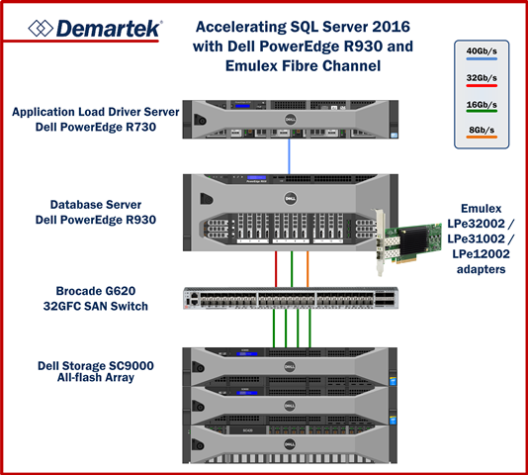
Accelerating SQL Server 2016
Dell PowerEdge R930 and Emulex Fibre Channel
LATENCY
32G vs 8G FC
32G vs 16G FC
70%
LESS TIME WITH
32G FC ADAPTER
46%
LESS TIME WITH
32G FC ADAPTER
THROUGHPUT
32G vs 8G FC
32G vs 16G FC
2.9x
WITH
32G FC ADAPTER
2x
WITH
32G FC ADAPTER

Slide 24
Running the demo …

Slide 25
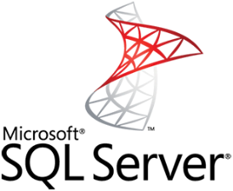
Legacy Network (8G Fibre Channel) Bottlenecks
All-Flash Storage
#1 buying reason of All-Flash Array: Improved Application Performance
Data-warehousing App Performance:
Queries Complete in ¼ of the Time
Maximizing Investment in AFA
Balancing the network to the Flash investment
½
¼
* Microsoft SQL Demartek Test Report, 2016

Slide 26
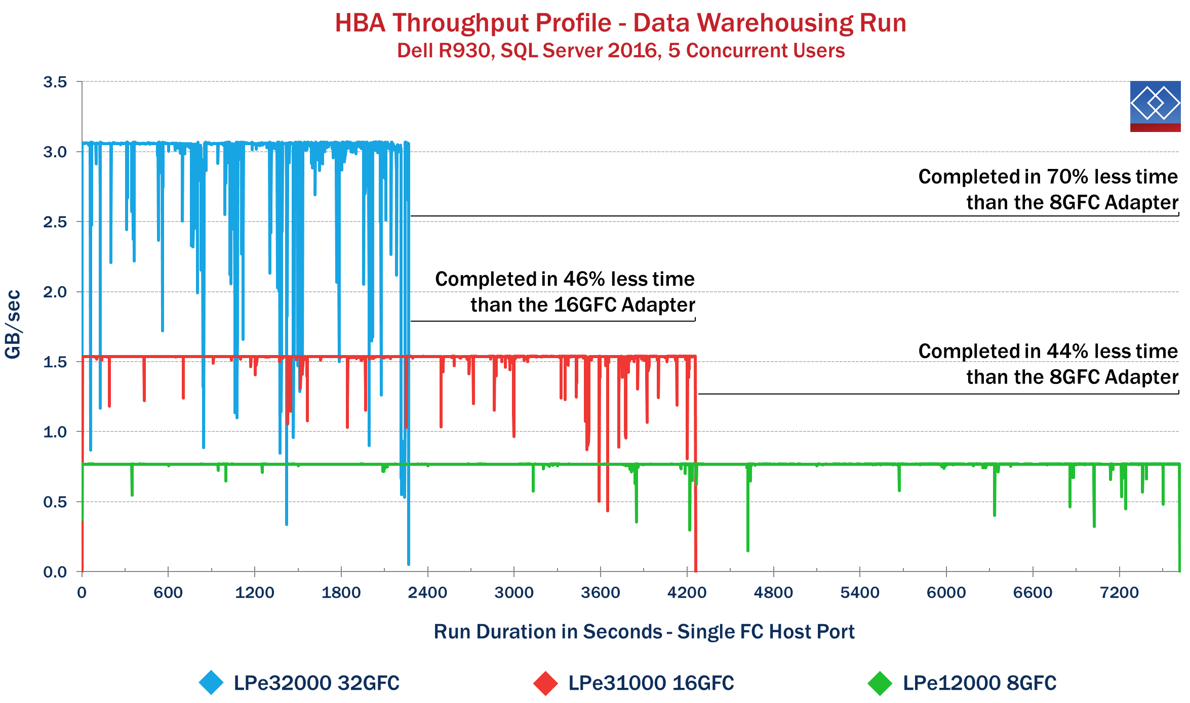
Throughput

Slide 27
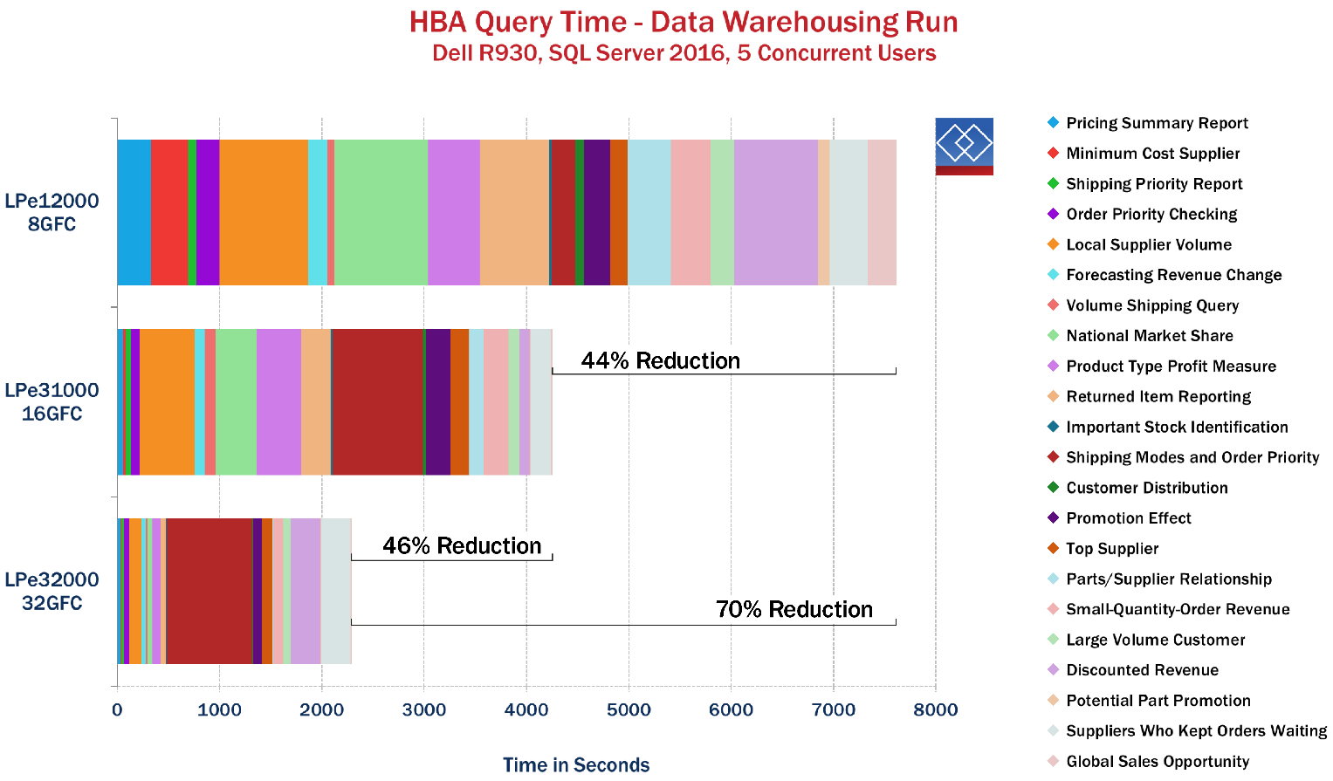
Query Response Time

Slide 28
In Summary…
Is your company still using SQL 2005?
If so, you likely need to migrate in response to Microsoft’s discontinued extended support for that version in April, 2016
  Are your databases on aging infrastructure?
  upgrading to Dell EMC Solution at the same time when you move to new version of SQL Server is a smart move!!

Slide 29

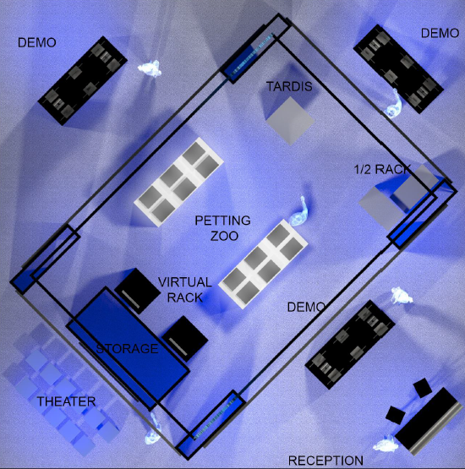
MSFT|Dell Technology & Windows Server 2016
DEMO
Visit Dell EMC Booth!
#801

Slide 31
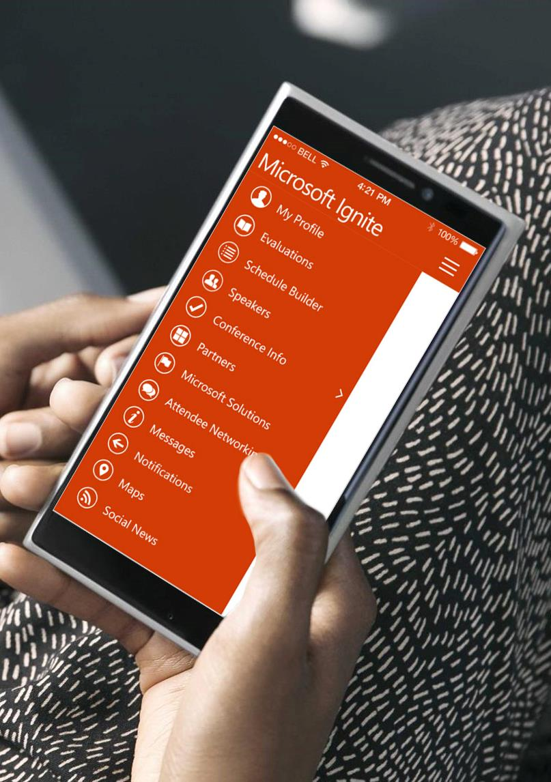

Please evaluate this session
Your feedback is important to us!
From your PC or Tablet visit MyIgnite at http://myignite.microsoft.com
From your phone download and use the Ignite Mobile App by scanning the QR code above or visiting https://aka.ms/ignite.mobileapp

Slide 32

Benefits of the OpenManage Integration Suite for Microsoft System Center
Reduce complexity and save time | Achieve efficiency and control costs | Empower productivity
Use fewer tools to manage your infrastructure Streamline operations with low-touch processes | Improve asset manageability Optimize utilization of IT resources Protect investments in existing systems management solutions | Eliminate time-consuming tasks Automate to increase availability and reduce human error

Slide 33
Free IT Pro resources
To advance your career in cloud technology
Plan your
career path
Cloud role mapping
Expert advice on skills needed
Self-paced curriculum by cloud role
$300 Azure credits and extended trials
Pluralsight 3 month subscription (10 courses)
Phone support incident
Weekly short videos and insights from Microsoft’s leaders and engineers
Connect with community of peers and Microsoft experts
Microsoft IT Pro Career Center
www.microsoft.com/itprocareercenter
Get started
with Azure
Microsoft IT Pro Cloud Essentials
www.microsoft.com/itprocloudessentials
Demos and
how-to videos
Microsoft Mechanics
www.microsoft.com/mechanics
Connect with peers and experts
Microsoft Tech Community
https://techcommunity.microsoft.com

