Slide 1
Sysinternals Primer, Ignite 2016 Edition
BRK3316
Aaron Margosis
Microsoft Cybersecurity Services

Slide 2
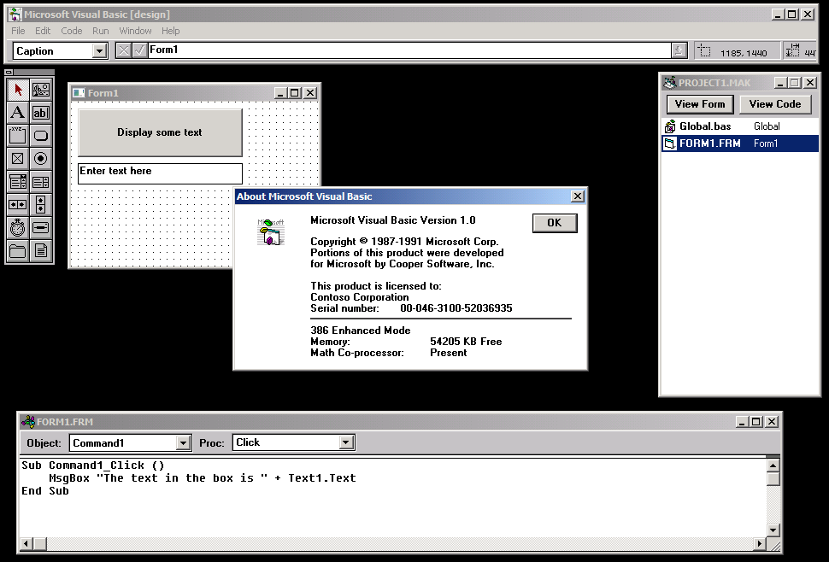
Happy 25th Birthday, Visual Basic!

Slide 3
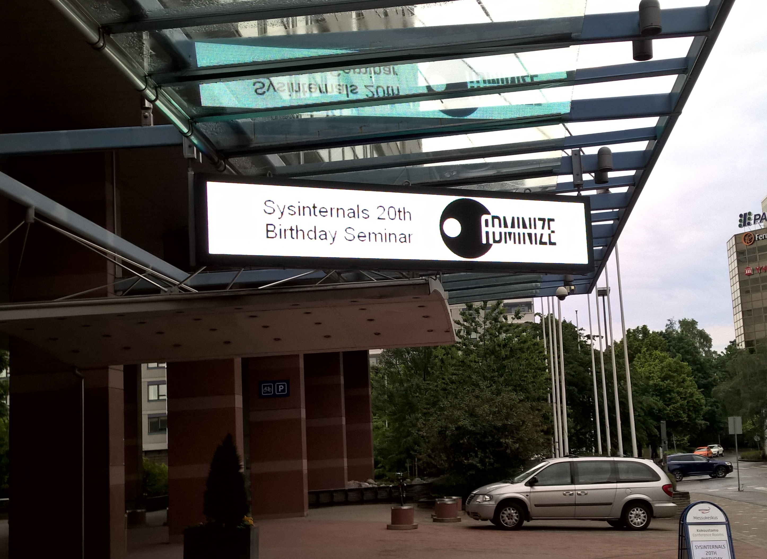

Slide 5
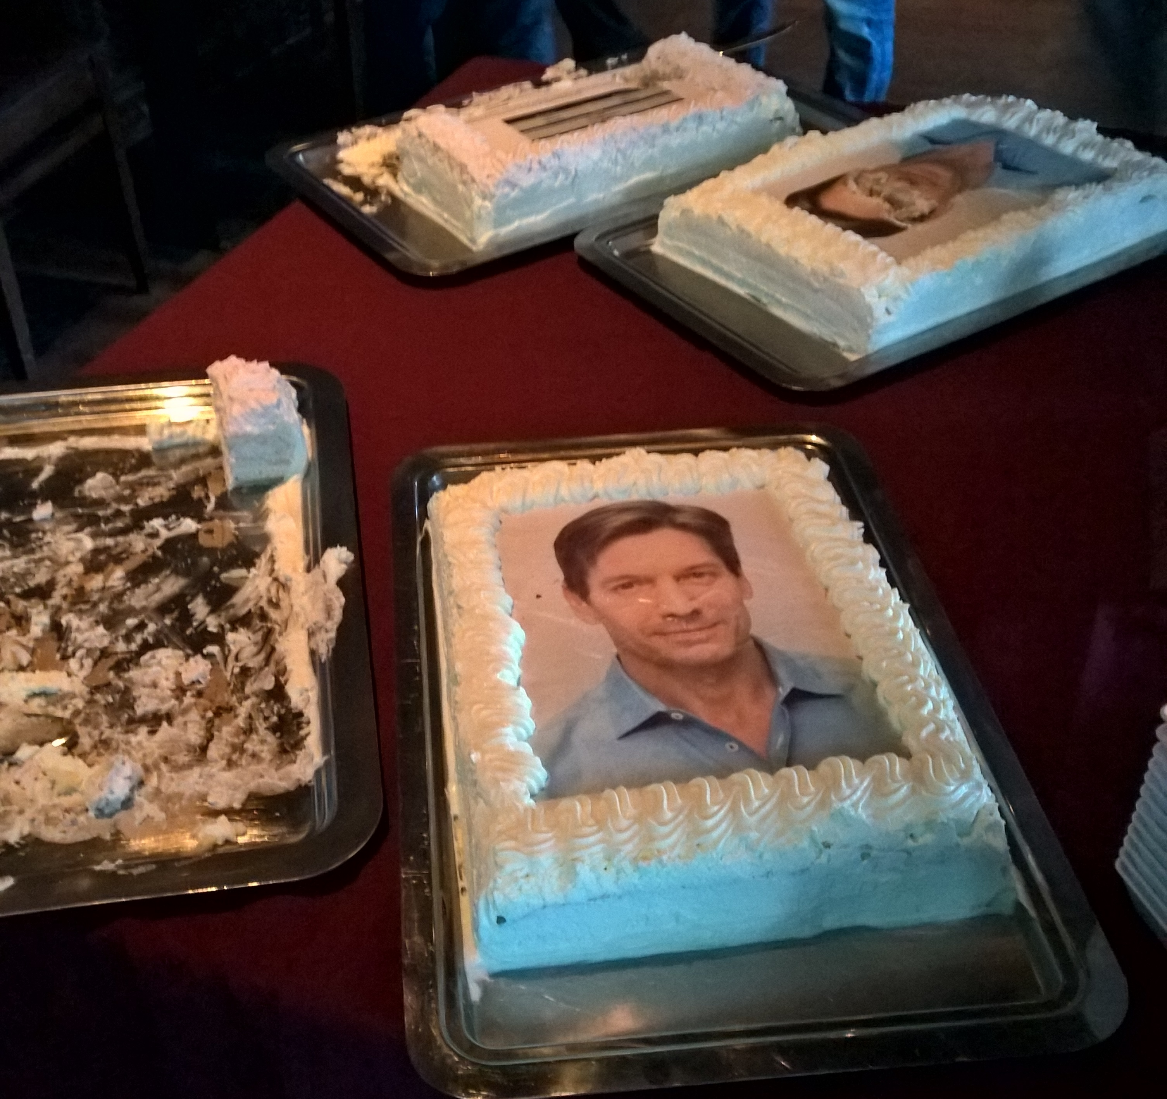
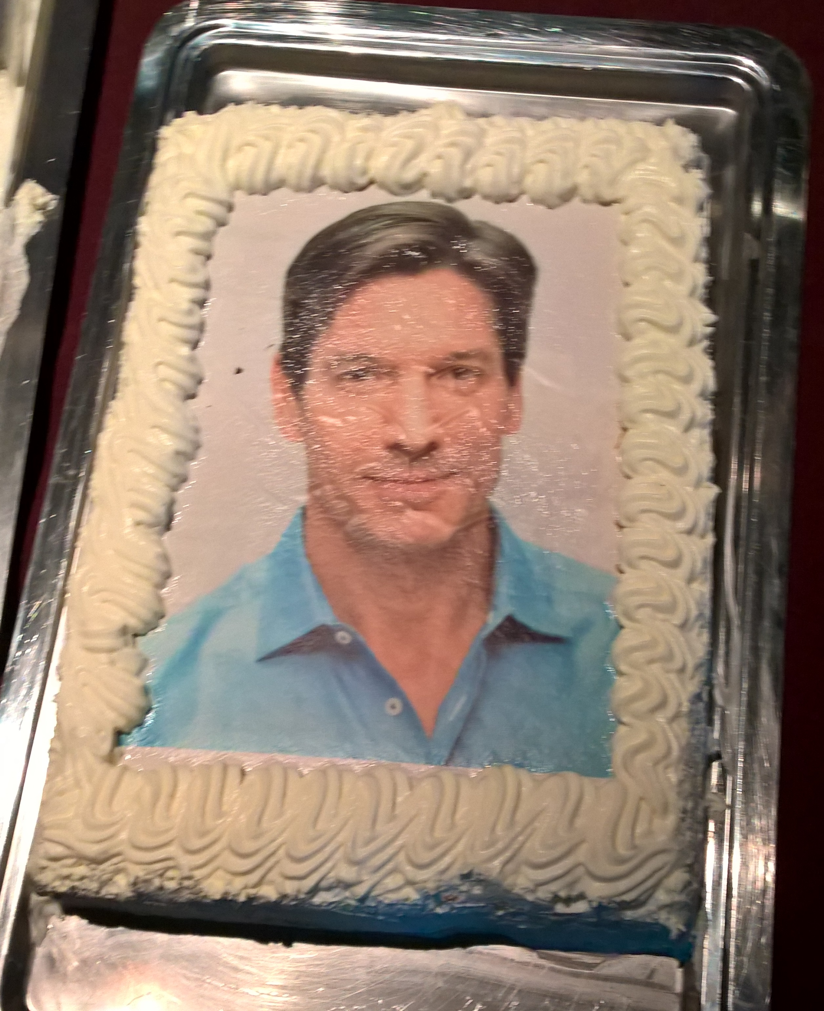
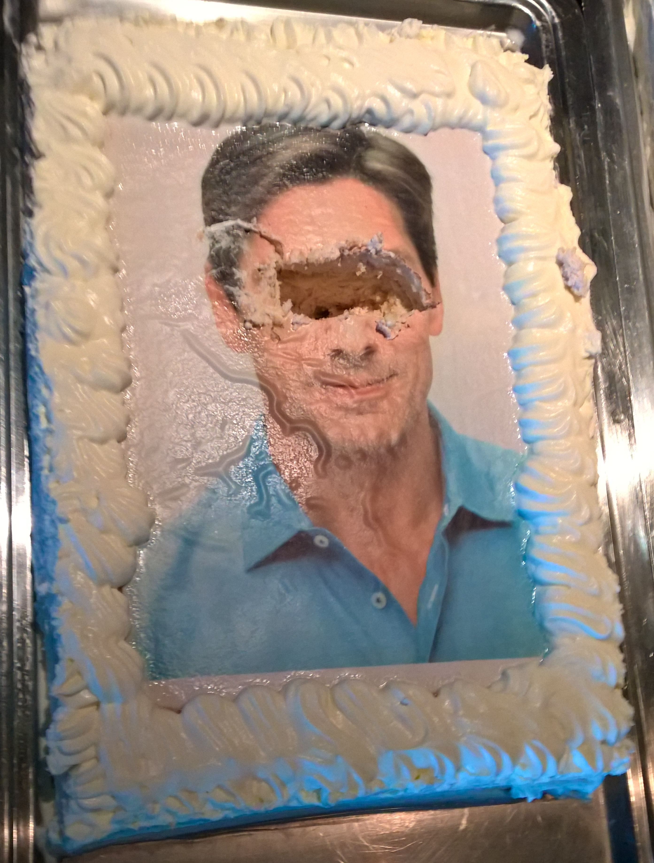

Slide 6
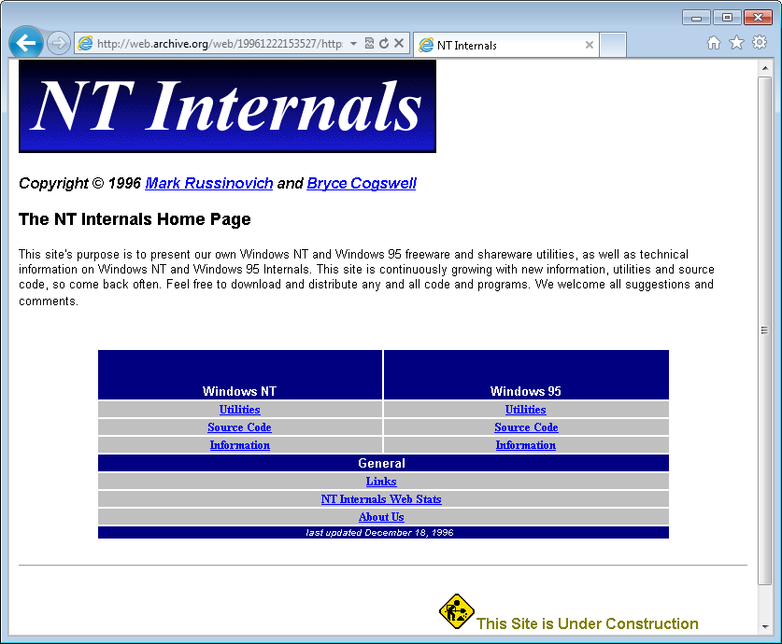
NTFSDOS, Regmon, Filemon

Slide 7
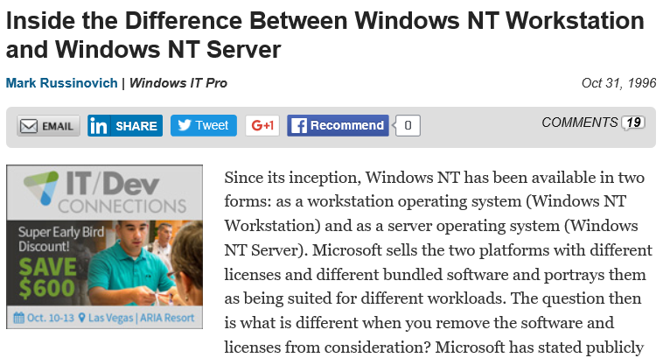
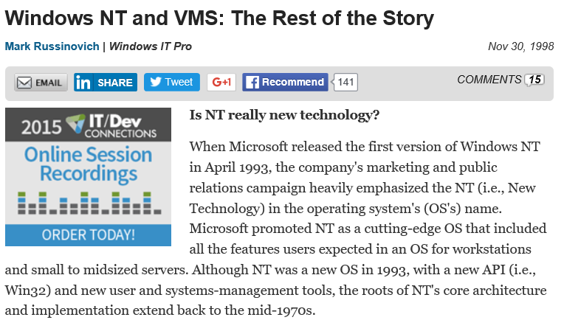
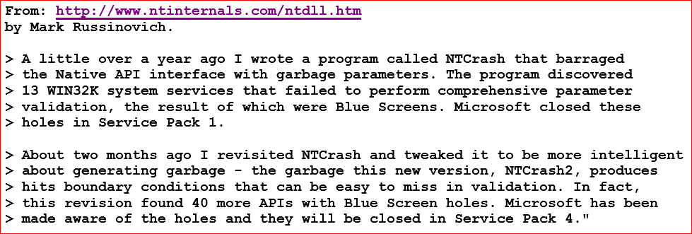
Technical articles (that Microsoft did not like!)

Slide 8
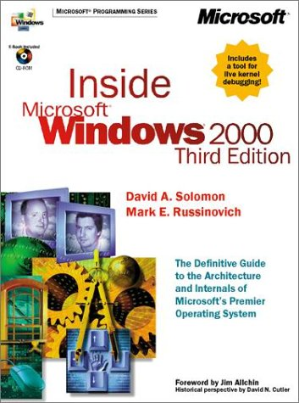
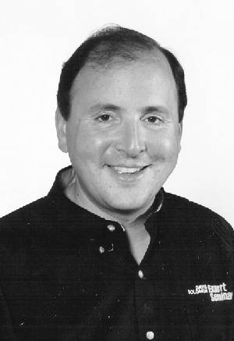
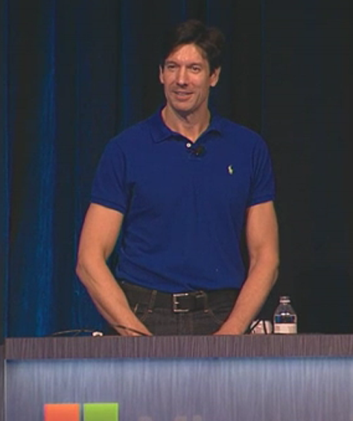
Mark → world-renowned expert

Slide 9
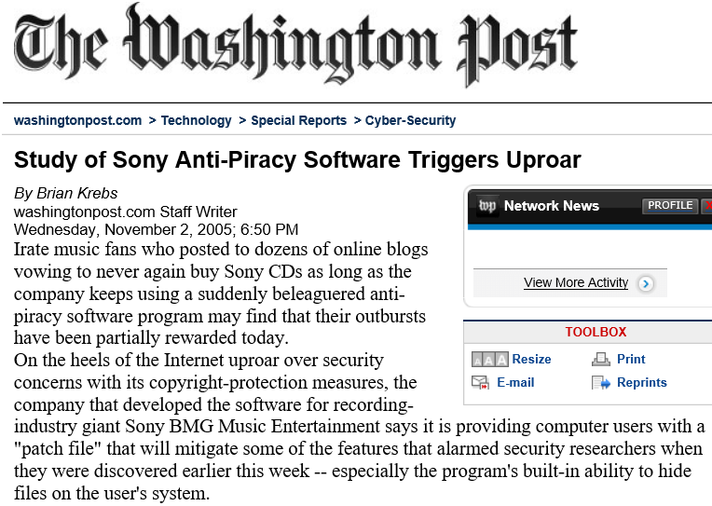
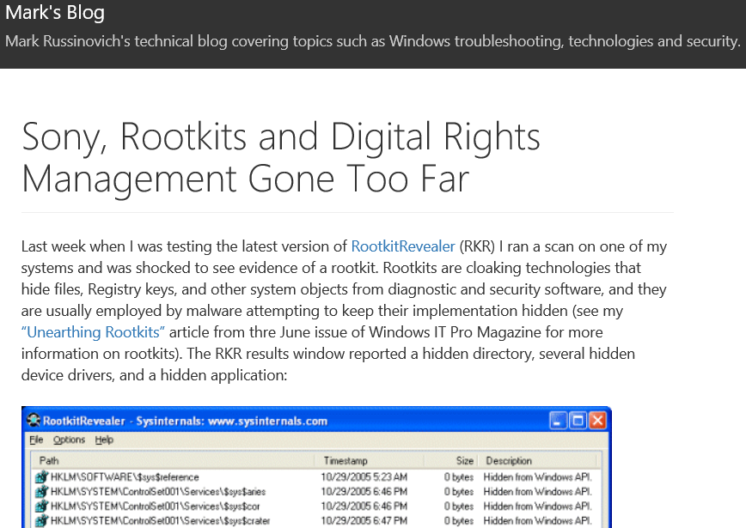
2005: The Sony rootkit

Slide 10
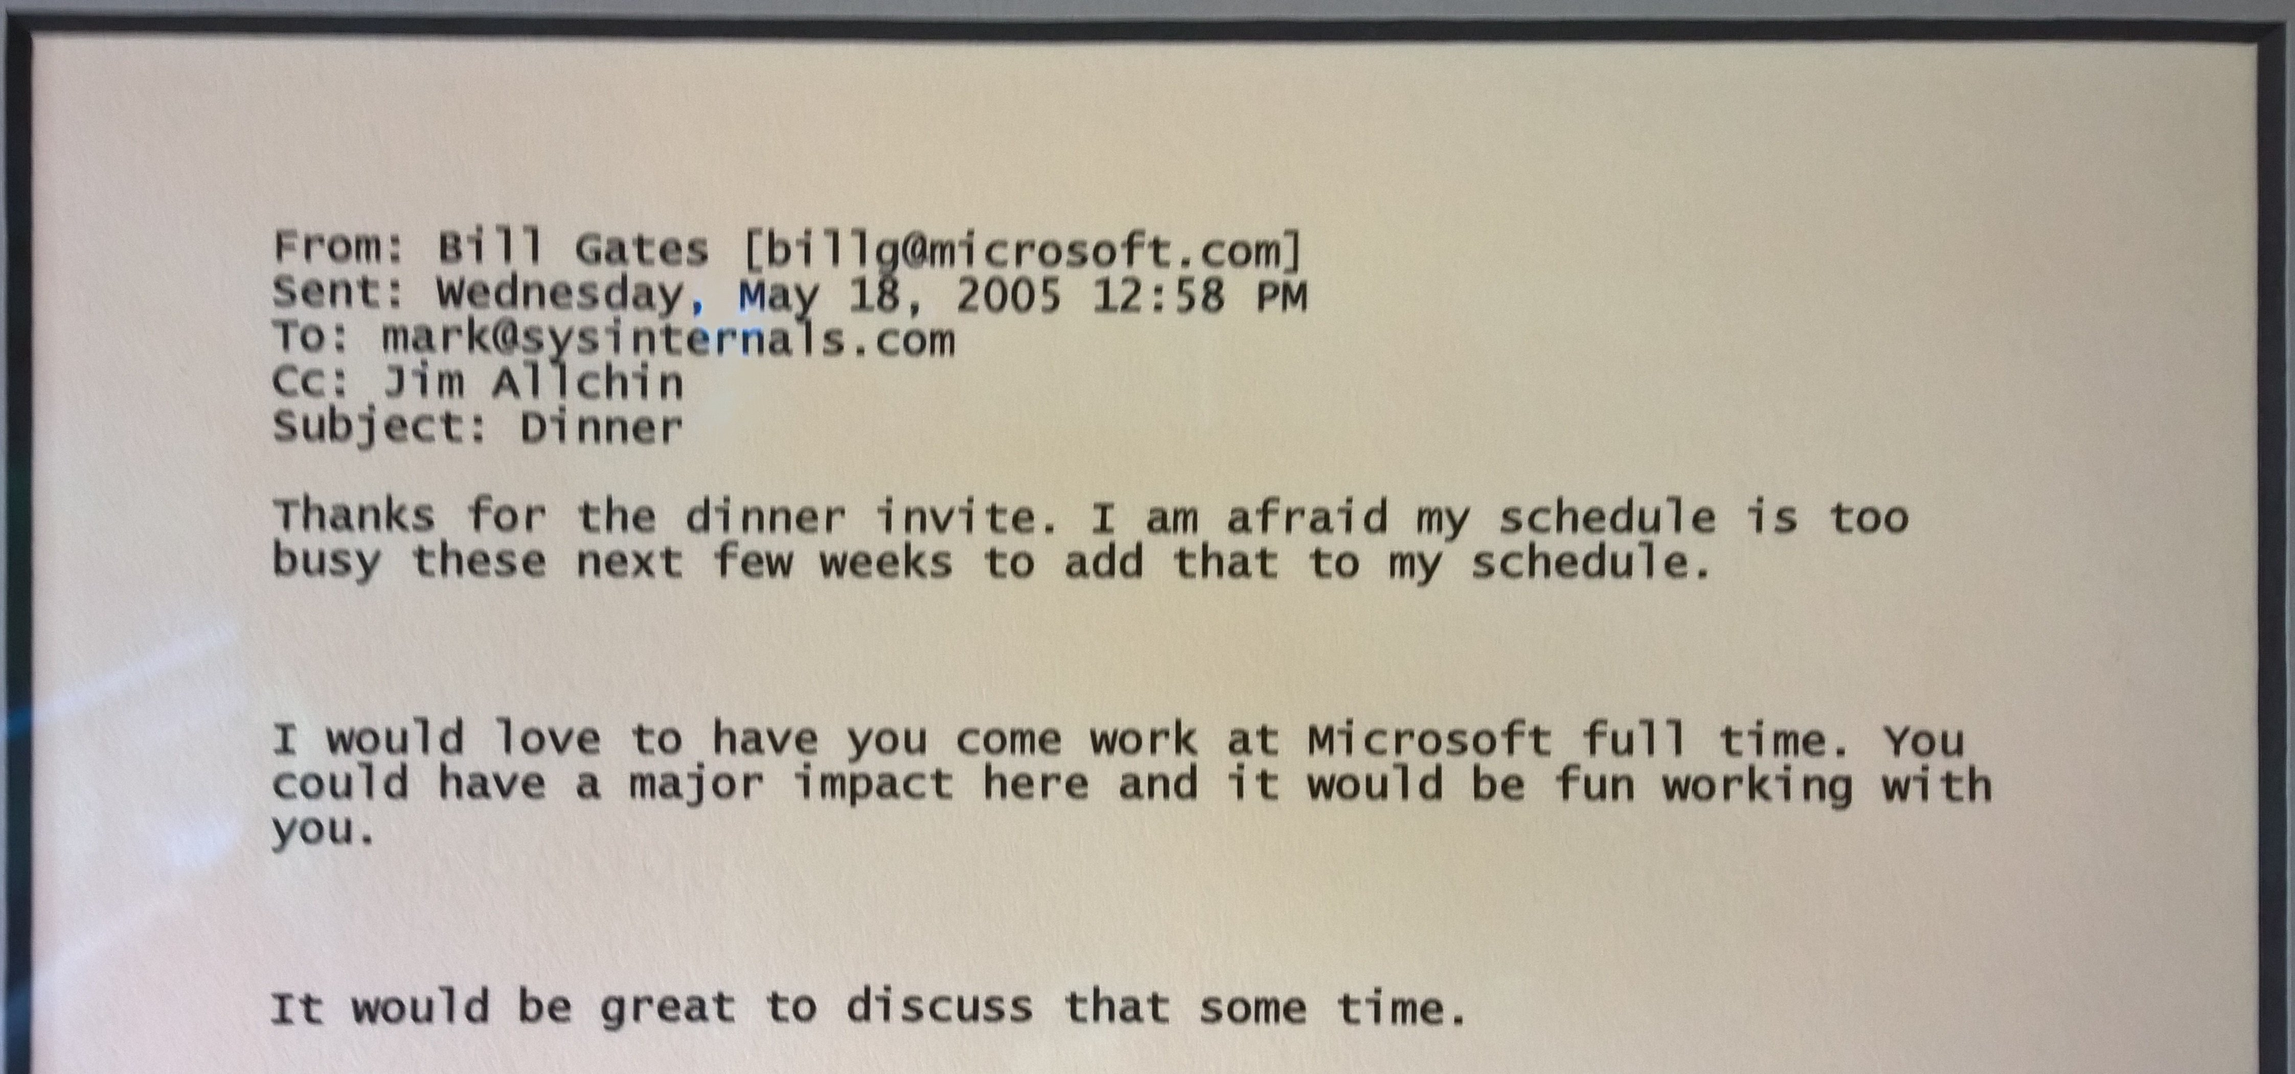
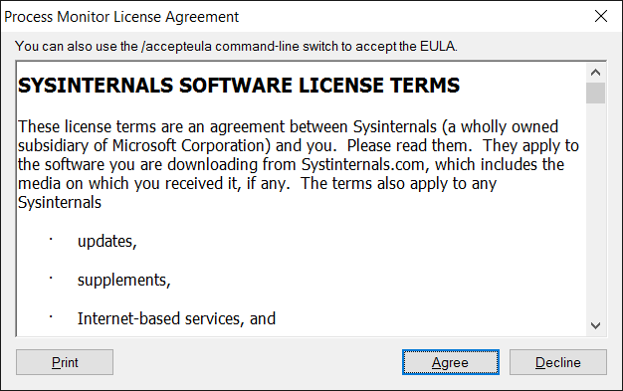
2006: acquired by Microsoft

Slide 11
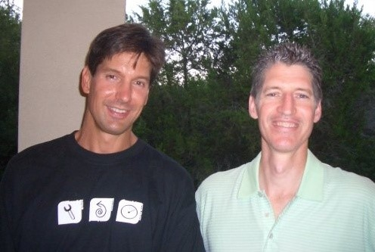
2010: Bryce retires; Mark goes to Azure

Slide 12
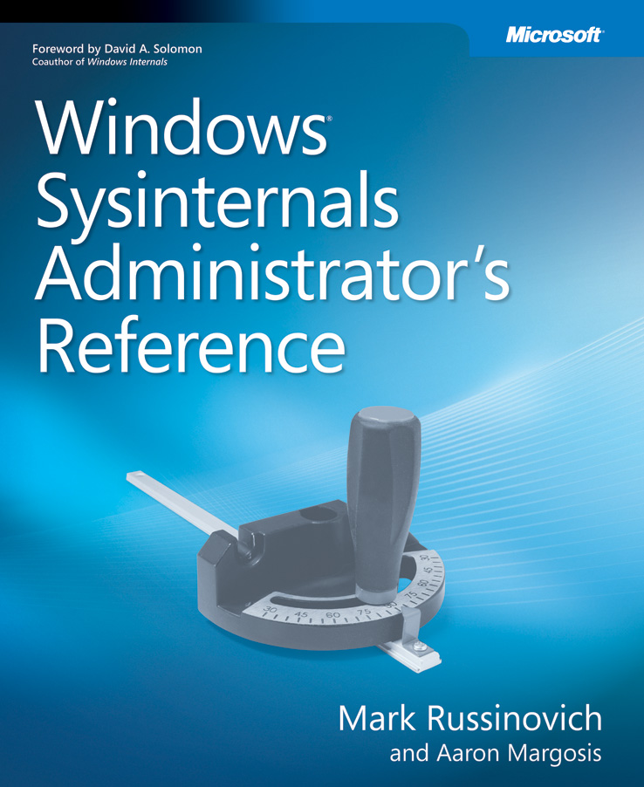
2011: The Sysinternals Administrator’s Reference
The official guide to the Sysinternals tools
Covers every tool, every feature, with tips
Written by Mark Russinovich and Aaron Margosis
Full chapters on the major tools
Process Explorer
Process Monitor
Autoruns
Other chapters by tool group
Security, Process, AD, Desktop, …
Case of the Unexplained

Slide 13
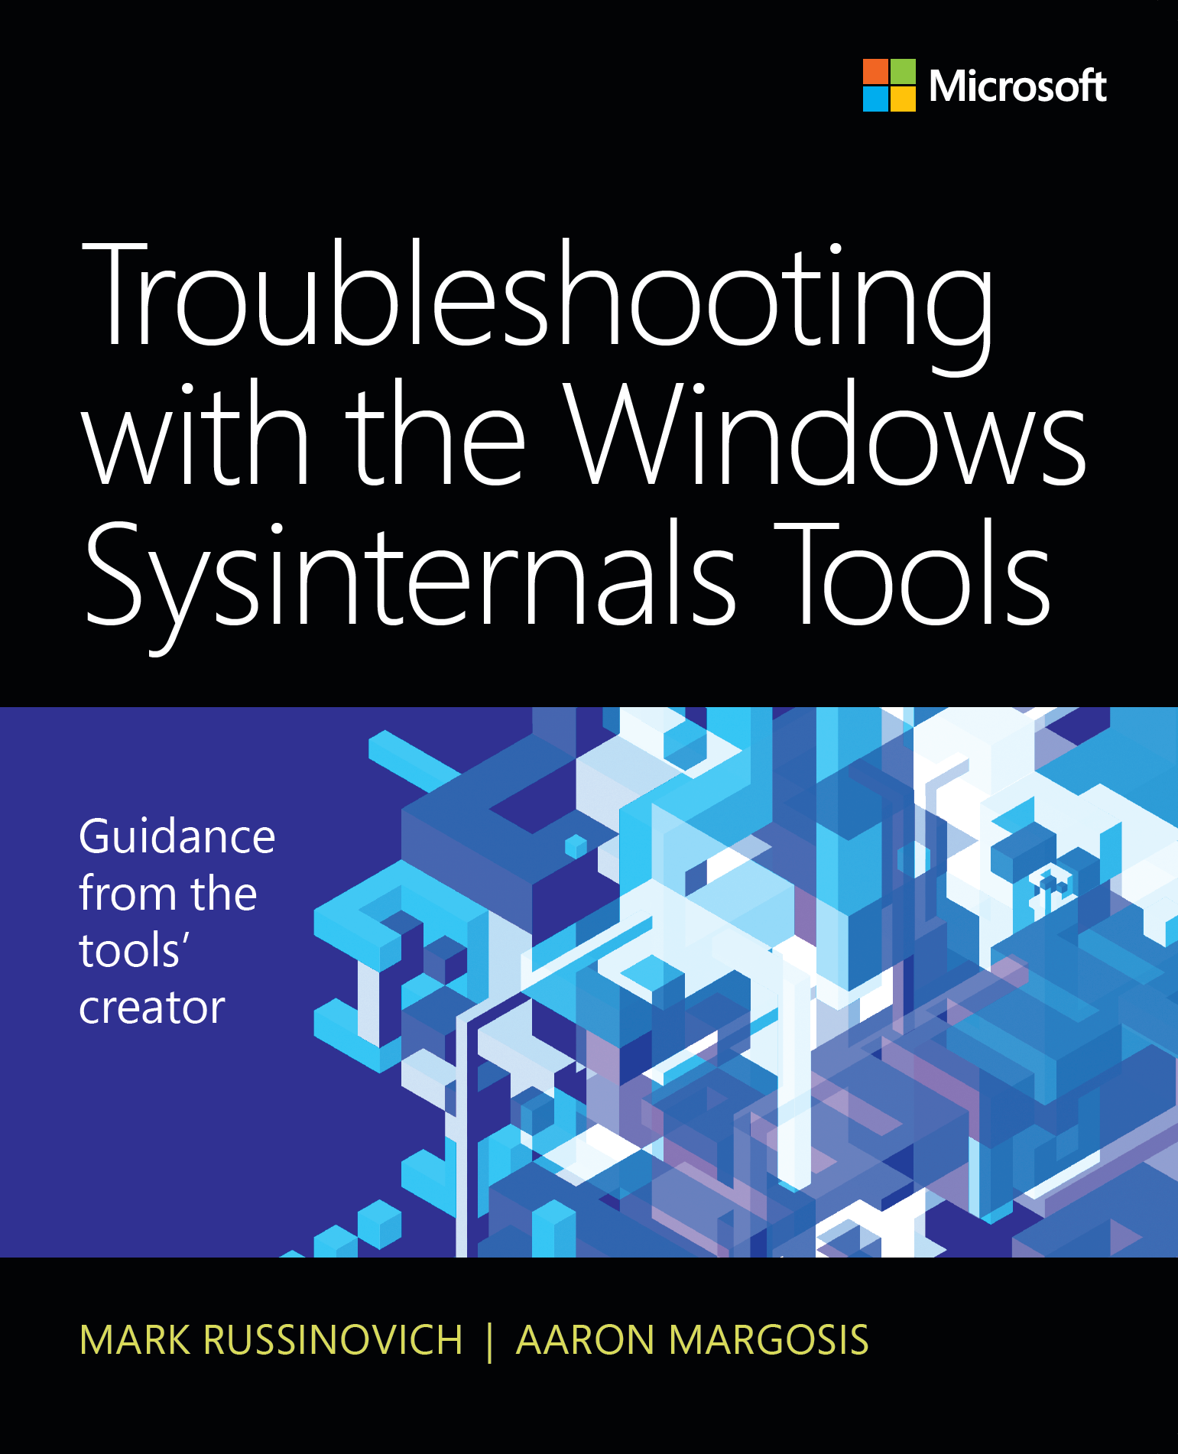
2016: Second edition – even more better!
40% more book!
ProcDump now a whole chapter
New tools, including Sysmon and PsPing
New, updated features for all tools
Deeper detail
Over 2.5x more cases
Just completed
Available in late October, 2016
25% discount on pre-orders at the Ignite bookstore
Book/insert signing with Mark and Aaron
Today, 2:30pm-3:00pm
Ignite Bookstore

Slide 14
Sysinternals for Nano Server

Slide 15
Nano Server
Minimal, headless installation option
No GUI, no GPO engine, no 32-bit support, …
Requires only 640KB RAM! (*)
(*) Obligatory fine print: this statement is not true.

Slide 16
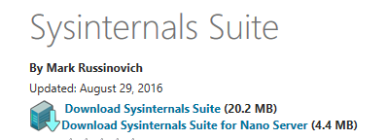
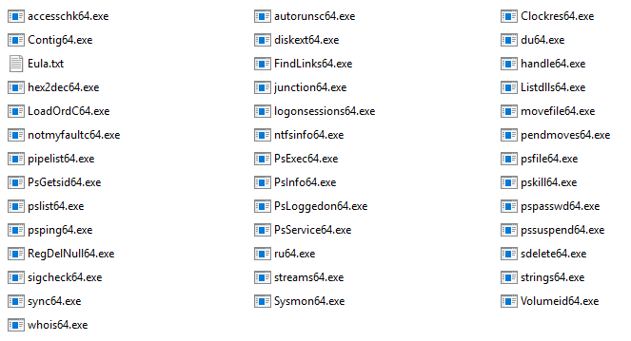
Sysinternals Suite for Nano Server

Slide 17
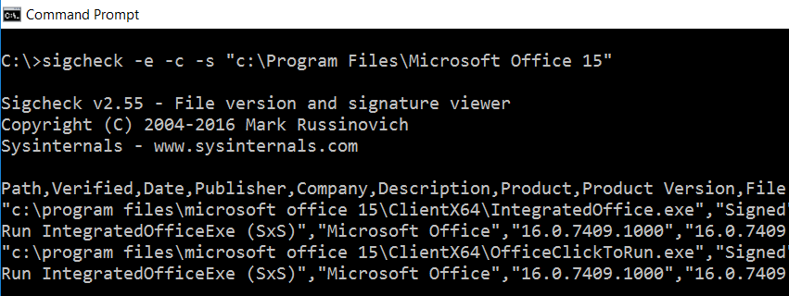
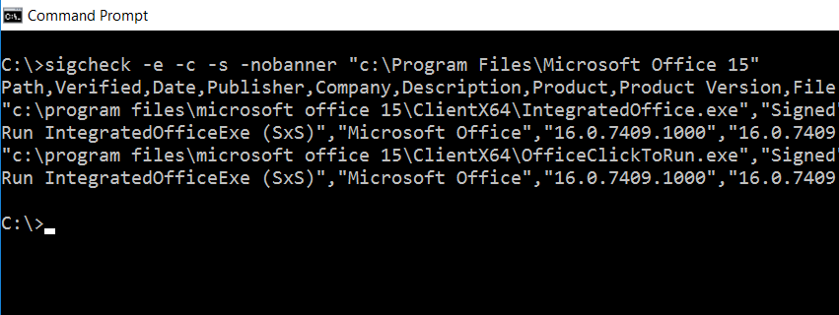
Oh, BTW…
Tools no longer write banners to stderr
–nobanner replaces –q in all command-line tools
autorunsc -a * -ct -nobanner -accepteula > autorunsc.csv
du -c -l 3 -nobanner -accepteula . > .\du.csv
sigcheck -e -ct -s -v -vt -nobanner -accepteula . > sigs.csv

Slide 18
OK. No more slides. Just demo.

Slide 19
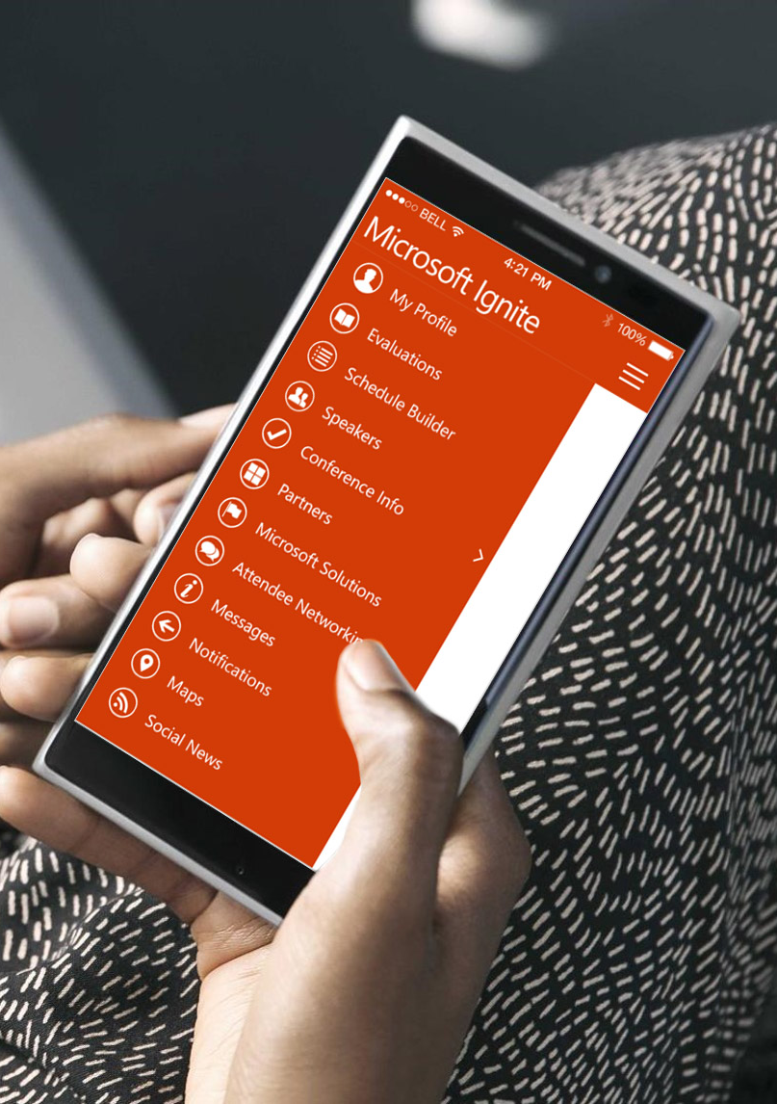
Please evaluate this session
Your feedback is important to us!
From your PC or Tablet visit MyIgnite at http://myignite.microsoft.com
From your phone download and use the Ignite Mobile App by scanning the QR code above or visiting https://aka.ms/ignite.mobileapp

