Slide 1
Optimize connectivity to
Microsoft Dynamics CRM Online
BRK3310
Brandon Kelly, Roger Gilchrist
Solution Architect

Slide 2
Introduction – Why am I here?
More and more, companies are moving their workloads to the cloud.
Connectivity is a key ingredient in ensuring reliability as these workloads move to the cloud.
Corporate networks may not have been scaled to allow for increased volume and business critical nature of internet traffic.
Dynamics CRM Online can play it’s part in this, with additional investments to address particular challenges coming
The most impactful area to focus on is ensuring a performant network connection from the client to the Internet.

Slide 3
CRM Online Performance

Slide 4
What makes CRM Online performant (or not)?
Browser
ISV
Code
Good performance entails an understanding of how to design the right implementation, code for efficiency, test for reliability and support for performance.
The best way to understand what performance bottlenecks exist is to start with a top-down approach.

Slide 5
What’s a top down approach?
App
Start with the experience closest to the end user.
Take a fiddler trace or browser’s F12 debug tools.
Platform
Attempt the same operation outside the UI with the SDK.
Evaluate plugins and workflows invoked by the action.
Data
Avoid complex security models if possible (extensive use of access teams, complex BU hierarchies)
Indexing may be needed, can be driven through Microsoft support case.

Slide 6
Connecting to CRM Online

Slide 7
Challenges
Internet
WAN
LAN
When looking at network connectivity, there are many contributory components
Important to break down and understand the relevant elements
Optimisations likely to come from multiple elements too
No single silver bullet typically involved

Slide 8
Challenge: LAN Connectivity
LAN Latency/ Saturation/ Client configuration

Slide 9
Challenge: WAN Connectivity
Poor WAN Connectivity/ slow proxy/ poor client configuration

Slide 10
Challenge: Internet Connectivity
Regional Connectivity
Inefficient Routing

Slide 11
Challenge: Internet Security
Security in Transit

Slide 12
Challenge: HTTP Chattiness
Time lost in round trips
Particularly as length of connection and latency increases

Slide 13
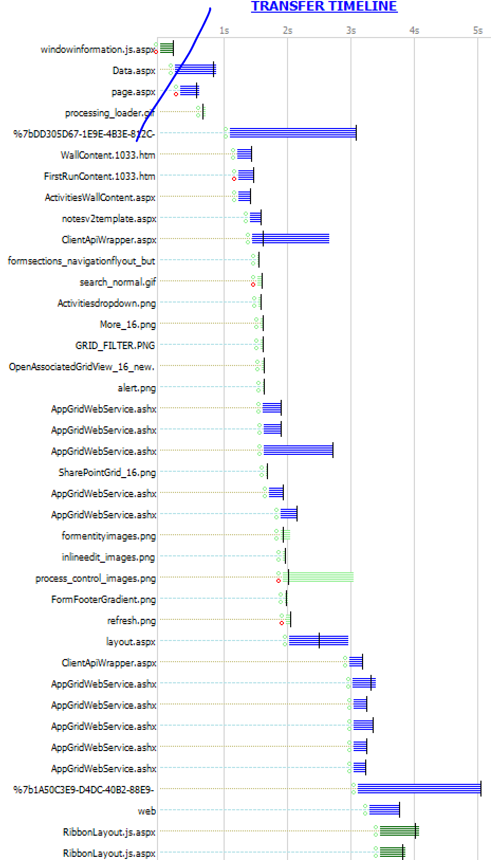
Challenge: HTTP Chattiness
CRM is particularly chatty, by design, in that cold loads will generate a lot of HTTP requests.
Warm loads (where data is already cached in the browser) are significantly more performant, however, script extensions as well as server integrations can change the affect of these requests.
As such, bandwidth and latency are key indicators of performance in many cases:
  Bandwidth should be at least 50kb/sec (minimum)
  Latency should be 150ms or less
  Organizations should surpass the minimums as much as possible.

Slide 14
Network Configuration Challenges

Slide 15
What performance would you expect
Consider:
  Within region
  Cross Region
Sanity check
  Expected latencies, and unexpected latencies
  Expected performance, can vary but > 10s definitely slower than needs to be

Slide 16
Consider location
Optimise for
  Compliance: may have compliance legislation insisting on location
  User base: most users/most important users ( important from perf perspective e.g. call centre users)
  Geography ( US to APAC quicker than EMEA to APAC)

Slide 17
Common challenges and optimisations
Poor routing: optimise routing paths
Slow proxies: whitelist or bypass proxy
Serial connections: TCP Window Scaling, max concurrent requests
Lack of client caching

Slide 18
Optimise slow implementation
May ‘get away’ with slow implementation locally
But distance amplifies expensive implementations
Reduce round trips
  Avoid web service requests from javascript
  Too many or expensive sub grids may impact form load times
Speed up requests
  Check for sync plug ins/workflows
  Check for blocking potential

Slide 19
Diagnose don’t ‘throw darts’
Don’t hope to hit with randomly thrown dart
Analyse where time is going
  Try it locally v remote ( set up trial in client region, try client in server region e.g. on Azure Iaas): if still slow, then server or implementation may be bigger cause
  Try it outside corporate network: bypasses proxies, routing
  Try vanilla org e.g. trial, to eliminate implementation impact
  Network tracing e.g. fiddler, see what calls are made, which are slow, which are serialising
Diagnostic tools
  What can Microsoft do for you (thousand eyes, telemetry)
  What can you do yourself?

Slide 20
Express Route

Slide 21
What is ExpressRoute – for IaaS
ExpressRoute provides a private, dedicated, high-throughput network connection between on-premises and Microsoft Azure/Online Services
Compliance
Predictable performance
Domain Joined
Private Network

Slide 22
What is ExpressRoute – for CRM
ExpressRoute provides a private, dedicated, high-throughput network connection between on-premises and Microsoft Azure/Online Services
Compliance
Predictable performance
Domain Joined
Private Network

Slide 23

Connectivity to Azure
Azure
Public Services
Access all Azure Services
Connectivity provider
infrastructure
ExpressRoute Peering Site
Customer’s
dedicated
connection
Customer’s
network
Azure Compute
Traffic to Azure Storage, SQL DB, …
Traffic to VNets

Slide 24
Public v Private Peering
Customer’s premises
Internet
DDOS, IDPS, Proxies
Internet edge
Firewall
Storage
SQL
Websites
Public Peering
Azure public services
Microsoft
Azure
IIS Servers
Extranet
ExpressRoute Circuit
Firewall
Private Peering
Exchange
AD/DNS
SQL Farm
Virtual Networks
Core Network

Slide 25

ExpressRoute Locations Roadmap
Locations:
Available Today
Washington D.C.
Silicon Valley, CA
London, UK
Atlanta
Dallas
Hong Kong
Singapore
Chicago
New York
Seattle
Roadmap* (NDA required)
FY15 Q1:
Amsterdam
Los Angeles
Tokyo
Sydney
Sao Paulo
FY15 Q2:
Dublin
Azure datacenters
ExpressRoute Locations (today)
ExpressRoute Locations (Roadmap)

Slide 26
Express Route: high level picture
Dedicated Connection Circuit
VPN Options

Slide 27
Express Route: high level picture
Doesn’t prevent direct access
Dedicated Connection Circuit
VPN Options

Slide 28


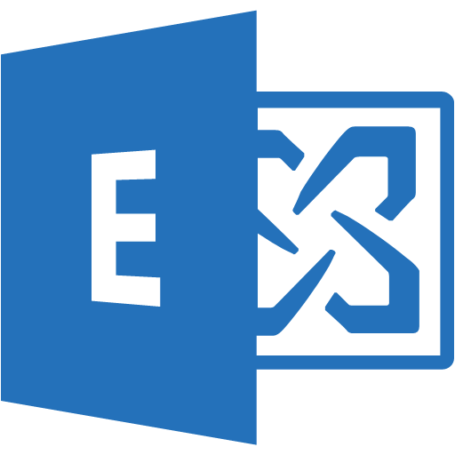















ExpressRoute & Microsoft Clouds
O365, CRM – Microsoft Peering
Partner Edge
Microsoft Edge
Customer’s
network
ExpressRoute
Circuit
Azure PaaS – Public Peering
Azure PaaS – Public Peering
Traffic to Office 365 Services and CRM Online
Traffic to public IP addresses in Azure
Traffic to Virtual Networks
Azure IaaS – Private Peering
Azure IaaS – Private Peering

Slide 29
Traffic to Microsoft
Customer Network
Traffic routed at network level
SR connected subnet must be public IP addresses
Microsoft Network
Internal Router configuration, routes traffic for Microsoft Online Services to ExpressRoute connected subnet
CRM Service
Router configuration routes traffic via BGP session
ExpressRoute
Connected
Subnet
Partner Edge
Microsoft Edge
Internal routing configuration routes traffic to appropriate service
ExpressRoute
Circuit
Microsoft Peering
Customer responsibility routing
Microsoft responsibility routing

Slide 30
Traffic from Microsoft
Customer Network
Microsoft Network
Connection made to the internal service
Public Internet
Requests to external services looked up against DNS
Then if IP registered against an ExpressRoute circuit, routes it internally
Traffic routed at network level
SR connected subnet must be public IP addresses to DNS published URLs
CRM Service
Router configuration routes traffic internally as appropriate either using public IP or NAT IP
ExpressRoute
Connected
Subnet
Partner Edge
Microsoft Edge
Traffic to IP registered against ExpressRoute routed over the BGP Session through the customer private circuit
ExpressRoute
Circuit
Microsoft Peering
Customer responsibility routing
Microsoft responsibility routing

Slide 31
Express Route Costs
Connectivity Provider Costs
Installation of hardware
Network setup & ongoing maintenance
Azure Subscription Costs:
Provision of service
Metered/Unlimited
Customer Network Configuration Costs
Time/Effort or costs to outsourced IT
Routing configuration, device management
Costs are likely per ExpressRoute circuit
If multiple locations, then likely costs multiplied by number of locations/circuits
Also will take time to configure at customer side, not simply ‘flip switch and enable’

Slide 32
ExpressRoute and CRM

Slide 33
CRM External Connectivity
Customer’s
network
O365, CRM – Microsoft Peering
On-Prem Exchange Server
EWS Connectivity from CRM SSS
Partner Edge
Microsoft Edge
Web Services Connectivity from CRM Plug ins/ to CRM endpoints
On-Prem Customer System
ExpressRoute
Circuit
Https Client connectivity to CRM
Azure PaaS – Public Peering
Client PCs
Azure IaaS – Private Peering

Slide 34
CRM Internal Cloud Connectivity
Azure PaaS
Azure PaaS
Exchange Web Service Requests
CRM Push messages to/pull messages from Service Bus
Data Sync for Search/Offline/ SQL Azure
Azure AD Authentication
EWS
O365, CRM
SharePoint Web Service Requests

Slide 35
CRM Public/ Private Cloud Connectivity
Azure PaaS
Requests to SQL Azure/Cortana Analytics Suite
Customer’s
network
Customer Push messages to/pull messages from Service Bus
Https client connectivity to Portals/Surveys
Web Service Requests to customer services
Web Service Requests to CRM from customer services
Web Service Requests to CRM from customer services
O365, CRM
Azure IaaS
Web Service Requests to customer services

Slide 36
Connections from Single Location
Connection simple from a single location
Customer Operations in Holland
Branch Nework in Holland
Customer Data Center
WAN Connection
Partner Edge
ExpressRoute
Connected
Subnet
ExpressRoute
Circuit

Slide 37
Connections from single region/ multiple locations
Within a region, having multiple locations requires routing to the single entry point to ER
Would typically have single ER circuit due to cost
Customer Operations in Holland
Branch Network in Holland
Customer Data Center
WAN Connection
Partner Edge
ExpressRoute
Connected
Subnet
WAN Connection
ExpressRoute
Circuit
WAN Connection

Slide 38
Connections from single region/ multiple locations
WAN connection separate from ExpressRoute
ER does not help if delays occur before entering ER
Customer Operations in Holland
Branch Network in Holland
Customer Data Centre
Using ExpressRoute will not overcome slow WAN network connections
WAN Connection
Partner Edge
ExpressRoute
Connected
Subnet
WAN Connection
ExpressRoute
Circuit
WAN Connection

Slide 39
Multiple connections from single region
Partner Edge
ExpressRoute
Circuit
WAN Connection
Customer Operations in Holland
Branch Network in Holland
Customer Data Centre
ExpressRoute
Connected
Subnet
Partner Edge
WAN Connection
ExpressRoute
Circuit
WAN Connection

Slide 40
Customer Operations in France
Not all connections need ER
Branch Network in France
Customer Data Centre
WAN Connection
Subnet
WAN Connection
Connection to Microsoft
Route via Internet
WAN Connection
Customer Operations in Holland
Branch Network in Holland
Customer Data Centre
WAN Connection
Partner Edge
ExpressRoute
Connected
Subnet
WAN Connection
ExpressRoute
Circuit
WAN Connection

Slide 41
Customer Operations in France
Branch Network in France
Customer Data Centre
WAN Connection
Partner Edge
ExpressRoute
Connected
Subnet
WAN Connection
ExpressRoute
Circuit
WAN Connection
But Multi-region can use
multiple ER circuits
Customer Operations in Holland
Branch Network in Holland
Customer Data Centre
WAN Connection
Partner Edge
ExpressRoute
Connected
Subnet
WAN Connection
ExpressRoute
Circuit
WAN Connection

Slide 42
Customer network configuration
Need to configure network to connect to ExpressRoute
Can be misconfigured in which case never reaches ER

Slide 43
Asymmetric Routing
Microsoft Cloud
Connection to Microsoft
1. Request to MS, via internet
2. Request routed via internet direct to Microsoft
4. Response rejected by firewall
Route via Internet
Customer Operations in Holland
Branch Network in Holland
Customer Data Center
3. Response routed via ExpressRoute
ExpressRoute
Connected
Subnet
Partner Edge
WAN Connection
ExpressRoute
Circuit
WAN Connection

Slide 44
Exchange Integration
Microsoft Network
Requests to Exchange On-Premises, routed via DNS lookup to an ExpressRoute connected subnet
Customer Network
CRM Service
Connections to the on-premises Exchange server would need to be protected at the customer gateway
ExpressRoute
Connected
Subnet
Partner Edge
Microsoft Edge
Traffic is routed over private connection
But the connection could come from any service, the network routing does not validate the requesting service is authorised to connect over that ExpressRoute circuit
ExpressRoute
Circuit
Microsoft Peering

Slide 45
Customer Service Integration
Microsoft Network
Requests to On-Premises systems, routed via DNS lookup to an ExpressRoute connected subnet
Customer Network
CRM Service
Connections to the on-premises service would need to be protected at the customer gateway
ExpressRoute
Connected
Subnet
Partner Edge
Microsoft Edge
Traffic is routed over private connection
But the connection could come from any service, the network routing does not validate the requesting service is authorised to connect over that ExpressRoute circuit
ExpressRoute
Circuit
Microsoft Peering

Slide 46
Working with other Online Services

Slide 47
Express Route to Azure/ Office365
Can reuse same Express Route connection across CRM Online and other Online Services

Slide 48
Connecting from Azure IaaS to CRM
No direct link between Azure IaaS and CRM servers
Within same data centre, will route internally

Slide 49
Mobility/ remote access
Connectivity can be direct to CRM Online
Control of client routing is not provided by ER, device/network management is required
Connectivity can also be via corporate infrastructure e.g. ADFS for authentication

Slide 50
Express Route: outbound traffic
Outbound traffic will route back via Express Route for CRM e.g. custom web service requests, Server Side Sync

Slide 51
Summary

Slide 52
Overview
Connectivity to Online can be impacted by a number of things
  Particularly if the first cloud service to be introduced, can hit existing limitations in internet connection
  Optimisations to the connection can be made in client and network
ExpressRoute often considered as performance benefit but more appropriately positioned as a Compliance capability avoiding traffic crossing the internet
Due to issues of configurations and expectations, approval required before enabling
  Making sure expectations are realistic before cost/effort expended by customer
  Ensure network assessments are done to avoid misconfiguration

Slide 53
Free IT Pro resources
To advance your career in cloud technology
Plan your
career path
Cloud role mapping
Expert advice on skills needed
Self-paced curriculum by cloud role
$300 Azure credits and extended trials
Pluralsight 3 month subscription (10 courses)
Phone support incident
Weekly short videos and insights from Microsoft’s leaders and engineers
Connect with community of peers and Microsoft experts
Microsoft IT Pro Career Center
www.microsoft.com/itprocareercenter
Get started
with Azure
Microsoft IT Pro Cloud Essentials
www.microsoft.com/itprocloudessentials
Demos and
how-to videos
Microsoft Mechanics
www.microsoft.com/mechanics
Connect with peers and experts
Microsoft Tech Community
https://techcommunity.microsoft.com

Slide 54


Please evaluate this session
Your feedback is important to us!
From your PC or Tablet visit MyIgnite at http://myignite.microsoft.com
From your phone download and use the Ignite Mobile App by scanning the QR code above or visiting https://aka.ms/ignite.mobileapp

