Slide 1
Migrate metadata and data to CRM Online with
Lifecycle Services accelerators
BRK3307
Simon Matthews
Principal Solutions Architect, CRM R&D

Slide 2
Agenda
Lifecycle Services
What is LCS and why does it matter?
Metadata Migrator
Metadata migration from alternative or legacy systems; including entities, attributes,
views and layouts
Data Loader
Data migration to Dynamics CRM Online with fewer errors and large volumes

Slide 3

What is LCS?
Lifecycle services is an Azure-based platform to help drive Predictable, Automated and Proactive delivery of Dynamics projects

Slide 4
LCS enables predictable, repeatable, high quality implementations
Project Manager
Repeatable and
predictable project experience with methodology automation
Developer
Reduce time to
develop high- quality customizations
PROJECT MANAGER
Define
BUSINESS
ANALYST
Operate
IT ADMINISTRATOR
Develop
DEVELOPER
Business Analyst
Data-driven
and predictable implementations
IT Administrator
Proactive monitoring
of the system

Slide 5
Agenda
Lifecycle Services
What is LCS and why does it matter?
Metadata Migrator
Metadata migration from alternative or legacy systems; including entities, attributes,
views and layouts
Data Loader
Data migration to Dynamics CRM Online with fewer errors and large volumes

Slide 6
What is LCS?
Lifecycle services is an Azure-based platform to help drive Predictable, Automated and Proactive delivery of Dynamics projects

Slide 7
LCS enables predictable, repeatable, high quality implementations
Project Manager
Repeatable and
predictable project experience with methodology automation
Developer
Reduce time to
develop high- quality customizations
PROJECT MANAGER
Define
BUSINESS
ANALYST
Operate
IT ADMINISTRATOR
Develop
DEVELOPER
Business Analyst
Data-driven
and predictable implementations
IT Administrator
Proactive monitoring
of the system

Slide 8
Metadata Migrator

Slide 9
Lifecycle Services Metadata Migrator
CLOUD SERVICE
Part of LCS, enables users to connect to legacy and alternative metadata models, providing tools to migrate these models to CRM Online
WEB BASED
Wizard driven metadata analysis, and solution generation
ANALYSIS
Assess source metadata through Power BI using a secure OData data endpoint
MAPPINGS
Automatically maps metadata from one system to another
Allow user to alter this mapping and re-use projects
CRM SOLUTIONS
Generated solution files include net new entities, attributes, views and forms

Slide 10
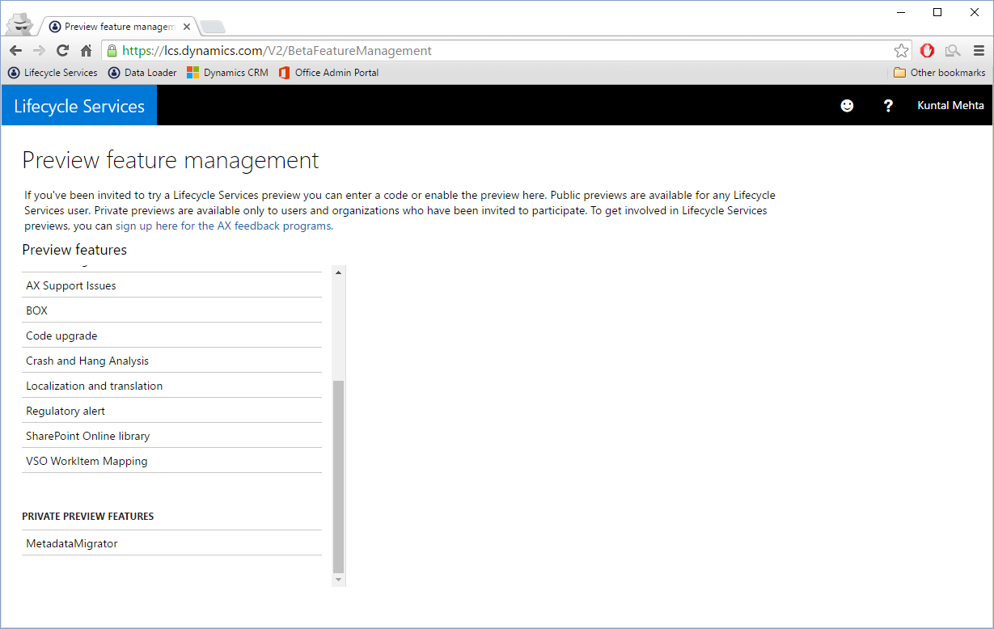
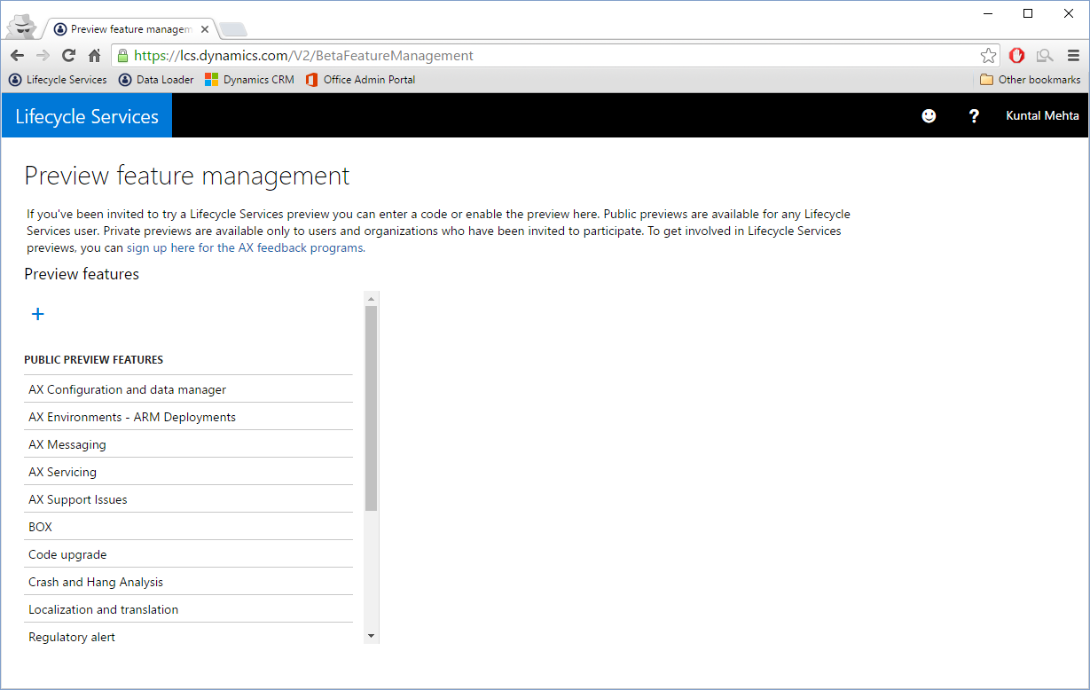
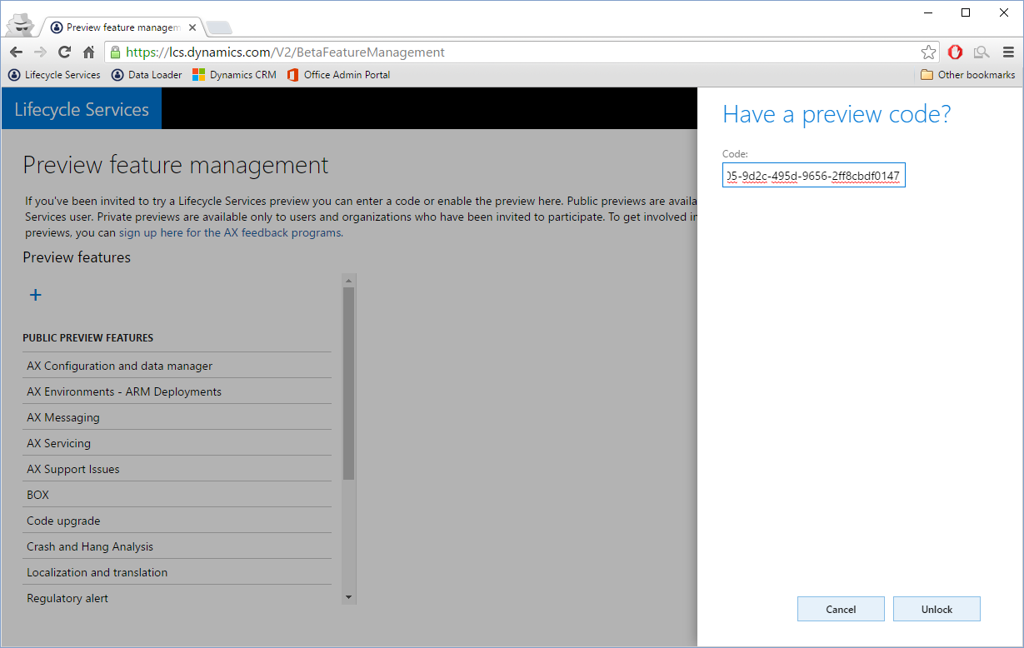
Preview feature management

Slide 11





How does it work?
Microsoft owned Azure subscription
RUNTIME
Azure Key Vault
Azure SQL
Azure storage account
Azure App services
Dynamics CRM API App
METADATA MIGRATOR
Connect to source metadata
Analyze metadata
Map metadata to generate CRM solution
MAP
METADATA
GENERATE
SOLUTION
Microsoft owned CRM instances
CRM SOLUTION

Slide 12
Demo
Metadata Migrator

Slide 13
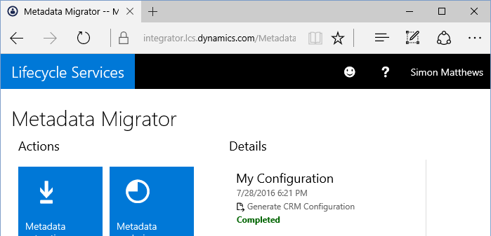
Roadmap
Q4 2016
Q1 2017
FUTURE
BETA
Launch to select participants
Support a subset of source types
Power BI reporting trough Power BI Desktop
PREVIEW
Launch to extended Preview program
Embedded Power BI reporting
One-click deployment of solutions
TO DO
Incorporate beta/preview feedback
Expand to additional source types
Support items such as reports, dashboards, system settings
Project style grouping to help manage multiple configurations

Slide 14
Data Loader

Slide 15
Lifecycle Services Data Loader
CLOUD SERVICE
Part of LCS, enables users to upload bulk datasets to Dynamics CRM Online with high throughput and reduced errors
WEB BASED
Wizard driven data upload and mapping
Mappings from source to target part of a reusable data project
FAST
Designed to take advantage of staged data in close proximity to target CRM instance
HIGH VOLUME
Able to handle much larger volumes of data than the existing CRM data import tool
SECURE
Azure Key Vault stores sensitive data with unique secrets per customer

Slide 16

How does it work?
DEPLOYER SERVICE
Centralized
Deploys Azure related artifacts
DATA LOADER
One time configuration
Import jobs
Microsoft owned Azure subscription
RUNTIME
Azure storage account
Azure App services
Dynamics CRM API App
RUNTIME
Azure storage account
Azure App services
Dynamics CRM API App
METADATA
DATA

Slide 17

Tips and tricks
Cleanse data
Remove unnecessary columns, add fields that support CRM data
pattern, split files where required, remove placeholder NULL values
Target metadata
Ensure CRM has the appropriate new entities, fields (both new and
existing entities) and option sets
Reduce bottlenecks
Disable all plugins, disable auditing, ensure all target data owners
have a security role
Created dates and alternative keys
Map created dates to “Record Created On”, add fields to store source
unique IDs, make these alternative keys in CRM

Slide 18
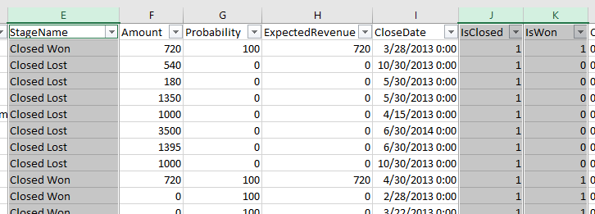
Status and Status Reason
E.g. Opportunity
Schema Name | Display Name
statecode | Status
statuscode | Status Reason
Need to map from alternative encoding
New columns in source data need to be created

Slide 19
Status and Status Reason
E.g. Opportunity
Status | Status Reason
Open | In Progress
 | On Hold
Won | Won
Lost | Canceled
 | Out Sold
StageName | statecode | statuscode
Closed Won | Won | Won
Closed Lost | Lost | Canceled
… | Open | In Progress
New columns

Slide 20
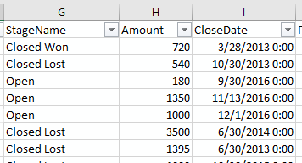
Data in context
StageName | Amount | CloseDate
Closed Won | 720 | 3/28/2013
Closed Lost | 540 | 10/30/2013
Closed Lost | 3500 | 6/30/2014
Closed Lost | 1395 | 6/30/2014
Actual Revenue and Actual Close Date
E.g. Opportunity
StageName | Amount | CloseDate
Open | 180 | 9/30/2016
Open | 1350 | 11/13/2016
Open | 1000 | 12/1/2016
Estimated Revenue and Estimated Close Date
Split source files
Map the same column different ways during import

Slide 21
Demo
Data Loader

Slide 22
Free IT Pro resources
To advance your career in cloud technology
Plan your
career path
Cloud role mapping
Expert advice on skills needed
Self-paced curriculum by cloud role
$300 Azure credits and extended trials
Pluralsight 3 month subscription (10 courses)
Phone support incident
Weekly short videos and insights from Microsoft’s leaders and engineers
Connect with community of peers and Microsoft experts
Microsoft IT Pro Career Center
www.microsoft.com/itprocareercenter
Get started
with Azure
Microsoft IT Pro Cloud Essentials
www.microsoft.com/itprocloudessentials
Demos and
how-to videos
Microsoft Mechanics
www.microsoft.com/mechanics
Connect with peers and experts
Microsoft Tech Community
https://techcommunity.microsoft.com

Slide 23


Please evaluate this session
Your feedback is important to us!
From your PC or Tablet visit MyIgnite at http://myignite.microsoft.com
From your phone download and use the Ignite Mobile App by scanning the QR code above or visiting https://aka.ms/ignite.mobileapp

