Slide 1
Explore adventures in the underland: Forensic techniques against hackers evading the hook
BRK3293
Paula Januszkiewicz
CQURE: CEO, Penetration Tester / Security Expert
CQURE Academy: Trainer
MVP: Enterprise Security, MCT
Contact: paula@cqure.us | http://cqure.us
@paulacqure
@CQUREAcademy

Slide 2
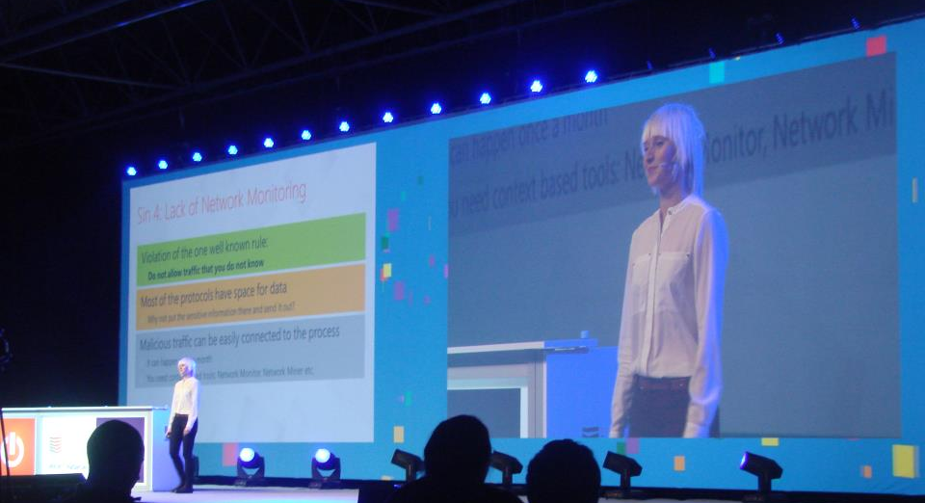
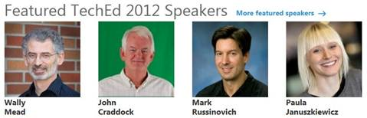
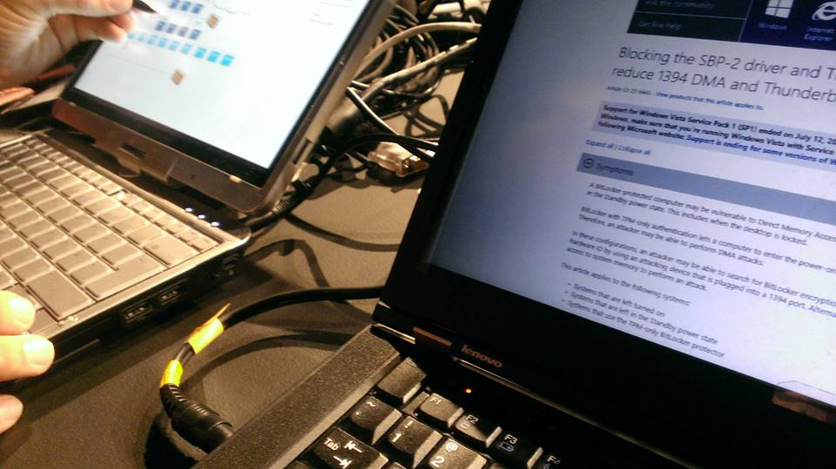
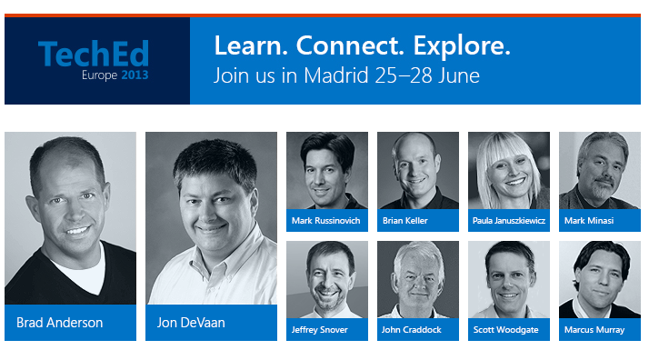
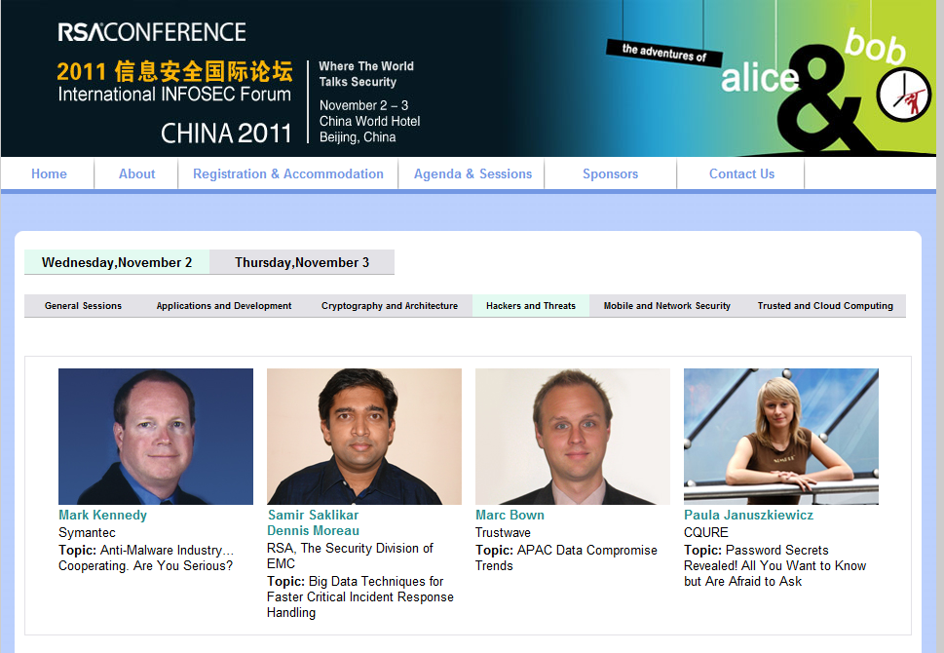

Slide 3
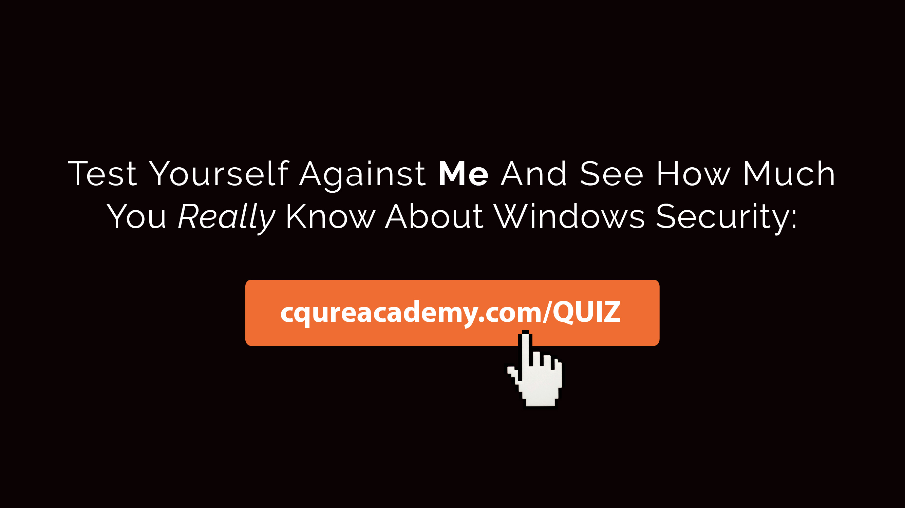

Slide 4
There is pretty much always something you can find…

Slide 5
Searching for a Trace: Disk
Disk
Profile, NTUSER
Run dialog
Most Recently Used (MRU), Management Console (MMC)
Remote Desktop connections
Prefetch files
Recent documents
Automatic Destinations (LNK)
Security Log
RDP Operational Log
Application Logs
Temporary Internet Files
Deleted files – recoverable from the disk
NTFS Structures
Hiberfil.sys
Memory dumps

Slide 6
Demo: Data on Disk Analysis

Slide 7
Techniques for Hiding vs. Recovering Data
File Level Games
Extension change
Joining files
Alternative data streams
Embedding
Playing with the content
Steganography
Deletion
Disk Level Games
Hiding data
Encryption

Slide 8
Demo: Data Recovery

Slide 9
Searching for a Trace: Memory
Memory
Handles
Processes
Hidden Processes (ActiveProcessLinks)
Files that can be extracted
Threads
Modules
Registry
API Hooks
Services
UserAssist
Shellbags
ShimCache
Event Logs
Timeline

Slide 10
Demo: Extracting Logs from Memory

Slide 11
Demo: Dump Analysis

Slide 12
Agenda
Intro
Proactive Monitoring
1
2
3
4
Passive Data Collection
Summary

Slide 13
Sysmon
Entry Information
Allows to build an attack timeline
Allows to define an entry point and anomalies
Collects and records system events to the Windows event log
It is free and easy to set up
Good practices
Filter out uninteresting events (image loads etc.)
Make sure event log is big enough
Centralize the events in a separate server
You can download Sysmon from Sysinternals.com

Slide 14
Demo: Sysmon in Action

Slide 15
Sysmon: Events and Filtering Examples
Filtering Rules
Include thread injections into lsass:
<CreateRemoteThread onmatch="include">
<TargetImage condition="image">lsass.exe</TargetImage>
</CreateRemoteThread >
Exclude all Microsoft-signed image loads:
<ImageLoad onmatch="exclude">
<Signature condition="contains">Microsoft</Signature>
<Signature condition="contains">Windows</Signature>
</ImageLoad>
Recorded Events
Event ID 1: Process creation
Event ID 2: A process changed a file creation time
Event ID 3: Network connection
Event ID 4: Sysmon service state changed
Event ID 5: Process terminated
Event ID 6: Driver loaded
Event ID 7: Image loaded
Event ID 8: CreateRemoteThread
Event ID 9: RawAccessRead
Event ID 10: ProcessAccess

Slide 16
Demo: Sysmon Customized

Slide 17
Demo: Sysmon and Network
+ getting info about the IP addresses

Slide 18
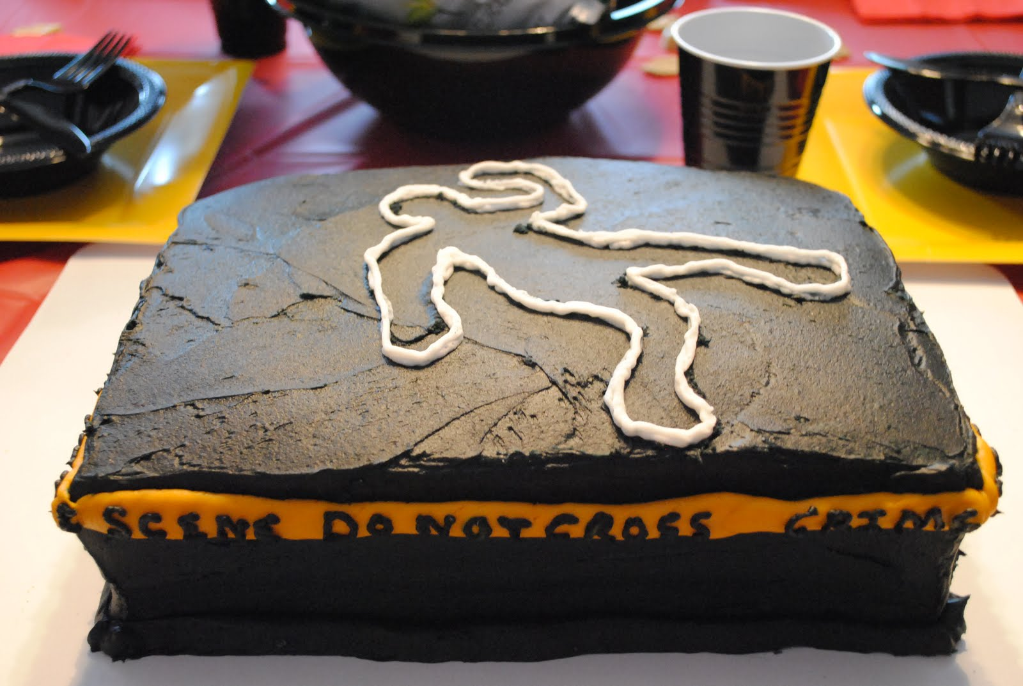
Forensics adventures: Summary
→ Make sure all tracing features on the drive and in the system are enabled: USN, Prefech etc.
→ Image first then play
→ Create Incident Response Procedure (most of the Customers we start the adventure with do not have it…)

Slide 22
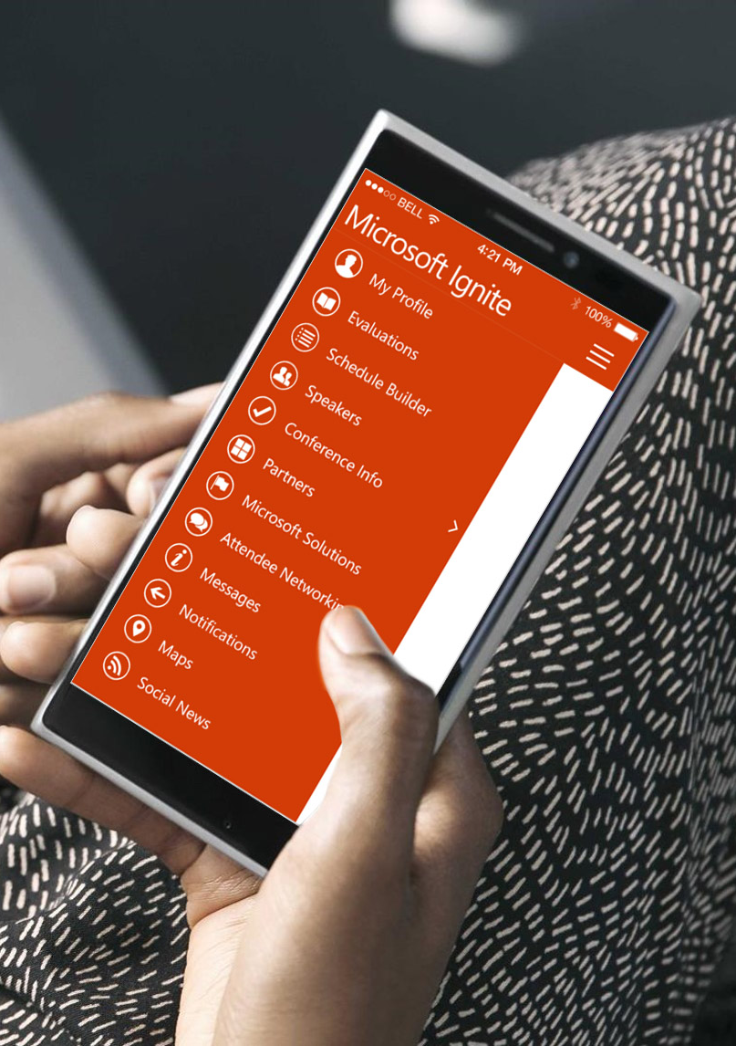
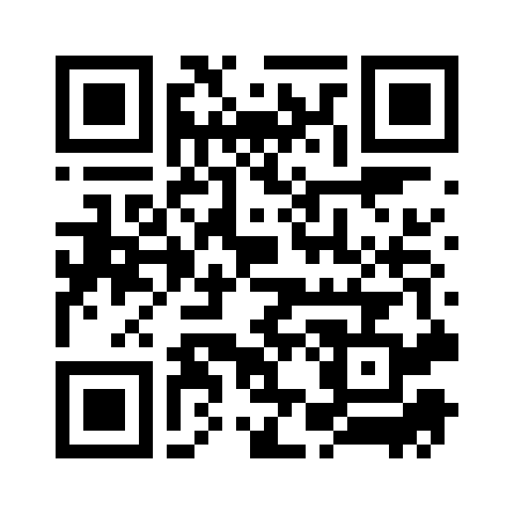
Please evaluate this session
Your feedback is important to us!
From your PC or Tablet visit MyIgnite at http://myignite.microsoft.com
From your phone download and use the Ignite Mobile App by scanning the QR code above or visiting https://aka.ms/ignite.mobileapp

