Slide 1
Secure Your Data at rest, on demand, now!
BRK3290
Tobiasz Janusz Koprowski
Data Platform MVP, MCT
Shadowland Consulting

Slide 2
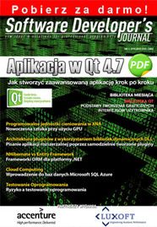
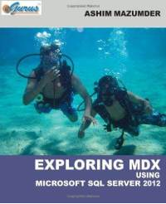
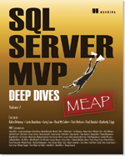
about me
independent consultant, security & licensing auditor
owner of shadowland consulting
microsoft certified trainer
data platform mvp (seven… years in a row)
subject matter expert at cqure
active blogger, influencer, technical writer
almost 10 years living in data processing center jungle
last 18 years working arroung banking and ict
polish information technology society board member
information security systems association board member
stem ambassador
@KoprowskiT

Slide 3
agenda
1 | Security in a Nutshell
2 | SQL Server Security Best Practices
3 | SQL Server 2014 Security Enhacement
4 | SQL Server 2016 Security Enhacement
5 | SQL Server Security in The Cloud
6 | Summary
Appendix

Slide 4
1 | Security In A Nutshell

Slide 5
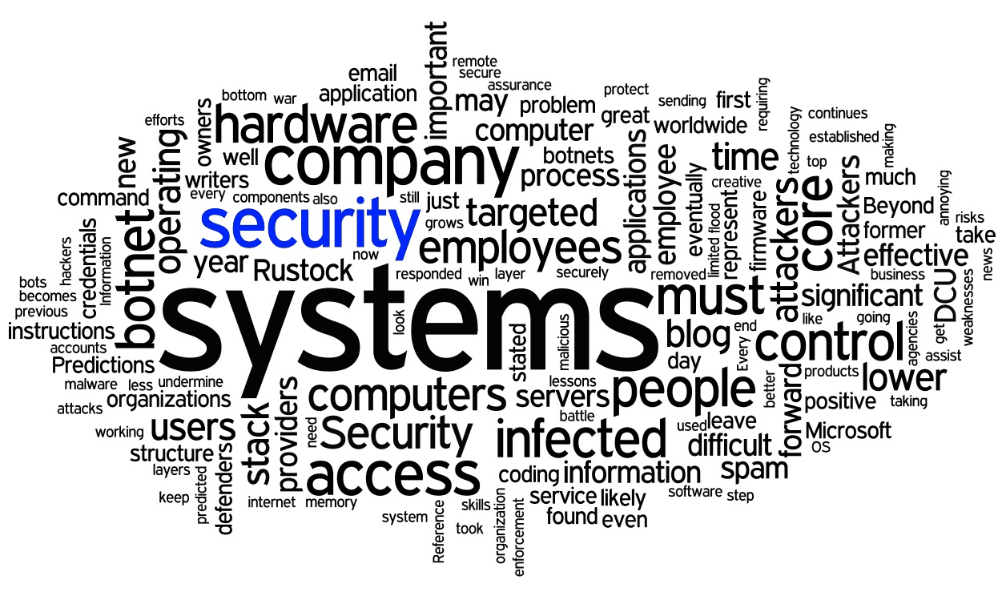

Slide 7
Security? What is this?
Security is the degree of resistance to, or protection from, harm. It applies to any vulnerable and valuable asset, such as a person, dwelling, community, nation, or organization.
As noted by the Institute for Security and Open Methodologies (ISECOM) in the Open Source Security Testing Methodology Manual (OSSTMM 3), security provides "a form of protection where a separation is created between the assets and the threat." These separations are generically called "controls," and sometimes include changes to the asset or the threat.

Slide 8
Categorizing Security {IT REALM}
Application security | http://bit.ly/18u8J6p
Computing security | http://bit.ly/1ARdRLd
Data security | http://bit.ly/185wfph
Information security | http://bit.ly/1ARe0ya
Network security | http://bit.ly/1C443R8

Slide 9
Categorizing Security {PHYSICAL REALM}
Airport security | http://bit.ly/1LPZcCZ
Food security | http://bit.ly/1MYnii6
Home security | http://bit.ly/1Gz3VI1
Infrastructure security | http://bit.ly/1Bm8LIF
Physical security | http://bit.ly/1Gz3VI1
Port security | http://bit.ly/1ARewMH
Supply chain security | http://bit.ly/1Ex7ob7
School security | http://bit.ly/17Dl735
Shopping mall security | http://bit.ly/1EUb1FV

Slide 10
Categorizing Security {POLITICAL REALM}
Homeland security | http://bit.ly/1AAwZhE
Human security | http://bit.ly/1DhojtU
International security | http://bit.ly/1MYoyli
National security | http://bit.ly/1FEnldu
Public security | http://bit.ly/1wqpX9P

Slide 11
Categorizing Security {SQL SERVER REALM}
Application
Computing
Data
Information
Network
Home
Infrastructure
Physical
National
Public

Slide 12
2 | SQL Server Security Best Practices

Slide 13
SQL Server Security Best Practices
MYTHS?
Efficiency and security have an inverse relationship to one another.
You can have high efficiency or high security, but not both.
Example: `Small Bank Company` tend to favor efficiency over security:
Cost limitations.
This is the first and obvious reason. Community banks are fighting a constant battle to remain competitive. Implementing security in systems adds costs - there is no way around it.
Risk.
It's not always a conscious decision for a bank to improve efficiency by sacrificing security. Sometimes there's a lack of understanding of the risks associated with the systems we deploy.
Personnel limitations.
The many-hats syndrome runs rampant in smaller community banks.
Regulatory emphasis.
The current regulatory environment stresses controls as they relate to policy and procedures.

Slide 14
authentication
SECURITY
BEST
PRACTICES
SQL Server supports:
Windows Authentication Mode which supports
Kerberos
NTLM (Windows NT Lan Manager)
Mixed Mode Authentication which supports
Windows Accounts
SQL Server specific accounts
Best Practice: use Windows Authentication mode
unless legacy application require Mixed Authentication for backward compability

Slide 15
secure sysadmin account
SECURITY
BEST
PRACTICES
sysadmin account (sa) is most vulnerable account when it’s not changed
potential SQL Server attackers, hackers aware of this account
Best Practice: change name of sysadmin account after installation
SSMS>Object Explorer>Logins>Rename (right click) / T-SQL

Slide 16
use complex password
SECURITY
BEST
PRACTICES
123456 (No change)*
password (No change)*
12345 (up 17)*
12345678 (down one)*
qwerty (down one)*
123456789 (no change)
1234 (up nine)*
baseball (new)*
dragon (new)*
football (new)*
1234567 (down four)*
monkey (up five)*
letmein (up one)*
abc123 (down nine)*
111111 (down eight)*
mustang (new)
access (new)
shadow (unchanged)*
master (new)*
michael (new)*
superman (new)*
696969 (new)
123123 (down 12)*
batman (new)*
trustno1 (down 1)*
Best Practice: ensure that complex password are used for sa and other sql-server-specific logins.
Think about ENFORCE EXPIRATION & MUST_CHANGE for any new SQL login

Slide 17
use specific logins
SECURITY
BEST
PRACTICES
Component | Windows Server 2008 | Windows 7 and Windows Server 2008 R2 and higher | Recommended accounts
Database Engine | NETWORK SERVICE | Virtual Account * | SQL_Engine
SQL Server Agent | NETWORK SERVICE | Virtual Account * | SQL_Agent
SSAS | NETWORK SERVICE | Virtual Account * | SQL_srvAS
SSIS | NETWORK SERVICE | Virtual Account * | SQL_srvIS
SSRS | NETWORK SERVICE | Virtual Account * | SQL_srvRS
SQL Server Distributed Replay Controller | NETWORK SERVICE | Virtual Account * | SQL_DRContro
SQL Server Distributed Replay Client | NETWORK SERVICE | Virtual Account * | SQL_DRReplay
FD Launcher (Full-text Search) | LOCAL SERVICE | Virtual Account
SQL Server Browser | LOCAL SERVICE | LOCAL SERVICE
SQL Server VSS Writer | LOCAL SYSTEM | LOCAL SYSTEM
Best Practice:
use different accounts for different sql-server oriented services

Slide 18
sysadmin membership
SECURITY
BEST
PRACTICES
Member of sysadmin fixed-server role can do whatever they want on SQL Server
by default sysadmin fixed-server role has CONTROL SERVER permission granted explicity
do not explicitly grant CONTROL SERVER for Windows logins, Windows Group logins and SQL logins
Best Practice:
carefully choose the membership of sysadmin fixed-server

Slide 19
general administration
SECURITY
BEST
PRACTICES
everything (almost always) works under sa account especially with CONTROL SERVER permission
institute dedicated Windows logins for DBAs,
and assign these logins sysadmin rights on SQL Server for administration purposes.
Best Practice: use built-in fixed server roles and database roles or
create your custom roles, then apply for specific logins

Slide 20
revoke guest access
SECURITY
BEST
PRACTICES
by default guest accounts exist in every user and system databases
is a potential security risk in lock down environment
those accounts could be targets for attackers
asssign public server role membership if you will need explicit access to user databases
Best Practice: disable all gueast user access from all user and system databases
(excluding msdb database)

Slide 21
limit public permission
SECURITY
BEST
PRACTICES
SQL Server has many Stored Procedures and many of them have public access permission:
OLE AUTOMATION:
sp_OACreate, sp_OAGetProperty, sp_OAStop, sp_OAMethod, sp_OAGerErrorInfo, sp_OADestroy, sp_OASetProperty
REGISTRY ACCESS:
xp_regremovemultistring, xp_regaddmultistring, xp_regread, xp_regdeletekey, xp_regdeletevalue, xp_regwrite
OTHER ROUTINES:
sp_sdidebug, xp_logevent, sp_sprintf, xp_dsninfo, xp_msver, sp_sscanf, xp_stopmail, xp_grantlogin, xp_eventlog, xp_dirtree
Best Practice: revoke public role access for some axtended procedures
and check other store procedures

Slide 22
hardening sql server ports
SECURITY
BEST
PRACTICES
default sql server port 1433/1434 is well known as standard target for hackers
by using SQL Server Configuration Manager you:
can change default port
can use specific TCP port instead of dynamic port
remember about similar TCP/UDP ports (1433, 1434)
Best Practice:
change default SQL Server port if it’s possible

Slide 23
disable sql server browser
SECURITY
BEST
PRACTICES
by default SQL Server Browser is disabled
it is necessary to run when multiple instances are running on a single server
any Windows user having the following rights would be capable to run the SQL Server Browser service:
deny access to this computer from the network
deny logon locally
deny logon as a batch job
deny logon through Terminal Services
log on as a service
read and write the SQL Server registry keys related to network communication (ports and pipes)
Best Practice:
do not enable sql server browser if it’s not necessary

Slide 24
secure service accounts
SECURITY
BEST
PRACTICES
different service accounts for different services
dedicated low-privileges domain accounts
check membership on a regular basis
use strong and different passwords for each account
Best Practice:
create good plan and make note about service accounts and passwords

Slide 25
Demo time
2 | SQL Server Security

Slide 26
3 | SQL Server 2014 Security Enhacements

Slide 27
transparent data encryption
SQL14 SECURITY ENHACEMENTS
first introduced with SQL Server 2008
protecting data by performing I/O encryption and decryption for database and log files
passphrase (less secure),
asymmetric key (strong protection, poor performance),
symmetric key (good performance, strong enough protection),
certificate (strong protection, good performance)
New functionality for backup:
takes non-encrypted backup data
encrypt data before writing to disk
compression is performed on the backup data first
then encryption is applied to compressed data
support for backup to Azure

Slide 28
encryption key management
SQL14 SECURITY ENHACEMENTS
Encryption options include:
encryption algorithm
certificate or asymmetric key
only asymmetric key reside in EKM is supported
multiple algorithm up to AES-256 are supported
manageable by PowerShell, SMO, SSMS, T-SQL
VERY IMPORTANT:
asymmetric key or certificate MUST be backed up
location MUST be different than backup location
No RESTORE without asymmetric key or certificate

Slide 29
connect any database
SQL14 SECURITY ENHACEMENTS
new server-level permission
grant CONNECT ANY DATABASE to a login that must connect to all databases currently exist and any new in future
does not grant any permission in any database beyond connect
to allow an auditing process to view all data or all database states CONNECT ANY DATABASE may be combined with:
SELECT ALL USER SECURABLES
VIEW SERVER STATE

Slide 30
impersonate any login
SQL14 SECURITY ENHACEMENTS
new server-level permission
when granted IMPERSONATE ANY LOGIN allows a middle-tier process to impersonate the account of clients connecting to it
when denied IMPERSONATE ANY LOGIN a high privileged login can be blocked from impersonating other logins
example:
CONTROL SERVER permission can be blocked from impersonating other logins

Slide 31
select all user securables
SQL14 SECURITY ENHACEMENTS
new server-level permission
when granted SELECT ALL USER SECURABLES a login (for example for auditing purposes) can view data in all databases that the user can connect to

Slide 32
SQL Server Express Security
by default:
instance name: SQLExpress
networking protocol: disabled
sql server browser: disabled
user (local) instances:
separated instance generated from parent instance
sysadmin privileges on SQL Express on local machine
runs as user process not as service process
only windows logins are supported
RANU instance (run as normal user)

Slide 33
Demo time
3 | SQL 2014 Security Enhacements

Slide 34
4 | SQL Server 2016 Security Enhacements

Slide 35
row-level security (1)
SQL16 SECURITY ENHACEMENTS
Row-Level Security enables customers to control access to rows in a database table based on the characteristics of the user executing a query (e.g., group membership or execution context).
RLS supports two types of security predicates.
Filter predicates silently filter the rows available to read operations (SELECT, UPDATE, and DELETE).
Block predicates explicitly block write operations (AFTER INSERT, AFTER UPDATE, BEFORE UPDATE, BEFORE DELETE) that violate the predicate.
Typical Examples
Restricting access to financial data based on an employee's region and role
Ensuring that tenants of a multi-tenant application can only access their own rows of data
Enabling different analysts to report on different subsets of data based on their position

Slide 36
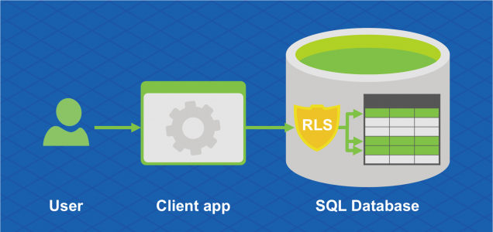
row-level security (2)
SQL16 SECURITY ENHACEMENTS
A hospital can create a security policy that allows nurses to view data rows for their own patients only.
A bank can create a policy to restrict access to rows of financial data based on the employee's business division, or based on the employee's role within the company.
A multi-tenant application can create a policy to enforce a logical separation of each tenant's data rows from every other tenant's rows. Efficiencies are achieved by the storage of data for many tenants in a single table. Of course, each tenant can see only its data rows.

Slide 37
dynamic data masking (1)
SQL16 SECURITY ENHACEMENTS
Default {Full masking according to the data types of the designated fields}
use XXXX or fewer Xs if the size of the field is less than 4 characters for string data types (nchar, ntext, nvarchar)
use a zero value for numeric data types (bigint, bit, decimal, int, money, numeric, smallint, smallmoney, tinyint, float, real)
use 01-01-1900 for date/time data types (date, datetime2, datetime, datetimeoffset, smalldatetime, time)
for SQL variant, the default value of the current type is used
for XML the document is used
use an empty value for special data types (timestamp table, hierarchyid, GUID, binary, image, varbinary spatial types)

Slide 38
dynamic data masking (2)
SQL16 SECURITY ENHACEMENTS
Credit card Masking method which exposes the last four digits of the designated fields and adds a constant string as a prefix in the form of a credit card. example: XXXX-XXXX-XXXX-1234
Social security number Masking method which exposes the last four digits of the designated fields and adds a constant string as a prefix in the form of an American social security number. example: XXX-XX-1234
Email Masking method which exposes the first letter and replaces the domain with XXX.com using a constant string prefix in the form of an email address. example: aXX@XXXX.com
Random number Masking method which generates a random number according to the selected boundaries and actual data types. If the designated boundaries are equal, then the masking function will be a constant number.
Custom text Masking method which exposes the first and last characters and adds a custom padding string in the middle. If the original string is shorter than the exposed prefix and suffix, only the padding string will be used. example: prefix[padding]suffix

Slide 39
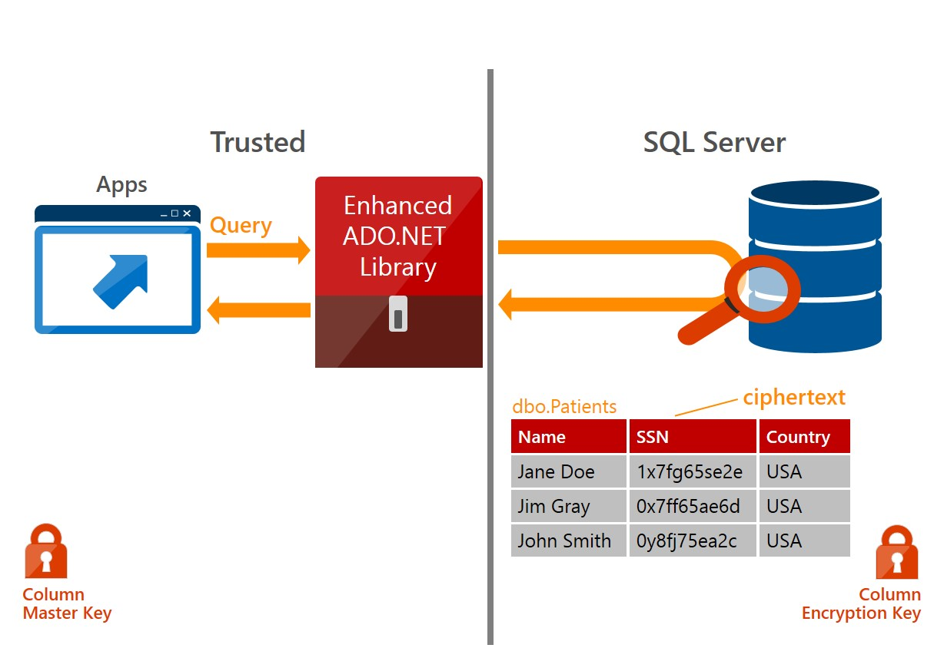
always encrypted (1)
SQL16 SECURITY ENHACEMENTS
is a client-side encryption technology that ensures sensitive data (and related encryption keys) are never revealed to the SQL Server or Azure SQL Database.
With Always Encrypted, a client driver transparently encrypts sensitive data before passing the data to the Database Engine, and it transparently decrypts data retrieved from encrypted database columns.

Slide 40
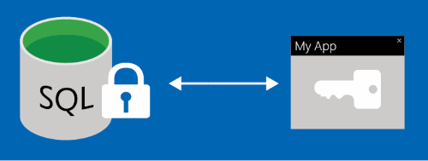
always encrypted (2)
SQL16 SECURITY ENHACEMENTS
additional layer of security that keeps valuable personal data such as:
social security numbers
private healthcare data
credit card information
protected even when the data is being used
Typical Scenarios
client and Data On-Premises
client On-Premises with Data in Azure
client and Data in Azure

Slide 41
demo time
4 | SQL 2016 Security Enhacements

Slide 42
5 | SQL Server Security in the Cloud

Slide 43
Cloud Security
http://bit.ly/1zmeYi2
Microsoft Cloud Security Approach in a Nutshell
Principles, patterns, and practices
Security engineering
Threats and countermeasures
Secure the network, host, and application
Application scenarios and solutions
Security frame
People, process, and technology
Application, infrastructure, and business

Slide 44
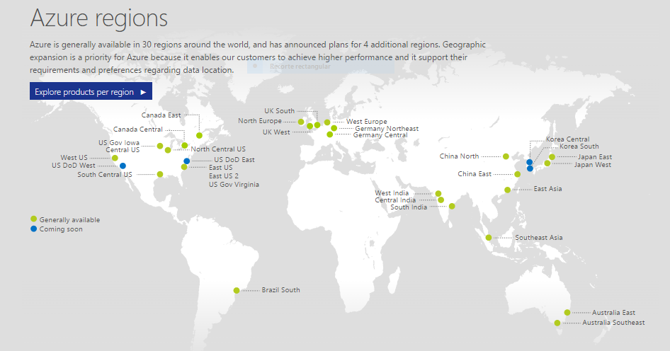
Security Requirements for Azure Platform

Slide 45
Security Requirements for Azure Platform
Newly announced Azure geographies and regions
Canada
Canada Central – Toronto
Canada East – Quebec City
Germany
Germany Central – Frankfurt
Germany Northeast – Magdeburg
UK
UK South – London
UK West – Cardiff

Slide 46
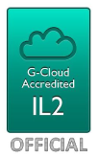
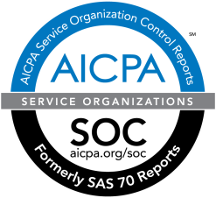
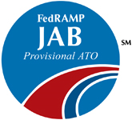
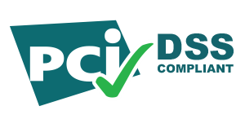
Security Requirements for Azure Platform
As a Service Provider Microsoft has an obligation to passing the several rules for security:
ISO 27001/27002 Audit and Certification
SOC 1/SSAE 16/ISAE 3402 and SOC 2 Attestations
Cloud Security Alliance (CSA) Cloud Controls Matrix (CCM)
Payment Card Industry (PCI) Data Security Standards (DSS) Level 1

Slide 47
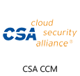
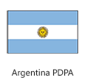
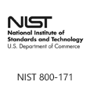
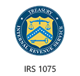
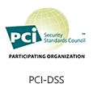
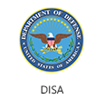
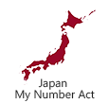
Security Requirements for Azure Platform

Slide 48
Security Requirements for Azure Platform
ISO/IEC 27001:2005 Audit and Certification
ISO Scope: The following Azure features are in scope for the current ISO audit: Cloud Services (including Fabric and RDFE), Storage (Tables, Blobs, Queues), Virtual Machines (including with SQL Server), Virtual Network, Traffic Manager, Web Sites, BizTalk Services, Media Services, Mobile Services, Service Bus, Workflow, Multi-Factor Authentication, Active Directory, Right Management Service, SQL Database, and HDInsight. This includes the Information Security Management System (ISMS) for Azure, encompassing infrastructure, development, operations, and support for these features. Also included are Power BI for Office 365 and Power Query Service.
SOC 1 and SOC 2 SSAE 16/ISAE 3402 Attestations
Scope: The following Azure features are in scope for the current SOC 1 Type 2 and SOC 2 Type 2 attestations: Cloud Services (includes stateless Web, and Worker roles), Storage (Tables, Blobs, Queues), Virtual Machines (includes persistent virtual machines for use with supported operating systems) and Virtual Network (includes Traffic Manager).

Slide 49
Security Requirements for Azure Platform
And of course requirements for Data Centers:
Physical security of the data centers (locks, cameras, biometric devices, card readers, alarms)
Firewalls, application gateways and IDS to protect the network
Access Control Lists (ACLs) applied to virtual local area networks (VLANs) and applications
Authentication and authorization of persons or processes that request access to data
Hardening of the servers and operating system instances
Redundant internal and external DNS infrastructure with restricted write access
Securing of virtual machine objects
Securing of static and dynamic storage containers

Slide 50
demo time
5 | SQL Server Security in the Cloud

Slide 51
6 | SUMMARY

Slide 52
SQL Server Security in the Cloud
Same security principals like SQL Server on premise
Full responsibility for DBA with Virtual Machine
Partial responsibility for DBA with Azure SQL Database
Automatic updates for Azure SQL Database
New functionality implemented by Microsoft
Some incompabilities with t-sql, functions, store procedures
Increased security by default on Azure platform

Slide 53
Three Pillars of a Secure Hybrid Cloud Environment
Pillar One: risk assessment and management
A definition of the risks that apply to various asset(s), based on their business criticality.
An assessment of the current status of each risk before it’s moved to the cloud. Using this information, each risk can be accepted, mitigated, transferred or avoided.
An assessment of the risk profile of each asset, assuming it has been moved to the cloud.
Pillar Two: policy and compliance
Cloud providers need to understand that simply listing compliance certifications isn’t sufficient. In line with the mantra of transparency explored in the previous point, providers should take a proactive stance to sharing their security implementations and controls.
Dimension Data often assists clients by providing them with a list of questions
that we believe they should be posing to cloud providers as part of the
evaluation process, to ensure they’re covering all the bases.’

Slide 54
Three Pillars of a Secure Hybrid Cloud Environment
Pillar Three: provider transparency
Governance: the ability of an organisation to govern and measure enterprise risk introduced by cloud.
Legal issues: regulations, and requirements to protect the privacy of data, and the security of information and computer systems.
Compliance and audit: maintaining and proving compliance when using the cloud.
Information management and data security: managing cloud data, and responsibility for data confidentiality, integrity and availability.
Portability and interoperability: the ability to move data or services from one provider to another, or bring them back in-house.
Business continuity and disaster recovery: operational processes and procedures for business continuity and disaster recovery.

Slide 55
Three Pillars of a Secure Hybrid Cloud Environment
Pillar Three: provider transparency
Data centre: evaluating any elements of a provider’s data centre architecture and operations that could be detrimental to ongoing services.
Incident response, notification and remediation: adequate incydent detection, response, notification, and remediation.
Application security: securing application software running on or developed in the cloud.
Encryption and key management: identifying proper encryption usage and scalable key management.
Identity and access management: assessing an organisation’s readiness to conduct cloud-based identity, entitlement, and access management.
Virtualisation: risks associated with multi-tenancy, virtual machine isolation and co- residence, hypervisor vulnerabilities, etc.

Slide 56
Recommendations
Create a new role for an Information Manager who owns information governance across (all SharePoint) environments
Train and educate all stakeholders about risk and liability
Assess the appropriateness of using SharePoint versus other document management tools
Define information governance policies for access, retention, archival, and backup
Automate risk controls
Audit user and data activities
Resources:
Microsoft TechNet
Microsoft MSDN
Legal Sources for Compliance Requirements

Slide 57
Appendix (Links And Credits)

Slide 58
links
ISECOM (the Institute for Security and Open Methodologies)
http://www.isecom.org/about-us.html
OSSTMM (Open Source Security Testing Methodology Manual)
http://www.isecom.org/research/osstmm.html
Library of Resources for Industrial Control System Cyber Security
https://scadahacker.com/library/index.html
patterns & practices: Cloud Security Approach in a Nutshell
https://technet.microsoft.com/en-us/ff742848.aspx
Microsoft Azure Trust Center: Security
http://azure.microsoft.com/en-us/support/trust-center/security/
10 Things to know about Azure Security
https://technet.microsoft.com/en-us/cloud/gg663906.aspx
Security Best Practice and Label Security Whitepapers
http://blogs.msdn.com/b/sqlsecurity/archive/2012/03/07/security-best-practice-and-label-security-whitepapers.aspx

Slide 59
links
Hello Secure World
http://www.microsoft.com/click/hellosecureworld/default.mspx
SQL Server Label Security Toolkit
http://sqlserverlst.codeplex.com/
SQL Server Best Practices Analyzer
Microsoft Baseline Configuration Analyzer 2.0
http://www.microsoft.com/en-us/download/details.aspx?id=16475
SQL Server 2005 Best Practices Analyzer (August 2008)
http://www.microsoft.com/en-us/download/details.aspx?id=23864
Microsoft® SQL Server® 2008 R2 Best Practices Analyzer
http://www.microsoft.com/en-us/download/details.aspx?id=15289
Microsoft® SQL Server® 2012 Best Practices Analyzer
http://www.microsoft.com/en-us/download/details.aspx?id=29302

Slide 60
links
Microsoft Security Assessment Tool
http://www.microsoft.com/downloads/details.aspx?FamilyID=6D79DF9C-C6D1-4E8F-8000-0BE72B430212&displaylang=en
Microsoft Application Verifier
http://www.microsoft.com/downloads/details.aspx?FamilyID=bd02c19c-1250-433c-8c1b-2619bd93b3a2&DisplayLang=en
Microsoft Threat Analysis & Modelling Tool
http://www.microsoft.com/downloads/details.aspx?FamilyID=59888078-9daf-4e96-b7d1-944703479451&DisplayLang=en
How To: Protect From SQL Injection in ASP.NET
http://msdn2.microsoft.com/en-us/library/ms998271.aspx
Securing Your Database Server
http://msdn.microsoft.com/en-us/library/aa302434.aspx
Threats and Countermeasures
http://www.microsoft.com/technet/security/guidance/serversecurity/tcg/tcgch00.mspx

Slide 61
links
Configure Windows Service Accounts and Permissions
https://msdn.microsoft.com/en-us/library/ms143504.aspx#Network_Service
Select an Account for the SQL Server Agent Service
https://msdn.microsoft.com/en-us/library/ms191543.aspx
Server Configuration - Service Accounts
https://msdn.microsoft.com/en-us/library/cc281953.aspx

Slide 62
azure resources: security
Azure Security: Technical Insights
Security Best Practices for Developing Azure Solutions
Protecting Data in Azure
Azure Network Security
Microsoft Antimalware for Azure Cloud Services and Virtual Machines
Microsoft Enterprise Cloud Red Teaming
Microsoft Azure Security and Audit Log Management
Security Management in Microsoft Azure
Crypto Services and Data Security in Azure

Slide 63
azure resources: security & privacy
Business Continuity for Azure
Understanding Security Account Management in Azure
Azure Data Security: Cleansing and Leakage
Scenarios and Solutions Using Azure Active Directory Access Control
Securing and Authenticating a Service Bus Connection
Azure Privacy Overview (PDF)
Azure Privacy Statement
Law Enforcement Request Report
Protecting Data and Privacy in the Cloud

Slide 64
azure resources: compliance & more
Response to Cloud Security Alliance Cloud Controls Matrix (DOC)
Azure HIPAA Implementation Guidance (PDF)
Azure Customer PCI Guide (PDF)
The Microsoft Approach to Cloud Transparency (PDF)
Microsoft Trustworthy Computing
Operational Security for Online Services Overview (PDF)
Data Classification for Cloud Readiness
CISO Perspectives on Data Classification (PDF)
An Introduction to Designing Reliable Cloud Services (PDF)
Deploying Highly Available and Secure Cloud Solutions (PDF)

Slide 65
azure resources
RESOURCE | DESCRIPTION
MSDN: Azure SQL Database MSDN: SQL Server in Azure Virtual Machines Azure.com: Azure SQL Database | Links to the library documentation.
Azure SQL Database and SQL Server -- Performance and Scalability Compared and Contrasted | This article explains performance differences and troubleshooting techniques when using Azure SQL Database and SQL Server running on-premises or in a VM.
Application Patterns and Development Strategies for SQL Server in Azure Virtual Machines | This article discusses the most common application patterns that apply to SQL Server in Azure VMs and also hybrid scenarios including Azure SQL Database.
Microsoft Enterprise Library Transient Fault Handling Application Block | This library lets developers make their applications running on Azure SQL Database more resilient by adding robust transient fault handling logic. Transient faults are errors that occur because of some temporary condition such as network connectivity issues or service unavailability. Since Azure SQL Database is a multitenant service, it is important to handle such errors to minimize any application downtime.

Slide 66
credits
Yes, 123456 is the most common password, but here’s why that’s misleading
http://arstechnica.com/security/2015/01/yes-123456-is-the-most-common-password-but-heres-why-thats-misleading/
CIO’s are Listening, Security is Important…
https://communities.intel.com/community/itpeernetwork/blog/2014/05/20/cio-s-are-listening-security-is-important

Slide 67
demo time (extra)
6 | SQL Server Files on-premise

Slide 68
after session
CONTACT:
MAIL: KoprowskiT@windowslive.com
SOCIAL MEDIA: facebook, twitter, linkedin, xing
BLOGS:
My MVP Blog: http://koprowskit.eu/geek/
ITPRO Anorak’s Vision: http://itblogs.pl/notbeautifulanymore/
Volume Licensing Specialites: http://koprowskit.eu/licensing/

Slide 69
Free IT Pro resources To advance your career in cloud technology
Plan your career path
Cloud role mapping
Expert advice on skills needed
Self-paced curriculum by cloud role
$300 Azure credits and extended trials
Pluralsight 3 month subscription (10 courses)
Phone support incident
Weekly short videos and insights from Microsoft’s leaders and engineers
Connect with community of peers and Microsoft experts
Microsoft IT Pro Career Center
www.microsoft.com/itprocareercenter
Get started with Azure
Microsoft IT Pro Cloud Essentials
www.microsoft.com/itprocloudessentials
Demos and how-to videos
Microsoft Mechanics
www.microsoft.com/mechanics
Connect with peers and experts
Microsoft Tech Community
https://techcommunity.microsoft.com

Slide 70
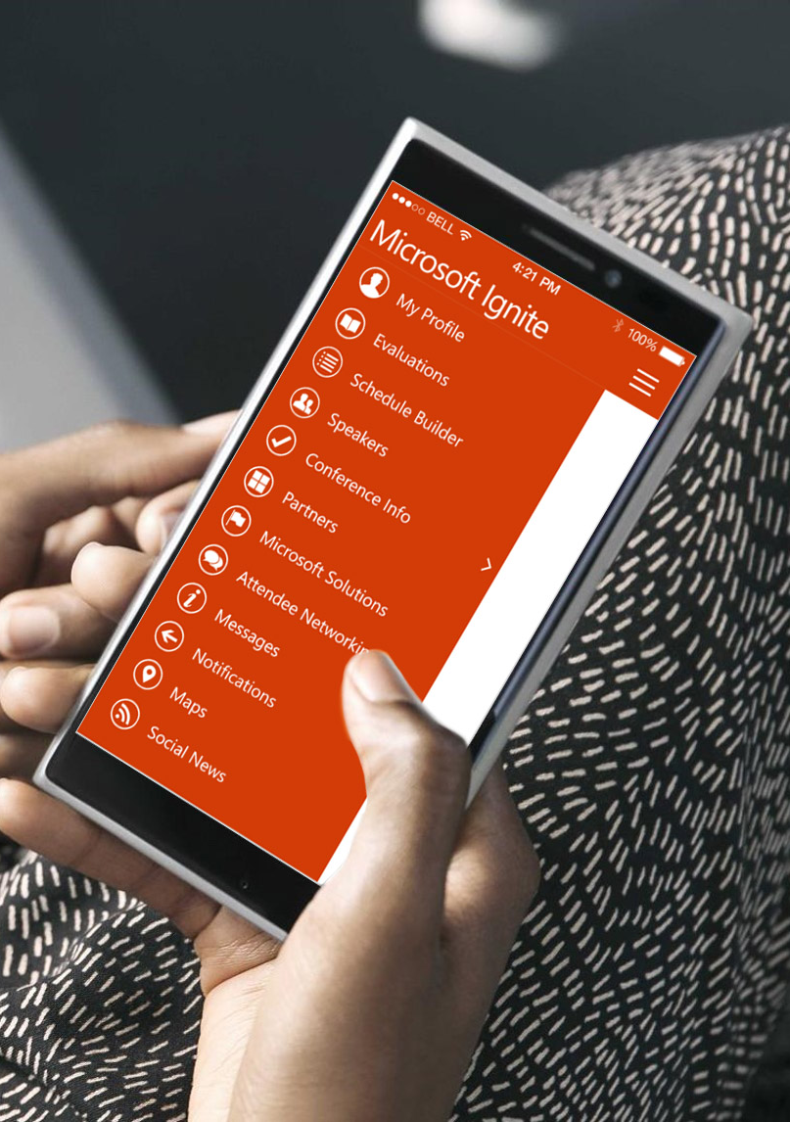
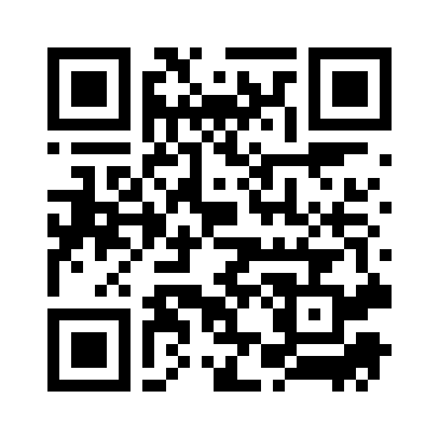
Please evaluate this session
Your feedback is important to us!
From your PC or Tablet visit MyIgnite at http://myignite.microsoft.com
From your phone download and use the Ignite Mobile App by scanning the QR code above or visiting https://aka.ms/ignite.mobileapp

