Slide 1
Helping Businesses Cut Spending,
Improve Processes, and Reduce Taxes Using Machine Learning and Cortana Analytics Suite
BRK3287
Michelle Wallig
Executive Director, Ernst & Young LLP, Tax Performance Advisory
Abhishek Sreesaila
Manager, EY, Advisory

Slide 2
Agenda
Microsoft – EY Alliance Background
Tax Data Management Overview
Illustrative Use Cases
Demos

Slide 3
Microsoft – EY Alliance Background

Slide 4
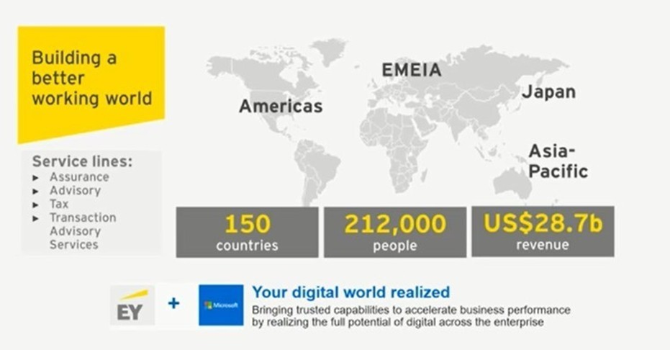
About EY

Slide 5

Why EY and Microsoft
A powerful combination of business and IT helping to realize the promise of digital
EY clients are going digital, exploring how to leverage the cloud.
EY has C-suite credibility as a business transformation leader, yet transformations are increasingly inspired by technology.
An alliance with Microsoft enhances EY’s ability to deliver more tailored digital enterprise solutions and outcomes across sectors.
Microsoft provides the cloud infrastructure and enterprise tools that power next generation business models (such as the Internet of Things).
Harnessing this potential requires more than technology: it requires end-to-end business transformation and outcome-centricity.
An alliance with EY elevates the conversation on how Microsoft platforms can help launch sustainable cloud business models.
At the highest level, the alignment of purpose between EY’s “Building a Better Working World” and Microsoft’s “Helping People and Businesses Throughout the World Reach Their Full Potential” forms the basis for a truly strategic, sustainable, go-to-market partnership.

Slide 6
Current Alliance Offerings
Transforming your business, one digital innovation at a time
PROGRAM MANAGEMENT
ANALYTICS
Program Performance Center
Project Portfolio Management
ePlaybook
3-D Spend Analytics
Data Quality and Cleansing
SAP Performance and Optimization
Project, Office 365
Azure, ML, Power BI
Your Digital World. Realized.
TRUSTED CLOUD
Trusted Cloud Diagnostic
Trusted Cloud Migration
Azure, Office 365
DIGITAL PROGRAM ACTIVATION
Digital Program Activation -adoption and benefit realization of Microsoft solutions
Portals and Collaboration
SECTOR-SPECIFIC OFFERINGS
Sector
Commercial Analytics Services Hub - CPR
Office 365

Slide 7
Tax Data Management Overview

Slide 8


Tax Data and Information Management: An important strategic driver
…but it’s a challenge to get and manage your tax data
Reporting & Analytics
Data Governance
Data Quality
Data Management / Architecture
“There is a lack of a reporting and analytics vision…“
“Our change request process is horrendous… It’s pretty much horrendous for every system we use”
“All my quality control is based on manual reconciliation”
“We have big cracks all over our walls but choose to paint over them rather than rebuild the walls”
“Everybody loves Excel… we have got ‘Excelitis’”
“People are measured by what they get done rather than how they get things done”
“I don’t think we have a common definition of what a common system is”
“There are disconnects in our data across a lot of our systems”
“We have created thousands of mini gods that say I want data this way, not that way…”
“Forecast accuracy is terrible, we embarrass ourselves”
“We didn’t get to the 29 systems by design, we did it because we could”
“Letting IT control Business rules is very dangerous”
“One plus one does not always equal two”
“If we could standardize leaders….”
“A functional need, a new system”
“Since we are more experienced, we do not really need metrics on paper to tell us where to go or what to do”
“Silos within silos within silos. It’s Silod cubed”
“we have a lot of Band-Aids and translators”

Slide 9
Tax Data and Information Management: Root cause challenges
In most companies, the availability of tax-relevant financial data is the single largest factor impacting efficiency and effectiveness of tax accounting, compliance, planning and audit support.
The more systems, processes and manual manipulations, the more difficult it becomes to ensure the integrity and accessibility of the data.
Shadow accounting
  Excessive manual effort and rework because data not available at right level
Information deficits
  Untimely access to reliable data for provisions, returns, planning and analysis
Fragmented processes
  Inconsistencies within tax, fragmented and manual-intensive processes for provisions, returns and basis calculations; lack of integration with finance, business units and IT
Rearview mirror focus
  Excessive time analyzing and reporting on past events
Reliance on spreadsheets
  Manual-intensive data manipulation within individual spreadsheets
Capacity allocation
  Ineffective use of limited resources; people not spending right amount of time on the right things due to manual, cumbersome processes
Understanding data sources
  Knowing how data is captured, what is needed and/or available
Tax/supplier relationships
  Explaining what tax data is needed and why; accountability for timely response to information requests made by tax

Slide 10
Tax Data and Information Management: How EY can help
Cortana Analytics Suite, MS Power BI
Tax Analytics
How we can help
Strategy
Analytics Design
System Selection
Analytics Configure
Assess and Recommend
CMC Integration
Analytics Requirements
Business Case Design
Data analytics is a means of supplying businesses with the relevant data they need to make better, quicker, smarter decisions that improve business performance and manage risk. Data analytics is a foundational element to the tax department’s transformation into a strategic business asset.
Possible Tax Data Management Activities
Assess tax’s need for advanced reporting options, such as ad hoc queries, dashboards or predictive analytics
Rationalize spreadsheets and current inventory of reports
Assist with software selection
Define a reporting strategy that covers key items, such as the use of ERP BI tools, data acquisition, report distribution and report governance
Develop custom data lakes, data marts and info cubes to support reporting requirements
Architect, design and build (or assist) analytics reporting
Help develop the funding business case
Manage
data
Perform
analytics
Drive
decisions
Improve
performance
Relevant data
Insights
$$$
Appropriate data sources
Business intelligence
and reporting
Manage risk
Continuous feedback loop

Slide 11
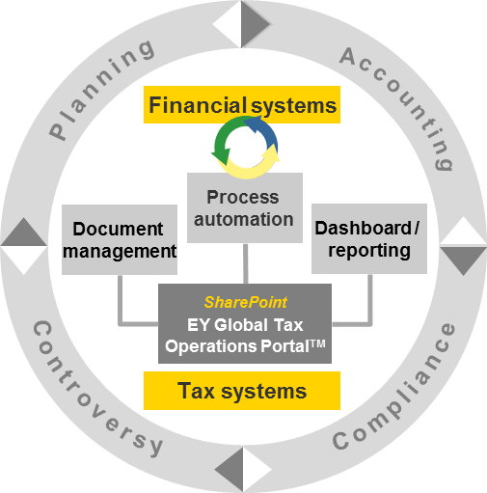
Tax Data Management and Analytics
What is it?
Enterprise tax data management platform and approach that provides security, quality, controls, retention and traceability for all your tax data
What does
it do?
Aligns, acquires, conforms and stores data from:
  Systems of record (i.e., ERP), tax transaction engines
  Documentation and work papers
Supplies data required by:
  Tax data analytics (dashboards), KPIs, collaboration tools, tax compliance and planning solutions
What are the benefits?
  Accessible transaction-detailed data for 100% of legal entities controlled and managed by the tax organization
  Smarter compliance – increased visibility into data for compliance, reporting and transfer pricing purposes
  Transparency of tax professional knowledge
  Traceable knowledge of your tax positions
  More efficient planning – near time scenario development and analytics, modern techniques
Common Areas Addressed
  Provision by legal entity
  385 regulations
  Transfer pricing
  Intercompany transactions
  BEPS country-by-country reporting

Slide 12
Tax Data Management: Big data benefits
PROCESS
PROCESS
VISIBILITY
  Automate the flow of data and documents
  Reduce time-consuming and manual processes
  Operate within a single, flexible and practical application
  Achieve real-time reporting to management
  Dashboarding and business analytics features
Big
Data
Document
Data
Workflow
Audit Trail
Search
Report
  Share information to users outside of tax
ACCESS
CONTROL
  Remove geographical boundaries
  Facilitate information sharing across the organization and external parties
  Minimize risks
  Real-time resource management
  Secure access to sites and documents
  Centralized, secure repository
  Advanced search capabilities
  Track and manage due dates
  Managed and administered by tax

Slide 13
Tax Data Management: Big data benefits outside of tax
PROCESS
FINANCE
LEGAL
  Global client profitability
  Office client margin analysis
  Advanced utilization analysis
  Allow pre-close views
  Sole financial archive
  Longer retention policy
  Defend litigation outside of tax returns
  Long-term retention of information, data and documents
  Legal documents could reside in a complementary data lake
Big
Data
Document
Data
Workflow
Audit Trail
Search
Report
EXTERNAL CUSTOMER
HR AND ASSETS
  Real-time resource management
  Secure access to sites and documents
  Detailed data by location
  Detailed data by resource
  Global cross-network analysis
  Understanding customer profile, sentiment
  Client activity
  Client billing details

Slide 14



Illustrative Use Cases
Client Profile #1:
Multinational multimedia
Fortune 500
Client Profile: The parent of dozens of digital marketing, PR and advertising companies includes well-known firms with offices in more than 100 countries.
Challenge: EY provided the business case and architecture for an enterprise implementation of a data lake to satisfy groups. The client was not able to see a complete set of financial books, currently missing 20% of the countries, while maintaining the integrity of local entity perspective and providing a global perspective.
Solution: Solution migrates a two-year-old tax data warehouse built-on SQL server to the Azure SQL big data lake platform. Data lake is sourced from Hyperion, PeopleSoft and SAP ERP transaction details from accounts payable, accounts receivable and assets.
Client Profile #2:
Large Telecom
Fortune 100
Client Profile: American telecommunications holding company that provides wireless services and is a major global internet provider. The company also offers wireless voice, messaging and broadband services through its various subsidiaries.
Challenge: Company-wide procurement initiative to take out $1.7b from its operating expenses
Solution: Defined, designed and built fixed asset and indirect tax data lake. Extending to other tax functions.

Slide 15
Illustrative Use Case: Multimedia Agency
Cut Spending
Big Data Lake Architecture
Improve Processes
Cortana Analytics: Intelligent Analytics
Reduce Taxes
Tax Transaction Details into Information Dashboards

Slide 16
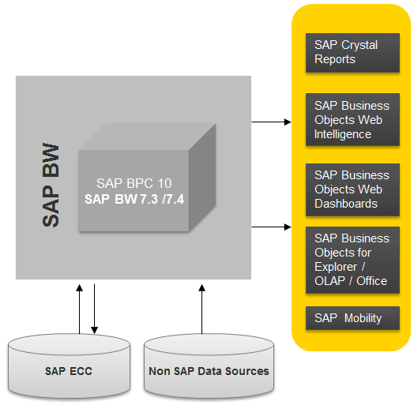




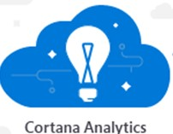
Illustrative Use Case: Large multimedia company
The data lake as part of the integrated data platform architecture
Traditional Data Warehouse Approach | Data Lake Hybrid Approach
Tax Reporting
Enterprise Information Accelerator
Reporting and analytics
Mapping Process
Legal Entity (GTN) to GL Company Code (granular)
Legal Entity (GTN) to Consolidation Tool (high level)
Structured
(Internal and external, e.g., CRM, ERP, billing)
ERP Data Warehouse
ERP Operations and Application Platform
Transactional Data
Global Master Data
ERP Database Platform
Visualization
Vora
Advanced analytics
Legal Entities
GL Company Code, Profit Center
HR Company Code
SA
MDM
Consolidation tool
Hadoop data lake
Enterprise data platform/big data environment
Quarterly Updates
Addition of New Consolidation Tool Entities
Deletion of Existing Consolidation Tool Entities
Near line storage
Tools
Financial, tax and operational reporting
Unstructured & legacy data
(Internal and external, e.g., call notes, sensor, social legacy ERP data)
Cold data
storage
Data
integration
Discovery
platform
Transactional Data and Changes Master Data
Staging
Archive
In-platform
analytics
ERP1
ERP2
ERP3
ERP4
ERP5
ERP6
HR
Legacy data
Sandboxes
Security
and audit
Features | Traditional Data Warehouse | Data Lake Hybrid
Development and hardware/system cost effectiveness
System scalability (global enterprise reach)
Reporting speed (report execution time)
Reporting flexibility due to data from multiple sources
Development time (data model development efforts)
Data read access (extraction of data)
Data loading (time to load data)
Data storage capacity (memory to host data)
Data Lake Benefits
Enables a massively scalable, cost-effective solution
Offers a single location for a business to hold and use data from virtually any source to meet its business needs
Includes features such as batch processing, real-time data queues, automated data flows, data publishing, data searches and indexing, data replication metadata management and archiving
Provides data to business users in near real time and without costly data processing and integration
Effectiveness:
Very High
High
Medium
Low

Slide 17
The Data Lake as Part of the Integrated Data Platform Architecture
The data lake powered by HDInsight is combined with the ERP systems to provide a cost-effective data solution.
The data lake would store historical data and also data from non-ERP source systems.
HDInsight is the platform for data discovery, acquisition, storage and organization, cleansing and integration with legacy systems to enable real value to the end business consumer and create an integrated and optimized environment.
Cortana Analytics Suite provides self-service user interface for reporting and analytics and modelling.
Enterprise Information Accelerator
Reporting and analytics
ERP Data Warehouse
ERP Operations and Application Platform
Structured
(Internal and external, e.g., CRM, ERP, billing)
Visualization
ERP Database Platform
Advanced analytics
Enterprise data platform/big data environment
Hadoop data lake
Financial, tax and operational reporting
Near line storage
Tools
Unstructured & legacy data
(Internal and external, e.g., call notes, sensor, social legacy ERP data)
Cold data
storage
Data
integration
Discovery
platform
Machine learning
Staging
Archive
In-platform
analytics
Legacy data
Sandboxes
Security
and audit
Master data, metadata, security, data governance
Information life cycle management

Slide 18
The Data Lake – a Scalable Solution for Managing Your Data World
A single location for all your business data
A data lake can hold data from almost any source and in any format for client use. Data can be put to use immediately with minimal preprocessing.
Open source components backed by enterprise vendor support
Open source software reduces acquisition costs. Commercial vendor support provides enterprise-level capabilities for critical business analytics requirements.
Data can be accessed in many ways
Data in a data lake can be accessed directly by users or cleansed, conformed and prepared for use by other components, such as analytics accelerators or real-time reporting packages.
Hadoop data lake
Massively scalable using commodity hardware
The data lake leverages low cost commodity hardware and rapidly scalable architectures that reduces operational cost by factors of
10 to 100.
Tools
Cold data
storage
Data
integration
Discovery
platform
Staging
Archive
In-platform
analytics
Master data repository
Data quality
Security
and audit
A flexible platform for any business case
A data lake hold can merge multiple legacy data sources with current operational data to give business users immediate access to data from newly acquired companies without costly integration.
Variety of implementation possibilities
Data lakes can be built in house, on data appliances, in the cloud or any combination. Embedded security, high availability and support tools meet the business’s toughest requirements.

Slide 19
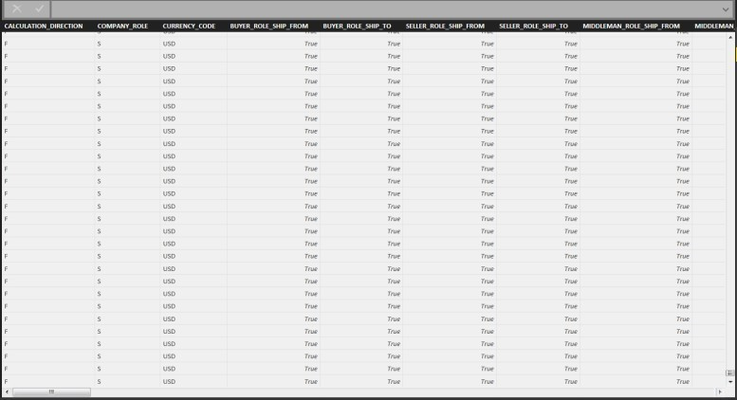
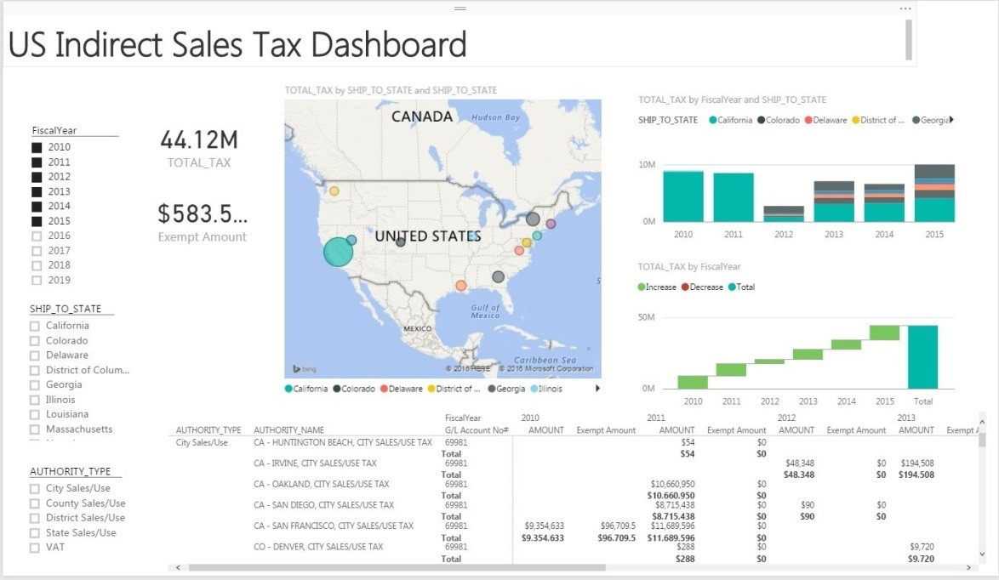
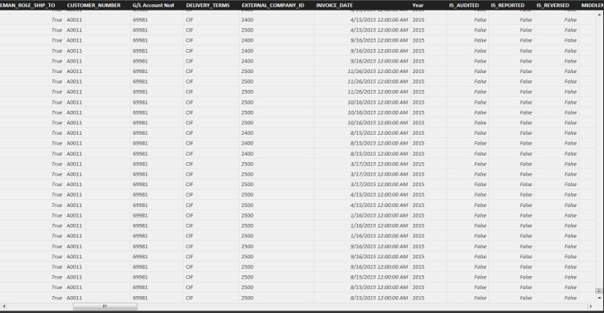
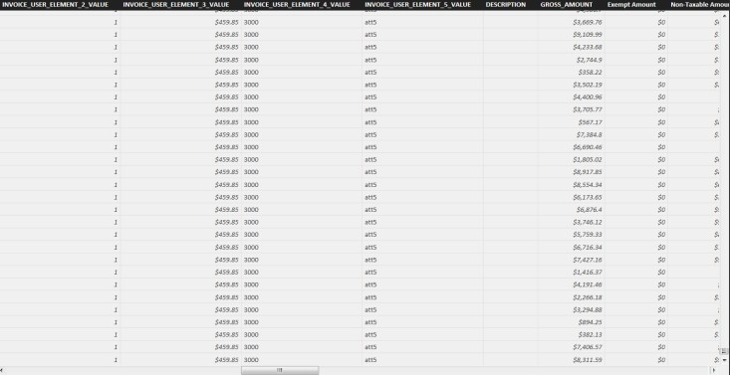
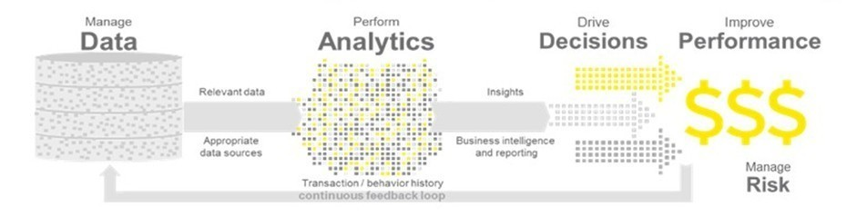
Demo: Microsoft Power BI - Indirect Tax Dashboard
From Transactions Data
To Information Dashboards

Slide 20
Client 2: Large Telecomm
Cut Spending
Azure Data Warehouse as part of Cortana Analytics Suite
Improve Processes
Replace Aging Leasing, Fixed Asset and Leasing Accounting Systems
Reduce Taxes
Tax Transaction Details into Information Dashboards

Slide 21


Illustrative Use Case: Large communications company
US
Lease and tax fixed asset management in the cloud
Telecommunications
Serve all the data needs for the various teams in the tax department and related finance and accounting departments
Increase tax savings by improving management of internal leasing, tax fixed assets and lease accounting
Replace aging leasing and tax systems with a cloud-based solution
Streamline IT processes by removing burden of maintaining specialized software for tax processes
Client anticipates millions of dollars in tax savings by replacing legacy procedures and standardizing tracking
Replacement/elimination of a series of existing legacy technologies and inefficient processes
Access to more relevant, more timely information for informed decision-making
Value to client:
Significant value enabled
Azure Data Factory
Azure Batch
SQL DW
HDInsight
Data Lake Store
Web apps
Application insights
Technology | Experience with extremely high data volumes and high responsiveness using Cortana Intelligence Suite and other Azure technologies, in particular Azure Data Warehouse as a part of the CAS Ability to leverage client Azure subscriptions or EY subscriptions for dev/test and production deployments
Team | Large team of technologists certified in Azure technologies while also providing business and sector-relevant specialty skills Agile team strategy with many iterative releases
Alliance | Unique EY-Microsoft digital alliance relationship
Synergy savings
Dept. savings
Use tax
Property tax

Slide 22


Processing large-scale datasets using Data Factory and Batch
Azure Data Factory - orchestrates and automates the movement and transformation of data.
Azure Data lake - used for data archival and audit purposes.
Azure Batch - enables large-scale parallel and high-performance computing (HPC) applications efficiently in the cloud
SQL Data Warehouse - provides blazing fast cloud data warehouse
Power BI - Self Service BI and Analytics
Azure Data Factory
Business Intelligence
Azure Storage
Finance Reporting
Staging
Analytics
Structured
Business Rules Engine
Azure Data Lake
Azure Batch 200X
SQL Data Warehouse
Cloud Based Data Orchestration
Lease/Fixed Assets Lifecycle Management

Slide 23
Demo

Slide 24
Video
http://youtu.be/bP80APYTSyI

Slide 25
Free IT Pro resources
To advance your career in cloud technology
Plan your
career path
Cloud role mapping
Expert advice on skills needed
Self-paced curriculum by cloud role
$300 Azure credits and extended trials
Pluralsight 3 month subscription (10 courses)
Phone support incident
Weekly short videos and insights from Microsoft’s leaders and engineers
Connect with community of peers and Microsoft experts
Microsoft IT Pro Career Center
www.microsoft.com/itprocareercenter
Get started
with Azure
Microsoft IT Pro Cloud Essentials
www.microsoft.com/itprocloudessentials
Demos and
how-to videos
Microsoft Mechanics
www.microsoft.com/mechanics
Connect with peers and experts
Microsoft Tech Community
https://techcommunity.microsoft.com

Slide 26


Please evaluate this session
Your feedback is important to us!
From your PC or tablet, visit MyIgnite at http://myignite.microsoft.com
From your phone, download and use the Ignite mobile app by scanning the QR code above or visiting https://aka.ms/ignite.mobileapp

Slide 27
EY | Assurance | Tax | Transactions | Advisory
About EY
EY is a global leader in assurance, tax, transaction and advisory services. The insights and quality services we deliver help build trust and confidence in the capital markets and in economies the world over. We develop outstanding leaders who team to deliver on our promises to all of our stakeholders. In so doing, we play a critical role in building a better working world for our people, for our clients and for our communities.
EY refers to the global organization, and may refer to one
or more, of the member firms of Ernst & Young Global Limited, each of which is a separate legal entity. Ernst & Young
Global Limited, a UK company limited by guarantee, does not provide services to clients. For more information about our organization, please visit ey.com.
Ernst & Young LLP is a client-serving member firm of
Ernst & Young Global Limited operating in the US.
© 2016 Ernst & Young LLP.
All Rights Reserved.
1609-2053938
ED None
This material has been prepared for general informational purposes
only and is not intended to be relied upon as accounting, tax or other
professional advice. Please refer to your advisors for specific advice.
ey.com

