Slide 1



Best practices for disaster recovery using Azure
BRK3284
Adam Glick
Sr. Program Manager – Azure Resiliency
AGlick@Microsoft.com
@MobileGlick
https://linkedin.com/in/MrAdamGlick
adamglick

Slide 2
Session objectives and takeaways
Session objective(s):
  Ability to discuss disaster recovery options available via the Azure platform
  Ability to apply best practices to achieve solution RPO and RTO targets
  Ability to recommend an effective and efficient DR strategy spanning the cloud and on-premises
Best practices:
Pick appropriate RPO and RTO
Plan for DR bandwidth
Code for deployment
Prepare your DR environment
Use the right tool for the job
Test and verify

Slide 3
Why is disaster recovery important?

Slide 4
“Failure is ALWAYS an option.”
Adam Savage, MythBusters

Slide 5

The eye of the beholder

Slide 6


Infallible truths (of cloud computing)
Software has bugs
Questionable code example:
Hardware will fail
function speed (distance, time){
return distance / time;
}
The Metric system and the English System are different.
Humans will make mistakes

Slide 7
Resiliency basics

Slide 8
Resiliency
Cost / Complexity
RPO / RTO
Backup
Disaster Recovery
High Availability
RTO >> 0
RTO > 0
RTO = 0
Considerations:
Application data
Application data
Configuration data
Runbooks
Capacity
Application data
Capacity
Design work
Best For:
Data deletion
Data corruption
Legal, Governance & Compliance
Protection for unplanned failures
Don’t want to re-architect for HA
Don’t want the cost of HA
Large scale failures
Mission critical apps
New apps
Localized failures

Slide 9
High availability and disaster recovery
Disaster recovery begins where high availability ends
Virtual machine (app)
Server (app)
Availability set (HA)
Cluster (HA)
Paired region (DR)
2nd site (DR)

Slide 10
Pick appropriate RPO and RTO

Slide 11
RTO and RPO
Recovery Time Objective (RTO)
  “The recovery time objective (RTO) is the targeted duration of time and a service level within which a business process must be restored after a disaster (or disruption) in order to avoid unacceptable consequences associated with a break in business continuity.”, https://en.wikipedia.org/wiki/Recovery_time_objective
Recovery Point Objective (RPO)
  “A recovery point objective, or “RPO”, is defined by business continuity planning. It is the maximum targeted period in which data might be lost from an IT service due to a major incident. The RPO gives systems designers a limit to work to.”, https://en.wikipedia.org/wiki/Recovery_point_objective
RPO
RTO
PTO*
Disaster
Lost Data
Down Time
*PTO: Take some time off. You’ve earned it. ☺

Slide 12
Picking RPO and RTO
RPO and RTO are a business decision
Get your current RPO and RTO
Test options and estimate costs
Get business owner agreement on RPO and RTO
Implement & measure

Slide 13
How does Azure help with DR?

Slide 14
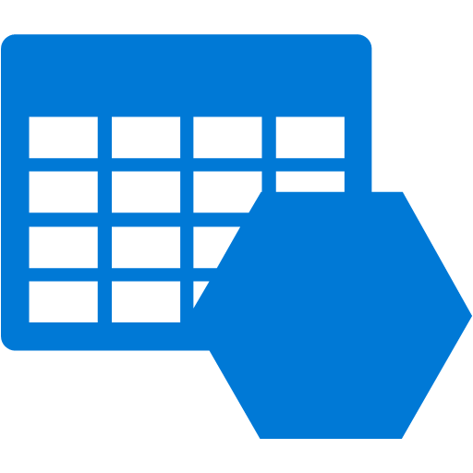
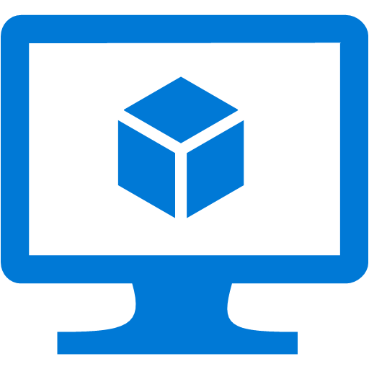
Disaster recovery in “the cloud”
No-loss data
On-demand infrastructure
Geographically dispersed
Pay only for what you use
$
$
$
$

Slide 15
DR in Azure - challenges
Bandwidth / network constraints
  De-duplication, compression, time-of-day, impact to normal business operations, etc.
Security
  Encryption, vendor/provider trust, identity management, key management, etc.
Compliance / regulatory
  Government, legal, or industry approval
Capacity
  Placement guarantees, quotas, regional resource availability
Vendor support
  SLA, network connectivity points, production support, and control

Slide 16
Azure Storage
From a disaster recovery perspective

Slide 17
Trivia time
When should you use GRS storage?
Always
When you want to have storage resiliency across fault domains
When you want to be able to failover to a secondary site
When you want to enable a multi-region deployment
Never

Slide 18
Azure Storage
GRS challenges for DR
  Not suitable for application consistent workloads
  No disk / VM consistency. Replication is async at the blob level (partition)
  No tenant / user control
  No SLA
  No ability to test
  No ability to view the data
  No orchestration
Guidance
  Custom sync code may be necessary. Access to the code? Strategic to the business?
  Preparing for something that will never (hopefully) happen.
GRS
You want DR on your terms!

Slide 19
Azure Storage
RA-GRS challenges for DR
  No SLA on replication. Target of 15 minutes.
  You need to monitor replication latency. How does this impact your RPO?
  Read Only – How do you use it? RTO impact?
LRS
  Only use as part of a self-managed storage replication plan in multiple regions

Slide 20
Plan your bandwidth

Slide 21
Bandwidth matters
Initial upload
  Largest bandwidth used
  Not time-sensitive
  Can be a phased approach
Ongoing usage
  Largest continuing cost
  Most critical to your operations

Slide 22

Example: bandwidth calculation
1 Hyper-V machine to Azure
1Mbps = 1 VM, 300 GB drive, 70% of drive used, 5% daily change rate, no compression
100 VMs = 100% saturated Azure S2S VPN Gateway

Slide 23
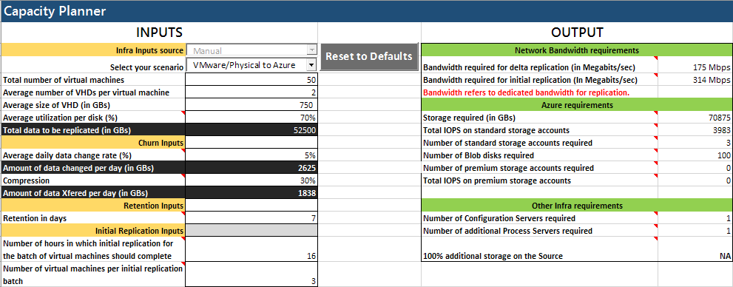
ASR Capacity Planner
  https://azure.microsoft.com/en-us/documentation/articles/site-recovery-capacity-planner/
  Quick or Detailed mode
  Single or Multiple Machines
  Are you REALLY prepared?

Slide 24
Code for deployment

Slide 25
3 tiers
Infrastructure - ARM templates
Applications - configuration scripts
Data – load (ETL)

Slide 26

Use ARM templates
Template everything
Break up your templates by role
Link templates to create your application

Slide 27
Build scripts
Configure your machines
Extensions
  Custom Script
  Custom Script for Linux
  Desired State Configuration (DSC)
Chef / Puppet / Ansible / Salt
Don’t forget your local launch script

Slide 28
Version your deployments
Think of production as a product
Any change goes into a new version
Keep you versions separate in source control
Tie the application version to the deployment version

Slide 29
Keep scripts up to date
Every change is made in the script
If it’s not in source control, it doesn’t exist
If you don’t have time to change the script now, you won’t have time when disaster strikes

Slide 30
Prove it by forcing no-logins to prod. and staging
This forces automation
This encourages robust DevOps code
This takes discipline
Make this part of your CI/CD pipeline

Slide 31
Prepare your DR environment

Slide 32
Preparing your environment ~ hybrid architecture
Ensure your authentication tools are syncing
Know your settings
Configure your network
Create your connections
Prepare your DNS/routing

Slide 33
Use the right tool for the job

Slide 34
3rd party tools
Pick the tool that is right for the customer
Focus on the infrastructure
Look at StorSimple, ExpressRoute, Cool Storage, & VMs

Slide 35


1st party tools
Azure Backup
Azure Site Recovery

Slide 36
Demo:
Azure Backup

Slide 37



Robust DR Strategy
Backup
  Backup protects from a historical perspective
  Understand the backup periods
  Need the ability to restore
  Available capacity
Azure Backup
Seagate Backup Services
StorSimple
Managed Backup Portal, Direct Restore, Cloud Connect
* A few of the options in the Azure Marketplace

Slide 38







Azure Site Recovery: The disaster recovery / migration solution
Site to Azure
Site to site
Any cloud
AWS
Physical/VMware to VMware
VMware
Hyper-V
Physical
VMM to VMM
Windows
Linux

Slide 39
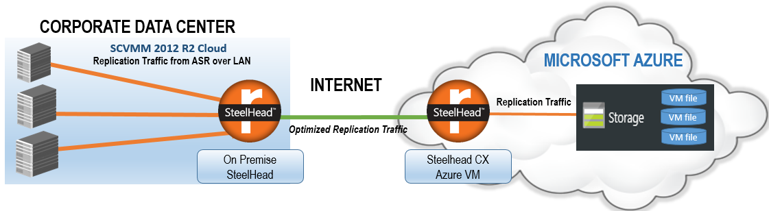
ASR guidance – bandwidth
Network saturation / throttling
  3rd party service – Riverbed (recent appliances are Resource Manager only)
    https://azure.microsoft.com/en-us/blog/azure-site-recovery-wan-optimization-with-riverbed/
  PowerShell cmdlet to limit bandwidth and time of day
    https://azure.microsoft.com/en-us/documentation/articles/site-recovery-faq/

Slide 40
ASR customer story
Scenario
  Disaster recovery solution for ~100 servers
  Azure Site Recovery
  RPO and RTO is 24 hours

Slide 41
ASR customer story
Scenario
  Disaster recovery solution for ~100 servers
  Azure Site Recovery
  RPO and RTO is 24 hours
Reality
  Initial seeding saturated outbound bandwidth
  Throttling during business hours
  Leverage Riverbed SteelHead appliance for compression
  Migrate to Resource Manager
  Microsoft CSA, Global Blackbelt, MCS, and Riverbed teams involved

Slide 42
ASR guidance
Process Server
  Each handles ~200 VMs and ~1.5-2 TB per day
  Use more based on number of VMs, data size, and change rate
Recovery Plan
  Limit of 50 VMs
  May need multiple recovery plans
Bandwidth
  Estimate capacity required for initial replication
  Estimate capacity required for steady state / delta replications/day
  Consider ExpressRoute – can aide with bandwidth and failback

Slide 43
ASR – what to watch for
Test failover
Azure to Azure
Availability Sets
Storage
Supported OS

Slide 44
Test and verify

Slide 45
Hope
without a plan
is a fantasy

Slide 46

What’s your RTO?
Tried to do the right thing
Root cause was poor data handling procedures
Multiple failures in restore operations
49 hrs. of downtime
http://support.gliffy.com/hc/en-us/articles/217896028-RESOLVED-Gliffy-Online-System-Outage

Slide 47
In review: session objectives and takeaways
Session objective(s):
  Ability to discuss disaster recovery options available via the Azure platform
  Ability to apply best practices to achieve solution RPO and RTO targets
  Ability to recommend an effective and efficient DR strategy spanning the cloud and on-premises
Best practices Recap:
Pick appropriate RPO and RTO
Plan your bandwidth
Code for deployment
Prepare your DR environment
Use the right tool for the job
Test and verify

Slide 48
Resources
Azure Site Recovery
  Best practices – https://azure.microsoft.com/en-us/documentation/articles/site-recovery-best-practices/
  Capacity planner – https://azure.microsoft.com/en-us/documentation/articles/site-recovery-capacity-planner/
  FAQ – https://azure.microsoft.com/en-us/documentation/articles/site-recovery-faq/
Disaster recovery guidance
  http://aka.ms/drtechguide

Slide 49
Related content
Backup born-in-the-cloud and hybrid applications with Operations Management Suite and Azure Backup 9/27 – 10:45AM-12:00PM
Design for scalability and high availability on Microsoft Azure 9/28 – 12:30PM-1:45PM
Run highly available solutions on Microsoft Azure 9/29 – 12:30PM-1:45PM
Reinvent disaster recovery leveraging Microsoft Azure cloud infrastructure 9/28 – 2:15PM-3:30PM
Migrate and disaster recovery Azure workloads using Operations Management Suite 9/29 – 9:00AM-10:15AM

Slide 50
Free IT Pro resources
To advance your career in cloud technology
Plan your
career path
Cloud role mapping
Expert advice on skills needed
Self-paced curriculum by cloud role
$300 Azure credits and extended trials
Pluralsight 3 month subscription (10 courses)
Phone support incident
Weekly short videos and insights from Microsoft’s leaders and engineers
Connect with community of peers and Microsoft experts
Microsoft IT Pro Career Center
www.microsoft.com/itprocareercenter
Get started
with Azure
Microsoft IT Pro Cloud Essentials
www.microsoft.com/itprocloudessentials
Demos and
how-to videos
Microsoft Mechanics
www.microsoft.com/mechanics
Connect with peers and experts
Microsoft Tech Community
https://techcommunity.microsoft.com

Slide 51


Please evaluate this session
Your feedback is important to us!
From your PC or Tablet visit MyIgnite at http://myignite.microsoft.com
From your phone download and use the Ignite Mobile App by scanning the QR code above or visiting https://aka.ms/ignite.mobileapp

Slide 52
Thank you!

Slide 53
Q&A
If you have questions please proceed to the
Q&A MICROPHONE located in your session room.

Slide 55
ASR Guidance
Network
  Understand on-premises network configuration (proxies, firewalls, etc.)
  Accessible from management server:
    *.hypervrecoverymanager.windowsazure.com
    *.accesscontrol.windows.net
    *.backup.windowsazure.com
    *.blob.core.windows.net
    *.store.core.windows.net
    https://www.msftncsi.com/ncsi.txt
    https://dev.mysql.com/get/archives/mysql-5.5/mysql-5.5.37-win32.msi
    Azure Datacenter IP Ranges for desired region (including West US, for authentication purposes)
Subscription
  Validate Azure subscription capacity / quota by doing a test failover

