Slide 1
Autoscale your applications with VM Scale Sets
BRK3283
Neil Gat, Guy Bowerman
Azure PM team

Slide 2
IN THIS Session
Why Scale sets?
Getting started
Monitoring & upgrading
Scale & Autoscale
preview

Slide 3
Why Scale Sets?

Slide 4
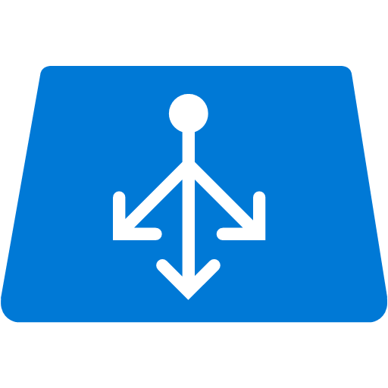
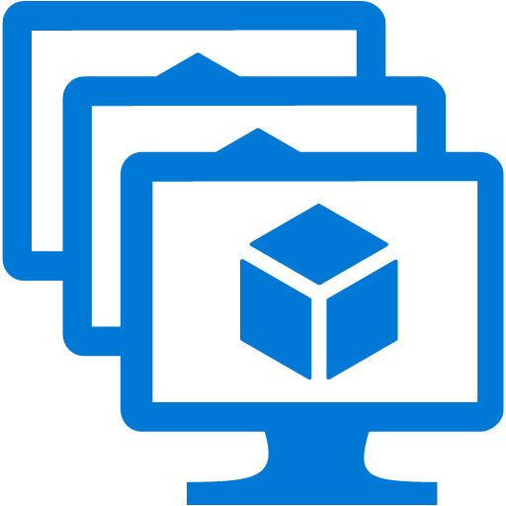
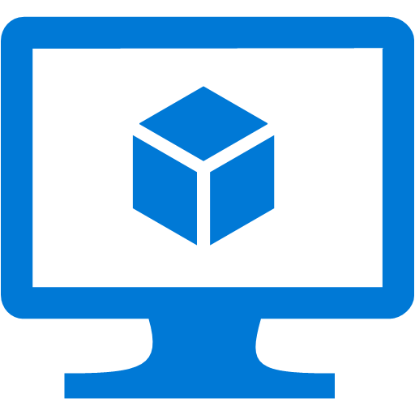
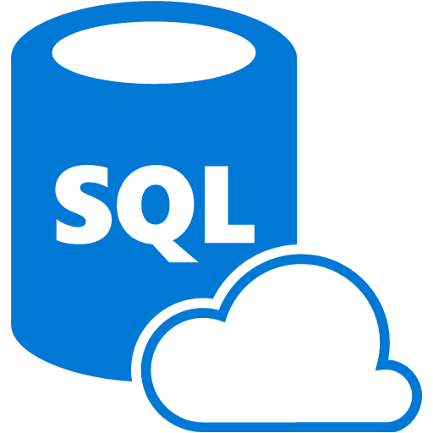

Compute requirements of a modern cloud app
Transparent, automatic, rapid scale
Simple manageability
High availability
Security - Patching / upgrades
Load Balancing
Compute nodes
Control nodes
Availability Set
Availability Set
Virtual Network

Slide 5
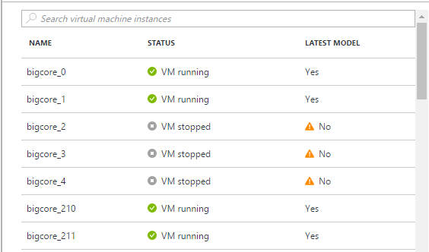
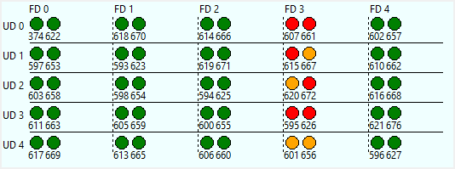
VM Scale Sets provide
Scale - Deploy identical resources
  Easily
  Rapidly
  At scale.. 10s – 10,000s of cores
Customization – PaaS-like ease of use with custom infrastructure requirements
Availability - Roll out updates without service interruption
Low cost - Dynamically increase/decrease compute power to optimize costs
Elasticity - Automatically scale to changing demand
https://azure.microsoft.com/en-us/documentation/services/virtual-machines-scale-sets/

Slide 6
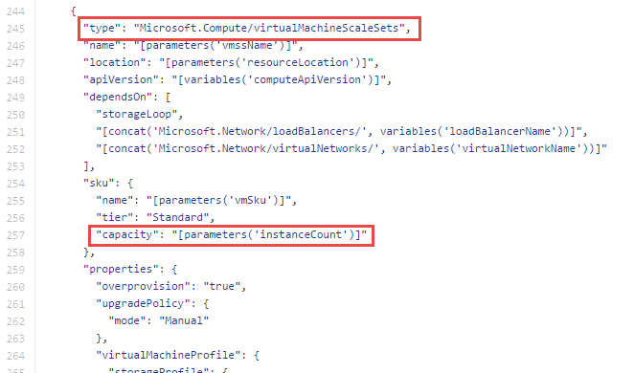
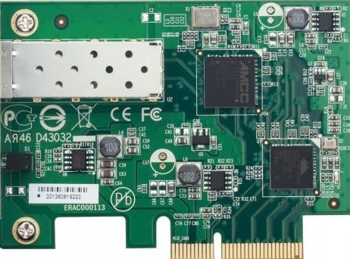


VM Scale Sets in Azure Resource Manager
Resource Group
VNet
Scale Set
Subnet
VM
VM
VM
VM
…
Scalable NIC
Scalable Storage
Extensions
https://github.com/Azure/azure-quickstart-templates - *vmss*

Slide 7
Getting Started

Slide 8
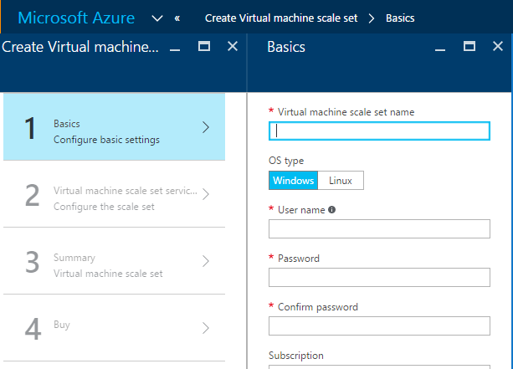

Deploying a scale set
Directly in the portal
From the command line
Use a template
  Launch from github, command, SDK etc.
SDK/REST
Consider in context of application...

Slide 9
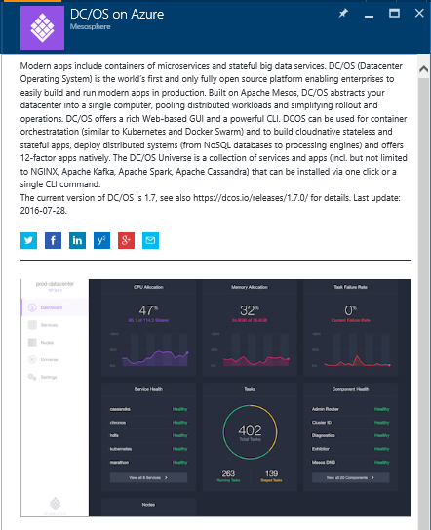





App deployment: Marketplace
Deploy off the shelf Marketplace solution
Predesigned infrastructure
E.g. Mesosphere DC/OS, Brocade, ACS, Service Fabric, Batch (Linux)

Slide 10
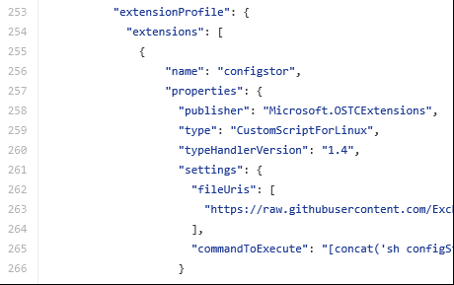
App deployment: VM Extensions
Run custom scripts or off the shelf extensions
Define with initial scale set deployment or add to existing infrastructure
Roll out extension updates like OS updates

Slide 11
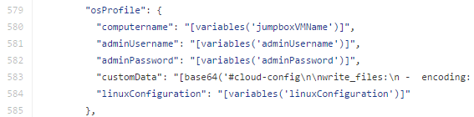
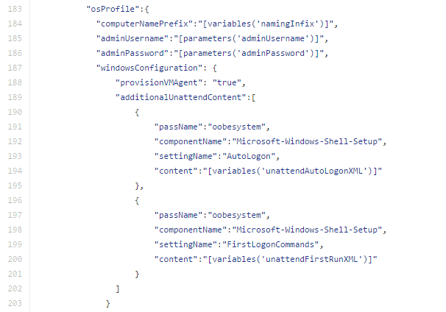
App deployment: customData/unattend
Deployment script encapsulated directly in VMSS properties
No dependency on external network connectivity

Slide 12
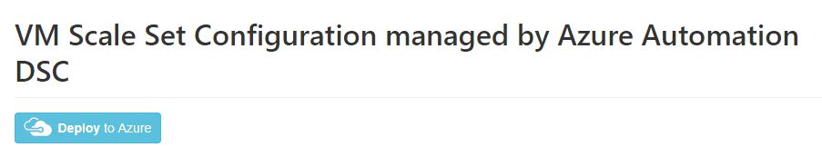
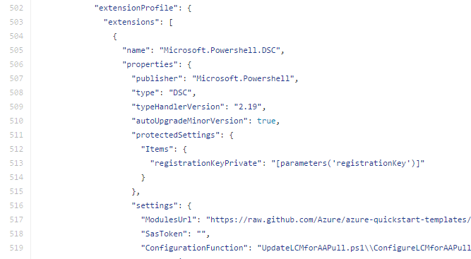
App deployment: Configuration Management
VMs register as nodes with configuration management host
Host maintains app consistency on nodes
Config manager handles complex app deployment requirements (e.g. reboots, dependencies)

Slide 13
App deployment: Containerized
Scale set is stable, scalable infrastructure
App containers managed independently of infrastructure
Application Orchestration
Containers
OS (Windows/Linux)
Infrastructure - VMSS

Slide 14






App deployment: custom image
Trigger Build
Dev checks in code
Build app
Test
Stage
Production
Bake app into image
Packer
Reuse the same image across stages
http://www.slideshare.net/LarryGuger/spinnaker-for-azure

Slide 15

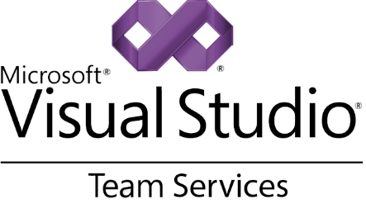
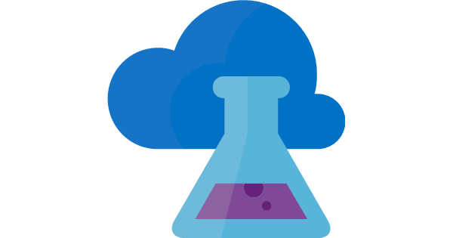
App deployment: custom image
Dev checks in code
BUILD
RELEASE
Test
Stage
Production
PACKAGE
Bake app into image
Azure DevTest Labs
Used as “Golden Image” Bakery
Reuse the same
“Golden Image” across stages
https://azure.microsoft.com/en-us/services/devtest-lab/

Slide 16
VMSS app deployment models
When to use which?
Model | When to use
Marketplace | Off the shelf solutions.
VM Extensions | Full control over app lifecycle management.
Custom data/unattend | Install custom app independently of external network.
Configuration manager | Centrally managed app installation, credentials & maintenance.
Containerized | Abstract app management from infrastructure. Cloud/DC agnostic.
Custom image | Small self-contained apps. Fast deploy. Immutable build, test, deploy pipelines.

Slide 17
VMSS app deployment example
On demand high perf MRI image reconstruction
Real time imaging is compute intensive
VMSS based bursting solution
Capacity increased as new scans requested
Add 8 nodes in ~3 mins
Automatic shutdown timer
capacity: 8->32 VMs
Size: F16
(Compute optimized)
VMSS
D3_V2 VM
Relay node
MRI
Load Balancing
Custom VM images
Custom script extension
Docker container
MRI host
Virtual Network
https://github.com/hansenms/azure_templates

Slide 18
Monitoring

Slide 19
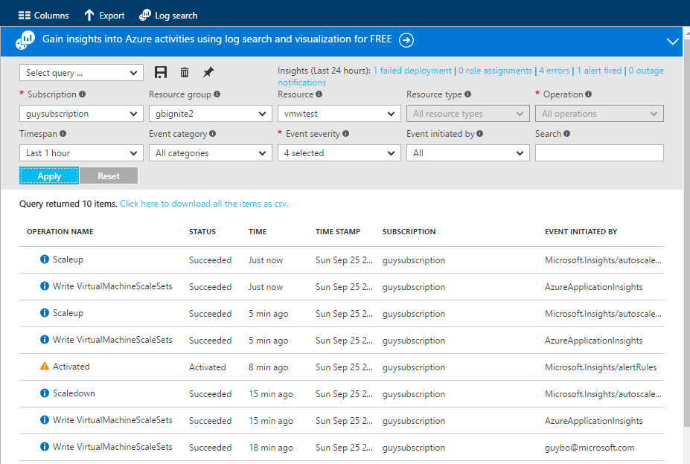
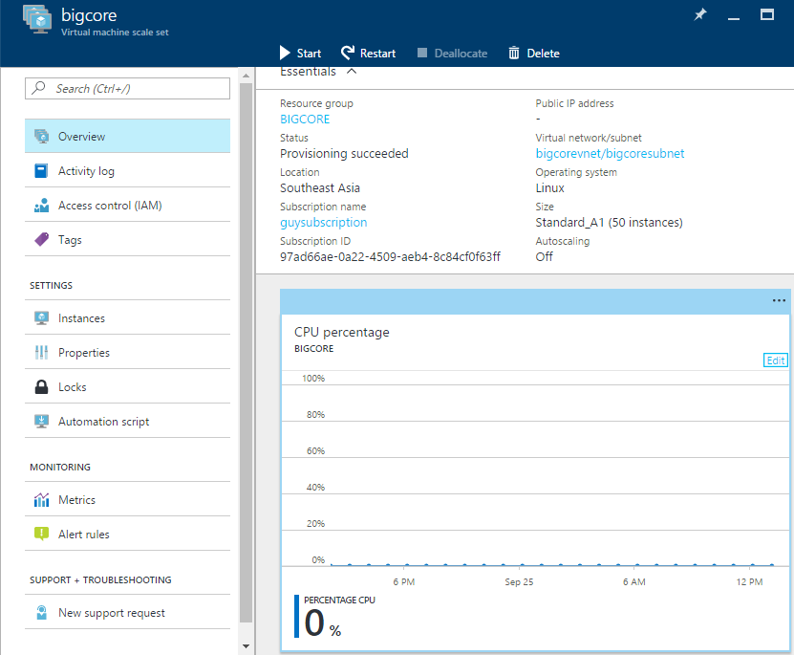
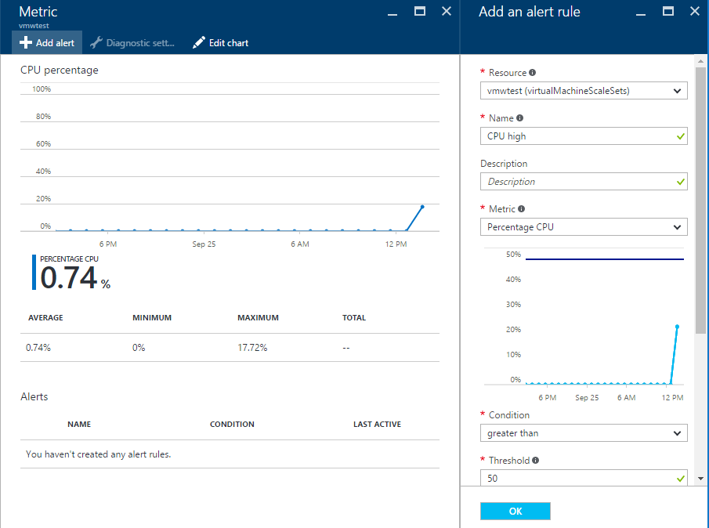
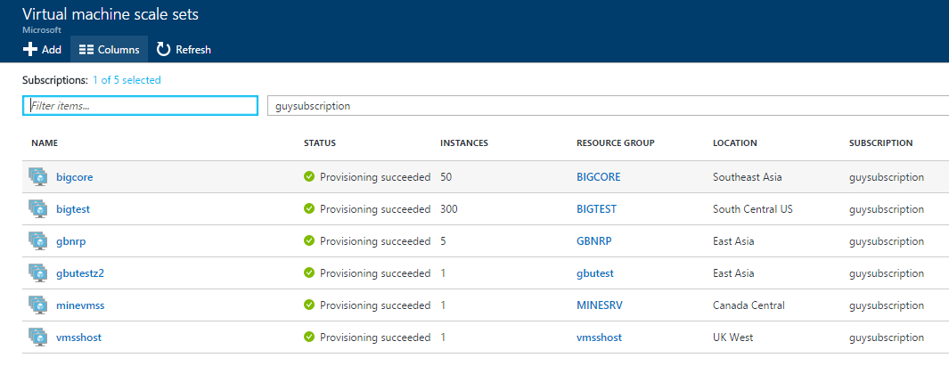
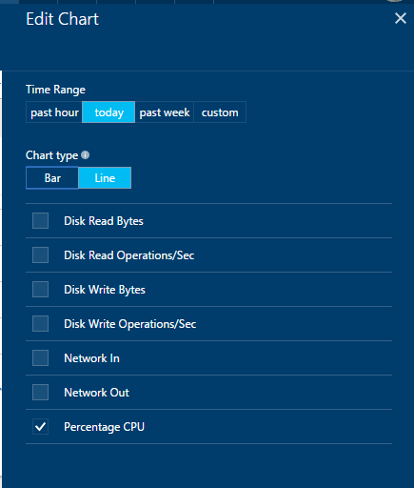
Monitoring - portal

Slide 20
Upgrades and patches

Slide 21
How do you update a scale set?
Application updates
  E.g. Configuration manager /container orchestrator
In-guest updates
  E.g. Patch extension
SKU
Version
Image URI
VM size
Extensions
VM image updates
Update image reference in model
capacity
...
Upgrade VMs

Slide 22
Scale

Slide 23
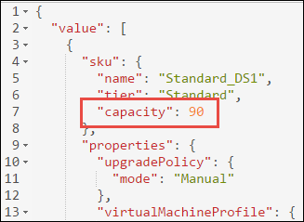
Scaling VM Scale Sets
Horizontal vs. vertical scale
Change the “capacity” property of the scale set
Redeploy
New VMs are spread across UDs, FDs, storage accounts
VM ID increases
VMs deleted by highest ID first

Slide 24
Scaling with PowerShell/CLI
PowerShell
$vmss = Get-AzureRmVmss -ResourceGroupName myvmss -VMScaleSetName myvmss
$vmss.Sku.Capacity = 10
Update-AzureRmVmss -ResourceGroupName myvmss -Name myvmss -VirtualMachineScaleSet $vmss
CLI
user@myvm: azure vmss scale –g rgname –n vmssname –C 10
Note: Use any tool which edits VMSS model (e.g. Resource Explorer)
Portal integration coming soon..

Slide 25
Autoscale

Slide 26
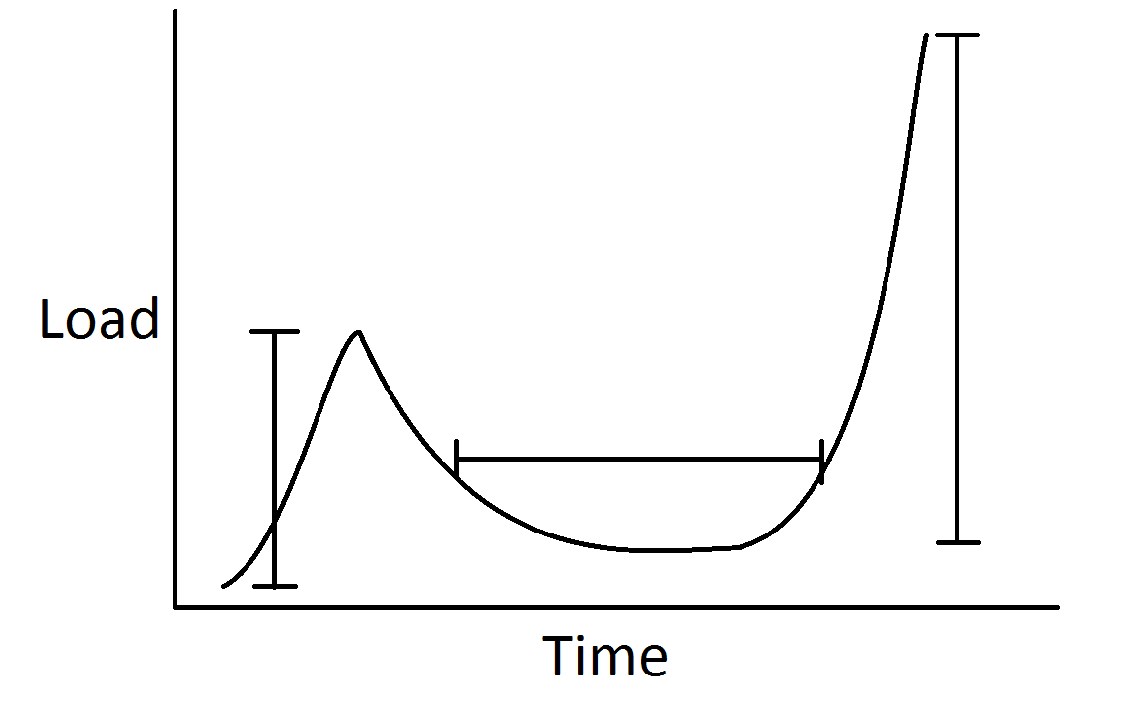
Autoscale: Why do I care?
3) Notifications
1) App Resiliency
2) Reduced Cost

Slide 27
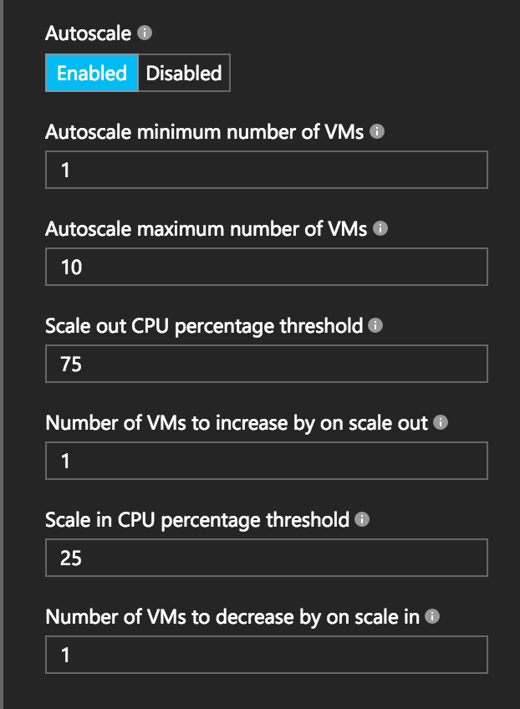
Autoscale: How do I get it?
Portal: get started in a few clicks
Resource Manager Template: have full control
CLI, PowerShell, Resource Explorer, SDKs, etc.
In-VM Agent
  Windows Azure Diagnostics agent
  Linux Azure Diagnostics agent

Slide 28
Autoscale
Scale Set
VM
VM
VM
WAD
WAD
WAD
capacity = n
WAD metrics
Scale action
6
3
Resource validations/checks
Insights Storage
Portal
Insights REST API calls
ARM/CSM
Monitoring Service
(Insights)
Create/update AutoScale setting
1
2
4
Schedule AutoScale job (runs every 5 minutes)
Insights SDK, PowerShell
AutoScale service
(background job)
5
Job collects metrics for AutoScale rules
Log AutoScale trigger events
Scale action (ask the Resource Provider to scale, via ARM)
https://github.com/Azure/azure-quickstart-templates

Slide 29
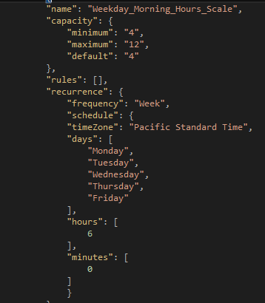
Autoscale: What about complex scenarios?
Simultaneously:
  Scale on a specific day
  Scale on a recurring schedule
  Scale on multiple resource metrics
Defined in Microsoft.Insights Autoscale rules resource

Slide 30
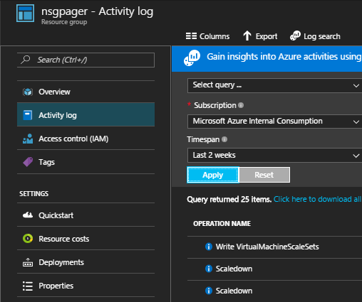
Autoscale: Can I debug it?
See scale events in the Activity Logs
See the underlying data through the REST API
  Or Azure Storage Explorer (in-VM metrics only)

Slide 31
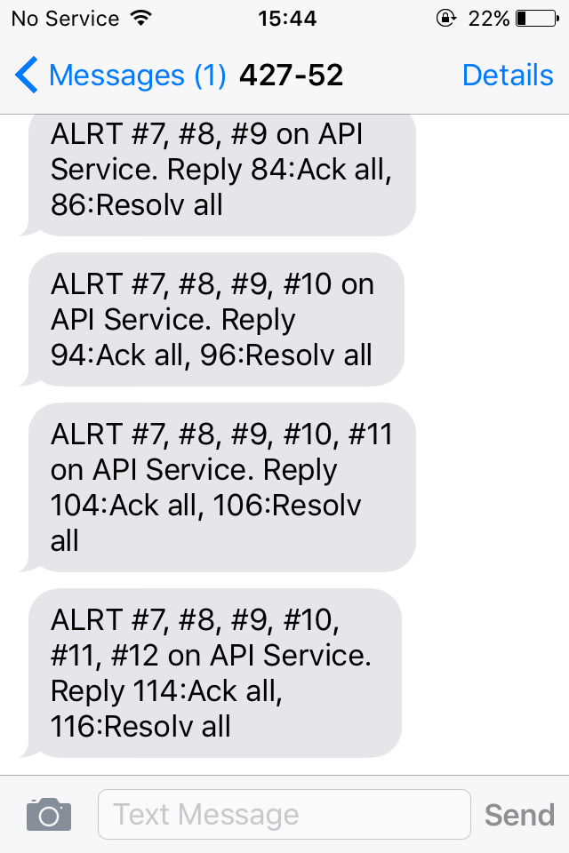
Autoscale: Can Azure notify me?
Auto-email your ops team!
Integrate with external APIs via Event Hooks
  Comes with basic payload
  Add your own payload

Slide 32
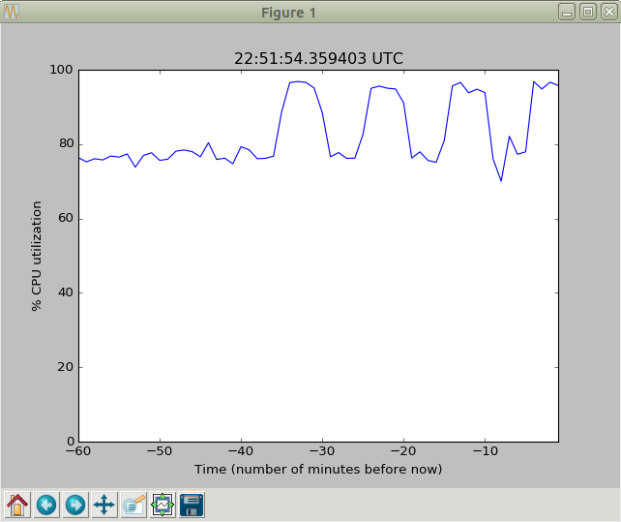
Autoscale: Can I build my own autoscale layer?
Yes, using the REST API for Autoscale and Scale Sets

Slide 33
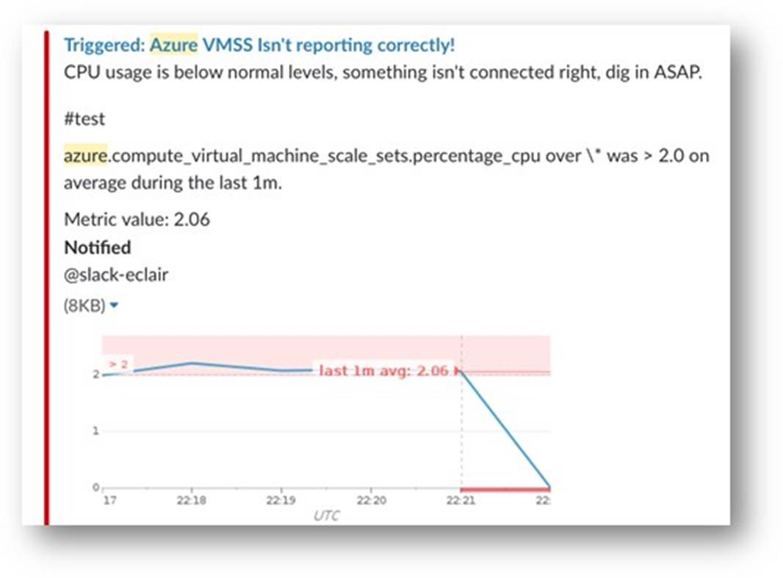
Autoscale: Is there tooling?
1st party integration
  Activity Logs
  Scale from the Azure Portal
  Modify autoscale configuration using Azure Resource Explorer
3rd party integration
  DataDog to show metrics and alerts for Azure VMs and scale sets
  Pager Duty to send alerts

Slide 34
Preview

Slide 35
Autoscale: What’s new?
Out of the box autoscale without diagnostics setup
  No configuring agents or reading data from a storage account
Fast & reliable metrics, monitoring, and autoscale
  1 min metrics
  Autoscale every 5 min, soon to be 1 min
  Data retention for 30 days
No In-VM Agent
  Improved reliability
  Simpler
  Many customers do not want MS agent inside their VMs

Slide 36
Autoscale
Scale Set
VM
VM
VM
WAD
WAD
WAD
capacity = n
WAD metrics
Scale action
6
3
Resource validations/checks
Insights Storage
Portal
Insights REST API calls
ARM/CSM
Monitoring Service
(Insights)
Create/update AutoScale setting
1
2
4
Schedule AutoScale job (runs every 5 minutes)
Insights SDK, PowerShell
AutoScale service
(background job)
5
Job collects metrics for AutoScale rules
Log AutoScale trigger events
Scale action (ask the Resource Provider to scale, via ARM)
https://github.com/Azure/azure-quickstart-templates

Slide 37
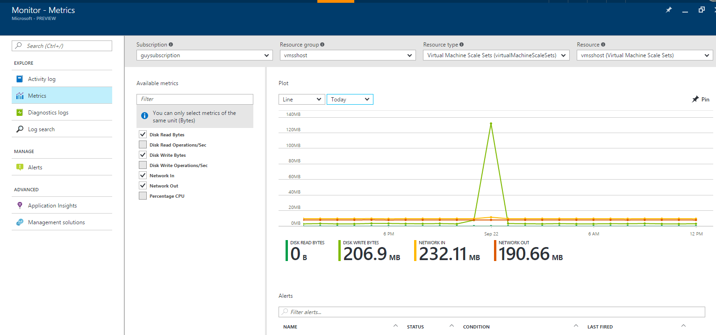
Autoscale: What’s new?
Out of the box autoscale without diagnostics setup
  No configuring agents or reading data from a storage account
Fast & reliable metrics, monitoring, and autoscale
  1 min metrics
  autoscale every 5 min, soon to be 1 min
  Data retention for 30 days
No In-VM Agent
  Improved reliability
  Simpler
  Many customers do not want MS
  agents inside their VMs

Slide 38
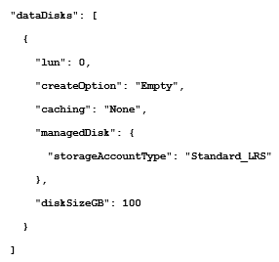
Preview – attached data drives
Custom images supported at scale
No more pre-creating storage accounts
Specify attached data drives in storageProfile
Good for:
  Big data, HADOOP
  Stateful workloads
  Lift and shift

Slide 39
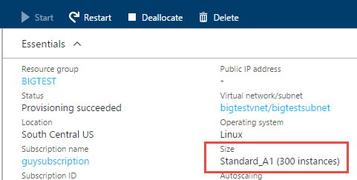
Roadmap
Ongoing portal integration
Larger scale sets
Integrated rolling upgrades
Networking enhancements
PaaS and application runtime features

Slide 40
Next steps
Reference | Link
Creating Virtual Machine Scale Sets using PowerShell cmdlets | https://azure.microsoft.com/en-us/documentation/articles/virtual-machines-windows-vmss-powershell-creating/
Quickly create a scale set using the Azure CLI | https://azure.microsoft.com/en-us/documentation/articles/virtual-machine-scale-sets-cli-quick-create/
Azure Autoscale Best Practices | https://azure.microsoft.com/en-us/documentation/articles/insights-autoscale-best-practices/
Azure Autoscale Emails and Webhooks | https://azure.microsoft.com/en-us/documentation/articles/insights-autoscale-to-webhook-email/
Integrate Pager Duty with Azure Resources | https://www.pagerduty.com/docs/guides/azure-integration-guide/
For VMSS Editor see https://github.com/gbowerman/vmssdashboard

Slide 41
Related content
Code | Title | Speaker/s | Day | Time
THR2134 | See the latest on high performance computing in Microsoft Azure | Corey Sanders, Rick Claus | Mon | 12:30pm
THR2167 | Introduce yourself to the new Azure Container Service | Corey Sanders, Rick Claus | Tue | 12:05pm
BRK2194 | Hear about the state and future direction of the Azure Compute services | Corey Sanders, Bryon Surace | Tue | 2:15pm
BRK2234 | Explore Microsoft Azure Monitoring & Diagnostics | Ashwin Kamath, Rajesh Ramabathiran | Tue | 4pm
BRK4008 | Dive deep into Azure Container Service | Ross Gardler | Tue | 4:30pm
THR2150 | Automate your hybrid infrastructure with Azure Resource Manager templates | Corey Sanders, Rick Claus | Wed | 12:05pm

Slide 42
Free IT Pro resources
To advance your career in cloud technology
Plan your
career path
Cloud role mapping
Expert advice on skills needed
Self-paced curriculum by cloud role
$300 Azure credits and extended trials
Pluralsight 3 month subscription (10 courses)
Phone support incident
Weekly short videos and insights from Microsoft’s leaders and engineers
Connect with community of peers and Microsoft experts
Microsoft IT Pro Career Center
www.microsoft.com/itprocareercenter
Get started
with Azure
Microsoft IT Pro Cloud Essentials
www.microsoft.com/itprocloudessentials
Demos and
how-to videos
Microsoft Mechanics
www.microsoft.com/mechanics
Connect with peers and experts
Microsoft Tech Community
https://techcommunity.microsoft.com

Slide 43


Please evaluate this session
Your feedback is important to us!
From your PC or Tablet visit MyIgnite at http://myignite.microsoft.com
From your phone download and use the Ignite Mobile App by scanning the QR code above or visiting https://aka.ms/ignite.mobileapp

