Slide 1
Deliver a BYOD program that employees and security teams will love with Microsoft Intune
BRK3281
Kent Agerlund
Chief Technical Architect, Coretech Global
@Agerlund | kent.Agerlund@coretechUS.com
#BRK3281

Slide 2
Agenda
Why Intune?
Lessons learned
Business cases

Slide 3
Why Intune?

Slide 4
Why Intune?
Security is more than remote-wiping a device
Can be integrated with existing management system
Not even Wayne Gretzky can beat a well-organized team by himself
Simply stronger together
Enterprise Mobility Suite
Azure Active Directory
  Password reset
  Software as a Service
  Multifactor authentication on-premises and in the cloud
Azure Rights Management
  Protect data anywhere anytime
Advanced threat protection
  Advanced Threat Analytics (ATA) collects domain controller traffic and knowledge about attack patterns, methods, and tactics
  Average time attackers stay in a network before detection is more than 140 days

Slide 5
Lessons learned

Slide 6
Top 5 lessons learned
Secure a sponsor
Define the ”data ecosystem”
Define starting point and end goal—not a big bang
Involve other IT functions
Services versus platform support
Finally, know the difference between BYOD and BAD

Slide 7

The data ecosystem
Who
How
Identity
Age

Slide 8
Develop an MDM adoption strategy
Device ownership
  Personal
  Corporate
Supported mobile platforms
  Intune
  Hybrid
  Office 365
Application requirements
  Infrastructure
  Application control
  * https://docs.microsoft.com/en-us/enterprise-mobility/Solutions/mdm-develop-mdm-adoption-strategy

Slide 9
Business cases
Data leakage
Application management
Application management
Certificate management
Certificate management
Certificate management
Compliance and Conditional Access
Compliance and Conditional Access
Compliance and Conditional Access
Compliance and Conditional Access
Basic Intune configurations
Basic Intune configurations
Basic Intune configurations
Basic Intune configurations
Basic Intune configurations

Slide 10


Business case #1
“The primary reason for implementing the Microsoft Enterprise Mobility Suite is automatic configuration of mobile iOS devices with email profiles and security policies”
Mr Thomas Hjortevang
The Danish Parliament
50% of Copenhageners commute to work every day on bicycle—rain or shine

Slide 11
Issues seen with device enrollment
iOS certificates expired
Android certificate missing
  https://docs.microsoft.com/en-us/intune/enduser/your-device-is-missing-a-required-certificate-android
Android version not supported all the way

Slide 12
Example architecture
Email
profiles
Microsoft
Firewall
AADC
Defender ATP
Primary site
Phone
Intune Hybrid
MDM
Firewall
Device
ATA
settings
ATA
Cloud services
Intranet

Slide 13
Demo
Basic security and choice of platform

Slide 14


Business case #2
“The primary reasons for implementing Microsoft Enterprise Mobility Suite are to support the company BYOD strategy, enhance mobile device security, and increase end user mobility”
Mr Helge Hansen
Project Manager
Hydropower is one of the oldest power sources, and it is a renewable source. Hydropower is less costly than most energy sources, and states in the United States that get the majority of their power from water have lower energy bills than the rest of the nation.

Slide 15


Office 365 CA architecture—EAS clients
Is device managed and compliant?
Device object
Device id
isManaged
MDMStatus
EASIDs
Who does what?
Intune:
Evaluate policy compliance for device
Azure AD: Authenticate user and provide device compliance status
Exchange Online: Enforce access to email based on device state
Exchange
Online
2
Return device state
3
Intune
Azure AD
7
Azure AD DRS
1
Set device management and compliance status
9
Attempt email connection
If not managed, push device into quarantine
Create EASID to device ID binding
4
6
Enroll into Intune
Quarantine
6
Unified Enrollment
10
Register device in
Azure AD
If managed, email access is granted
5
(Workplace Join + management)
Quarantine email
Step 1: Enroll device
Step 2: Register EAS client
EAS client
8
Register EAS
email client

Slide 16
The Exchange connector service account #1
Create and AD security group
new-adgroup -name Intune-Conditional-Access -GroupScope Universal
Create the Exchange management roles
New-ManagementRole -Name “Intune-Organization-Client-Access" -Parent "Organization Client Access"
New-ManagementRole -Name “Intune-Mail-Recipients" -Parent "Mail Recipients"
New-ManagementRole -Name “Intune-Recipient-Policies" -Parent "Recipient Policies"
New-ManagementRole -Name “Intune-Exchange-Servers" -Parent "Exchange Servers“
Create the following Exchange role group
New-RoleGroup “Intune-Role-Group" -Roles “Intune-Organization-Client-Access", “Intune-Mail-Recipients", “Intune-Recipient-Policies", “Intune-Exchange-Servers“
Add the security SCCM-Conditional-Access as a member of Intune-Role-Group
Add-RoleGroupMember Intune-Role-Group -Member Intune-Conditional-Access

Slide 17
The Exchange connector service account #2
Clean up management roles for unneeded cmdlets
Get-ManagementRoleEntry “Intune-Organization-Client-Access\*" | ? { $_.Name –ne "Set-CASMailbox" } | Remove-ManagementRoleEntry -confirm:$false
Get-ManagementRoleEntry “Intune-Mail-Recipients\*" | where { $_.name -ne "Set-CASMailbox" } | Remove-ManagementRoleEntry -confirm:$false
Get-ManagementRoleEntry “Intune-Recipient-Policies\*" | where { $_.name -ne "Get-ActiveSyncMailboxPolicy" } | Remove-ManagementRoleEntry -confirm:$false
Get-ManagementRoleEntry “Intune-Exchange-Servers\*" | where { $_.name -ne "Get-ExchangeServer" } | Remove-ManagementRoleEntry -confirm:$false
Add needed cmdlets to the Intune-Organization-Client-Access management role
Add-ManagementRoleEntry “Intune-Organization-Client-Access\Get-ActiveSyncDeviceAccessRule"
Add-ManagementRoleEntry “Intune-Organization-Client-Access\Get-ActiveSyncDevice"
Add-ManagementRoleEntry “Intune-Organization-Client-Access\Get-ActiveSyncOrganizationSettings"
Add-ManagementRoleEntry “Intune-Organization-Client-Access\Set-ActiveSyncDeviceAccessRule"
Add-ManagementRoleEntry “Intune-Organization-Client-Access\New-ActiveSyncDeviceAccessRule"

Slide 18
The Exchange connector service account #3
Add needed cmdlets to the Intune-Mail-Recipients management role
Add-ManagementRoleEntry “Intune-Mail-Recipients\Get-Recipient"
Add-ManagementRoleEntry "Intune-Mail-Recipients\Get-ActiveSyncDeviceStatistics"
Add-ManagementRoleEntry "Intune-Mail-Recipients\Clear-ActiveSyncDevice"
Add-ManagementRoleEntry "Intune-Mail-Recipients\Remove-ActiveSyncDevice“
Add needed cmdlets to the Intune-Recipient-Policies management role
Add-ManagementRoleEntry "Intune-Recipient-Policies\Set-ActiveSyncMailboxPolicy"
Add-ManagementRoleEntry "Intune-Recipient-Policies\New-ActiveSyncMailboxPolicy“
Add needed cmdlets to the Intune-Exchange-Servers management role
Add-ManagementRoleEntry “Intune-Exchange-Servers\Set-ADServerSettings"

Slide 19
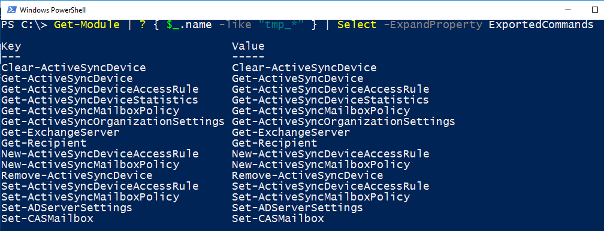
In case you want to test the permissions
Connect to Exchange as the service user
Get-Module | ? { $_.name -like "tmp_*" } | Select -ExpandProperty ExportedCommands
Place a device in quarantine
Set-CASMailbox -Identity ServiceAccount -ActiveSyncBlockedDeviceIDs @{ ADD = “DeviceName" }

Slide 20
Example architecture
NLB
Email
profiles
NDES
Certificate
Microsoft
Firewall
WAP
Firewall
AD FS
Authority
Wi
Azure
-
Fi
Conditional
profiles
Access
Phone
NLB
ConfigMgr CB
Certificate
VPN profiles
Intune Hybrid
profiles
MDM
Device
Firewall
WAP
Firewall
AD FS
settings
Exchange
Exchange
Cloud services
DMZ
Intranet
connector
2010

Slide 21
Demo
Conditional Access

Slide 22


Business case #3
“The primary reason for implementing Microsoft Intune is to replace the existing mobile device management platform with a platform that offers a more secure platform overall for managing Windows 10 and mobile devices”
Mr Bo Rejnholt
Project Manager, Ferring Pharmaceuticals
“In just two days, tomorrow will become yesterday.”
—Unknown

Slide 23
Certificate workflow
1. Certificate profile created in ConfigMgr.
2. Profile is sent to the Intune service, where details about the cert policy are used to create the challenge for device(s).
3. Profile is pushed to mobile device by Intune service during the next check-in. This policy contains the URL of the NDES Server (through WAP), as well as the challenge generated by Intune.
4. Device contacts the NDES server using the URL from Step 3 and provides the challenge response.
5. NDES Server (together with ConfigMgr module) talks to the Certificate Registration Point (CRP) role to validate the challenge.
6. CRP responds to NDES server with “true” or “false” to challenge verification (again, over 443 SSL).
7. If the challenge is true, then the NDES server communicates with the CA to get a certificate for the device.
8. NDES delivers certificate to mobile device.

Slide 24
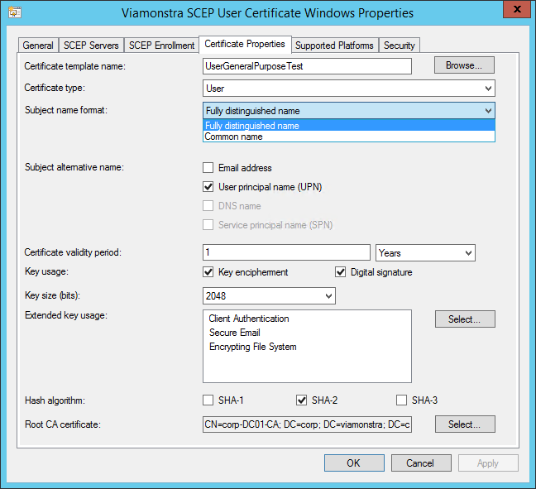
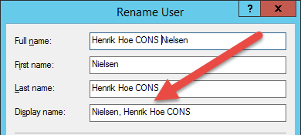
Usefull tips
Root certificates are easy and do not use NDES
Resource cert requirements
WI-FI profiles can use Pre-shared secrets or certificates
Watch out for Fully distinguished name as the subject name
Subject Name in CSR: "CN="Nielsen\, Henrik Hoe CONS,OU=test,DC=test,DC=com"" and challenge: "CN=Nielsen\, Henrik Hoe CONS,OU=test,DC=test,DC=com" do not match for CertRequestId: ModelName=ScopeId_9FF14ED8-DE8E-4AFD-94D1-D546F6DCBE68/ConfigurationPolicy_b999b410-4fce-43e4-b058-399fc84cdd07;Version=12;Hash=-2122617072

Slide 25
Example architecture
NLB
NLB
Email
profiles
NDES
Certificate
Microsoft
Firewall
WAP
Direct access
Firewall
AD FS
Authority
Azure
Wi
-
Fi
Conditional
profiles
Access
Phone
NLB
NLB
Primary site
Certificate
VPN profiles
Intune Hybrid
profiles
MDM
Firewall
WAP
Direct access
Firewall
AD FS
Device
settings
Exchange
Exchange
Cloud services
DMZ
Intranet
connector

Slide 26
Demo
Certificates & WI-FI

Slide 27

Business case #4
“US manufacturing company”
The primary reasons for implementing Microsoft Enterprise Mobility Suite are to protect data from being leaked and enhance mobile device security.
On average, a cow produces 7 gallons of milk each day.
The average American consumes 27 pounds of cheese per year.

Slide 28
Applications
Applications
Store apps
Line-of-business apps
Licensed apps
Security
Managed apps
Managed apps without device enrollment
Windows Information Protection
Azure Information Protection
Restrict data leakage
  Allow/block copy/paste
  Allow/block screen capture
  Allow/block print
  Prevent file backup to unauthorized locations
  Restrict sharing of data between applications

Slide 29
Demo
Application support

Slide 30
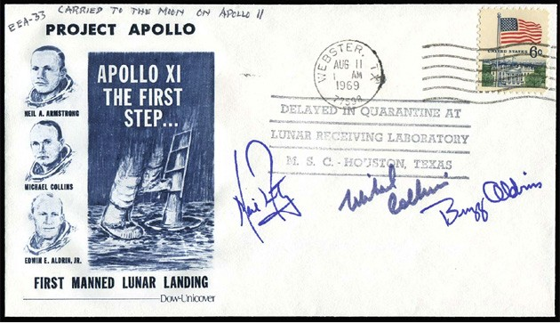
Business case #5
The Guardian Life Insurance Company of America
“The need to provide one of our highly mobile external user community's with a secure and customizable computing management solution with minimal, to no, infrastructure footprint".
The Apollo astronauts, unable to qualify for life insurance and not insured by NASA, resorted to “insurance autographs,” signing just before launch in the expectation that the value would skyrocket in the event of their deaths.

Slide 31
Key Driver, Constraints, Value Add
Ability to securely leverage a full featured collaboration suite while preventing data leakage
Encountered shortcommings with OWA
    Mail - feature missing
    Calendar – missing integration
    Contact – missing management feature
    Tasks – missing functionalty
Ability to accurately and consistently ensure adherance to Corporate Security Policies *

Slide 32
Demo
Data protection on Windows devices

Slide 33
Links
Get started
  Intune https://docs.microsoft.com/en-us/intune/
  Showcase Office 365 & EMS http://aka.ms/cloudarchmobility
Conditional Access
  Cisco ISE https://docs.microsoft.com/en-us/intune/deploy-use/restrict-access-to-networks
  How does conditional access work? https://docs.microsoft.com/en-us/intune/deploy-use/restrict-access-to-email-and-o365-services-with-microsoft-intune
Wi-Fi profiles
  Creating Windows profiles http://blog.coretech.dk/kea/windows-wi-fi-profiles/
  Creating Android profiles http://blog.coretech.dk/kea/deploying-wifi-profiles-with-pre-shared-secret-to-android-devices-using-configmgr/
Troubleshooting
  Android https://docs.microsoft.com/en-us/intune/enduser/your-device-is-missing-a-required-certificate-android
  Error configuring MDM provider http://blog.coretech.dk/kea/unknown-error-creating-the-intune-connector-in-configuration-manager-cb/
  Log files and enrolling devices http://blog.coretech.dk/kea/error-enrolling-devices-into-intune-configuration-manager-1602/

Slide 34
Check out other sessions
BRK3149 - Learn what's new with OSD in System Center Configuration Manager and Microsoft Deployment Toolkit (Tuesday 9 A.M.)
BRK2138 – Intune and Configuration Manager overview (Tuesday 10:45 A.M.)
BRK3225 - Secure access to Office 365, SaaS, and on-premises apps and files with Azure AD and Intune (Tuesday 2:15 P.M.)
BRK2273 - Secure Android devices and apps with Intune (Wednesday 10:45 A.M.)
BRK3101 - Manage and secure iOS and Mac devices in your organization with Intune (Wednesday 2:15 P.M.)
BRK2120 - Manage modern enterprise applications with Microsoft Intune & HockeyApp (Wednesday 4 P.M.)
BRK3012 - Enhance Windows 10 security and management with ConfigMgr, Intune, and new cloud services (Wednesday 4 P.M.)
BRK3093 - Accelerate your Microsoft Enterprise mobility and security deployment with FastTrack (Thursday 9 A.M.)
BRK3102 - Conduct a successful pilot deployment of Microsoft Intune (Thursday 10:45 A.M.)
BRK2292 - Learn how Intune helped Avanade’s global workforce get more productive (Thursday, 12:45 P.M.)
BRK2137 - Align your Windows 10 management strategy to end-user and IT needs (Thursday 4 P.M.)
BRK3281 - Deliver a BYOD program that employees and security teams will love with Intune (Friday 12:30 P.M.)

Slide 35
Free IT Pro resources
To advance your career in cloud technology
Plan your
career path
Cloud role mapping
Expert advice on skills needed
Self-paced curriculum by cloud role
$300 Azure credits and extended trials
Pluralsight 3 month subscription (10 courses)
Phone support incident
Weekly short videos and insights from Microsoft’s leaders and engineers
Connect with community of peers and Microsoft experts
Microsoft IT Pro Career Center
www.microsoft.com/itprocareercenter
Get started
with Azure
Microsoft IT Pro Cloud Essentials
www.microsoft.com/itprocloudessentials
Demos and
how-to videos
Microsoft Mechanics
www.microsoft.com/mechanics
Connect with peers and experts
Microsoft Tech Community
https://techcommunity.microsoft.com

Slide 36


Please evaluate this session
Your feedback is important to us!
From your PC or Tablet visit MyIgnite at http://myignite.microsoft.com
From your phone download and use the Ignite Mobile App by scanning the QR code above or visiting https://aka.ms/ignite.mobileapp

