Slide 1
Deliver business insights with Microsoft Dynamics AX and Power BI
BRK3274
Milinda Vitharana
Principal Program Manager
Clay Wesener
Senior Program Manager

Slide 2
AGENDA
Journey from Data to Action…
Ready-made Power BI content for Dynamics AX
Introducing Entity Store for advanced analytics
Building and shipping great reports
What customers are saying …

Slide 3
Customer journey from data to action…
Data
Recommendations
What should I do?
Decision
Action
Decision automation
Decision support
Predictions
What will happen?
Interactive dashboards
Why did it happen?
Static reports
What happened?
Manual process
Value

Slide 4

Customer journey from static reports to interactive data exploration
Built-in experiences,
operational
Business documents,
high volume printing
Financial
statements
Data
exploration
Chart controls
SSRS operational reporting
Management reporter
Power BI

Slide 5
Journey from data exploration to recommendations with Cortana Intelligence Suite
Dynamics AX
Cortana intelligence
Microsoft services & content
Dynamics AX Power BI content
Embedded Power BI Reports
Tools and frameworks
Intelligent business processes
People
Machine learning
AX Operational DB
Cognitive services
Customer/partner content and apps
Power BI content
Embedded Power BI reports
Attached business apps
Intelligent business processes
Entity store
Power BI
Data
Intelligence
Action

Slide 6
DEMO: ready-made Power BI content for Dynamics AX
Clay Wesener

Slide 7
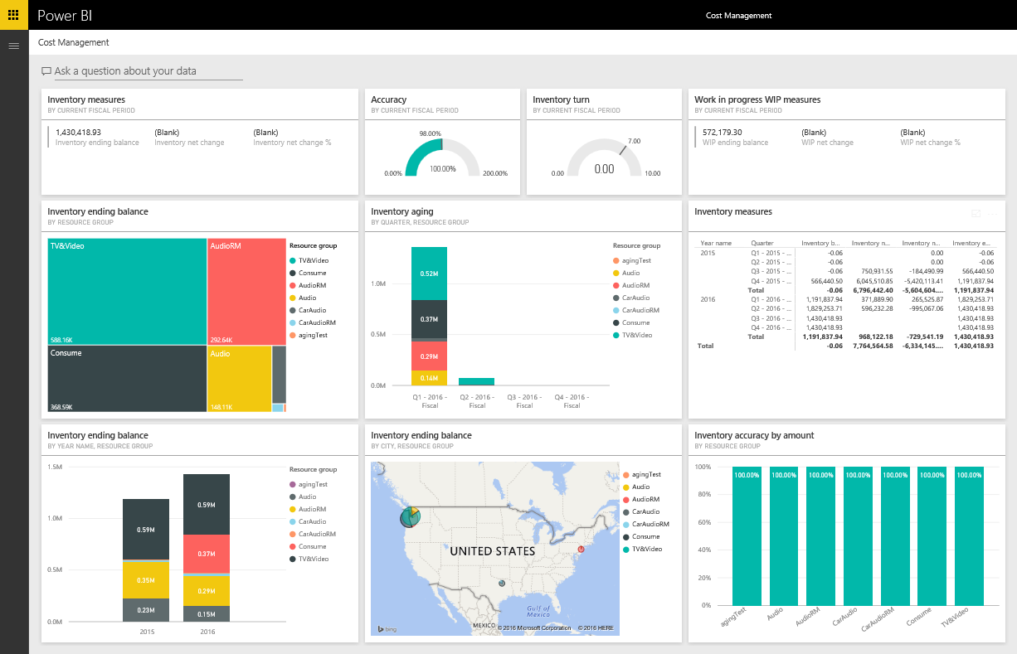
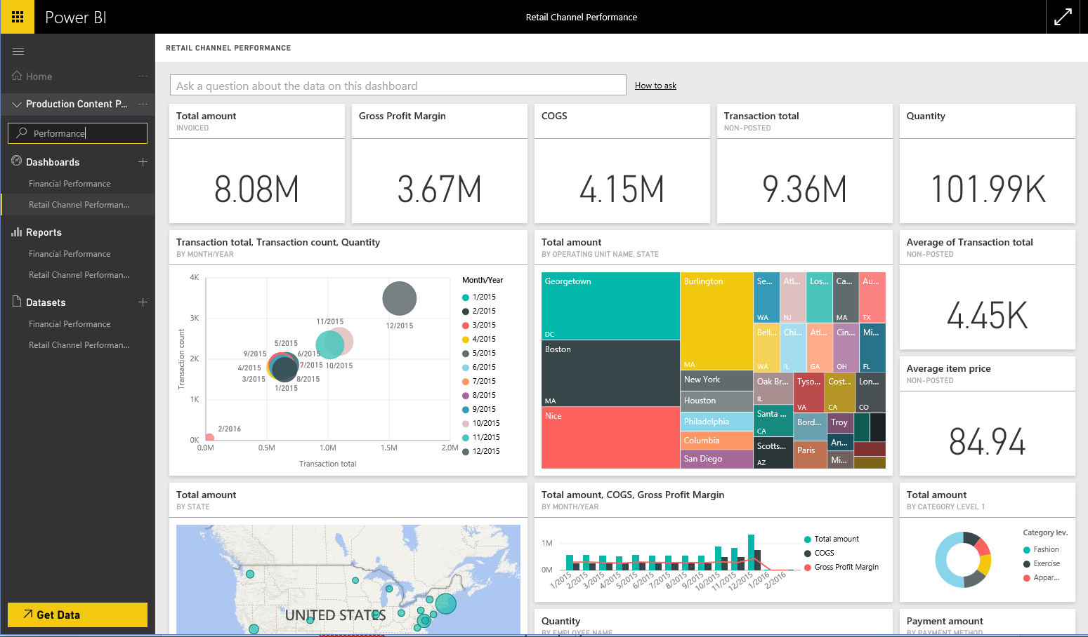
Ready-made Power BI content
Available now
Coming in fall release . . .
Financial performance
Project & Practice Management
Insights designed specifically for CFOs by providing details on financial performance.
Cost Accounting
Human Resource Manager
Cost Management
Access insights about operational performance designed for COOs and CFOs
Hiring Manager
Retail channel management
This content pack is designed specifically for the channel managers who focus on sales performance to predict trends and uncover insights

Slide 8




Entity store for Dynamics AX
An extensible data store for advanced analytics on operational data from Dynamics AX and other systems
Reporting data
Near real-time data sync from Dynamics AX
Rich data modeling using Dynamics AX metadata
Auto-generated Power BI models, secured using Dynamics AX roles
Enables citizen developers to create rich visual experiences and Apps
Predictions and recommendations using Cortana Intelligence suite
Ingest IoT and external data for mash-ups with Dynamics AX data
Auto provisioned with Dynamics AX – or in your subscription
Other systems
Sensors &
devices

Slide 9
Dynamics AX”7” Data
Read/write workloads
Read only workloads
Analytics workloads
Sales Order entry, Sales confirmation, Print Invoices
Read-only workloads: Charts, KPIs, Tiles, Operational Reports
Trend reports, Predictions, Power BI reports
Real Time
Real Time
Near Real-time
Seconds
Minutes
Primary DB
Secondary DB
Entity store

Slide 10
DEMO: Building and shipping great reports with Entity store
Milinda Vitharana

Slide 11
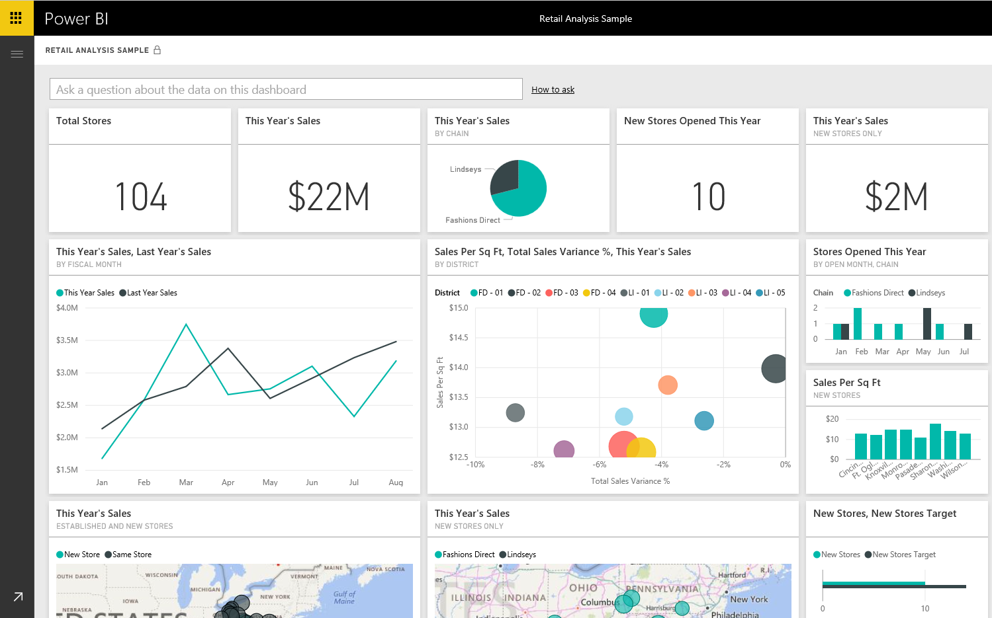
High volume, near-real time Power BI architecture
Dataset
Power BI dashboards & reports
Direct query
Transactional DB
Entity store
Minutes

Slide 12

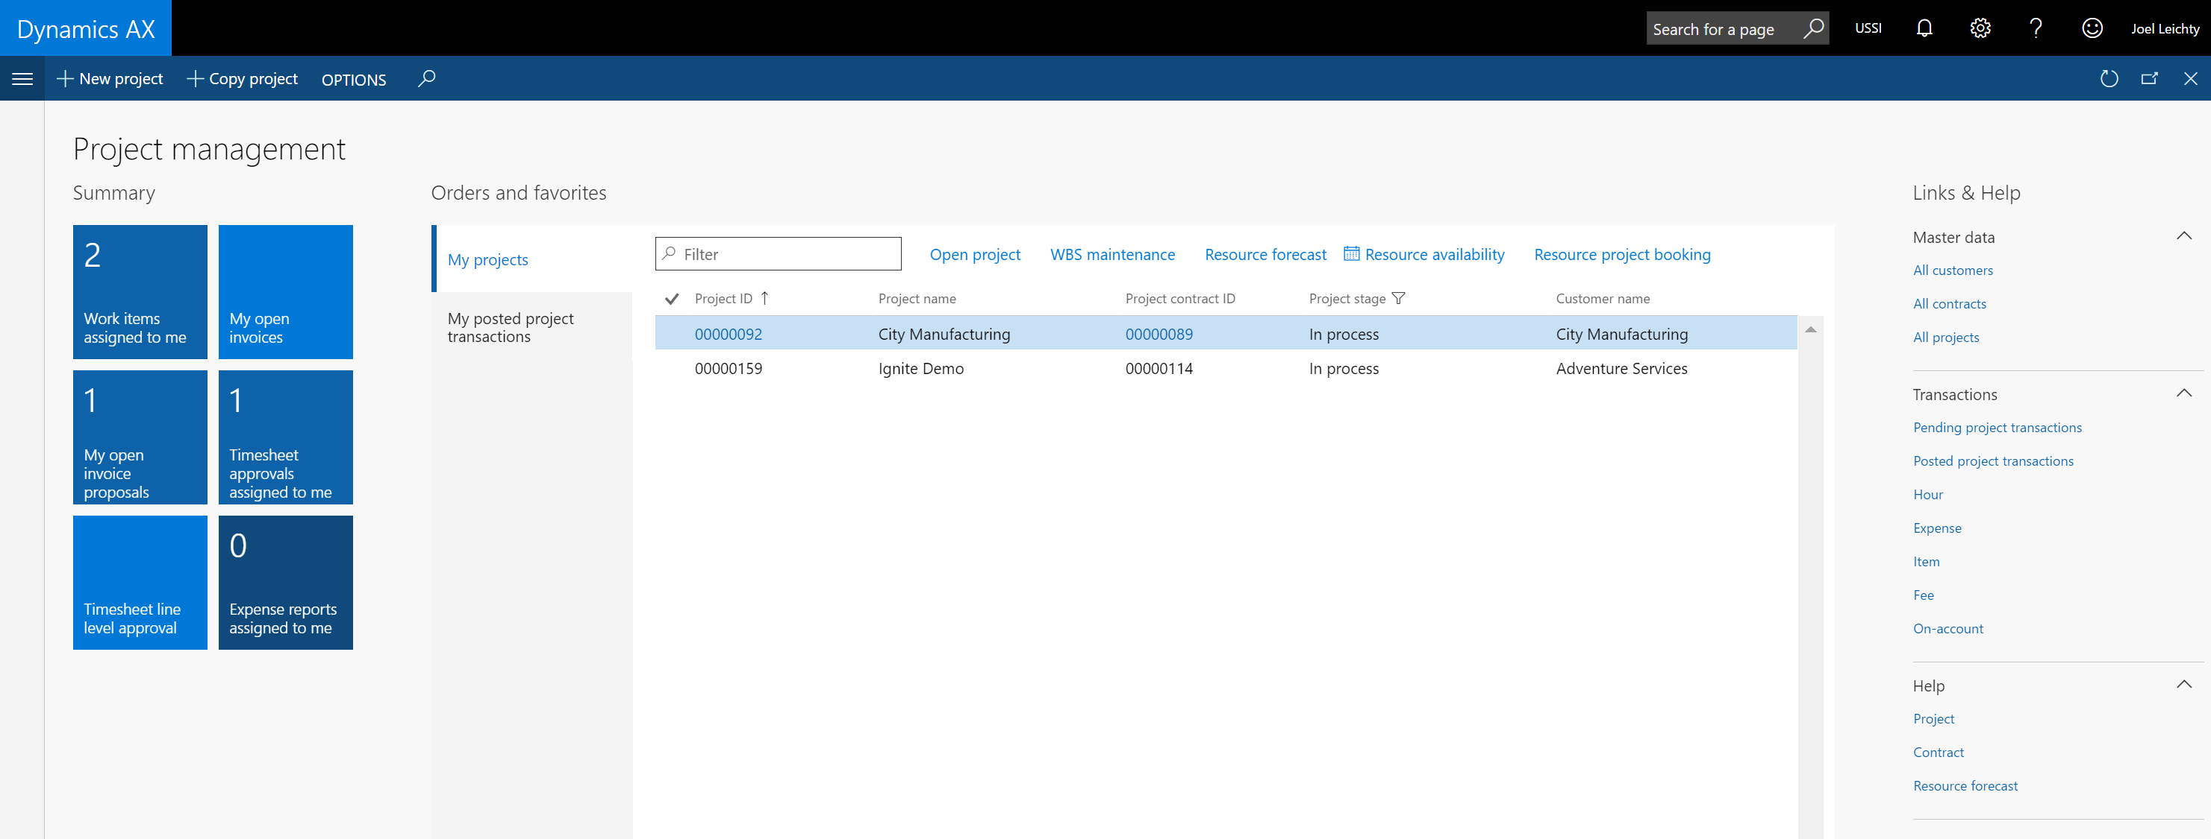
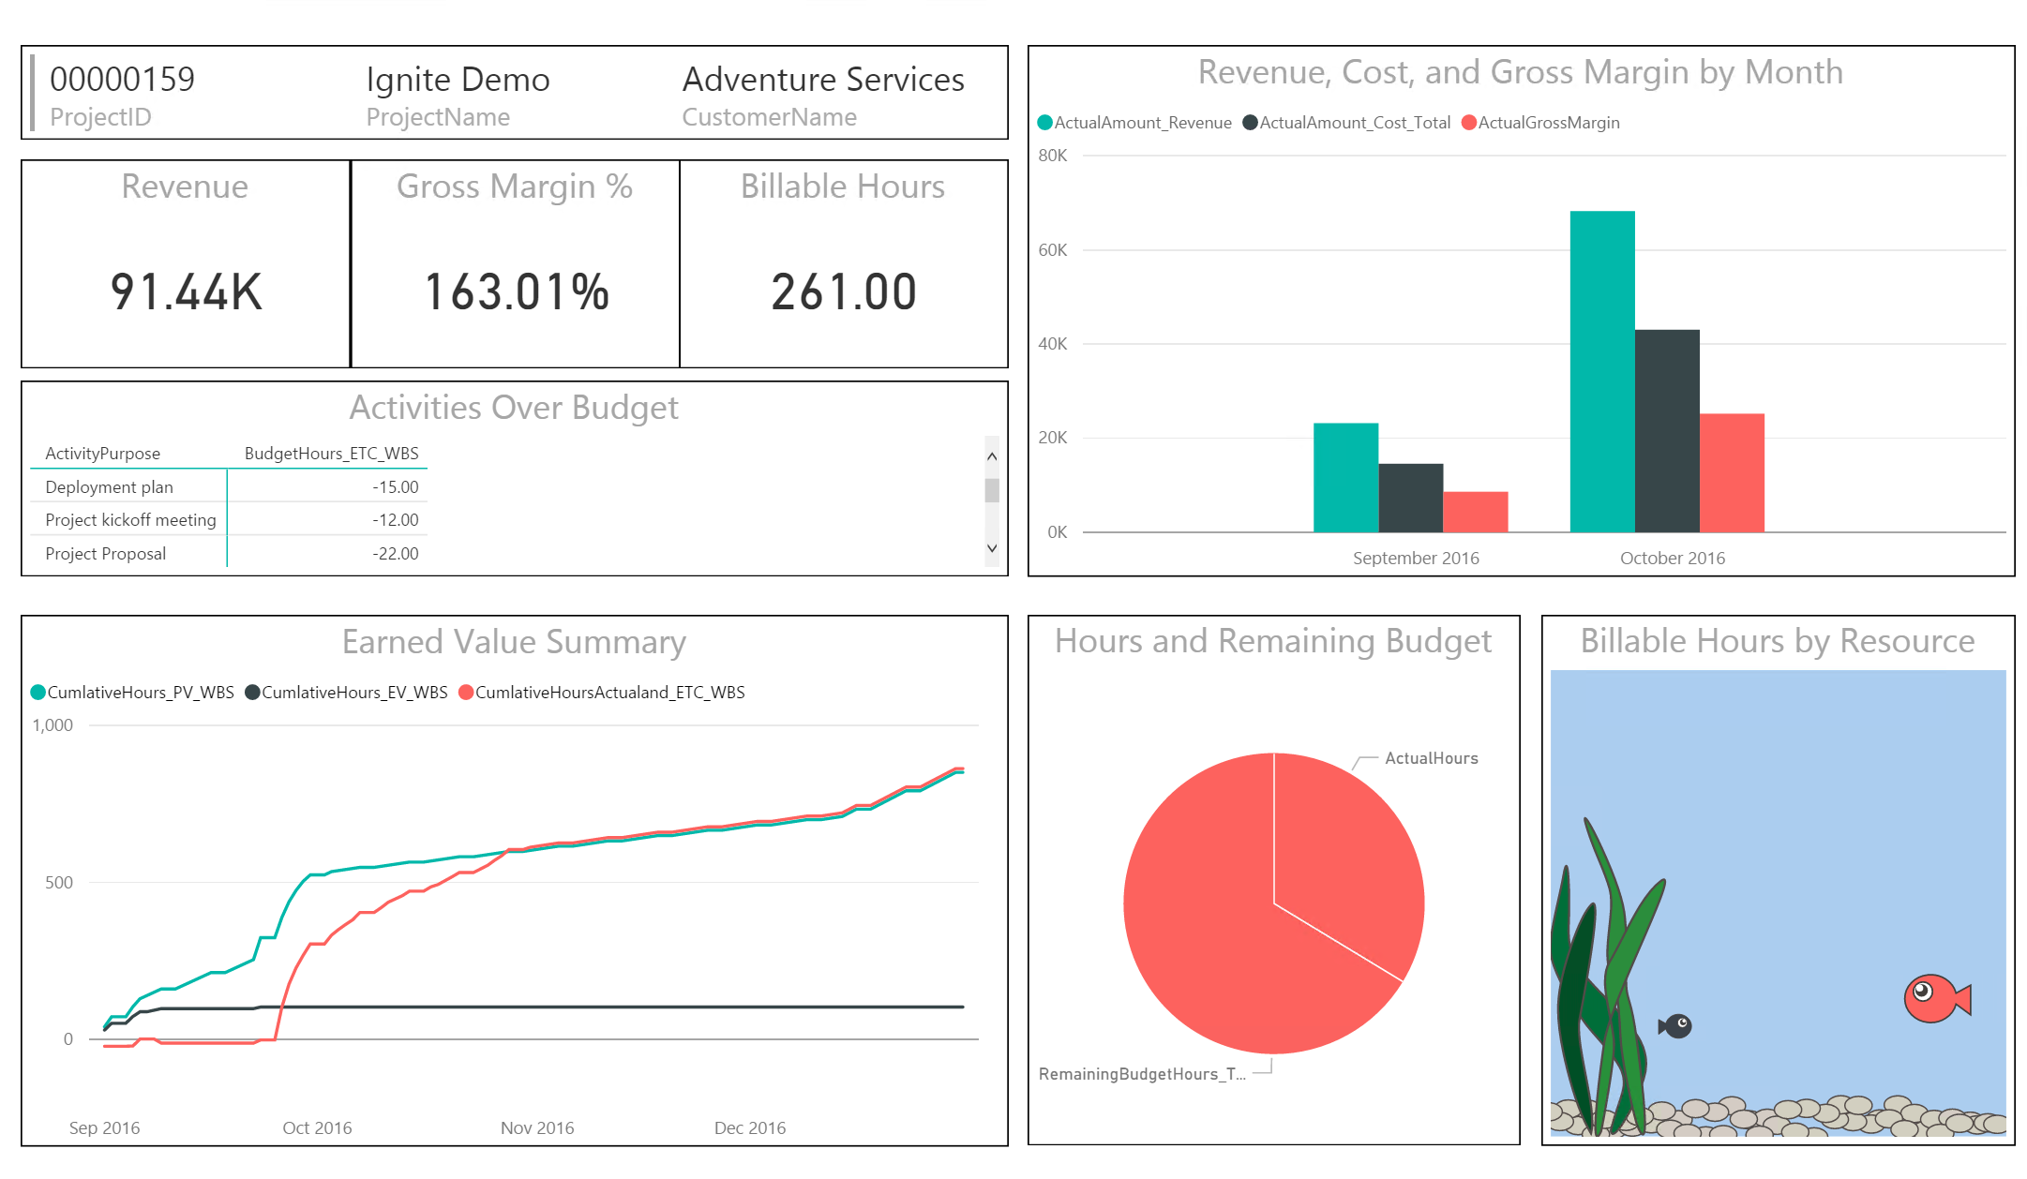


What customers are saying …
Service industry solution for Dynamics AX with rich workspaces and Power BI content
Sales and marketing
Global project administration
Project management
Project status
Project tasks
Resource management
Project accounting
Joel Leichty
Solution Architect
SAGlobal Inc
Dynamics AX MVP

Slide 13
Try this at home …
Links to Resources
Hands-on labs

Slide 14
Free IT Pro resources
To advance your career in cloud technology
Plan your
career path
Cloud role mapping
Expert advice on skills needed
Self-paced curriculum by cloud role
$300 Azure credits and extended trials
Pluralsight 3 month subscription (10 courses)
Phone support incident
Weekly short videos and insights from Microsoft’s leaders and engineers
Connect with community of peers and Microsoft experts
Microsoft IT Pro Career Center
www.microsoft.com/itprocareercenter
Get started
with Azure
Microsoft IT Pro Cloud Essentials
www.microsoft.com/itprocloudessentials
Demos and
how-to videos
Microsoft Mechanics
www.microsoft.com/mechanics
Connect with peers and experts
Microsoft Tech Community
https://techcommunity.microsoft.com

Slide 15


Please evaluate this session
Your feedback is important to us!
From your PC or Tablet visit MyIgnite at http://myignite.microsoft.com
From your phone download and use the Ignite Mobile App by scanning the QR code above or visiting https://aka.ms/ignite.mobileapp

